Slide 1

Architecture and DevOps journey of Bot

Slide 2
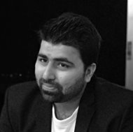
Sohel Shekha
Microsoft MVP | Mobile Architect
---------------------
shekha.sohel@gmail.com
@ShekhaSohel

Slide 3


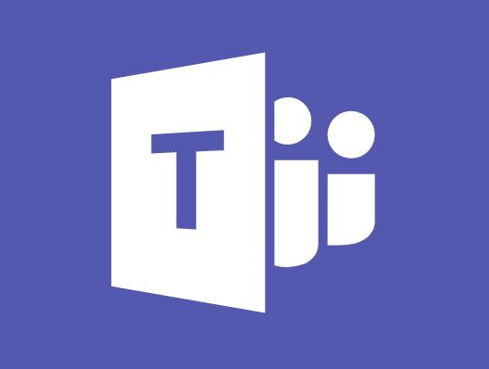

Short Survey!
Have you tried Bot development?
Notes:
Silo approach

Slide 4
Bot development Challenges...

Slide 5
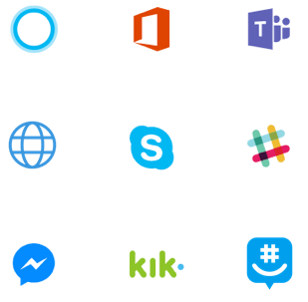
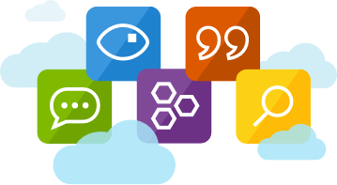
Design & Develop
Monitor
Test
Multiple Platforms
Different Tech Stack
Notes:
website or app to email, GroupMe, Facebook Messenger, Kik, Skype, Slack, Microsoft Teams, Telegram, text/SMS, Twilio, Cortana, and Skype for Business.

Slide 6
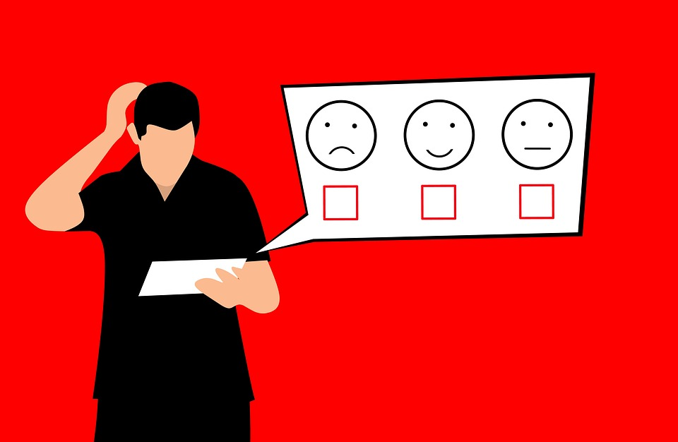
User Experience

Slide 7
MS Bot Framework -> write once

Slide 8
Development Tools
Connectors, SDK, templates
Cross Platform
website, app, email, IMs
Intelligence
LUIS, Cognitive Services
Notes:
website or app to email, GroupMe, Facebook Messenger, Kik, Skype, Slack, Microsoft Teams, Telegram, text/SMS, Twilio, Cortana, and Skype for Business.

Slide 9
Azure Bot Service

Slide 10


Azure Bot Service
Manage Bot Logic
Build & Host
Connect LUIS
Continuous Deployment
Test
Publish
Local editor or Source Control

Slide 11
Demo Time

Slide 12
Microsoft Language Understanding Intelligent Service (LUIS)

Slide 13
Language Understanding (LUIS)
• Cognitive Services
• Http
• Any platform/app
• Intents
• Entities
Semantic
Integration
Model
Prebuilt Entities
Learning
Training

Slide 14
Development Workflow

Slide 15
Workflow
Mockup
Create
Build
Publish
Test
Connect
Track

Slide 16
Workflow
• VSTS
• Github
• Online editor
• Continuous Deployment
• Emulator
Create
Build
Publish
Test
Connect
Track

Slide 17
Workflow
• VSTS
• Github
• Online editor
• Continuous Deployment
• Emulator
Create
Build
Publish
Test
• Channels
• Skype
• Web
• Telegram
• and so on
• Analytics
• Application Insights
Connect
Track

Slide 18
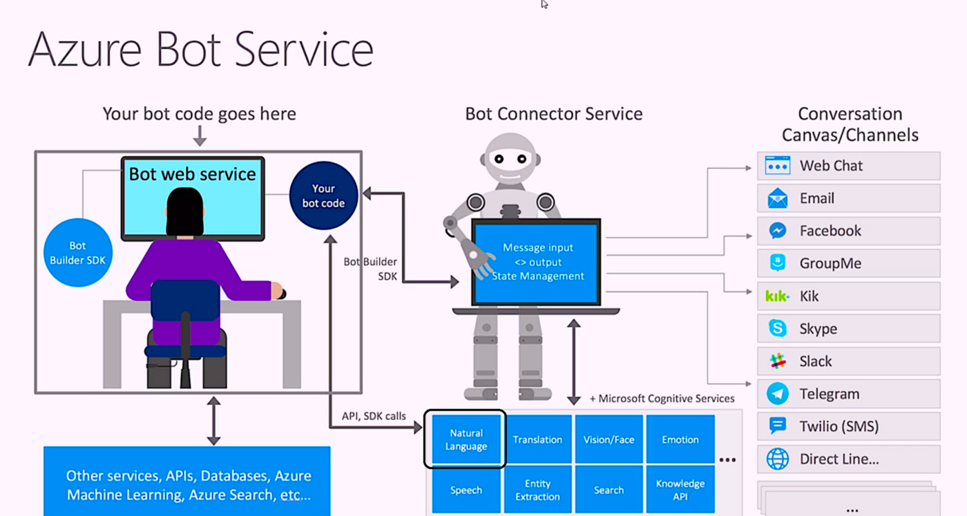
Image_from:https://medium.com/@ashish_fagna/introduction-to-microsoft-azure-bot-service-luis-language-understanding-8826d29d013e

Slide 19
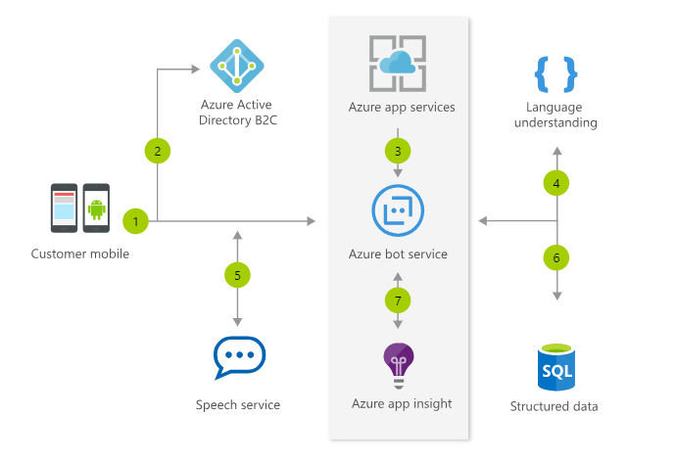
https://azure.microsoft.com/en-in/services/bot-service/

Slide 20
Getting started:
https://azure.microsoft.com/en-in/services/bot-service/
Code Samples:
https://github.com/Microsoft/BotBuilder-Samples

Slide 21
Q&A
@shekhasohel

Slide 22
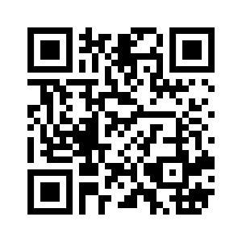
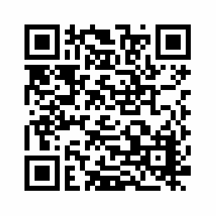

Save the date
Thursday, Dec 27, 2018
Microsoft Re-Connect 2018
https://www.meetup.com/MumbaiMobileDev/

