Slide 1



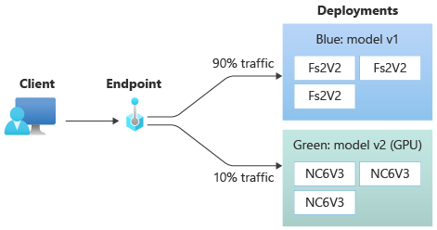


ML Process
ML Workspace
Sweep Job
Deployment
Endpoint
Training
Learning Rate
Momemtum
Best validation Accuracy

Slide 2
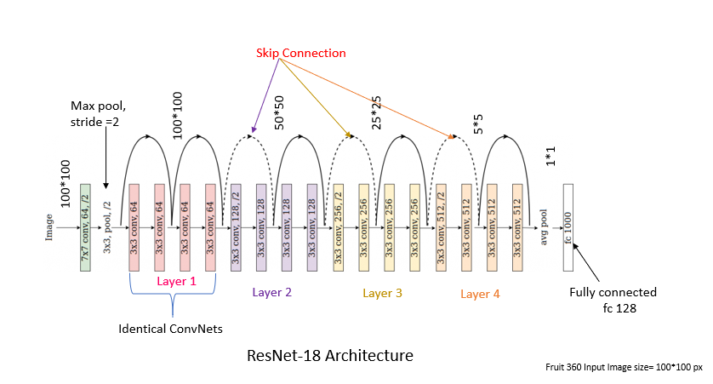


Training (fine-tuning)

Slide 3
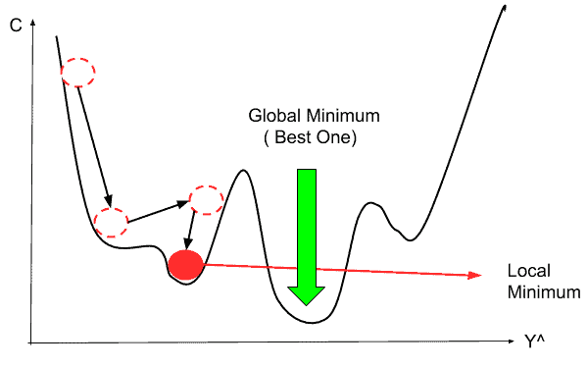
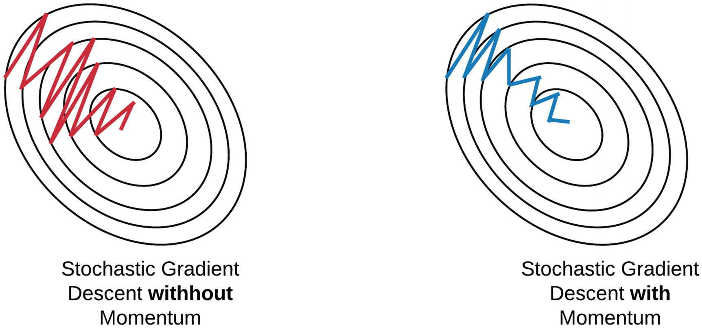
Stochastic gradient descent
Stochastic gradient descent works quite well out of the box in most cases.
Sometimes, however, its updates can start "oscillating".
To solve this problem, it has been proposed the momentum technique, which can both speed up learning and increase the accuracy

Slide 4

Deployment
ACI Deployment
Best Model
NC6v3

