Slide 1
Overview of the Global Arrays
Parallel Software Development Toolkit
Bruce Palmer
Manoj Kumar Krishnan, Sriram Krishnamoorthy, Ahbinav Vishnu, Jeff Daily
Pacific Northwest National Laboratory

Slide 2
Overview
Programming Model
Basic Functions in GA
Advanced Functionality
Applications
Summary

Slide 3
Distributed Data vs Shared Memory
Distributed Data:
  Data is explicitly associated with each processor, accessing data requires specifying the location of the data on the processor and the processor itself.
Data locality is explicit but data access is complicated. Distributed computing is typically implemented with message passing (e.g. MPI)
(0xf5670,P0)
(0xf32674,P5)
P0
P1
P2

Slide 4
Distributed Data vs Shared Memory (Cont).
Shared Memory:
  Data is an a globally accessible address space, any processor can access data by specifying its location using a global index
Data is mapped out in a natural manner (usually corresponding to the original problem) and access is easy. Information on data locality is obscured and leads to loss of performance.
(1,1)
(47,95)
(106,171)
(150,200)

Slide 5
Global Arrays
Distributed dense arrays that can be accessed through a shared memory-like style
Physically distributed data
single, shared data structure/ global indexing
e.g., access A(4,3) rather than buf(7) on task 2
Global Address Space

Slide 6
Global Arrays (cont.)
Shared memory model in context of distributed dense arrays
Much simpler than message-passing for many applications
Complete environment for parallel code development
Compatible with MPI
Data locality control similar to distributed memory/message passing model
Extensible
Scalable

Slide 7
Core Capabilities
Distributed array library
  dense arrays 1-7 dimensions
  four data types: integer, real, double precision, double complex
  global rather than per-task view of data structures
  user control over data distribution: regular and irregular
Collective and shared-memory style operations
  ga_sync, ga_scale, etc
  ga_put, ga_get, ga_acc
  nonblocking ga_put, ga_get, ga_acc
Interfaces to third party parallel numerical libraries
  PeIGS, Scalapack, SUMMA, Tao
    example: to solve a linear system using LU factorization
    call ga_lu_solve(g_a, g_b)
    instead of
    call pdgetrf(n,m, locA, p, q, dA, ind, info)
    call pdgetrs(trans, n, mb, locA, p, q, dA,dB,info)

Slide 8
Interoperability and Interfaces
Language interfaces to Fortran, C, C++, Python
Interoperability with MPI and MPI libraries
  e.g., PETSC, CUMULVS
Explicit interfaces to other systems that expand functionality of GA
  ScaLAPACK-scalable linear algebra software
  Peigs-parallel eigensolvers
  TAO-advanced optimization package

Slide 9
Structure of GA
Application programming language interface
F90
Java
Fortran 77
C
C++
Python
Babel
distributed arrays layer
memory management, index translation
Global Arrays and MPI are completely interoperable. Code can contain calls to both libraries.
Message Passing
Global operations
ARMCI
portable 1-sided
communication
put,get, locks, etc
system specific interfaces
OpenIB, Portals, DCMF, LAPI, threads, Elan, Sockets, …

Slide 10
Linking the GA library
Also, to test your GA programs, suggested compiler/linker
options are as follows.
GA libraries are built in /home/d3g293/ga-4-0-5/lib/LINUX64
INCLUDES = -I/home/d3g293/ga-4-0-5/include
For Fortran Programs:
FLAGS = -g -Vaxlib -cm -w90 -w95 -align -cm -w90 -w95
-align -i8
LIBS = -L/home/d3g293/ga-4-0-5/lib/LINUX64 -lglobal -lma
-llinalg -larmci -L/home/software/ia64/mpich-1.2.7-gcc/lib
-ltcgmsg-mpi -lmpich -lm
For C Programs:
FLAGS = -g -nofor_main -cm -w90 -w95 -align -cm -w90 -w95
-align -i8
LIBS = -L/home/d3g293/ga-4-0-5/lib/LINUX64 -lglobal -lma
-llinalg -larmci -L/home/software/ia64/mpich-1.2.7-gcc/lib
-ltcgmsg-mpi -lmpich -lm -lm

Slide 11
Creating Global Arrays
integer array handle
minimum block size on each processor
character string
g_a = NGA_Create(type, ndim, dims, name, chunk)
float, double, int, etc.
array of dimensions
dimension

Slide 12
One-sided Communication
Message Passing:
  Message requires cooperation on both sides. The processor sending the message (P1) and the processor receiving the message (P0) must both participate.
receive
send
P0
P1
message passing
MPI
One-sided Communication:
  Once message is initiated on sending processor (P1) the sending processor can continue computation. Receiving processor (P0) is not involved. Data is copied directly from switch into memory on P0.
put
P0
P1
one-sided communication
SHMEM, ARMCI, MPI-2-1S

Slide 13
Remote Data Access in GA
Message Passing:
identify size and location of data blocks
loop over processors:
  if (me = P_N) then
    pack data in local message buffer
    send block of data to message buffer on P0
  else if (me = P0) then
    receive block of data from P_N in message buffer
    unpack data from message buffer to local buffer
  endif
end loop
copy local data on P0 to local buffer
Global Arrays:
NGA_Get(g_a, lo, hi, buffer, ld);
}
}
Global Array handle
Global upper and lower indices of data patch
Local buffer and array of strides
P0
P2
P1
P3

Slide 14
Data Locality
What data does a processor own?
NGA_Distribution(g_a, iproc, lo, hi);
Where is the data?
NGA_Access(g_a, lo, hi, ptr, ld)
Use this information to organize calculation so that
maximum use is made of locally held data

Slide 15
Global Array Model of Computations
Shared Object
Shared Object
copy to shared object
get
put
copy to local memory
compute/update
local memory
local memory
local memory

Slide 16
Sync
GA_Sync is a collective operation
It acts as a barrier, which synchronizes all the processes and also ensures that all outstanding communication operations are completed
sync

Slide 17
Basic GA Commands
GA programming model is very simple.
Most of a parallel program can be written with these basic calls
  GA_Initialize, GA_Terminate
  GA_Nnodes, GA_Nodeid
  GA_Create, GA_Destroy
  GA_Put, GA_Get
  GA_Sync

Slide 18
Example: Matrix Multiply
global arrays representing matrices
=
•
nga_put
nga_get
=
•
dgemm
local buffers on the processor

Slide 19
Matrix Multiply
(a better version)
more scalable!
(less memory, higher parallelism)
=
•
atomic accumulate
get
=
•
dgemm
local buffers on the processor

Slide 20
Example: 1-D Transpose

Slide 21
Example: 1-D Transpose (cont.)
#define NDIM 1
#define TOTALELEMS 197
#define MAXPROC 128
program main
implicit none
#include "mafdecls.fh"
#include "global.fh"
integer dims(3), chunk(3), nprocs, me, i, lo(3), hi(3), lo1(3)
integer hi1(3), lo2(3), hi2(3), ld(3), nelem
integer g_a, g_b, a(MAXPROC*TOTALELEMS), b(MAXPROC*TOTALELEMS)
integer heap, stack, ichk, ierr
logical status
heap = 300000
stack = 300000

Slide 22
Example: 1-D Transpose (cont.)
c initialize communication library
call mpi_init(ierr)
c initialize ga library
call ga_initialize()
me = ga_nodeid()
nprocs = ga_nnodes()
dims(1) = nprocs*TOTALELEMS + nprocs/2 ! Unequal data distribution
ld(1) = MAXPROC*TOTALELEMS
chunk(1) = TOTALELEMS ! Minimum amount of data on each processor
status = ma_init(MT_F_DBL, stack/nprocs, heap/nprocs)
c create a global array
status = nga_create(MT_F_INT, NDIM, dims, "array A", chunk, g_a)
status = ga_duplicate(g_a, g_b, "array B")
c initialize data in GA
do i=1, dims(1)
a(i) = i
end do
lo1(1) = 1
hi1(1) = dims(1)
if (me.eq.0) call nga_put(g_a,lo1,hi1,a,ld)
call ga_sync() ! Make sure data is distributed before continuing

Slide 23
Example: 1-D Transpose (cont.)
c invert data locally
call nga_distribution(g_a, me, lo, hi)
call nga_get(g_a, lo, hi, a, ld) ! Use locality
nelem = hi(1)-lo(1)+1
do i = 1, nelem
b(i) = a(nelem - i + 1)
end do
c invert data globally
lo2(1) = dims(1) - hi(1) + 1
hi2(1) = dims(1) - lo(1) + 1
call nga_put(g_b,lo2,hi2,b,ld)
call ga_sync() ! Make sure inversion is complete

Slide 24
Example: 1-D Transpose (cont.)
c check inversion
call nga_get(g_a,lo1,hi1,a,ld)
call nga_get(g_b,lo1,hi1,b,ld)
ichk = 0
do i= 1, dims(1)
if (a(i).ne.b(dims(1)-i+1).and.me.eq.0) then
write(6,*) "Mismatch at ",i
ichk = ichk + 1
endif
end do
if (ichk.eq.0.and.me.eq.0) write(6,*) "Transpose OK"
status = ga_destroy(g_a) ! Deallocate memory for arrays
status = ga_destroy(g_b)
call ga_terminate()
call mpi_finalize(ierr)
stop
end

Slide 25
Non-Blocking Communication
Allows overlapping of data transfers and computations
  Technique for latency hiding
Nonblocking operations initiate a communication call and then return control to the application immediately
operation completed locally by making a call to the wait routine
NGA_Nbget(g_a, lo, hi, buf, ld, nbhandle)
NGA_Nbwait(nbhandle)

Slide 26
SUMMA Matrix Multiplication
Issue NB Get A and B blocks
do (until last chunk)
issue NB Get to the next blocks
wait for previous issued call
compute A*B (sequential dgemm)
NB atomic accumulate into “C”
matrix
done
Computation
Comm.
(Overlap)
A
B
C=A.B
Advantages:
- Minimum memory
- Highly parallel
- Overlaps computation and communication
- latency hiding
- exploits data locality
- patch matrix multiplication (easy to use)
- dynamic load balancing
=
patch matrix multiplication

Slide 27
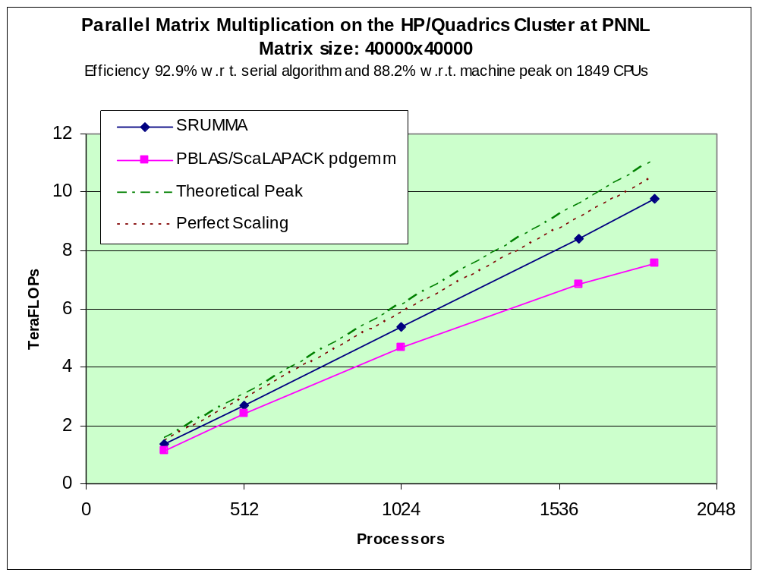
SUMMA Matrix Multiplication:
Improvement over PBLAS/ScaLAPACK

Slide 28
Read and Increment
nga_read_inc: remotely updates a particular element in an integer global array and returns the original value:
  Applies to integer arrays only
  Can be used as a global counter for dynamic load balancing
NGA_Read_inc
(Read and Increment)
c Create task counter
call nga_create(MT_F_INT,one,one,chunk,g_counter)
call ga_zero(g_counter)
:
itask = nga_read_inc(g_counter,one,one)
... Translate itask into task ...
Global Array
Global Lock
(access to data
is serialized)

Slide 29
Global Array Processor Groups
Many parallel applications can potentially make use of groups. These include
  Numerical evaluation of gradients
  Monte Carlo sampling over initial conditions or uncertain parameter sets
  Free energy perturbation calculations (chemistry)
  Nudged elastic band calculations (chemistry and materials science)
  Sparse matrix-vector operations (NAS CG benchmark)
  Data layout for partially structured grids
  Multi-physics applications

Slide 30
Global Array Processor Groups
If the individual calculations are small enough then each processor can be used to execute one of the tasks (embarrassingly parallel algorithms).
If the individual tasks are large enough that they must be distributed amongst several processors then the only option (usually) is to run each task sequentially on multiple processors. This limits the total number of processors that can be applied to the problem since parallel efficiency degrades as the number of processors increases.
Speedup
Processors

Slide 31
Multiple Tasks with Groups
Tasks
Processors
6
Results
10
9
5
8
7
6
4
5
4
3
3
2
1
2
1

Slide 32
Multiple Tasks with Groups
Tasks
Processors
Results
10
9
5
8
7
6
4
5
4
3
3
2
1
2
1

Slide 33
Global Array Processor Groups
Alternatively the collection of processors can be decomposed into processor groups. These processor groups can be used to execute parallel algorithms independently of one another. This requires
global operations that are restricted in scope to a particular group instead of over the entire domain of processors (world group)
distributed data structures that are restricted to a particular group

Slide 34
Processor Groups (Schematic)
Group A
Group B
World Group

Slide 35
Multiple Tasks with Groups
Tasks
Processors
6
Results
10
9
5
8
7
6
4
5
4
3
3
2
1
2
1

Slide 36
Creating Processor Groups
integer function ga_pgroup_create(list, count)
Returns a handle to a group of processors. The total number
of processors is count, the individual processor IDs are located
in the array list.
subroutine ga_pgroup_set_default(p_grp)
Set the default processor to p_grp. All arrays created after this
point are created on the default processor group, all global
operations are restricted to the default processor group unless
explicit directives are used. Initial value of the default processor
group is the world group.

Slide 37
Explicit Operations on Groups
Explicit Global Operations on Groups
ga_pgroup_sync(p_grp)
ga_pgroup_brdcst(p_grp,type,buf,lenbuf,root)
ga_pgroup_igop(p_grp,type,buf,lenbuf,op)
ga_pgroup_dgop(p_grp,type,buf,lenbuf,op)
Query Operations on Groups
ga_pgroup_nnodes(p_grp)
ga_pgroup_nodeid(p_grp)
Access Functions
integer function ga_pgroup_get_default()
integer function ga_pgroup_get_world()

Slide 38
Communication between Groups
Copy and copy_patch operations are supported for global arrays that are created on different groups. One of the groups must be completely contained in the other (nested).
The copy or copy_patch operation must be executed by all processors on the nested group (group B in illustration)
Group B
Group A

Slide 39
MD Example
Spatial Decomposition Algorithm:
Partition particles among processors
Update coordinates at every step
Update partitioning after fixed
number of steps
P₀
P₁
P₂
P₃
P₄
P₅
P₆
P₇

Slide 40
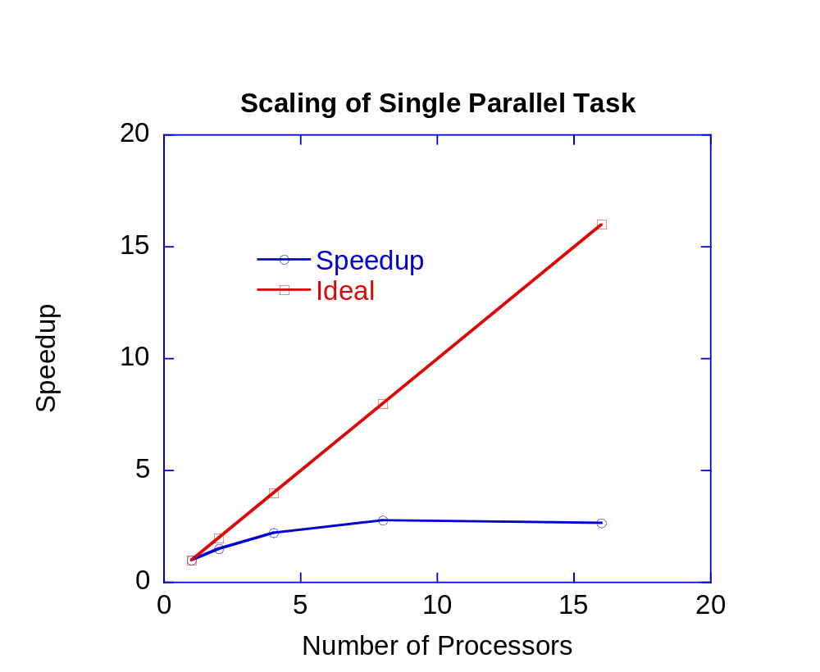
MD Parallel Scaling

Slide 41
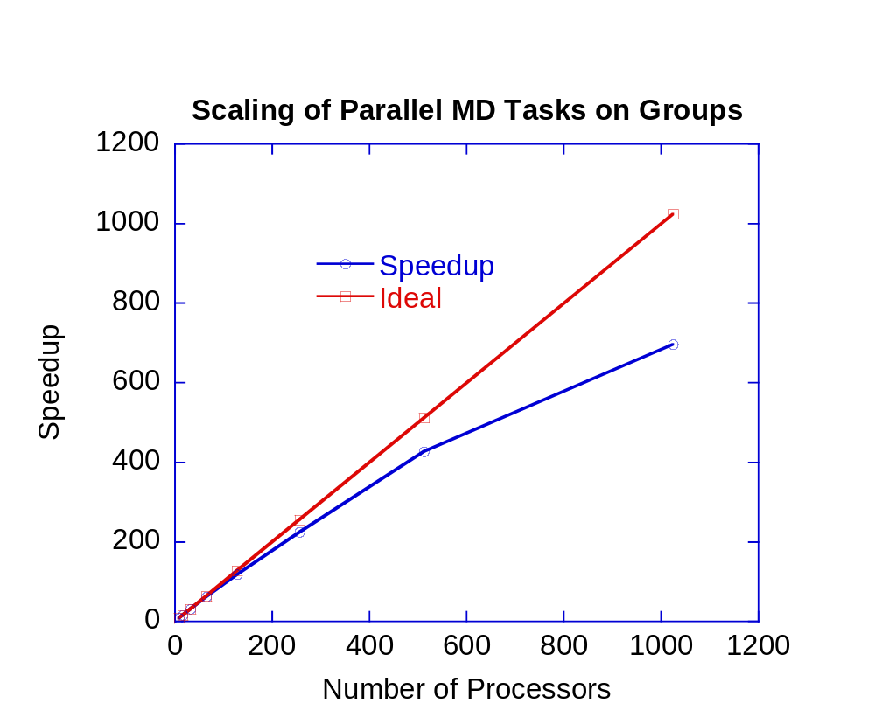
MD Performance on Groups

Slide 42
Sparse Data Manipulation
ga_scan_add
ga_scan_copy
g_mask: 1 0 0 0 0 0 1 0 1 0 0 1 0 0 1 1 0
g_src: 1 2 3 4 5 6 7 8 9 10 11 12 13 14 15 16 17
g_dest: 1 3 6 10 15 21 7 15 9 19 30 12 25 39 15 16 33
g_mask: 1 0 0 0 0 1 0 1 0 0 1 0 0 0 1 1 0
g_src: 5 8 7 3 2 6 9 7 3 4 8 2 3 6 9 10 7
g_dest: 5 5 5 5 5 6 6 7 7 7 8 8 8 8 9 10 10

Slide 43
Sparse Data Manipulation
ga_pack
ga_unpack
g_mask: 1 0 0 0 0 1 0 1 0 0 1 0 0 0 1 0 0
g_src: 1 2 3 4 5 6 7 8 9 10 11 12 13 14 15 16 17
g_dest: 1 6 8 11 15
g_mask: 1 0 0 0 0 1 0 1 0 0 1 0 0 0 1 0 0
g_src: 1 6 8 11 15
g_dest: 1 0 0 0 0 6 0 8 0 0 11 0 0 0 15 0 0

Slide 44
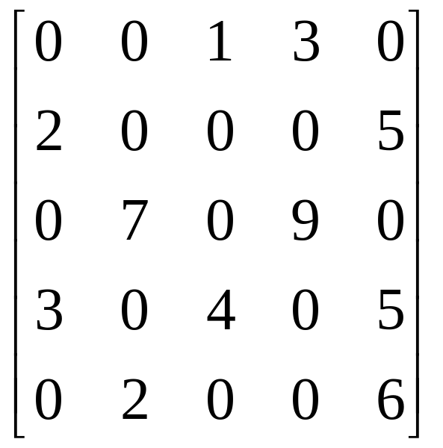
Compressed Sparse Row Matrix
VALUES: 1 3 2 5 7 9 3 4 5 2 6
J-INDEX: 3 4 1 5 2 4 1 3 5 2 5
I-INDEX: 1 3 5 7 10 12

Slide 45
Sparse Matrix-Vector Multiply
nga_access
nga_gather

Slide 46
Sparse Matrix-Vector Multiply
ga_elem_multiply
=
ga_scan_add
ga_pack

Slide 47
Block-cyclic Data Distributions
Normal Data Distribution
Block Cyclic Data Distribution

Slide 48
Block-cyclic Data Distributions
Simple Distribution
Scalapack Distribution
0
1
0
1
0
1
0
0
6
12
18
24
30
0,0
0,1
1
1
7
13
19
25
31
1,0
1,1
2
8
14
20
26
32
0
3
9
15
21
27
33
1
4
10
16
22
28
34
0
5
11
17
23
29
35
1

Slide 49
Block-cyclic Data Distributions
Most operations work exactly the same, data distribution is transparent to the user
Some operations (matrix multiplication, non-blocking put, get) not implemented
Additional operations added to provide access to data associated with particular sub-blocks
You need to use the new interface for creating Global Arrays to get create block-cyclic data distributions

Slide 50
Creating Block-cyclic Arrays
integer function ga_create_handle()
subroutine ga_set_data(g_a,ndim,dims,type)
subroutine ga_set_array_name(g_a,name)
subroutine ga_set_block_cyclic(g_a,b_dims)
subroutine ga_set_block_cyclic_proc_grid(g_a,
dims,proc_grid)
subroutine ga_allocate(g_a)

Slide 51
Block-Cyclic Methods
subroutine ga_get_block_info(g_a,num_blocks,block_dims)
integer function ga_total_blocks(g_a)
subroutine nga_access_block_segment(g_a,
iproc,index,length)
subroutine nga_access_block(g_a,idx,index,ld)
subroutine nga_access_block_grid(g_a,
subscript,index,ld)

Slide 52
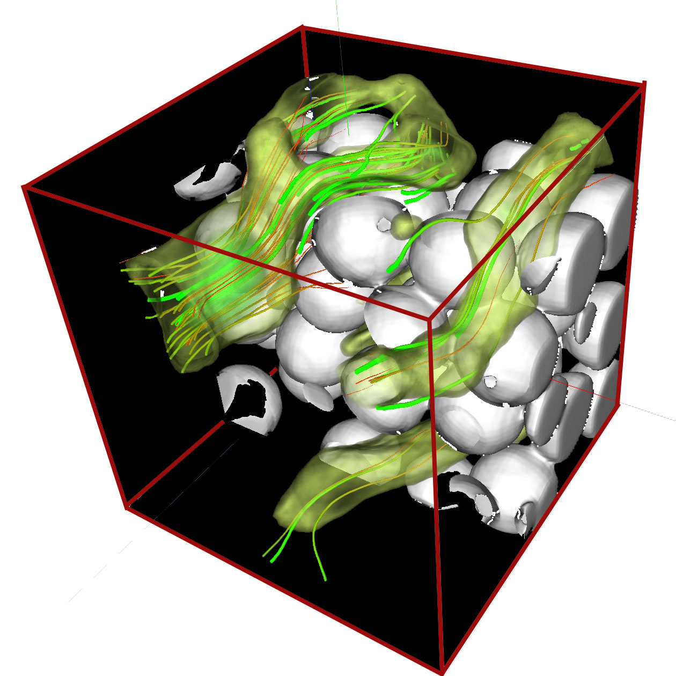
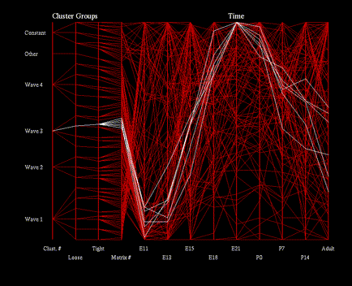
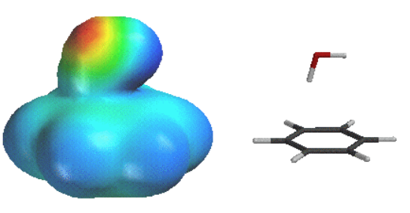
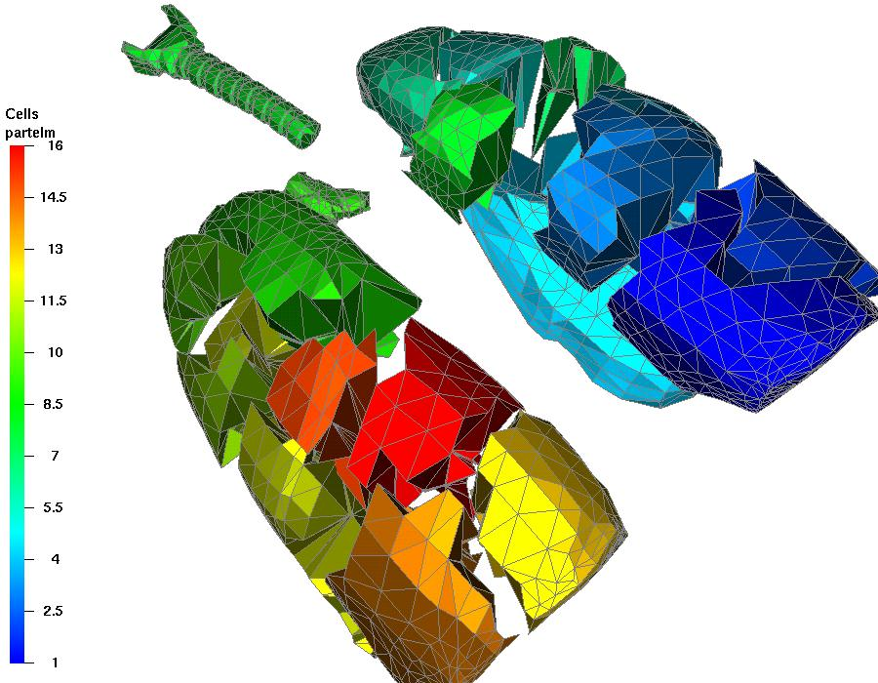
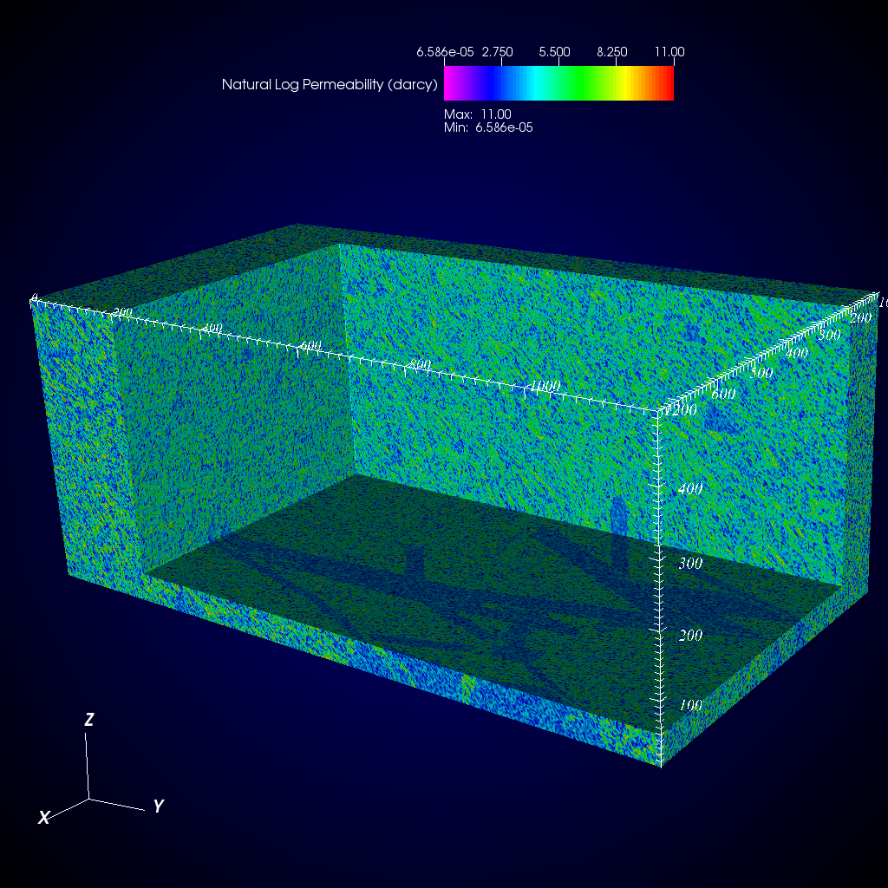
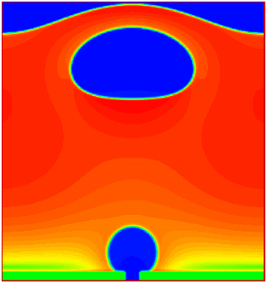
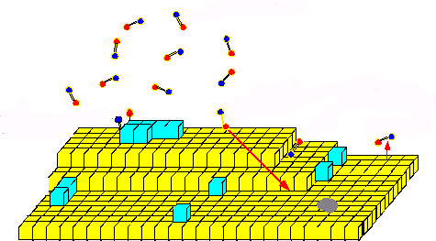
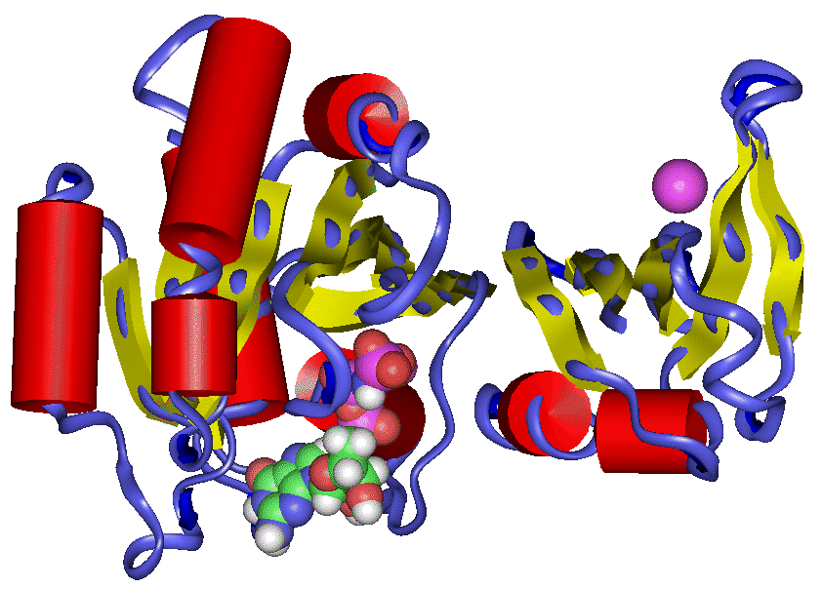
Other Application Areas
bioinformatics
electronic structure chemistry GA is the standard programming model
smoothed particle hydrodynamics
biology
thermal flow simulation
hydrology
material sciences
molecular dynamics
Others: financial security forecasting, astrophysics, visual analytics

Slide 53
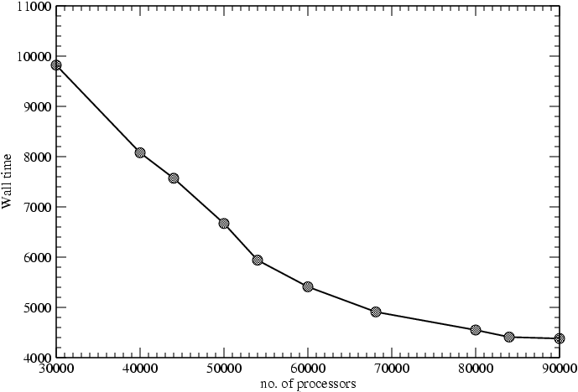
NWChem Scaling
NWChem CCSD module
Edo Apra, ORNL

Slide 54
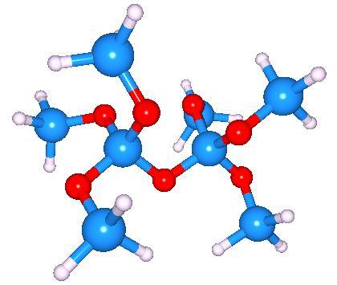

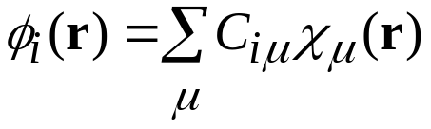
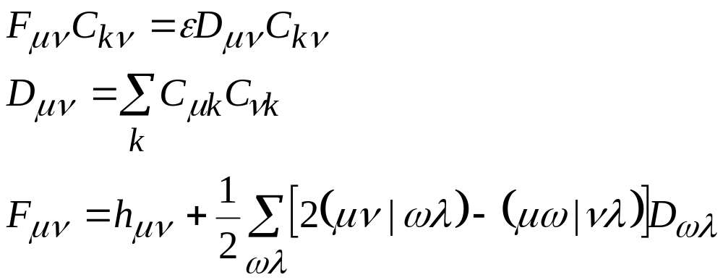
Hartree-Fock SCF
Obtain variational solutions to the electronic Schrödinger equation
within the approximation of a single Slater determinant.
Assuming the one electron orbitals are expanded as
the calculation reduces to the self-consistent eigenvalue problem

Slide 55
Parallelizing the Fock Matrix
The bulk of the work involves computing the 4-index elements (μν|ωλ). This is done by decomposing the quadruple loop into evenly sized blocks and assigning blocks to each processor using a global counter. After each processor completes a block it increments the counter to get the next block
do i
do j
do k
do l
F(i,j)=..
467
Read and increment counter
Accumulate results
Evaluate
block

Slide 56
Ghost Cells
normal global array
global array with ghost cells
Operations:
NGA_Create_ghosts - creates array with ghosts cells
  GA_Update_ghosts - updates with data from adjacent processors
  NGA_Access_ghosts - provides access to “local” ghost cell elements
  NGA_Nbget_ghost_dir - nonblocking call to update ghosts cells

Slide 57
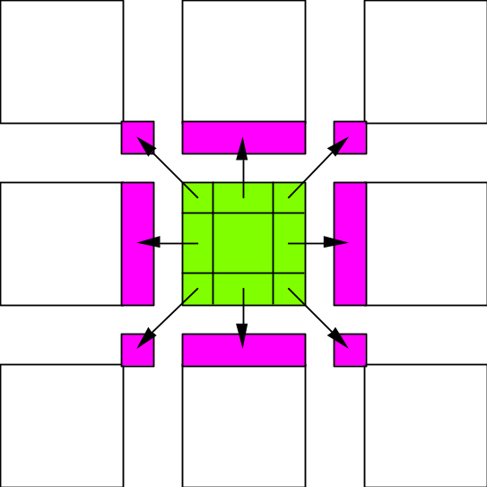
Ghost Cell Update
Automatically update ghost cells with appropriate data from neighboring processors. A multiprotocol implementation has been used to optimize the update operation to match platform characteristics.

Slide 58
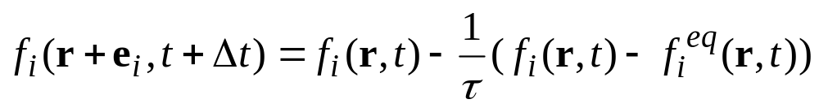
Lattice Boltzmann Simulation
Relaxation
Stream

Slide 59
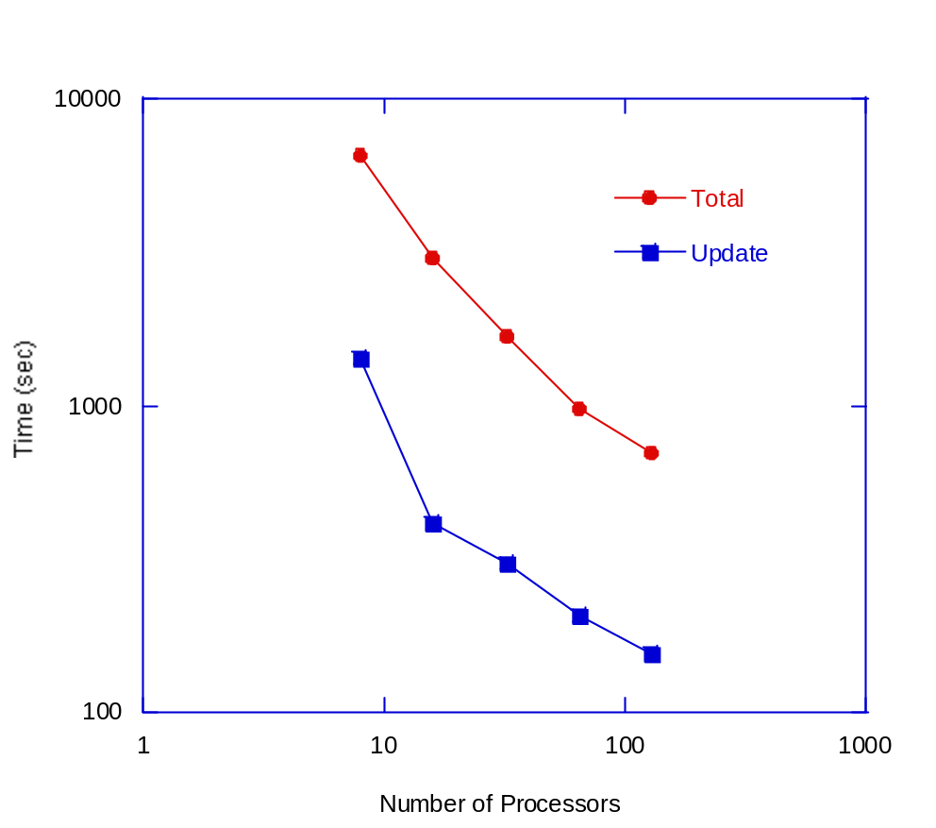
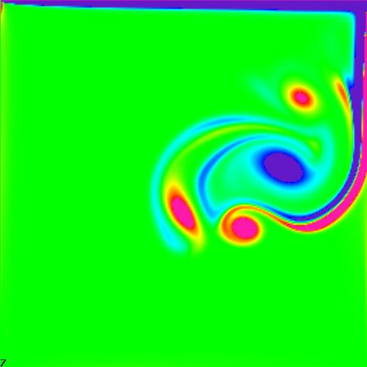
Lattice Boltzmann Performance

Slide 60
ScalaBLAST
ScalaBLAST is for doing high-throughput BLAST calculations in a cluster or supercomputer.
ScalaBLAST divides the collection of queries over available processors
  Proportional speedup on a few processors or on thousands
  Efficient on commodity clusters or on high-end machines
Deals with constantly growing database size by distributing one copy of database across processors using a single Global Array

Slide 61
Disk Resident Arrays
Extend GA model to disk
  system similar to Panda (U. Illinois) but higher level APIs
Provide easy transfer of data between N-dim arrays stored on disk and distributed arrays stored in memory
Use when
  Arrays too big to store in core
  checkpoint/restart
  out-of-core solvers
disk resident array
global array

Slide 62
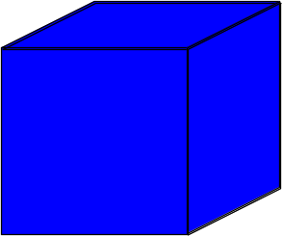
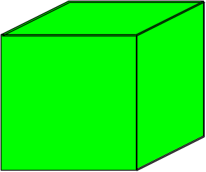
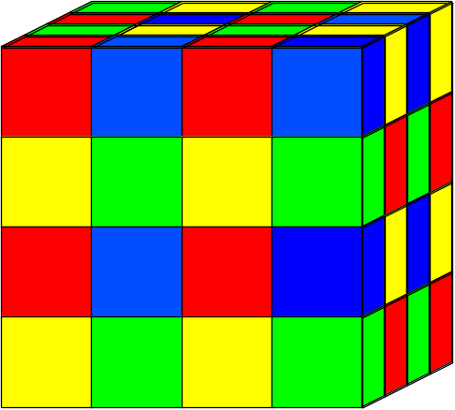


High Bandwidth Read/Write
Disk Resident Array
Disks
Disk Resident Arrays automatically decomposed into multiple files

Slide 63
Related Programming Tools
Co-Array Fortran
  Distributed Arrays
  One-Sided Communication
  No Global View of Data
UPC
  Model Similar to GA but only applicable to C programs
  Global Shared Pointers could be used to implement GA functionality
    C does not really support multi-dimensional arrays
High level functionality in GA is missing from these systems

Slide 64
Summary
The idea has proven very successful
  efficient on a wide range of architectures
    core operations tuned for high performance
  library substantially extended but all original (1994) APIs preserved
  increasing number of application areas
Supported and portable tool that works in real applications
Future work
  Fault tolerance
  Work queues

Slide 65
Source Code and More
Information
Version 4.2 available
Homepage at http://www.emsl.pnl.gov/docs/global/
Platforms (32 and 64 bit)
  IBM SP, BlueGene/L, BlueGene/P
  Cray X1, XD1, XT4, XT5
  Linux Cluster with Ethernet, Myrinet, Infiniband, or Quadrics
  HP
  SGI Altix
  Solaris
  Fujitsu
  Windows

Slide 66
Useful GA Functions (Fortran)
subroutine ga_initialize()
subroutine ga_terminate()
integer function ga_nnodes()
integer function ga_nodeid()
logical function nga_create(type,dim,dims,name,chunk,g_a)
integer type (MT_F_INT, MT_F_DBL, etc.)
integer dim
integer dims(dim)
character*(*) name
integer chunk(dim)
integer g_a
logical function ga_duplicate(g_a,g_b,name)
integer g_a
integer g_b
character*(*) name
logical function ga_destroy(g_a)
integer g_a
subroutine ga_sync()

Slide 67
Use GA Functions (Fortran)
subroutine nga_distribution(g_a, node_id, lo, hi)
integer g_a
integer node_id
integer lo(dim)
integer hi(dim)
subroutine nga_put(g_a, lo, hi, buf, ld)
integer g_a
integer lo(dim)
integer hi(dim)
fortran array buf
integer ld(dim-1)
subroutine nga_get(g_a, lo, hi, buf, ld)
integer g_a
integer lo(dim)
integer hi(dim)
fortran array buf
integer ld(dim-1)

Slide 68
Useful GA Functions (C)
void GA_Initialize()
void GA_Terminate()
int GA_Nnodes()
int GA_Nodeid()
int NGA_Create(type,dim,dims,name,chunk) Returns GA handle g_a
int type (C_INT, C_DBL, etc.)
int dim
int dims[dim]
char* name
int chunk[dim]
int GA_Duplicate(g_a,name) Returns GA handle g_b
int g_a
char* name
void GA_Destroy(g_a)
int g_a
void GA_Sync()

Slide 69
Useful GA Functions (C)
void NGA_Distribution(g_a, node_id, lo, hi)
int g_a
int node_id
int lo[dim]
int hi[dim]
void NGA_Put(g_a, lo, hi, buf, ld)
int g_a
int lo[dim]
int hi[dim]
void* buf
int ld[dim-1]
void NGA_Get(g_a, lo, hi, buf, ld)
int g_a
int lo[dim]
int hi[dim]
void* buf
int ld[dim-1]

Slide 70
Problems 1 and 2
Chose Fortran or C version of problems (whichever language you prefer)
  Xxxx.c or xxx.F
Search file for comments marked with ###
Using the text as hints, replace the comments with subroutines or functions from the GA library to create a working code
Compile and run

Slide 71
Problem 1 (1D Transpose)
Transpose a distributed 1D vector containing N elements in the order 1,2,...,N into a distributed vector containing N elements in the order N,N-1,...,2,1
Fortran version of this problem is in the file transp1D.F.tutorial
C version is in transp1D.c.tutorial
Working versions of these codes are in transp1D.F and transp1D.c

Slide 72
Problem 2 (Matrix Multiplication)
A simple matrix multiply algorithm that initializes two large matrices as GAs. It then multiplies a block of columns by a block or rows from the GAs locally on each processor and copies the result into a third global array
Fortran version of this problem is in the file matrix.F.tutorial
C version is in matrix.c.tutorial
Working versions are in matrix.F and matrix.c

Slide 73
Problem 3
Both the codes in problems 1 & 2 initialize the data by initializing a local array on processor 0 with all the data and then copying it to a distributed global array. For real problems it is usually undesirable to have all the data located on one processor at any point in the calculation. Can you modify these codes (problem 1 and 2) so that each processor only initializes the data owned by that processor?
1D transpose (Problem 1)
  Modify code so that each processor only initializes the local array a() with the data owned by that processor and then copy that data to the global array g_a
  Hint: Use nga_distribution and nga_put
  You will also need to modify the result checking part of the code as well so that it also only uses smaller portions of the total GA
  Hint: copy locally held part of result GA into local array b and corresponding part of original vector into local array a and compare (use arrays lo, hi, lo2, hi2 to get this data).
Matrix Multiply (Problem 2)
  Modify code so that each processor only initializes the local arrays a and b with the data held locally by that processor. Then copy that data to the global arrays g_a and g_b.
  Hint: Use nga_distribution and nga_put

