Slide 1
Overview of the Global Arrays
Parallel Software Development Toolkit: Introduction to Global Address Space Programming Models
P. Saddayappan², Jarek Nieplocha¹ , Bruce Palmer¹, Manojkumar Krishnan¹, Vinod Tipparaju¹
¹Pacific Northwest National Laboratory
²Ohio State University

Slide 2
Outline of the Tutorial
Parallel programming models
Global Arrays (GA) programming model
GA Operations
  Writing, compiling and running GA programs
  Basic, intermediate, and advanced calls
    With C and Fortran examples
GA Hands-on session

Slide 3
Performance vs. Abstraction and Generality
Domain
Specific
Systems
“Holy Grail”
GA
CAF
MPI
OpenMP
Scalability
Abstraction-M
Autoparallelized
C/Fortran90
Generality

Slide 4
Parallel Programming Models
Single Threaded
  Data Parallel, e.g. HPF
Multiple Processes
  Partitioned-Local Data Access
    MPI
  Uniform-Global-Shared Data Access
    OpenMP
  Partitioned-Global-Shared Data Access
    Co-Array Fortran
  Uniform-Global-Shared + Partitioned Data Access
    UPC, Global Arrays, X10

Slide 5
High Performance Fortran
Single-threaded view of computation
Data parallelism and parallel loops
User-specified data distributions for arrays
Compiler transforms HPF program to SPMD program
  Communication optimization critical to performance
Programmer may not be conscious of communication implications of parallel program
HPF$ Independent HPF$ Independent
DO I = 1,N DO I = 1,N
HPF$ Independent HPF$ Independent
DO J = 1,N DO J = 1,N
A(I,J) = B(J,I) A(I,J) = B(I,J)
END END
END END
s=s+1
A(1:100) = B(0:99)+B(2:101)
HPF$ Independent
Do I = 1,100
A(I) = B(I-1)+B(I+1)
End Do

Slide 6
Message Passing Interface
Messages
Most widely used parallel programming model today
Bindings for Fortran, C, C++, MATLAB
P parallel processes, each with local data
  MPI-1: Send/receive messages for inter-process communication
  MPI-2: One-sided get/put data access from/to local data at remote process
Explicit control of all inter-processor communication
  Advantage: Programmer is conscious of communication overheads and attempts to minimize it
  Drawback: Program development/debugging is tedious due to the partitioned-local view of the data
P₀
P₁
P_{k}
Private Data

Slide 7
OpenMP
Shared Data
Uniform-Global view of shared data
Available for Fortran, C, C++
Work-sharing constructs (parallel loops and sections) and global-shared data view ease program development
Disadvantage: Data locality issues obscured by programming model
P₀
P₁
P_{k}
Private Data

Slide 8
Co-Array Fortran
Co-Arrays
Partitioned, but global-shared data view
SPMD programming model with local and shared variables
Shared variables have additional co-array dimension(s), mapped to process space; each process can directly access array elements in the space of other processes
  A(I,J) = A(I,J)[me-1] + A(I,J)[me+1]
Compiler optimization of communication critical to performance, but all non-local access is explicit
P₀
P₁
P_{k}
Private Data

Slide 9
Unified Parallel C (UPC)
Shared Data
SPMD programming model with global shared view for arrays as well as pointer-based data structures
Compiler optimizations critical for controlling inter-processor communication overhead
  Very challenging problem since local vs. remote access is not explicit in syntax (unlike Co-Array Fortran)
  Linearization of multidimensional arrays makes compiler optimization of communication very difficult
Performance study with NAS benchmarks (PPoPP 2005, Mellor-Crummey et. al.) compared CAF and UPC
  Co-Array Fortran had significantly better scalability
  Linearization of multi-dimensional arrays in UPC was a significant source of overhead
P₀
P₁
P_{k}
Private Data

Slide 10
Global Arrays vs. Other Models
Advantages:
Inter-operates with MPI
  Use more convenient global-shared view for multi-dimensional arrays, but can use MPI model wherever needed
Data-locality and granularity control is explicit with GA’s get-compute-put model, unlike the non-transparent communication overheads with other models (except MPI)
Library-based approach: does not rely upon smart compiler optimizations to achieve high performance
Disadvantage:
Only useable for array data structures

Slide 11
Distributed Data vs Shared Memory
Shared Memory:
  Data is in a globally accessible address space, any processor can access data by specifying its location using a global index
Data is mapped out in a natural manner (usually corresponding to the original problem) and access is easy. Information on data locality is obscured and leads to loss of performance.
(1,1)
(47,95)
(106,171)
(150,200)

Slide 12
Global Arrays
Distributed dense arrays that can be accessed through a shared memory-like style
Physically distributed data
single, shared data structure/ global indexing
e.g., access A(4,3) rather than buf(7) on task 2
Global Address Space

Slide 13
Global Array Model of Computations
Shared Object
Shared Object
copy to shared object
get
put
copy to local memory
compute/update
local memory
local memory
local memory
Shared memory view for distributed dense arrays
Get-Local/Compute/Put-Global model of computation
MPI-Compatible; Currently usable with Fortran, C, C++, Python
Data locality and granularity control similar to message passing model

Slide 14
Overview of the Global Arrays
Parallel Software Development Toolkit: Global Arrays Programming Model
Jarek Nieplocha¹ , Bruce Palmer¹, Manojkumar Krishnan¹, Vinod Tipparaju¹, P. Saddayappan²
¹Pacific Northwest National Laboratory
²Ohio State University

Slide 15
Overview Of GA
Programming model
Structure of the GA toolkit
Overview of interfaces

Slide 16
Distributed vs Shared Data View
Distributed Data:
  Data is explicitly associated with each processor, accessing data requires specifying the location of the data on the processor and the processor itself.
Data locality is explicit but data access is complicated. Distributed computing is typically implemented with message passing (e.g. MPI)
(0xf5670,P0)
(0xf32674,P5)
P0
P1
P2

Slide 17
Distributed vs Shared Data (Cont).
Shared Data:
  Data is in a globally accessible address space, any processor can access data by specifying its location using a global index
Data is mapped out in a natural manner (usually corresponding to the original problem) and access is easy. Information on data locality is obscured and leads to loss of performance.
(1,1)
(47,95)
(106,171)
(150,200)

Slide 18
Global Arrays
Distributed dense arrays that can be accessed through a shared data-like style
Physically distributed data
single, shared data structure/ global indexing
e.g., access A(4,3) rather than buf(7) on task 2
Global Address Space

Slide 19
Global Arrays (cont.)
Shared data model in context of distributed dense arrays
Much simpler than message-passing for many applications
Complete environment for parallel code development
Compatible with MPI
Data locality control similar to distributed memory/message passing model
Extensible
Scalable

Slide 20
Global Array Model of Computations
Shared Object
Shared Object
copy to shared object
get
put
copy to local memory
compute/update
local memory
local memory
local memory

Slide 21
Creating Global Arrays
integer array handle
minimum block size on each processor
character string
g_a = NGA_Create(type, ndim, dims, name, chunk)
float, double, int, etc.
array of dimensions
dimension

Slide 22
Remote Data Access in GA vs MPI
Message Passing:
identify size and location of data blocks
loop over processors:
  if (me = P_N) then
    pack data in local message buffer
    send block of data to message buffer on P0
  else if (me = P0) then
    receive block of data from P_N in message buffer
    unpack data from message buffer to local buffer
  endif
end loop
copy local data on P0 to local buffer
Global Arrays:
NGA_Get(g_a, lo, hi, buffer, ld);
}
}
Global Array handle
Global upper and lower indices of data patch
Local buffer and array of strides
P0
P2
P1
P3

Slide 23
One-sided Communication
Message Passing:
  Message requires cooperation on both sides. The processor sending the message (P1) and the processor receiving the message (P0) must both participate.
receive
send
P0
P1
message passing
MPI
One-sided Communication:
  Once message is initiated on sending processor (P1) the sending processor can continue computation. Receiving processor (P0) is not involved. Data is copied directly from switch into memory on P0.
put
P0
P1
one-sided communication
SHMEM, ARMCI, MPI-2-1S

Slide 24
Data Locality in GA
What data does a processor own?
NGA_Distribution(g_a, iproc, lo, hi);
Where is the data?
NGA_Access(g_a, lo, hi, ptr, ld)
Use this information to organize calculation so that maximum use is made of locally held data

Slide 25
Example: Matrix Multiply
global arrays representing matrices
=
•
nga_put
nga_get
=
•
dgemm
local buffers on the processor

Slide 26
Matrix Multiply
(a better version)
more scalable!
(less memory, higher parallelism)
=
•
atomic accumulate
get
=
•
dgemm
local buffers on the processor

Slide 27
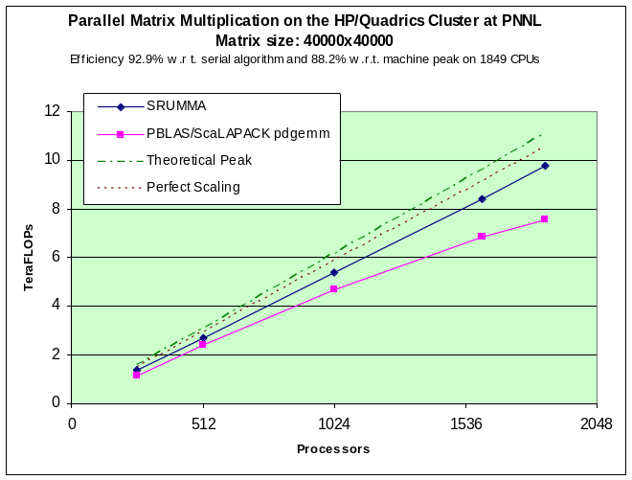
SRUMMA Matrix Multiplication
(an even better version)
Issue NB Get A and B blocks
do (until last chunk)
issue NB Get to the next blocks
wait for previous issued call
compute A*B (sequential dgemm)
NB atomic accumulate into “C”
matrix
done
Computation
Comm.
(Overlap)
A
B
C=A.B
http://hpc.pnl.gov/projects/srumma/

Slide 28
Structure of GA
Application programming language interface
F90
Java
Fortran 77
C
C++
Python
Babel
distributed arrays layer
memory management, index translation
Global Arrays and MPI are completely interoperable. Code can contain calls to both libraries.
MPI
Global
operations
ARMCI
portable 1-sided communication
put, get, locks, etc
system specific interfaces
LAPI, GM/Myrinet, threads, VIA,..

Slide 29
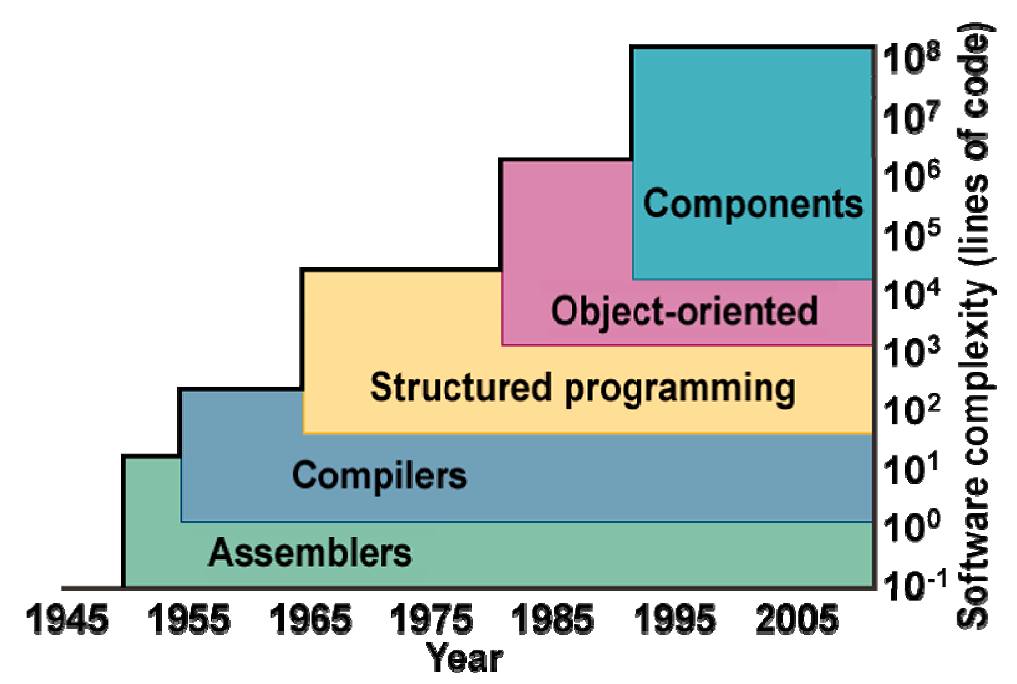
From Programming Models to Component Software
Complexity of scientific software increases with simulation fidelity, multi-physics coupling, computer power
Applications increasingly often adopt modular design with modules (components) written using different languages and programming models
The Common Component Architecture
(CCA) brings the component software
approach to scientific HPC
  DoE Scidac project
CCA
Common Component Architecture

Slide 30

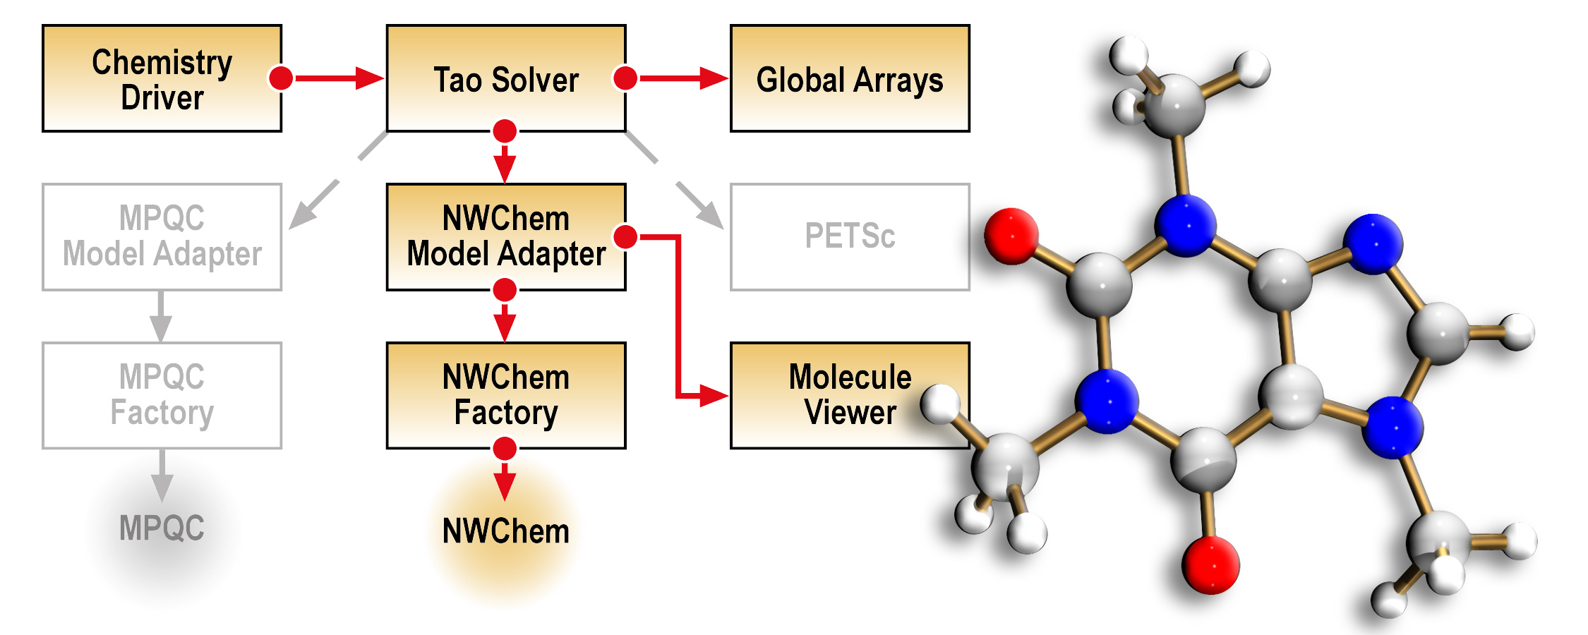
GA and CCA
Developed using Common Component Architecture (CCA)
  Standard for Plug N’ Play HPC Component technology
  Advantages: software complexity and interoperability within and across scientific domains, addressing issues in programming language interoperability, domain-specific common interfaces, dynamic composability
GA Component provides explicit interfaces (CCA ports) to other systems that expand functionality of GA
  For example: GA’s interoperability with TAO (Toolkit for Advanced Optimization – ANL) optimization component
  Language interoperable Fortran, C, C++, Python, Java and F90
Multi-level Parallelism in applications using CCA’s MCMD Programming Model and GA Processor groups
CCA-based quantum chemistry application which integrates NWChem, GA, TAO, PETSc, MPQC Components

Slide 31
Disk Resident Arrays
Extend GA model to disk
  system similar to Panda (U. Illinois) but higher level APIs
Provide easy transfer of data between N-dim arrays stored on disk and distributed arrays stored in memory
Use when
  Arrays too big to store in core
  checkpoint/restart
  out-of-core solvers
disk resident array
global array

Slide 32
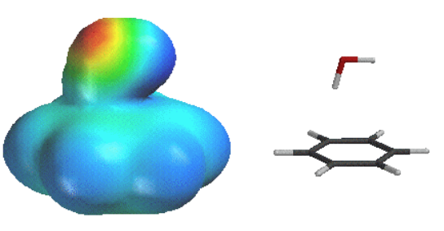
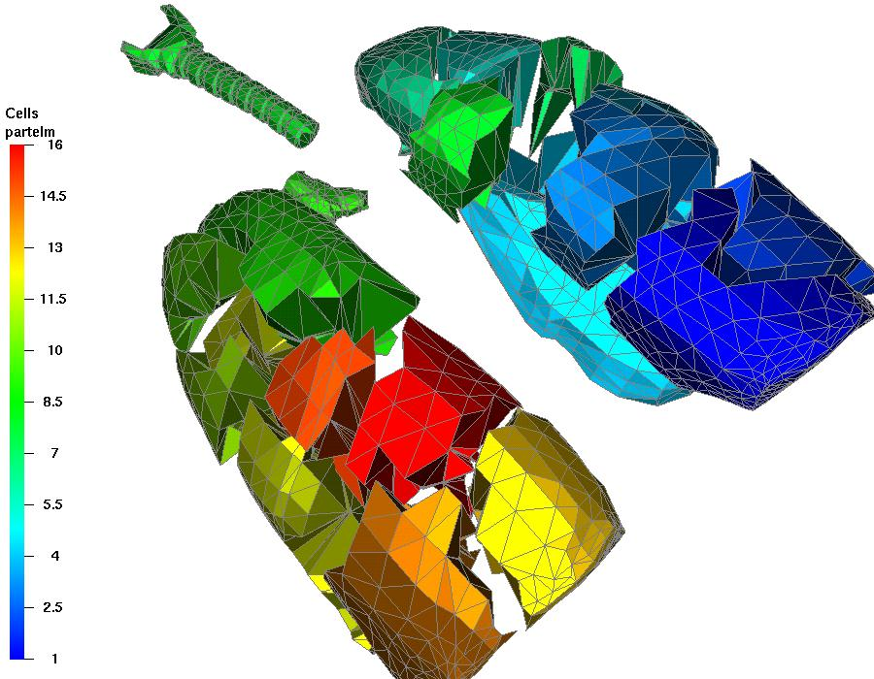
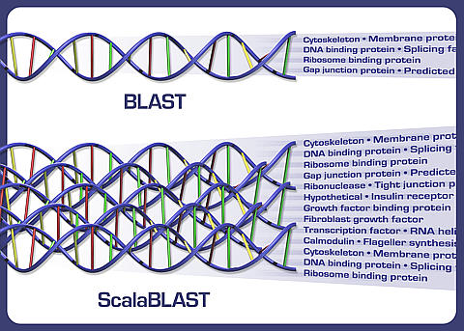
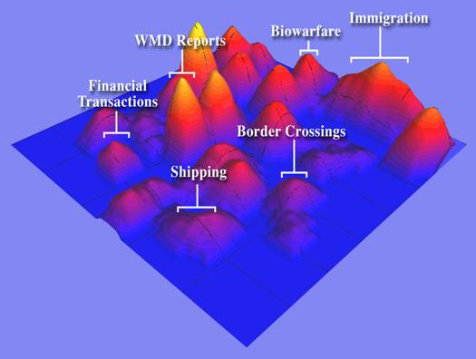
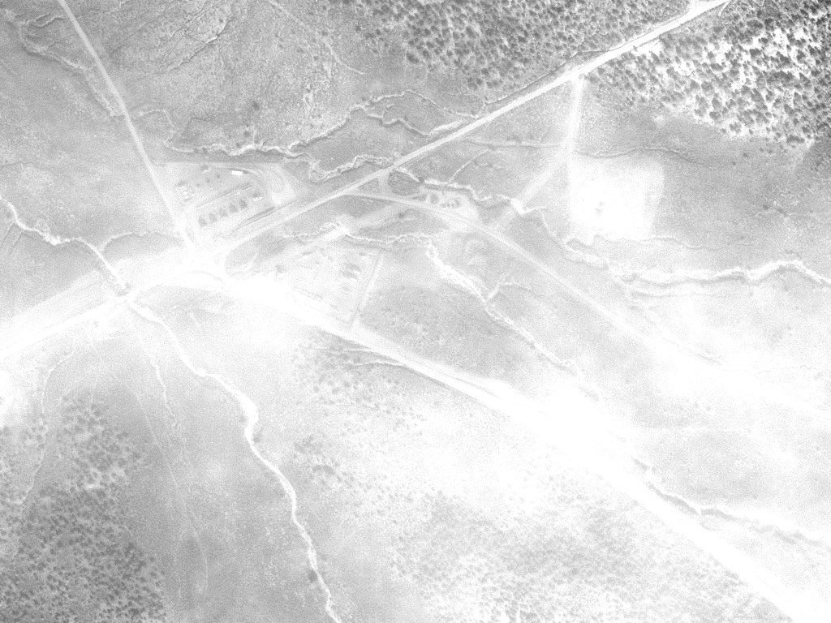
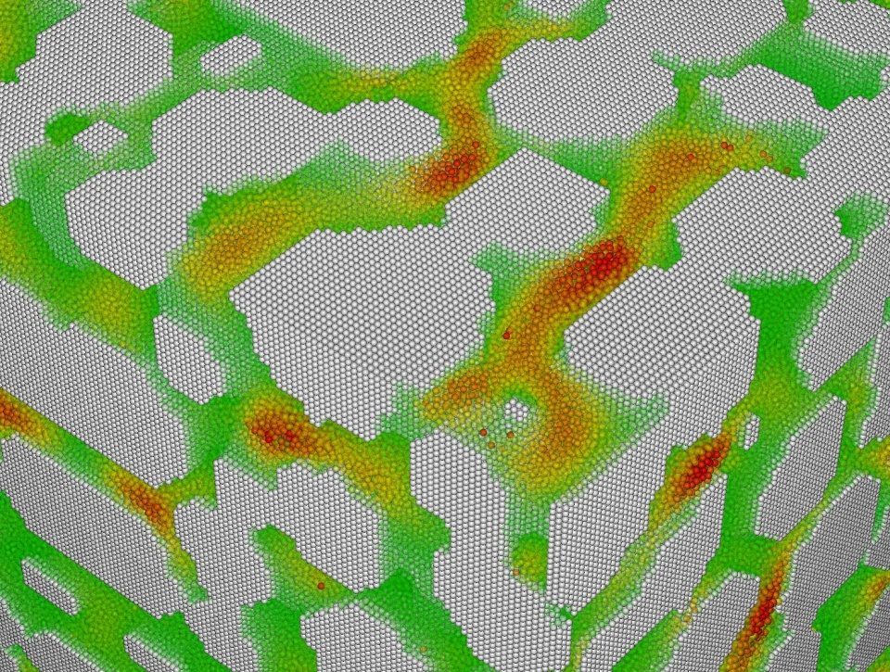
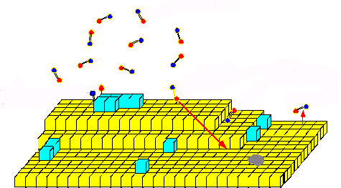
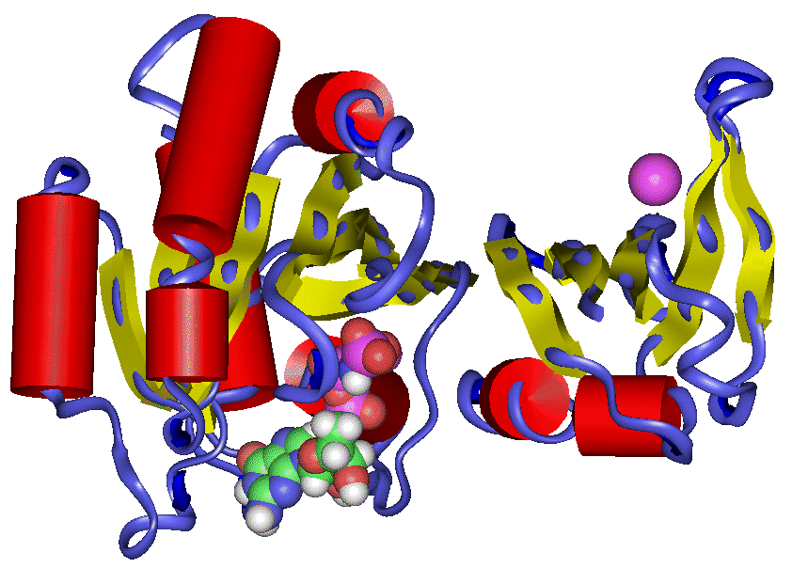
Application Areas
electronic structure chemistry
Major area
bioinformatics
Biology: organ simulation
visual analytics
smooth particle hydrodynamics
Visualization and image analysis
material sciences
molecular dynamics
Others: financial security forecasting, astrophysics, geosciences, atmospheric chemistry

Slide 33
New Applications
ScalaBLAST
C. Oehmen and J. Nieplocha. ScalaBLAST: "A scalable implementation of BLAST for high performance data-intensive bioinformatics analysis." IEEE Trans. Parallel Distributed Systems, Vol. 17, No. 8, 2006
Parallel Inspire
Krishnan M, SJ Bohn, WE Cowley, VL Crow, and J Nieplocha,
"Scalable Visual Analytics of Massive Textual Datasets",
Proc. IEEE International Parallel and Distributed
Processing Symposium, 2007.
Smooth Particle Hydrodynamics

Slide 34
Source Code and More
Information
Version 4.0 available
Homepage at http://www.emsl.pnl.gov/docs/global/
Platforms (32 and 64 bit)
  IBM SP, BlueGene
  Cray X1, XD1, XT3, XT4
  Linux Cluster with Ethernet, Myrinet, Infiniband, or Quadrics
  Solaris
  Fujitsu
  Hitachi
  NEC
  HP
  Windows

Slide 35
Overview of the Global Arrays
Parallel Software Development Toolkit: Getting Started, Basic Calls
Manojkumar Krishnan¹, Jarek Nieplocha¹ , Bruce Palmer¹, Vinod Tipparaju¹, P. Saddayappan²
¹Pacific Northwest National Laboratory
²Ohio State University

Slide 36
Outline
Writing, Building, and Running GA Programs
Basic Calls
Intermediate Calls
Advanced Calls

Slide 37
Writing, Building and Running
GA programs
Installing GA
Writing GA programs
Compiling and linking
Running GA programs
For detailed information
  GA Webpage
    GA papers, APIs, user manual, etc.
    (Google: Global Arrays)
    http://www.emsl.pnl.gov/docs/global/
  GA User Manual
    http://www.emsl.pnl.gov/docs/global/user.html
  GA API Documentation
    GA Webpage => User Interface
    http://www.emsl.pnl.gov/docs/global/userinterface.html
  GA Support/Help
    hpctools@pnl.gov or hpctools@emsl.pnl.gov
  2 mailing lists: GA User Forum, and GA Announce

Slide 38
Installing GA
Required environment settings
  TARGET: Used to set the platform
    E.g. setenv TARGET LINUX (32 bit Linux platform)
    See chapter 2 of GA user manual for the complete list
  ARMCI_NETWORK: Specify the underlying network communication protocol
    This setting is required only on clusters with a high performance network
    E.g. If the underlying network is Infiniband using OpenIB protocol
      setenv ARMCI_NETWORK OPENIB
  GA requires MPI for basic start-up and process management
    You can either use MPI or TCGMSG wrapper to MPI.
      To use MPI, setenv MSG_COMMS MPI
      To use TCGMSG-MPI wrapper, setenv USE_MPI y
    Also set MPI_LIB and MPI_INCLUDE, which contain the path to MPI include and libraries
    Set LIBMPI which point to the actual MPI libs e.g. setenv LIBMPI -lmpich
Please refer to chapter 2 of user manual for other optional arguments
“make” or “gmake” to build GA libraries
To override the default compiler and optimization flags when building GA:
  gmake FC=f90 CC=cc FOPT=-O4 COPT=-g

Slide 39
Writing GA Programs
GA Definitions and Data types
  C programs include files: ga.h, macdecls.h
  Fortran programs should include the files: mafdecls.fh, global.fh.
GA Initialize, GA_Terminate --> initializes and terminates GA library
#include <stdio.h>
#include "mpi.h“
#include "ga.h"
#include "macdecls.h"
int main( int argc, char **argv ) {
MPI_Init( &argc, &argv );
GA_Initialize();
printf( "Hello world\n" );
GA_Terminate();
MPI_Finalize();
return 0;
}

Slide 40
Writing GA Programs
GA requires the following functionalities from a message passing library (MPI/TCGMSG)
  initialization and termination of processes
  Broadcast, Barrier
  a function to abort the running parallel job in case of an error
The message-passing library has to be
  initialized before the GA library
  terminated after the GA library is terminated
GA is compatible with MPI
#include <stdio.h>
#include "mpi.h“
#include "ga.h"
#include "macdecls.h"
int main( int argc, char **argv ) {
MPI_Init( &argc, &argv );
GA_Initialize();
printf( "Hello world\n" );
GA_Terminate();
MPI_Finalize();
return 0;
}

Slide 41
Compiling and Linking GA Programs
2 ways
  Use the GA Makefile in global/testing
  Your Makefile
GA Makefile in global/testing
  To compile and link your GA based program, for example “app.c” (or “app.f”, ..)
    Copy to $GA_DIR/global/testing, and type
    make app.x or gmake app.x
  Compile any test program in GA testing directory, and use the appropriate compile/link flags in your program

Slide 42
Compiling and Linking GA Programs (cont.)
Your Makefile
  Please refer to the INCLUDES, FLAGS and LIBS variables, which will be printed at the end of a successful GA installation on your platform
  You can use these variables in your Makefile
    For example: gcc $(INCLUDES) $(FLAGS) –o ga_test ga_test.c $(LIBS)
INCLUDES = -I./include -I/msrc/apps/mpich-1.2.6/gcc/ch_shmem/include
LIBS = -L/msrc/home/manoj/GA/cvs/lib/LINUX -lglobal -lma -llinalg
-larmci -L/msrc/apps/mpich-1.2.6/gcc/ch_shmem/lib -lmpich –lm
For Fortran Programs:
FLAGS = -g -Wall -funroll-loops -fomit-frame-pointer -malign-double
-fno-second-underscore -Wno-globals
For C Programs:
FLAGS = -g -Wall -funroll-loops -fomit-frame-pointer -malign-double
-fno-second-underscore -Wno-globals
NOTE: Please refer to GA user manual chapter 2 for more information

Slide 43
Running GA Programs
Example: Running a test program “ga_test” on 2 processes
mpirun -np 2 ga_test
Running a GA program is same as MPI

Slide 44
Outline
Writing, Building, and Running GA Programs
Basic Calls
Intermediate Calls
Advanced Calls

Slide 45
GA Basic Operations
GA programming model is very simple.
Most of a parallel program can be written with these basic calls
  GA_Initialize, GA_Terminate
  GA_Nnodes, GA_Nodeid
  GA_Create, GA_Destroy
  GA_Put, GA_Get
  GA_Sync

Slide 46
GA Initialization/Termination
There are two functions to initialize GA:
  Fortran
    subroutine ga_initialize()
    subroutine ga_initialize_ltd(limit)
  C
    void GA_Initialize()
    void GA_Initialize_ltd(size_t limit)
To terminate a GA program:
  Fortran subroutine ga_terminate()
  C void GA_Terminate()
integer limit - amount of memory in bytes per process [input]
program main
#include “mafdecls.h”
#include “global.fh”
integer ierr
c
call mpi_init(ierr)
call ga_initialize()
c
write(6,*) ‘Hello world’
c
call ga_terminate()
call mpi_finilize()
end

Slide 47
Parallel Environment - Process Information
Parallel Environment:
  how many processes are working together (size)
  what their IDs are (ranges from 0 to size-1)
To return the process ID of the current process:
  Fortran integer function ga_nodeid()
  C int GA_Nodeid()
To determine the number of computing processes:
  Fortran integer function ga_nnodes()
  C int GA_Nnodes()

Slide 48
Parallel Environment - Process Information (EXAMPLE)
program main
#include “mafdecls.h”
#include “global.fh”
integer ierr,me,nproc
call mpi_init(ierr)
call ga_initialize()
me = ga_nodeid()
size = ga_nnodes()
write(6,*) ‘Hello world: My rank is ’ + me + ‘ out of ‘ +
! size + ‘processes/nodes’
call ga_terminate()
call mpi_finilize()
end
$ mpirun –np 4 helloworld
Hello world: My rank is 0 out of 4 processes/nodes
Hello world: My rank is 2 out of 4 processes/nodes
Hello world: My rank is 3 out of 4 processes/nodes
Hello world: My rank is 1 out of 4 processes/nodes

Slide 49
GA Data Types
C Data types
  C_INT - int
  C_LONG - long
  C_FLOAT - float
  C_DBL - double
  C_SCPL - single complex
  C_DCPL - double complex
Fortran Data types
  MT_F_INT - integer (4/8 bytes)
  MT_F_REAL - real
  MT_F_DBL - double precision
  MT_F_SCPL - single complex
  MT_F_DCPL - double complex

Slide 50
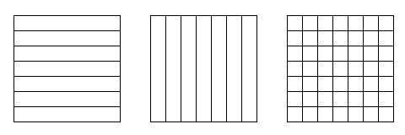
Creating/Destroying Arrays
To create an array with a regular distribution:
  Fortran logical function nga_create(type, ndim, dims, name, chunk, g_a)
  C int NGA_Create(int type, int ndim, int dims[], char *name, int chunk[])
character*(*) name - a unique character string [input]
integer type - GA data type [input]
integer dims() - array dimensions [input]
integer chunk() - minimum size that dimensions
should be chunked into [input]
integer g_a - array handle for future references [output]
dims(1) = 5000
dims(2) = 5000
chunk(1) = -1 !Use defaults
chunk(2) = -1
if (.not.nga_create(MT_F_DBL,2,dims,’Array_A’,chunk,g_a))
+ call ga_error(“Could not create global array A”,g_a)

Slide 51
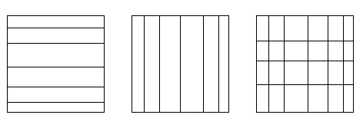
Creating/Destroying Arrays (cont.)
To create an array with an irregular distribution:
  Fortran logical function nga_create_irreg (type, ndim, dims, array_name,
  map, nblock, g_a)
  C int NGA_Create_irreg(int type, int ndim, int dims[], char* array_name, nblock[], map[])
character*(*) name - a unique character string [input]
integer type - GA datatype [input]
integer dims - array dimensions [input]
integer nblock(*) - no. of blocks each dimension is divided into [input]
integer map(*) - starting index for each block [input]
integer g_a - integer handle for future references [output]

Slide 52
Creating/Destroying Arrays (cont.)
Example of irregular distribution:
  The distribution is specified as a Cartesian product of distributions for each dimension. The array indices start at 1.
    The figure demonstrates distribution of a 2-dimensional array 8x10 on 6 (or more) processors. block[2]={3,2}, the size of map array is s=5 and array map contains the following elements map={1,3,7, 1, 6}.
    The distribution is nonuniform because, P1 and P4 get 20 elements each and processors P0,P2,P3, and P5 only 10 elements each.
5
5
P0
P3
2
P1
P4
4
P2
P5
2
block(1) = 3
block(2) = 2
map(1) = 1
map(2) = 3
map(3) = 7
map(4) = 1
map(5) = 6
if (.not.nga_create_irreg(MT_F_DBL,2,dims,’Array_A’,map,block,g_a))
+ call ga_error(“Could not create global array A”,g_a)

Slide 53
Creating/Destroying Arrays (cont.)
To duplicate an array:
  Fortran logical function ga_duplicate(g_a, g_b, name)
  C int GA_Duplicate(int g_a, char *name)
Global arrays can be destroyed by calling the function:
  Fortran subroutine ga_destroy(g_a)
  C void GA_Destroy(int g_a)
integer g_a, g_b;
character*(*) name;
name - a character string [input]
g_a - Integer handle for reference array [input]
g_b - Integer handle for new array [output]
call nga_create(MT_F_INT,dim,dims,
+ ‘array_a’,chunk,g_a)
call ga_duplicate(g_a,g_b,‘array_b’)
call ga_destroy(g_a)

Slide 54
Put/Get
Put copies data from a local array to a global array section:
  Fortran subroutine nga_put(g_a, lo, hi, buf, ld)
  C void NGA_Put(int g_a, int lo[], int hi[], void *buf, int ld[])
Get copies data from a global array section to a local array:
  Fortran subroutine nga_get(g_a, lo, hi, buf, ld)
  C void NGA_Get(int g_a, int lo[], int hi[], void *buf, int ld[])
integer g_a global array handle [input]
integer lo(),hi() limits on data block to be moved [input]
double precision/complex/integer buf local buffer [output]
integer ld() array of strides for local buffer [input]
Shared Object
Shared Object
get
put
copy to shared object
copy to local memory
compute/update
local memory

Slide 55
Put/Get (cont.)
Example of put operation:
  transfer data from a local buffer (10 x10 array) to (7:15,1:8) section of a 2-dimensional 15 x10 global array into lo={7,1}, hi={15,8}, ld={10}
global
lo
hi
local
double precision buf(10,10)
:
:
call nga_put(g_a,lo,hi,buf,ld)

Slide 56
Atomic Accumulate
Accumulate combines the data from the local array with data in the global array section:
  Fortran subroutine nga_acc(g_a, lo, hi,
  buf, ld, alpha)
  C void NGA_Acc(int g_a, int lo[],
  int hi[], void *buf, int ld[],
  void *alpha)
integer g_a array handle [input]
integer lo(), hi() limits on data block to be moved [input]
double precision/complex buf local buffer [input]
integer ld() array of strides for local buffer [input]
double precision/complex alpha arbitrary scale factor [input]
global
local
ga(i,j) = ga(i,j)+alpha*buf(k,l)

Slide 57
Sync
Sync is a collective operation
It acts as a barrier, which synchronizes all the processes and ensures that all the Global Array operations are complete at the call
The functions are:
  Fortran subroutine ga_sync()
  C void GA_Sync()
sync

Slide 58
Global Operations
Fortran subroutine ga_brdcst(type, buf, lenbuf, root)
subroutine ga_igop(type, x, n, op)
    subroutine ga_dgop(type, x, n, op)
C void GA_Brdcst(void *buf, int lenbuf, int root)
void GA_Igop(long x[], int n, char *op)
void GA_Dgop(double x[], int n, char *op)

Slide 59
Global Array Model of Computations
Shared Object
Shared Object
copy to shared object
get
put
copy to local memory
compute/update
local memory
local memory
local memory

Slide 60
Locality Information
Discover array elements held by each processor
  Fortran nga_distribution(g_a,proc,lo,hi)
  C void NGA_Distribution(int g_a, int proc, int *lo, int *hi)
integer g_a array handle [input]
integer proc processor ID [input]
integer lo(ndim) lower index [output]
integer hi(ndim) upper index [output]
do iproc = 1, nproc
write(6,*) ‘Printing g_a info for processor’,iproc
call nga_distribution(g_a,iproc,lo,hi)
do j = 1, ndim
write(6,*) j,lo(j),hi(j)
end do
dnd do

Slide 61
Example: Matrix Multiply
/* Determine which block of data is locally owned. Note that
the same block is locally owned for all GAs. */
NGA_Distribution(g_c, me, lo, hi);
/* Get the blocks from g_a and g_b needed to compute this block in
g_c and copy them into the local buffers a and b. */
lo2[0] = lo[0]; lo2[1] = 0; hi2[0] = hi[0]; hi2[1] = dims[0]-1;
NGA_Get(g_a, lo2, hi2, a, ld);
lo3[0] = 0; lo3[1] = lo[1]; hi3[0] = dims[1]-1; hi3[1] = hi[1];
NGA_Get(g_b, lo3, hi3, b, ld);
/* Do local matrix multiplication and store the result in local
buffer c. Start by evaluating the transpose of b. */
for(i=0; i < hi3[0]-lo3[0]+1; i++)
for(j=0; j < hi3[1]-lo3[1]+1; j++)
btrns[j][i] = b[i][j];
/* Multiply a and b to get c */
for(i=0; i < hi[0] - lo[0] + 1; i++) {
for(j=0; j < hi[1] - lo[1] + 1; j++) {
c[i][j] = 0.0;
for(k=0; k<dims[0]; k++)
c[i][j] = c[i][j] + a[i][k]*btrns[j][k];
}
}
/* Copy c back to g_c */
NGA_Put(g_c, lo, hi, c, ld);
=
•
nga_put
nga_get
=
•
dgemm

Slide 62
Overview of the Global Arrays
Parallel Software Development Toolkit: Intermediate and Advanced APIs
Bruce Palmer¹, Jarek Nieplocha¹ , Manojkumar Krishnan¹, Vinod Tipparaju¹, P. Saddayappan²
¹Pacific Northwest National Laboratory
²Ohio State University

Slide 63
Outline
Writing, Building, and Running GA Programs
Basic Calls
Intermediate Calls
Advanced Calls

Slide 64
Basic Array Operations
Whole Arrays:
  To set all the elements in the array to zero:
    Fortran subroutine ga_zero(g_a)
    C void GA_Zero(int g_a)
  To assign a single value to all the elements in array:
    Fortran subroutine ga_fill(g_a, val)
    C void GA_Fill(int g_a, void *val)
  To scale all the elements in the array by factorval:
    Fortran subroutine ga_scale(g_a, val)
    C void GA_Scale(int g_a, void *val)

Slide 65
Basic Array Operations (cont.)
Whole Arrays:
  To copy data between two arrays:
    Fortran subroutine ga_copy(g_a, g_b)
    C void GA_Copy(int g_a, int g_b)
    Arrays must be same size and dimension
      Distribution may be different
call ga_create(MT_F_INT,ndim,dims,
‘array_A’,chunk_a,g_a)
call nga_create(MT_F_INT,ndim,dims,
‘array_B’,chunk_b,g_b)
... Initialize g_a ....
call ga_copy(g_a, g_b)
“g_a”
“g_b”
0
1
2
0
1
2
3
4
5
3
4
5
6
7
8
6
7
8
Global Arrays g_a and g_b distributed on a 3x3 process grid

Slide 66
Basic Array Operations (cont.)
Patch Operations:
  The copy patch operation:
    Fortran subroutine nga_copy_patch(trans, g_a, alo, ahi, g_b, blo, bhi)
    C void NGA_Copy_patch(char trans, int g_a, int alo[], int ahi[],
    int g_b, int blo[], int bhi[])
    Number of elements must match
“g_a”
“g_b”
0
1
2
Copy
0
1
2
3
4
5
3
4
5
6
7
8
6
7
8

Slide 67
Basic Array Operations (cont.)
Patches (Cont):
  To set only the region defined by lo and hi to zero:
    Fortran subroutine nga_zero_patch(g_a, lo, hi)
    C void NGA_Zero_patch(int g_a, int lo[] int hi[])
  To assign a single value to all the elements in a patch:
    Fortran subroutine nga_fill_patch(g_a, lo, hi, val)
    C voidNGA_Fill_patch(int g_a, int lo[] int hi[], void *val)
  To scale the patch defined by lo and hi by the factor val:
    Fortran subroutine nga_scale_patch(g_a, lo, hi, val)
    C voidNGA_Scale_patch(int g_a, int lo[] int hi[], void *val)
  The copy patch operation:
    Fortran subroutine nga_copy_patch(trans, g_a, alo, ahi, g_b, blo, bhi)
    C void NGA_Copy_patch(char trans, int g_a, int alo[], int ahi[],
    int g_b, int blo[], int bhi[])

Slide 68
Scatter/Gather
Scatter puts array elements into a global array:
  Fortran subroutine nga_scatter(g_a, v, subscrpt_array, n)
  C void NGA_Scatter(int g_a, void *v, int *subscrpt_array[], int n)
Gather gets the array elements from a global array into a local array:
  Fortran subroutine nga_gather(g_a, v, subscrpt_array, n)
  C void NGA_Gather(int g_a, void *v, int *subscrpt_array[], int n)
integer g_a array handle [input]
double precision v(n) array of values [input/output]
integer n number of values [input]
integer subscrpt_array location of values in global array [input]

Slide 69
Scatter/Gather (cont.)
Example of scatter operation:
  Scatter the 5 elements into a 10x10 global array
    Element 1 v[0] = 5 subsArray[0][0] = 2
    subsArray[0][1] = 3
    Element 2 v[1] = 3 subsArray[1][0] = 3
    subsArray[1][1] = 4
    Element 3 v[2] = 8 subsArray[2][0] = 8
    subsArray[2][1] = 5
    Element 4 v[3] = 7 subsArray[3][0] = 3
    subsArray[3][1] = 7
    Element 5 v[4] = 2 subsArray[4][0] = 6
    subsArray[4][1] = 3
  After the scatter operation, the five elements would be scattered into the global array as shown in the figure.
 | 0 | 1 | 2 | 3 | 4 | 5 | 6 | 7 | 8 | 9
0
1
2 |  |  |  | 5
3 |  |  |  |  | 3 |  |  | 7
4
5
6 |  |  |  | 2
7
8 |  |  |  |  |  | 8
9
integer subscript(ndim,nlen)
:
call nga_scatter(g_a,v,subscript,nlen)

Slide 70
Read and Increment
Read_inc remotely updates a particular element in an integer global array and returns the original value:
  Fortran integer function nga_read_inc(g_a, subscript, inc)
  C long NGA_Read_inc(int g_a, int subscript[], long inc)
  Applies to integer arrays only
  Can be used as a global counter for dynamic load balancing
integer g_a [input]
integer subscript(ndim), inc [input]
NGA_Read_inc
(Read and Increment)
c Create task counter
call nga_create(MT_F_INT,one,one,chunk,g_counter)
call ga_zero(g_counter)
:
itask = nga_read_inc(g_counter,one,one)
... Translate itask into task ...
Global Array
Global Lock
(access to data
is serialized)

Slide 71
Outline
Writing, Building, and Running GA Programs
Basic Calls
Intermediate Calls
Advanced Calls

Slide 72
Access
To provide direct access to local data in the specified patch of the array owned by the calling process:
  Fortran subroutine nga_access(g_a, lo, hi,
  index, ld)
  C void NGA_Access(int g_a,
  int lo[], int hi[], void *ptr, int ld[])
  Processes can access the local position of the global array
    Process “0” can access the specified patch of its local position of the array
    Avoids memory copy
0
1
2
Access: gives a pointer to this local patch
3
4
5
6
7
8
call nga_create(MT_F_DBL,2,dims,’Array’,chunk,g_a)
:
call nga_distribution(g_a,me,lo,hi)
call nga_access(g_a,lo,hi,index,ld)
call do_subroutine_task(dbl_mb(index),ld(1))
call nga_release(g_a,lo,hi)
subroutine do_subroutine_task(a,ld1)
double precision a(ld1,*)

Slide 73
Locality Information (cont.)
Global Arrays support abstraction of a distributed array object
Object is represented by an integer handle
A process can access its portion of the data in the global array
To do this, the following steps need to be taken:
  Find the distribution of an array, i.e. which part of the data the calling process owns
  Access the data
  Operate on the data: read/write
  Release the access to the data
0
1
3
4

Slide 74
Non-blocking Operations
The non-blocking APIs are derived from the blocking interface by adding a handle argument that identifies an instance of the non-blocking request.
  Fortran
    subroutine nga_nbput(g_a, lo, hi, buf, ld, nbhandle)
    subroutine nga_nbget(g_a, lo, hi, buf, ld, nbhandle)
    subroutine nga_nbacc(g_a, lo, hi, buf, ld, alpha, nbhandle)
    subroutine nga_nbwait(nbhandle)
  C
    void NGA_NbPut(int g_a, int lo[], int hi[], void *buf,
    int ld[], ga_nbhdl_t* nbhandle)
    void NGA_NbGet(int g_a, int lo[], int hi[], void *buf,
    int ld[], ga_nbhdl_t* nbhandle)
    void NGA_NbAcc(int g_a, int lo[], int hi[], void *buf,
    int ld[], void *alpha, ga_nbhdl_t* nbhandle)
    int NGA_NbWait(ga_nbhdl_t* nbhandle)
integer nbhandle - non-blocking request handle [output/input]

Slide 75
Non-Blocking Operations
double precision buf1(nmax,nmax)
double precision buf2(nmax,nmax)
:
call nga_nbget(g_a,lo1,hi1,buf1,ld1,nb1)
ncount = 1
do while(.....)
if (mod(ncount,2).eq.1) then
... Evaluate lo2, hi2
call nga_nbget(g_a,lo2,hi2,buf2,nb2)
call nga_wait(nb1)
... Do work using data in buf1
else
... Evaluate lo1, hi1
call nga_nbget(g_a,lo1,hi1,buf1,nb1)
call nga_wait(nb2)
... Do work using data in buf2
endif
ncount = ncount + 1
end do

Slide 76
SRUMMA Matrix Multiplication
Issue NB Get A and B blocks
do (until last chunk)
issue NB Get to the next blocks
wait for previous issued call
compute A*B (sequential dgemm)
NB atomic accumulate into “C”
matrix
done
Computation
Comm.
(Overlap)
A
B
C=A.B
Advantages:
- Minimum memory
- Highly parallel
- Overlaps computation and communication
- latency hiding
- exploits data locality
- patch matrix multiplication (easy to use)
- dynamic load balancing
=
patch matrix multiplication
http://hpc.pnl.gov/projects/srumma/

Slide 77

SRUMMA Matrix Multiplication:
Improvement over PBLAS/ScaLAPACK

Slide 78
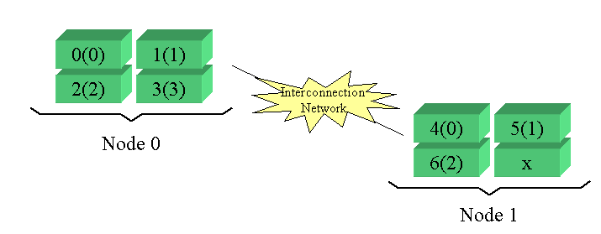
Cluster Information
Example:
2 nodes with 4 processors each. Say, there are 7 processes created.
  ga_cluster_nnodes returns 2
  ga_cluster_nodeid returns 0 or 1
  ga_cluster_nprocs(inode) returns 4 or 3
  ga_cluster_procid(inode,iproc) returns a processor ID

Slide 79
Cluster Information (cont.)
To return the total number of nodes that the program is running on:
  Fortran integer function ga_cluster_nnodes()
  C int GA_Cluster_nnodes()
To return the node ID of the process:
  Fortran integer function ga_cluster_nodeid()
  C int GA_Cluster_nodeid()
N0
N1

Slide 80
Cluster Information (cont.)
To return the number of processors available on node inode:
  Fortran integer function ga_cluster_nprocs(inode)
  C int GA_Cluster_nprocs(int inode).
To return the processor ID associated with node inode and the local processor ID iproc:
  Fortran integer function ga_cluster_procid(inode,
  iproc)
  C int GA_Cluster_procid(int inode, int iproc)
integer inode [input]
inode [input]
integer inode,iproc [input]
inode,iproc [input]
0(0)
1(1)
2(2)
3(3)
4(0)
5(1)
6(2)
7(3)

Slide 81
Accessing Processor Memory
Node
SMP Memory
R₈
R₉
R₁₀
R₁₁
ga_access
P₈
P₉
P₁₀
P₁₁

Slide 82
Processor Groups
To create a new processor group:
  Fortran integer function ga_pgroup_create(list, size)
  C int GA_Pgroup_create(int *list, int size)
To assign a processor groups:
  Fortran logical function nga_create_config(type,
  ndim, dims, name, chunk, p_handle, g_a)
  C int NGA_Create_config(int type, int ndim,
  int dims[], char *name, int p_handle, int chunk[])
integer g_a - global array handle [input]
integer p_handle - processor group handle [output]
integer list(size) list of processor IDs in group [input]
integer size number of processors in group [input]

Slide 83
Processor Groups
group A
group B
group C
world group

Slide 84
Processor Groups (cont.)
To set the default processor group
  Fortran subroutine ga_pgroup_set_default(p_handle)
  C void GA_Pgroup_set_default(int p_handle)
To access information about the processor group:
  Fortran
    integer function ga_pgroup_nnodes(p_handle)
    integer function ga_pgroup_nodeid(p_handle)
  C
    int GA_Pgroup_nnodes(int p_handle)
    int GA_Pgroup_nodeid(int p_handle)
integer p_handle - processor group handle [input]

Slide 85
Processor Groups (cont.)
To determine the handle for a standard group at any point in the program:
  Fortran
    integer function ga_pgroup_get_default()
    integer function ga_pgroup_get_mirror()
    integer function ga_pgroup_get_world()
  C
    int GA_Pgroup_get_default()
    int GA_Pgroup_get_mirror()
    int GA_Pgroup_get_world()

Slide 86
Default Processor Group
c
c create subgroup p_a
c
p_a=ga_pgroup_create(list, nproc)
call ga_pgroup_set_default(p_a)
call parallel_task()
call ga_pgroup_set_default(ga_pgroup_get_world())
subroutine parallel_task()
p_b=ga_pgroup_create(new_list, new_nproc)
call ga_pgroup_set_default(p_b)
call parallel_subtask()

Slide 87
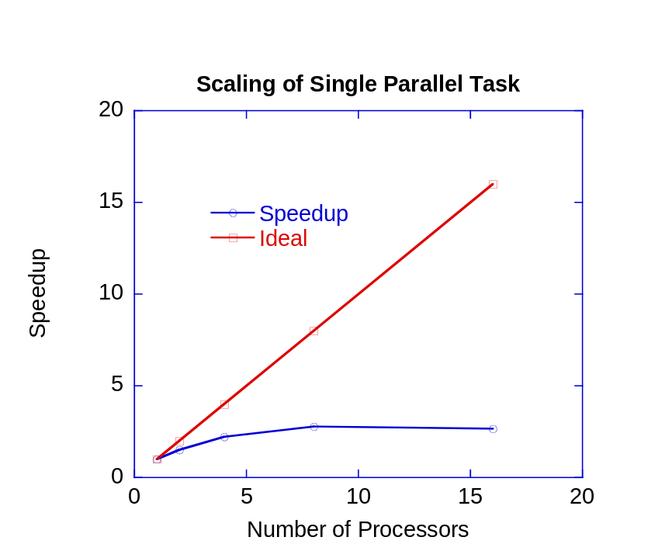
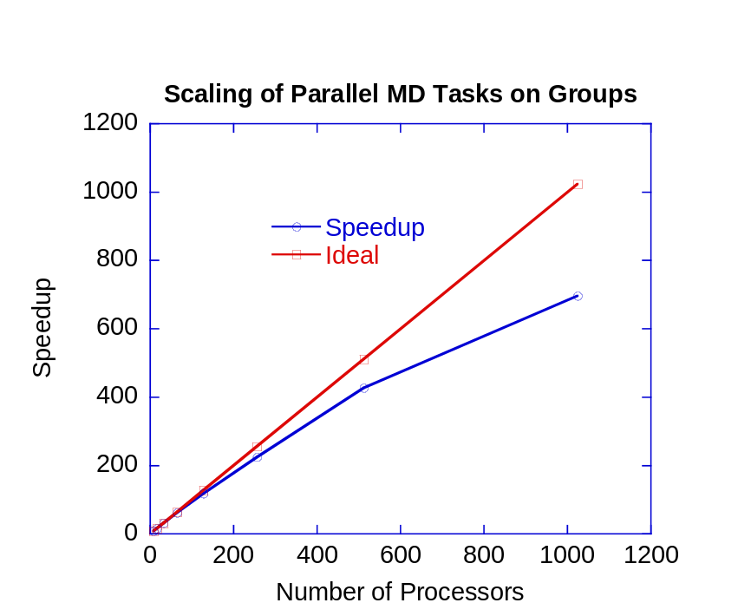
MD Application on Groups

Slide 88
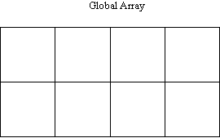
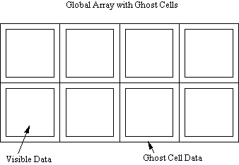
Creating Arrays with Ghost Cells
To create arrays with ghost cells:
  For arrays with regular distribution:
    Fortran logical function nga_create_ghosts(type,
    dims, width, array_name, chunk, g_a)
    C int int NGA_Create_ghosts(int type,
    int ndim, int dims[], int width[],
    char *array_name, int chunk[])
  For arrays with irregular distribution:
    n-d Fortran logical function
    nga_create_ghosts_irreg(type,
    dims, width, array_name, map, block,
    g_a)
    C int int NGA_Create_ghosts_irreg(int type,
    int ndim, int dims[], int width[],
    char *array_name, int map[], int block[])
integer width(ndim) - array of ghost cell widths [input]
Code

Slide 89
Ghost Cells
normal global array
global array with ghost cells
Operations:
NGA_Create_ghosts - creates array with ghosts cells
  GA_Update_ghosts - updates with data from adjacent processors
  NGA_Access_ghosts - provides access to “local” ghost cell elements
  NGA_Nbget_ghost_dir - nonblocking call to update ghosts cells

Slide 90
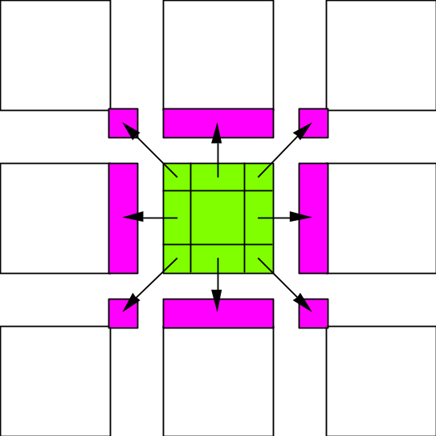
Ghost Cell Update
Automatically update ghost cells with appropriate data from neighboring processors. A multiprotocol implementation has been used to optimize the update operation to match platform characteristics.

Slide 91
Periodic Interfaces
Periodic interfaces to the one-sided operations have been added to Global Arrays in version 3.1 to support computational fluid dynamics problems on multidimensional grids.
They provide an index translation layer that allows users to request blocks using put, get, and accumulate operations that possibly extend beyond the boundaries of a global array.
The references that are outside of the boundaries are wrapped around inside the global array.
Current version of GA supports three periodic operations:
  periodic get
  periodic put
  periodic acc
global
local
call nga_periodic_get(g_a,lo,hi,buf,ld)

Slide 92
Periodic Get/Put/Accumulate
Fortran subroutine nga_periodic_get(g_a, lo, hi, buf, ld)
C void NGA_Periodic_get(int g_a, int lo[], int hi[], void *buf, int ld[])
Fortran subroutine nga_periodic_put(g_a, lo, hi, buf, ld)
C void NGA_Periodic_put(int g_a, int lo[], int hi[], void *buf, int ld[])
Fortran subroutine nga_periodic_acc(g_a, lo, hi, buf, ld, alpha)
C void NGA_Periodic_acc(int g_a, int lo[], int hi[], void *buf, int ld[], void *alpha)

Slide 93
Lock and Mutex
Lock works together with mutex.
Simple synchronization mechanism to protect a critical section
To enter a critical section, typically, one needs to:
  Create mutexes
  Lock on a mutex
  Do the exclusive operation in the critical section
  Unlock the mutex
  Destroy mutexes
The create mutex functions are:
  Fortran logical function ga_create_mutexes(number)
  C int GA_Create_mutexes(int number)
number - number of mutexes in mutex array [input]

Slide 94
Lock and Mutex (cont.)
Lock
Unlock

Slide 95
Lock and Mutex (cont.)
The destroy mutex functions are:
  Fortran logical function ga_destroy_mutexes()
  C int GA_Destroy_mutexes()
The lock and unlock functions are:
  Fortran
    subroutine ga_lock(int mutex)
    subroutine ga_unlock(int mutex)
  C
    void GA_lock(int mutex)
    void GA_unlock(int mutex)
integer mutex [input] ! mutex id

Slide 96
Fence
Fence blocks the calling process until all the data transfers corresponding to the Global Array operations initiated by this process complete
For example, since ga_put might return before the data reaches final destination, ga_init_fence and ga_fence allow process to wait until the data transfer is fully completed
  ga_init_fence();
  ga_put(g_a, ...);
  ga_fence();
The initialize fence functions are:
  Fortran subroutine ga_init_fence()
  C void GA_Init_fence()
The fence functions are:
  Fortran subroutine ga_fence()
  C void GA_Fence()

Slide 97
Synchronization Control in Collective Operations
To eliminate redundant synchronization points:
  Fortran subroutine ga_mask_sync(prior_sync_mask, post_sync_mask)
  C void GA_Mask_sync(int prior_sync_mask, int post_sync_mask)
logical first - mask (0/1) for prior internal synchronization [input]
logical last - mask (0/1) for post internal synchronization [input]
duplicate
sync
duplicate
sync
call ga_duplicate(g_a, g_b)
call ga_mask(0,1)
call ga_zero(g_b)
sync
zero
sync
zero
sync
sync
sync

Slide 98
Linear Algebra
Whole Arrays:
  To add to arrays:
    Fortran subroutine ga_add(alpha, g_a, beta, g_b, g_c)
    C void GA_Add(void *alpha, int g_a, void *beta, int g_b, int g_c)
  To multiply arrays:
    Fortran subroutine ga_dgemm(transa, transb, m, n, k, alpha, g_a, g_b, beta, g_c)
    C void GA_Dgemm(char ta, char tb, int m, int n, int k, double alpha, int g_a,
    int g_b, double beta, int g_c )
double precision/complex/integer alpha, beta [input]
integer g_a, g_b, g_c - array handles [input]
double/complex/int *alpha - scale factor [input]
double/complex/int *beta - scale factor [input]
character*1 transa, transb [input]
integer m, n, k [input]
double precision alpha, beta [input] (DGEMM)
double complex alpha, beta [input] (ZGEMM)
integer g_a, g_b [input]
integer g_c [output]

Slide 99
Linear Algebra (cont.)
Whole Arrays (cont.):
  To compute the element-wise dot product of two arrays:
    Three separate functions for data types
      Integer
        Fortran ga_idot(g_a, g_b)
        C GA_Idot(int g_a, int g_b)
      Double precision
        Fortran ga_ddot(g_a, g_b)
        C GA_Ddot(int g_a, int g_b)
      Double complex
        Fortran ga_zdot(g_a, g_b)
        C GA_Zdot(int g_a, int g_b)
integer g_a, g_b [input]
integer GA_Idot(int g_a, int g_b)
long GA_Ldot(int g_a, int g_b)
float GA_Fdot(int g_a, int g_b)
double GA_Ddot(int g_a, int g_b)
DoubleComplex GA_Zdot(int g_a, int g_b)

Slide 100
Linear Algebra (cont.)
Whole Arrays (cont.):
  To symmetrize a matrix:
    Fortran subroutine ga_symmetrize(g_a)
    C void GA_Symmetrize(int g_a)
  To transpose a matrix:
    Fortran subroutine ga_transpose(g_a, g_b)
    C void GA_Transpose(int g_a, int g_b)

Slide 101
Linear Algebra (cont.)
Patches:
  To add element-wise two patches and save the results into another patch:
    Fortran subroutine nga_add_patch(alpha, g_a, alo, ahi, beta,
    g_b, blo, bhi, g_c, clo, chi)
    C void NGA_Add_patch(void *alpha, int g_a, int alo[], int ahi[],
    void *beta, int g_b, int blo[], int bhi[], int g_c,
    int clo[], int chi[])
integer g_a, g_b, g_c [input]
dbl prec/comp/int alpha, beta scale factors [input]
integer ailo, aihi, ajlo, ajhi g_a patch coord [input]
integer bilo, bihi, bjlo, bjhi g_b patch coord [input]
integer cilo, cihi, cjlo, cjhi g_c patch coord [input]

Slide 102
Linear Algebra (cont.)
Patches (cont.):
  To perform matrix multiplication:
    Fortran subroutine ga_matmul_patch(transa, transb, alpha, beta, g_a, ailo,
    aihi, ajlo, ajhi, g_b, bilo, bihi, bjlo, bjhi, g_c, cilo, cihi, cjlo, cjhi)
    C void GA_Matmul_patch(char *transa, char* transb, void* alpha,
    void *beta, int g_a, int ailo, int aihi, int ajlo, int ajhi, int g_b, int bilo,
    int bihi, int bjlo, int bjhi, int g_c, int cilo, int cihi, int cjlo, int cjhi)
integer g_a, ailo, aihi, ajlo, ajhi patch of g_a [input]
integer g_b, bilo, bihi, bjlo, bjhi patch of g_b [input]
integer g_c, cilo, cihi, cjlo, cjhi patch of g_c [input]
dbl prec/comp alpha, beta scale factors [input]
character*1 transa, transb transpose flags [input]

Slide 103
Linear Algebra (cont.)
Patches (cont.):
  To compute the element-wise dot product of two arrays:
    Three separate functions for data types
      Integer
        Fortran nga_idot_patch(g_a, ta, alo, ahi, g_b, tb, blo, bhi)
        C NGA_Idot_patch(int g_a, char* ta, int alo[],
        int ahi[], int g_b, char* tb, int blo[], int bhi[])
      Double precision
        Fortran nga_ddot_patch(g_a, ta, alo, ahi, g_b, tb, blo, bhi)
        C NGA_Ddot_patch(int g_a, char* ta, int alo[],
        int ahi[], int g_b, char* tb, int blo[], int bhi[])
      Double complex
        Fortran nga_zdot_patch(g_a, ta, alo, ahi, g_b, tb, blo, bhi)
        C NGA_Zdot_patch(int g_a, char* ta, int alo[],
        int ahi[], int g_b, char* tb, int blo[], int bhi[])
integer g_a, g_b [input]
integer GA_Idot(int g_a, int g_b)
long GA_Ldot(int g_a, int g_b)
float GA_Fdot(int g_a, int g_b)
double GA_Ddot(int g_a, int g_b)
DoubleComplex GA_Zdot(int g_a, int g_b)

Slide 104
Block-Cyclic Data Distributions
Normal Data Distribution
Block-Cyclic Data Distribution

Slide 105
Block-Cyclic Data (cont.)
Simple Distribution
Scalapack Distribution
0
1
0
1
0
1
0
0
6
12
18
24
30
0,0
0,1
1
1
7
13
19
25
31
1,0
1,1
2
8
14
20
26
32
0
3
9
15
21
27
33
1
4
10
16
22
28
34
0
5
11
17
23
29
35
1

Slide 106
Block-Cyclic Data (cont.)
Most operations work exactly the same, data distribution is transparent to the user
Some operations (matrix multiplication, non-blocking put, get) not implemented
Additional operations added to provide access to data associated with particular sub-blocks
You need to use the new interface for creating Global Arrays to get create block-cyclic data distributions

Slide 107
Creating Block-Cyclic Arrays
Must use new API for creating Global Arrays
  Fortran subroutine ga_set_block_cyclic(g_a, dims)
  subroutine ga_set_block_cyclic_proc_grid(g_a, dims, proc_grid)
  C void GA_Set_block_cyclic(int g_a, int dims[])
  void GA_Set_block_cyclic_proc_grid(g_a, dims[], proc_grid[])
  integer dims[] - dimensions of blocks
  integer proc_grid[] - dimensions of processor grid (note that product of all
  proc_grid dimensions must equal total number of processors)

Slide 108
Block-Cyclic Methods
Methods for accessing data of individual blocks
  Fortran subroutine ga_get_block_info(g_a, num_blocks, block_dims)
  integer function ga_total_blocks(g_a)
  subroutine nga_access_block_segment(g_a, iproc, index, length)
  subroutine nga_access_block(g_a, idx, index, ld)
  subroutine nga_access_block_grid(g_a, subscript, index, ld)
  C void GA_Get_block_info(g_a, num_blocks[], block_dims[])
  int GA_Total_blocks(int g_a)
  void NGA_Access_block_segment(int g_a, int iproc, void *ptr, int *length)
  void NGA_Access_block(int g_a, int idx, void *ptr, int ld[])
  void NGA_Access_block_grid(int g_a, int subscript[], void *ptr, int ld[])
  integer length - total size of blocks held on processor
  integer idx - index of block in array (for simple block-cyclic distribution)
  integer subscript[] - location of block in block grid (for Scalapack distribution)

Slide 109
Interfaces to Third Party Software Packages
Scalapack
  Solve a system of linear equations
  Compute the inverse of a double precision matrix
TAO
  General optimization problems
Interoperability with Others
  PETSc
  CUMULVS

Slide 110
Locality Information
To determine the process ID that owns the element defined by the array subscripts:
  n-DFortran logical function nga_locate(g_a, subscript, owner)
  C int NGA_Locate(int g_a,
  int subscript[])
integer g_a array handle [input]
Integer subscript(ndim) element subscript [input]
integer owner process id [output]
0
4
8
1
5
9
2
6
10
3
7
11
owner=5

Slide 111
Locality Information (cont.)
To return a list of process IDs that own the patch:
  Fortran logical function nga_locate_region(g_a, lo,
  hi, map,proclist, np)
  C int NGA_Locate_region(int g_a,
  int lo[], int hi[],int *map[],
  int procs[])
integer np - number of processors that own [output]
a portion of block
integer g_a - global array handle [input]
integer ndim - number of dimensions of the
global array
integer lo(ndim) - array of starting indices for array
section [input]
integer hi(ndim) - array of ending indices for array
section [input]
integer map(2*ndim,*) - array with mapping information [output]
integer procs(np) - list of processes that own a part
of array section [output]
0
4
8
1
5
9
2
6
10
3
7
11
procs = {0,1,2,4,5,6}
map = {lo₀₁,lo₀₂,hi₀₁,hi_{02,}
lo₁₁,lo₁₂,hi₁₁,hi₁₂,
lo₂₁,lo₂₂’hi₂₁,hi₂₂,
lo₄₁,lo₄₂,hi₄₁,hi₄₂,
lo₅₁,lo₅₂,hi₅₁,hi₅₂’
lo₆₁’lo₆₂,hi₆₁,hi₆₂}

Slide 112
New Interface for Creating Arrays
Developed to handle the proliferating number of properties that can be assigned to Global Arrays
Fortran integer function ga_create_handle()
  subroutine ga_set_data(g_a, dim, dims, type)
  subroutine ga_set_array_name(g_a, name)
  subroutine ga_set_chunk(g_a, chunk)
  subroutine ga_set_irreg_distr(g_a, map, nblock)
  subroutine ga_set_ghosts(g_a, width)
  subroutine ga_set_block_cyclic(g_a, dims)
  subroutine ga_set_block_cyclic_proc_grid(g_a, dims, proc_grid)
  logical function ga_allocate(g_a)

Slide 113
New Interface for Creating Arrays
  C int GA_Create_handle()
  void GA_Set_data(int g_a, int dim, int *dims, int type)
  void GA_Set_array_name(int g_a, char* name)
  void GA_Set_chunk(int g_a, int *chunk)
  void GA_Set_irreg_distr(int g_a, int *map, int *nblock) void GA_Set_ghosts(int g_a, int *width)
  void GA_Set_block_cyclic(int g_a, int *dims)
  void GA_Set_block_cyclic_proc_grid(int g_a, int *dims, int *proc_grid)
  int GA_Allocate(int g_a)

Slide 114
New Interface for Creating Arrays (Cont.)
integer ndim,dims(2),chunk(2)
integer g_a, g_b
logical status
c
ndim = 2
dims(1) = 5000
dims(2) = 5000
chunk(1) = 100
chunk(2) = 100
c
c Create global array A using old interface
c
status = nga_create(MT_F_DBL, ndim, dims, chunk, ‘array_A’, g_a)
c
c Create global array B using new interface
C
g_b = ga_create_handle()
call ga_set_data(g_b, ndim, dims, MT_F_DBL)
call ga_set_chunk(g_b, chunk)
call ga_set_name(g_b, ‘array_B’)
call ga_allocate(g_b)

Slide 115
Example Code
1-D Transpose (Fortran)
1-D Transpose (C)
Matrix Multiply (Fortran)
Matrix Multiply (C)

Slide 116
Example: 1-D Transpose

Slide 117
Transpose Example – C
int ndim, dims[1], chunk[1], ld[1], lo[1], hi[1];
int lo1[1], hi1[1], lo2[1], hi2[1];
int g_a, g_b, a[MAXPROC*TOTALELEMS],b[MAXPROC*TOTALELEMS];
int nelem, i;
/* Find local processor ID and number of processors */
int me=GA_Nodeid(), nprocs=GA_Nnodes();
/* Configure array dimensions. Force an unequal data distribution */
ndim = 1; /* 1-d transpose */
dims[0] = nprocs*TOTALELEMS + nprocs/2;
ld[0] = dims[0];
chunk[0] = TOTALELEMS; /* minimum data on each process */
/* create a global array g_a and duplicate it to get g_b */
g_a = NGA_Create(C_INT, 1, dims, "array A", chunk);
if (!g_a) GA_Error("create failed: A", 0);
if (me==0) printf(" Created Array A\n");
g_b = GA_Duplicate(g_a, "array B");
if (! g_b) GA_Error("duplicate failed", 0);
if (me==0) printf(" Created Array B\n");

Slide 118
Transpose Example – C (cont.)
/* initialize data in g_a */
if (me==0) {
printf(" Initializing matrix A\n");
for(i=0; i<dims[0]; i++) a[i] = i;
lo[0] = 0;
hi[0] = dims[0]-1;
NGA_Put(g_a, lo, hi, a, ld);
}
/* Synchronize all processors to guarantee that everyone has data before proceeding
to the next step. */
GA_Sync();
/* Start initial phase of inversion by inverting the data held locally on each processor.
Start by finding out which data each processor owns. */
NGA_Distribution(g_a, me, lo1, hi1);
/* Get locally held data and copy it into local buffer a */
NGA_Get(g_a, lo1, hi1, a, ld);
/* Invert data locally */
nelem = hi1[0] - lo1[0] + 1;
for (i=0; i<nelem; i++) b[i] = a[nelem-1-i];

Slide 119
Transpose Example – C (cont.)
/* Invert data globally by copying locally inverted blocks into
* their inverted positions in the GA */
lo2[0] = dims[0] - hi1[0] -1;
hi2[0] = dims[0] - lo1[0] -1;
NGA_Put(g_b,lo2,hi2,b,ld);
/* Synchronize all processors to make sure inversion is complete */
GA_Sync();
/* Check to see if inversion is correct */
if(me == 0) verify(g_a, g_b);
/* Deallocate arrays */
GA_Destroy(g_a);
GA_Destroy(g_b);

Slide 120
Transpose Example - Fortran
integer dims(3), chunk(3), nprocs, me, i, lo(3), hi(3), lo1(3)
integer hi1(3), lo2(3), hi2(3), ld(3), nelem
integer g_a, g_b, a(MAXPROC*TOTALELEMS), b(MAXPROC*TOTALELEMS)
integer heap, stack, ichk, ierr
logical status
heap = 300000
stack = 300000
c
c Initialize communication library
c
#ifdef USE_MPI
call mpi_init(ierr)
#else
call pbeginf
#endif
c
c Initialize GA library
c
call ga_initialize()

Slide 121
Transpose Example – Fortran (cont.)
c
c Find local processor ID and number of processors
c
me = ga_nodeid()
nprocs = ga_nnodes()
if (me.eq.0) write(6,101) nprocs
101 format('Using ',i4,' processors')
c
c Allocate memory for GA library
c
status = ma_init(MT_F_DBL, stack/nprocs, heap/nprocs)
c
c Configure array dimensions. Force an unequal data distribution.
c
dims(1) = nprocs*TOTALELEMS + nprocs/2
ld(1) = MAXPROC*TOTALELEMS
chunk(1) = TOTALELEMS ! Minimum data on each processor
c
c Create global array g_a and then duplicate it to get g_b
c
status = nga_create(MT_F_INT, NDIM, dims, "Array A", chunk, g_a)
status = ga_duplicate(g_a, g_b, "Array B")

Slide 122
Transpose Example – Fortran (cont.)
c
c Initialize data in g_a
c
do i = 1, dims(1)
a(i) = i
end do
lo1(1) = 1
hi1(1) = dims(1)
c
c Copy data from local buffer a to global array g_a. Only do this for
c processor 0.
c
if (me.eq.0) call nga_put(g_a, lo1, hi1, a, ld)
c
c Synchronize all processors to guarantee that everyone has data
c before proceeding to the next step.
c
call ga_sync

Slide 123
Transpose Example – Fortran (cont.)
c
c Start initial phase of inversion by inverting the data held locally on
c each processor. Start by finding out which data each processor owns.
c
call nga_distribution(g_a, me, lo, hi)
c
c Get locally held data and copy it into local buffer a
c
call nga_get(g_a, lo, hi, a, ld)
c
c Invert local data
c
nelem = hi(1) - lo(1) + 1
do i = 1, nelem
b(i) = a(nelem - i + 1)
end do
c
c Do global inversion by copying locally inverted data blocks into
c their inverted positions in the GA
c
lo2(1) = dims(1) - hi(1) + 1
hi2(1) = dims(1) - lo(1) + 1
call nga_put(g_b, lo2, hi2, b, ld)

Slide 124
Transpose Example – Fortran (cont.)
c
c Synchronize all processors to make sure inversion is complete
c
call ga_sync()
c
c Check to see if inversion is correct. Start by copying g_a into local
c buffer a, and g_b into local buffer b.
c
call nga_get(g_a, lo1, hi1, a, ld)
call nga_get(g_b, lo1, hi1, b, ld)
ichk = 0
do i = 1, dims(1)
if (a(i).ne.b(dims(1)-i+1) .and. me.eq.0) then
write(6,111) i,a(i),b(dims(1)-i+1)
111 format('Mismatch at ',3i8)
ichk = ichk + 1
endif
end do
if (ichk.eq.0.and.me.eq.0) write(6,*) 'Transpose OK'

Slide 125
Transpose Example – Fortran (cont.)
c
c Deallocate memory for arrays and clean up GA library
c
if (me.eq.0) write(6,*) 'Terminating...'
status = ga_destroy(g_a)
status = ga_destroy(g_b)
call ga_terminate
#ifdef USE_MPI
call mpi_finalize
#else
call pend
#endif
stop
end

Slide 126
Matrix Multiply Example – C
int dims[NDIM], chunk[NDIM], ld[NDIM];
int lo[NDIM], hi[NDIM], lo1[NDIM], hi1[NDIM];
int lo2[NDIM], hi2[NDIM], lo3[NDIM], hi3[NDIM];
int g_a, g_b, g_c, i, j, k, l;
/* Find local processor ID and the number of processors */
int me=GA_Nodeid(), nprocs=GA_Nnodes();
/* Configure array dimensions. Force an unequal data distribution */
for(i=0; i<NDIM; i++) {
dims[i] = TOTALELEMS;
ld[i]= dims[i];
chunk[i] = TOTALELEMS/nprocs-1; /*minimum block size on each process*/
}

Slide 127
Matrix Multiply Example – C (cont.)
/* create a global array g_a and duplicate it to get g_b and g_c*/
g_a = NGA_Create(C_DBL, NDIM, dims, "array A", chunk);
if (!g_a) GA_Error("create failed: A", NDIM);
if (me==0) printf(" Created Array A\n");
g_b = GA_Duplicate(g_a, "array B");
g_c = GA_Duplicate(g_a, "array C");
if (!g_b || !g_c) GA_Error("duplicate failed",NDIM);
if (me==0) printf(" Created Arrays B and C\n");
/* initialize data in matrices a and b */
if(me==0)printf(" Initializing matrix A and B\n");
k = 0; l = 7;
for(i=0; i<dims[0]; i++) {
for(j=0; j<dims[1]; j++) {
a[i][j] = (double)(++k%29);
b[i][j] = (double)(++l%37);
}
}

Slide 128
Matrix Multiply Example – C (cont.)
/* Copy data to global arrays g_a and g_b */
lo1[0] = 0;
lo1[1] = 0;
hi1[0] = dims[0]-1;
hi1[1] = dims[1]-1;
if (me==0) {
NGA_Put(g_a, lo1, hi1, a, ld);
NGA_Put(g_b, lo1, hi1, b, ld);
}
/* Synchronize all processors to make sure everyone has data */
GA_Sync();
/* Determine which block of data is locally owned. Note that
the same block is locally owned for all GAs. */
NGA_Distribution(g_c, me, lo, hi);

Slide 129
Matrix Multiply Example – C (cont.)
/* Get the blocks from g_a and g_b needed to compute this block in
g_c and copy them into the local buffers a and b. */
lo2[0] = lo[0];
lo2[1] = 0;
hi2[0] = hi[0];
hi2[1] = dims[0]-1;
NGA_Get(g_a, lo2, hi2, a, ld);
lo3[0] = 0;
lo3[1] = lo[1];
hi3[0] = dims[1]-1;
hi3[1] = hi[1];
NGA_Get(g_b, lo3, hi3, b, ld);
/* Do local matrix multiplication and store the result in local
buffer c. Start by evaluating the transpose of b. */
for(i=0; i < hi3[0]-lo3[0]+1; i++)
for(j=0; j < hi3[1]-lo3[1]+1; j++)
btrns[j][i] = b[i][j];

Slide 130
Matrix Multiply Example – C (cont.)
/* Multiply a and b to get c */
for(i=0; i < hi[0] - lo[0] + 1; i++) {
for(j=0; j < hi[1] - lo[1] + 1; j++) {
c[i][j] = 0.0;
for(k=0; k<dims[0]; k++)
c[i][j] = c[i][j] + a[i][k]*btrns[j][k];
}
}
/* Copy c back to g_c */
NGA_Put(g_c, lo, hi, c, ld);
verify(g_a, g_b, g_c, lo1, hi1, ld);
/* Deallocate arrays */
GA_Destroy(g_a);
GA_Destroy(g_b);
GA_Destroy(g_c);

