Slide 1
NgRx
Angular Store Architecture
By
Kathambari.P
Developer,
Glabs,
TVR

Slide 2
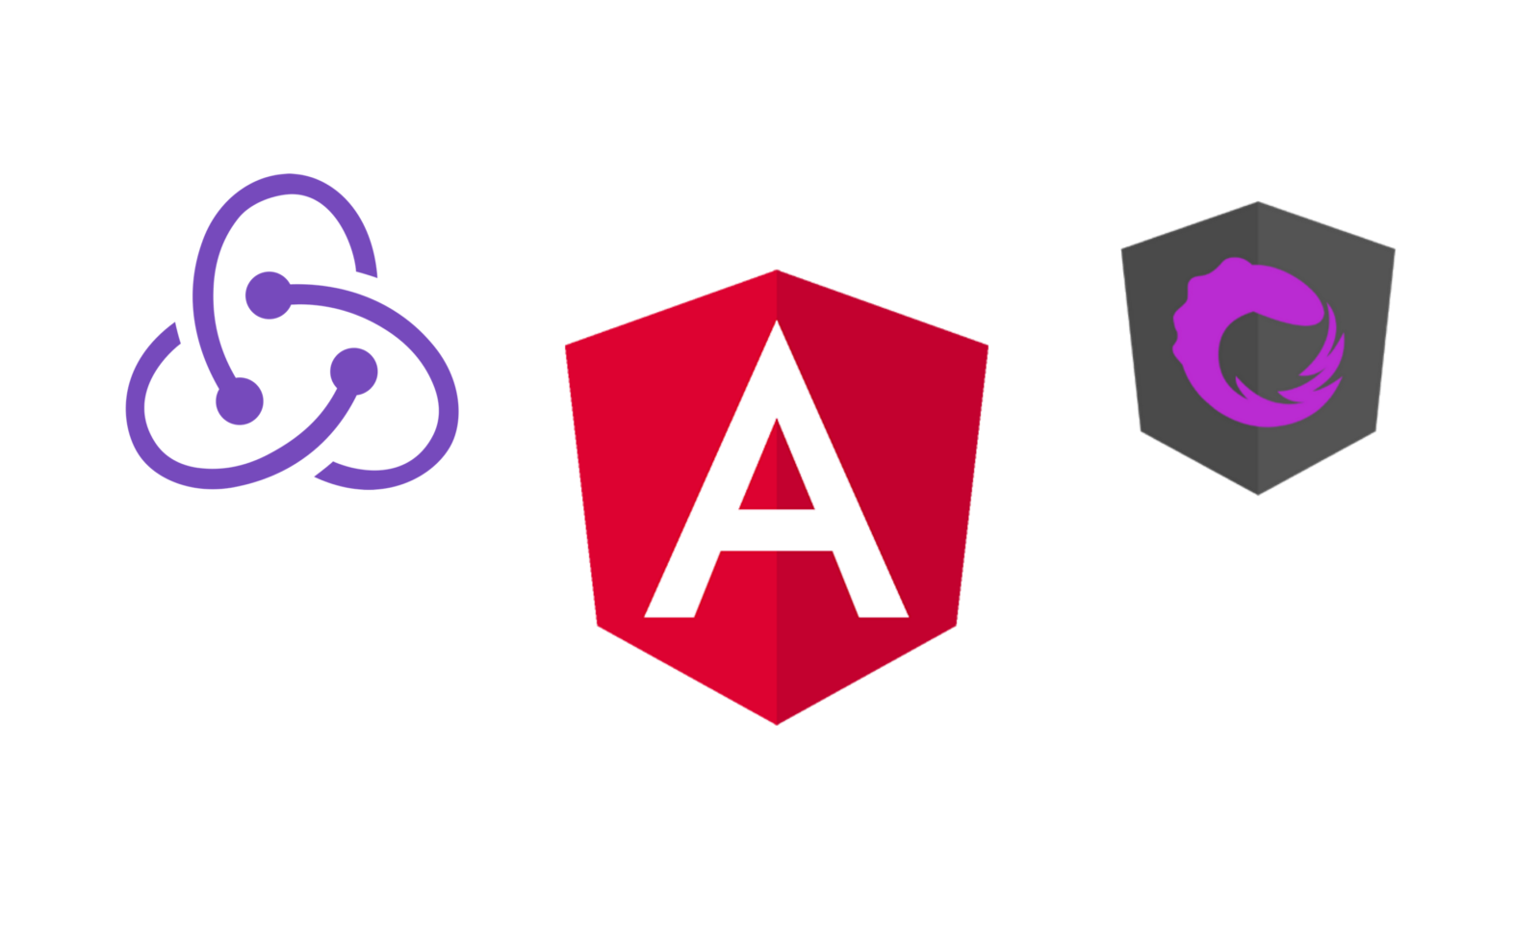
NgRx = Redux+RxJs+Angular Apps

Slide 3
NgRx
Centralized Store Architecture
Set of application design patterns
Adding as a library, a big dependency for our app
When to use NgRx?
If our state information is hard to maintain

Slide 4
NgRx Libraries Collection of libraries to implement redux path in angular applications
@ngrx/store - the core library
@ngrx/effects - used to handle communication with a back-end server
@ngrx/router-store - to connect the angular router to ngrx store
@ngrx/entity - used to manage record collections
@ngrx/store-devtools - allows us to inspect and debug the
application
@ngrx/schematics - scaffolding library that provides CLI commands to generate files

Slide 5
Redux
State Container to predict the state information
Hottest library for JS applications
A design pattern that keeps all application data in a single JS object.
Popular in React Apps and more Applicable in Angular Apps
Principles
Single source of truth
The state is read only(immutable)
All changes in the state are made by pure functions called Reducers

Slide 6
RxJs
RxJs – react lib
Powered state management for angular applications inspired by Redux

Slide 7
Example- Learning app
In this app if we are having large no. of users , it will cause a performance problem.
For this reason - We are using a store architecture
To reduce the no. of Http requests to our application server
To improve user experience
Navigating to the applications, reduce the no. of spinners as the user transitions between the multiple screens of the applications

Slide 8
Main reason
Lot of logic to be implemented with the UI
UI have to reflect the changes immediately
Advantage of using Store architecture
The UI have to update automatically by less contacting with the server

