Slide 1
Node js Environment Setup
Banu priya.S

Slide 2
Node js Environment Setup
Go to the official site of Node.js:https://nodejs.org/en/download/
Choose your required version of node
Run the downloaded .msi file

Slide 3
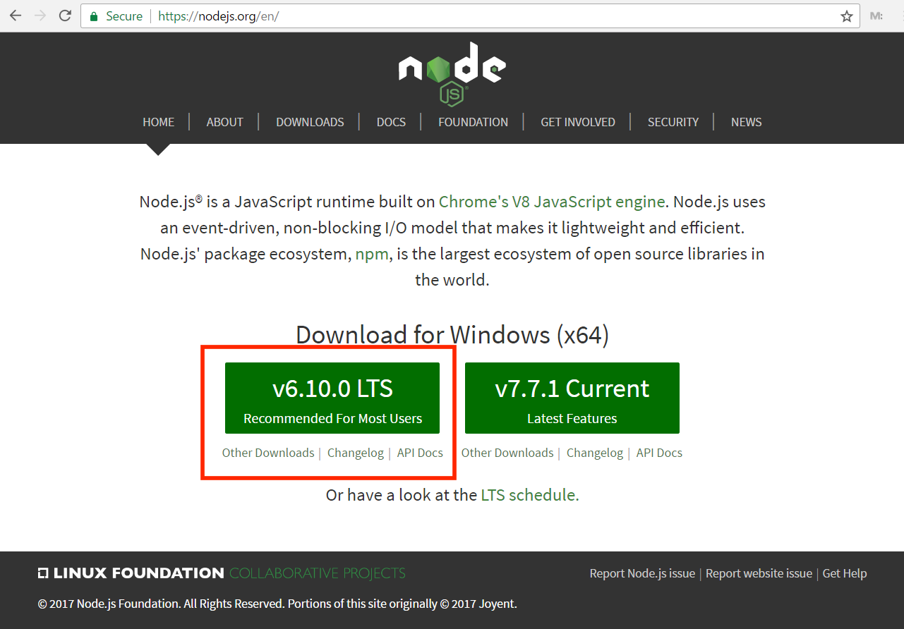
Download Node js

Slide 4
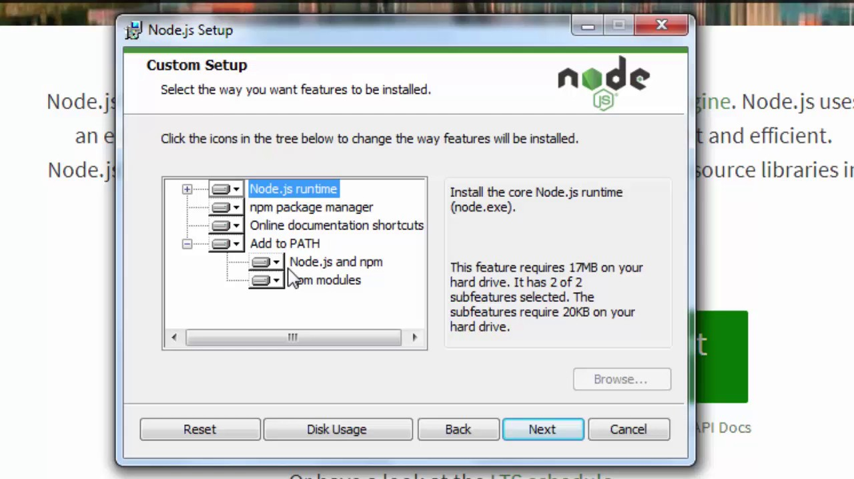
Node.js runtime……. It helps in executed program
Npm……already pre defined Modules

Slide 5
NPM-Node Package Manager:
Each modules an be bundled under a single package
Npm is used to install,update,uninstall, configure node.js platform modules/ packages very easily
SYNTAX:
npm install
Suppose we r install third party modules
npm install <package name> --save

Slide 6
NODE JS “REQUIRE”
The modules/packages available can be imported in .js file using require function
Ex: -require(“current.js file”)
- require(http)
This helps in loading “http” package in current .js file

Slide 7
Debugger
Console
Modules
Streaming
Cluster
Node.js
Call Back function
DNS
Domain
Events
Global
Error Handling
Buffer
Net

Slide 8
Call back function :
It as an asynchronous equivalent for a functions
Helps in non-blocking code
Helps in maintain performance for single threaded node.js

Slide 9
EVENTS:
Support Node.JS to maintain concurrency
Node thread keeps an event loop
It fires corresponding event when task is completed
Event signals event listener function to get executed
Events Emitter:
Objects that generate events are called event emitters

Slide 10
Event module must be imported for creating event emitters
Event listener instance can create new event through emit()

