Slide 1
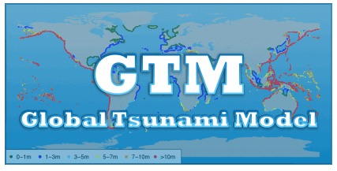

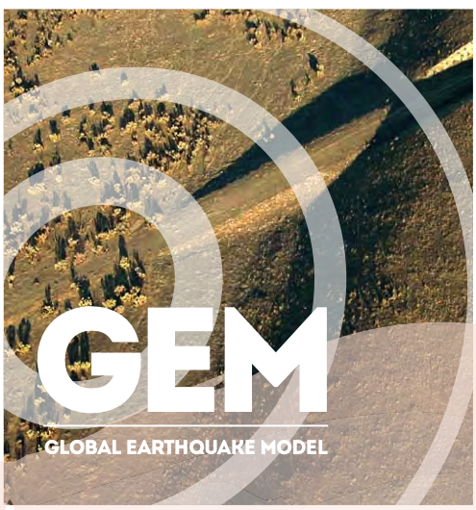

Improved understanding of tsunami hazard and risk
(and related disciplines)
Develop standards and guidelines for probabilistic assessment
Harmonize efforts and products
(e.g. regional data and projects)
Reference regional and global hazard/risk models
Basis for multi-hazard risk assessment
(e.g. previous experience in GAR)
Integration of results and tools with related organizations such as GEM and GVM

Slide 2

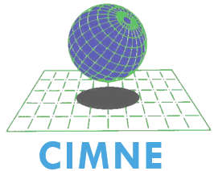

























Gathering the global network
Formalising UNISDR endorsement

