Slide 1
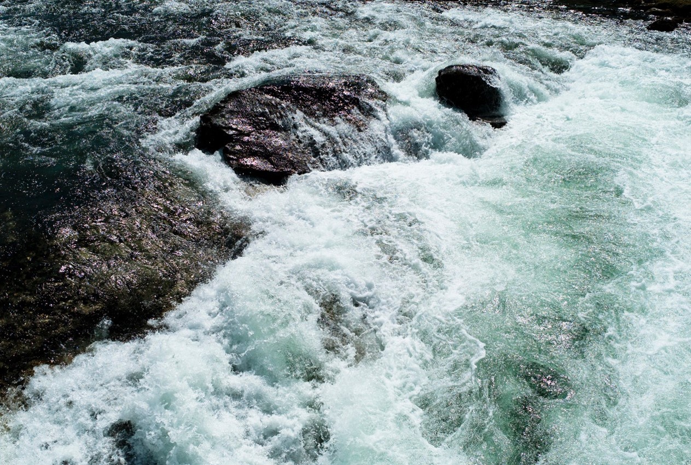
Introduction to the scoping meeting towards a Global Tsunami Model (GTM)
F. Løvholt¹, C. Harbitz¹, J. Griffin², G. Davies², S. Lorito³, R. Basili³, J. Selva³, M.A. Baptista⁴, R. Omira⁴, L. Matias⁴, A. Babeyko⁵, E. Geist⁶
1 – NGI, 2 – Geoscience Australia, 3 – INGV, 4 – IPMA, 5 – GFZ Potzdam, 6 – USGS

Slide 2
Provisional Agenda
10.30-10.50 Welcome, introduction, and outline
10.50-11.20 Interest / slides from partners
11.20-12.00 Round table discussion (scientific!)
12.00-12.20 Presentations by GEM and GVM
12.20-12.45 Organization issues (if time)
12.45-13.00 Wrap up and conclusion

Slide 3
Objectives of this meeting
Evaluate interest for going forward with GTM
Attendance and number of positive responses already indicate broad interest
Feasibility for a broad and joint effort by the tsunami community
Discuss the scientific scope
Must be agreed before going forward with further organizational issues, structure, leadership, funding (next meeting)
Define an initial project / scope
Start with PTHA only, earthquake and non-seismic?
Define the time and place for the next meeting

Slide 4
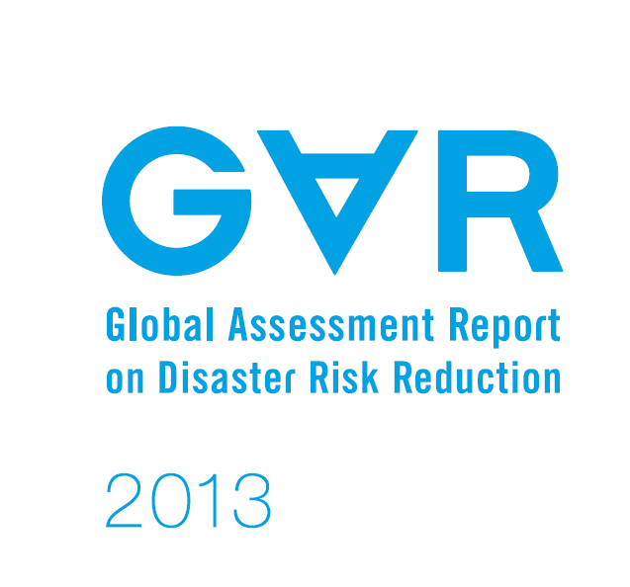
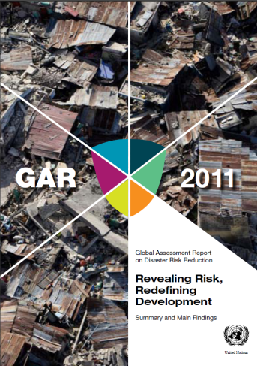
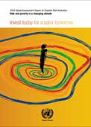
Background - previous global tsunami hazard assessments: input to Global Assessment Reports «GAR»
Issued by UN-ISDR every second year from 2009-2015
Provides comparative basis for the risk posed by various natural hazards and joint mapping tools
Broad scientific involvement, including the global models (GEM, GVM)
Proposes policy initiatives to address gaps and challenges
Scope and time for next version not yet decided – will be oriented towards Sendai Framework of Action (SFA)
Work towards GAR has motivated the initiative for a GTM

Slide 5
Historical review of past global tsunami hazard and risk assessments for the GAR
GAR09 (NGI)
Method: Simple (crude) scenario based approach, partly global coverage
Joint collaboration: Email requests.
GAR13 (NGI, GA)
Method: Scenario based approach. Some PTHA
Joint collaboration: NGI and GA. Email requests.
Request for contributions: Preliminary attempt for “GTM” like collaboration –proposed at Town Hall meeting at AGU 2012 (prior to GAR15)
GAR15 (NGI, GA, CIMNE, URS, INGV, IPMA, USGS)
Method: PTHA
Multi institutional collaboration: Main work by NGI, GA, CIMNE, assistance on sources and PTHA from other collaborators
Beyond GAR15 – Increase multilateral collaboration through the Global Tsunami Model and expand the scientific topic beyond GAR

Slide 6
How will a Global Tsunami Model improve our understanding of the present risk situation?
Involving the full tsunami hazard and risk community may:
Harmonize efforts and products
Develop standardized and open source tools for hazard and risk analysis
Develop guidelines and good practices
Integrate datasets from other providers
Become a term of reference for regional efforts (standards)
Validation of methods – improve our understanding of the risk drivers

Slide 7
Interplay between local, regional, and global models
Different degree of sophistication on different scales
Global and regional model should provide the same mean characteristics as the more sophisticated ones
Presently (GAR) we have only the global model
Interactive development
Local or regional model
Update – calibrate global model
On project level and ongoing activities
National, local and regional projects and efforts
Where (geographically) can your institution contribute
Utilize ongoing activities (local projects, stakeholders, data etc)
Harmonized efforts (e.g. ASTARTE compilation of tsunami sources for NEAM, proposal submitted for NEAM regional PTHA)
Update / calibrate global models
Emphasize collaboration with the GEM and GVM!

Slide 8
Example objectives for PTRA in GTM – subject for discussion – to be updated
Development of tools for doing
PTHA (probabilistic hazard)
PTRA (probabilistic risk)
PTHA
For earthquakes (large subduction zone earthquakes, local sources, background seismicity)
Non-seismic sources (landslides, volcanoes)
Regional run-up and exposure
Understanding and quantifying uncertainty in PTHA and PTRA
Process and sensitivity studies (e.g. heterogeneous slip effects, fault parameter sensitivity)
Epistemic uncertainty of long term recurrence for earthquakes
Improving fundamental datasets (not necessarily to be generated by GTM)
High accuracy and resolution global bathymetry and elevation data
Improved subduction zone geometry, slip-rate and coupling models (interaction with GEM)
Landslide deposits, unstable slopes, geophysical data, layering etc.
Vulnerabilities
Model development and benchmarking
Validation of tsunami hazard and risk models

Slide 9
Points to be discussed today
Scientific topics
Additional objectives
Define an initial project / scope
Preliminary organizers? MoU?
Next meeting: where, when, topics?
(Other projects to be included – geographical coverage)
(Organizational aspects)

Slide 10
Suggested topics - grouped
1a) Seismic source (probability and modeling)
1b) Non Seismic source (probability and modeling)
1c) Tsunami modeling
1d) PTHA: framework 1e) PTHA+: uncertainty, validation, testing
2) Vulnerability (Fragility,mortality++)
3a) PTRA: framework 3b) PTRA+: uncertainty, validation, testing
4) Tools (models, formats, DB, validation/verification)
5) Organization (boards, website)

Slide 11
Organizational aspects
Identify partners having leadership activities
It is not necessarily NGI that will lead
Leadership should preferably to be spread across organizations
Platform for exchange, webpage, data, models ++
Need to define initial projects with limited scope (realistic)
Identify possible funding agencies for global model (such as ideal funds, re-insurance industry, EU-projects, World Bank ++)
To be discussed further

Slide 12
Extras

Slide 13
How will a Global Tsunami Model improve our understanding of the present risk situation?
Involving the full tsunami hazard and risk community may:
Enable work on hazard and risk analysis on global, regional, and local scales
Include, within a probabilistic framework, also smaller earthquake and non-seismic sources
Increase model sophistication, performance and validation
Include a sound and feasible uncertainty treatment
Harmonize efforts and products
Go beyond the scope of GAR
Develop standardized and open source tools for hazard and risk analysis
Develop guidelines and good practices
Integrate datasets from other providers
Become a term of reference for regional efforts
Validation of methods – improve our understanding of the risk drivers

Slide 14
What can the GTM do towards the objectives stated by the UNESCO-IOC TOWS working group?
(1) Current knowledge on "tsunami earthquakes"
(2) Maximum credible earthquake size and its likelihood estimated by various methods
(3) Harmonization of different approaches
(4) Best practices for tsunami hazard assessments.

