Slide 1
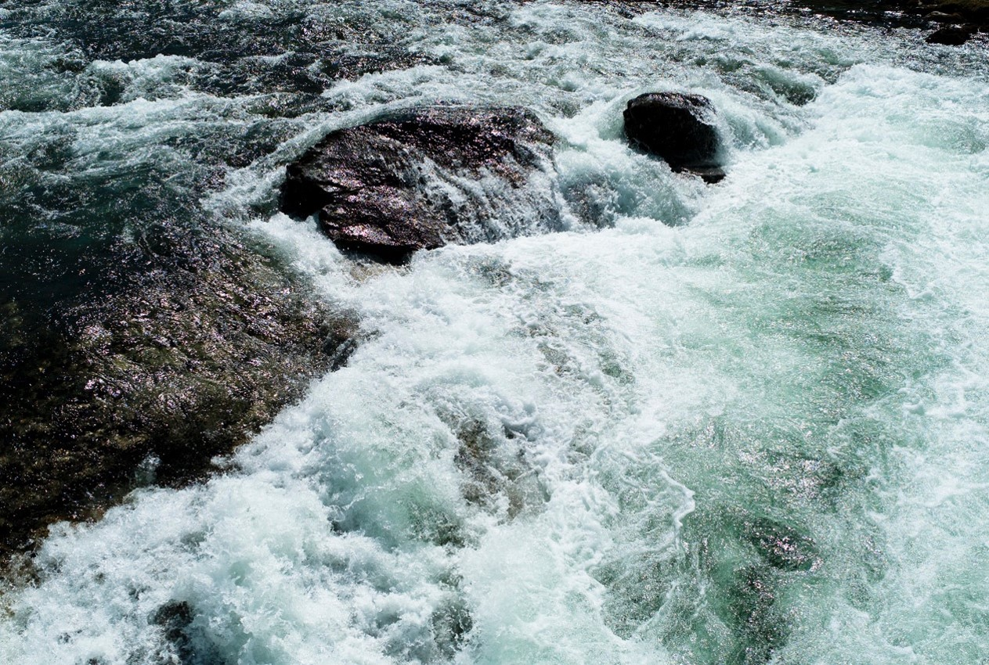
Global Tsunami Model (GTM)
Draft objectives and recap from first scoping meeting
F. Løvholt, C.B. Harbitz
NGI
Second GTM scoping meeting, AECOM, Oakland 13.12.2015

Slide 2


Background
Multi-institutional work on hazard and risk for the UN-ISDR (Global Assessment Report, GAR)
Idea: Need to gather scientific community for
Collective effort for improved understanding of global tsunami hazard and risk
Improve methods, develop guidelines and standards, harmonize efforts
Non-exclusive initiative ↔ open for the community
Initiative from the tsunami community itself
Proposers: NGI, GA, INGV, USGS, IPMA, GFZ
No owners or funding at present
Yet GTM should ensure relevance towards external stakeholders
Societal relevance
Ambition will – to a considerable extent – depend on success in attracting external funding

Slide 3
The first GTM scoping meeting
Held at IUGG in Prague 29.06.2015
Objective – to discuss and define content to fill GTM
Short and long term
Points from proponents introduced and accepted
Additional points raised, discussed, and included
Organizational issues were not discussed
The GTM organization structure is therefore presently open for discussion
GTM organization main topic for the present meeting

Slide 4

Broad interest in first scoping meeting
Expressed interest or present at meeting
NGI (Løvholt, Harbitz)
INGV (Lorito, Selva, Basili, Tonini)
Geoscience Australia (Cummins, Davies, Griffin)
IPMA (Baptista, Matias, Omira)
IRIDES (Imamura, Suppasri, Mas)
GNS (Power)
METU (Kanoglu, Yalciner)
University of Malaga (Macias)
AECOM (Thio)
MMAF (Muhari)
Univ Bologna (Tinti)
KOERI (Özer, Necmioglu)
MSI (Didenkulova)
PARI (Takagawa)
ICMMG (Giusiakov)
Northwestern University (Okal)
MRI/JMA (Tsushima)
NOAA (Wei, Titov)
Non-present but expressed interest
USGS (Geist)
GFZ (Babeyko)
USC (Lynett)
ITB (Latief)
CIMNE (Bernal, Cardona)
Univ Hamburg (Behrens)
Univ Cantabria (Gonzalez, Gonzalez-Riancho, Aguirre-Ayerbe)
Univ Washington (Gonzalez, Leveque, Adams)
AUTH (Pitilakis)
Total
27 organizations
45 scientists
“External participants” global models
GEM (Pagani, Schneider)
GVM (Jenkins)

Slide 5
Outcomes from the first GTM meeting (1)
Involving the full tsunami hazard and risk community may:
Harmonize efforts and products
Develop standardized and open source tools, guidelines and practices, for among others
Hazard and risk analysis
Probabilistic framework and uncertainty analysis
Underlying methods – source and tsunami models
Dissemination, mitigation measures, ethical perspectives
Integrate datasets from other providers or compile databases where non-existent
Validation of methods
Basic methods (e.g. simulation tools)
Towards hazard and risk data - improve our understanding of the risk drivers

Slide 6
Outcomes from the first GTM meeting (2)
GTM should work on different regional scales
Become a term of reference for regional efforts
Ensure compatibility from regional to local scales
Methodology standard and global reference for hazard and risk maps
Utilize ongoing activities or planned activities
GTM endorsement – compatible methods or results
Harmonized efforts between institutions
e.g. – integrate national hazard maps to regional scale (TSUMAPS-NEAM – INGV++)
e.g. multifunctional tools for interfacing models (Tsunami API - GNS)
Facilitate integration of results and tools from related organizations such as GEM and GVM – and assign borderlines

Slide 7
Scientific objectives from the first GTM meeting (1)
Seismic source (probability and modeling)
Interfacing the GEM, adaptation for tsunami sources and recurrence
Non Seismic source (probability and modeling)
Interfacing GVM, ICL, submarine landslide community
Tsunami modelling
Development of methods and numerical tools
Models, unified code interfaces
Benchmark tests
Model and data repositories – licensing and / or open source
PTHA (seismic and non-seismic→ landslides and volcanoes)
Different frameworks
Uncertainty treatment
Validation and testing
Mapping

Slide 8
Scientific objectives from the first GTM meeting (2)
Vulnerability and fragility
Fragility and mortality
Uncertainty treatment
Probabilistic Tsunami Risk Assessment
Framework and uncertainty
Validation, testing, mapping
Dissemination
Geo-ethics, transparency
Risk and uncertainty communication, interfacing stakeholders
Questionnaires, training, data exchange

Slide 9
Proposed first objective for the GTM
Need for a first project to spark GTM
Initially - Focus on tsunami hazard
Employ and develop PTHA
Beyond standard practice on subduction zone earthquakes (such as GAR)
Methods and guidelines
Focus on non-seismic sources
Focus on crustal earthquakes
Pilot study – TSUMAPS-NEAM
Also - knowhow from GAR and related projects should be entered into GTM and thus contribute to knowhow

Slide 10
Global Tsunami Model (GTM)
Possible organisational structure
C.B. Harbitz, F. Løvholt
NGI
Second GTM scoping meeting, AECOM, Oakland 13.12.2015

Slide 11
Scope
Present organizational structure of GEM and GVM (as we understand it) as a background
Propose a structure for GTM
Provide a basis for plenary discussion
Conclude as far as possible on the most suitable structure
Set up a working group based recommendations from this meeting

Slide 12
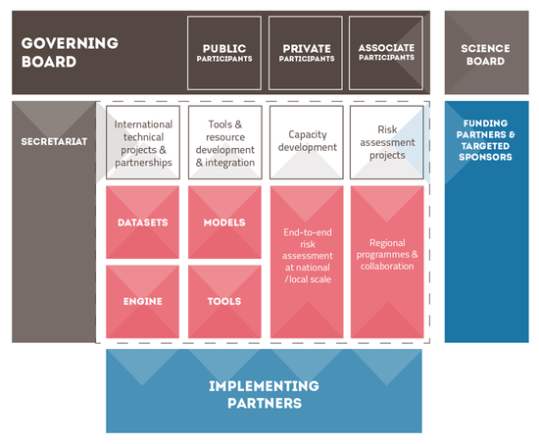
GEM structure
Proposal to OECD - large seed funding - realized in 2009
Organization with a considerable permanent staff
Secretariat in Pavia
Broad international partnership
Similar objectives as proposed for GTM
Funding from national partners?

Slide 13
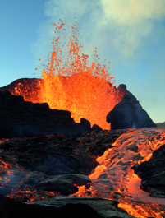
GVM structure
Emerged from UK “VOGRIPA” project
Primary focus – a joint global volcano database
More recently also hazard and risk (also GAR contribution)
Similar board structure as GEM
Management board
Science board
Present secretariat at Univ Bristol
Secretariat proposed to move / change cyclically
Limited funding – efficient utilization from individual projects
In kind contributions and human resources from partners

Slide 14
Way forward towards establishing a GTM
Initiation phase
Compose a working group for determining the organization
Directions for working group from this meeting
Elements that need to be discussed and planned for
Board (management and advisory / scientific board)
Physical location of secretariat (NGI not a likely candidate)
Composition of a limited number of topical working groups
Timeline for working groups
Commitment from partners - Letter of Intent
GTM endorsement mechanism for external projects
Webpage and repository

Slide 15
Proposed organizational structure for discussion (1)
Possible boards:
Recruit management and scientific board in a similar fashion as GEM and GVM
Scientific / advisory board – gives recommendations to management board
Management and scientific / advisory boards
Tsunami scientists within and outside GTM
Related scientists from e.g. GEM and GVM
External stakeholders (UN, WB, industry and possible funding agencies)

Slide 16
Proposed management model for discussion (2)
Smaller group than GEM – likely more similar to GVM in size
Ambition must also reflect the amount of funding raised
GTM Scientific objectives concern development of tools, standards, and guidelines, which is more similar to GEM
This may imply that
We favor a flexible organization without permanent staff (like GVM)
We need a secretariat that could be permanent or circulating (preferred)
The secretariat could be placed at (governmental) organizations that are less dependent on the external funding (than private ones)?
We need a scientific organizational structure that looks more like GEM
The first-phase working groups should reflect this organizational structure
The first phase working groups should recommend targeted and harmonized GTM activities, and compile overview of existing initiatives that GTM may endorse and include

Slide 17
Webpage, repository and secretariat
Establishment and efficient utilization of web-page and data and model repository a critical issue for success of GTM
For harmonized efforts
Need to efficiently utilize and link to decentralized and external resources
Efficient distribution and utilization of common resources (tools and data)
Dissemination purposes
Secretariat and centralized web-page and resources do not necessarily need to be physically located in the same place
Locate web-page at organization that is likely to provide long-term maintenance
Enable circulation of secretariat

Slide 18
Suggested working groups (WGs)
GTM organization WG
Some other possible groups and volunteer participants listed below
Funding and stakeholder WG (could be merged with the one above)
Anawat Suppasri (Univ Tohoku)
Possible Scientific WGs
Source modeling
Andrey Babeyko (GFZ)
Modeling workflow and validation, numerical modeling
Jörn Behrens (UHam) Andrey Babeyko (GFZ)
Probabilistic hazard analysis
Mauricio Gonzalez (UC)
Probabilistic risk assessment
Ignacio Aguirre Ayerbe (UC) Pino Gonzalez-Riancho
Dissemination and geo-ethics

Slide 19
Global Tsunami Model (GTM)
External stakeholders and possibilities for attracting funding
F. Løvholt, C.B. Harbitz
NGI
Second GTM scoping meeting, AECOM, Oakland 13.12.2015

Slide 20
Needs to ensure external GTM relevance
Need to integrate GTM objectives with external bodies for relevance and funding purposes
National and international body stakeholders
UN organizations (UN-ISDR, IOC-UNESCO)
World Bank
National and regional governments (such as the EU)
These organizations are to some extent well aware of our initiative
Industry
Re-insurance and risk assessment
Mutual synergies with related disciplines
Volcanoes (e.g. GVM)
Landslides (e.g. ICL, submarine mass movement community)
Earthquakes (e.g. GEM)

Slide 21
Potential funding sources
Who should we target for funding activities and secretariat?
Industry – such as re-insurance and risk?
Independent foundations?
National and international science councils?
Some preliminary uncoordinated contacts have been made
Contact with industry on funding and scientific interaction
A more targeted and coordinated effort is needed
Possible prerequisites for advertising the GTM
Written document, such as a white paper
Plans for GTM products and services
Dissemination and discussion with external stakeholders and industry
Working group concerning funding

Slide 22
Balancing funding and utilization of related activities
Funding may be needed for
Organizing workshops and meetings
Personnel exchange?
Students and postdocs working under GTM umbrella
Hourly based salaries for private organizations
Secretariat / GTM host – webpage etc.
Target areas where GTM sees need
Ongoing / in-kind activities needs to be utilized and endorsed by GTM
Related projects
Strategically founded activities in e.g. governmental organizations
Linked and disseminated via proposed GTM web page

Slide 23
Follow up activities on dissemination
White paper – broad author list?
Describe state-of-the-art on tsunami hazard and risk community
Outline future tasks for GTM
Different levels (short document, scientific paper)?
Needed for dissemination purposes
Dissemination meeting with stakeholders?
Possible contact – OASIS risk network (based on phone meeting)
Possible dissemination on insurance risk community meeting in Florida (winter / spring?)
Feedback on industry needs
Other dissemination
UN-ISDR science meeting in Geneva, January
GTM poster presentation
Expected notification from UN-ISDR Tuesday 15 December
Poster submission deadline in case of acceptance, 31 December
Invite re-insurance industry? Other Stakeholders? Dedicated workshop (possibly in London?) was proposed by OASIS

Slide 24
WG Organization
Setup secretariat/identify host
Coordinate white paper (5 months, for Worldbank understanding Risk meeting)
What/Why/How?
Identify needs
Commitment structure/letters of interest/MOU
Study internal financial contributions or in-kind
Study requirements for Formal/legal structure
Timeframe of 1 yr for getting off the ground
Independent reviewers in management board
WG members - NGI (C.B. Harbitz), IPMA (M.A. Baptista), GA (P. Cummins), UniBo (A. Armigliato), NOAA (V. Titov), INGV (?)

Slide 25
WG Stakeholders and funding
Contribute to goal and objectives of the whitepaper
Collect info on national/regional initiatives
Identify stakeholders/sponsors
Needs of stakeholders/funding opportunities
Link to products developed under GTM
Educational and capacity building aspects
Present at meetings
ISDR meeting (Jan 2016)
Cat Risk Management meeting (Feb 16)
TOWS (Feb 22-26)
Worldbank (May 16-20) Istanbul
Workshop with OASIS and third parties
Study issues with proprietary data/software
Contact agencies working in developing countries
WG members: IRIDES (A. Suppasri), A. Yalciner (METU), NGI, (F. Løvholt), GA (?), INGV (?), Issa El Hussain (Oman), possibly more?

Slide 26
WG methods (1)
Summarize the different methodological portifolios and identify gaps
Source modeling, tsunami modeling, probability framework, hazard, vulnerability, risk …
Identify overlaps with related groups (e.g. GEM, GVM, CSDMS)
Identify topics for pilot projects
Harmonization of outputs and intermediate data
Interoperability – on methodological framework – basic model interfaces
Determining the scope of software development
Testing, validation, and benchmarking
Available open source vs proprietary code for internal exchange
Software engineering support

Slide 27
WG methods (2)
Review other platforms such as GEM, SCEC
Development of joint tools for instance with GEM
Aspect of multihazard earthquake-tsunami coupling
Review possible hosting platforms such as OASIS and RMS
Technical discussion forums
Technical part of the white paper
Data (topography, bathymetry, census data, ++) – interfacing external databases, feasibility and quality aspects
Work Group members: AECOM (H.K. Thio) Chair GNS (W. Power), UHam (J. Behrens), UC (M Gonzalez, IA Ayerbe, P Gonzalez-Riancho), GFZ (A. Babeyko), UMA (MJ Castro, JM Gonzalez-Vida, J Macias), METU (U. Kanoglu),, UW (R. Leveque), INGV (Basili, Lorito, Selva), IPMA (R. Omira), UniBo (A. Armigliato), NOAA (Y. Wei), CEA (A. Gailler), USGS (E. Geist)?, IRIDES (A. Suppasri)

