Slide 1

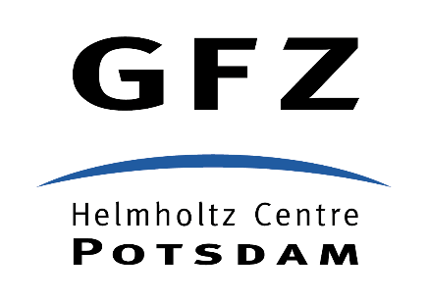
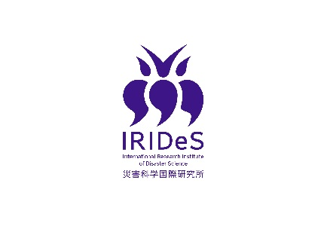
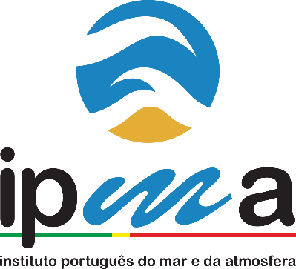
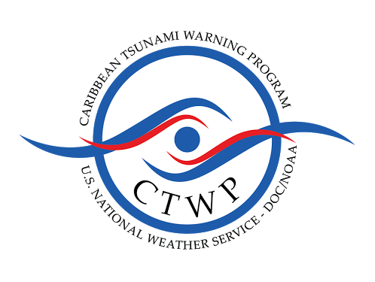


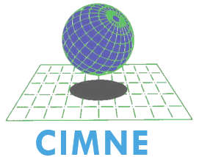




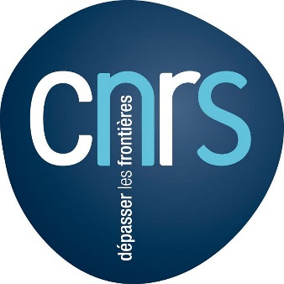


A Global Tsunami Model (GTM) network for increased understanding of tsunami hazard and risk
Løvholt F¹, Harbitz CB¹, Griffin J², Davies G², Cummins P², Lorito S³, Selva J³, Basili R³, Baptista MA⁴, Babeyko A⁵, Geist E⁶, Parsons T⁶, Thio HK⁷, Leveque R⁸, Power W⁹, Burbidge D⁹, Müeller C⁹, Horspool N⁹, Yalciner A¹⁰, Kanoglu U¹⁰, Suppasri A¹¹, Imamura F¹¹, Aguirre Ayerbe I¹⁴, Gonzalez-Riancho¹⁴, Gonzalez M¹⁴, Wei Y^{8,15}, Titov V¹⁵, von Hildebrandt-Andrade C¹⁶, Macias J¹⁷, Gonzalez-Vida JM¹⁷, Gailler A¹⁸, Necmioglu O¹⁹, Lynett P²⁰, Paris R²¹, Cardona O²², Bernal G²³ et al*
¹NGI, ²Geoscience Australia, ³INGV, ⁴IPMA, ⁵GFZ Potzdam, ⁶USGS, ⁷AECOM, ⁸Univ Washington, ⁹GNS, ¹⁰METU, ¹¹IRIDES, ¹⁴Univ Cantabria, ¹⁵NOAA, ¹⁶NOAA-CTWP, ¹⁷Univ Malaga, ¹⁸CEA, ¹⁹KOERI, ²⁰USC, ²¹CNRS, ²²INGENIAR, ²³CIMNE *+other organisations expressing interest
Abstract: The 2004 Indian Ocean and 2011 Tohoku tsunamis highlighted the need for a thorough understanding of the risk posed by relatively infrequent but disastrous tsunamis. The latest Global Assessment Report (GAR15) resulted in fully global probabilistic tsunami hazard and risk maps, briefly presented here. Still, this complex assessment needs improvements based on the state-of-the-art research, e.g. in the treatment of uncertainty or inclusion of non-seismic tsunami sources, and in vulnerability and risk assessment. Towards implementing the Sendai Framework of Disaster Risk Reduction (SFDRR), further efforts are needed, requiring interdisciplinary expertise. We are therefore establishing a Global Tsunami Model (GTM) with the aim of i) a better understanding of tsunami hazard and risk analysis on a global scale and ii) providing a portfolio of validated tools for tsunami hazard and risk assessment at different scales.
GTM - towards integrating, standardizing, and harmonizing work on tsunami hazard and risk
What is GTM?
GTM General Objectives
A joint network of tsunami scientists working on probabilistic tsunami hazard and risk
Proposed initiative from the tsunami community based on GAR – (ToR in preparation)
Interested collaborators represents almost 30 organisations across the globe
A preliminary webpage is under construction (http://www.globaltsunamimodel.org)
Harmonize efforts and products – GTM endorsement
Develop standardized and open source tools, guidelines and practices
Validate methods
Provide results on global and regional scales to become a term of reference for local hazard and risk analysis
Facilitate integration of results and tools from related organizations such as the Global Earthquake Model (GEM) and Global Volcano Model (GVM)
Dissemination and geo-ethics
Why GTM?
GTM preliminary Scientific Objectives
(working group established – white paper in preparation)
Contribute to the implementation of the SFDRR – in particular towards Priority 1 – Understanding risk
Bring a new generation of global hazard and risk maps based on the previous GAR15 work (below)
Understand the factors driving risk
Promote standards and validated tools for tsunami hazard and risk assessment
Capacity building to practitioners and stakeholders
A broader involvement of the global tsunami community yields better understanding of tsunami risk
Seismic sources: probability and modeling, both subduction zone and crustal earthquakes
Non-Seismic sources: landslides and volcanoes, probability and modeling
Tsunami modeling
Development of methods and numerical tools
Empirical and numerical Probabilistic Tsunami Hazard Assessment
Vulnerability and fragility
Probabilistic Tsunami Risk Assessment
Global tsunami hazard and risk analysis and mapping based on GAR15
Methods: Probabilistic tsunami hazard and risk assessment (PTHA and PTRA)
Sources: Large earthquakes (magnitudes exceeding 7.8)
Hazard quantification: Probability for the tsunami run-up height or flow depth to exceed a threshold value
Quantifying the tsunami risk as probability of losses: Combining global exposure datasets, physical vulnerability curves and hazard maps
Large uncertainties related to: Source recurrence, exposure and inundation, vulnerability etc. → Hence global maps should be used with caution, and only for global and regional assessments
Global tsunami hazard map (due to earthquakes) for a return period of 2500 years (Davies et al. submitted), showing the mean run-up values.
Relative probable maximum loss, PML (loss/national exposed value) map for a return period of 1500 years (Løvholt et al. in press, INGENIAR and CIMNE, 2015). The largest PML’s occur for small islands (not visible)
Main characteristics of the global tsunami hazard
Dominated by earthquakes sources (about 80%). Other important sources are landslides and volcanoes.
Although tsunamis propagate far – most damage (fatality and building damage) occurs near the source.
The 50 most destructive historical tsunamis events caused 97% of all lives lost. In recent history, the 2004 Indian Ocean and 2011 Tohoku tsunamis dominate
The infrequent tsunamis involving return periods of several hundreds to thousands of years dominate losses and challenge risk modelers
The source (earthquake) statistics are poorly constrained at these return periods
This makes the evaluation and communication of uncertainties as an important part of tsunami risk assessment
References
Løvholt F, Griffin J, and Salgado-Galvez M (in press), Tsunami hazard and risk assessment at a global scale, Encylopedia of Complexity and System Science, Springer
Davies G, Griffin J, Løvholt F, Glimsdal S, Harbitz CB, Thio HK, Lorito S, Basili R, Selva J, Geist E, and Baptista MA (submitted), A global probabilistic tsunami hazard assessment, Proceedings of Arthur Holmes Meeting, Geological Society of London
INGENIAR & CIMNE (2015). Update on the Probabilistic Modelling of Natural Risks at Global Level: Global Risk Model. Background paper prepared for the Global Assessment Report on Disaster Risk Reduction 2015.

