Slide 1

Boston Control Center
A machine that listens to the city
scan.boston
FENWAY SPORTS GROUP · AUGUST 2026 · MATT KAROLIAN, BOSTON GLOBE MEDIA
EVERYTHING IN THIS DECK IS MACHINE-TRANSCRIBED RADIO · UNVERIFIED · NOT FOR PUBLICATION
Notes:
Thanks for having me. This is a nights-and-weekends thing at the Globe that got out of hand, in a good way. It listens to the city's emergency radio around the clock, and I want to walk through how it actually works, plainly, and then show it to you live. One thing up front: everything you'll see is machine transcription of scanner radio. It is unverified by design, and you'll watch the system admit that over and over. That admission is the design.

Slide 2
Scanner radio evaporates.
Said once, to whoever happened to be listening. Then gone.
NO REWIND · NO SEARCH · NO MEMORY
BOSTON CONTROL CENTER
UNVERIFIED · NOT FOR PUBLICATION
Notes:
For about a century the fix for this was a person sitting next to a speaker all night, and reporters still do exactly that. The radio tells you everything once. If you were making coffee, you missed the shooting. That is the entire problem statement, and it turned out to be the product spec too: give the radio a memory.

Slide 3
What this is
ELEVEN RADIOS IN, ONE LIVING RECORD OUT
Police, fire, EMS, and transit radio across Greater Boston, transcribed as it is spoken. Every transmission is typed, located, threaded into incidents, archived with its own audio, and answerable in plain English. Five verbs, and the rest is detail: it listens, it writes everything down, it figures out where, it threads calls into stories, and it checks its own work. Built inside Boston Globe Media as a newsroom tool. Runs unattended.
16,075
TRANSMISSIONS KEPT IN ONE 48-HOUR WINDOW
107
CITIES AND TOWNS HEARD IN THAT WINDOW
99.9%
OF TRANSMISSIONS CARRY PLAYABLE AUDIO
BOSTON CONTROL CENTER
UNVERIFIED · NOT FOR PUBLICATION
Notes:
The one-sentence version: it turns radio, which evaporates, into a record you can see, search, and replay. The plan for the next ten minutes is those five verbs, one at a time, in plain English. The numbers on the right are from a real 48-hour pull this week, so nothing tonight is a projection, and anything on a slide I can also show you live.

Slide 4
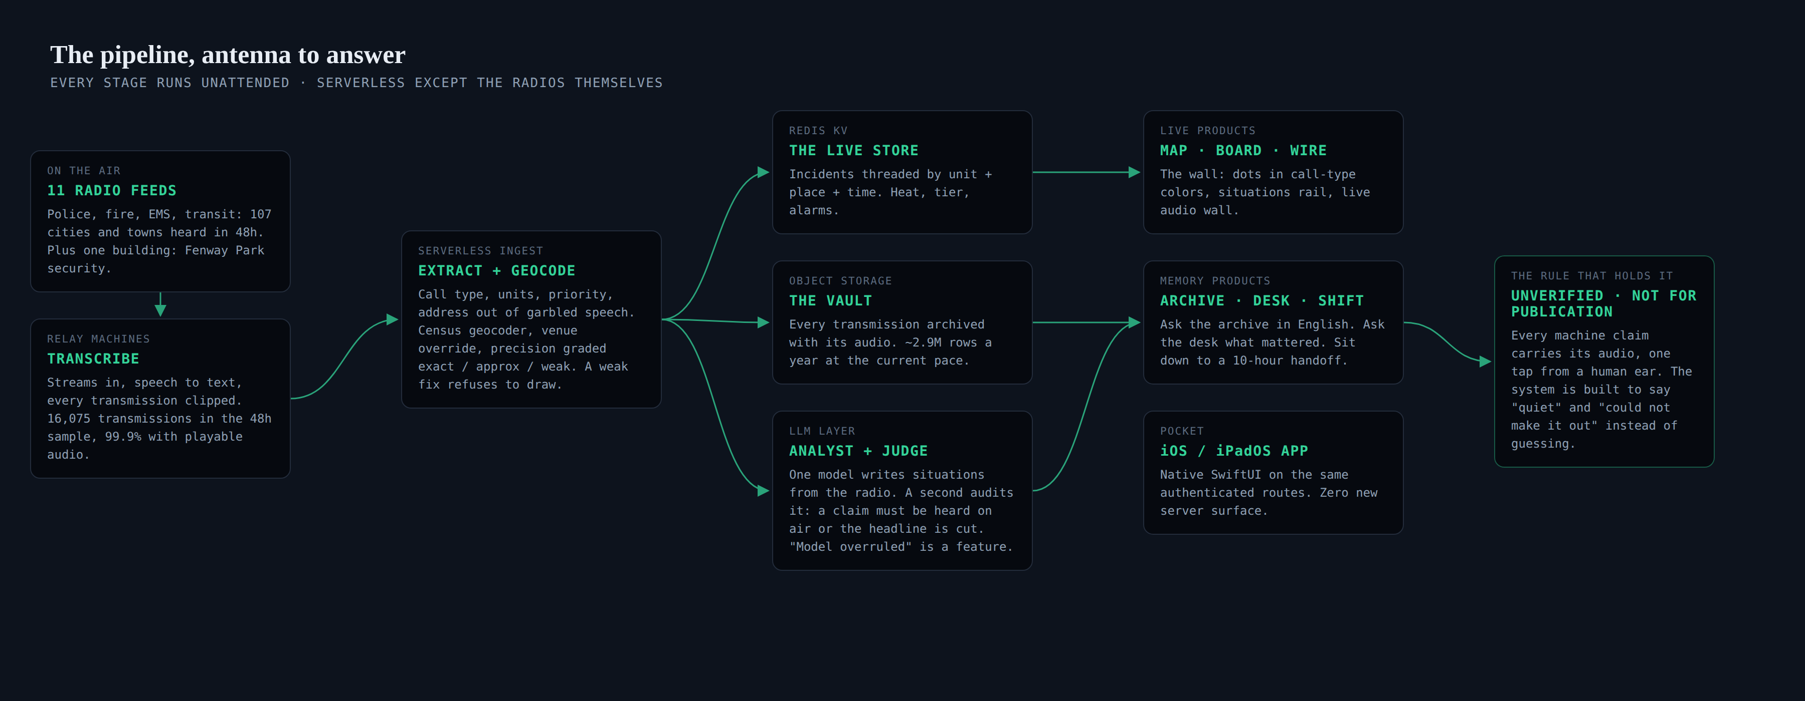
Vercel serverless · Upstash Redis · Vercel Blob · models via OpenRouter · the only hardware we own is the radios
The whole machine in one picture. The next five slides walk it left to right.
BOSTON CONTROL CENTER
UNVERIFIED · NOT FOR PUBLICATION
Notes:
Here is the whole thing in one picture, and then I'll take it a stage at a time. Relay machines listen to the streams and transcribe. A serverless layer pulls structure out of the speech and pins it to the map. Redis holds the live board, object storage keeps every transmission with its audio, and a pair of models writes the narrative and audits it. There are no servers we babysit. The bill is small enough that nobody has asked me about it yet.

Slide 5
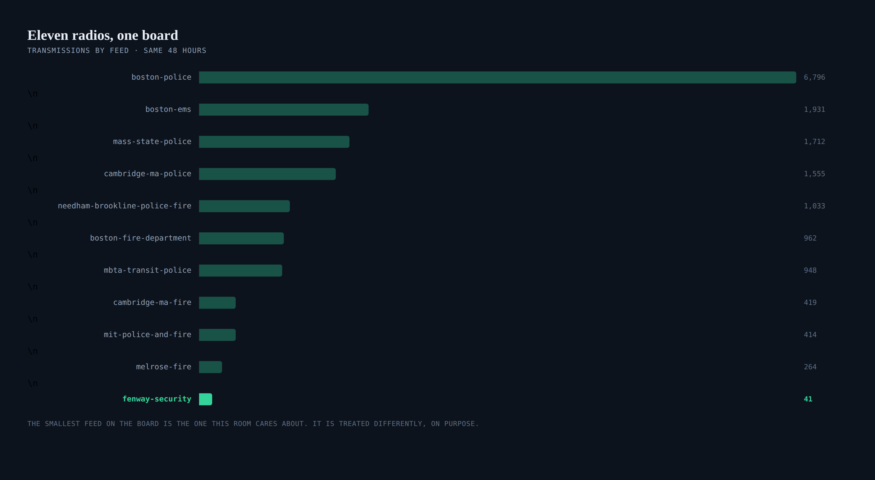
Verb one: it listens. Ten of these radios cover towns. The eleventh covers one building; hold that thought.
BOSTON CONTROL CENTER
UNVERIFIED · NOT FOR PUBLICATION
Notes:
Verb one, it listens. Eleven radios around the clock. Boston Police is the firehose, around 3,400 transmissions a day on its own. The one to remember is the bottom row: Fenway Park's security radio, 41 transmissions in this window, the smallest feed on the board. It matters far beyond its size and we'll come back to it near the end.

Slide 6
It writes everything down
ONE REAL ROW · TUESDAY 8:58 A.M. · EAST BOSTON
THE RADIO SAID
THE ROW IT BECOMES
“Coming in for an AMB in progress, 406 Meridian, apartment 11. Caller's stating the neighbor just assaulted her.”
at 2026-08-18T12:58:06Z feed boston-police callType assault units AMB address 406 Meridian St, Boston lat, lon 42.38032, -71.03933 precision exact tier 2 (violence signal) incident inc-msyo4wyn · threaded clip ▸ audio, one tap from every claim
fifteen seconds of air, gone unless somebody was listening
Sixteen thousand of these per two days. Each one is two API calls away from any question you can phrase.
BOSTON CONTROL CENTER
UNVERIFIED · NOT FOR PUBLICATION
Notes:
Verb two, it writes everything down. This is a real row from Tuesday morning in East Boston. Fifteen seconds of speech becomes a type, a unit, an exact address, a severity tier, membership in a threaded incident, and the audio itself. The clip is the load-bearing part. Every claim this system ever makes keeps its receipt, and that rule is what makes the rest of the machine trustworthy enough to use.

Slide 7
It figures out where, and admits when it can't
EVERY GEOCODE IS GRADED · WEAK FIXES NEVER DRAW
12,281
Three quarters of everything said on the air names no findable place. A weak fix is the town centroid, which for Boston is a spot by City Hall, and drawing them piled thousands of unrelated calls into a phantom mass incident at Government Center. So a weak fix refuses to draw. The call keeps its card in every list; the map declines to state a place nobody said. A wrong pin is worse than no pin.
OF 16,075 FIXES IN 48H WERE WEAK: PLACEABLE ONLY AS “SOMEWHERE IN BOSTON”
EXACT 1,783 · APPROX 537 · WEAK 12,281
BOSTON CONTROL CENTER
UNVERIFIED · NOT FOR PUBLICATION
Notes:
Verb three, it figures out where, and this slide is really about the second half of the sentence. We learned it the embarrassing way: the map used to draw weak fixes, and it looked like a permanent riot at City Hall, a ring of unrelated dots stacked on the centroid. Now every fix carries a grade and everything downstream, the map, the search, the grouping, only trusts exact and approximate. The system states less than it knows, on purpose.

Slide 8
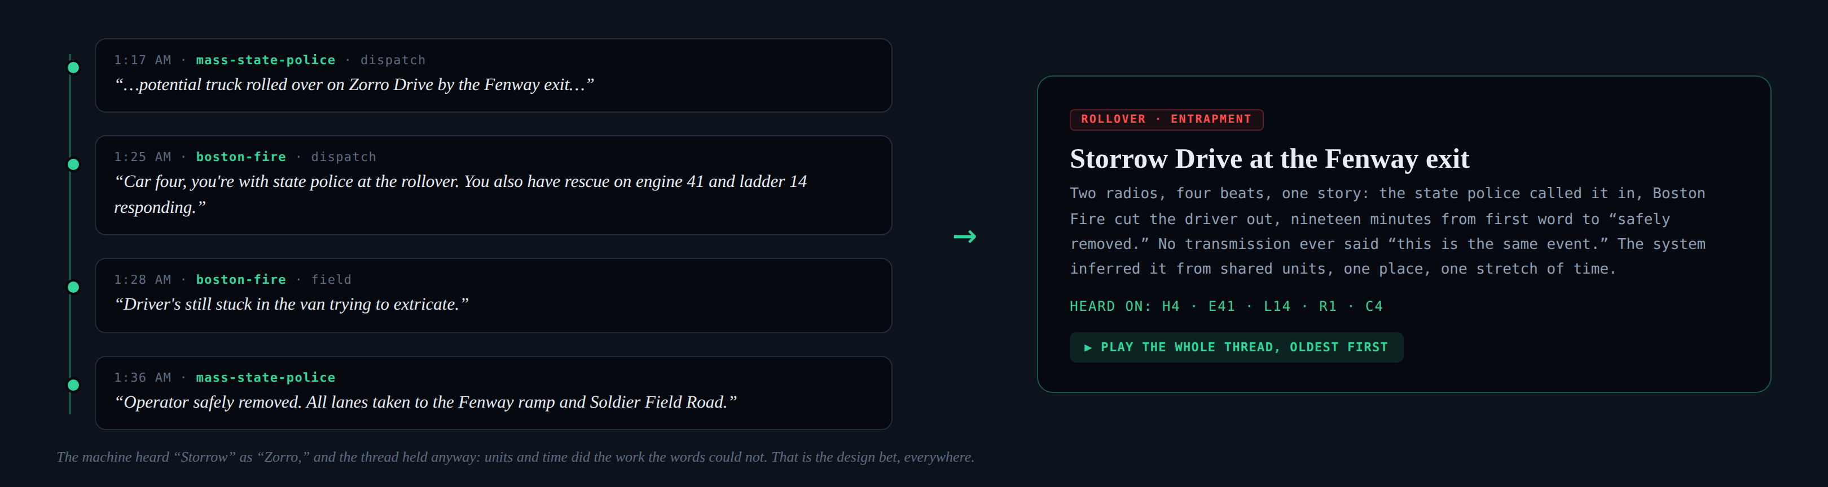
It threads calls into stories
REAL THREAD · STORROW DRIVE · 1:17 TO 1:36 A.M. TUESDAY
No transmission carries a story id. Stories are inferred: shared units, one place, one stretch of time. Venue calls skip the distance rule entirely, because inside one building distance separates nothing.
BOSTON CONTROL CENTER
UNVERIFIED · NOT FOR PUBLICATION
Notes:
Verb four is the hard one, and my favorite slide. Nobody on the radio ever says 'this is the same event.' A state trooper calls in a rollover, Boston Fire cuts the driver out, two different radios, nineteen minutes. The system stitched it into one story from shared units, one place, one stretch of time. And notice the transcriber heard Storrow Drive as Zorro Drive. The thread held anyway, because we bet on structure instead of words everywhere the words might lose, and the words are always the least reliable part.

Slide 9
It checks its own work
ONE MODEL WRITES · A SECOND MODEL AUDITS · DISAGREEMENT PRINTS
THE ANALYST
THE JUDGE
THE BOARD
Reads batches of raw transcript and writes the situations board: headline, summary, location, priority. Good at narrative. Too eager, left alone.
Audits every claim against the transcript. A “confirmed” nobody said on air gets stripped. Severity with no root in the audio gets cut. Two addresses never merge into one story.
What survives, printed with its scars: the screen literally says “model overruled” and why, so an editor sees the disagreement instead of a false clean answer.
Quiet is an acceptable answer. “Could not make it out” is an acceptable answer. Guessing is not.
BOSTON CONTROL CENTER
UNVERIFIED · NOT FOR PUBLICATION
Notes:
Verb five, it checks its own work. We stopped trusting single-model output early. One model writes the story, and a second model's entire job is to catch what the first one made up. If nobody said 'confirmed' on the air, the word comes out of the headline. And when the judge wins, the screen says 'model overruled,' in public. My read is that this is the only honest way to put language models in front of professionals: show the disagreement and keep the receipt, which is always the audio.

Slide 10
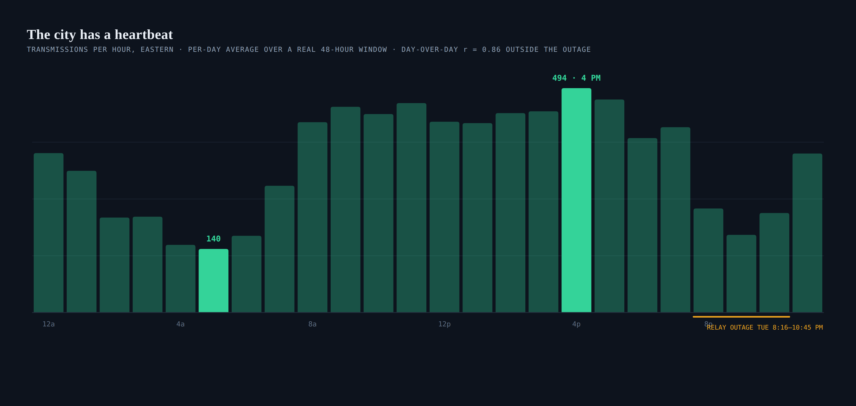
The two days' hourly curves correlate at r = 0.86. Even the failure is recorded: the amber mark is our own relay outage, kept in the archive like everything else.
BOSTON CONTROL CENTER
UNVERIFIED · NOT FOR PUBLICATION
Notes:
Transmissions per hour across the same 48 hours: quietest at five in the morning, peak at four in the afternoon, and the two days' curves correlate at 0.86, so the shape is stable enough to be a baseline. Two honest footnotes I like showing. The 4 p.m. peak is almost entirely routine, which is the point: the baseline is boring, that is what makes the exceptions visible. And the amber mark is us: our relays dropped for two and a half hours Tuesday evening, and the archive shows it rather than papering over it. Outside that outage, the longest the entire city went quiet in two days was fourteen minutes, at five in the morning.

Slide 11
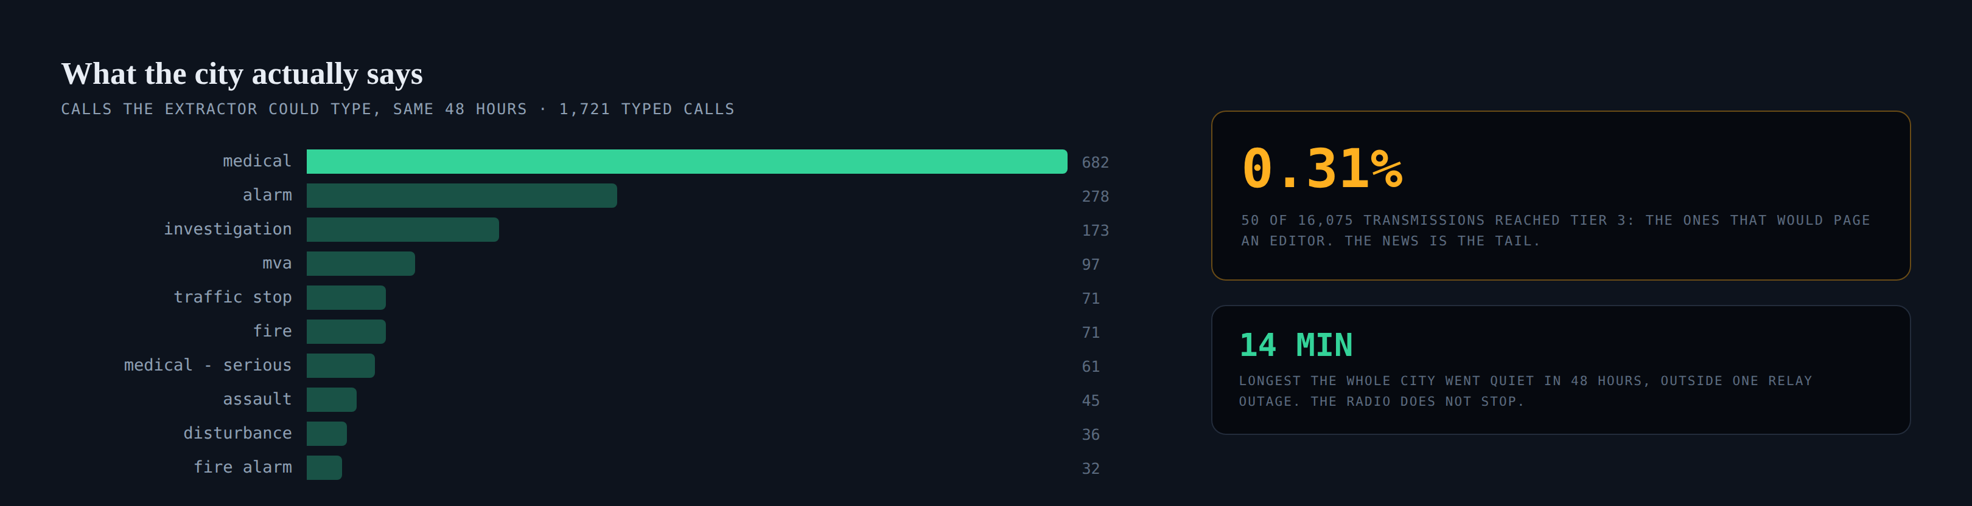
Medicals and alarms are the city's background hum. Tier is the machine's severity score: wounds, weapons, working fires, escalations.
BOSTON CONTROL CENTER
UNVERIFIED · NOT FOR PUBLICATION
Notes:
What is the city actually saying? Of the calls the extractor could confidently type in this window, forty percent are medicals, then alarms, then investigations. Violence is a thin slice. And the number I keep coming back to is on the right: fifty transmissions out of sixteen thousand reached tier three, the grade that would page an editor. A third of one percent. The news is the tail, and you can only see a tail if you recorded the whole animal.

Slide 12
The surfaces
THE LIVE HALF AND THE MEMORY HALF, ONE STORE UNDER ALL OF IT
THE MAP
THE BOARD + WIRE
LISTEN
Dots in call-type colors, situations ringed, venue calls squared. The wall of the operation.
Situations as an editor would brief them, over the raw transcript ticker as it happens.
The raw wall: any feed, live, several at once, straight off the air. Zero interpretation in the way.
THE ARCHIVE
THE DESK
SHIFT CHANGE
Ask in English: “stabbing last night in Dorchester.” Time, type, place parsed; scenes returned with audio.
A running 20-minute read that is allowed to say “quiet.” Ask it questions; answers cite their clips.
Sit down to the last 10 hours: what is open now, the major calls, the also-heard. A handoff, not a feed.
BOSTON CONTROL CENTER
UNVERIFIED · NOT FOR PUBLICATION
Notes:
What all of that machinery is for. The top row is the live half: the map, the board, and the raw listening wall, which is several streams at once, exactly like a newsroom scanner shelf. The bottom row is the memory half, and that is the genuinely new thing: an archive you can question in English, a desk read that is allowed to say it is quiet, and a briefing for whoever just sat down. Radio never had a rewind button before.

Slide 13
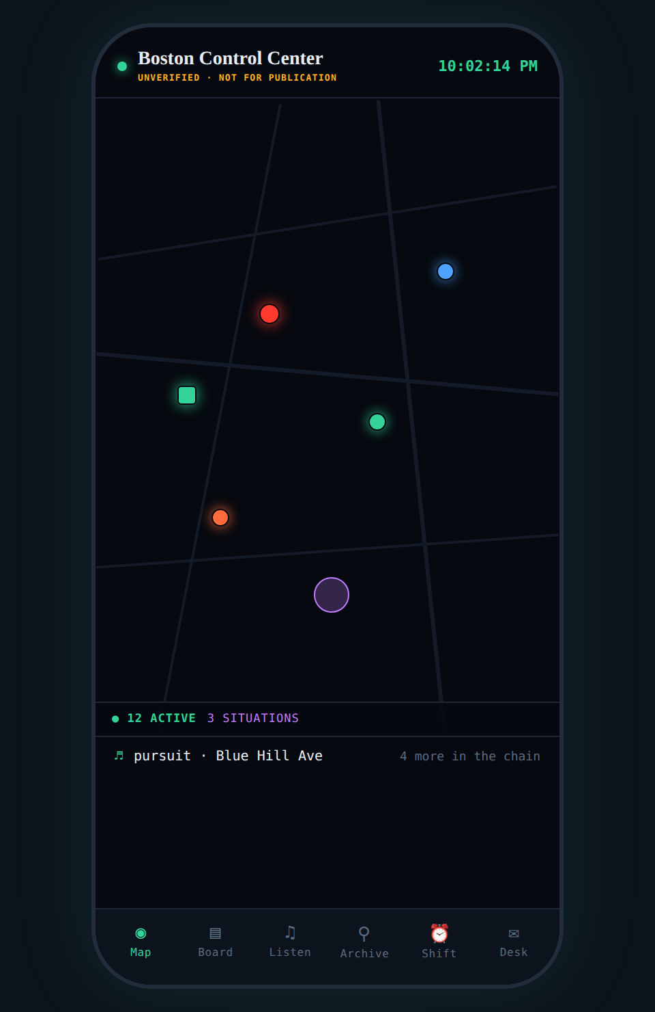
The wall, in a pocket
NATIVE IOS / IPADOS, SAME ROUTES, NO NEW SERVER SURFACE
Native SwiftUI, six tabs: Map, Board, Listen, Archive, Shift, Desk. One shared radio player, chains transmissions oldest-first from any screen. The phone holds no state the server does not own. Delete the app, reinstall it: the board is the board. Credentials live in the device Keychain. Audio keeps playing with the screen locked, which is how a night editor actually uses it. Empty folder to running on a phone: one day.
BOSTON CONTROL CENTER
UNVERIFIED · NOT FOR PUBLICATION
Notes:
The app exists because the wall is useless in an elevator. The design decision worth naming: the phone owns nothing. Every screen is a window onto the same server routes the wall reads, which is why it went from an empty folder to running on a phone in a day, and why there was no new security surface to think about.

Slide 14
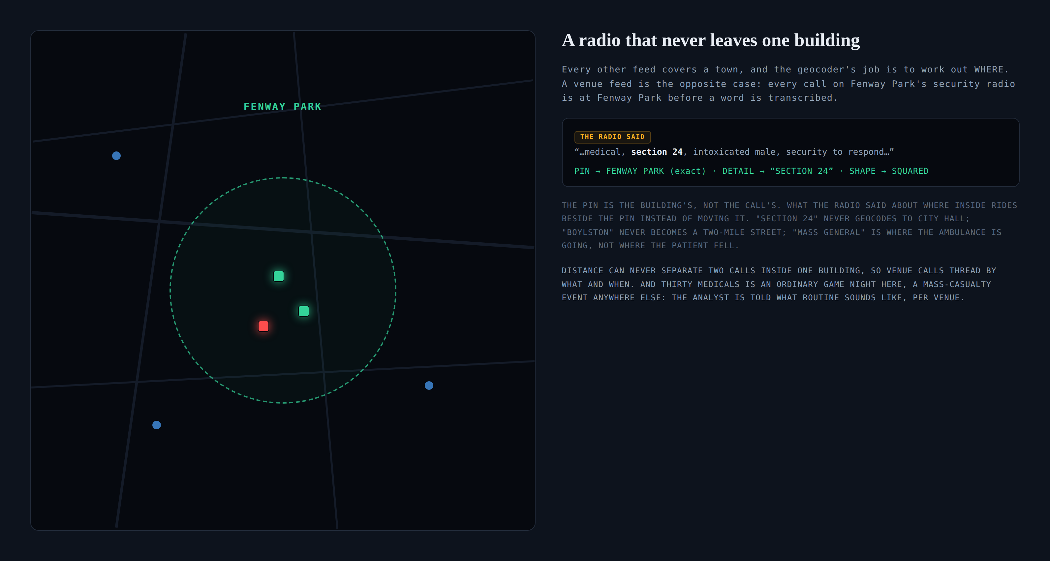
BOSTON CONTROL CENTER
UNVERIFIED · NOT FOR PUBLICATION
Notes:
The newest idea in the system, and it came from the smallest feed breaking our assumptions. Every rule so far assumed a radio covers a town. Fenway Park's security radio covers one building, so the rules invert: the pin is the building's, always. 'Section 24' rides beside the pin instead of geocoding to nowhere. Distance can never separate two calls, so they thread by what and when. And the analyst is told thirty medicals is an ordinary game night there, a catastrophe anywhere else. For this room I'll just say: if a second building ever wants this treatment, it is a config row and an audio relay. That is the entire sales pitch, I promise.

Slide 15
What compounds
~2.9M ROWS A YEAR AT TODAY'S PACE · A NIGHTLY FILE AND A LAPTOP
RECURRENCE
THE PULSE
RADIO GAP
STATE ST · 73×
494 VS 140
BOS 7.4 · CAM 5.5 MIN
Repeat places surface problem properties and corners. A year of this is a beat no official release provides.
Peak hour vs. quietest, day-over-day r = 0.86. Baselines turn anomalies into pages: “tonight is 3× normal.”
Median dispatch voice to first field voice (n=112, n=25). By neighborhood, over a year, with audio receipts.
HOSPITAL FLOWS
WORKLOAD
LEAD TIME
BMC · 65 MENTIONS
A1 · 372 TX
TO BE MEASURED
More than the next three hospitals combined. Where the city's ambulances actually go, heard nightly.
One ambulance dispatch voice, 372 transmissions in 48h. Staffing and fatigue curves fall out of this.
Log when the air first said it vs. when the statement landed. The head start, measured, over months.
Every number here is computed from the same 48-hour pull. The honest versions need months of accumulation, which is the point: the move is to never stop recording.
BOSTON CONTROL CENTER
UNVERIFIED · NOT FOR PUBLICATION
Notes:
What the archive becomes if you just keep it running. Every number here except lead time is computed from the same 48-hour pull, so treat them as teasers of year-scale questions. Repeat places, a stable pulse, the radio gap between dispatch and the first voice on scene, where the ambulances actually go, and which units carry the load: BMC gets mentioned more than the next three hospitals combined, and one ambulance dispatch voice spoke 372 times in two days. My favorite part for this room: three million rows a year is small data. All of this is a nightly file and a laptop, no cluster, no pipeline team.

Slide 16
What is hard, honestly
THREE FIGHTS, ONE DESIGN RULE
SPEECH
PLACE
MODELS
Scanner audio is brutal: codes, cross-talk, garble. It heard Storrow as “Zorro” an hour into this deck's own example.
Geocoders lie with confidence. “Boylston” is a two-mile street; hospital names are destinations, not scenes.
Language models write beautifully past their evidence. Left alone they confirm things nobody said.
Keep the clip one tap from every claim, so a human ear settles it in seconds.
Grade every fix, refuse to draw the weak ones, let venues override geography entirely.
A second model audits the first, claims must be heard on air, and “quiet” is an acceptable answer.
The rule everywhere: the machine states less than it knows and shows its work.
BOSTON CONTROL CENTER
UNVERIFIED · NOT FOR PUBLICATION
Notes:
I want to be straight about the failure modes, because anyone who builds anything like this hits the same three. Speech, place, and models all fail confidently. The answer turned out to be the same every time: keep the raw evidence attached, grade the claims, and make the system comfortable saying less. A dashboard that guesses is like a smoke detector that hums a little all the time. You stop hearing it the week you install it.

Slide 17
See it live
scan.boston
The wall, live · one archive question, typed in front of you · the shift briefing · two raw streams at once · the phone
Matt Karolian · Boston Globe Media
BOSTON CONTROL CENTER
UNVERIFIED · NOT FOR PUBLICATION
Notes:
Then I stop talking and drive. The wall first and let it breathe, then I type one archive question live, show the shift briefing, put two raw streams on at once so the room hears the wall of scanners, and hand somebody the phone. If questions pull toward their buildings, the venue slide already said the quiet part: a config row and an audio relay.

