Slide 1
BOSTON GLOBE MEDIA · NEWSROOM ENABLEMENT
TRAINING KIT
Data Dumpster
for newsrooms
Find the signal. Check the context. Bring one useful answer back to the room.
01
Orientation
Workflow
Guardrails
Notes:
PRESENTER CUE
Open by framing the tool as a daily newsroom decision aid—not a social media scorekeeping toy.
SOURCES
- Data Dumpster production application and internal product documentation, accessed Aug. 7, 2026.

Slide 2
DATA DUMPSTER · NEWSROOM TRAINING
Three questions organize the whole product
Start with a newsroom question, then choose the view that answers it.
01
02
03
What happened?
Why did it happen?
What do we do next?
Cross-Channel and Newsroom Screen
Top Content, Social Posts and Story Cloud
Weekly Report, Briefs and Alerts
See the leaders, the volume and the platform mix.
Open the posts. Look for topic, format, timing and distribution patterns.
Turn the signal into a huddle note, a test or a leadership readout.
2
Notes:
PRESENTER CUE
Ask the room to name a recent question they tried to answer manually. Map it to one of these three buckets.
SOURCES
- Data Dumpster information architecture, production application, accessed Aug. 7, 2026.

Slide 3
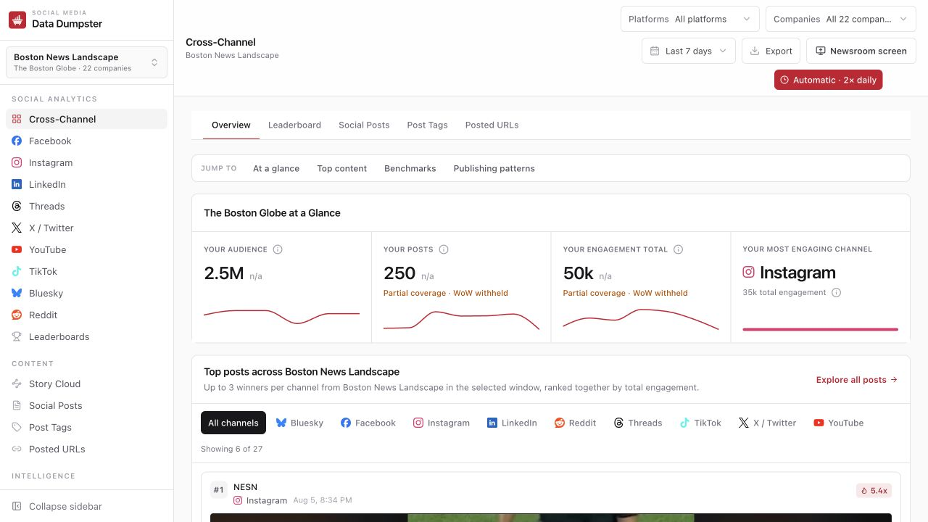
DATA DUMPSTER · NEWSROOM TRAINING
Set the context before you read a number
Most bad reads start with the wrong landscape, date window or company filter.
1
Landscape
Who belongs in the comparison set—and which company is the focus?
2
Date window
Use the same window when you compare totals, rates or week-over-week movement.
3
Filters
Platform and company filters change the question. Reset them before sharing a finding.
3
Notes:
PRESENTER CUE
Demonstrate changing the landscape and date range. Emphasize that screenshots and exported numbers should carry that context.
SOURCES
- Screenshot: Data Dumpster Cross-Channel, Boston News Landscape, captured Aug. 7, 2026.

Slide 4
DATA DUMPSTER · NEWSROOM TRAINING
The at-a-glance row is a scorecard—not a verdict
Use the four measures together; no single tile tells the whole story.
Audience
Posts
Engagement
Most engaging channel
Latest follower reading in the window. It is a stock, never a sum.
How much the selected account set published in the window.
Measured reactions, comments and amplification added across posts.
Where the focus company earned the most measured engagement.
4
Notes:
PRESENTER CUE
Pause on audience: widening the date range does not add follower readings together. It changes which latest reading qualifies.
SOURCES
- Screenshot: Data Dumpster Cross-Channel, captured Aug. 7, 2026.
- Metric definitions: internal Data Dumpster metric contracts.

Slide 5
DATA DUMPSTER · NEWSROOM TRAINING
Top content is where patterns become actionable
Use the cards to move from rank to a hypothesis you can test.
Avoid
A strong read has four parts
“This post won because the algorithm liked it.”
1
Open the post
Media, copy and link context matter.
2
Check the denominator
Big total or true outlier for that account?
Prefer
3
Name the pattern
Topic, format, timing, platform or distribution.
“Video explainers about a live local event outperformed this account’s usual post—let’s test the format again.”
4
Choose a test
What can the newsroom repeat or challenge?
5
Notes:
PRESENTER CUE
Model the difference between observation and explanation. The tool supplies evidence; the newsroom supplies editorial context.
SOURCES
- Data Dumpster top-post workflow and outlier labeling, internal product documentation.

Slide 6
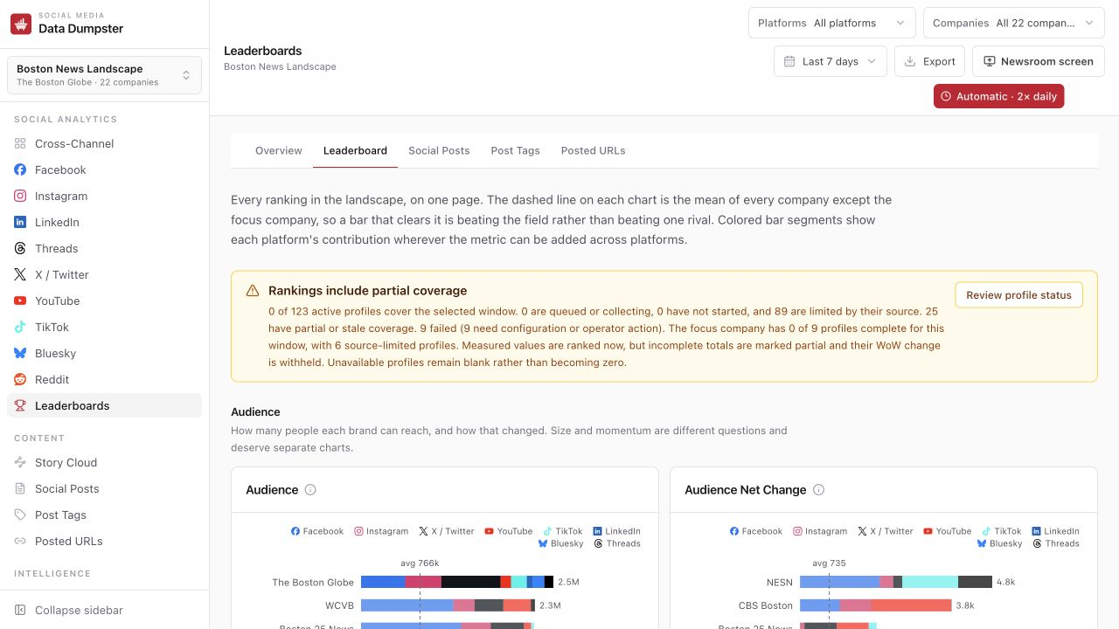
DATA DUMPSTER · NEWSROOM TRAINING
Leaderboards answer relative questions
Use them when the question is “compared with whom?” rather than “how big?”
Rank
Position among measured companies in the selected landscape and window.
Dashed mean
Average of the field excluding the focus company; clearing it means beating the field.
Colored segments
Each platform’s contribution when the metric can be added across channels.
6
Notes:
PRESENTER CUE
Use one real leaderboard question: Who is publishing most? Who is generating the most engagement? Who is growing fastest? Keep those separate.
SOURCES
- Screenshot: Data Dumpster Leaderboards, captured Aug. 7, 2026.

Slide 7
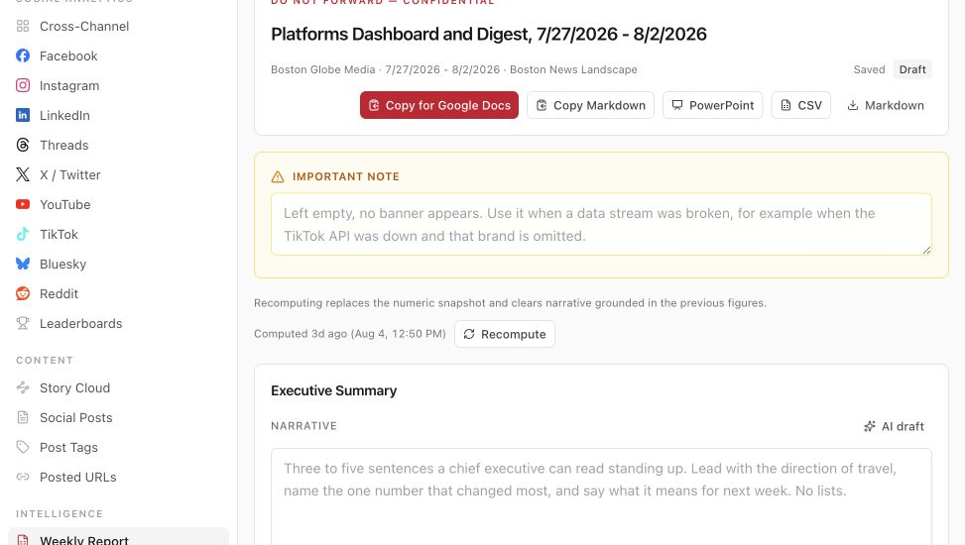
DATA DUMPSTER · NEWSROOM TRAINING
The weekly report turns analysis into a repeatable ritual
Numbers are computed; newsroom context and the executive narrative remain deliberate editorial work.
✓
Recompute first
Refresh the stored numeric snapshot when source data changed.
✓
Write the meaning
Use the narrative fields for the “so what,” not arithmetic.
✓
Complete manual inputs
Paste-box sections are clearly labeled when Data Dumpster cannot read the source system.
✓
Export and deliver
PowerPoint, CSV and Markdown support different audiences.
7
Notes:
PRESENTER CUE
Explain the line between computed facts and editorial narrative. Recomputing replaces the numeric snapshot and can invalidate prose written against older figures.
SOURCES
- Screenshot: Data Dumpster Weekly Report workspace, captured Aug. 7, 2026.

Slide 8
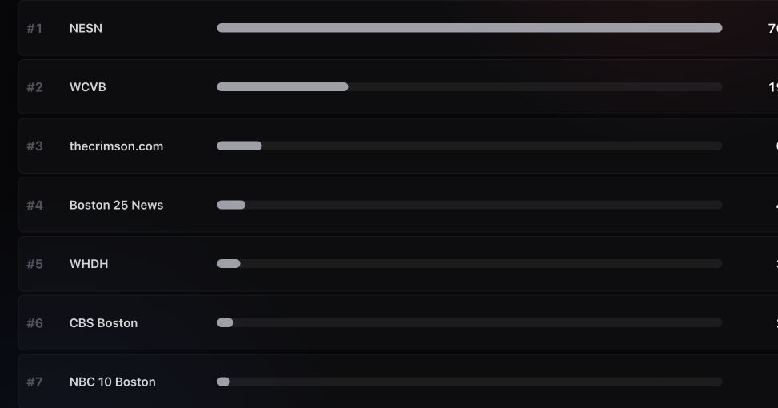
DATA DUMPSTER · NEWSROOM TRAINING
The Newsroom Screen is built for a standing huddle
It rereads stored data; leaving it on does not trigger new vendor collection.
Slide 1
Rolling 24-hour engagement leaders
Slide 2
Top content on every platform today
Controls
Fullscreen · pause · next/previous · refresh display data
8
Notes:
PRESENTER CUE
Open the Newsroom Screen in a new tab, enter fullscreen and show the pause button. Its five-minute reread checks the database only; collection stays on the scheduled cadence.
SOURCES
- Screenshot: Data Dumpster Newsroom Screen, captured Aug. 7, 2026.
- Refresh behavior: internal Data Dumpster collection architecture.

Slide 9
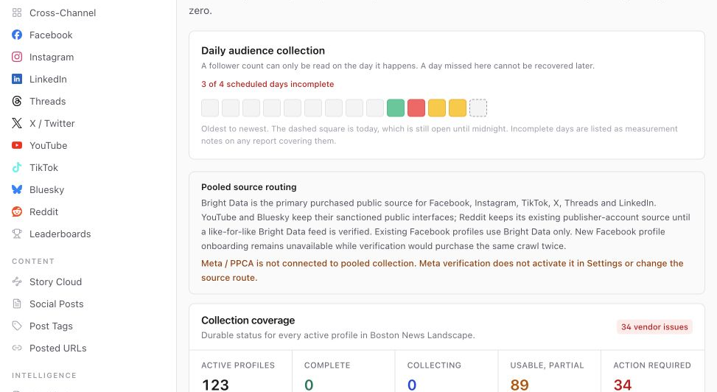
DATA DUMPSTER · NEWSROOM TRAINING
Data quality labels change what you can claim
Partial does not mean broken—but it does limit comparisons and week-over-week language.
When you see a warning
1. Read what is still usable.
2. Check whether the missing piece affects the claim.
3. Withhold trend language when the product withholds WoW.
4. Escalate “action required” to an operator.
Blank is safer than a fake zero.
9
Notes:
PRESENTER CUE
Use a current warning as a teaching moment. A number can be visible and useful while a complete historical comparison is not yet supportable.
SOURCES
- Screenshot: Data Dumpster Social Profiles, captured Aug. 7, 2026.

Slide 10
DATA DUMPSTER · NEWSROOM TRAINING
Five labels every newsroom user should know
These are evidence labels—not error messages to click past.
Complete
The profile covers the requested window.
Usable, partial
Recent data can be shown; some history or snapshots are missing.
Source-limited
The vendor cannot certify the full window or metric.
Action required
Configuration, credentials or operator attention is needed.
WoW withheld
The comparison is not trustworthy enough to publish.
10
Notes:
PRESENTER CUE
Have trainees paraphrase each label in their own words. The goal is confident, appropriately qualified use—not avoiding the product whenever a caveat appears.
SOURCES
- Data Dumpster source-state contract and production labels.

Slide 11
DATA DUMPSTER · NEWSROOM TRAINING
Build Data Dumpster into three newsroom rhythms
The product is most useful when the question and the meeting cadence are predictable.
8–10 AM
During a story
Once a week
Morning huddle
Response check
Performance review
Newsroom Screen
24-hour leaders
Today’s platform winners
Social Posts
Platform view
Competitor filter
Leaderboards
Weekly Report
Export
Leave with one story or format worth watching.
Decide whether to extend, repackage or hold.
Name the pattern, the caveat and next week’s test.
11
Notes:
PRESENTER CUE
Invite each desk to choose one rhythm for the first month. Consistency beats trying every feature at once.
SOURCES
- Recommended newsroom adoption workflow; synthesized from Data Dumpster product capabilities.

Slide 12
DATA DUMPSTER · NEWSROOM TRAINING
Four guardrails keep the read honest
Use these before a finding leaves the room.
Carry the context
✓
✓
Treat audience as a stock
Landscape, date window, platform and company filters belong with the number.
Use the latest follower snapshot in the window. Never add daily follower readings.
Respect withheld comparisons
✓
✓
Separate evidence from explanation
No prior baseline or incomplete coverage means no invented percentage change.
Data Dumpster shows what happened; newsroom context explains why.
If the tool leaves a cell blank, do not turn the blank into zero.
12
Notes:
PRESENTER CUE
These guardrails mirror the product’s metric contracts. Ask trainees which one is easiest to violate under deadline pressure.
SOURCES
- Data Dumpster metric contracts: audience stock, zero-baseline change, and fact-sheet verification.

Slide 13
DATA DUMPSTER · NEWSROOM TRAINING
Practice: bring one useful answer back in 10 minutes
Work in the Boston News Landscape. Use the last seven complete days unless your question needs another window.
1
Name the current engagement leader
Use Leaderboards and record the context.
2
Find one top post worth discussing
Open the card and name the topic, format and platform.
3
Check the evidence label
Is the profile complete, usable/partial, source-limited or action required?
4
Propose one action
Repeat, repackage, investigate or deliberately do nothing.
Share-out format: Finding · Evidence · Caveat · Next move
13
Notes:
PRESENTER CUE
Let people work in pairs. Keep the share-out to 30 seconds per pair and insist on a caveat when the interface displays one.
SOURCES
- Training exercise designed for the Data Dumpster production interface.

Slide 14
THE HABIT
Context → signal → action
START HERE
Boston News
Landscape
Open the right landscape.
Name what the evidence supports.
Bring one decision back to the room.
Cross-Channel
Newsroom Screen
Weekly Report
Notes:
PRESENTER CUE
Close by asking each participant to name one workflow they will use this week.
SOURCES
- Data Dumpster production application and training synthesis.

