Slide 1
DATE
Ovcharuk Darya
20/03/2024
BANKING SYSTEM
England vs Pridnestrovie

Slide 2
PLAN:
Banking System of PMR
Main specs and system structure
Compressional Bank of Pridnestrovie
PMR Banks Monterey
General overview of bank system
Definition of the banking system
Role bank system in global economics
1
2
Banking System of England
Structure and organizations of banking system
Commercial Banks and theirs type
Monetary of England
3
4
Comparasion of systems&results

Slide 3


The banking system is a network of financial institutions that collect savings and provide loans. It ensures liquidity, manages risks, and facilitates international transactions.
The banking system plays a pivotal role in the economy by mobilizing savings and directing them towards productive purposes through loans and investments.
BANKING System

Slide 4


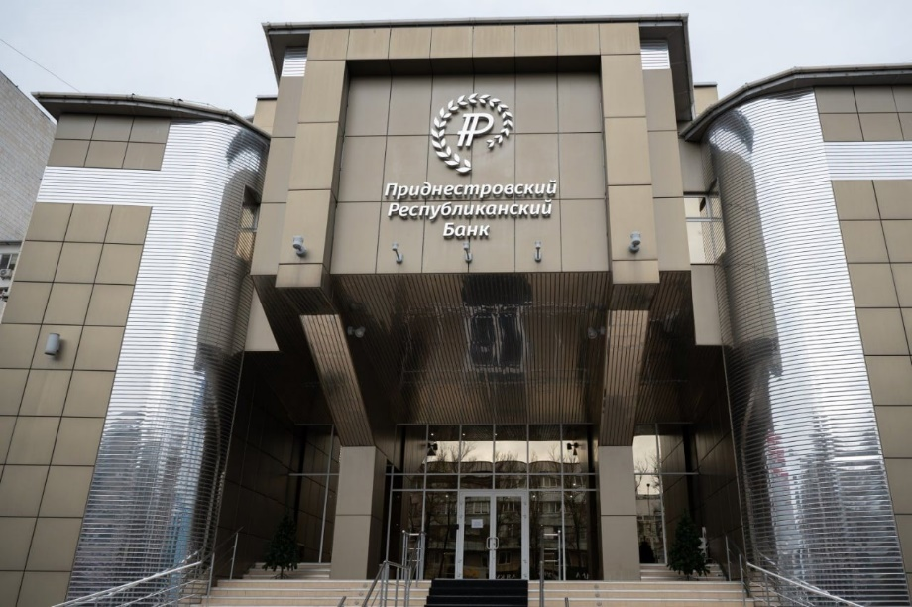

BANKING SYSTEM of PMR
Banking system of Transnistria consists of two levels:
The Republican bank of Pridnestrovie
Comercial Banks
(Agropombank, EximBank, SberBank)

Slide 5

BANKING SYSTEM of PMR
Banking system of Transnistria consists of two levels:
Maintaining stability and development of the banking system.
Establishing for the country's consistent and sustainable economic development.
Ensuring the stability of the national currency.
Profit-making is not the primary goal of the central bank's activities.
The Central Transnistrian Republican Bank
Comercial Banks
(Agropombank, EximBank, SberBank)

Slide 6
One of the largest commercial banks of the Pridnestrovian Moldavian Republic. The Bank has established an extensive branch network. Agroprombank's infrastructure is represented by the head office, 7 branches in all cities of Transnistria, 16 expanded bra
One of the largest commercial banks and the only bank in the PMR that has a state guarantee of safety and return of citizens' deposits
One of the largest commercial banks and the only bank in the PMR that has a state guarantee of safety and return of citizens' deposits
BANKING SYSTEM of PMR
The Central Transnistrian Republican Bank
Maintaining stability and development of the banking system.
Establishing for the country's consistent and sustainable economic development.
Ensuring the stability of the national currency.
Profit-making is not the primary goal of the central bank's activities.

Slide 7
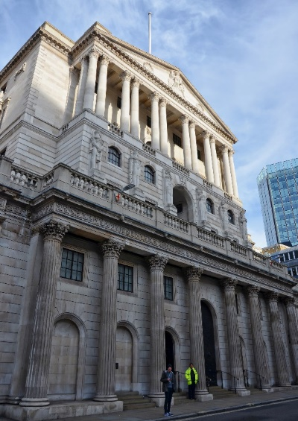
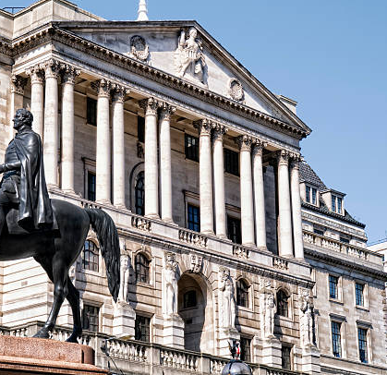
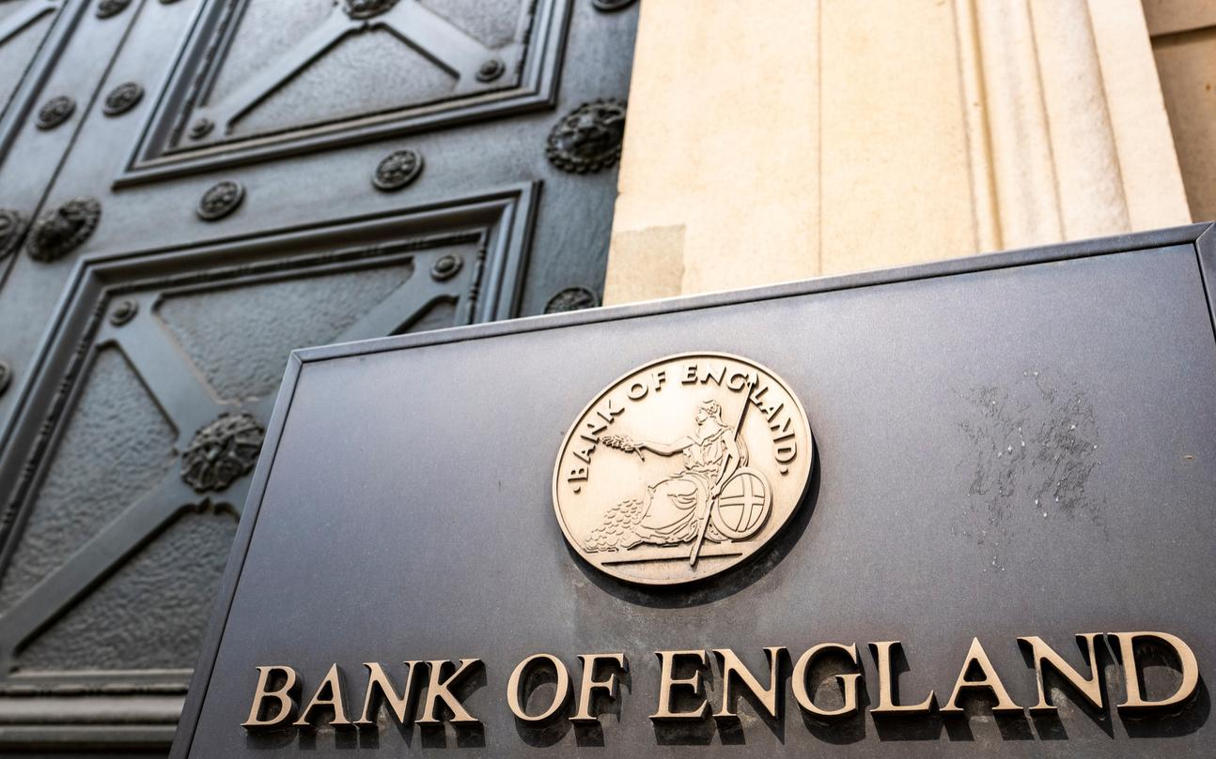
BANKING SYSTEM of ENGLAND
England's economy is one of the largest and most dynamic in the world, The bank system of England consists of two levels: The Bank of England and commercial banks.

Slide 8
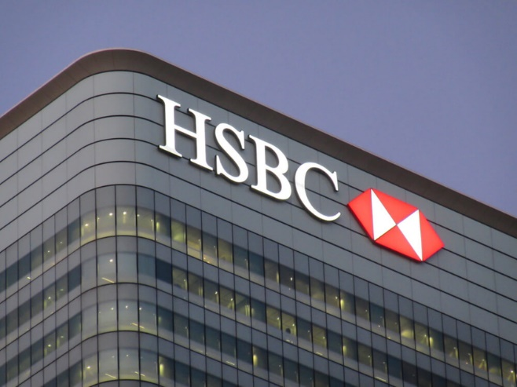
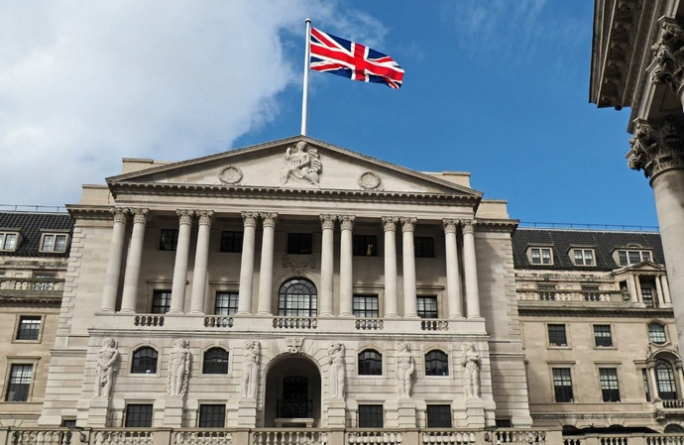
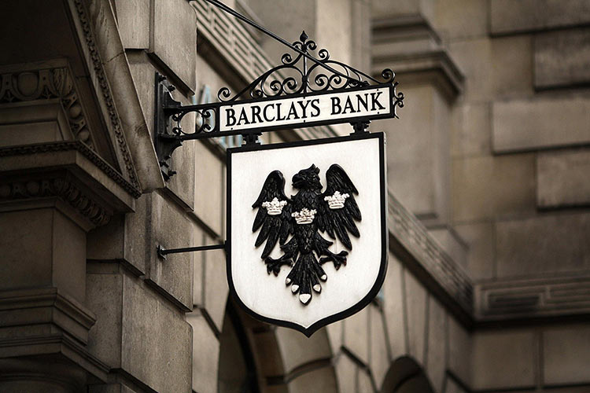
BANKS of England
Savings banks
Merchant banks
Clearing banks
Handling deposits, loans, regulations, and providing tailored services for different regions and industries.
The National Savings Bank serve their founding agencies with state capital, focusing on public payment
Operate in the field of foreign trade and international financial and credit operations

Slide 9
In the Bank
(about a Credit-Card System)
In a large, dimly lighted room with acoustic walls and ceilings to deaden sound, about fifty operators — predominantly women — are sitting at a battery of monitors with a keyboard beneath each. It is here that holders of the blue, green, and gold credit cards are given or refused credit. When a card is presented anywhere in payment for goods or services, the place of business can accept the card without question if the amount is below an agreed limit, usually between twenty-five and fifty dollars. For a larger purchase, authorization is needed, though it takes only seconds to obtain. The approval procedures move at jet speed. From where ever they are, merchants and others dial directly to the credit-card processing center of the bank. Automatically each call is routed to a free operator, whose first words are, “What is your merchant number?” As soon as the answer has been given, the operator types the figures, which appears simultaneously on the monitor. Next she asks the card number and amount of credit being sought. They are also typed and displayed. The operator presses the key, feeding the information to a computer, which instantly signals “accepted” or “declined”. The first means that credit is good and the purchase has been approved, the second that the cardholder is delinquent and credit has been cut off. The operator informs the merchant, the computer records the transaction. On a normal day fifteen thousand calls come in.

Slide 10
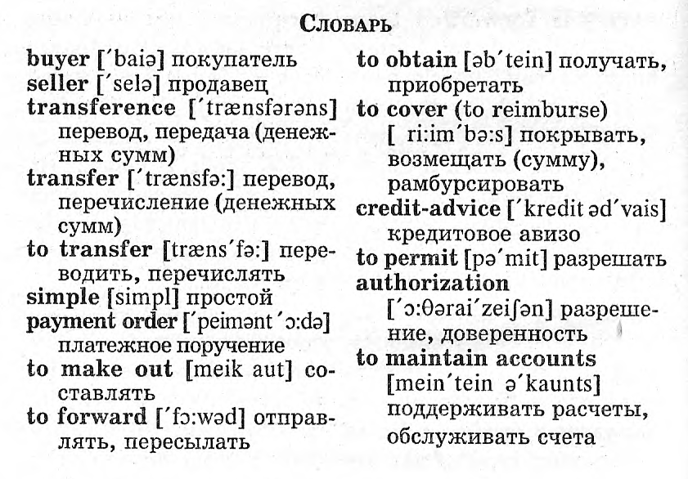

Slide 11
Answer the questions after the text «In the bank»
1. How many operators are sitting in the room of the credit-card processing center?
2. What are they supposed to answer in the situation when the computer is flashing the «stolen card» message?
3. What reward does a storekeeper get for retaining a stolen card?
4. How many purchases can a cardholder make during a single day not to alert the operator?
5. What do criminals do to decide if a stolen card can be used again?

Slide 12
Повторение конструкций страдательного залога Passive Voice.
1.We could not cancel the order because they had already sent it. We could not cancel the order because it …
2. The inflation influenced our business in the Middle East very badly. Our business in the Middle East …
3. They will make their advertisement soon. Their advertisement …
4. We are printing our catalogues by Friday this week. Our catalogues …
5. We make the compressors for those machines here. The compressors for those machines …
6. He has not fixed the date for the next appointment. The date for the next appointment …
7. We received this letter from Continental Equipment a week ago. This letter from Continental Equipment …
8. We can pay you in advance if you want. You …
9. They had to discuss the Contract before his departure. The Contract … 10. If I had lost that much public money, they would have fired me. If I had lost that much public money….

Slide 13
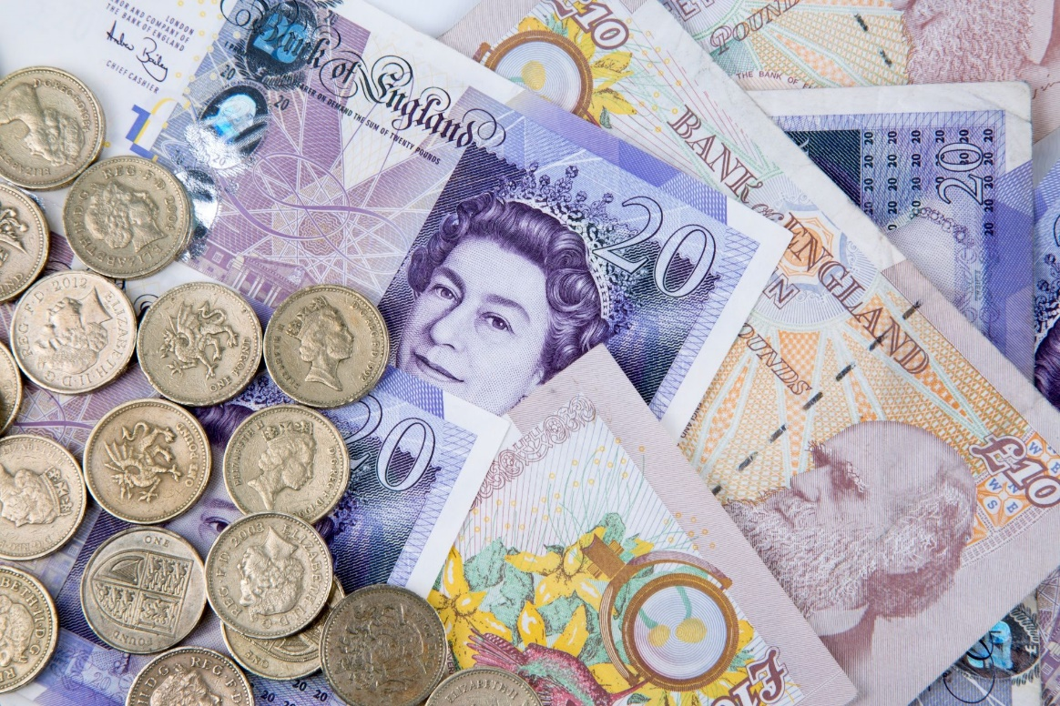
Monetary system of England
England currency is called the pound, and the symbol is £. It is similar to American currency, as they have paper money and money made of metal, or coins. There are 100 pence in a pound, and coins come in denominations of 1 penny

Slide 14
Write out equivalents from the text
Плательщик указывает способ покрытия платежного поручения
Поддержать расчеты друг с другом
Перечисление
Банковский перевод производится через (посредством)
Домашний банк и платящий банк
Третий банк - корреспондент

Slide 15
Translate phrases
Bank transfers; mail transfer; telegraphic transfer; simple transference; a Paying Bank; a third Correspondent Bank’ to maintain ant account; to obtain the funds, the latter forwards a credit-advice to…

Slide 16
Complete the sentences with the answers from the second column
Grocery
Money is changed at..
Films are shown at..
Teeth are filled at..
Hair is cut at..
Fruit and vegetables are sold at..
Photographs are taken at..
Newspapers are sold at..
Cars are repaired at..
Clothes are washed at..
dentist
bank
garage
hairdresser’s
launderette
newsagent’s
cinema
studio
Check

Slide 17
Find synonyms
To reimburse
To send
Remitter
To obtain
To forward
To get
Payer
To keep
Amount
Sum
To give money back
Payee
Compensation
Remittee
To acknowledge
Reimbursement
To admit
Check
To maintain

Slide 18
end.

