Slide 1


Slide 2

Alex Quigley
10205691
BSHCE 4
Networking & Mobile

Slide 3
OVERVIEW
Background
Repositories
Concurrency
Security
File Tokenization

Slide 4
OVERVIEW
Globlock
Why Globlock
Demonstration
How it works

Slide 5
OVERVIEW
Globlock
Reflection
Questions

Slide 6
REPOSITORIES
Repositories
Multiple Documents
Multiple Revisions
Central Location

Slide 7
REPOSITORIES
Github
Command Line
Requires Technical Skill
Difficult to Manage & Track

Slide 8
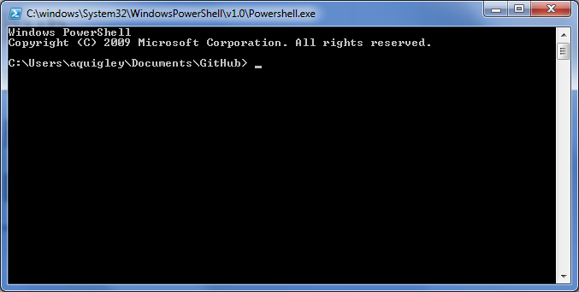
REPOSITORIES

Slide 9
REPOSITORIES
Dropbox
Share requires steps
Who has access
Difficult to Manage & Track

Slide 10
REPOSITORIES
Repositories add..
Needed central location for files and file revisions
Layers of complexity, difficulty, time

Slide 11
CONCURRENCY
Concurrent Access
One file one user
Single, latest revision
File security and control

Slide 12
SECURITY
File security adds…
Improved management and structure
Additional costs, complexity and time

Slide 13
ABSTRACTION
File abstractions
Physical Possession
Physical Handover
Responsibility
‘Pass the baton’

Slide 14
The Solution…
GLOBLOCK

Slide 15
SECURE
System Architecture & Physical Design:
2 Factor Authentication

Slide 16
CONCURRENT
The systems very nature and structure enforce concurrent access

Slide 17
OPEN SOURCE
System Architecture & Physical Design:
2 Factor Authentication

Slide 18
SIMPLE
File repository
Central Location
Full revision storage

Slide 19
SIMPLE
No overheads
Intuitive
No complexity

Slide 20
ABSTRACT
So simple…
You won’t even realize you’re using it

Slide 21
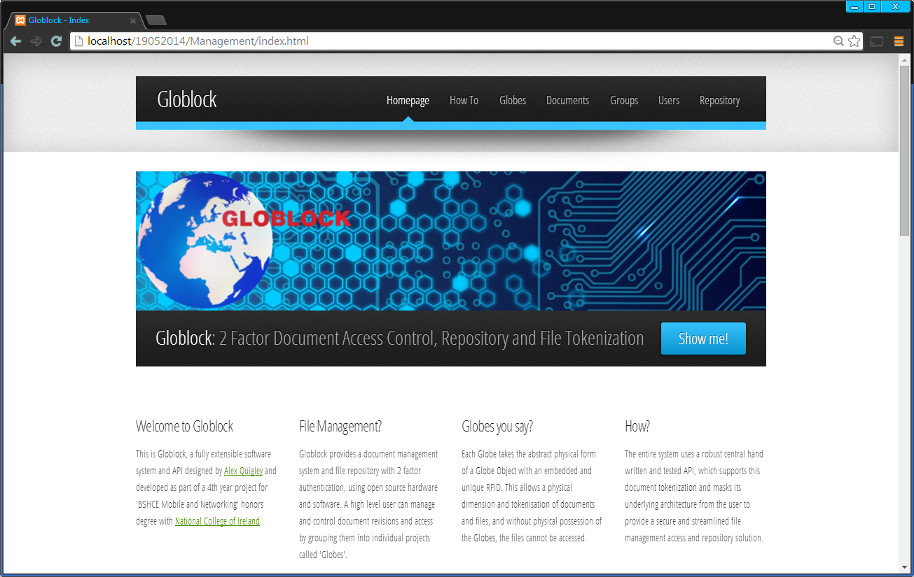
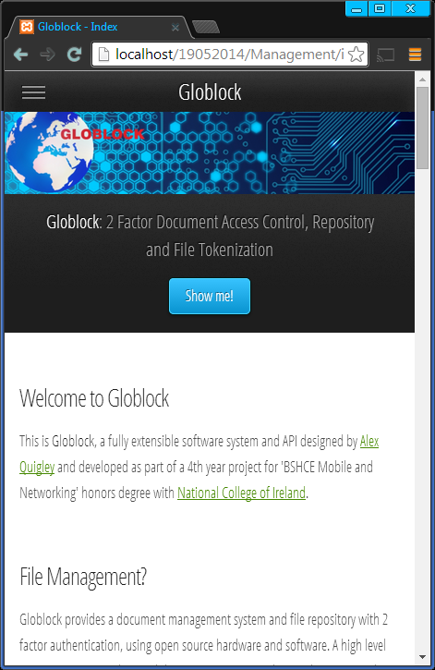
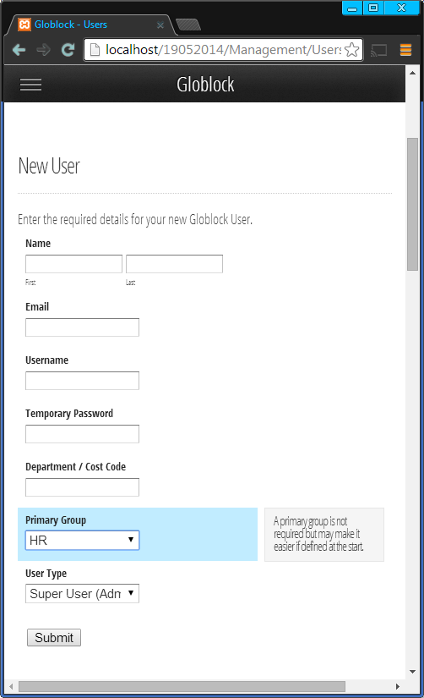
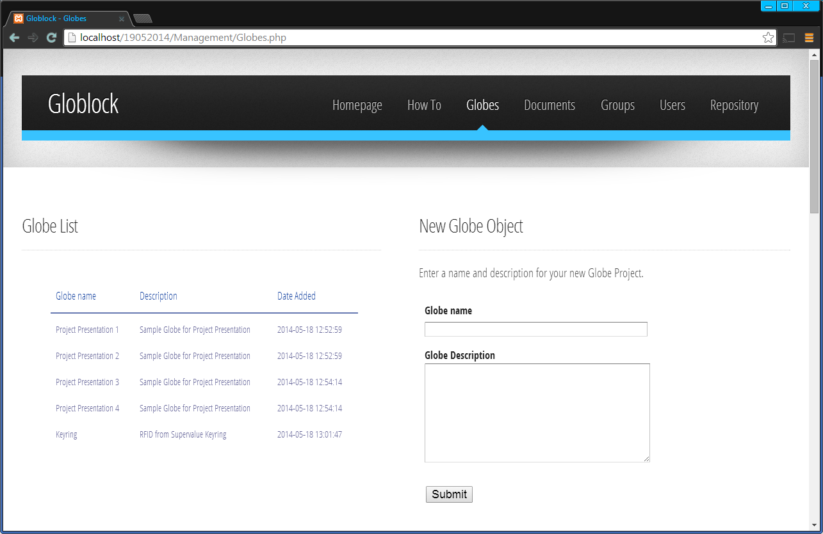
DEMO
Management
Web Application

Slide 22
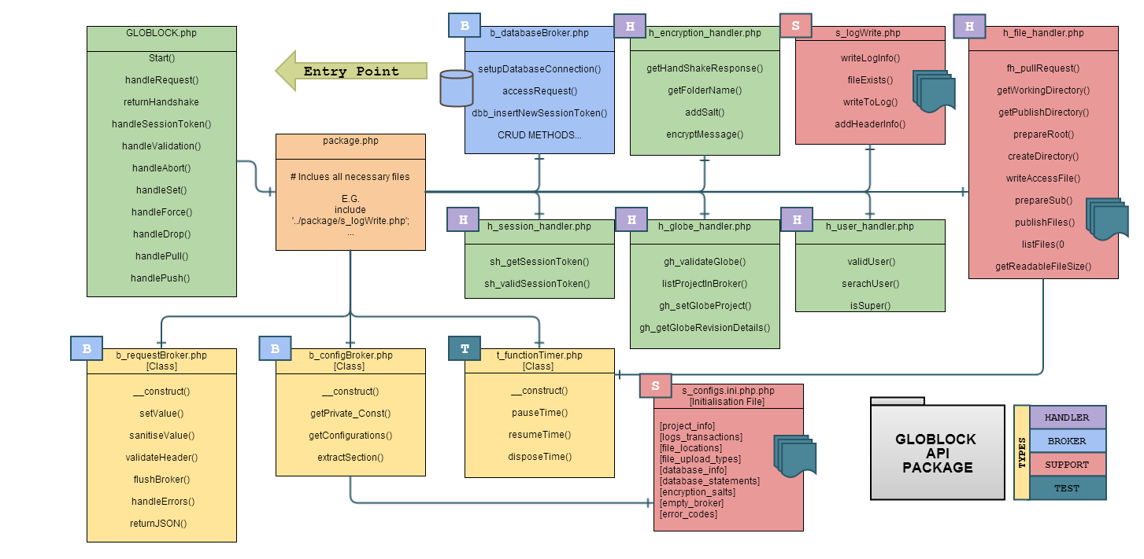
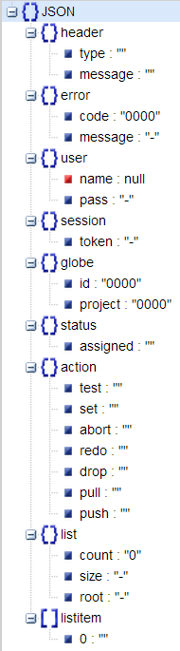
DEMO
Core
API

Slide 23
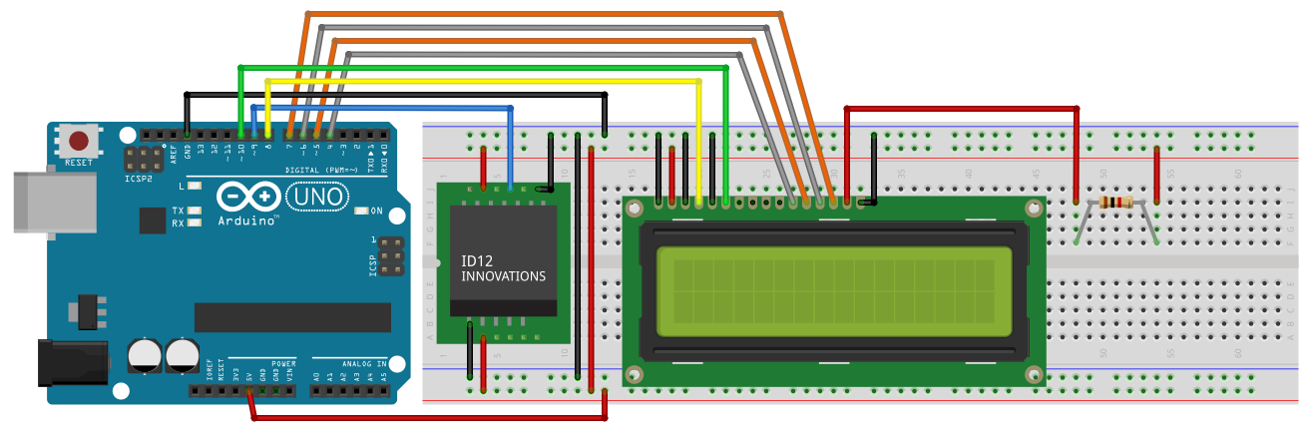
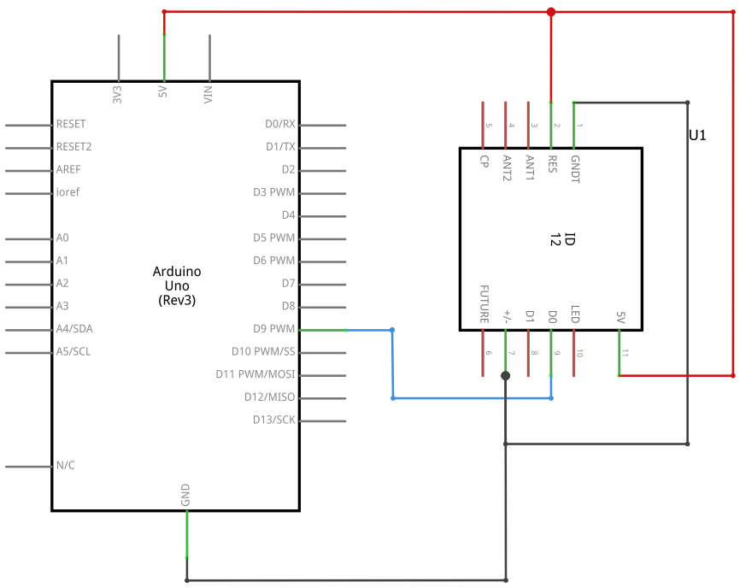
DEMO
Hardware
Interface

Slide 24
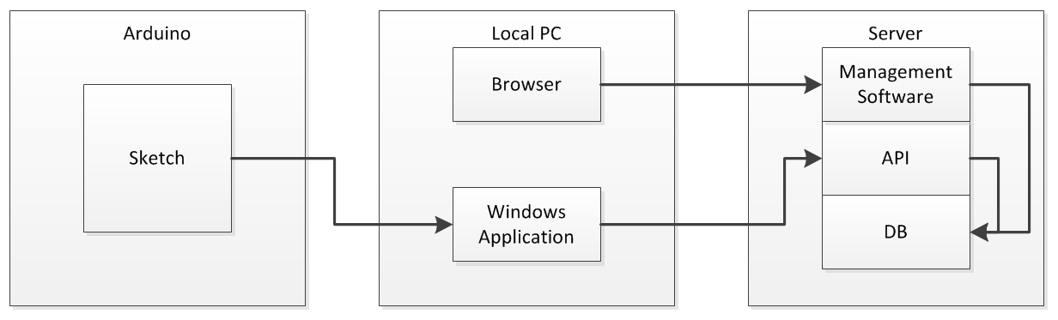
DECODED

Slide 25
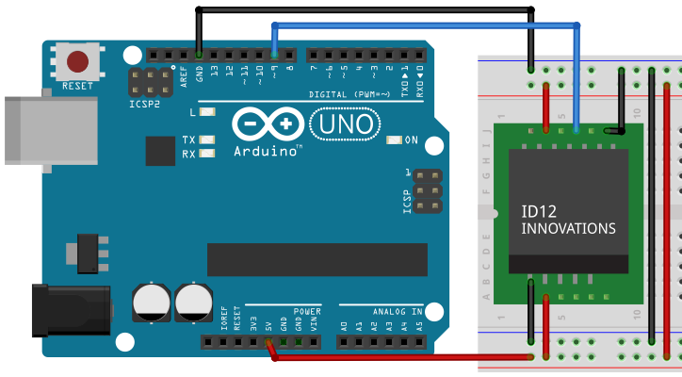

Slide 26
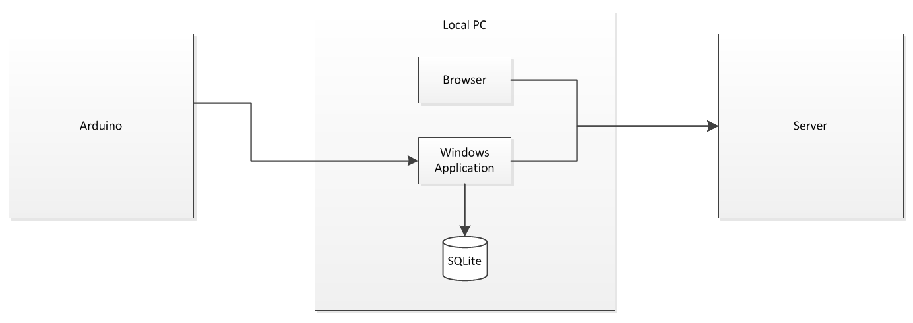
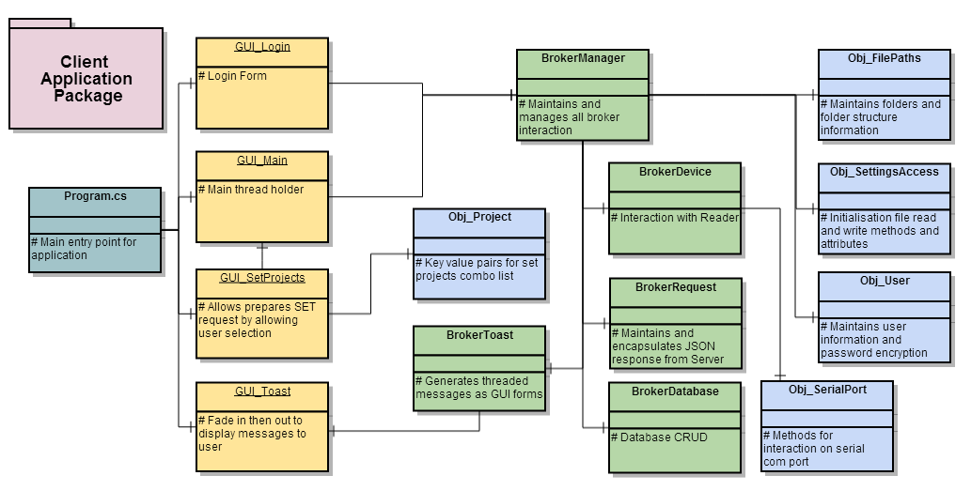
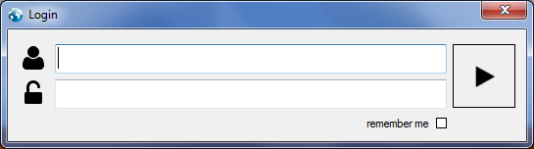
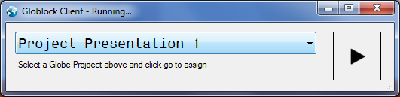

Slide 27
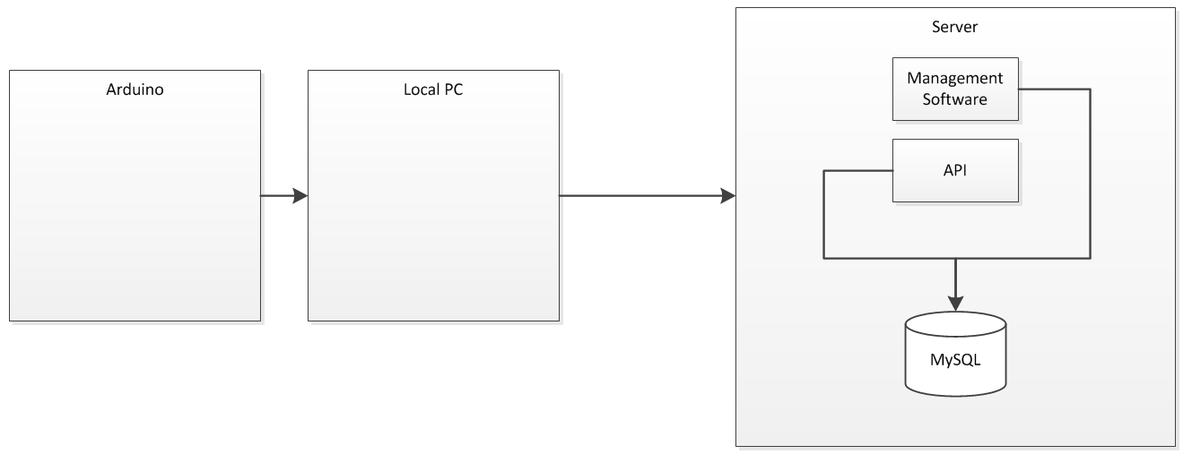
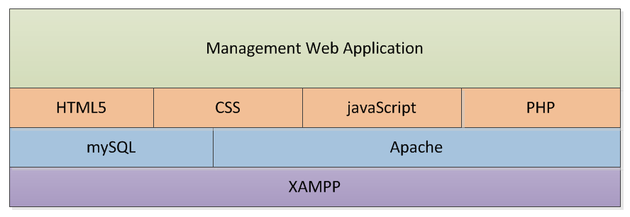
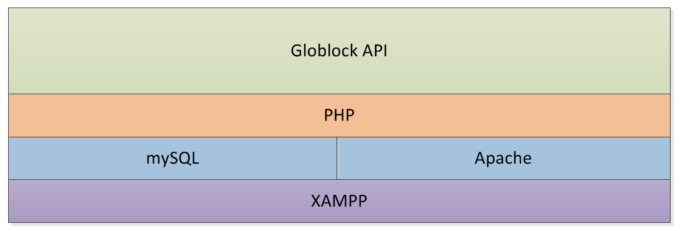

Slide 28
HANDSHAKE
Is SERVER alive
SESSION
Authentication/Activity Lifecycle
VALIDATE
Validation & Available Actions
ABORT
Disposes of Session Token
SET
Associates an Physical Object
DROP
Drops an Association
FORCE
Overwrites Association
PULL
Pulls files down from Server
PUSH
Pushes files up to Server

Slide 29
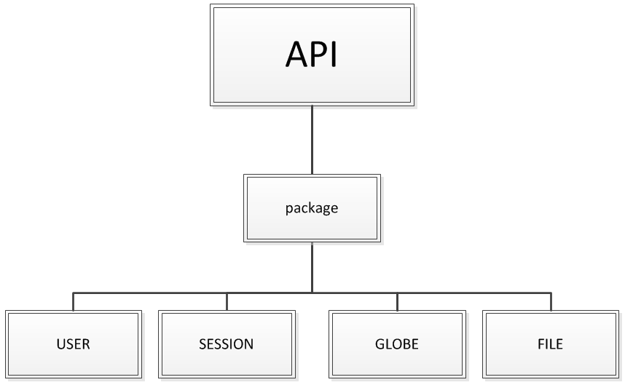
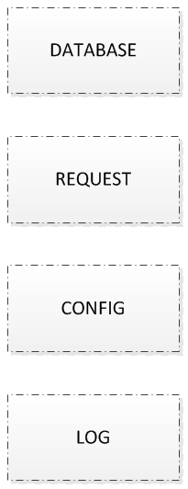
REQUEST
JSON

Slide 30
REFLECTION
Background
Repositories
Concurrency
Security
File Tokenization

