Slide 1
WiMan Intelligent Layout: NEW!
Size and Positions:
Display Mode: Windowed
Previous control box space: 180px wide
Arrows: 70px (140) total width
No more “Side Bar”
No more “Control Box”
Widget 1
380W, 210H
Widget 2
380W, 210H
Widget 3
380W, 210H
1210X, 66Y
Widget space: 1140W, 210H
0X, 66Y
70W
1280

Slide 2
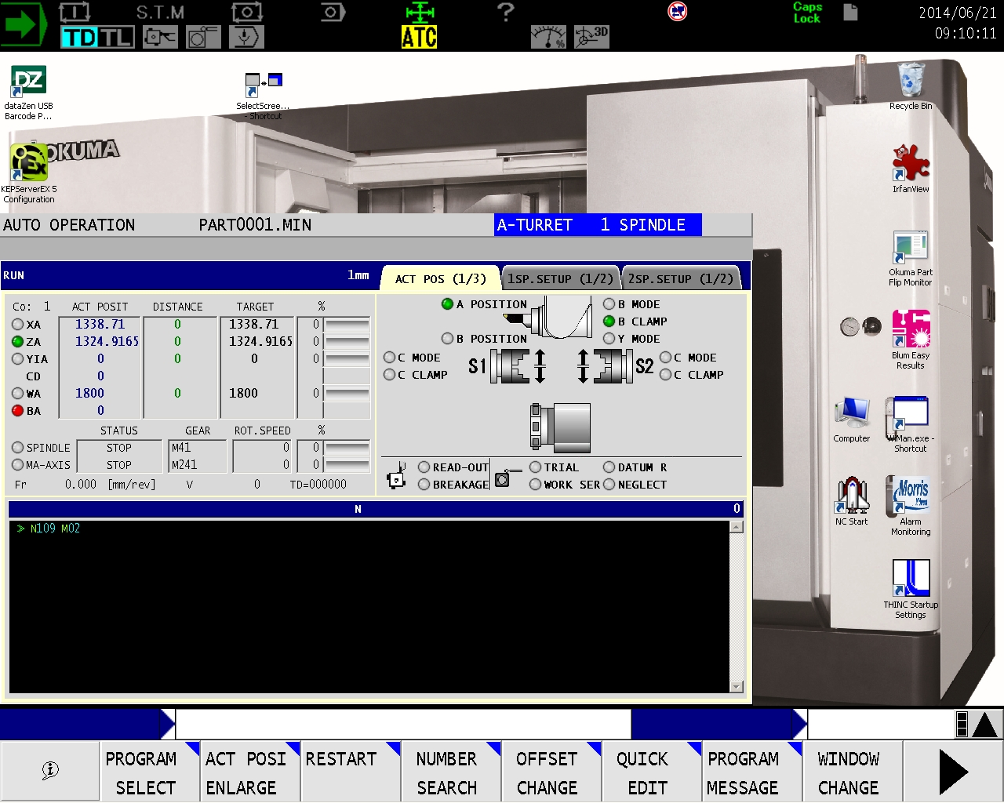
STATUS DISPLAY
Desktop “Top Bar”
Operation ?
Desktop “Side Bar”
Alarms ?
Screen Title Bar
“Main” Screen ?
Input Bar ?
V?
Function Menu

Slide 3
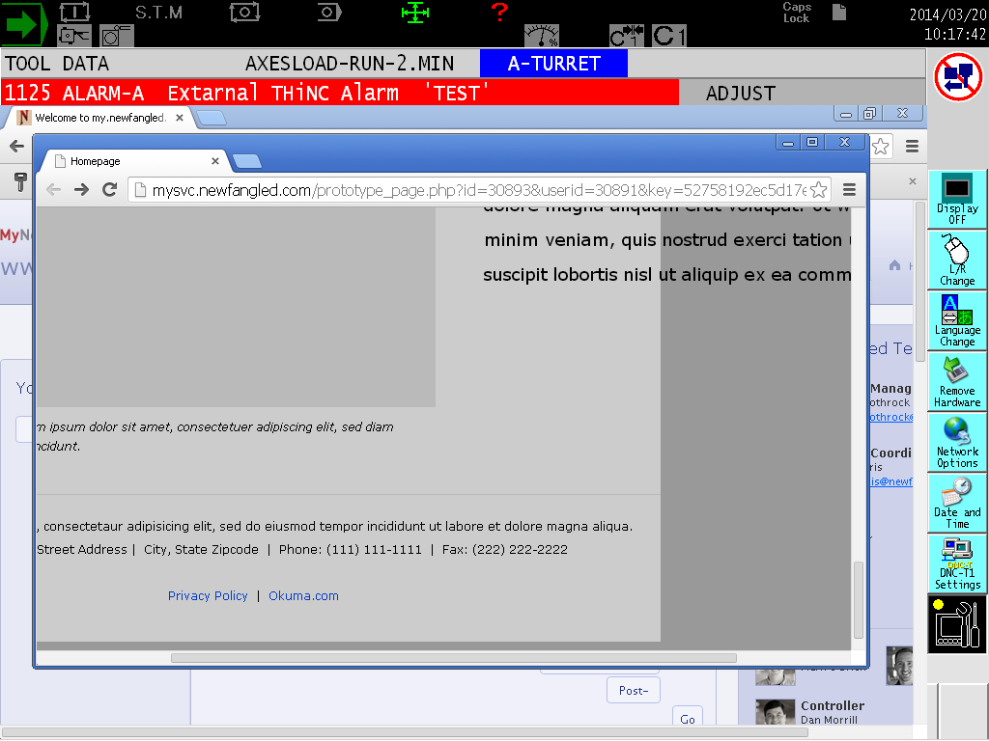
1024px wide
Max Width 960px
845 x 460px
Max height 660px
Scroll bar centered – 860px wide

