Slide 1

OSP Widget Manager Layout
Size and Positions:
WindowStyle="None”
Three standard window sizes are allowed,
referred to as UU size (unit utilization).
The widget display area measures 1140 x 206 pixels.
We then divided this by 3 to give the base unit of 380 x 206.
Thus, up to three 1UU widgets may be displayed in their entirety, simultaneously.
Small (1UU): 380W x 208H
Medium (2UU): 760W x 208H
Large (3UU): 1140W x 208H
For more Information, refer to the OSP Widget Manager User's Manual
Widget 1
380W, 206H
Widget 2
380W, 206H
Widget 3
380W, 206H
1210X, 66Y
Widget space: 1140W, 206H
0X, 66Y
1280
70W

Slide 2
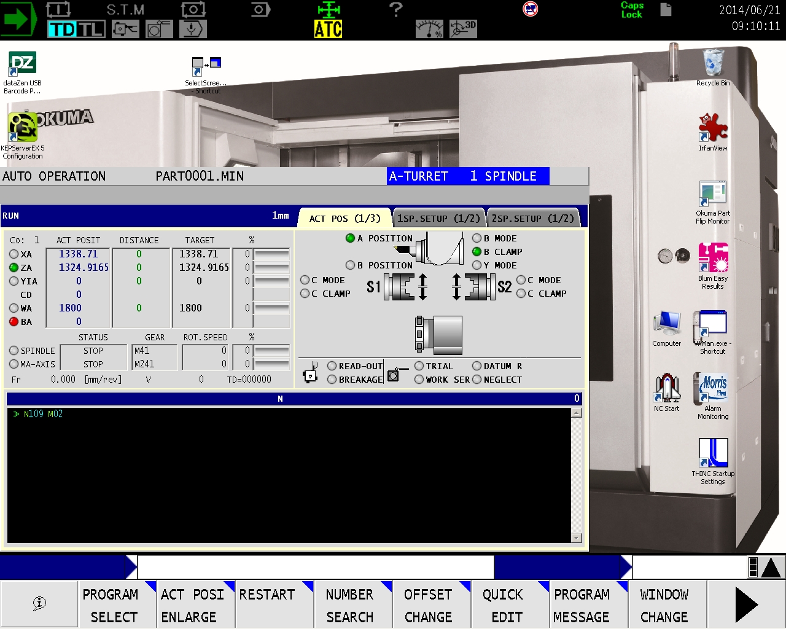
STATUS DISPLAY
Desktop “Top Bar”
Operation ?
Desktop “Side Bar”
Alarms ?
Screen Title Bar
“Main” Screen ?
Input Bar ?
V?
Function Menu
Notes:
This layout is only available on 19” display models.

Slide 3
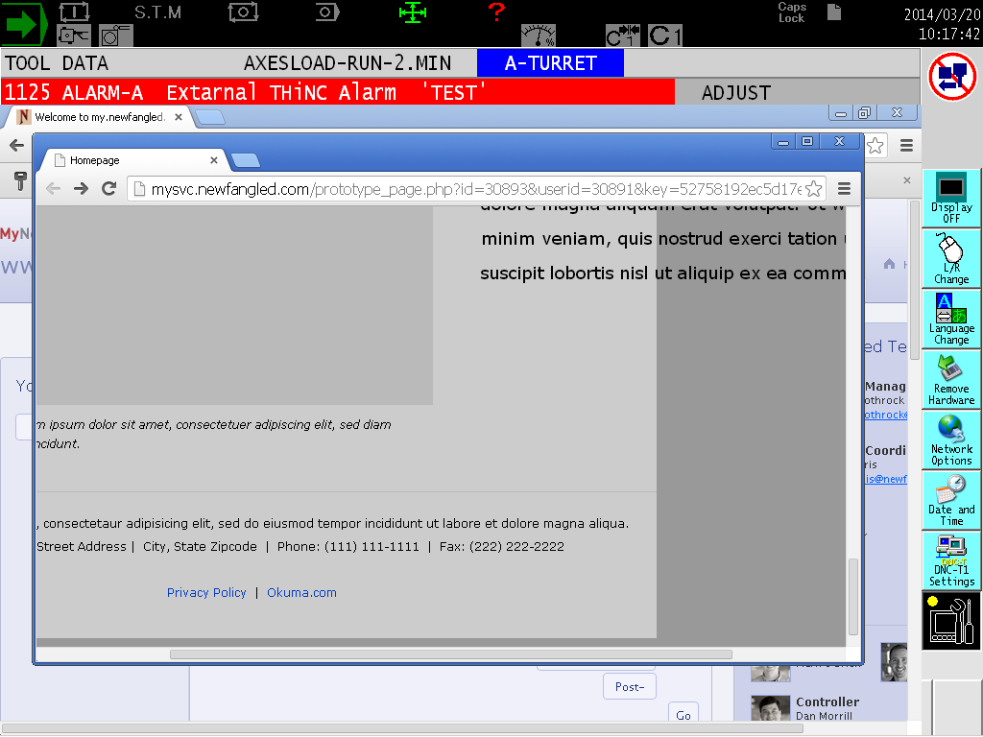
1024px wide
Max Width 960px
845 x 460px
Max height 660px
Scroll bar centered – 860px wide
Notes:
This is on a standard 15” display.

