Slide 1
REAL-TIME ENVIRONMENTAL

Slide 2
INTRODUCTION:
Our project focuses on leveraging IBM COGNOS Analytics for analyzing Real-time Environmental data. With COGNOS' versatile toolbox including List, Text Item, Block, Table, Crosstab, and Visualization features, we delve into data exploration and analysis. By uncovering trends and patterns, we aim to the fundamentals of environmental monitoring based on air quality, water pollution, and climate patterns in India. Join us as we utilize COGNOS to extract actionable insights and drive informed decision-making in Real-time Environmental.

Slide 3
ABSTRACT:
This project focuses on harnessing the power of sensor data from environmental monitoring devices to enable real-time tracking and analysis of critical environmental factors. By leveraging advanced analytics and BI capabilities, the project aims to monitor and manage air quality, water pollution, and climate patterns in a proactive and efficient manner. The project will provide decision-makers with valuable insights and actionable information to make informed environmental management decisions, promote sustainability, and safeguard the well-being of communities and ecosystems.

Slide 4
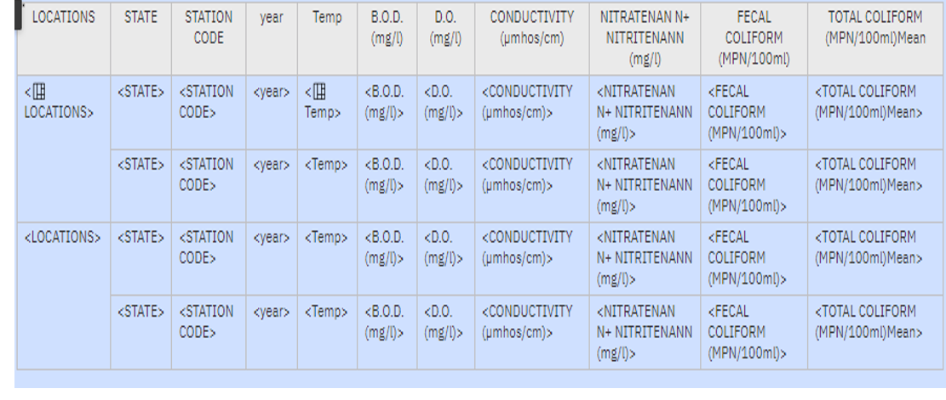
Water pollution

Slide 5
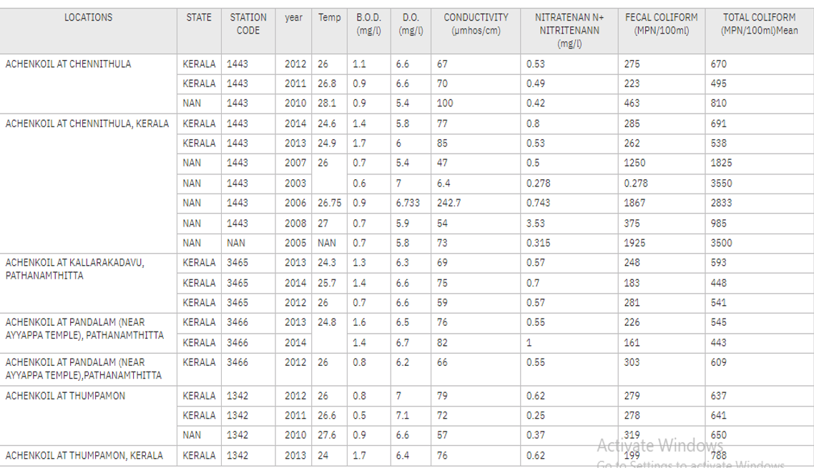
OUTPUT:

Slide 6
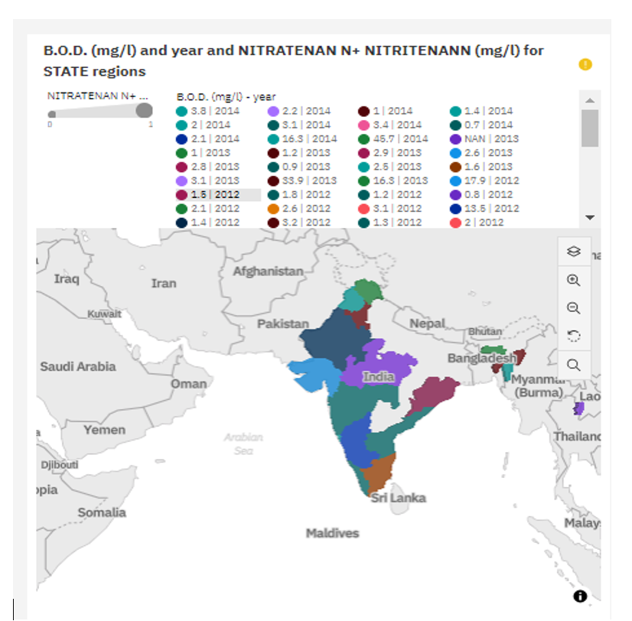

Slide 7
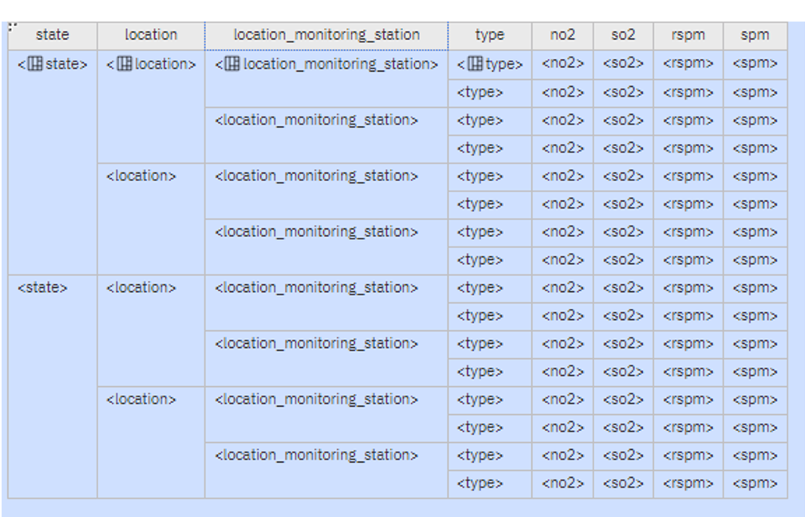
Air quality

Slide 8
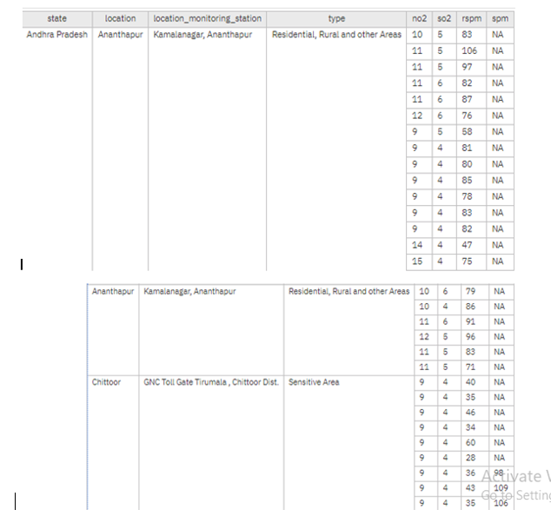
OUTPUT:

Slide 9
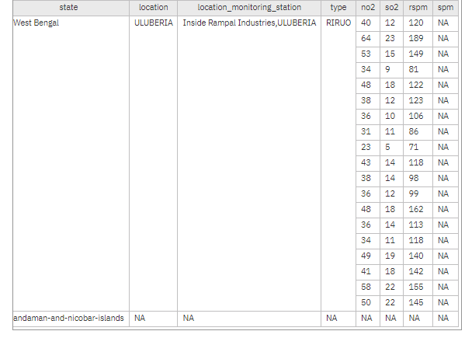

Slide 10
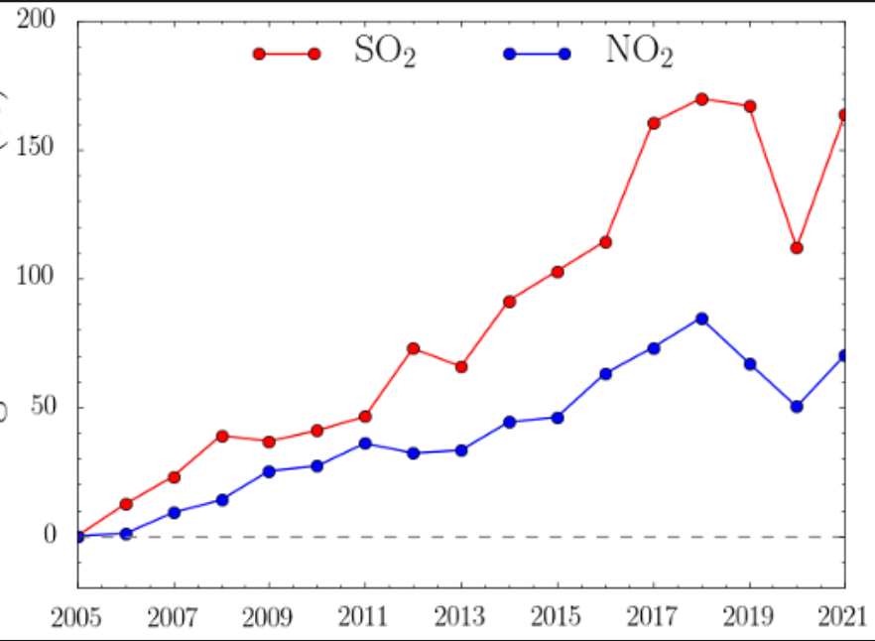

Slide 11

Climate patterns

Slide 12
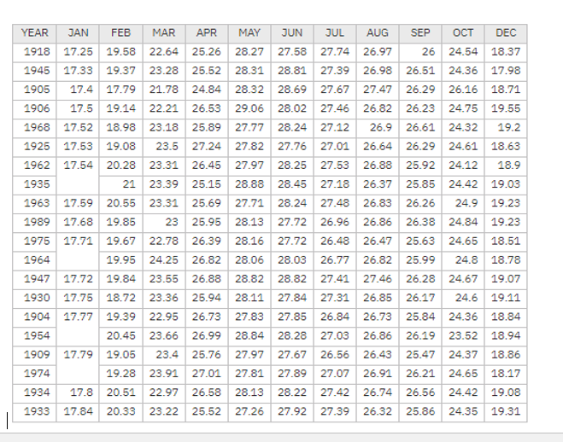
OUTPUT:

Slide 13
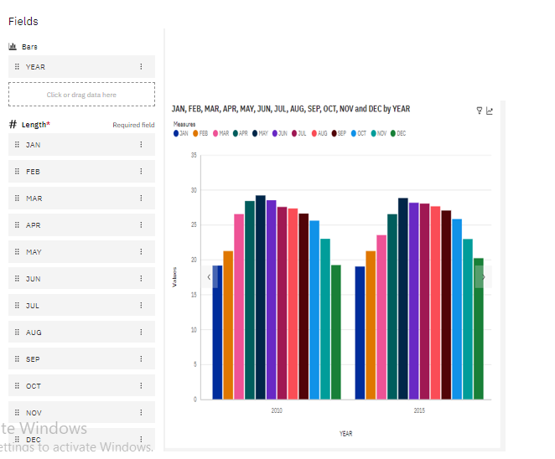

Slide 14
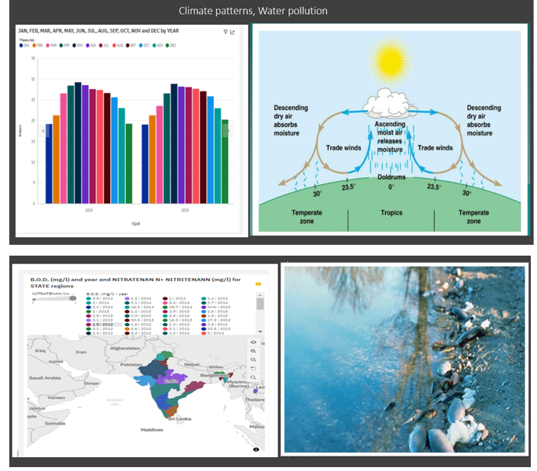
FINAL DASH BOARD OF REAL-TIME ENVIRONMENTAL:

Slide 15
CONCLUTION:
Our project has used IBM COGNOS Analytics to study environmental data better. We've explored different parts of the data using tools like lists, tables, and visualizations. By doing this, we've found trends and patterns that help environmental. This shows how important it is to use data to make smart decisions in the environmental industry.
REFERENCE:
https://us1.ca.analytics.ibm.com/bi/?perspective=home
https://www.kaggle.com/datasets/jessemostipak/environmental-booking-demand

