Slide 1
Onexi Meeting
January 5, 2017

Slide 2
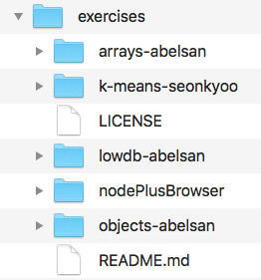
Active Learning Repo Publishing
Pick Up
Exercises
Repo
Check
Required Files
Run Test
Filter:
Remove
Solution
Repackage
in new
Folder
Publish
New Repo
Github

Slide 3
Start On Your Own Machine/Repo
You can work locally
When ready push to to
https://github.com/onexi/exercises

Slide 4
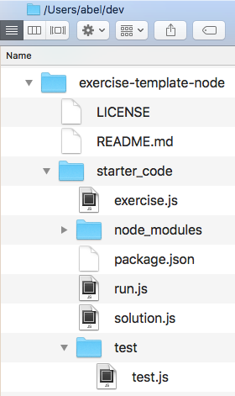
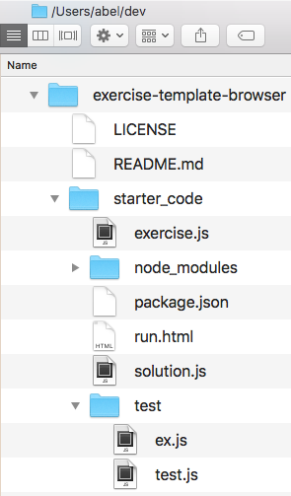
Templates – Active Learning
https://github.com/onexi/exercise-template-node
https://github.com/onexi/exercise-template-browser
Node
Template
Browser
Template

Slide 5
Node Template
Important:
Delete git info
from template.
Remove hidden
.git folder
Everything should be in starter_code folder

Slide 6
Node Template
Required
Files

Slide 7
Node Template
Make sure all exercises are written in exercise.js

Slide 8
Node Template
Make sure all tests are written in test.js

Slide 9
Node Template
Make sure test.js points to solution.js
while pushing to the master repo (the solution references will be sanitized upon building and publishing)

Slide 10
Data in “data.json”
If you need a data file, name it “data.json”

Slide 11
Difference
between
node and browser template

Slide 12

Templates – HW TBD
Anuj
Sam
Kai

Slide 13

Is doing quizzes the same way crazy?
Note: Track IP on Active Learning

Slide 14
Schedule
Excel
Important Dates:
- Friday January 6th (pre-alpha)
- Friday January 13th (DUE DATE)
- Friday January 20th (beta testing)

