Slide 1

Python

Slide 2
Data types
Text type | str
Numeric type | int, float complex
Sequence type | list, tuple, range
Mapping type | dict
Set types | set, frozenset
Boolean types | bool
Binary types | bytes, bytearray, memoryview
None type | NoneType

Slide 3
Data types
getting the data type of any object by using type()
Example:
x=5
print(type(x))
-> Output: <class ´int´>
in Python the data type is set when you assign a value to a variable
x = 5 -> int
x = „Hello World“ -> str
x = {„apple“, „banana“, „orange“} -> set
x = b“Hello“ -> bytes
you can also set a specific data type by using constructor functions
x = str(„Hello World“)
x = float(20.5)
x = list((„apple“, „banana“, „orange“))

Slide 4
Strings
„hello“ or ´hello´
display with print()
Multiline strings
assigned using tree quotes “““ … … “““ or three single quotes ‘‘‘ … … ‘‘‘
Note: in the result, line breaks are inserted at the same position as in the code
Strings are Arrays
square brackets can be used to access elements of a string
Example:
a = „Hello, World!“
print(a[1])
-> Output: e
String length -> use the len() function
print(len(a))
-> Output: 13

Slide 5
Strings
Slicing
used to return a range of characters
get characters from position 2 to 5 (not included) -> print(b[2 : 5])
slice from the start to position 5 (not included) -> print(b[ : 5])
slice to the end from position 2 -> print(b[2 : ])
negative indexes to start the slice from the end -> print(b[-5 : -2])
-> Output: orl
-> from „o“ in „World!“ (position -5) to, but not included, „d“ (position -2)
Modification
upper(), lower(), strip() – remove whitespace before and/ or after text, replace() – replace a string with another string, split() – split into substrings

Slide 6
Operators
+ | Addition
- | Subtraction
* | Multiplication
/ | Division
% | Modulo
** | Exponentiation
// | Floor division

Slide 7
Logical and bitwise Operators
and | returns true if both statements are true | x < 5 and x < 10
or | returns true if one of the statements is true | x < 5 or x < 4
not | Reverse the result, returns False if the result is true | not(x < 5 and x < 10)
& | AND | Sets each bit to 1 if both bits are 1
| | OR | Sets each bit to 1 if one of two bits is 1
^ | XOR | Sets each bit to 1 if only one of two bits is 1
~ | NOT | Inverts all the bits
<< | Zero fill left shift | Shift left by pushing zeros in from the right and let the leftmost bits of all
>> | Signed right shift | Shift right by pushing copies of the leftmost bin in from the left and let the rightmost bits fall off

Slide 8
Lists
Lists are used to store multiple items in a single variable
Lists are ordered and changable, which means that we can add, remove and change items in a list after it has been created
Lists can contain different data types
From Python‘s perspective, lists are defined as objects with the data type ‘list‘
4 collection data types in Python‘s programming language
List – is a collection which is ordered and changeable. Allows duplicate members.
Tuple – is a collection which is ordered and unchangeable. Allows duplicate members.
Set – is a collection which is unordered, unchangable and unindexed. No duplicate members.
Dictionary – is a collection which is ordered and changable. No duplicate members.

Slide 9
Lists
Add
append() -> adds elements to the end of a list
insert() -> adds elements to a specified index
extend() -> adds another list to the current list – adds elements at the end of the list
Remove
remove() -> removes a specified item
pop() -> removes a specified index – if not specified it removes the last index
del() -> deletes a list completely
clear() -> empties a list – list still remains, but without content
Sort
sort() -> sorts a list alphanumerically, ascending, by default
sort descending -> keyword argument reverse = True
reverse() -> reverses the current order of a list

Slide 10
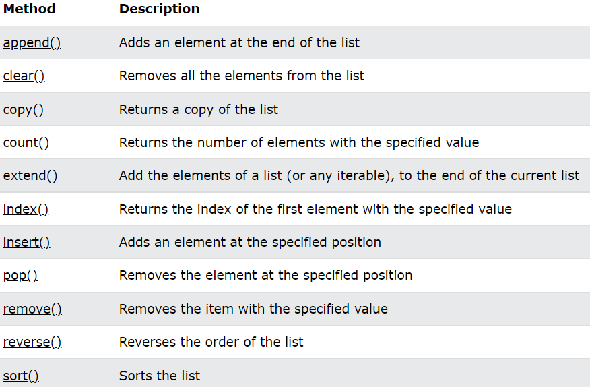
Lists

Slide 11
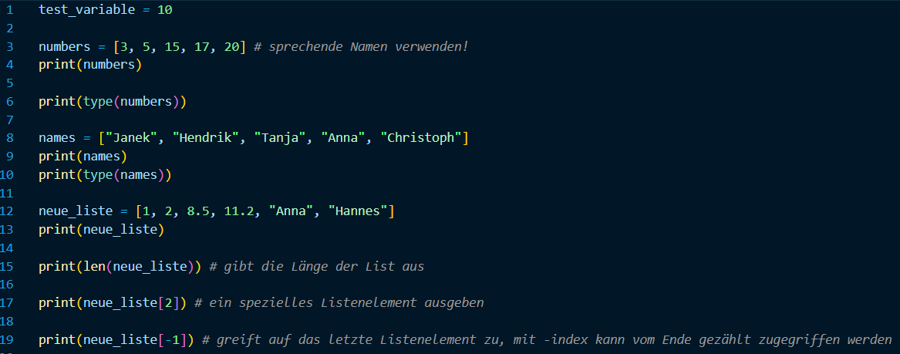
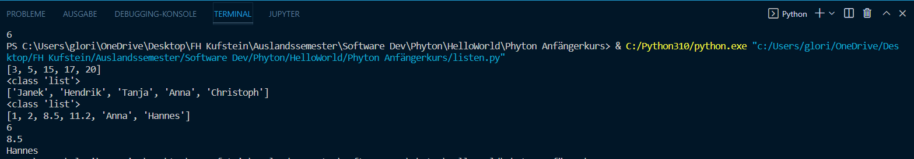
Lists

Slide 12
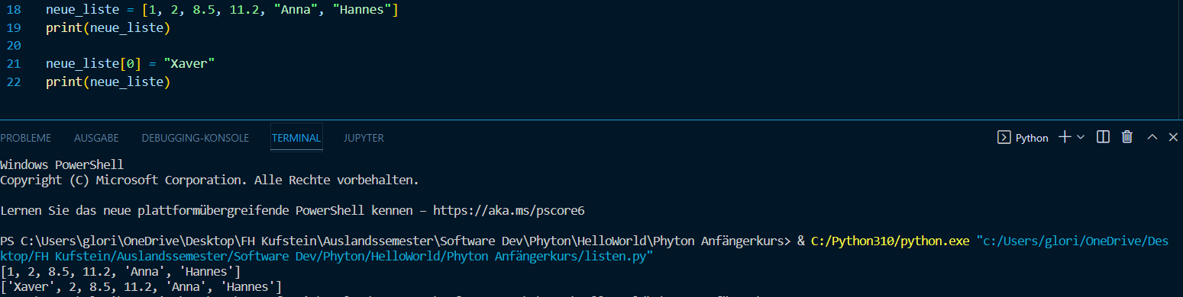
Lists
Overwrite elements:

Slide 13
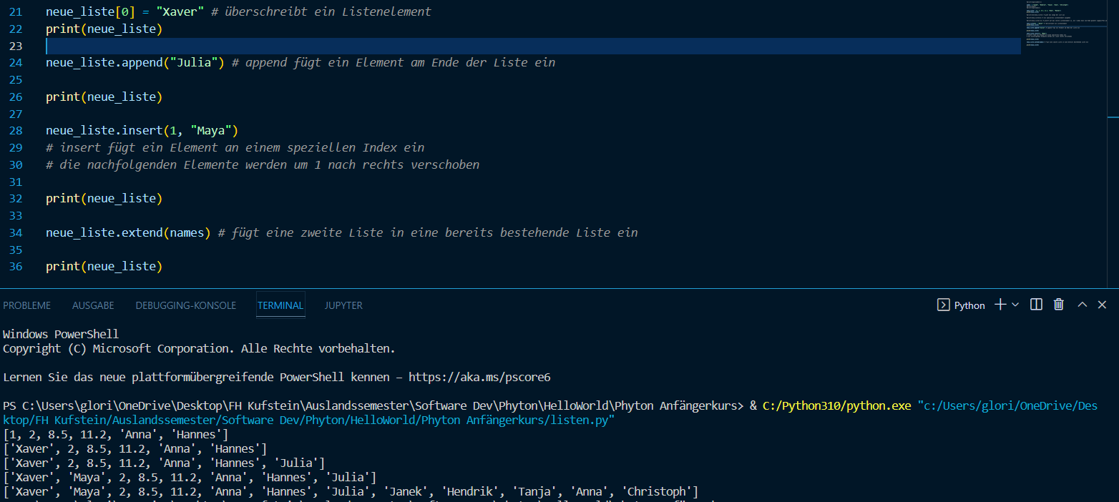
Lists
different ways to add elements to a list

Slide 14
Tuples
tuples are used to store multiple items in a single variable
a tuple is a collection, which is ordered and unchangeable
tuple items are ordered, unchangeable, indexed and allow duplicate values
Methods:
count() -> returns the number of times a specified value occurs in a tuple
index() -> searches the tuple for a specified value and returns the position where it was found

Slide 15
If … Else … Elif
Indentation
whitespace at the beginning of the line – otherwise you will get an error
(other languages often use curly-brackets { } instead)
Elif
„if the previous condition was false, then try this one“
can be used between if and else if you want to check more conditions
in Java → else if
Else
catches anything which isn‘t caught by the previous conditions

Slide 16
If … Else … Elif
Short Hand If
If you have only one statement to execute, you can put it on the same line as the if statement
Example: if a > b: print(“a is greater than b”)
Short Hand If … Else
If you have only one statement to execute, one for if, and one for else, you can put it all on the same line
Example: print(“A”) if a > b else print(“B”)
You can also have multiple else statements in one line:
print(“A) if a > b else print(“=“) if a == b else print(“B)

Slide 17
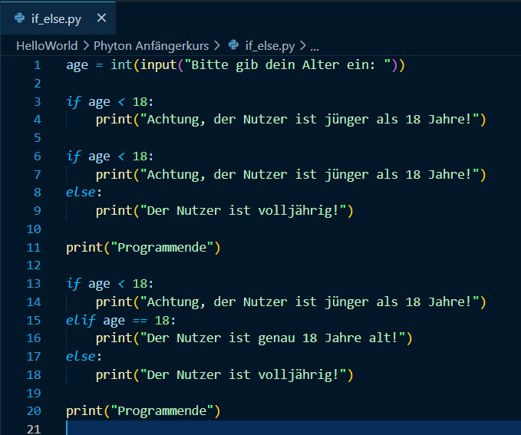
If … Else … Elif

Slide 18
While Loop
Loop head
Loop body - indented below the head
Difference to if-statement: the condition in the loop head decides not only whether the loop body is executed, but also for how long in succession
in the first step it is checked whether the condition is true - if so, the loop body is executed. Next, the loop head is checked again if it is true. The loop continues until the condition is false.
Endless loop = a loop that can never return false
to prevent this, i must be incremented
Any number of instructions can be in the loop body.

Slide 19
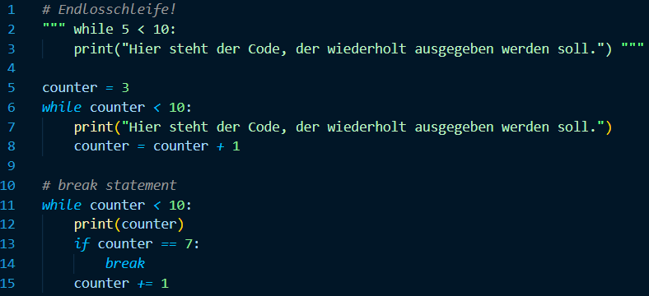
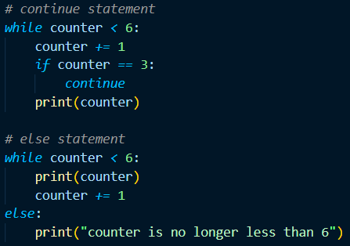
While Loop
break = can stop the loop even if the while condition is true
continue = can stop the current iteration and continue with the next
else = can run a block of code once when the condition no longer is true

Slide 20
For Loop
Loop head
Loop body - indented below the head
Purpose:
iterate through iterable objects (e.g. lists)
counter loop
break = can stop the loop before it has looped through all the items
continue = can stop the current iteration of the loop, and continue with the next
range = to loop through a set of code a specified number of times, starts with 0 as default value, possible to specify the starting value
else keyword in a for loop: specifies a block of code to be executed when the loop is finished

Slide 21
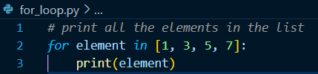
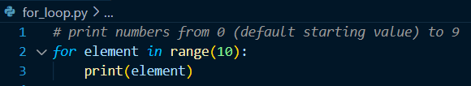
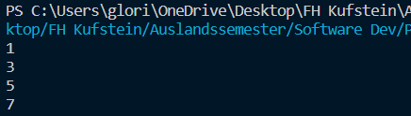
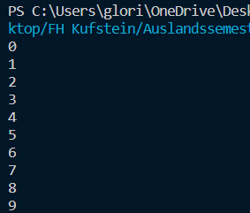
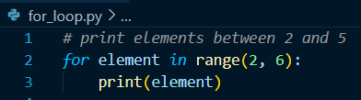
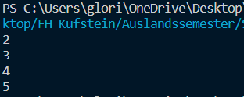
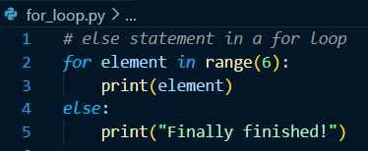
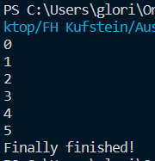
For Loop

Slide 22
Functions
Functions enable better structuring in the program
Individual functionalities of the program are outsourced to different functions
Function = sub-program
Arguments:
… are specified after the function name, inside the parentheses (brackets).
it is possible to add as many arguments as you want, just separate them with a comma.
Arguments vs. Parameters
A parameter is the variable listed inside the parentheses in the function definition.
An argument is the value that is sent to the function when it is called.
def = definition = starts a function
Python Functions (w3schools.com)

Slide 23
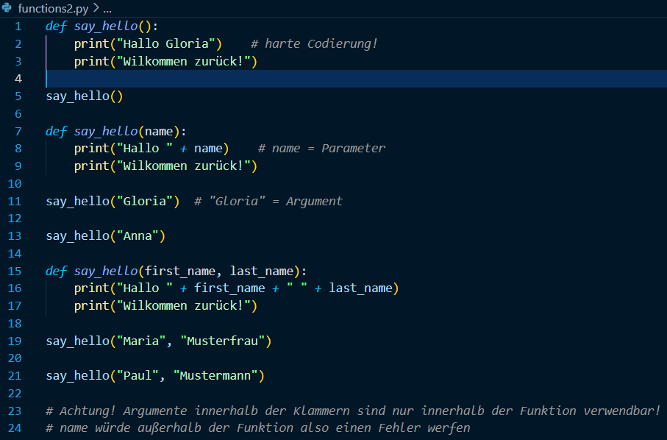
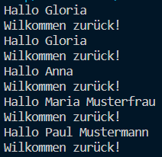
Function

Slide 24
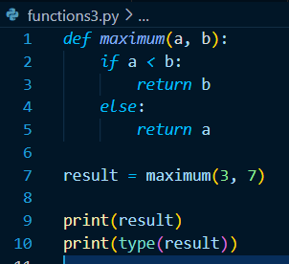

Function

