Slide 1

Python

Slide 2
Data types
Text type | str
Numeric type | int, float complex
Sequence type | list, tuple, range
Mapping type | dict
Set types | set, frozenset
Boolean types | bool
Binary types | bytes, bytearray, memoryview
None type | NoneType

Slide 3
Data types
getting the data type of any object by using type()
Example:
x=5
print(type(x))
-> Output: <class ´int´>
in Python the data type is set when you assign a value to a variable
x = 5 -> int
x = „Hello World“ -> str
x = {„apple“, „banana“, „orange“} -> set
x = b“Hello“ -> bytes
you can also set a specific data type by using constructor functions
x = str(„Hello World“)
x = float(20.5)
x = list((„apple“, „banana“, „orange“))

Slide 4
Strings
„hello“ or ´hello´
display with print()
Multiline strings
assigned using tree quotes “““ … … “““ or three single quotes ‘‘‘ … … ‘‘‘
Note: in the result, line breaks are inserted at the same position as in the code
Strings are Arrays
square brackets can be used to access elements of a string
Example:
a = „Hello, World!“
print(a[1])
-> Output: e
String length -> use the len() function
print(len(a))
-> Output: 13

Slide 5
Strings
Slicing
used to return a range of characters
get characters from position 2 to 5 (not included) -> print(b[2 : 5])
slice from the start to position 5 (not included) -> print(b[ : 5])
slice to the end from position 2 -> print(b[2 : ])
negative indexes to start the slice from the end -> print(b[-5 : -2])
-> Output: orl
-> from „o“ in „World!“ (position -5) to, but not included, „d“ (position -2)
Modification
upper(), lower(), strip() – remove whitespace before and/ or after text, replace() – replace a string with another string, split() – split into substrings

Slide 6
Operators
+ | Addition
- | Subtraction
* | Multiplication
/ | Division
% | Modulo
** | Exponentiation
// | Floor division

Slide 7
Logical and bitwise Operators
and | returns true if both statements are true | x < 5 and x < 10
or | returns true if one of the statements is true | x < 5 or x < 4
not | Reverse the result, returns False if the result is true | not(x < 5 and x < 10)
& | AND | Sets each bit to 1 if both bits are 1
| | OR | Sets each bit to 1 if one of two bits is 1
^ | XOR | Sets each bit to 1 if only one of two bits is 1
~ | NOT | Inverts all the bits
<< | Zero fill left shift | Shift left by pushing zeros in from the right and let the leftmost bits of all
>> | Signed right shift | Shift right by pushing copies of the leftmost bin in from the left and let the rightmost bits fall off

Slide 8
Lists
Lists are used to store multiple items in a single variable
Lists are ordered and changable, which means that we can add, remove and change items in a list after it has been created
Lists can contain different data types
From Python‘s perspective, lists are defined as objects with the data type ‘list‘
4 collection data types in Python‘s programming language
List – is a collection which is ordered and changeable. Allows duplicate members.
Tuple – is a collection which is ordered and unchangeable. Allows duplicate members.
Set – is a collection which is unordered, unchangable and unindexed. No duplicate members.
Dictionary – is a collection which is ordered and changable. No duplicate members.

Slide 9
Lists
Add
append() -> adds elements to the end of a list
insert() -> adds elements to a specified index
extend() -> adds another list to the current list – adds elements at the end of the list
Remove
remove() -> removes a specified item
pop() -> removes a specified index – if not specified it removes the last index
del() -> deletes a list completely
clear() -> empties a list – list still remains, but without content
Sort
sort() -> sorts a list alphanumerically, ascending, by default
sort descending -> keyword argument reverse = True
reverse() -> reverses the current order of a list

Slide 10
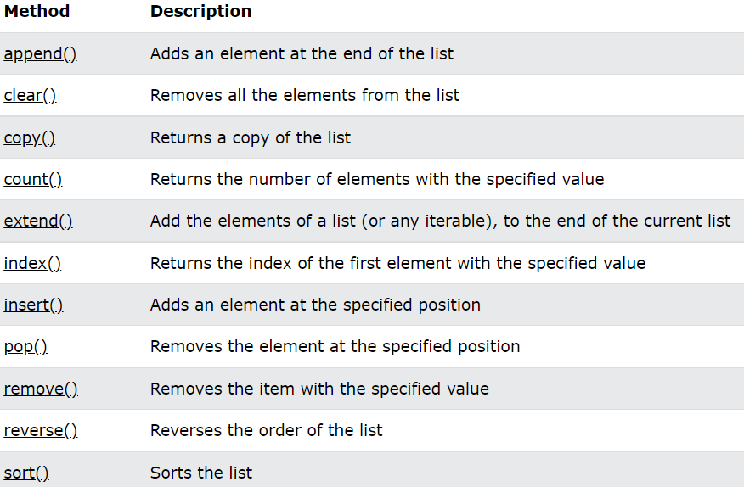
Lists

Slide 11
Tuples
tuples are used to store multiple items in a single variable
a tuple is a collection, which is ordered and unchangeable
tuple items are ordered, unchangeable, indexed and allow duplicate values
Methods:
count() -> returns the number of times a specified value occurs in a tuple
index() -> searches the tuple for a specified value and returns the position where it was found

Slide 12
If … Else
indentation

