Slide 1
ParQ: a memory-efficient approach for query-level parallelism
M.S. Defense
Qianqian Gao
Directed by Prof. Lixin Gao

Slide 2
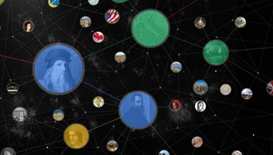
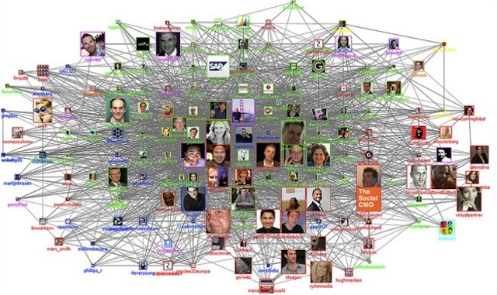
Growing volumes of data and users
Goal: already algorithms is developed in progress. They now can answer a single queries good.
But its hard for them to improve to answer multiple jobs. Because they are…
Our approach can help to develop them to process multiple query.
Google Knowledge Graph
1.6 billion entities
Facebook
1.18 billion active users
Notes:
The future of big data...
Nowadays, the volumes...
Some knowledge base,

Slide 3
Growing volumes of data user
Goal: already algorithms is developed in progress. They now can answer a single queries good.
But its hard for them to improve to answer multiple jobs. Because they are…
Our approach can help to develop them to process multiple query.
When is the date of Da Vinci’s birthday?
A mutual friend?
How to find interesting information?
Algorithms/query systems
Notes:
--It has become a challenge that how to find wanted information from it.
--Therefore, more and more algorithms focus on finding interesting..
--Query systems are developed to adopt a specific algorithm and aim to answer queries on a target dataset
--Such app.

Slide 4
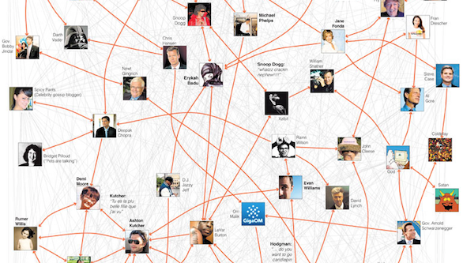
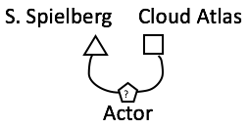
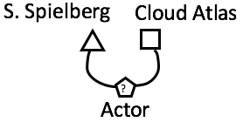
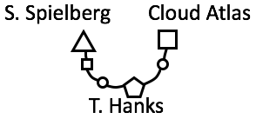
Query system example
Freebase
A query system [1] is able to find the best several answers for a query from a graph.
COMPUTA-
-TINS
Notes:
--Online collection…global resource…
--A query on Freebase is a request…
--In order to answers...in a recent paper, a query system is designed and…It is able
--Such query system is very useful in practical app. but…The job execution logs from a large Chinese social network shows...

Slide 5
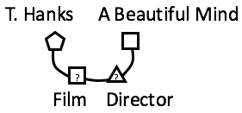
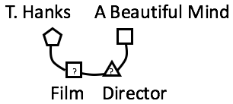
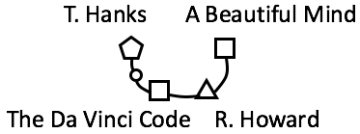
COMPUTA-
-TIONS
COMPUTA-
-TIONS
Memory usage doubles. Running time increases.
Notes:
--Inherently designed for…tightly combines…
--Therefore, this query system don't allow in-memory... and must keep two..
--As a result
--So although this query system is good at a single query. Answering multiple queries is still a problem to be solved.

Slide 6
So when executing multiple concurrent jobs…
Can’t be shared among jobs.
… makes it is hard to develop to answer multiple concurrent graph.
JOB 1
STATIC DATA
COMPUTA-
-TIONS
running time*n
QUERY 1
STATIC DATA
DYNAMIC DATA
ANSWER 1
QUERY 2
…
JOB 1
QUERY 1
STATIC DATA
DYNAMIC DATA
ANSWER 1
memory usage*n
limited jobs
longer running time
JOB 2
QUERY 2
STATIC DATA
DYNAMIC DATA
ANSWER 2
…
Notes:
--We define a job as a process...Since all computations are performed on the...
--In order to read...
--That is, each individual job has to maintain an exclusive copy of the static data even if...
--Therefore, although...when...
(Figure 2) Starts n jobs and keeps n copies...

Slide 7


Problem
Many researches focus on developing query systems to answer queries on datasets
Single job
Multiple jobs
Challenges, solution
Related work.
Related solutions
Store sharable data in disk
Focus on a specific system
Notes:
In a word, QS are developed to ...there are a lot of researches aims to improving single job processing
some existing query systems are already good at processing a single job,
answering multiple queries is still a problem to be solved.
There are also some…

Slide 8
Solution: ParQ
Help to develop query systems to process concurrent queries efficiently by sharing in-memory static data
Challenges:
An API
Generality
Ability to work in a distributed environment
Notes:
Realizing this problem, this thesis aims to find an approach to help such existing query systems to process concurrent queries efficiently

Slide 9
Design
JOB 1
STATIC DATA
QUERY 1
STATIC DATA
DYNAMIC DATA
ANSWER 1
JOB 2
QUERY 2
STATIC DATA
ANSWER 2
STATIC DATA
DYNAMIC DATA
…
QP 1
QP 1
DYNAMIC DATA
ANSWER 1
DL
QUERY 1
DL
QUERY 2
STATIC DATA
QP 2
QP 2
Data Loader
DYNAMIC DATA
ANSWER 2
…
Query Processor
Notes:
According to these requirement...
In the original system, one job needs to...
Since almost all jobs …main idea...
The design of ParQ splits…
ParQ will always starts only...

Slide 10
Design
JOB 1
STATIC DATA
QUERY 1
STATIC DATA
DYNAMIC DATA
ANSWER 1
JOB 2
QUERY 2
STATIC DATA
ANSWER 2
STATIC DATA
DYNAMIC DATA
QP 1
DYNAMIC DATA
ANSWER 1
QUERY 1
DL
STATIC DATA
QUERY 2
STATIC DATA
QP 2
DYNAMIC DATA
ANSWER 2
Notes:
Consider this figure…

Slide 11
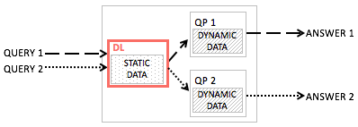
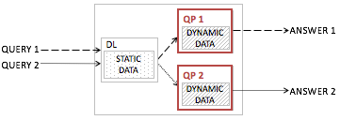
An API
DataLoader
DataLoader(string workerID)
void loadData(sring path)
QueryProcessor
QueryProcessor(string workerID)
//methods to fetch data int getInt(string index, string label) int getFromVectorInt(string index, string label, string vectorIndex)
Notes:
ParQ has three ability.
ParQ provides an API, so that by using the API, users can directly adopt ParQ to existing query systems.

Slide 12

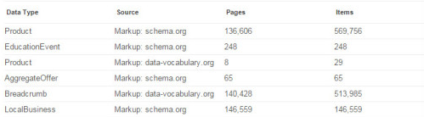
Generality
DataLoader
DataLoader(string workerID)
void loadData(sring path)
Notes:
Second, ParQ can adapt to different query systems.
Data loader…
For different query systems, the static data organizations are also different.
To support different static data…

Slide 13
Generality
DataLoader
DataLoader(string workerID)
void loadData(sring path)
 | label1 | label2
 | type1 | type2
index1 | data1 | data2
index2 | data3 | data3
label1
type1
data1
data3
Data loader expects static data to be in this format :
a line represents a set of data, indexed by a unique identifier;
the data in different lines should be organized in the same sequence;
users should assign labels and data types to the columns.
index1 | data1 | data2
Notes:
To support different systems…

Slide 14
Generality
DataLoader
DataLoader(string workerID)
void loadData(sring path)
 | label1 | label2
 | type1 | type2
index1 | data1 | data2
index2 | data3 | data3
 | NodeType | Neighbor
 | int | vector<int>
0 | -100 | 12 13
1 | -100 | 12 13 14 15
-100 —> as int, labeled by 0 and NodeType
12 13 —> as vector<int>, labeled by 0 and Neighbor
-100
12 13

Slide 15
Generality
QueryProcessor
QueryProcessor(string workerID)
//methods to fetch data int get(string index, string label) int getFromVector(string index, string label, string vectorIndex)
 | NodeType | Neighbor
 | int | vector<int>
0
1
0, NodeType, integer —> -100
0, Neighbor, vector<int> —> 12 13
-100
12 13
Notes:
--As for query processor,
--Each query processor is responsible for one query.
--The API provides a series method…

Slide 16
Ability to work in a distributed environment
QP 1
QP 0
ANSWER 1
0
1
DL
QUERY 1
DL
0
1
0
QUERY 2
QP 2
0
ANSWER 2
QP
0
1
PHYSICAL MACHINE 0
DataLoader(string workerID)
QueryProcessor(string workerID)
Notes:
What’s more…
Example…
In distributed model…
Example…
The structure of class…using...to assign....
Example…

Slide 17
Application
ParQ
QP
DYNAMIC DATA
ANSWER 1
QUERY 1
DL
QUERY 2
STATIC DATA
QP
DYNAMIC DATA
ANSWER 2
How to apply ParQ?
Split the tasks into data loader and query processor
Represent the static data into required format
Use the API

Slide 18

1. Split the tasks into data loader and query processor.
JOB 1
JOB 0
JOB 1
STATIC DATA
DYNAMIC DATA
QUERY 1
STATIC DATA
DYNAMIC DATA
ANSWER 1
if current job is data loader
create an instance of DataLoader;
call corresponding functions； terminate；
else if current job is query processor
create an instance of QueryProcessor; call corresponding functions； terminate；
Notes:
It will skip data loading to perform computation dirctly.

Slide 19
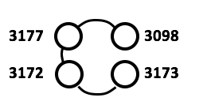
JOB 1
JOB 0
JOB 1
STATIC DATA
DYNAMIC DATA
QUERY 1
STATIC DATA
DYNAMIC DATA
ANSWER 1
 | label1 | label2
 | type1 | type2
index1 | data1 | data2
index2 | data3 | data3
2. Represent the static data into required format.
 | type | neighbors
 | int | vector<int>
3177 | -100 | 3098 3172
3173 | -100 | 3172
3172 | -100 | 3173
3098 | -100 | 3177
Notes:
Now the data loader can read the file automatically and query processors can get requested data from the shared memory.

Slide 20
JOB 1
DL
QP
STATIC DATA
DYNAMIC DATA
QUERY 1
STATIC DATA
DYNAMIC DATA
ANSWER 1
Add Apis.
DL
QP 1
QP 2
Static Data
getInt
loadData
getFromVectorInt
2. Using the API.
Notes:
And last, we call corresponding methods at the right place.

Slide 21
Application examples

Slide 22
The top-k star query system
A massive information network: labeled entities and their relationships.
JOB 1
QUERY 1
STATIC DATA
DYNAMIC DATA
ANSWER 1
QUERY 1
ANSWER 1
An unknown entity and known facts.
Best k answers that are the most relevant.
Notes:
Answers pattern match queries in massive information networks.
An entities can be a person or a thing.
Can’t share the static data among jobs...

Slide 23
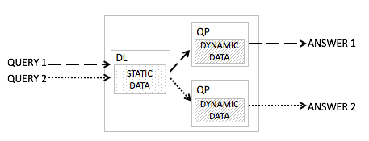
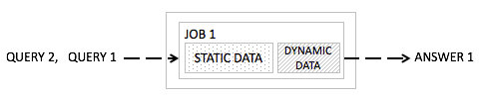
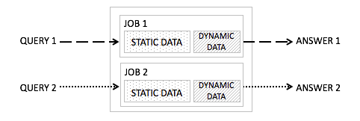
ParQ is compared with the original system running in two ways.
PARQ
(Parallel/single)
Serial/single
Parallel/duplicated
Notes:
In order to examine the performance...we designed and performed...which includes...
Graph, The graph describes the relationship among authors
The experiments are performed on a local computer cluster...

Slide 24
Comparison of the memory usage
Notes:
--Shaded…
--For answering a single query…
Serial/single… But for ParQ...
Parallel/duplicated

Slide 25
Comparison of the running time for completing queries
Notes:
First, for answering a single query,
Serial/single
Parallel/duplicated… 5 or less.. 10
In conclusion...

Slide 26
The personalized PageRank system [2]
Web graph that describes the directed links between webpages
JOB 1
QUERY 1
STATIC DATA
DYNAMIC DATA
ANSWER 1
QUERY 1
ANSWER 1
Personal preferences
Best k answers that are the most relevant.
Notes:
This system has the same problem that it can’t share the static data among jobs...
Therefore we apply…

Slide 27
ParQ is compared with the original system running in two ways.
PARQ
(Parallel/single)
Serial/single
Parallel/duplicated
Notes:
Similarly…
60MB Web graph

Slide 28
Comparison of the memory usage
Notes:
One different with the last one is that
The reason is that in this experiment, the volume of static data is small. It is about 60 MB.
From this example, we can see ParQ is more suitable for the case where static data is larger.
But on the other hand, although here, ParQ require more memory than Serial/single,

Slide 29
Comparison of the running time for completing queries

Slide 30
The belief propagation system [3]
Factor graph that describes the direct probabilistic interactions between events.
JOB 1
QUERY 1
STATIC DATA
DYNAMIC DATA
ANSWER 1
QUERY 1
ANSWER 1
Personal preferences
Best k answers that are the most relevant.
Notes:
This system has the same problem that it can’t share the static data among jobs...
Therefore we apply…

Slide 31
ParQ is compared with the original system running in two ways.
PARQ
(Parallel/single)
Serial/single
Parallel/duplicated
Notes:
Similarly…
60MB Web graph

Slide 32
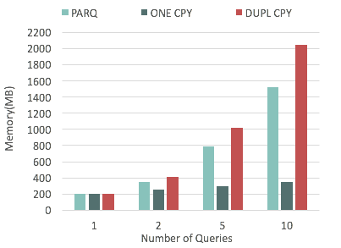
Comparison of the memory usage
Notes:
One different with the last one is that
The reason is that in this experiment, the volume of static data is small. It is about 60 MB.
From this example, we can see ParQ is more suitable for the case where static data is larger.
But on the other hand, although here, ParQ require more memory than Serial/single,

Slide 33
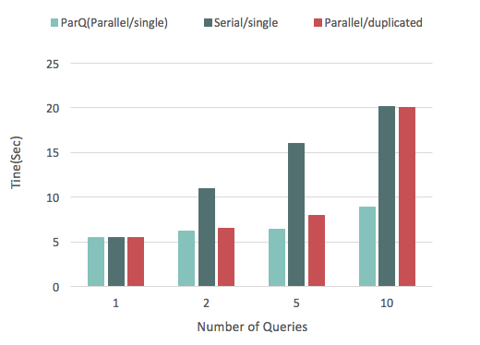
Comparison of the running time for completing queries

Slide 34
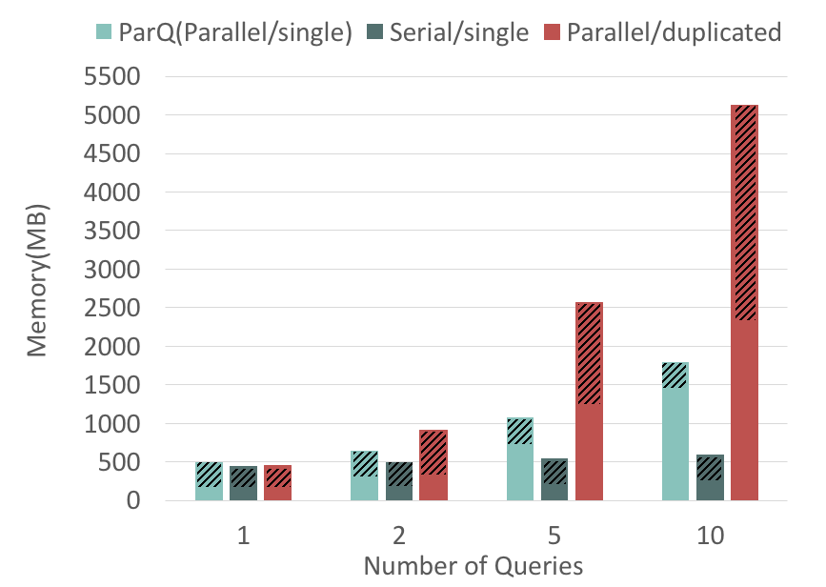
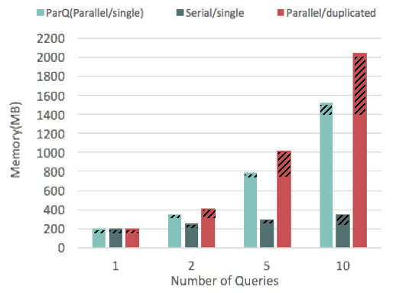
ParQ is more suitable when the size of static data is much larger than the size of dynamic data
It is still useful in term of the running time

Slide 35
Conclusion
Query systems are developed to answer queries on a dataset
Good on single query
Inefficient on multiple queries
ParQ is a memory-efficient approach that enables a query system to concurrently answer multiple queries.
An API
Ability to work in a distributed environment
Generality
Notes:
--Many research focus on developing...
--Some existing query systems are already good when processing a single job, but still has problem when processing multiple jobs.
That is, they do not allow multiple jobs to share the in-memory static data, which leads to longer job completion time and large memory usage.
...implement ParQ, to realize job-level parallelism by enabling static data sharing.

Slide 36
Time line
Activity | Period
Read papers and do research | Sep. 2014 – Oct. 2014
Formulate overall plan | Nov. 2014
Evaluate possible approaches that may achieve the goals | Dec. 2014
Formulate the overall design of ParQ | Jan. 2015
Implement main methods of ParQ | Feb. 2015 – Apr. 2015
Improve ParQ to adapt to distributed environment | May. 2015 – Jun. 2015
Complete writing and proposal | Jul. 2015 – Sep. 2015
Study more query systems | Oct. 2015 – Dec. 2015
Improve ParQ so that it can process more data types | Jan. 2016 – Feb. 2016
Adopted improved ParQ and perform experiments | Mar. 2016 – Apr. 2016
Complete writing | May. 2016
Complete thesis defense | Jul. 2016
Just future work

Slide 37
References
[1] Jin, J., et al.: An Index-Free Approach for Top-k Star Queries on Billion Node Graphs. IEEE (2015)
[2] Khemmarat, S., et al.: Fast top-k path-based relevance query on massive graphs. ICDE’14 (2014)
[3] Yin J., et al.: Scalable Distributed Belief Propagation with Prioritized Block Updates. ACM (2014)

Slide 38
Thank you for your valuable time, comments and encouragement!

Slide 39
The top-k star query system is able to find the best k answers for a query from a graph.
Freebase
COMPUTA-
-TIONS
Notes:
Online collection…global resource…
A query on Freebase is a request…
In order to answers... a query system...find best k...
Such query system is very useful in practical app. but…The job execution logs from a large Chinese social network shows that at peak time, there are more than 20 jobs submitted to the platform.

Slide 40
PROBLEM
COMPUTA-
-TIONS
COMPUTA-
-TIONS
Memory usage doubles. Running time increases.
Notes:
Inherently designed for…tightly combines…
Therefore, this query system don't ... must keep two..

Slide 41
IMPLEMENTATION
QP
uesless
DYNAMIC DATA
ANSWER 1
QUERY 1
DL
QUERY 2
STATIC DATA
QP
DYNAMIC DATA
ANSWER 2
ParQ:
enables an existing query system to concurrently answer multiple queries by sharing static data
Provides an API
Notes:
Based on the overall design, we implement the ParQ system to be...
ParQ provides a standard API. So now, if your query system can't but...

Slide 42
IMPLEMENTATION
QP
uesless
DYNAMIC DATA
ANSWER 1
QUERY 1
DL
QUERY 2
STATIC DATA
QP
DYNAMIC DATA
ANSWER 2
This approach ensures:
keeps only one copy of static data among jobs;
can be directly used by existing query systems;
adapt to different query systems;
be able to work in a distributed environment.
Notes:
The design ensures only one copy of static data is kept among jobs. Users can directly adopt ParQ to existing query systems by using API.
Next...How the Api works...

Slide 43
Comparison of the running time for completing queries
Notes:
Serial/one-graph
Parallel/multi-graph… 5 or less.. 10

Slide 44
Comparison of the memory usage
Notes:
(Serial/one-graph)… because answering queries also generates…
But first for ParQ...and second as shown...
(Parallel/multi-graph)…
In conclusion…

Slide 45
1. Split the tasks into data loader and query processor.
JOB 1
QUERY 1
STATIC DATA
DYNAMIC DATA
ANSWER 1
JOB 1
JOB 0
JOB 1
STATIC DATA
DYNAMIC DATA
QUERY 1
STATIC DATA
DYNAMIC DATA
ANSWER 1
Notes:
First, by using an if statement... Using an identifier.
if current job is data loader
create an instance of DataLoader;
call corresponding functions；
terminate；
else if current job is query processor
create an instance of QueryProcessor;
call corresponding functions；
terminate；

