Slide 1
STA130 Week2
TA: Gloria
Contact: shiyi.hou@mail.utoronto.ca
Notes:
Attendence
How to seek for help:
First try office hours and piazza as instructed in course syllabus; because:
More efficient
If not use those recourses, they may be adjusted
In special cases, you can email me, I will usually get back to you within 24 hours, but no immediate reply is guaranteed.

Slide 2
Vocabularies - Boxplot
To describe the distribution of the data:
Mean: the average
Median: the number x such that 50% of data is greater than x and the other 50% of data is smaller than x
Standard deviation: to measure the spread of data
Variance: also to measure the spread of data
To visualize the distribution of the data using plots:
Boxplot
Interquartile range: IQR = Q3 – Q1, IQR is such that 50% data fall within this range
Quartile: including Q1, Q2, Q3, and Q4.
Outlier: data points that are far away from the majority of the data points.
Notes:
A complete data analysis process would involve: collecting data and cleaning data, EDA, and then move onto data analysis
In the first two weeks, what we really are doing is to lay the basics you need to know before you start to learn statistics: EDA(four types of graphs + summary table) and the basics of using R
The relative position of the Median and the Mean can vary, depending on the skewness of the distribution
Quantile v.s. quartile

Slide 3
Vocabularies – R Language Terminologies
Types of variables
Character variable: a word with quotation marks
Numeric(quantitative) variable: variables represented in integers and decimal numbers
Logical variable: TRUE and FALSE
More:
R object: the variable name in R in which input values are stored
(atomic) Vector: think of it as a list, a collection of values,
Data frame: used for storing datasets, with column being variables and rows being the observations
Summary table: displays summary statistics, constructed using R function: summarize( )
Summary statistics: e.g. mean, min, standard deviation, etc.
Proportion: refers to the fraction of the total that possesses a certain attribute
Notes:
Vector c() can only contain one variable type – if more than one data types exist, they will be automatically stored as strings
same for data frame (within the same column)

Slide 4
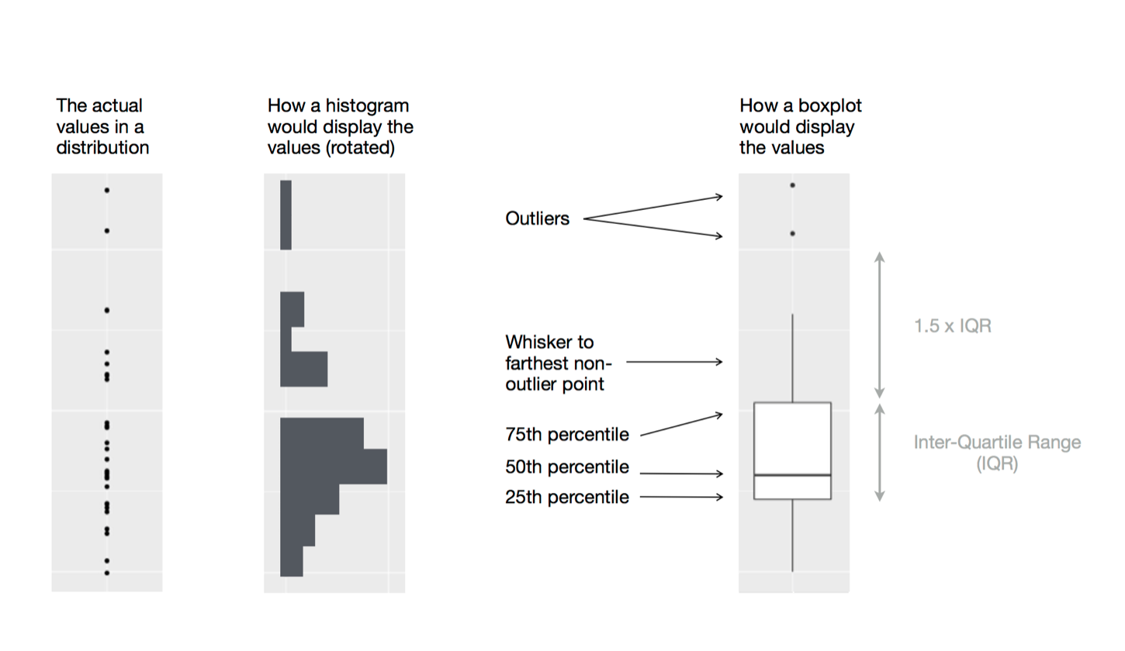
Boxplot
Whisker need not to have a length of 1.5*IQR( as long as it stays within the 1.5*IQR range) , for examples when all the data points are condensed together;
However, the whisker can sometimes have length up to 1.5*IQR, when the data points are more dispersed.
More examples

Slide 5
What does boxplot do
To summarize the distribution of a quantitative variables
Five statistics:
Minimum
Maximum
Medium (NOT mean)
1st quartile
3rd quartile
And outliers
To summarize these vales according to a categorical variable of interest
Example:
Amount of rainfall, a continuous variable
How this distribution varies by important categorical variables, such as: month, region, year, etc.

Slide 6
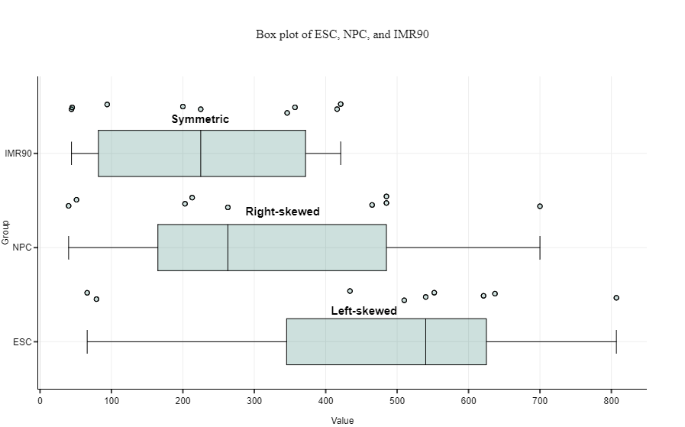
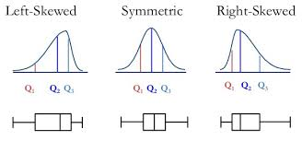

Slide 7

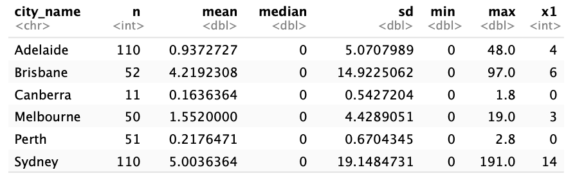
Group discussion
Why might it be useful to provide a summary table? (You made one in Question 2h)
Notes:
If you want to more precise summary of your data
Easier to compare numerical distributions across groups

Slide 8
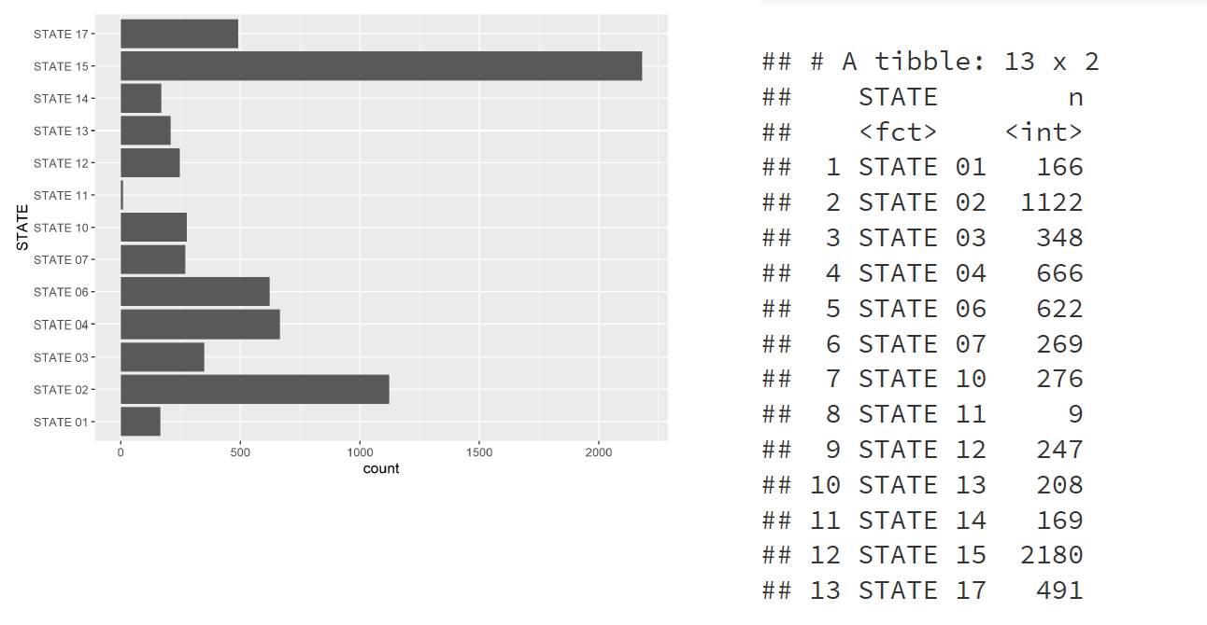
Would you prefer the bar chart or the table?
Which state has the most insurance claims in our sample?

Slide 9
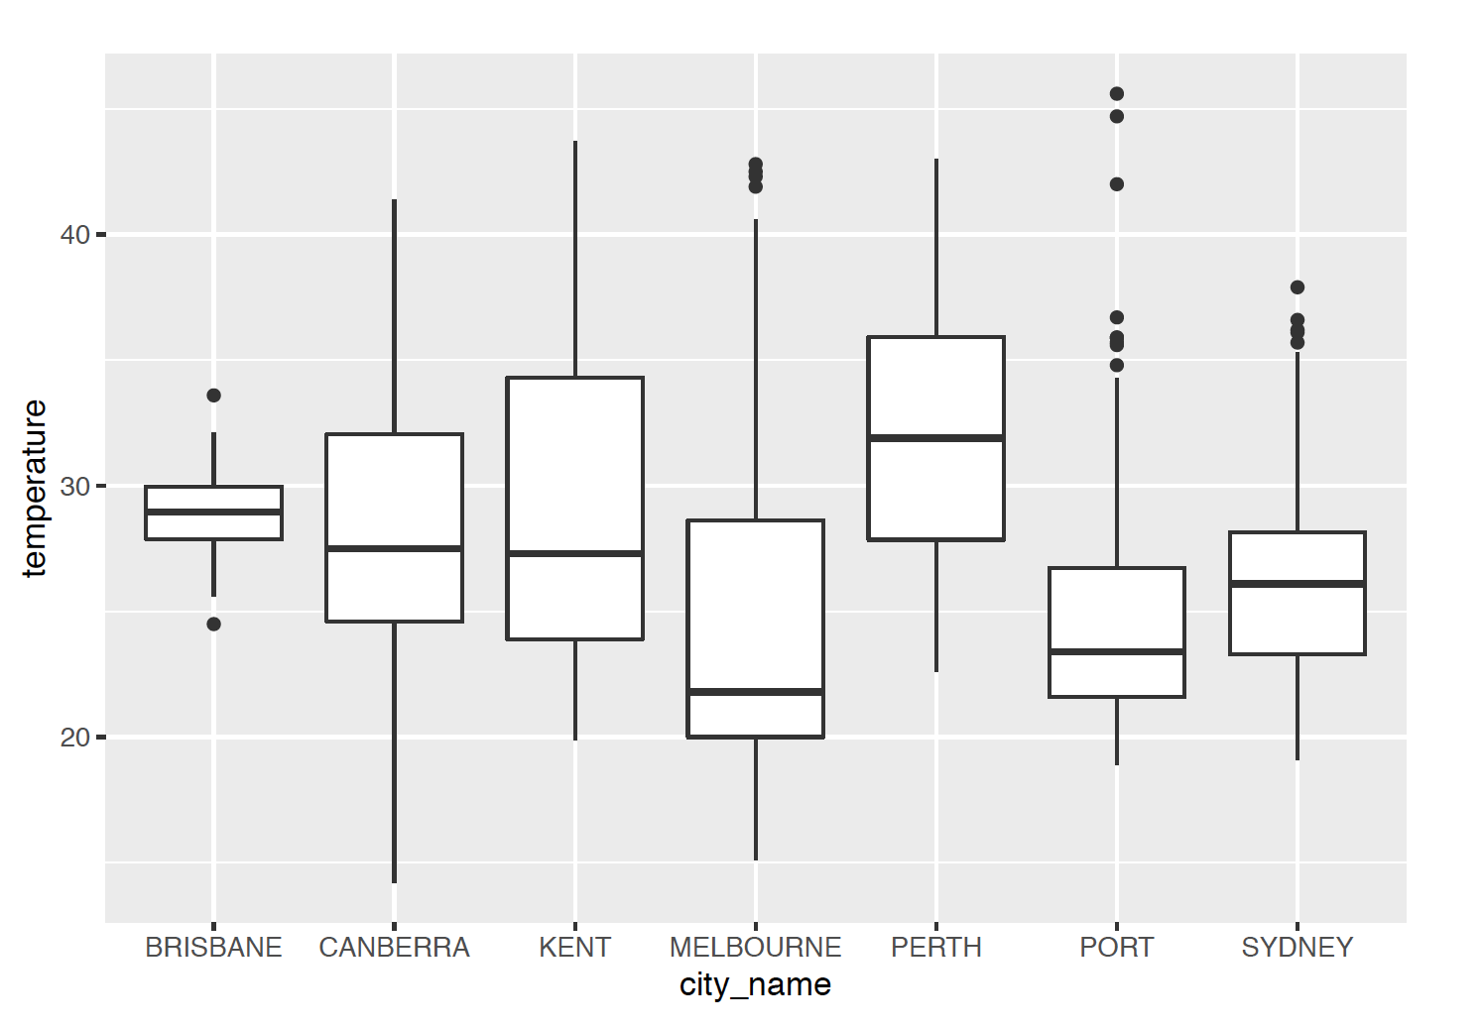
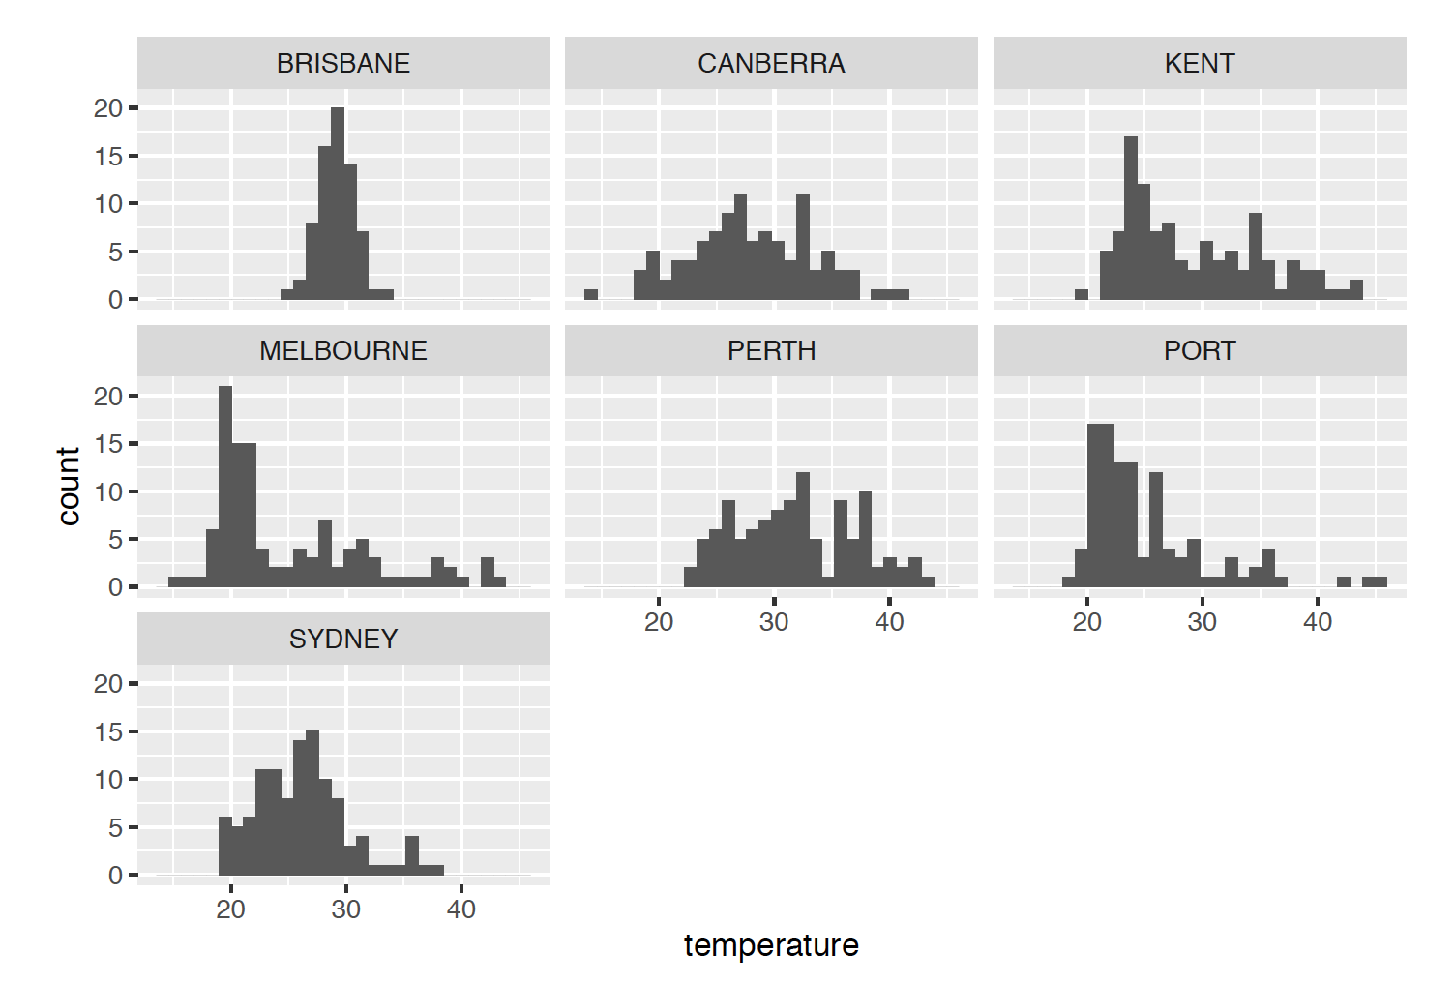
Group discussion
For Question 1, you used both histograms and boxplots to visualize your data.
Which features were easier/harder to observe from each of the visualizations?
In what situations may you want to choose a boxplot over a histogram, or vice versa? Explain.

Slide 10
Histogram v.s. Boxplot
Histogram:
Underlying distribution of the data.
Histograms are normally used to represent moderate to large amount of continuous data and we need at least 25 data points to determine if a histogram follows a particular distribution. If the data size is too small or the measurement system has a low resolution, the histogram may show very few columns and may not accurately display the shape of the distribution.
Boxplot:
Comparing several distributions against each other.
Summarize key statistics from the data, and the outliers.
They provide a quick way for examining the variation present in the data.
A wider range boxplot indicates more variability.
Example: Sometimes when we're comparing distributions we don't care about overall shape, but rather where the distributions lie with regard to one another. Plotting the quantiles side by side can be a useful way of doing this without distracting us with other details that we may not care about.

Slide 11
More on Histogram v.s. Boxplot
Both charts effectively represent different data sets; however, in certain situations, one chart may be superior to the other in achieving the goal of identifying variances among data.
The type of chart chosen depends on
the type of data collected
rough analysis of data trends
and project goals.
Let’s look at some case-by-case comparisons:
Notes:
Variance of data

Slide 12
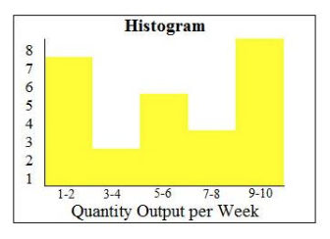
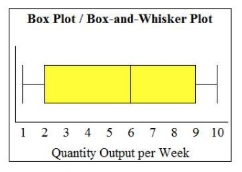
Scenario 1: Histogram or Boxplot
A histogram is highly useful when wide variances exist among the observed frequencies for a particular data set:
This histogram shows that there are three peaks within the data, indicating it is tri-modal (three commonly recurring groups of numbers). Had this data simply been graphed using a box plot, the values would average one another out, causing the distribution to look roughly normal.

Slide 13
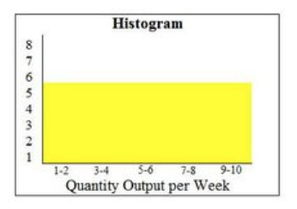
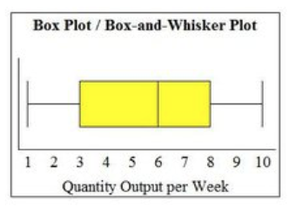
Scenario 2: Histogram or Boxplot
A histogram is preferable over a box plot is when there is very little variance among the observed frequencies:
This histogram shows that there is little variance across the groups of data; however, when the same data points are graphed on a box plot, the distribution looks roughly normal with a high portion of the values falling below six.

Slide 14
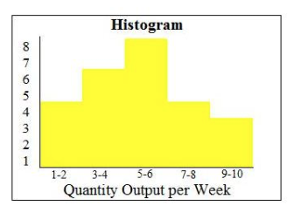
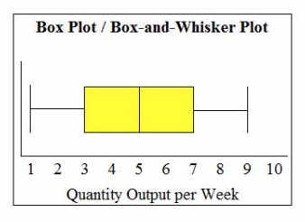
Scenario 3: Histogram or Boxplot
This is an instance when a box plot can be more useful than a histogram.
This occurs when there is moderate variation among the observed frequencies, which causes the histogram to look ragged and non- symmetrical due to the way the data is grouped. This may lead one to assume the data is slightly skewed. However, when a box plot is used to graph the same data points, the chart indicates a perfect normal distribution.

Slide 15
Summary:
Histograms: The paired histograms give us a good overall impression of the distribution of ticket prices among survivors and non-survivors, but it is difficult to extract estimates of the mean, median, and quantiles, as well as the bounds of each bin.
Boxplots: The boxplots make it easy for us to compare the medians, quartiles, IQR (and outliers) of ticket prices across the two groups, although we cannot easily extract exact values for these. Also, since boxplots only display a small number of summary statistics, we lose information about the shape of the distributions.
Summary table: The summary table makes it easy to compare numerical values of key statistics. It is only from the summary table that we noticed that some passengers were recorded to have paid 0 pounds for their tickets. However, it is more difficult to get a quick sense of the overall shape of the distributions from these summary statistics alone, although these could be used to sketch a pair of boxplots.

Slide 16
When communicating your work, it’s important to include 4 critical items:
The purpose. What is it that you’re studying? Why should we care about the analytical work you’ve done?
A summary of the methods you used. What did you do? Why did you do it this way?
A summary of the results. We don’t need to know everything you found – only the most critical things relating to your purpose! Remember, sometimes less is more!
A conclusion. What is your take away message? Remember, a conclusion is not the place to present new findings.
Notes:
Common problems we see often from grading the writing exercise 1:
Lack of introduction – the purpose of the your analysis, i.e. what you are trying to find through your analysis; and also how does your analysis can potential create values for your collaborator
The reference between your word and your graph is not clear enough, hard to follow
The explanations on your observations are not detailed enough
Didn’t use statistical terms to describe → recommended way: be professional and using terminologies where you can, also use plain language to explain the the concept to your audience.

Slide 17
Most importantly, your “story” should be clear, concise, cohesive, and complete! Like a real story, it should have a clear beginning, middle and end.
Complete — cover the important parts of the project, study, or analysis
Concise — contain no excess wordiness or unnecessary information
Clear — readable, well organized, and not too jargon-laden
Cohesive — flows smoothly between the parts

