Slide 1
Word embedding for bug severity prediction
By: Gloria Ezzat
Supervised By: Dr Abeer Hamdy
Major: Software Engineering
ID: 150753

Slide 2
Outlines
Introduction
Bug Report Example
Bug Triaging Process
Problem
Examples of related work
Suggested Solution
Work Methodology & Work Plan

Slide 3

Introduction

Slide 4
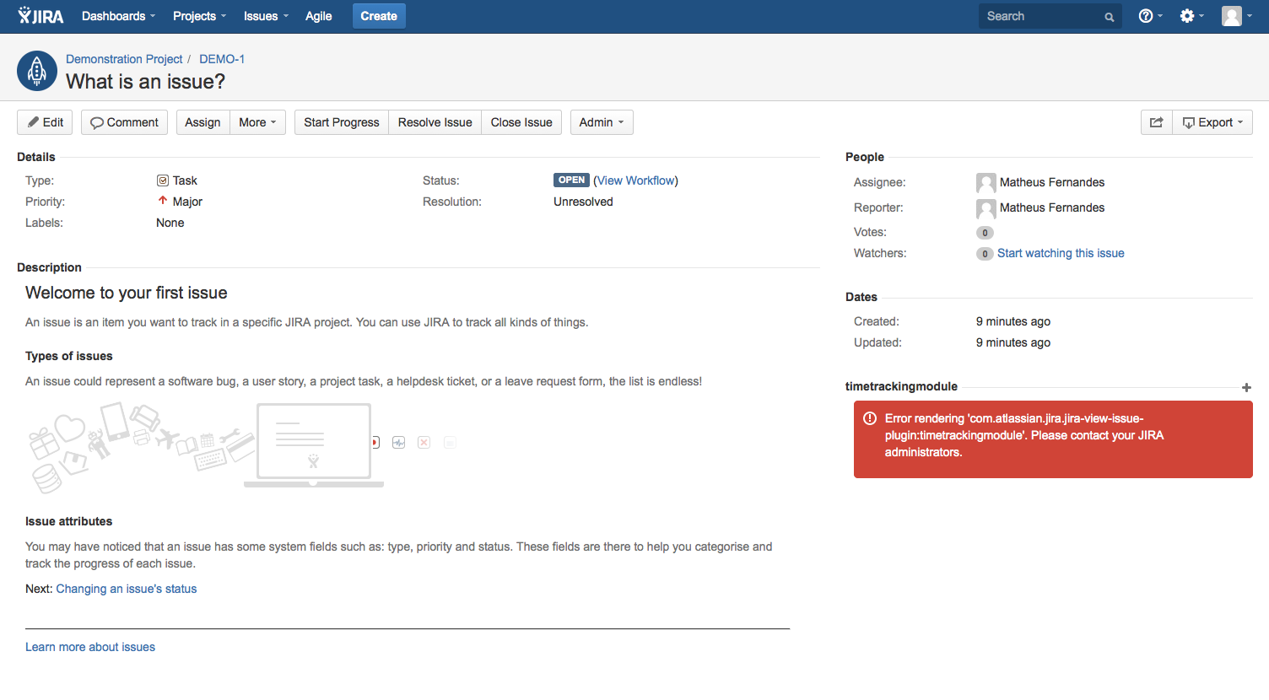
Bug Report Example
Developer assigned to solve the bug
Bug Title
Bug Severity
The person who had reported the bug
Bug Description

Slide 5
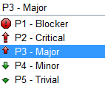
Bug Severity levels

Slide 6
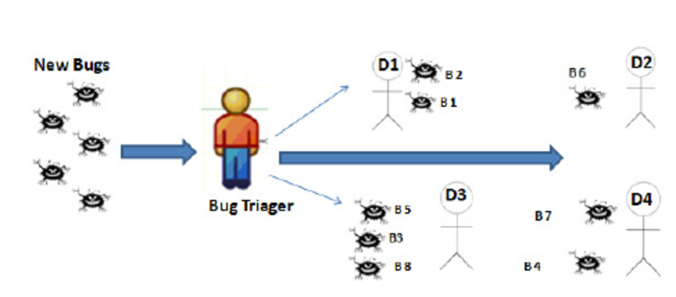
Bug Repository

Slide 7
The problem of a manual triaging system software
Wasting time
Wasting money
Wasting energy
Inaccurate results
Inefficient results

Slide 8
Related work techniques
Natural Language Processing techniques used to automate the bug triage process:
Bag of words technique
Skip-gram model technique
Paragraph vector technique
Classification techniques
K-nearest neighbour
Support vector machine
Deep learning: neural networks

Slide 9
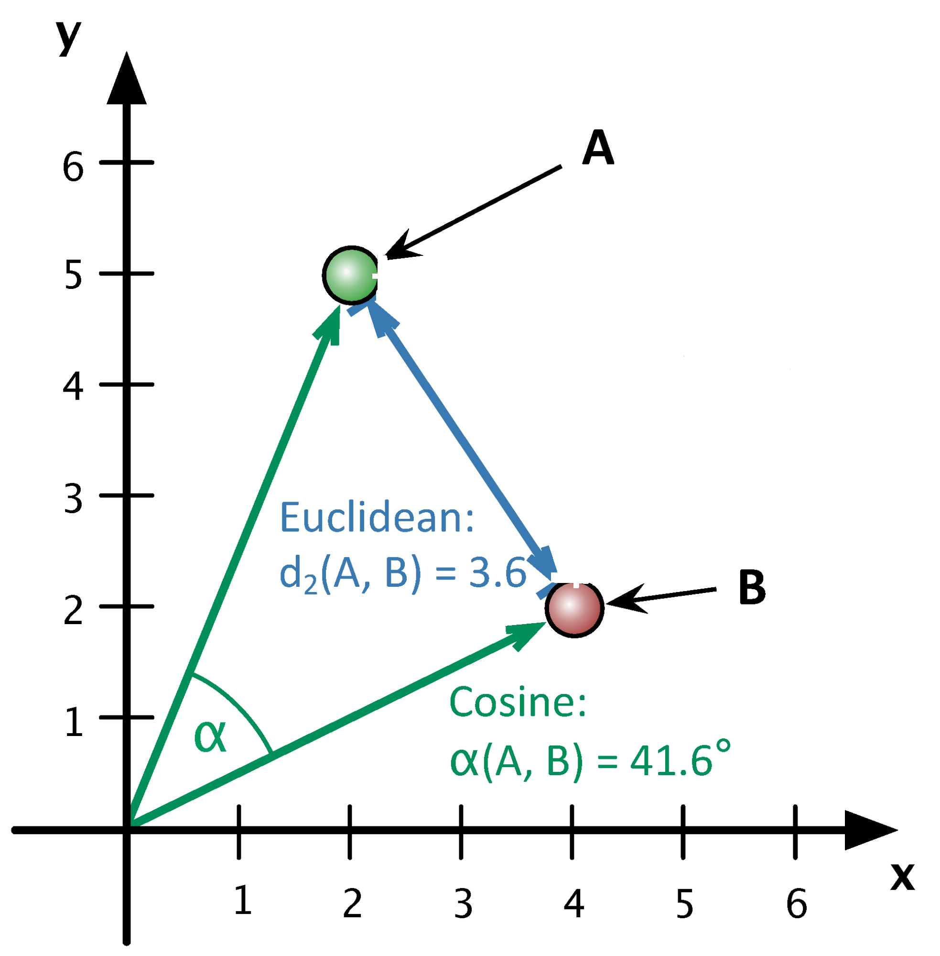
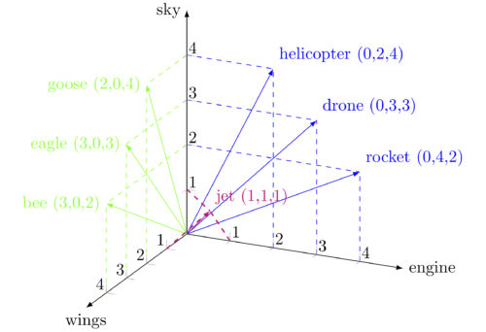
Suggested solution
Word Embedding technique
Classification techniques
Doc2vec model: a technique that represents the document as vector of vectors in which a single word is represented as a vector.
K-nearest neighbour: using cosine similarity and Euclidean distance
Deep learning

Slide 10
Work methodology
Read datasets from excel sheet using Pandas library in Python
Divide datasets into training and testing sets
Apply word embedding technique: Doc2vec using Gensim library
Apply K-nearest neighbour classifier using Sklearn library
Calculate confusion matrix for K=1, 5, 10, 15
Apply deep learning classifier technique using Keras library

Slide 11
Thank you
Any questions??

