Slide 1
ROLLS ROYCE DATA STORYTELLING CHALLENGE
Submitted BY:
Rawaida binti Kamarudin
Weijiang lin (Gloria)
MSC Data Analytics, the university of Sheffield

Slide 2
Scenario 1 - corrective maintenance
Unexpected engines / components failure during maintenance
Check existing spare for engine / component replacement
VISUAL A
VISUAL B
*Able to check engine / component current
spares availability*
A
Spare Engine Availability
Spare Component Availability
Faulty engine / component sent to testing site
VISUAL C
VISUAL D
*Predicting probability of new maintenance period (overhaul / repair) based on existing maintenance period*
A
If no spares available, swap with other engines / components or buy in advance
Testing Site Availability
Maintenance Period Prediction
VISUAL E
VISUAL F
B
Scenario 2 - Modification Campaign
Cost / Year Maintenance Trend
Maintenance Demand for Engines / Components

Slide 3
Scenario 2 – MODIFICATION CAMPAIGN
B
VISUAL G
VISUAL H
Develop engine / component failure tendency (based on pre-existing data)
Notify operator for new modification campaign
Position of Current Engine (Map / Location –based)
Likelihood of Engine / Component Failure
Replace in-use engines / components
VISUAL I
Engine / component replacement operating window (per operator)
Faulty engine / component sent to testing site
Back to Scenario 1

Slide 4
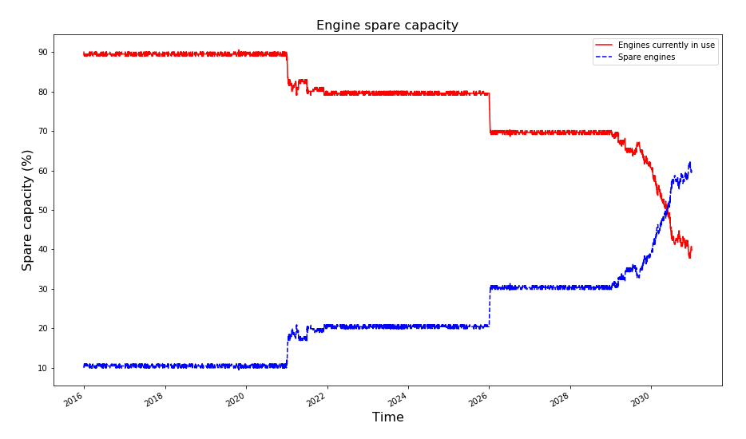
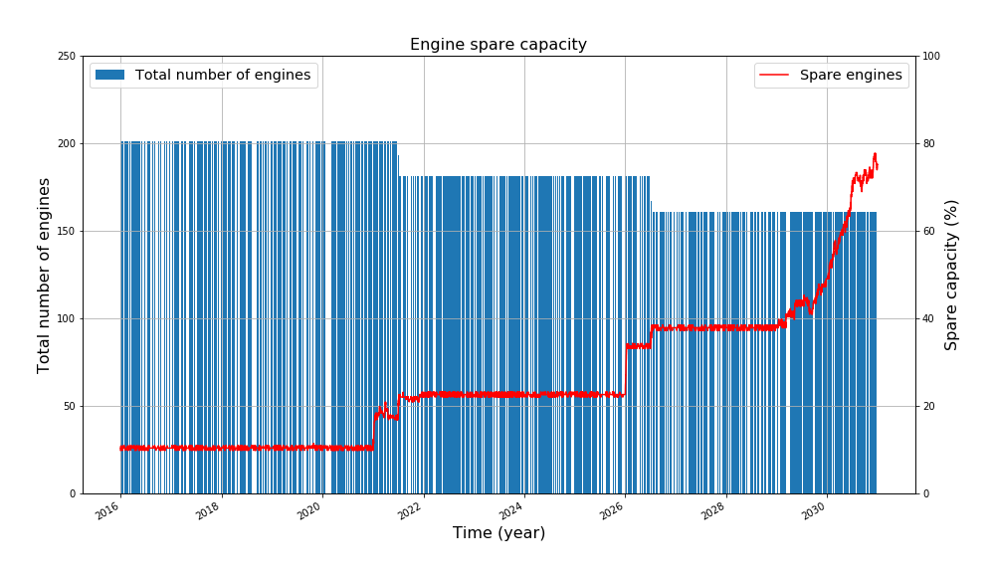
VISUAL A – SPARE ENGINE AVAILABILITY
THE IDEA – Assist operator & spares planner in knowing availability of engines year on year based on forecasted data
Assumptions: No additional / new engines added to the total pool throughout 15 year period (2016 – 2030)
Tables Utilized: Equipment List & Output Equipment Activities

Slide 5
VISUAL B – SPARE COMPONENT AVAILABILITY
THE IDEA – Assist operator & spares planner in knowing availability of components year on year based on forecasted data
Assumptions:
Tables Utilized:

Slide 6
VISUAL C – TESTING SITE AVAILABILITY
THE IDEA – Advise workshop manager to know current load of testing site (either repair or overhaul) year on year based on forecasted data
Assumptions:
Tables Utilized:

Slide 7
VISUAL D – MAINTENANCE PERIOD PREDICTION
THE IDEA – Advise operator on the probability of maintenance period (how long) based on the forecasted data of the engines / components
Assumptions:
Tables Utilized:

Slide 8
VISUAL E – Cost / YEAR MAINTENANCE TREND
THE IDEA – Measure cost / year maintenance trending for all the related maintenance activities
Assumptions:
Tables Utilized:

Slide 9
VISUAL F – MAINTENANCE DEMAND
THE IDEA – Portray the demand by prediction of the existing factors e.g. operating hours, operating cycles, equipment & component configuration, etc.
Assumptions:
Tables Utilized:

Slide 10
VISUAL G – MAP of CURRENT ENGINE LOCATION
THE IDEA – Visualize the existing location of engine and components in-used by the flight operators. Require new data type e.g. coordinates of each flights (Flight Radar)
Assumptions:
Tables Utilized:

Slide 11
VISUAL H – LIKELIHOOD OF FAILURE
THE IDEA – Prediction of likelihood failure for engines or components based on the inputs from the existing maintenance trend (or demand). Feedback for in-used engines / components
Assumptions:
Tables Utilized:

Slide 12
VISUAL I – REPLACEMENT OPERATING WINDOW
THE IDEA – Aid operator on the best time for engines or components call-back for maintenance & testing
Assumptions:
Tables Utilized:

