Slide 1

Recommendations IN Practice
ITEM-TO-ITEM COLLABORATIVE FILTERING
PRESENTED BY:
Xie Guohuan/解国欢
2020-07-24

Slide 2
OUTLINE
 GENERAL INTRODUCTION OF RECOMMENDATION
 DIFFERENT TYPES OF RECOMMENDER SYSTEMS
 RECOMMENDATION ALGORITHM CHALLENGES
IMPLICIT USER FEEDBACK
 USER AND ITEM BASED FILTERING
 TRADITIONAL COLLABRATIVE FILTERING
 CLUSTER MODELS
 SEARCH BASED METHODS
 ITEM-TO-ITEM COLLABRATIVE FILTERING
 SCALABILITY
 CONCLUSION

Slide 3



Recommendation algorithms are best known for their use on e-commerce websites where they use input about a customer’s interests to generate a list of recommendation items.
Many applications use only the items that customers purchase and explicitly rate to represent their interests, but they can also use other attributes, including items viewed, demographic data, subject interests, and favorite artists.
待会儿看怎么替换掉
35 % of amazon revenue is from recommendation engine
Recommendation problem usually can be formulated as two kinds of problem:
The first one is predicting problem,the second on is ranking problem;
Recommendation is primarilly used to upgrade profits for merchants;
This if often achieved by less obvious ways;
Relevance;
Novelty;
Serendipity;
Increasing Recommendation divisity;
INTRODUCTION

Slide 4






1. Collaborative Filtering.
Cluster models.
Search based methods.
Demographic based Recommender system.
Knowledge based Recommender system.
Hybrid filtering.
DIFFERENT TYPES OF RECOMMENDER SYSTEMS

Slide 5
Collaborative Filtering:
significant dependencies between user and item-centric activities;
Recommendations is always based on previous interaction between users and items,because past interests are good indicators of future choices.
Use observed ratings to predict unobserved ratings,then base on the ratings to rank items for user
Most of the collaborative filtering algorithm leverage either the item-item corelations or user-user corelations to make recommendation.
Some memory-based collaborative filtering algorithm can be expressed as regression model.

Slide 6







OLDER CUSTOMER CAN HAVE A GLUT OF INFORMATION BASED ON THOUSANDS OF PURCHASES AND RATINGS.
A LARGE RETAILER MIGHT HAVE HUGE AMOUNTS OF DATA, TENS OF MILLIONS OF CUSTOMERS AND MILLIONS OF DISTINCT CATALOG ITEMS.
MANY APPLICATIONS REQUIRE THE RESULTS SET TO BE RETURNED IN REAL TIME, IN MORE THAN HALF A SECOND WHILE STILL PRODUCING HIGH QUALITY RECOMMENDATIONS.
NEW CUSTOMERS TYPICALLY HAVE EXTREMELY LIMITED INFORMATION BASED ON ONLY A FEW PURCHASES OR PRODUCT RATINGS.
CUSTOMER DATA IS VOLATILE: EACH INTERACTION PROVIDES VALUABLE CUSTOMER DATA, AND THE ALGORITHM MUST RESPOND IMMEDIATELY TO THE NEW INFORMATION.
RECOMMENDATION ALGORITHM CHALLENGES

Slide 7
It takes no effort to collect implicit feedback,such as buying , view , click and book marking an item in terms of the work of a customer
The basic idea of recommender systems is to utilize these various source of data to infer user’s interest;
The entity to which the recommendation is provided is refered as the user and the product being recommended is refered as item.
The basic principle of recommendation is that significant dependencies exist between user and item-centric activities.
Unary ratings;
No negative feedback:it is hard to reliably to infer which item a user didn’t like;
Implicit feedback is inherently noisy: we can only guess users’preferences and true motives,for example
The numerical value of explicit ratings indicate preferences whereras the numerical value of implicit feedback indicates confidence;a recurring event will reflect users’opinion;
Evaluation of implicit-feedback recommender requires appropriate measures;
IMPLICIT USER FEEDBACK

Slide 8




User preference definition:
Confidence level definition:
Preference indicates by:
Minimize the cost function: the term for regularizing:
Collaborative filtering for implicit user feedback

Slide 9



COLLABORATIVE FILTERING AND CLUSTER MODELS FOCUS ON FINDING SIMILAR SET OF CUSTOMERS WHOSE PURCHASED AND RATED ITEMS OVERLAP WITH THE USER’S PURCHASED AND RATED ITEMS.
SEARCH-BASED METHODS AND ITEM- TO-ITEM COLLABORATIVE FILTERING FOCUS ON FINDING SIMILAR ITEMS, NOT SIMILAR CUSTOMERS.
USER BASED AND ITEM BASED FILTERING

Slide 10
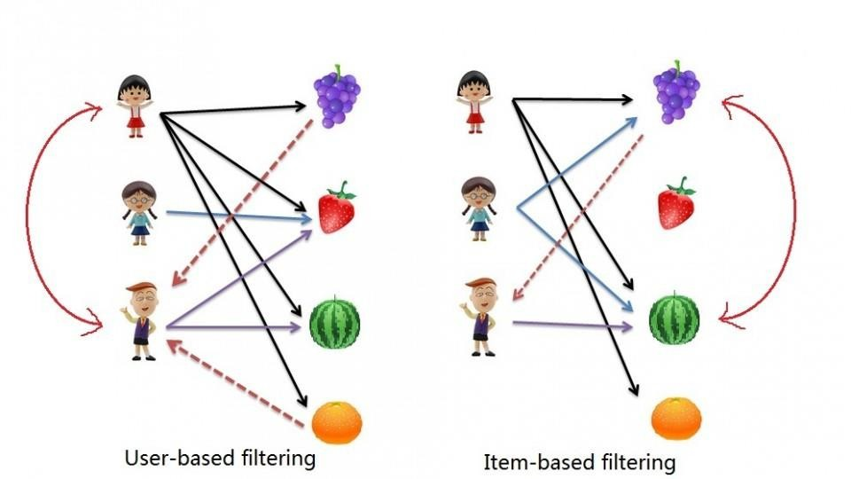

Slide 11
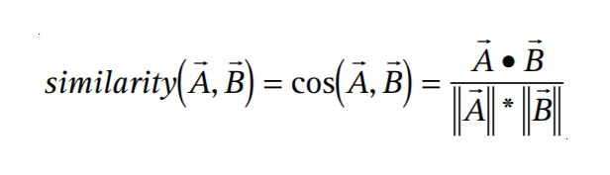
The algorithm generates recommendations based on few customers who are most similar to the user.
Here the similarity between the two customers is calculated using the cosine similarity.
TRADITIONAL COLLABORATIVE FILTERING
The component vector are positive for purchased or positively rated items and negative for negatively rated items.

Slide 12
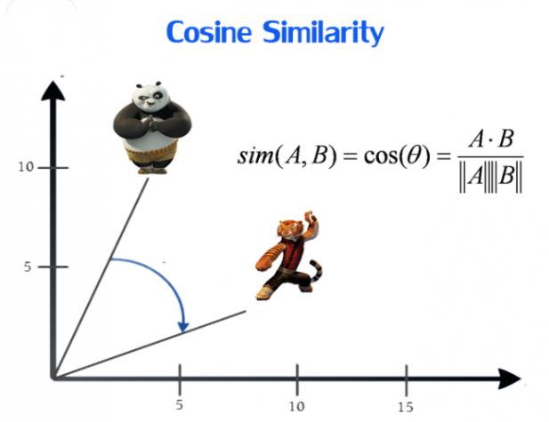

Slide 13
LIMITATIONS
 Using collaborative filtering is computationally expensive
 Worst case complexity is O(MN)[M- Number of customers, N-
Number. of product catalog].
 The final performance of the algorithm is O(M+N).
 The algorithm encounters severe performance and scaling issues.
 We can reduce M and N by a large factor but with the cost of recommendation quality.

Slide 14








Divide the customer base into many segments and assign the user to the segment containing the most similar customers
Segments are created using
clustering.
The algorithm’s goal is to assign the user to the segment containing the most similar customers. It then uses the purchases and ratings of the customers in the segment to generate recommendations.
Cluster models have better online scalability and performance than collaborative filtering because they compare the user to a controlled number of segments rather than the entire customer base.
CLUSTER MODELS

Slide 15
LIMITATIONS
 Cluster models group numerous customers together in a segment, match a user to a segment, and then consider all customers in the segment similar customers for the purpose of making recommendations.
 Because the similar customers that the cluster models find are not the most similar customers, the recommendations they produce are less relevant.
 online user–segment classification becomes almost as expensive as finding similar customers using collaborative filtering.

Slide 16
SEARCH-BASED METHODS
 Search- or content-based methods treat the recommendations
problem as a search for related items.
 The algorithm constructs a search query to find other popular items by the same author, artist, or director, or with similar keywords or subjects.
 If the user has few purchases or ratings, search based recommendation algorithms scale and perform well.

Slide 17


Slide 18
LIMITATIONS
 For users with thousands of purchases, however, it’s impractical to base a query on all the items.
 The algorithm must use a subset or summary of the data, reducing quality.
 In all cases, recommendation quality is relatively poor.
 Recommendations should help a customer find and discover new, relevant, and interesting items.

Slide 19
ITEM-TO-ITEM COLLABORATIVE FILTERING
 Rather than matching the user to similar customers, item-to-item
collaborative filtering matches each of the user’s purchased and rated items to similar items, then combines those similar items into a recommendation list.
 To determine the most-similar match for a given item, the algorithm builds a similar-items table by finding items that customers tend to purchase together.
 We could build a product-to-product matrix by iterating through all item pairs and computing a similarity metric for each pair. However, many product pairs have no common customers, and thus the approach is inefficient in terms of processing time and memory usage.

Slide 20
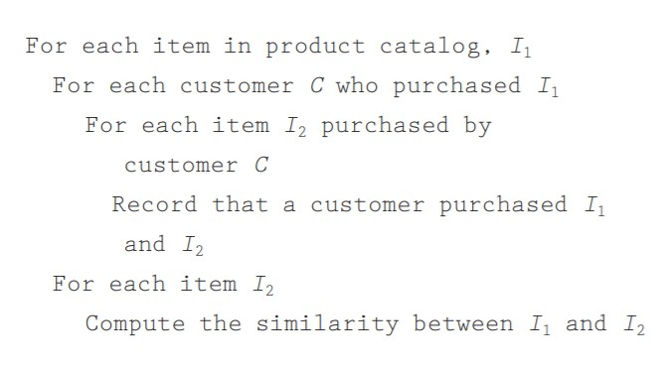

Slide 21
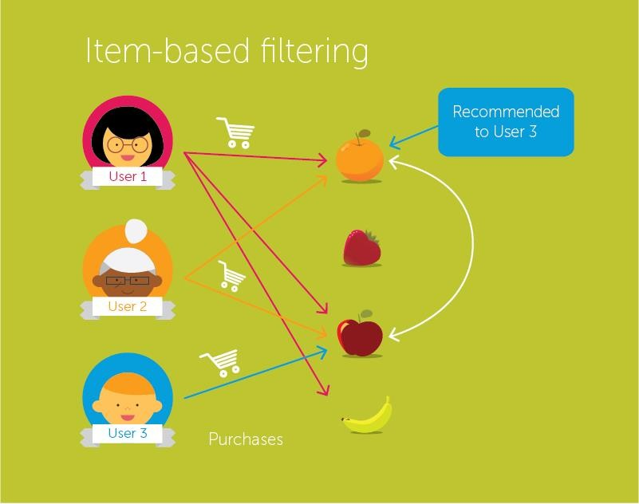

Slide 22
HOW IT WORKS
 It’s possible to compute the similarity between two items in various ways, but a common method is to use the cosine measure, in which each vector corresponds to an item rather than a customer, and the vector’s M dimensions correspond to customers who have purchased that item.
 This offline computation of the similar-items table is extremely time intensive, with O(N2 M) as worst case, but in real time it is O(NM).
 Given a similar-items table, the algorithm finds items similar to each of the user’s purchases and ratings, aggregates those items, and then recommends the most popular or correlated items. This computation is very quick, depending only on the number of items the user purchased or rated.

Slide 23
SCALABILITY
 Traditional collaborative filtering does little or no offline computation, and its online computation scales with the number of customers and catalog items.
 Cluster models can perform much of the computation offline, but
recommendation quality is relatively poor. To improve it, it’s possible to increase the number of segments, but this makes the online user–segment classification expensive.
 Search-based models build keyword, category, and author indexes offline, but fail to provide recommendations with interesting, targeted titles. They also scale poorly for customers with numerous purchases and ratings.
 For item-to-item it is dependent only on how many items the user has purchased or rated. Thus, the algorithm is fast even for extremely large data sets. Because the algorithm recommends highly correlated similar items, recommendation quality is excellent.

Slide 24
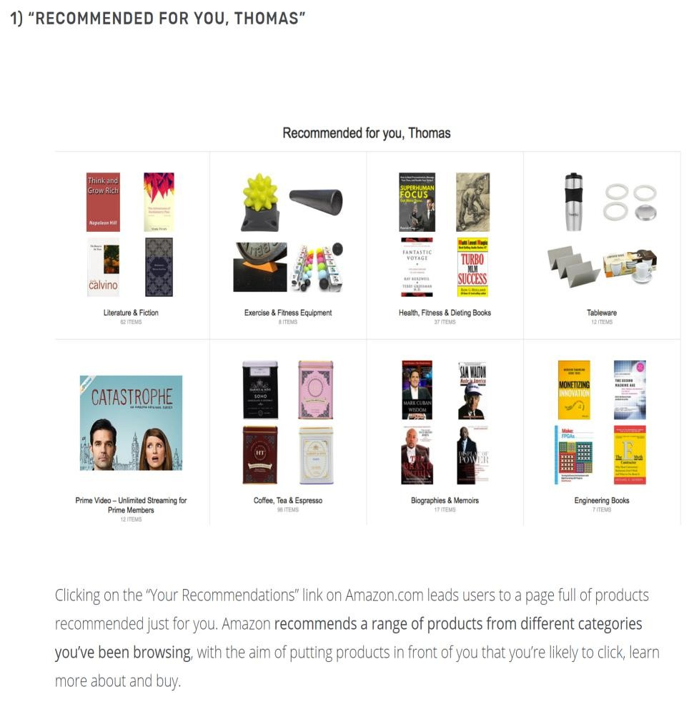
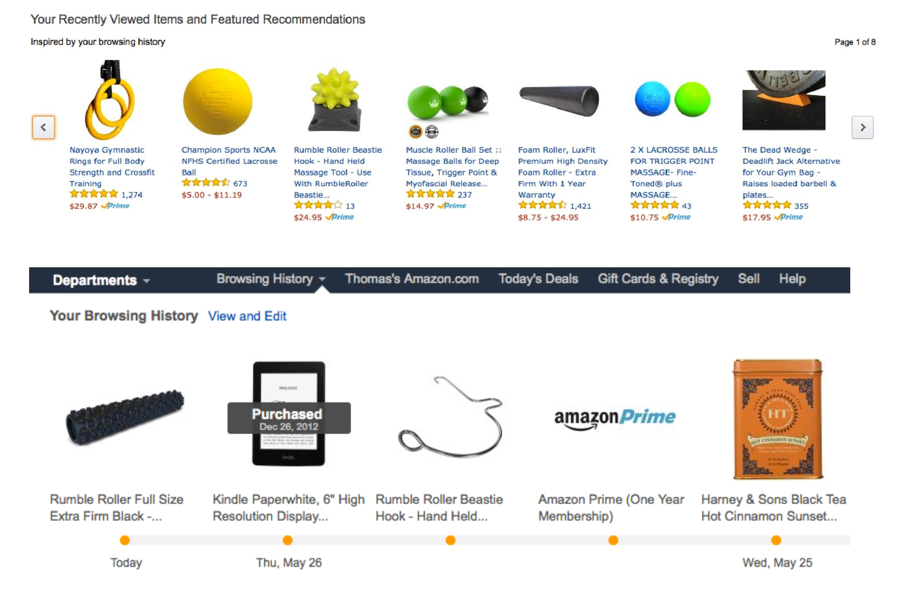
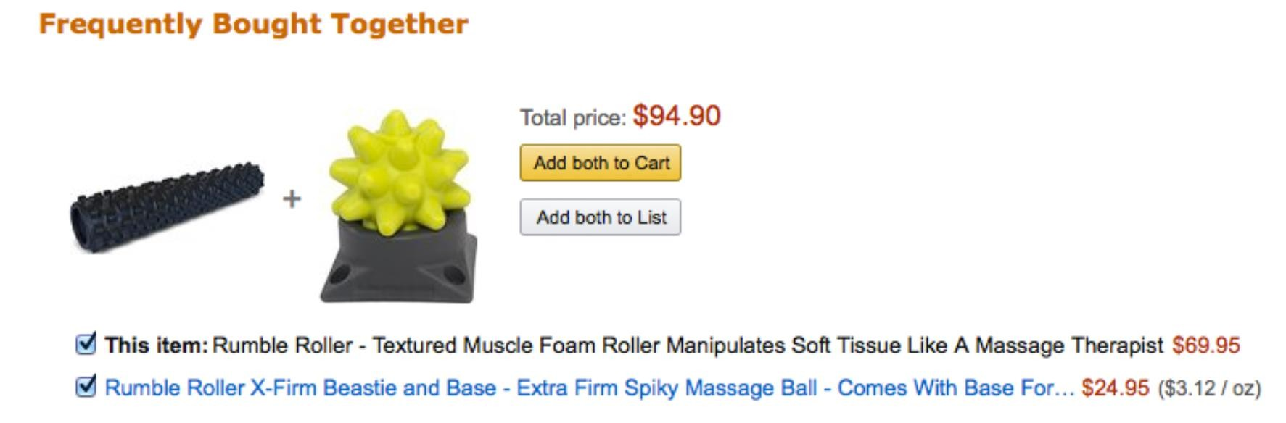

Slide 25
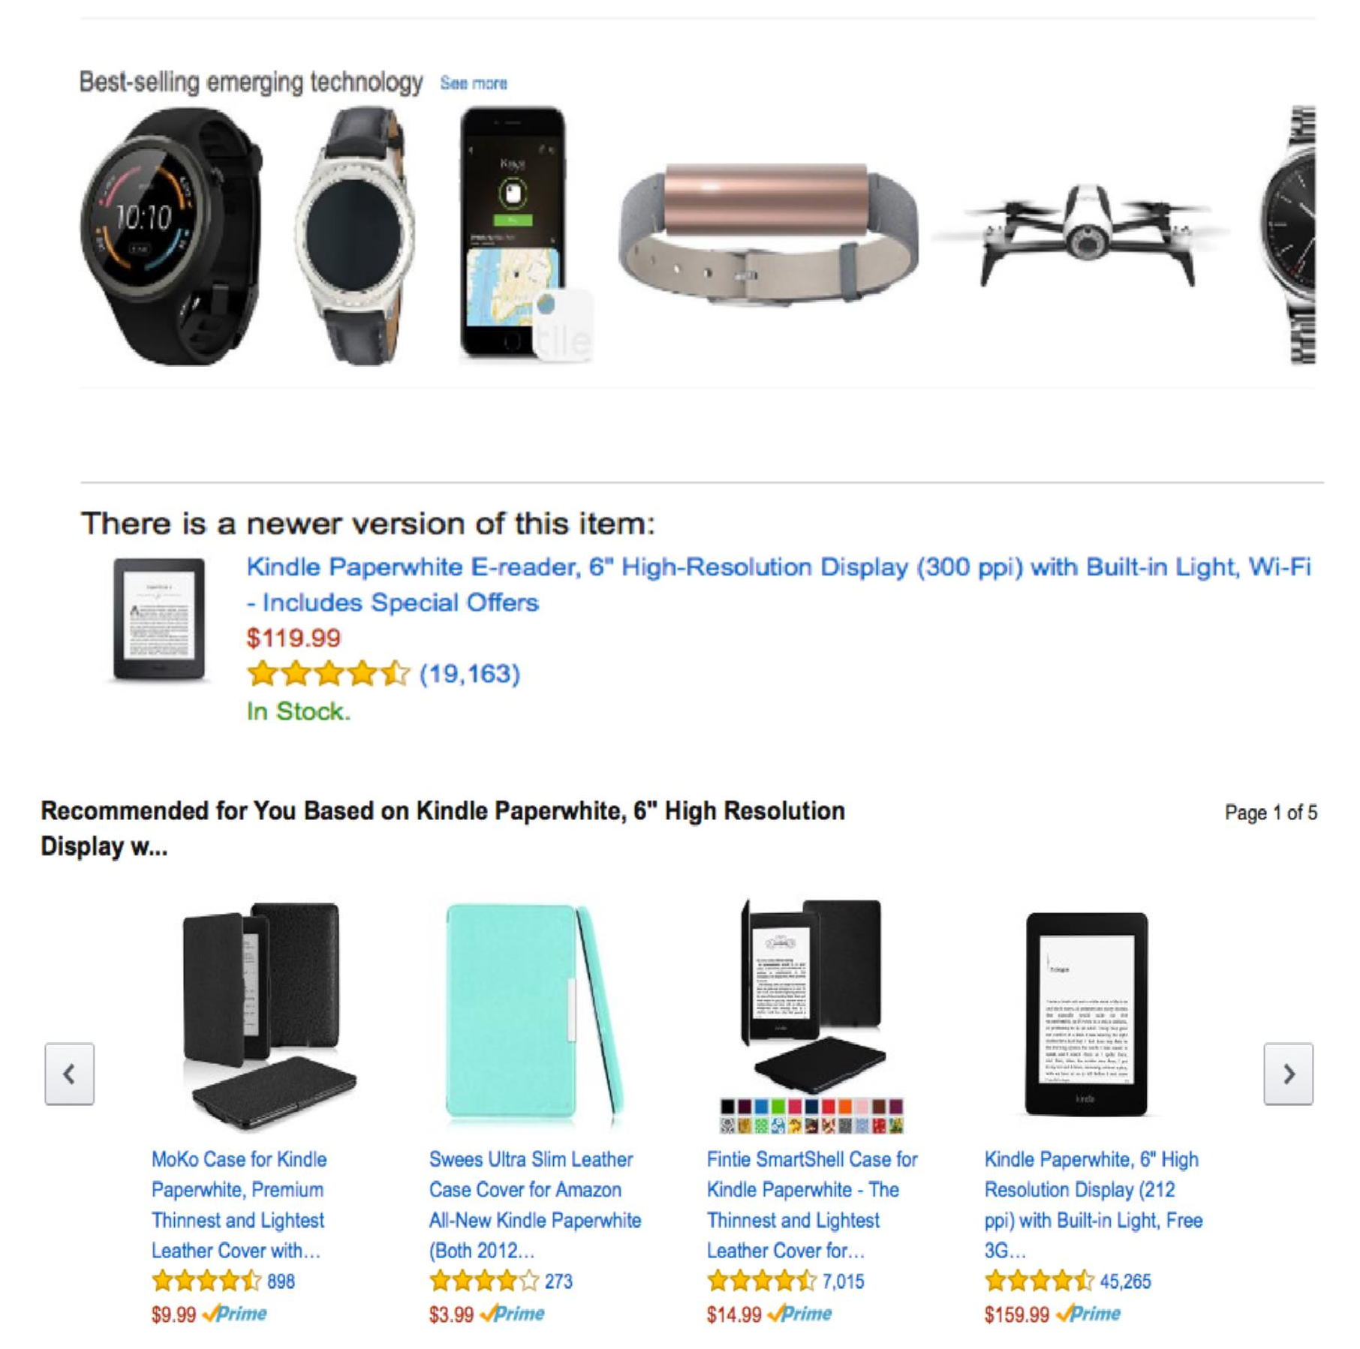

Slide 26



Recommendation algorithms provide an effective form of targeted marketing by creating a personalized shopping experience for each customer.
Unlike other algorithms, item-to- item collaborative filtering is able to meet the challenges.
In the future, we expect the retail industry to more broadly apply recommendation algorithms for targeted marketing, both online and offline.
CONCLUSION

Slide 27
THANK YOU

