Slide 1
Sparse Dictionary Learning
K - SVD

Slide 2
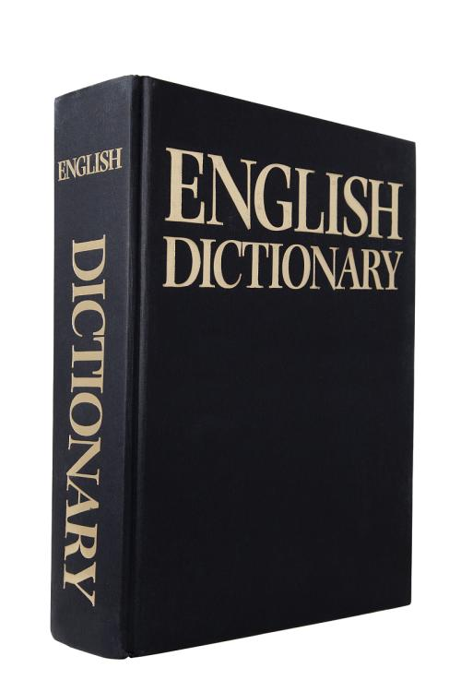
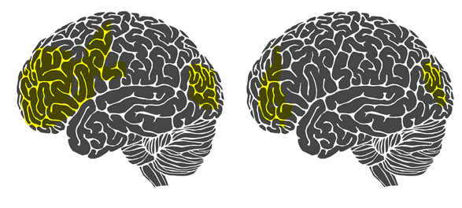
Dictionary Learning
A reduced dimension representation for large data sets
Dictionary learning always tries to learn the most plain features hidden behind samples.
(If the simplest feature of the sample is the best feature of it)
Sparse Representation
Represent as much knowledge as possible with fewer resources
(fast calculating speed)

Slide 3
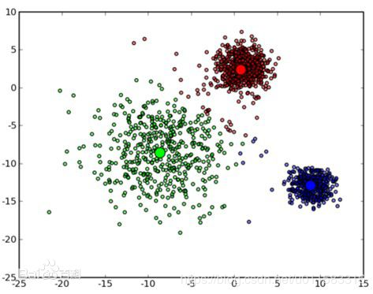
k-means
clustering algorithm
what is k?
K is the number of current classes in clustering algorithm
what is means?
Means is a mean algorithm

Slide 4
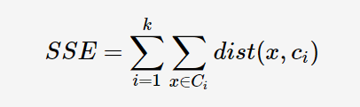
■ Selecting K points as initial clustering centers
■ According to the center of each cluster, the distance between each object and these centers is calculated, and the objects are re-divided according to the minimum distance.
■ Recalculate the center of each cluster.
■ When a certain condition is satisfied and if the classification does not change, the algorithm terminates, otherwise it continues to 2-3.
objective function:

Slide 5
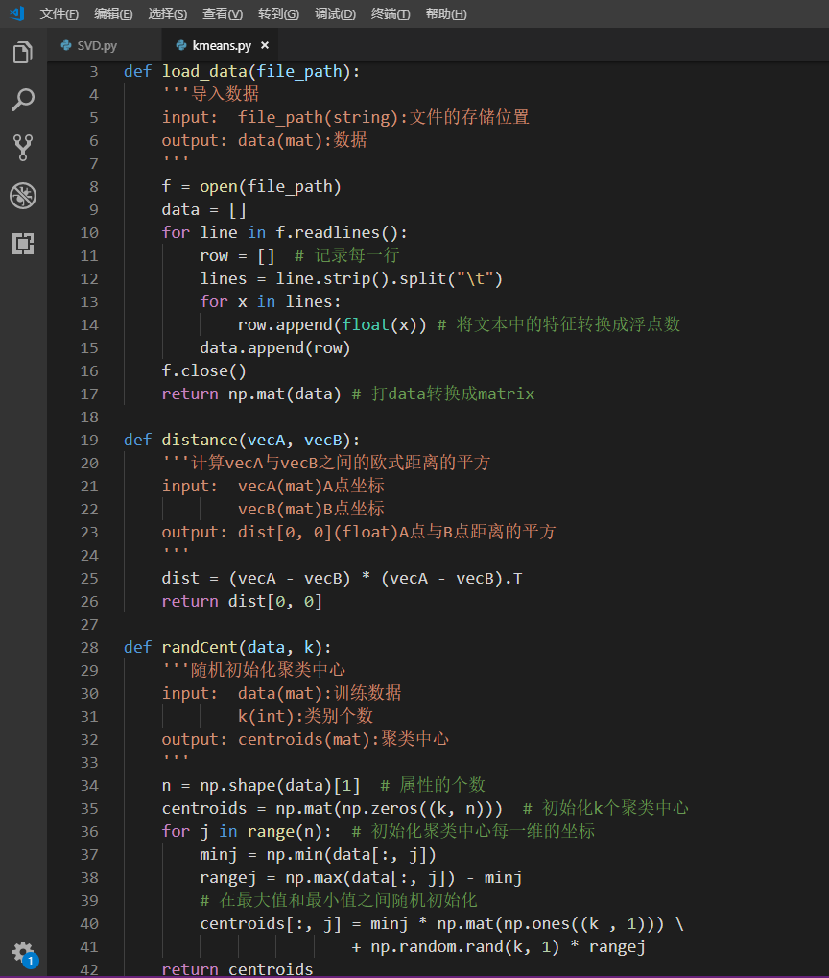
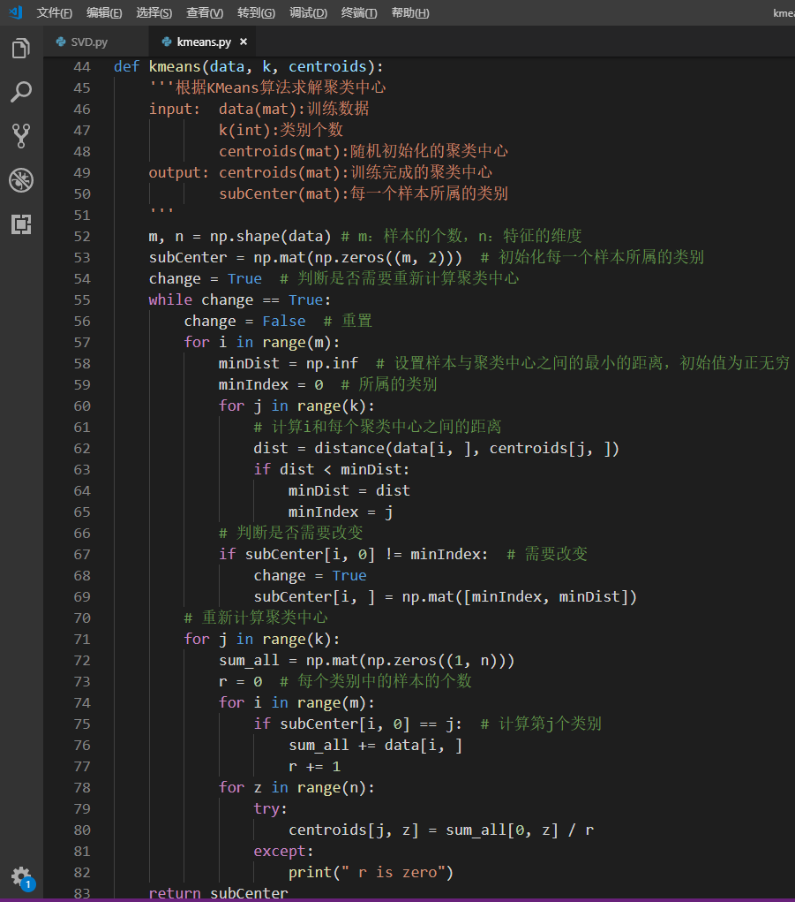

Slide 6
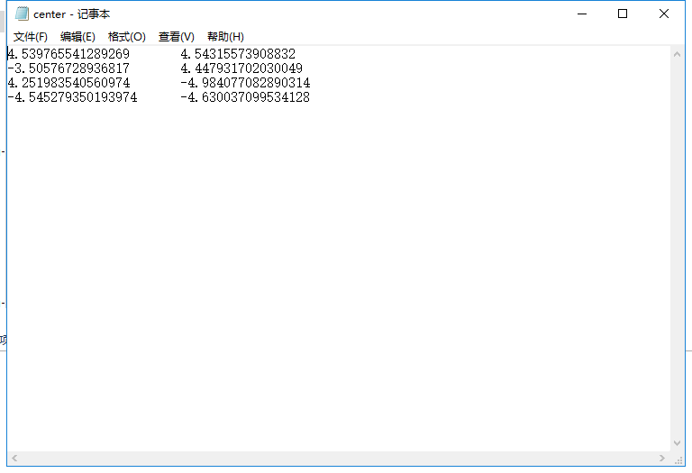
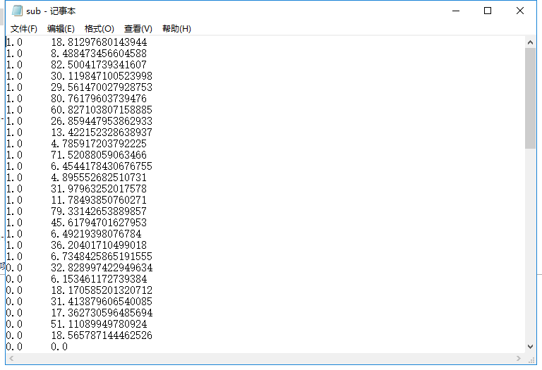

Slide 7
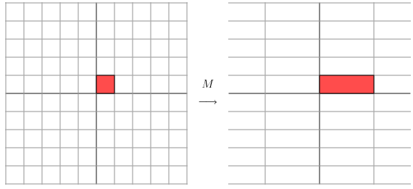
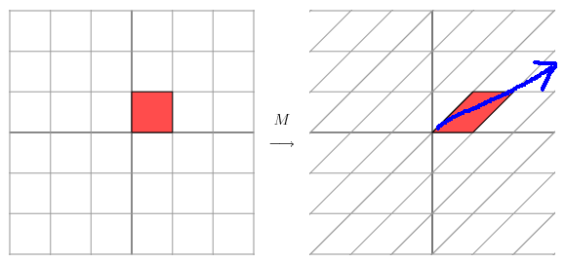
SVD(Singular Value Decomposition)
① Eigen Value Decomposition(for square matrix)
expression1:
expression2:
→ a matrix is a linear transformation
: eigenvector
: eigenvalue
: matrix of eigenvectors
: diagonal matrix

Slide 8
Conclusion: matrix transformation will cause a distortion on plane.
If you want to describe a linear transformation, main direction is a good choice.
in expression2: Σ is a diagonal matrix in which the eigenvalues are arranged from large to small.
The eigenvectors corresponding to these eigenvalues describe the direction of change of the matrix (from major change to minor change).It's obvious in the first
picture.

Slide 9
When the matrix is of high dimension, this transformation also has many directions.
We get the first N eigenvectors by eigenvalue decomposition and there will be N directions.
We can approximate the linear transformation(matrix) by using these directions.
Task: Extract the most important features of this matrix.
Conclusion: eigenvalues → the importance of the corresponding feature
eigenvectors → the feature
The limit of EigenValue Decomposition: square matrix.

Slide 10
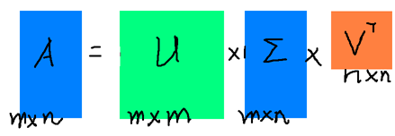
SVD(Singular Value Decomposition)
②Singular Value Decomposition(for any matrix)
if ,
U: m*m(unitary matrix) Σ: m*n(diagonal matrix) V: n*n(unitary matrix)
Deduction:
SVD
get V
get singular value
get U

Slide 11
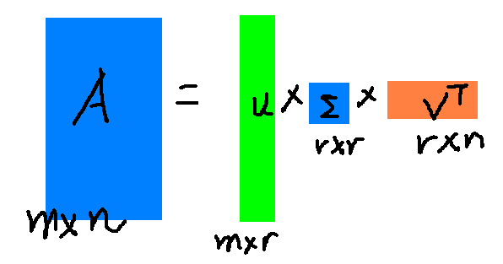
Properties of SVD
singular values in Σ arranged from large to small
singular values reduce particularly fast
In most cases,the sum of the first 10% or even 1% singular values accounts for more than 99% of the sum of all singular values.
Conclusion: r: the first r singular values

Slide 12
K-SVD(L0-norm) Dictionary Learning
K-SVD can be regarded as a generalization of K-means.
K-means algorithm can only approximate each signal with one atom, and each signal in K-SVD is represented by a linear combination of multiple atoms.
X is as sparse as possible, and each column of D is a normalized vector.
: matrix of samples
: dictionary
: coefficient matrix

Slide 13
Instead of approximating each sample using only one atom, we can learn a dictionary of K atoms to approximate a sample:
Since L0-norm is adopted,when updating D,we only care about the number of non-zeros in α but not the values of them.

Slide 14
How to learn?
step1:
Initialize dictionary D randomly:
choose K samples from set Y, initialize the coefficient matrix with 0.
step2:
Sparse coding for each sample with D unchanged.
objective function:
supposing there is a sample y, and a dictionary(K=4)
get sparse coding X of Y, and make X more sparser.

Slide 15
1.
find the closest vector of y,
α1*y、α2*y、α3*y、α4*y
choose the largest value of the four expressions consider α2.
2.
Since α2 is so close to y, we can design x to make α2 and y closer.
b is unknown, so work it out.
equation: y - b * α2 = 0
by using Least squares we can get optimum solution but not real solution.
3.
after we get b, we do : y' = y - b * α2
{
if(y' <= ε) get another y
else make it better!
}

Slide 16
4. make it better.
do: α1*y’、α3*y’、α4*y’
choose the largest value consider α3
then:
equation: y - b * α2 - c * α3 = 0 , get b, c.
equation: y' = y - b * α2 - c * α3
check:
{
if(y' <= ε) get another y
else make it better!
}
5.remember to choose who has more zeros.
Don't forget

Slide 17
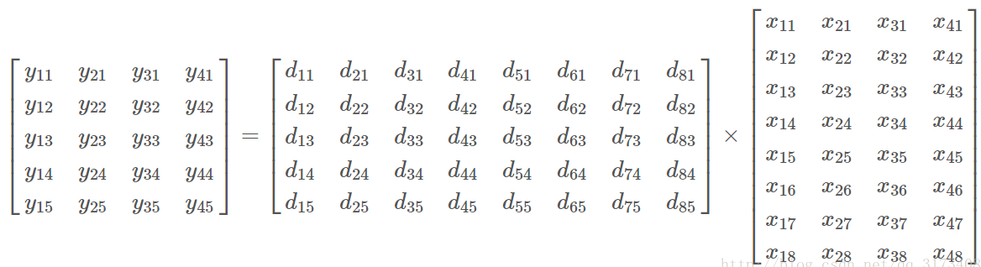
Update dictonary and coding matrix(Iteration)
Update dictionaries by column: when the atoms in column K are updated, the other atoms remain unchanged.
Assuming that we are going to update the kth atom , the objective function is:
consider:

Slide 18
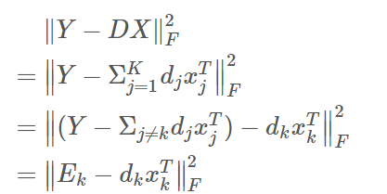

To the bigger matrix, we can do some changes:
Since D and X are stored by column, we need to transpose x in following expression:
Now, the problem is how to get new d and x:
traget: make nominal.
when we update ,we just need to update nonzero atoms.

Slide 19
make :
New problem:
if decomposition directly, the zero-elements will be changed to non-zero.
Solution:
In the process of iteration,we can find the last Y which used in D.
example:
In , assuming that is not zero, then the corresponding column 1,3 of Y is the signal K in D.
SVD
approach
approach

Slide 20
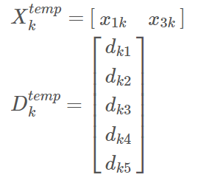
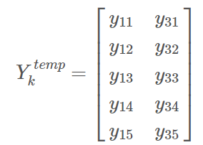
split:
In this way, we can get X and D which only at non-zero position.Then calculate the objective function
Do SVD: , take the first column of as , take the first column of *
as .
Then the algorithm is updated iteratively until it converges.

Slide 21
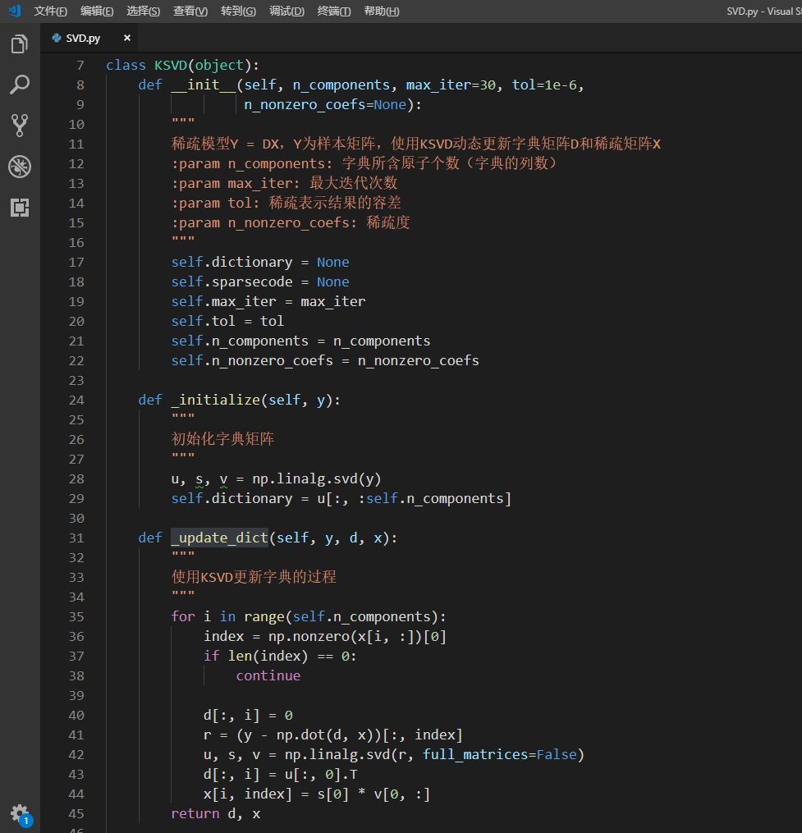
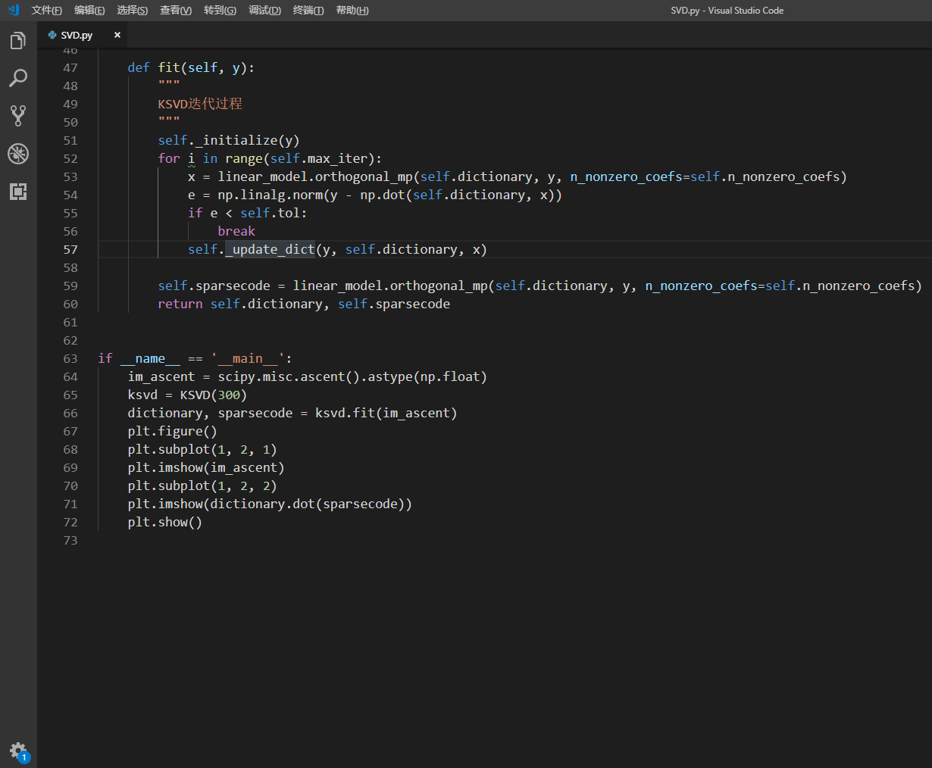

Slide 22
