Slide 1
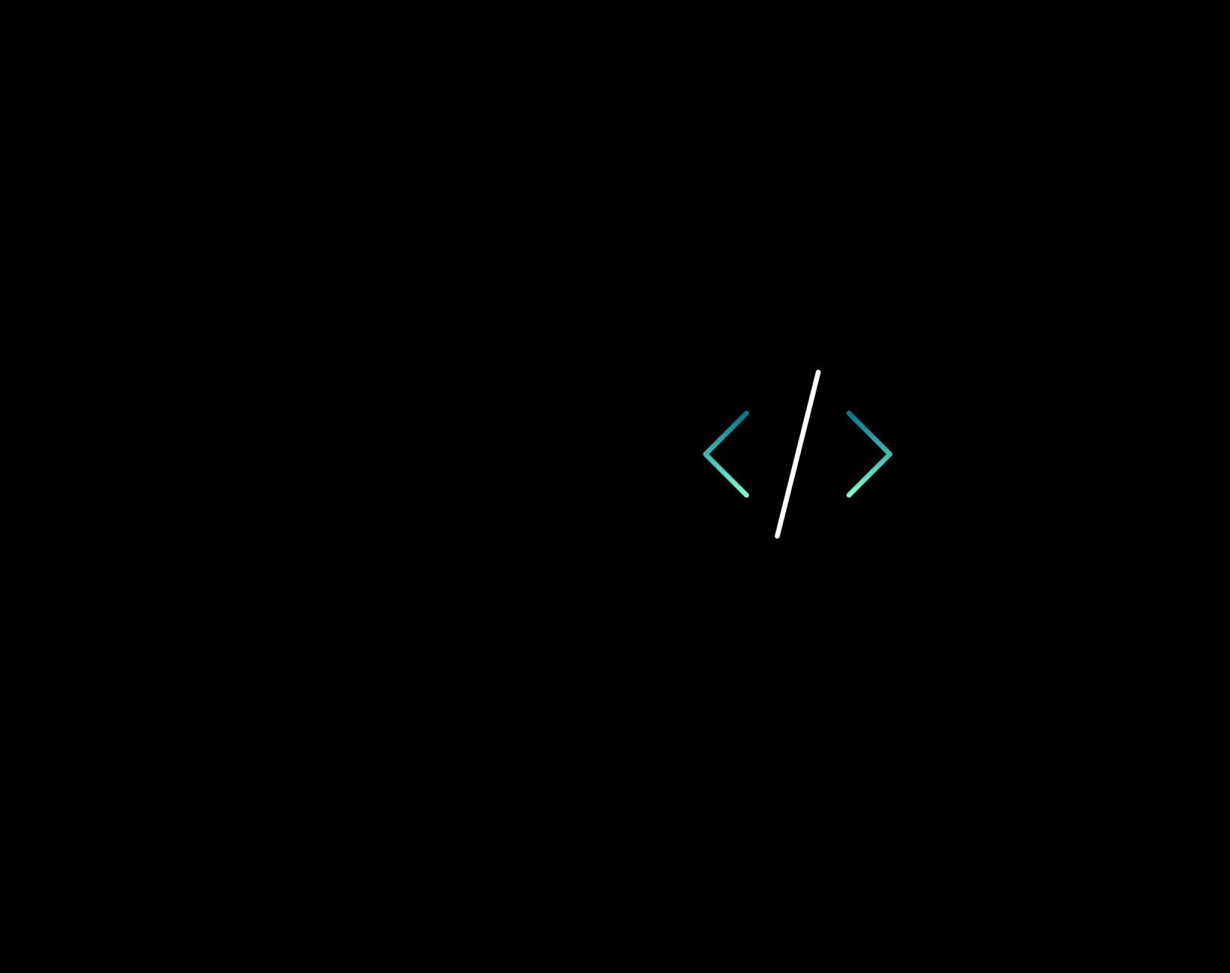
Search algorithm using BWT and FM index
Glorija Došlo, 2023/3106
Jovana Nikolić, 2022/3233

Slide 2
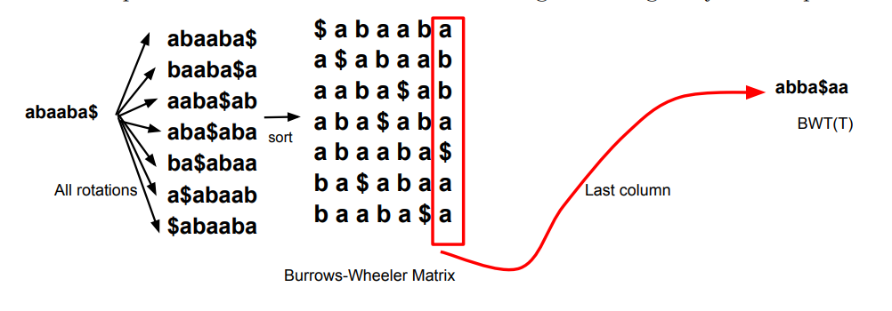
Burrows-Wheeler Transformation
BWT is reversible transformation used for searching the strings within the string
How to construct BWT matrix?
Construct all rotations of original string
Sort them
The last column of the BWT matrix represents transformed version of original string
What is B-rank?
Assigned to the characters in the BWT matrix
Represents how many times certain character appeared in the string so far
Used to find original string from BWT

Slide 3
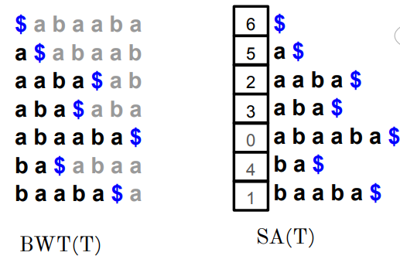
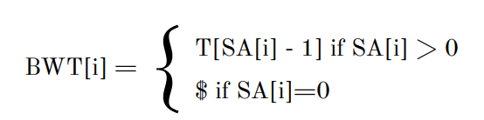
Suffix array
Data structure used in string processing
How to construct suffix array?
Find all suffixes of the original string
Sort them lexicographically
The suffix array contains indexes of the beginnings of sorted suffixes in original string
Optimization
Use checkpoints to save only certain values inside array

Slide 4
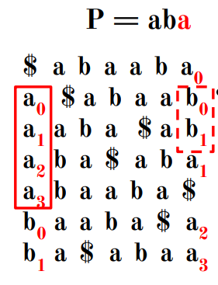
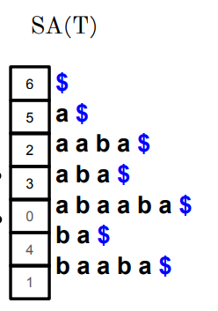
FM search
Search for patterns within a text using the FM index
How to do the search?
Start with the shortest suffix in pattern
Use first and last column with ranks of BW matrix
Extend suffixes until pattern length is reached
Look at the suffix array to find on which indexes pattern begins in the original string

Slide 5
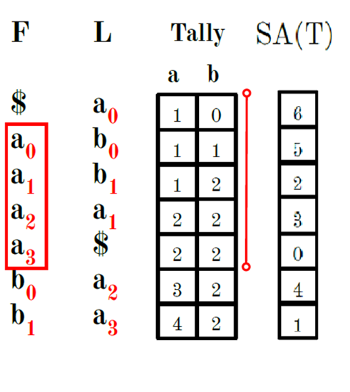
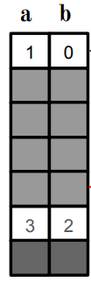

FM search optimizations
Tally matrix
Constructed based on BWT
Stores the count of occurrences of character up to that position
Used for fast calculations of character ranks
Optimization
Use checkpoints to save only certain values inside tally matrix
Suffix array
Contains only checkpoint values

Slide 6

Coffea arabica
TALLY CHECKPOINT: 128
SUFFIX ARRAY CHECKPOINT: 16
Original code performance
Sequence: ATGCATG
Execution time [s]: 0.734
Sequence: TCTCTCTA
Execution time [s]: 0.687
Sequence: TTCACTACTCTCA
Execution time [s]: 0.765
Memory usage [MB]: 1931.63
Optimized code performance
Sequence: ATGCATG
Execution time [s]: 0.047
Sequence: TCTCTCTA
Execution time [s]: 0.016
Sequence: TTCACTACTCTCA
Execution time [s]: 0.0
Memory usage [MB]: 186.42

Slide 7
Mus pahari
TALLY CHECKPOINT: 128
SUFFIX ARRAY CHECKPOINT: 16
Original code performance
Sequence: ATGATG
Execution time [s]: 5.328
Sequence: CTCTCTA
Execution time [s]: 15.203
Sequence: TCACTACTCTCA
Execution time [s]: 10.8
Memory usage [MB]: 5685.00
Optimized code performance
Sequence: ATGATG
Execution time [s]: 4.203
Sequence: CTCTCTA
Execution time [s]: 3.969
Sequence: TCACTACTCTCA
Execution time [s]: 0.0
Memory usage [MB]: 522.26

Slide 8
Aquila chrysaetos
TALLY CHECKPOINT: 128
SUFFIX ARRAY CHECKPOINT: 16
Original code performance
Sequence: CCAAAGA
Execution time [s]: 1.234
Sequence: TACATTT
Execution time [s]: 1.406
Sequence: AGGAAAAAT
Execution time [s]: 1.156
Memory usage [MB]: 2947.47
Optimized code performance
Sequence: CCAAAGA
Execution time [s]: 0.047
Sequence: TACATTT
Execution time [s]: 0.141
Sequence: AGGAAAAAT
Execution time [s]: 0.016
Memory usage [MB]: 283.25

Slide 9
Questions?

