Slide 1
Improving Music Recommendation Systems For Youngsters
Borislav Semerdzhiev

Slide 2
Background of the research
Music plays a crucial part in a child’s development
Most music recommenders cater to the adult group
There is no single best strategy for recommending to youngsters

Slide 3
Research Question
Main research question
Sub-questions
Determine which features of a song influence a listener’s opinion about a song.
Determine how to represent these features as a continuous/discrete variable.
Build a profile for a user using those approximated ratings and song features.
Predict a rating to a song that the user hasn’t heard using the constructed profile.

Slide 4
Methods
Read previous researches to determine important features from songs
Spotify API to extract the features
Use implicit feedback techniques to approximate user ratings
Use collaborative filtering to make new predictions
Test the model on unseen data

Slide 5
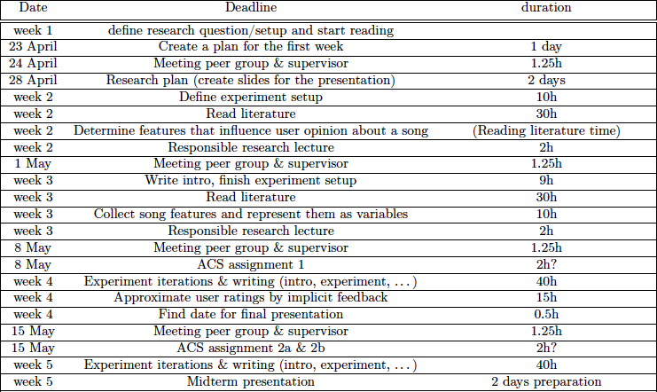
Planning of the research project

Slide 6
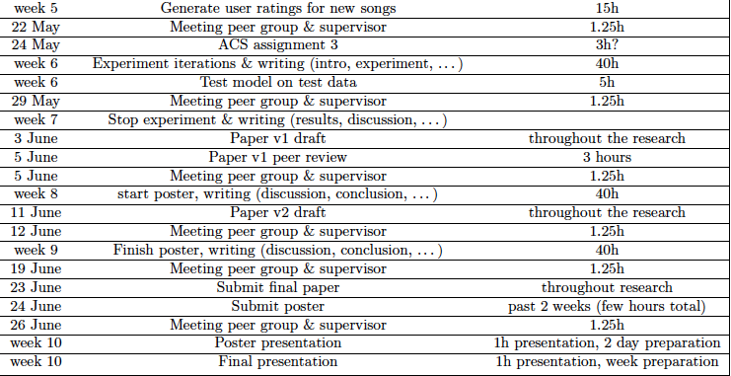
Planning of the research project

Slide 7
Thank you for the attention!

