Slide 1
Financial Performance Dashboards
Overview of Sales and Profit Analysis (2022-2024)

Slide 2
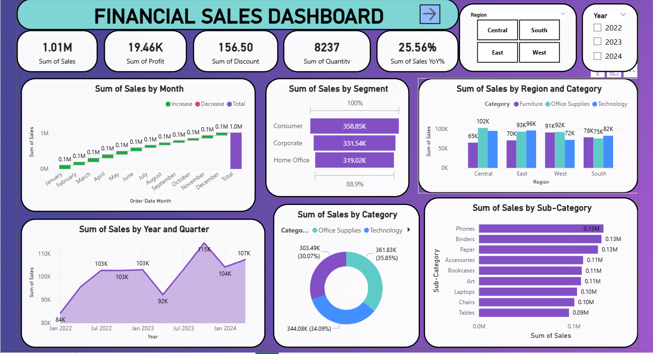
Financial Sales Dashboard

Slide 3
SALES OVERVIEW
This dashboard provides insights into overall sales performance, segmented by month, region, category, and customer segment.
• Total Sales: 1.01M with a YoY growth of 25.56%
• Highest sales recorded in December with consistent monthly growth.
• Technology leads with 35.85% contribution, followed by Office Supplies (34.08%) and Furniture (30.07%).
• Central region generated the highest sales (102K), while South recorded the lowest (82K).

Slide 4
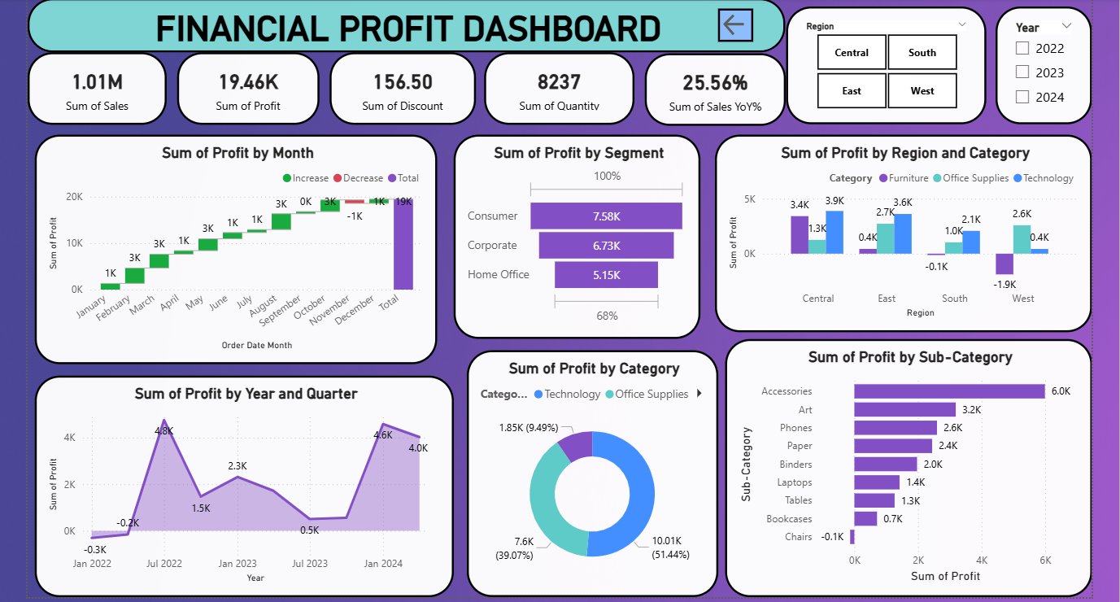
Financial Profit Dashboard

Slide 5
PROFIT OVERVIEW
This dashboard focuses on profit trends across categories, regions, and time periods.
• Total Profit: 19.46K generated mainly from Technology and Office Supplies.
• Highest profit achieved in Q3 2023 (4.6K), showing strong mid-year performance.
• Accessories sub-category delivered the highest profit (6K), while Chairs showed slight losses (-0.1K).
• Regional analysis shows Central and East as profitable, while West recorded minor losses.

Slide 6
Overall Insights & Recommendations
Sales have shown steady growth across all regions and categories, driven by Technology and Office Supplies.
Profit margins are highest in Technology and Accessories, but some regions (West, South) need improvement.
Focus on optimizing low-performing sub-categories like Chairs and Bookcases.
Regional marketing and distribution strategies can further enhance performance.
Strengthen inventory and discount management to sustain profit growth.

Slide 7
THANK YOU

