Slide 1

Faculty of Computer Science
School of Software Engineering
SQLite RDBMS Extension for Data Indexing Using B-tree Modifications
Student: Anton Rigin
Academic Supervisor: Sergey Shershakov, Senior Lecturer at School of Software Engineering
Presentation at SYRCoSE 2019
Saratov, 2019

Slide 2

Faculty of Computer Science
Outline
B-tree and modifications
SQLite and extensions
B-tree modifications C++ library and research conducted
Motivation, existing solutions and main goals
Algorithm of selecting the index structure
Technologies used
Implementation
Usage example and experiment conducted

Slide 3
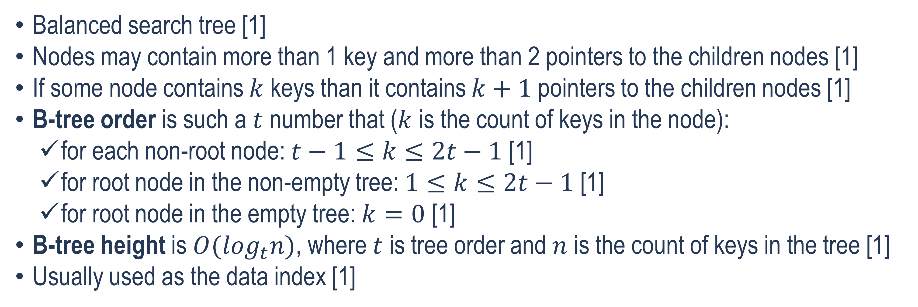
Faculty of Computer Science
B-tree
Balanced search tree [1]
Nodes may contain more than 1 key and more than 2 pointers to the children nodes [1]
If some node contains $k$ keys than it contains $k+1$pointers to the children nodes [1]
B-tree order is such a $t$ number that ($k$ is the count of keys in the node):
for each non-root node: $t−1≤k≤2t−1$ [1]
for root node in the non-empty tree: $1≤k≤2t−1$ [1]
for root node in the empty tree: $k=0$ [1]
B-tree height is $O(\log_{t}n)$, where $t$ is tree order and $n$ is the count of keys in the tree [1]
Usually used as the data index [1]
[1] R. Bayer and E. McCreight, “Organization and maintenance of large ordered indexes,” Acta Informatica, vol. 1, no. 3, pp. 173 – 189, 1972.
3

Slide 4
Faculty of Computer Science
B-tree
Root node
Pointer to child
Key
The B-tree example, t = 6
Leaf node
4

Slide 5
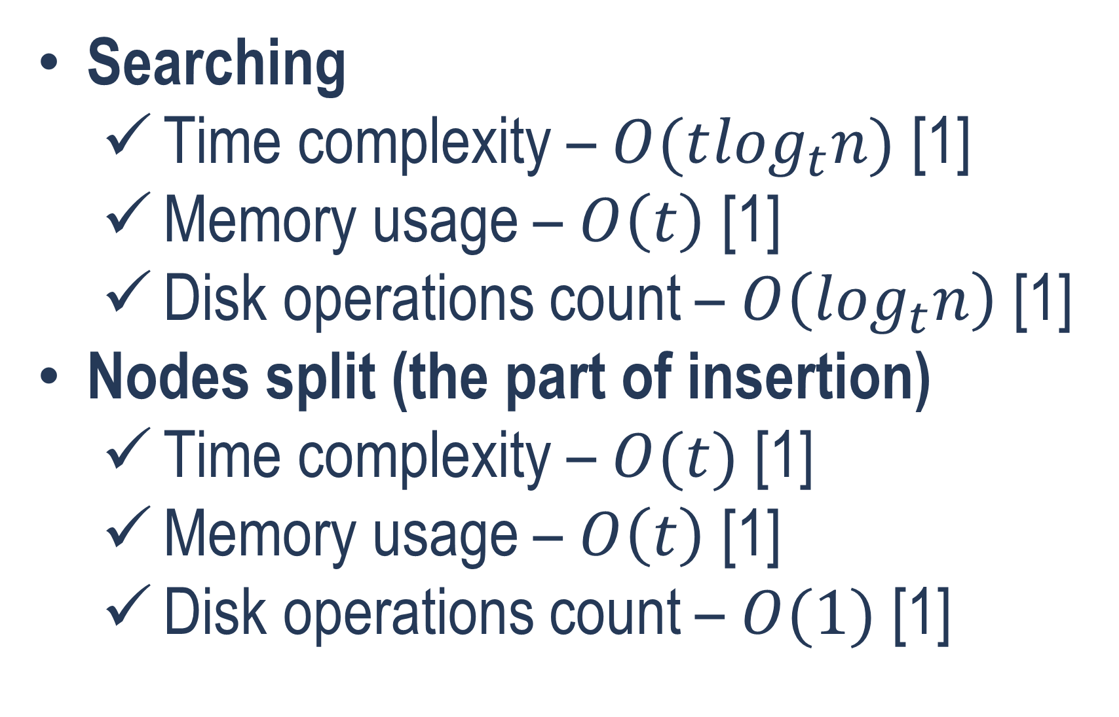
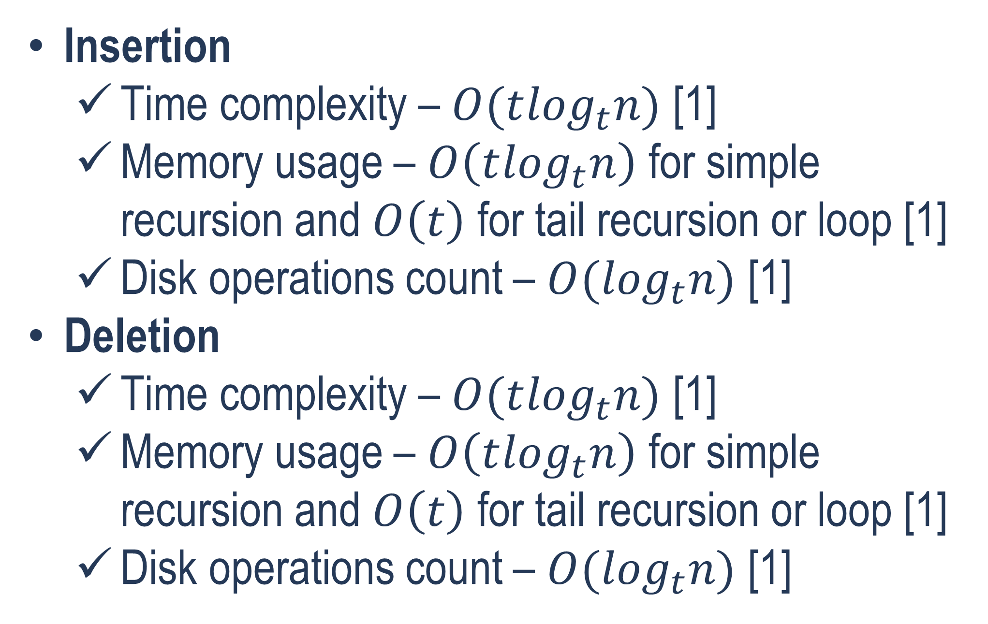
Faculty of Computer Science
B-tree Operations
Insertion
Time complexity – $O(t\log_{t}n)$ [1]
Memory usage – $O\left(t\log_{t}n\right)$ for simple recursion and $O\left(t\right)$ for tail recursion or loop [1]
Disk operations count – $O(\log_{t}n)$ [1]
Deletion
Time complexity – $O(t\log_{t}n)$ [1]
Memory usage – $O\left(t\log_{t}n\right)$ for simple recursion and $O\left(t\right)$ for tail recursion or loop [1]
Disk operations count – $O(\log_{t}n)$ [1]
Searching
Time complexity – $O(t\log_{t}n)$ [1]
Memory usage – $O\left(t\right)$ [1]
Disk operations count – $O\left(\log_{t}n\right)$ [1]
Nodes split (the part of insertion)
Time complexity – $O(t)$ [1]
Memory usage – $O\left(t\right)$ [1]
Disk operations count – $O(1)$ [1]
[1] R. Bayer and E. McCreight, “Organization and maintenance of large ordered indexes,” Acta Informatica, vol. 1, no. 3, pp. 173 – 189, 1972.
5

Slide 6
Faculty of Computer Science
B-tree Modifications
B⁺-tree
Only leaf nodes contain real keys (real data), other nodes contain router keys [2]
Deletion is probably faster than in B-tree
B*-tree
Each node (except of the root node) is filled at least by 2/3 not 1/2 [3]
Keys insertion in B*-tree is expected to be faster than in B-tree
B^{*+}-tree
Developed previously by author of this work [4]
Combines the main B⁺-tree and B*-tree features together [4]
[2] K. Pollari-Malmi. (2010). B+-trees [PDF paper]. Available: https://www.cs.helsinki.fi/u/mluukkai/tirak2010/B-tree.pdf
[3] “B*-tree.” NIST Dictionary of Algorithms and Data Structures. Available: https://xlinux.nist.gov/dads/HTML/bstartree.html (accessed Dec. 24, 2018). [4] A. Rigin, “On the Performance of Multiway Trees in the Problem of Structured Data Indexing,” (in Russian), coursework, Dept. Soft. Eng., HSE, Moscow, Russia, 2018.
6

Slide 7


Faculty of Computer Science
SQLitE
Popular open-source embedded relational DBMS
Written in the C language
Uses the B-tree as the default index
SQLite extensions are the dynamically linked libraries [5]
[5] “Run-Time Loadable Extensions.” SQLite.org. Available: https://www.sqlite.org/loadext.html (accessed Jan. 20, 2019).

Slide 8

Faculty of Computer Science
B-tree Modifications C++ Library
Developed previously [4]
Contains B-tree, B⁺-tree, B*-tree and B^{*+}-tree implementations
In the current work connected to the SQLite as the run-time loadable extension
[4] A. Rigin, “On the Performance of Multiway Trees in the Problem of Structured Data Indexing,” (in Russian), coursework, Dept. Soft. Eng., HSE, Moscow, Russia, 2018.
8

Slide 9
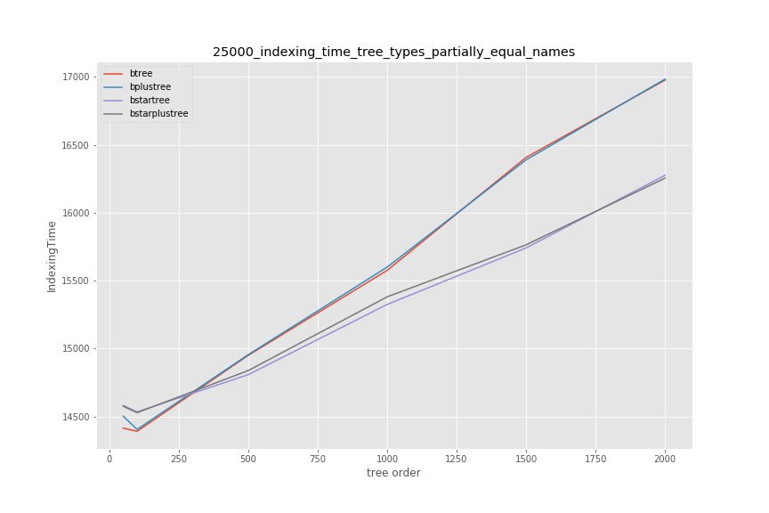
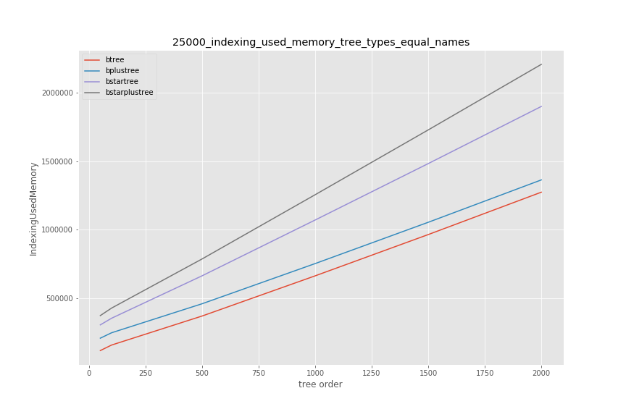
Faculty of Computer Science
Research Conducted using the B-tree Modifications C++ Library
[4] A. Rigin, “On the Performance of Multiway Trees in the Problem of Structured Data Indexing,” (in Russian), coursework, Dept. Soft. Eng., HSE, Moscow, Russia, 2018.
9

Slide 10
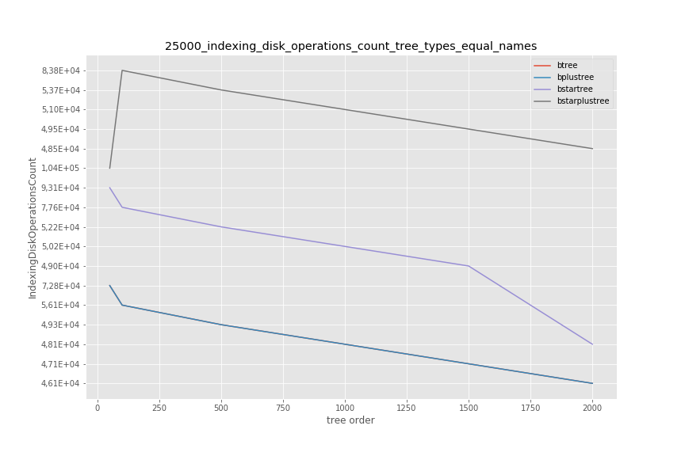
Faculty of Computer Science
Research Conducted using the B-tree Modifications C++ Library
[4] A. Rigin, “On the Performance of Multiway Trees in the Problem of Structured Data Indexing,” (in Russian), coursework, Dept. Soft. Eng., HSE, Moscow, Russia, 2018.
10

Slide 11
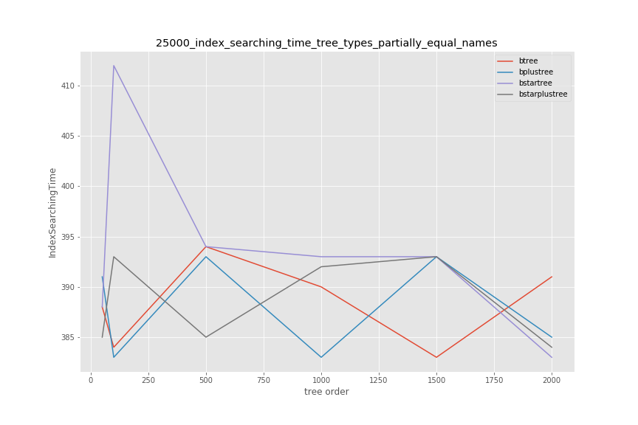
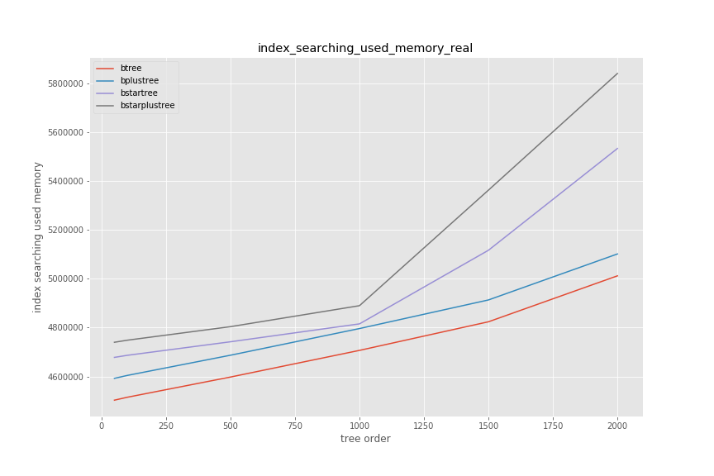
Faculty of Computer Science
Research Conducted using the B-tree Modifications C++ Library
[4] A. Rigin, “On the Performance of Multiway Trees in the Problem of Structured Data Indexing,” (in Russian), coursework, Dept. Soft. Eng., HSE, Moscow, Russia, 2018.
11

Slide 12
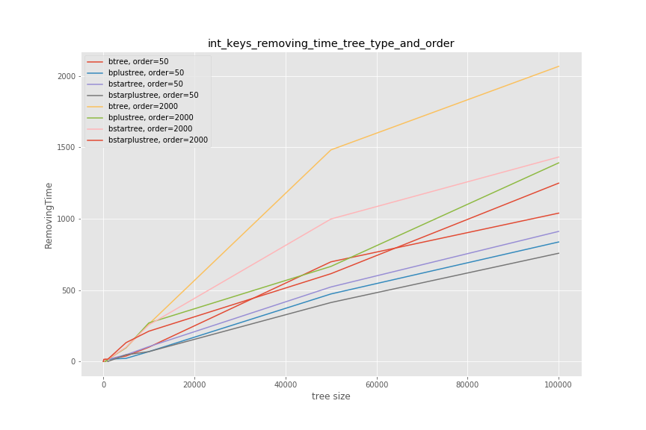
Faculty of Computer Science
Research Conducted using the B-tree Modifications C++ Library
[4] A. Rigin, “On the Performance of Multiway Trees in the Problem of Structured Data Indexing,” (in Russian), coursework, Dept. Soft. Eng., HSE, Moscow, Russia, 2018.
12

Slide 13
Faculty of Computer Science
Motivation and existing solutions
Motivation
In the current time, the data amounts are continuously growing
It is necessary to develop new efficient approaches to data indexing in the DBMSs
SQLite contains a small number of index structures by default – it is relevant to add new ones
Existing solutions
B-tree is the default index structure in the SQLite
There are some SQLite extensions (for example, the extension adding the R-tree indexing)
No extensions with B⁺-tree, B*-tree, and B^{*+}-tree were found
13

Slide 14
Faculty of Computer Science
The Main Goals of the Work
To add B-tree modifications such as B⁺-tree, B*-tree and B^{*+}-tree to SQLite
To develop and implement an algorithm that would allow selecting the indexing data structure (B⁺-tree, B*-tree or B^{*+}-tree) when a user manipulates a table
14

Slide 15
Faculty of Computer Science
Algorithm of Selecting the Index Structure
Selects from the B-tree modifications (B⁺-tree, B*-tree and B^{*+}-tree)
Executed at the start of each table operation (search, insertion, updating, deletion)
Performs the index structure rebuilding only on each 1000-th operation and only for the first 10000 operations
Index structure selection depends on the ratios of the numbers of operations of different types (search, insert, delete) on the tree
The tree order of the B-trees and their modifications used in the SQLite extension developed in this work equals 750
The B⁺-tree is used by default in the SQLite extension
15

Slide 16
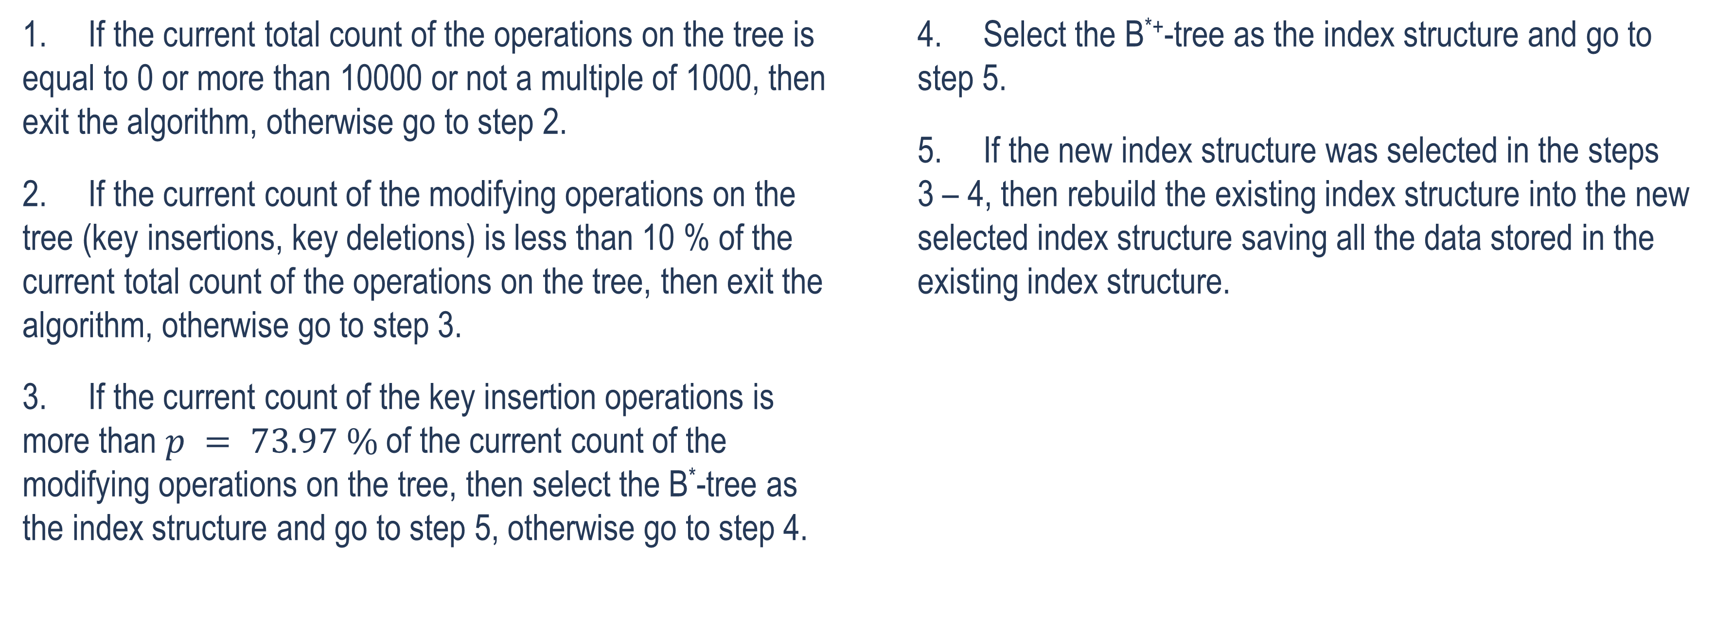
Faculty of Computer Science
Algorithm of Selecting the Index Structure
1. If the current total count of the operations on the tree is equal to 0 or more than 10000 or not a multiple of 1000, then exit the algorithm, otherwise go to step 2.
2. If the current count of the modifying operations on the tree (key insertions, key deletions) is less than 10 % of the current total count of the operations on the tree, then exit the algorithm, otherwise go to step 3.
3. If the current count of the key insertion operations is more than $p = 73.97 \%$ of the current count of the modifying operations on the tree, then select the B*-tree as the index structure and go to step 5, otherwise go to step 4.
4. Select the B^{*+}-tree as the index structure and go to step 5.
5. If the new index structure was selected in the steps 3 – 4, then rebuild the existing index structure into the new selected index structure saving all the data stored in the existing index structure.
16

Slide 17
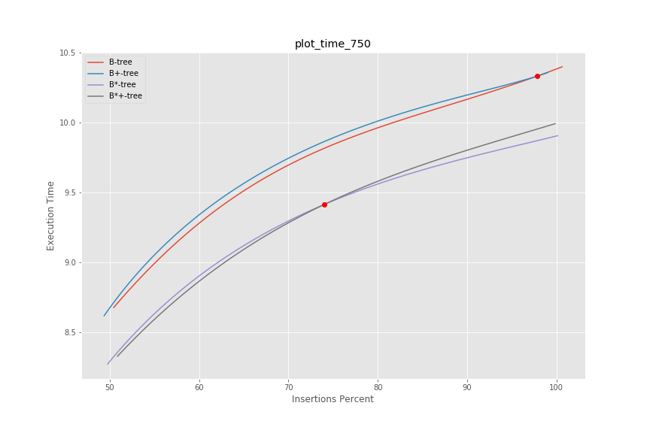
Faculty of Computer Science
Algorithm of Selecting the Index Structure
17

Slide 18

Faculty of Computer Science
Tree Key Structure
primary key value
row id (8 bytes)

Slide 19






Faculty of Computer Science
Technologies Used

Slide 20
Faculty of Computer Science
Implementation
The C API for the B-tree modifications library is implemented as dynamically shared library using the extern “C” { … } C++ statement
The SQLite extension registers the btrees_mods module for creating the virtual tables
Virtual table is any table created using such a module
The extension also registers the btreesModsVisualize, btreesModsGetTreeOrder, btreesModsGetTreeType functions

Slide 21
Faculty of Computer Science
Implementation
Method | Purpose
btreesModsCreate(sqlite3*, void*, int, const char* const*, sqlite3_vtab**, char**) | Creates a new table.
btreesModsUpdate(sqlite3_vtab*, int, sqlite3_value**, sqlite_int64*) | Inserts, deletes or updates a value of a row in the table.
btreesModsFilter(sqlite3_vtab_cursor*, int, const char*, int, sqlite3_value**) | Searches for a row in the table.

Slide 22
Faculty of Computer Science
Implementation
Method | Purpose
btreesModsVisualize(sqlite3_context*, int, sqlite3_value**) | Outputs the graphical representation of the table’s index structure (tree) into the GraphViz DOT file.
btreesModsGetTreeOrder(sqlite3_context*, int, sqlite3_value**) | Outputs the order of the tree used as the table’s index structure.
btreesModsGetTreeType(sqlite3_context*, int, sqlite3_value**) | Outputs the type of the tree (1 – B-tree, 2 – B⁺-tree, 3 – B*-tree, 4 – B^{*+}-tree) used as the table’s index structure.

Slide 23
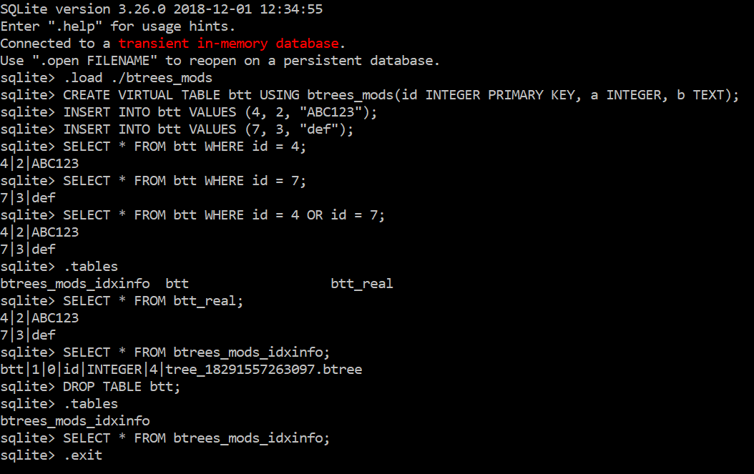
Faculty of Computer Science
Usage Example

Slide 24
Faculty of Computer Science
Experiment conducted using the Sqlite Extension
Operation on the table | Total execution time (ms) | Mean execution time per row (ms)
Table creation | 20 | -
First 500 rows insertion | 10301 | 20.6
Next 500 rows insertion | 10322 | 20.6
1001st row insertion (including the B⁺-tree into the B*-tree rebuilding) | 40 | 40
Next 499 rows insertion | 9386 | 18.8
Last 500 rows insertion | 9032 | 18.1

Slide 25
Faculty of Computer Science
Experiment conducted using the Sqlite Extension
Operation on the table | Total execution time (ms) | Mean execution time per row (ms)
First 500 rows deletion | 11558 | 23.1
Next 500 rows deletion | 10708 | 21.4
1001st row insertion (including the B*-tree into the B^{*+}-tree rebuilding) | 62 | 62
Next 499 rows deletion | 9418 | 18.9
Last 500 rows deletion | 8863 | 17.7
1000 rows insertion | 18890 | 18.9
Next 5000 rows insertion (including the B^{*+}-tree into the B*-tree rebuilding) | 92395 | 18.5

Slide 26
Faculty of Computer Science
Experiment conducted using the Sqlite Extension
The key insertion on the B*-tree was faster than on the B⁺-tree
The key deletion on the B^{*+}-tree was faster than on the B*-tree
The key insertion on the B*-tree is slightly faster than on the B^{*+}-tree
The search on the table takes about 1 ms on all the B-tree modifications considered in this work

Slide 27
Faculty of Computer Science
Summary
The developed B^{*+}-tree has smaller computational complexity of keys insertion and deletion than B-tree, however it has greater memory usage
B-trees modifications library is connected to the SQLite as an extension using developed in this work C API
Research conducted using this library is presented
Algorithm of selecting the index structure is developed and implemented
Experiment on the trees performance is conducted using the developed SQLite extension

Slide 28
Faculty of Computer Science
References
[1] R. Bayer and E. McCreight, “Organization and maintenance of large ordered indexes,” Acta Informatica, vol. 1, no. 3, pp. 173 – 189, 1972.
[2] K. Pollari-Malmi. (2010). “B⁺-trees,” University of Helsinki. [PDF paper]. Available: https://www.cs.helsinki.fi/u/mluukkai/tirak2010/B-tree.pdf
[3] “B*-tree.” NIST Dictionary of Algorithms and Data Structures. Available: https://xlinux.nist.gov/dads/HTML/bstartree.html (accessed Dec. 24, 2018).
[4] A. Rigin, “On the Performance of Multiway Trees in the Problem of Structured Data Indexing,” (in Russian), coursework, Dept. Soft. Eng., HSE, Moscow, Russia, 2018.
[5] “Run-Time Loadable Extensions.” SQLite.org. Available: https://www.sqlite.org/loadext.html (accessed Jan. 20, 2019).

Slide 29
Thank you for your attention!
amrigin@edu.hse.ru
anton19979@yandex.ru
anton19979@yandex-team.ru

