Slide 1

Higher School of Economics
Faculty of Computer Science, School of Software Engineering
SQLite RDBMS Extension for Data Indexing Using B-tree Modifications
Anton Rigin, Sergey Shershakov
May 30 2019, SYRCoSE 2019, Saratov State University

Slide 2

Faculty of Computer Science
Outline
B-tree and modifications
Motivation, existing solutions and main goals
SQLite and extensions
B-tree modifications C++ library and research conducted
Algorithm of selecting the index structure
Implementation details
Usage example and experiment conducted

Slide 3
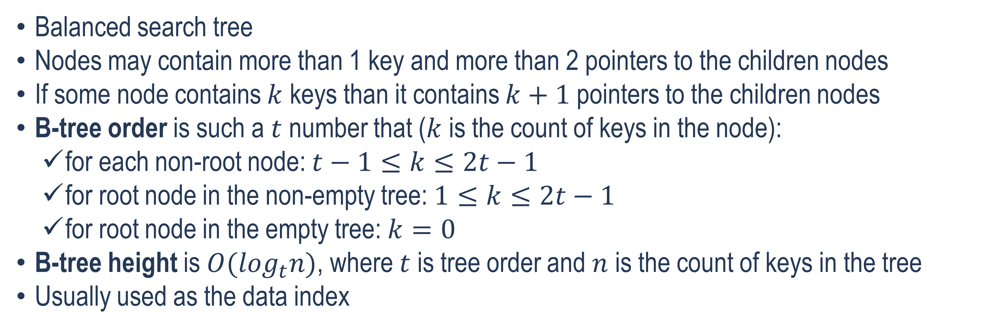
Faculty of Computer Science
B-tree
Balanced search tree
Nodes may contain more than 1 key and more than 2 pointers to the children nodes
If some node contains $k$ keys than it contains $k+1$pointers to the children nodes
B-tree order is such a $t$ number that ($k$ is the count of keys in the node):
for each non-root node: $t−1≤k≤2t−1$
for root node in the non-empty tree: $1≤k≤2t−1$
for root node in the empty tree: $k=0$
B-tree height is $O(\log_{t}n)$, where $t$ is tree order and $n$ is the count of keys in the tree
Usually used as the data index
[1] R. Bayer and E. McCreight, “Organization and maintenance of large ordered indexes,” Acta Informatica, vol. 1, no. 3, pp. 173 – 189, 1972.
3

Slide 4
Faculty of Computer Science
B-tree
Root node
Pointer to child
Key
The B-tree example, t = 6
Leaf node
4

Slide 5
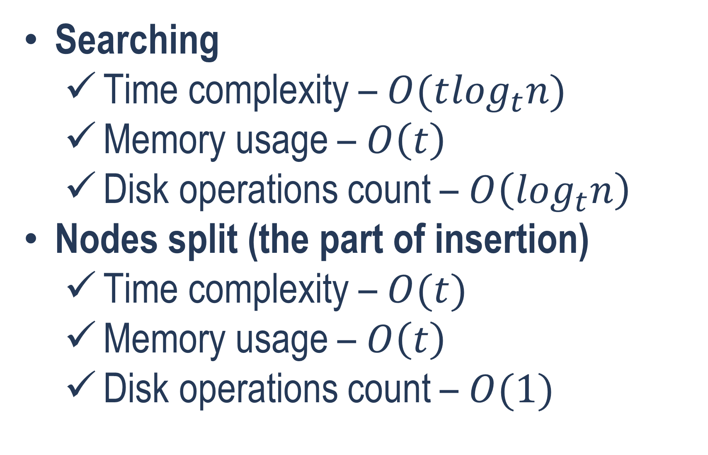
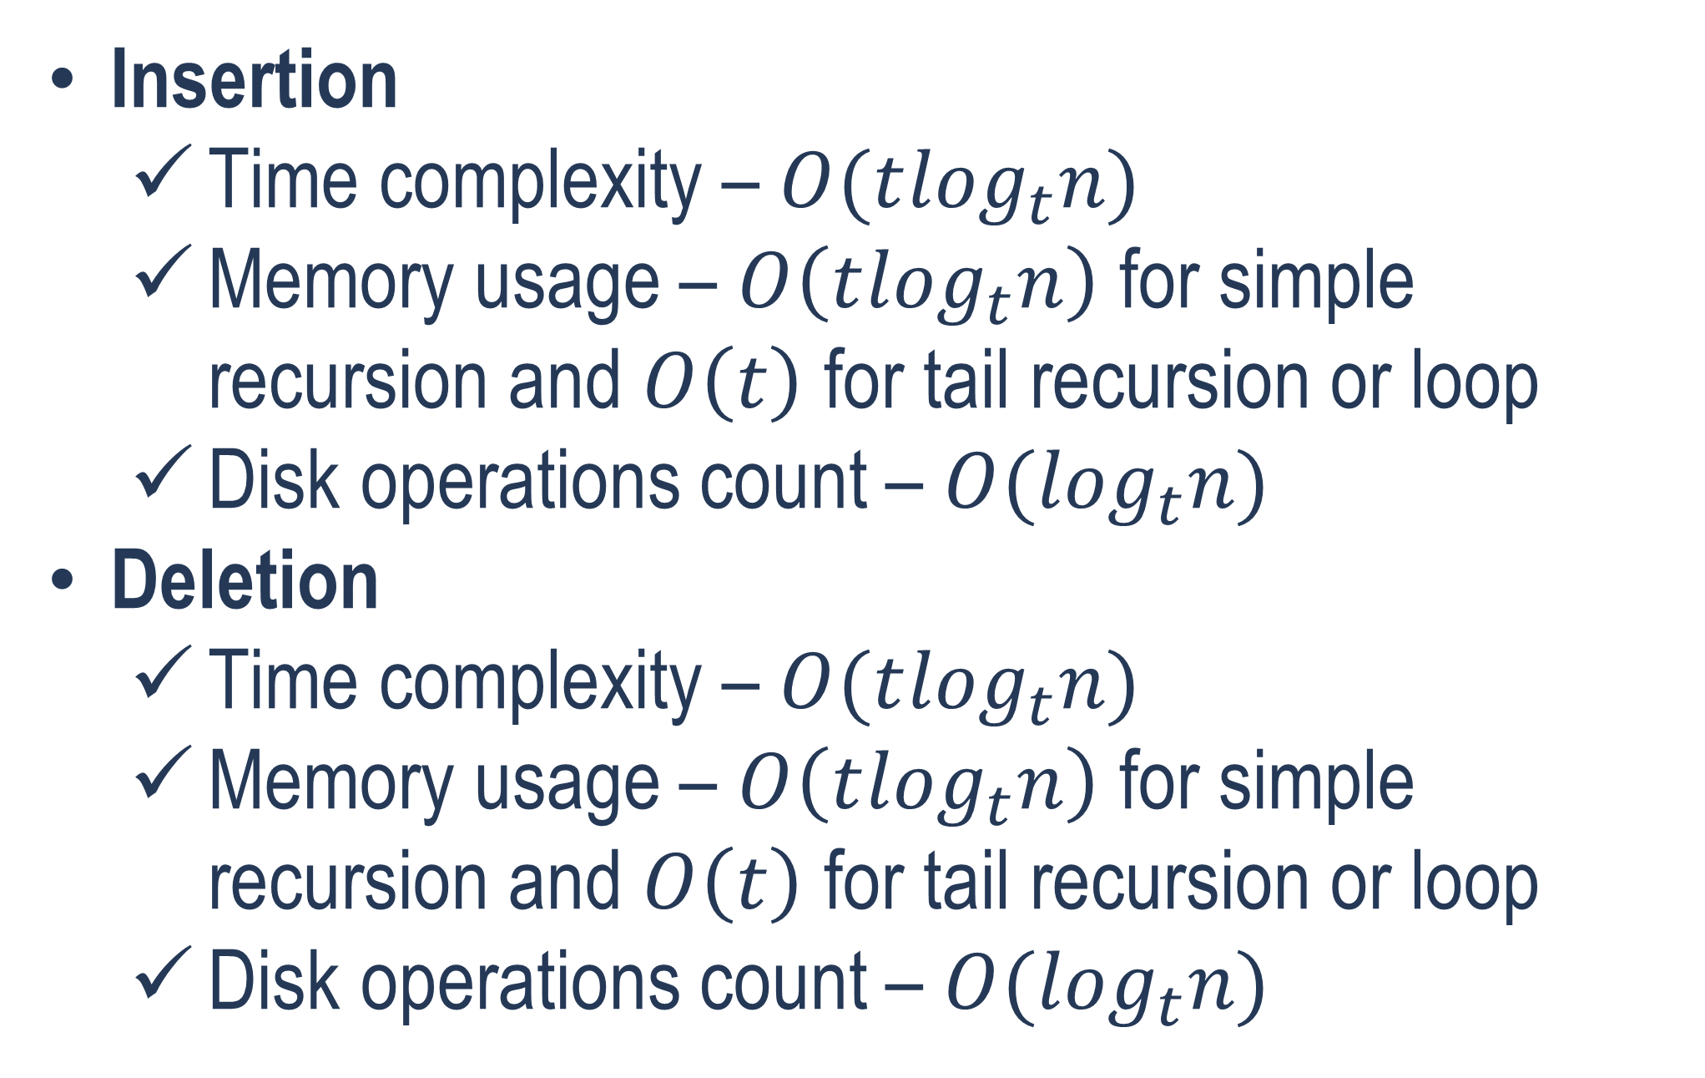
Faculty of Computer Science
B-tree Operations
Insertion
Time complexity – $O(t\log_{t}n)$
Memory usage – $O\left(t\log_{t}n\right)$ for simple recursion and $O\left(t\right)$ for tail recursion or loop
Disk operations count – $O(\log_{t}n)$
Deletion
Time complexity – $O(t\log_{t}n)$
Memory usage – $O\left(t\log_{t}n\right)$ for simple recursion and $O\left(t\right)$ for tail recursion or loop
Disk operations count – $O(\log_{t}n)$
Searching
Time complexity – $O(t\log_{t}n)$
Memory usage – $O\left(t\right)$
Disk operations count – $O\left(\log_{t}n\right)$
Nodes split (the part of insertion)
Time complexity – $O(t)$
Memory usage – $O\left(t\right)$
Disk operations count – $O(1)$
[1] R. Bayer and E. McCreight, “Organization and maintenance of large ordered indexes,” Acta Informatica, vol. 1, no. 3, pp. 173 – 189, 1972.
5

Slide 6
Faculty of Computer Science
B-tree Modifications
B⁺-tree
Only leaf nodes contain real keys (real data), other nodes contain router keys [2]
Deletion is probably faster than for B-tree and B*-tree
B*-tree
Each node (except of the root node) is filled at least by 2/3 not 1/2 [3]
Keys insertion for B*-tree is expected to be faster than for B-tree and B⁺-tree
B^{*+}-tree
Developed by authors of this work [4]
Combines the main B⁺-tree and B*-tree features together
[2] K. Pollari-Malmi. (2010). B+-trees [PDF paper]. Available: https://www.cs.helsinki.fi/u/mluukkai/tirak2010/B-tree.pdf
[3] “B*-tree.” NIST Dictionary of Algorithms and Data Structures. Available: https://xlinux.nist.gov/dads/HTML/bstartree.html (accessed Dec. 24, 2018). [4] A. Rigin, “On the Performance of Multiway Trees in the Problem of Structured Data Indexing,” (in Russian), coursework, Dept. Soft. Eng., HSE, Moscow, Russia, 2018.
6

Slide 7
Faculty of Computer Science
Motivation and existing solutions
Motivation for developing of yet another SQLite extension
In the current time, the data amounts are continuously growing
It is necessary to develop new efficient approaches to data indexing in the DBMSs
SQLite contains a small number of index structures by default – it is relevant to add new ones
Existing solutions
B-tree is the default index structure in the SQLite
There are some SQLite extensions (for example, the extension adding the R-tree indexing)
No extensions with B⁺-tree, B*-tree, and B^{*+}-tree were found
7

Slide 8
Faculty of Computer Science
The Main Goals of the Work
To add new indexing engines to SQLite based on B-tree modifications (B⁺-tree, B*-tree and B^{*+}-tree)
To develop and implement an algorithm that would allow selecting the suitable indexing data structure (B⁺-tree, B*-tree or B^{*+}-tree) according to performed operations for some specific table
8

Slide 9


Faculty of Computer Science
SQLitE
Popular open-source embedded relational DBMS
Written in the C language
Uses the B-tree as the default index
SQLite is expandable by dynamically linked libraries [5]
[5] “Run-Time Loadable Extensions.” SQLite.org. Available: https://www.sqlite.org/loadext.html (accessed Jan. 20, 2019).

Slide 10

Faculty of Computer Science
C++ LIBRARY OF B-TREE MODIFICATIONS
Contains B-tree, B⁺-tree, B*-tree and B^{*+}-tree implementations [4]
In the current work connected to the SQLite as the run-time loadable extension
[4] A. Rigin, “On the Performance of Multiway Trees in the Problem of Structured Data Indexing,” (in Russian), coursework, Dept. Soft. Eng., HSE, Moscow, Russia, 2018.
10

Slide 11
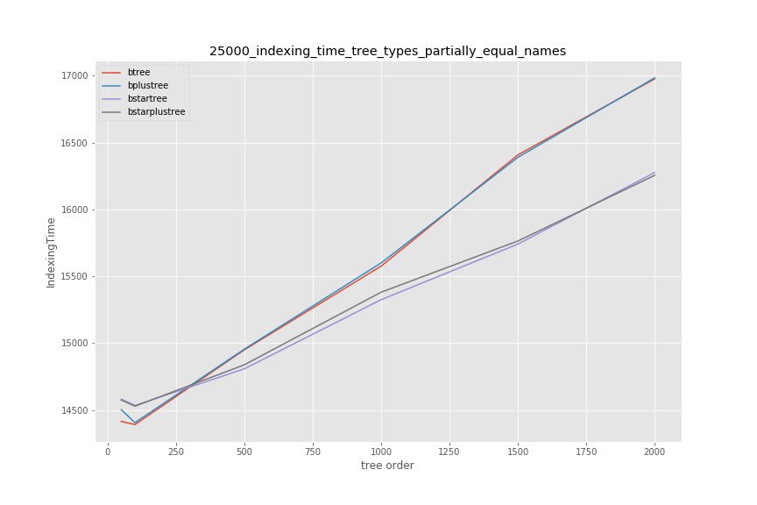
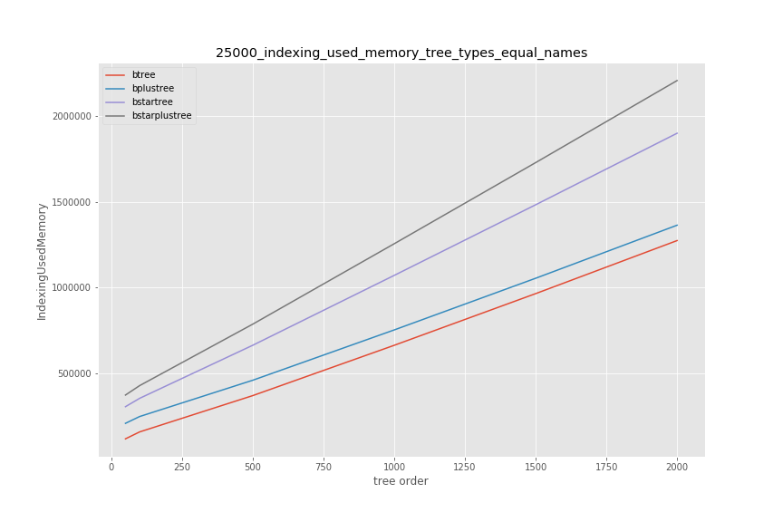
Faculty of Computer Science
Research Conducted using the B-tree Modifications
[4] A. Rigin, “On the Performance of Multiway Trees in the Problem of Structured Data Indexing,” (in Russian), coursework, Dept. Soft. Eng., HSE, Moscow, Russia, 2018.
11

Slide 12
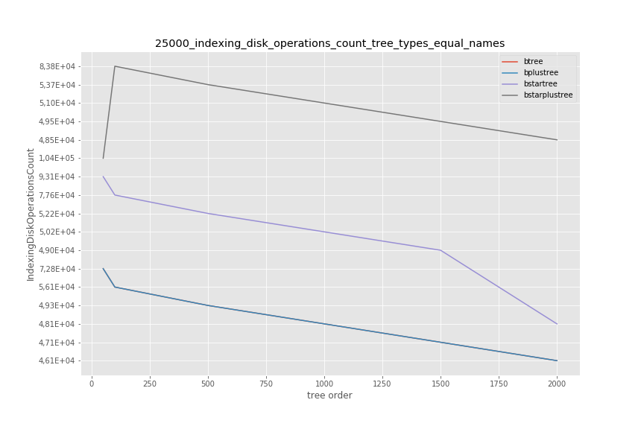
Faculty of Computer Science
Research Conducted using the B-tree Modifications
[4] A. Rigin, “On the Performance of Multiway Trees in the Problem of Structured Data Indexing,” (in Russian), coursework, Dept. Soft. Eng., HSE, Moscow, Russia, 2018.
12

Slide 13
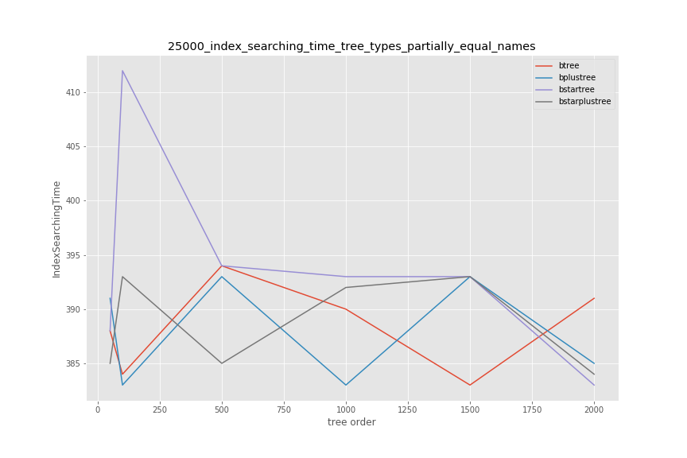
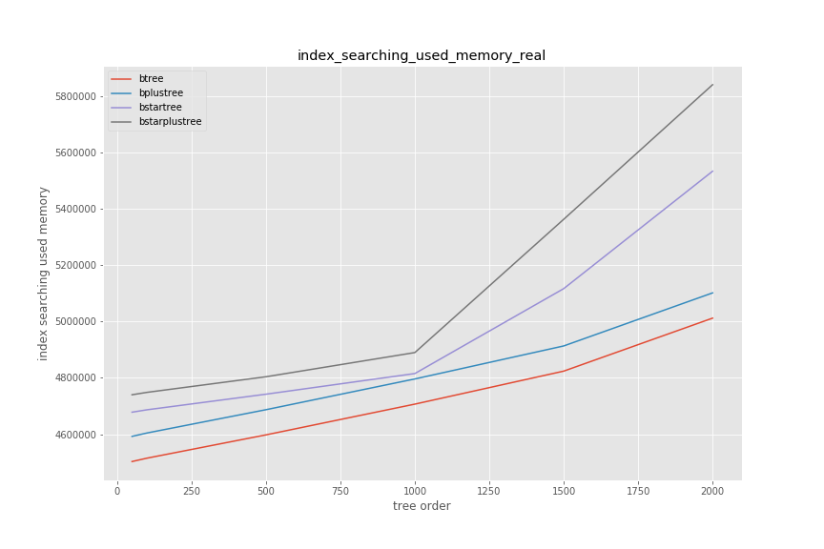
Faculty of Computer Science
Research Conducted using the B-tree Modifications
[4] A. Rigin, “On the Performance of Multiway Trees in the Problem of Structured Data Indexing,” (in Russian), coursework, Dept. Soft. Eng., HSE, Moscow, Russia, 2018.
13

Slide 14
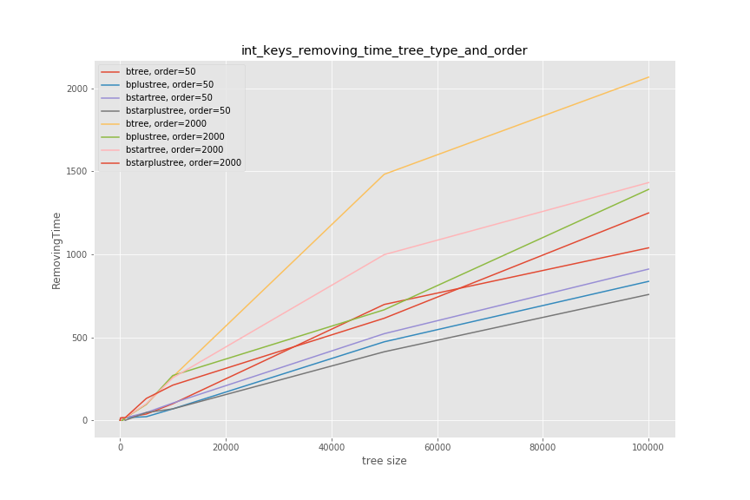
Faculty of Computer Science
Research Conducted using the B-tree Modifications
[4] A. Rigin, “On the Performance of Multiway Trees in the Problem of Structured Data Indexing,” (in Russian), coursework, Dept. Soft. Eng., HSE, Moscow, Russia, 2018.
14

Slide 15
Faculty of Computer Science
Selecting the Index Structure
The index structure is selected from the B-tree modifications (B⁺-tree, B*-tree and B^{*+}-tree)
Selecting is executed at the start of each table operation (search, insertion, updating, deletion)
The index structure rebuilding is performed only at each 1000-th operation and only for the first 10000 operations
Index structure selection depends on the ratios of the numbers of operations of different types (search, insert, delete), applied to a tree
The tree order of the B-tree and its modifications used in the SQLite extension developed in this work is chosen to be equal to 750
The B⁺-tree is used by default in the developed SQLite extension
15

Slide 16
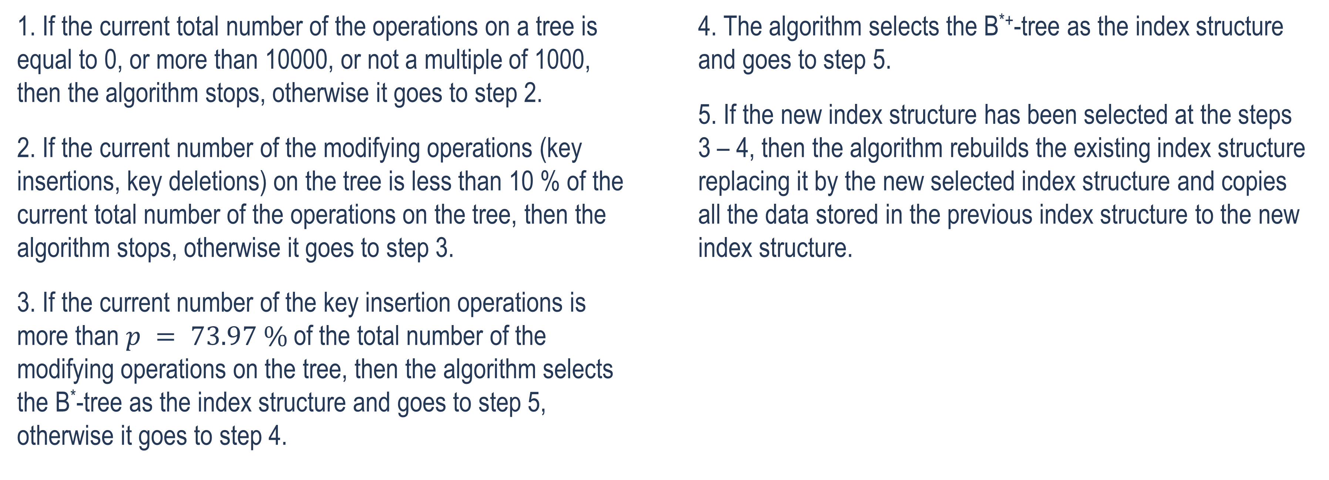
Faculty of Computer Science
Algorithm of Selecting the Index Structure
1. If the current total number of the operations on a tree is equal to 0, or more than 10000, or not a multiple of 1000, then the algorithm stops, otherwise it goes to step 2.
2. If the current number of the modifying operations (key insertions, key deletions) on the tree is less than 10 % of the current total number of the operations on the tree, then the algorithm stops, otherwise it goes to step 3.
3. If the current number of the key insertion operations is more than $p = 73.97 \%$of the total number of the modifying operations on the tree, then the algorithm selects the B*-tree as the index structure and goes to step 5, otherwise it goes to step 4.
4. The algorithm selects the B^{*+}-tree as the index structure and goes to step 5.
5. If the new index structure has been selected at the steps 3 – 4, then the algorithm rebuilds the existing index structure replacing it by the new selected index structure and copies all the data stored in the previous index structure to the new index structure.
16

Slide 17
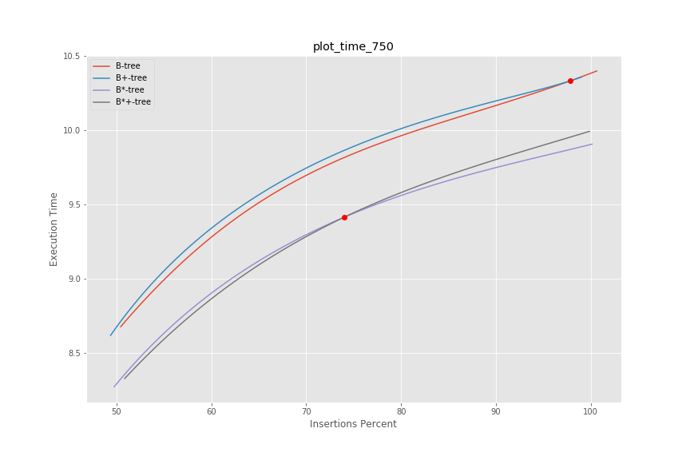
Faculty of Computer Science
Selecting the Index Structure
17

Slide 18

Faculty of Computer Science
Tree Key Structure
primary key value
row id (8 bytes)

Slide 19
Faculty of Computer Science
Implementation Details
The C API for the B-tree modifications library is implemented as dynamically shared library using the extern “C” { … } C++ convention
The SQLite extension registers btrees_mods module for creating the virtual tables
A virtual table is any table created using such a module
The extension also registers btreesModsVisualize, btreesModsGetTreeOrder, btreesModsGetTreeType functions

Slide 20
Faculty of Computer Science
Implementation Details
Method | Purpose
btreesModsCreate(sqlite3*, void*, int, const char* const*, sqlite3_vtab**, char**) | Creates a new table.
btreesModsUpdate(sqlite3_vtab*, int, sqlite3_value**, sqlite_int64*) | Inserts, deletes or updates a value of a row in the table.
btreesModsFilter(sqlite3_vtab_cursor*, int, const char*, int, sqlite3_value**) | Searches for a row in the table.

Slide 21
Faculty of Computer Science
Implementation Details
Method | Purpose
btreesModsVisualize(sqlite3_context*, int, sqlite3_value**) | Outputs the graphical representation of the table’s index structure (tree) into the GraphViz DOT file.
btreesModsGetTreeOrder(sqlite3_context*, int, sqlite3_value**) | Outputs the order of the tree used as the table’s index structure.
btreesModsGetTreeType(sqlite3_context*, int, sqlite3_value**) | Outputs the type of the tree (1 – B-tree, 2 – B⁺-tree, 3 – B*-tree, 4 – B^{*+}-tree) used as the table’s index structure.

Slide 22
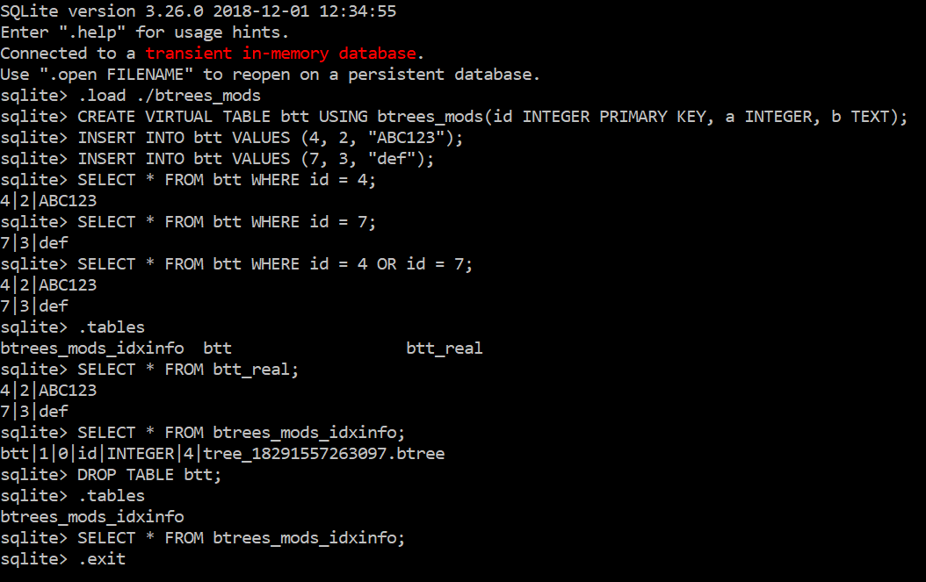
Faculty of Computer Science
Usage Example

Slide 23
Faculty of Computer Science
Experiment conducted using the Sqlite Extension
Operation on the table | Total execution time (ms) | Mean execution time per row (ms)
Table creation | 20 | -
First 500 rows insertion | 10301 | 20.6
Next 500 rows insertion | 10322 | 20.6
1001st row insertion (including the B⁺-tree into the B*-tree rebuilding) | 40 | 40
Next 499 rows insertion | 9386 | 18.8
Last 500 rows insertion | 9032 | 18.1

Slide 24
Faculty of Computer Science
Experiment conducted using the Sqlite Extension
Operation on the table | Total execution time (ms) | Mean execution time per row (ms)
First 500 rows deletion | 11558 | 23.1
Next 500 rows deletion | 10708 | 21.4
1001st row insertion (including the B*-tree into the B^{*+}-tree rebuilding) | 62 | 62
Next 499 rows deletion | 9418 | 18.9
Last 500 rows deletion | 8863 | 17.7
1000 rows insertion | 18890 | 18.9
Next 5000 rows insertion (including the B^{*+}-tree into the B*-tree rebuilding) | 92395 | 18.5

Slide 25
Faculty of Computer Science
Experiment conducted using the Sqlite Extension
The key insertion into the B*-tree was faster than into the B⁺-tree
The key deletion from the B^{*+}-tree was faster than from the B*-tree
The key insertion into the B*-tree was slightly faster than into the B^{*+}-tree
The search in a table took about 1 ms on all the B-tree modifications considered in this work

Slide 26
Faculty of Computer Science
Summary
The developed B^{*+}-tree has smaller running time for keys insertion and deletion than B-tree, however it has greater memory usage
The B-tree modifications library is connected to the SQLite as an extension using C API developed in this work
The experiments were conducted using the developed library
The algorithm of automatic selection of the suitable index structure is developed and implemented
Experiments calculating performance of indexing table data were conducted using the developed SQLite extension

Slide 27
Faculty of Computer Science
References
[1] R. Bayer and E. McCreight, “Organization and maintenance of large ordered indexes,” Acta Informatica, vol. 1, no. 3, pp. 173 – 189, 1972.
[2] K. Pollari-Malmi. (2010). “B⁺-trees,” University of Helsinki. [PDF paper]. Available: https://www.cs.helsinki.fi/u/mluukkai/tirak2010/B-tree.pdf
[3] “B*-tree.” NIST Dictionary of Algorithms and Data Structures. Available: https://xlinux.nist.gov/dads/HTML/bstartree.html (accessed Dec. 24, 2018).
[4] A. Rigin, “On the Performance of Multiway Trees in the Problem of Structured Data Indexing,” (in Russian), coursework, Dept. Soft. Eng., HSE, Moscow, Russia, 2018.
[5] “Run-Time Loadable Extensions.” SQLite.org. Available: https://www.sqlite.org/loadext.html (accessed Jan. 20, 2019).

Slide 28
Thank you for your attention!
amrigin@edu.hse.ru
anton19979@yandex.ru
anton19979@yandex-team.ru

Slide 29






Faculty of Computer Science
Technologies Used

