Slide 1

National Research University Higher School of Economics Faculty of Computer Science
Master’s Programme ‘System and Software Engineering’
Reference and Data Semantic-Based Simulator of Petri Nets Extension with the Use of Renew Tool
Student: Anton Rigin (group mSSE19)
Supervisor: Sergey Shershakov Senior Lecturer at School of Software Engineering, Research Fellow at Laboratory of Process-Aware Information Systems (PAIS Lab)
Moscow, 2020

Slide 2

Faculty of Computer Science / Master’s Programme ‘System and Software Engineering’
Description of Subject Area
Concurrent software systems modelling and validation
Process mining
The techniques of analysis of business processes based on event logs
Petri nets and their modifications

Slide 3
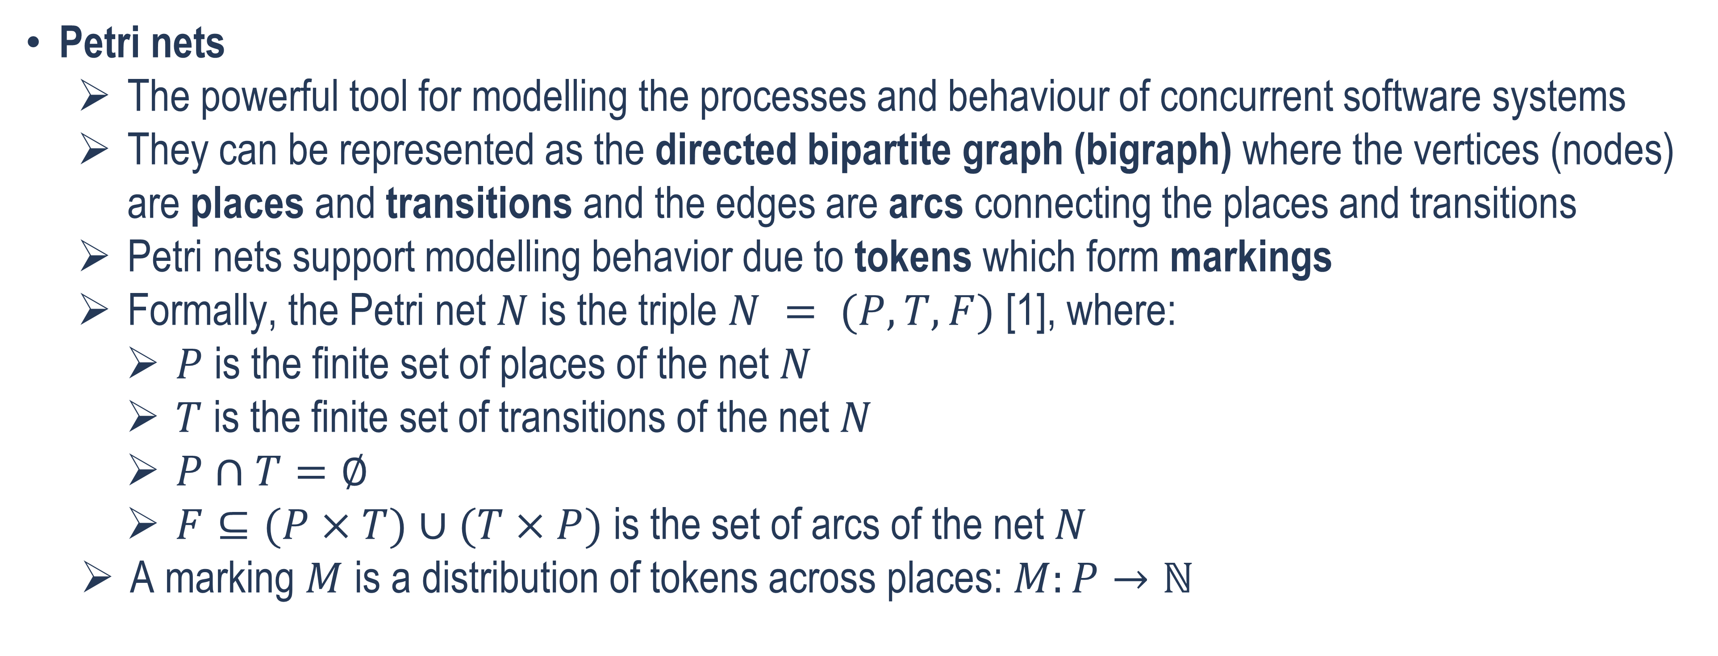
Faculty of Computer Science / Master’s Programme ‘System and Software Engineering’
Basic terms, concepts, definitions (1/8)
Petri nets
The powerful tool for modelling the processes and behaviour of concurrent software systems
They can be represented as the directed bipartite graph (bigraph) where the vertices (nodes) are places and transitions and the edges are arcs connecting the places and transitions
Petri nets support modelling behavior due to tokens which form markings
Formally, the Petri net $N$ is the triple $N = (P, T, F)$ [1], where:
$P$ is the finite set of places of the net $N$
$T$ is the finite set of transitions of the net $N$
$P∩T=∅$
$F⊆(P×T)∪(T×P)$ is the set of arcs of the net $N$
A marking $M$ is a distribution of tokens across places: $M:P→ℕ$

Slide 4
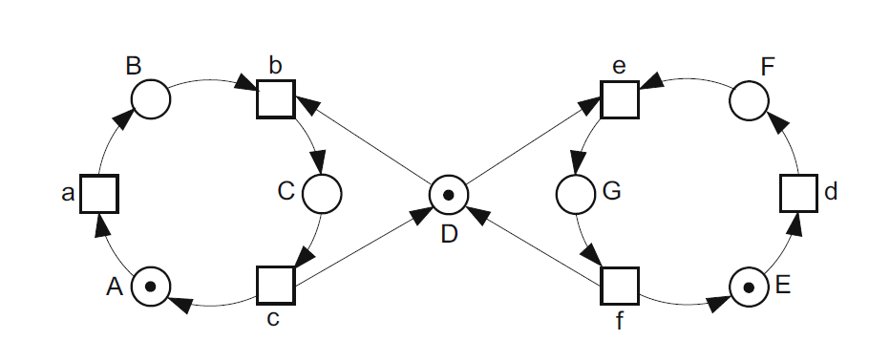
Faculty of Computer Science / Master’s Programme ‘System and Software Engineering’
Basic terms, concepts, definitions (2/8)
The example of Petri net for modelling the mutual exclusion [1]

Slide 5
Faculty of Computer Science / Master’s Programme ‘System and Software Engineering’
Basic terms, concepts, definitions (3/8)
Coloured Petri nets
The Petri nets in which data types of tokens and arc expressions are defined and used [2] [3]
These data types are called colours [2] [3]
Reference Petri nets
The Petri nets which have reference semantics rather than value semantics [4]
The tokens in such nets are references to objects (for example to other Petri nets – this concept called hierarchical Petri nets, nets within nets or nested nets) [4] [5]

Slide 6
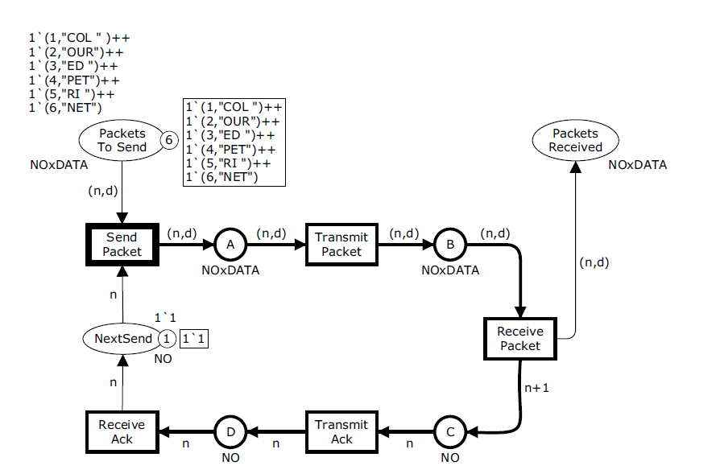
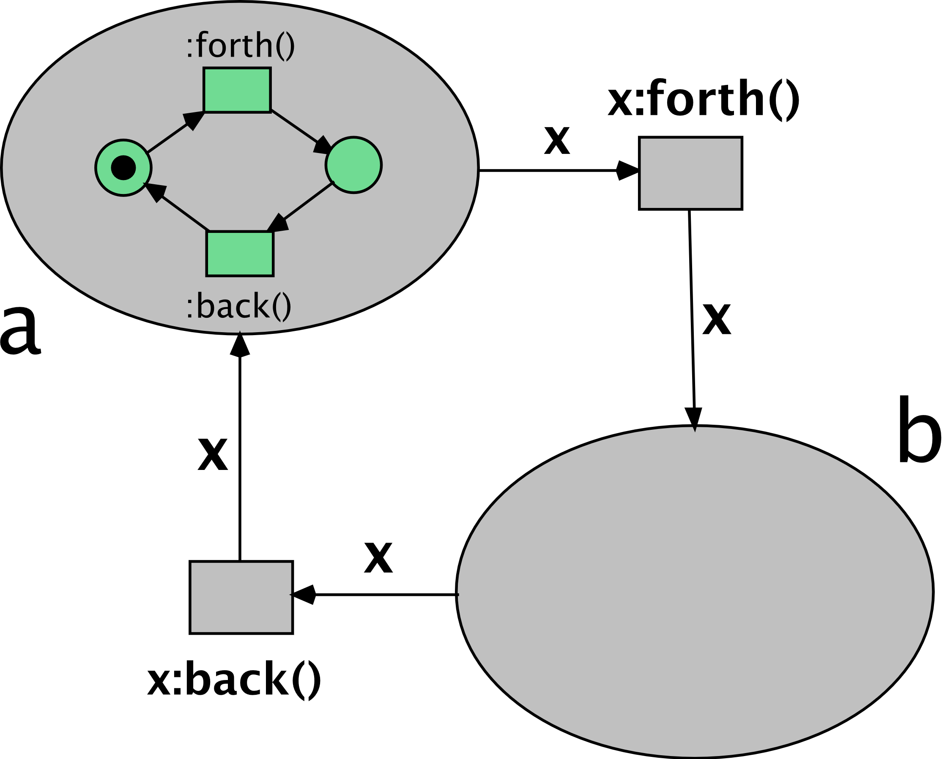
Faculty of Computer Science / Master’s Programme ‘System and Software Engineering’
Basic terms, concepts, definitions (4/8)
The example of hierarchical reference Petri net [6]
The example of coloured Petri net for modelling the simple transport protocol [3]

Slide 7
Faculty of Computer Science / Master’s Programme ‘System and Software Engineering’
Basic terms, concepts, definitions (5/8)
DB-nets
Were introduced by Marco Montali and Andrey Rivkin in 2016 [7]
DB-net is the model consisting of three layers [7]:
Control layer is the modified coloured Petri net
Data logic layer interconnects the control layer and persistence layer and allows to access and manipulate the persistent data using queries and actions
Persistence layer represents the relational database with constraints
DB-nets allow to consider the process and the persistent data used by this process simultaneously [7]

Slide 8
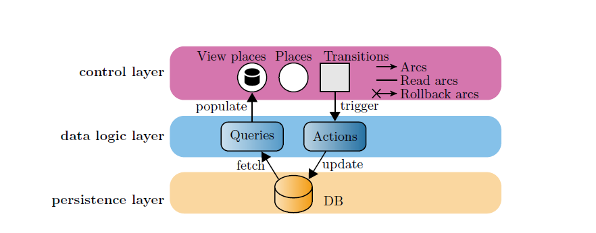
Faculty of Computer Science / Master’s Programme ‘System and Software Engineering’
Basic terms, concepts, definitions (6/8)
The DB-net structure [8]

Slide 9
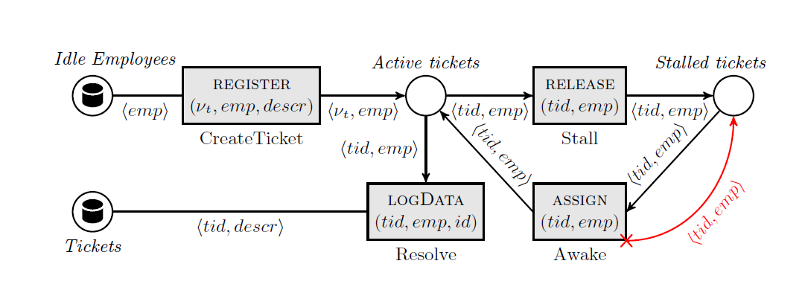
Faculty of Computer Science / Master’s Programme ‘System and Software Engineering’
Basic terms, concepts, definitions (7/8)
The example of the DB-net’s control layer [7]

Slide 10
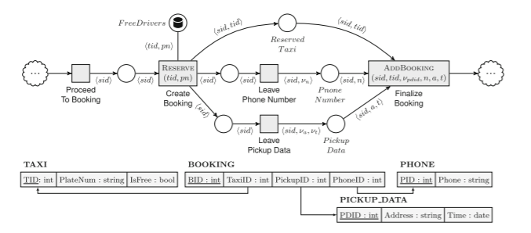
Faculty of Computer Science / Master’s Programme ‘System and Software Engineering’
Basic terms, concepts, definitions (8/8)
The example of the DB-net [7]

Slide 11
Faculty of Computer Science / Master’s Programme ‘System and Software Engineering’
Relevance and Motivation
Petri nets are used as a popular technique for modelling the behavior of concurrent programs
The Petri nets and their modifications implemented in many different software tools (CPN Tools for the coloured Petri nets [9], Renew for the reference Petri nets [5] and so on)
However, the standard Petri nets as well as coloured Petri nets and reference Petri nets cannot consider the state of persistent data
The DB-nets solve this problem [7]
However, there is no published program implementations of the DB-nets
Renew is a powerful software tool which implements reference Petri nets [5]
Therefore, it could be useful to implement the DB-nets with the reference semantics support as the plugin for the Renew
This implementation will allow to model the behavior of the programs with reference semantics (which are very common in such programming languages as Java) with considering the state of persistent data

Slide 12
Faculty of Computer Science / Master’s Programme ‘System and Software Engineering’
Objective and Tasks
Objective
Implementing the software tool for simulating DB-nets with reference semantics support as the plugin for the Renew
Tasks
Learning the existing Renew’s design and code
Formulating the formal functional and non-functional requirements for the software tool (the DB-nets Renew plugin)
Developing the design of the software tool
Implementing the DB-nets concept in the form of Renew plugin
Testing the developed software tool using some real enterprise data or artificially generated data
Documenting the developed software tool

Slide 13
Faculty of Computer Science / Master’s Programme ‘System and Software Engineering’
Initial Functional Requirements (1/2)
The program shall allow user to model the db-net control layer using the Renew tool’s graphical user interface (GUI) elements for net’s interactive drawing
The program shall allow user to create the database schema at the db-net persistence layer using the Renew tool’s GUI based dialog windows
The program shall allow user to declare queries and actions for the db-net data logic layer using the Renew tool’s GUI based dialog windows
The program shall allow user to simulate the modeled db-net’s run using the Renew tool’s GUI

Slide 14
Faculty of Computer Science / Master’s Programme ‘System and Software Engineering’
Initial Functional Requirements (2/2)
The program shall allow user to input the external data for the db-net’s run during the db-net’s run simulation where it is necessary according to the db-net model using the Renew tool’s GUI
The program shall allow user to save the modeled db-net using the Renew tool’s GUI
The program shall allow user to open the previously saved modeled db-net using the Renew tool’s GUI

Slide 15




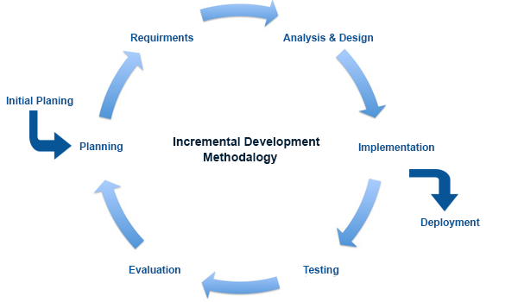

Faculty of Computer Science / Master’s Programme ‘System and Software Engineering’
Methods, Tools and Technologies to be used
The DB-net with the reference semantics support is a core model used in the project
The methods of constructing DB-net and simulating its run are used
Renew is a main software tool used in the project
Technological stack: Java SE 8, Apache Ant, JavaCC, JUnit 4 and SQLite (the latter is planned to be used as the relational DBMS for the persistent layer of the DB-net)
The elements of the incremental SLC model and prototyping approach are used in the project [10]

Slide 16
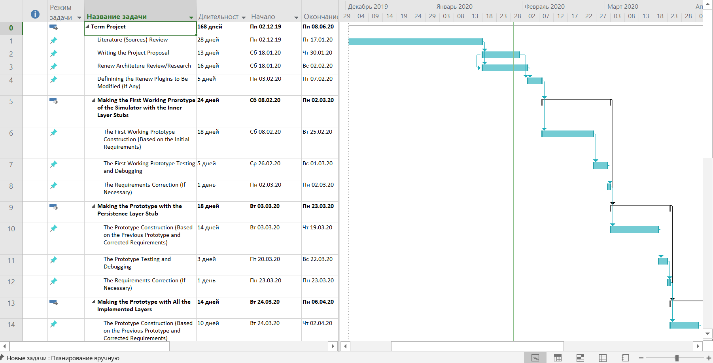
Faculty of Computer Science / Master’s Programme ‘System and Software Engineering’
Work Plan – the Project’s Gantt Chart (1/2)

Slide 17
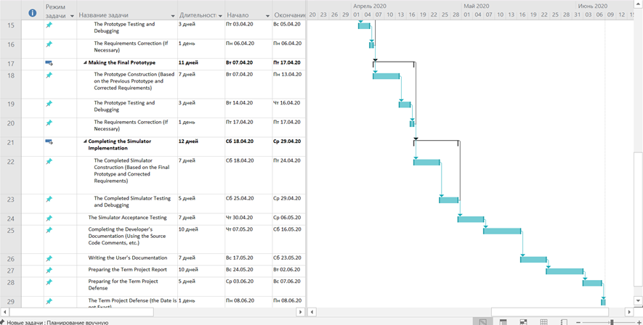
Faculty of Computer Science / Master’s Programme ‘System and Software Engineering’
Work Plan – the Project’s Gantt Chart (2/2)

Slide 18
Faculty of Computer Science / Master’s Programme ‘System and Software Engineering’
Current Results
The existing Renew code and design is learnt
The functional requirements are formulated
The simple Renew plugin which writes its setup to log is created

Slide 19
Faculty of Computer Science / Master’s Programme ‘System and Software Engineering’
Expected Results
The developed, tested and documented software tool for simulating DB-nets with reference semantics support as the plugin for the Renew is expected
The developed software tool is expected to be applicable for cases where it is necessary to consider both process and the persistent data
The term project can be continued in the 2nd year as the master thesis which will possibly include development of some new features for the developed software tool and conducting a research with using a real enterprise data of some of the PAIS Lab’s business partners (for example, the Exactpro Systems and London Stock Exchange)

Slide 20
Faculty of Computer Science / Master’s Programme ‘System and Software Engineering’
References (1/3)
[1] W. Reisig. Understanding Petri Nets: Modeling Techniques, Analysis Methods, Case Studies. Berlin, Heidelberg, Germany: Springer, 2013.
[2] J. Kurt. “A Brief Introduction to Coloured Petri Nets,” in Third Int. Workshop on TACAS, Enschede, the Netherlands, Apr. 2 – 4, 1997, pp. 203 – 208.
[3] J. Kurt and M. K. Lars. Coloured Petri Nets: Modelling and Validation of Concurrent Systems. Berlin, Heidelberg, Germany: Springer, 2009.
[4] B. Farwer. “LLPN – Linear Logic Petri Nets: What are Object Petri Nets?” Wayback Machine. https://web.archive.org/web/20051103131745/http://www.llpn.com/OPNs.html (accessed Dec. 1, 2019).

Slide 21
Faculty of Computer Science / Master’s Programme ‘System and Software Engineering’
References (2/3)
[5] “Renew – The Reference Net Workshop.” Renew.de. http://www.renew.de/ (accessed Dec. 1, 2019)
[6] “File:Forthandback.svg.” Wikimedia Commons. https://commons.wikimedia.org/wiki/File:Forthandback.svg (accessed Dec. 5, 2019).
[7] M. Montali and A. Rivkin. “DB-Nets: On the Marriage of Colored Petri Nets and Relational Databases,” in Transactions on Petri Nets and Other Models of Concurrency XII, M. Koutny, J. Kleijn, W. Penczek, Eds., Berlin, Heidelberg, Germany: Springer, 2017, pp. 91 – 118.

Slide 22
Faculty of Computer Science / Master’s Programme ‘System and Software Engineering’
References (3/3)
[8] M. Montali and A. Rivkin. “DB-Nets: On the Marriage of Colored Petri Nets and Relational Databases.” ResearchGate. https://www.researchgate.net/publication/310122815_DB-Nets_on_The_Marriage_of_Colored_Petri_Nets_and_Relational_Databases (accessed Jan. 25, 2020).
[9] “CPN Tools – A tool for editing, simulating, and analyzing Colored Petri nets.” CPNTools.org. http://cpntools.org/ (accessed Dec. 1, 2019).
[10] P. Bourque and R.E. Fairley, Eds., “Software Life Cycle Models,” in Guide to the Software Engineering Body of Knowledge, Version 3.0, USA: IEEE Computer Society, 2014, ch. 8, sec. 2.2, pp. 8-5–8-6.

Slide 23
Thank you for your attention!
amrigin@edu.hse.ru
anton19979@yandex.ru
HSE Address: 20 Myasnitskaya Ulitsa, Moscow 101000 Russia | 11 Pokrovsky Boulevard, Moscow 109028 Russia

