Slide 1

National Research University Higher School of Economics Faculty of Computer Science
Master’s Programme ‘System and Software Engineering’
Reference and Data Semantic-Based Simulator of Petri Nets Extension with the Use of Renew Tool
Term Project (Coursework)
Student: Anton Rigin (group mSSE19)
Supervisor: Sergey Shershakov Senior Lecturer at School of Software Engineering, Research Fellow at Laboratory of Process-Aware Information Systems (PAIS Lab), Faculty of Computer Science, HSE
Moscow, 2020

Slide 2

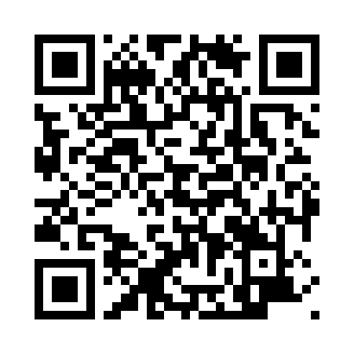
Faculty of Computer Science / Master’s Programme ‘System and Software Engineering’
Outline
Description of subject area
Basic terms, concepts, definitions
Relevance and motivation
Objective and tasks
Functional requirements
Renew db-nets plugin architecture & design
Methods, tools and technologies used
Results
The project’s GitHub repository:
https://github.com/Glost/db_nets_renew_plugin

Slide 3
Faculty of Computer Science / Master’s Programme ‘System and Software Engineering’
Description of Subject Area
Concurrent software systems modelling and validation
Process mining
The techniques of analysis of business processes based on event logs
Petri nets and their modifications

Slide 4
Faculty of Computer Science / Master’s Programme ‘System and Software Engineering’
Basic terms, concepts, definitions (1/8)
Petri nets
The powerful tool for modelling the processes and behaviour of concurrent software systems
They can be represented as the directed bipartite graph (bigraph) where the vertices (nodes) are places and transitions and the edges are arcs connecting the places and transitions
Petri nets support modelling behavior due to tokens which form markings

Slide 5
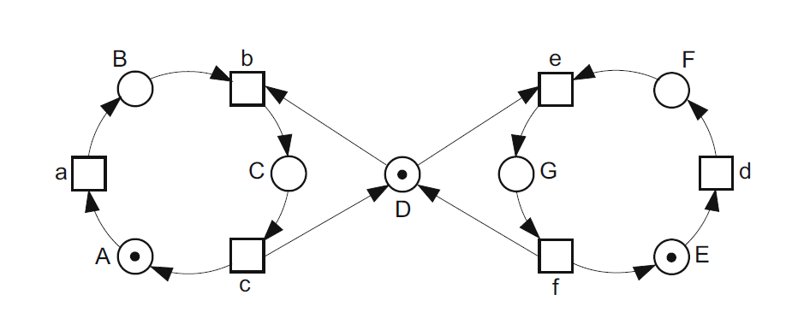
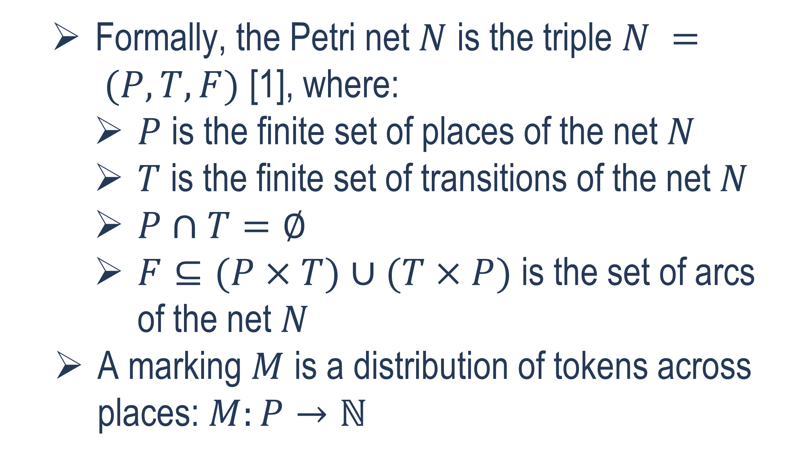
Faculty of Computer Science / Master’s Programme ‘System and Software Engineering’
Basic terms, concepts, definitions (2/8)
Formally, the Petri net $N$ is the triple $N = (P, T, F)$ [1], where:
$P$ is the finite set of places of the net $N$
$T$ is the finite set of transitions of the net $N$
$P∩T=∅$
$F⊆(P×T)∪(T×P)$ is the set of arcs of the net $N$
A marking $M$ is a distribution of tokens across places: $M:P→ℕ$
The example of Petri net for modelling the mutual exclusion [1]

Slide 6
Faculty of Computer Science / Master’s Programme ‘System and Software Engineering’
Basic terms, concepts, definitions (3/8)
Coloured Petri nets
The Petri nets in which data types of tokens and arc expressions are defined and used [2] [3]
These data types are called colours [2] [3]
Reference Petri nets
The Petri nets which have reference semantics rather than value semantics [4]
The tokens in such nets are references to objects (for example to other Petri nets – this concept called hierarchical Petri nets, nets within nets or nested nets) [4] [5]

Slide 7
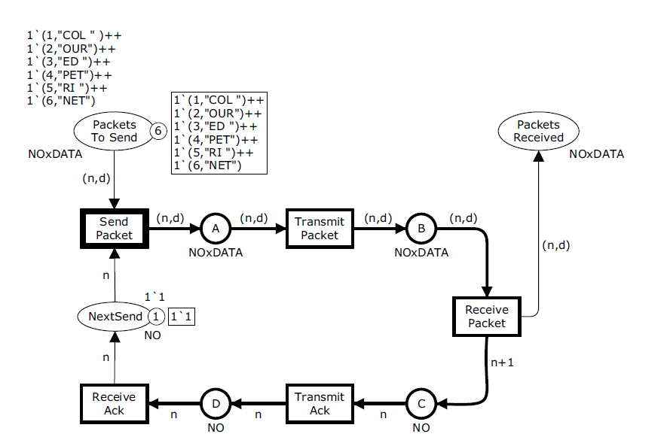
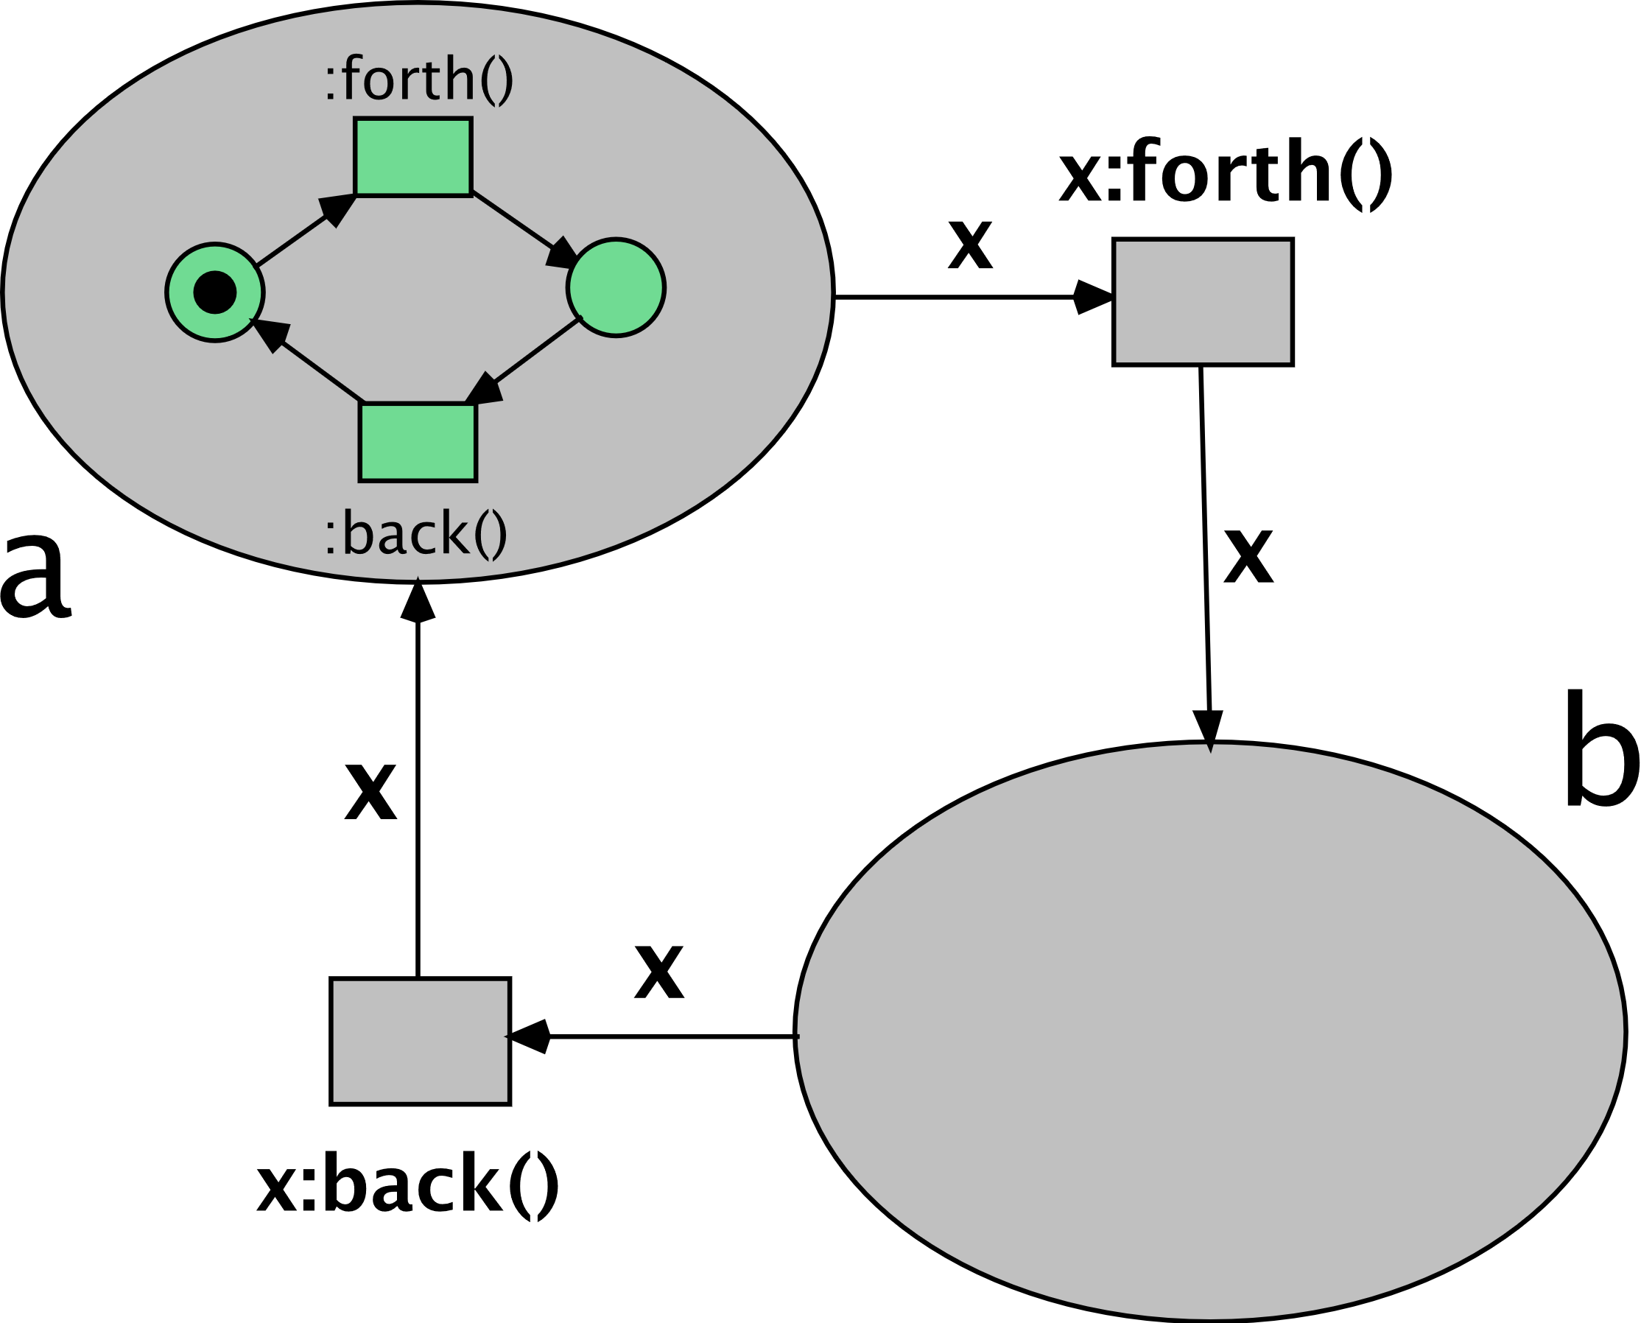
Faculty of Computer Science / Master’s Programme ‘System and Software Engineering’
Basic terms, concepts, definitions (4/8)
The example of hierarchical reference Petri net [6]
The example of coloured Petri net for modelling the simple transport protocol [3]

Slide 8
Faculty of Computer Science / Master’s Programme ‘System and Software Engineering’
Basic terms, concepts, definitions (5/8)
DB-nets
Were introduced by Marco Montali and Andrey Rivkin in 2016 [7]
DB-net is the model consisting of three layers [7]:
Control layer is the modified coloured Petri net
Data logic layer interconnects the control layer and persistence layer and allows to access and manipulate the persistent data using queries and actions
Persistence layer represents the relational database with constraints
DB-nets allow to consider the process and the persistent data used by this process simultaneously [7], which the other Petri nets modifications cannot
Because of this, it seems to be useful to implement the DB-nets in the software tool since there are no such software implementations available now

Slide 9
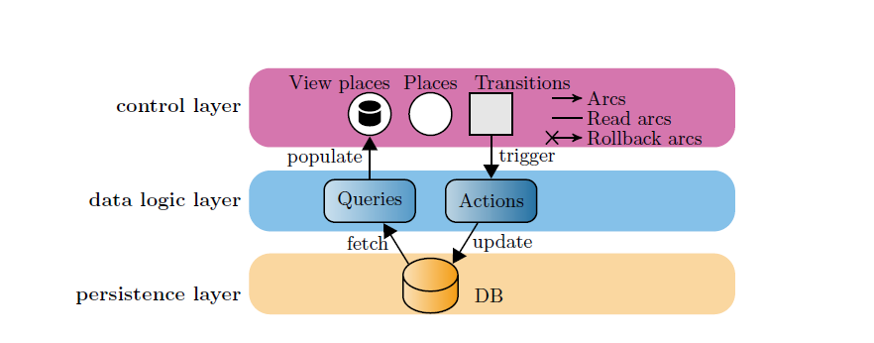
Faculty of Computer Science / Master’s Programme ‘System and Software Engineering’
Basic terms, concepts, definitions (6/8)
The DB-net structure [8]

Slide 10
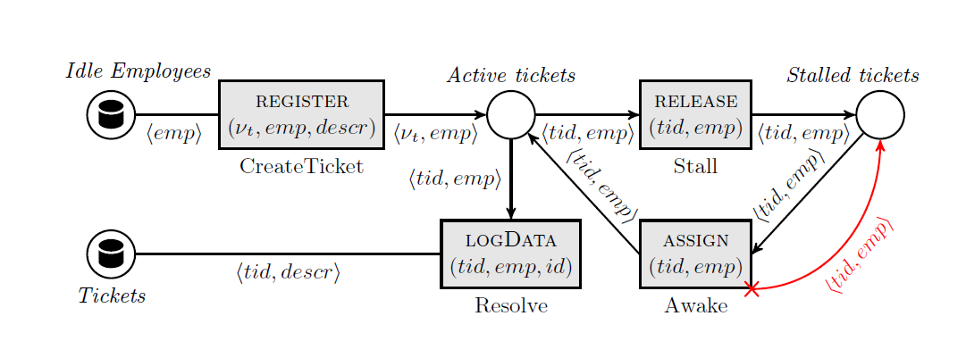
Faculty of Computer Science / Master’s Programme ‘System and Software Engineering’
Basic terms, concepts, definitions (7/8)
The example of the DB-net’s control layer [7]

Slide 11
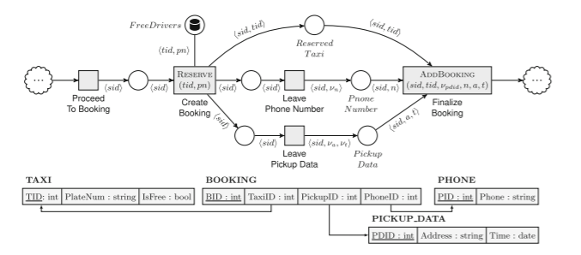
Faculty of Computer Science / Master’s Programme ‘System and Software Engineering’
Basic terms, concepts, definitions (8/8)
The example of the DB-net [7]

Slide 12
Faculty of Computer Science / Master’s Programme ‘System and Software Engineering’
Relevance and Motivation
Petri nets are used as a popular technique for modelling the behavior of concurrent programs
The Petri nets and their modifications implemented in many different software tools (CPN Tools for the coloured Petri nets [9], Renew for the reference Petri nets [5] and so on)
However, the standard Petri nets as well as coloured Petri nets and reference Petri nets cannot consider the state of persistent data
As it was already mentioned, the DB-nets solve this problem [7]
However, there is no published program implementations of the DB-nets
Renew is a powerful software tool which implements reference Petri nets [5]
Therefore, it should be useful to implement the DB-nets with the reference semantics support as the plugin for the Renew
This implementation allows to model the behavior of the programs with reference semantics (which are very common in such programming languages as Java) with considering the state of persistent data

Slide 13
Faculty of Computer Science / Master’s Programme ‘System and Software Engineering’
Objective and Tasks
Objective
Implementing the software tool for simulating DB-nets with reference semantics support as the plugin for the Renew
Tasks
Learning the existing Renew’s design and code
Formulating the formal functional requirements for the software tool (the DB-nets Renew plugin)
Developing the design of the software tool
Implementing the DB-nets concept in the form of Renew plugin
Testing the developed software tool using some real enterprise data or artificially generated data
Documenting the developed software tool

Slide 14
Faculty of Computer Science / Master’s Programme ‘System and Software Engineering’
Functional Requirements (1/2)
The program shall allow user to model the db-net control layer using the Renew tool’s graphical user interface (GUI) elements for net’s interactive drawing
The program shall allow user to create the database schema at the db-net persistence layer using the Renew tool’s GUI
The program shall allow user to declare queries and actions for the db-net data logic layer using the Renew tool’s GUI

Slide 15
Faculty of Computer Science / Master’s Programme ‘System and Software Engineering’
Functional Requirements (2/2)
The program shall allow user to simulate the modeled db-net’s run using the Renew tool’s GUI
The program shall allow user to save the modeled db-net using the Renew tool’s GUI
The program shall allow user to open the previously saved modeled db-net using the Renew tool’s GUI

Slide 16
Faculty of Computer Science / Master’s Programme ‘System and Software Engineering’
Renew DB-Nets Plugin Architecture & Design (1/4)
Renew is plugin-based – each piece of code, each class belongs to one of its plugins [5]
Renew is written in Java as well as its plugins [5]
Renew uses Apache Ant as a build system [5]
The DB-net plugin is developed using the existing Renew base plugins as examples
The DB-net plugin extends the classes of the following base Renew plugins:
CH (DrawPlugin) – plugin with number of drawing utils
Formalism – plugin with number of Petri nets’ and their elements’ formalisms
GUI – plugin with number of GUI tools
Simulator – plugin for simulating the modelled Petri net
Util – plugin with number of different Renew utility classes
The plugin also uses the org.xerial.sqlite-jdbc library as the SQLite JDBC driver library [10] for implementing the db-net’s persistence layer.

Slide 17
Faculty of Computer Science / Master’s Programme ‘System and Software Engineering’
Renew DB-Nets Plugin Architecture & Design (2/4)
The Renew DB-Nets Plugin Class Diagram – on the next slides

Slide 18
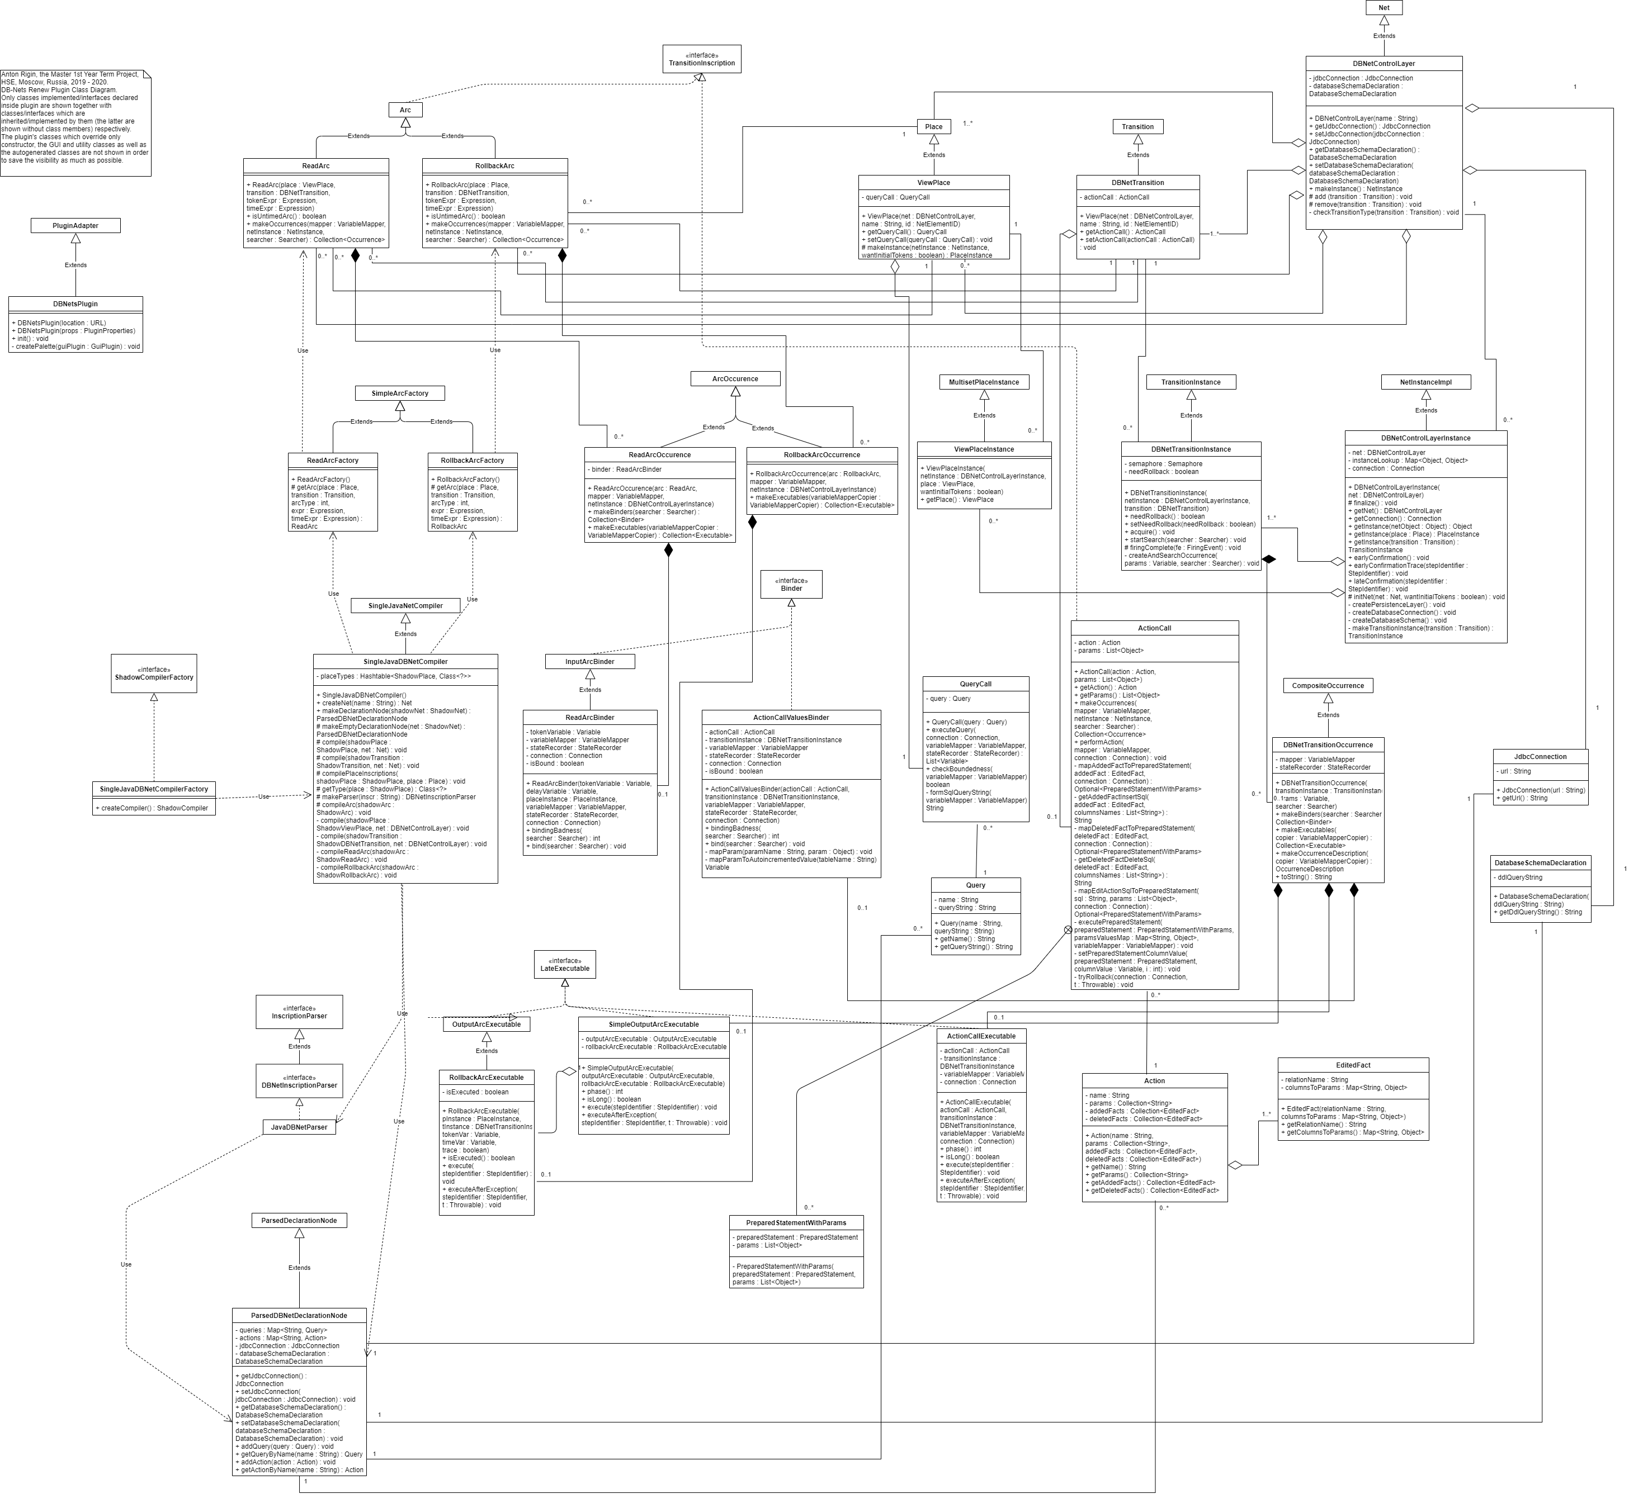

Slide 20




Faculty of Computer Science / Master’s Programme ‘System and Software Engineering’
Methods, Tools and Technologies used
The DB-net with the reference semantics support is a core model used in the project
The methods of constructing DB-net and simulating its run are used
Renew is a main software tool used in the project
Technological stack: Java SE 8, Apache Ant, JavaCC and SQLite (the latter is used as the relational DBMS for the persistent layer of the DB-net)

Slide 21
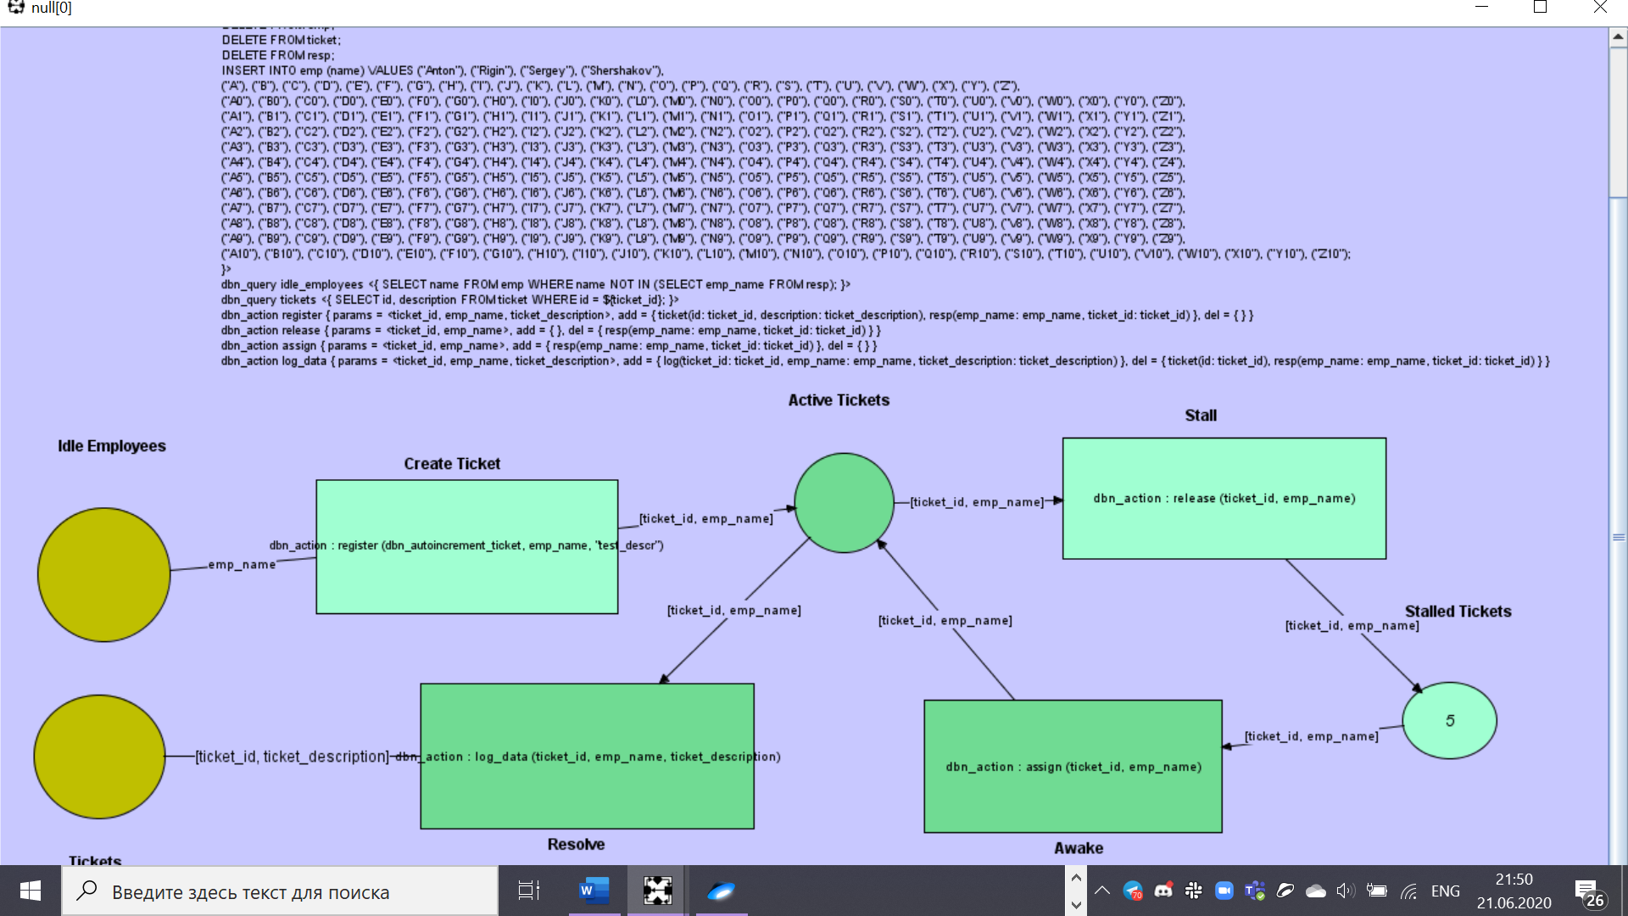
Faculty of Computer Science / Master’s Programme ‘System and Software Engineering’
Results (1/4)

Slide 22
Faculty of Computer Science / Master’s Programme ‘System and Software Engineering’
Results (2/4)
The developed software tool allows to model the db-nets in the Renew GUI and to simulate them with usage of the SQLite RDBMS in the db-net’s persistence layer implementation
The developed software tool is applicable for cases where it is necessary to consider both process and the persistent data
This program is the first software implementation of the db-net formalism available in public

Slide 23
Faculty of Computer Science / Master’s Programme ‘System and Software Engineering’
Results (3/4)
The demonstration

Slide 24
Faculty of Computer Science / Master’s Programme ‘System and Software Engineering’
Results (4/4)
The term project can be continued in the 2nd year as the master thesis which will possibly include development of some new features for the developed software tool and conducting a research with using a real enterprise data of some of the PAIS Lab’s business partners (for example, the Exactpro Systems and London Stock Exchange)
The work is planned to be presented on a dedicated conference
The possible ways of the further development of the plugin are adding ability for user to input the external data during the simulation by the Renew’s request, increasing the usability by adding more understandable error outputting and others

Slide 25
Faculty of Computer Science / Master’s Programme ‘System and Software Engineering’
References (1/3)
[1] W. Reisig. Understanding Petri Nets: Modeling Techniques, Analysis Methods, Case Studies. Berlin, Heidelberg, Germany: Springer, 2013.
[2] J. Kurt. “A Brief Introduction to Coloured Petri Nets,” in Third Int. Workshop on TACAS, Enschede, the Netherlands, Apr. 2 – 4, 1997, pp. 203 – 208.
[3] J. Kurt and M. K. Lars. Coloured Petri Nets: Modelling and Validation of Concurrent Systems. Berlin, Heidelberg, Germany: Springer, 2009.
[4] B. Farwer. “LLPN – Linear Logic Petri Nets: What are Object Petri Nets?” Wayback Machine. https://web.archive.org/web/20051103131745/http://www.llpn.com/OPNs.html (accessed Dec. 1, 2019).

Slide 26
Faculty of Computer Science / Master’s Programme ‘System and Software Engineering’
References (2/3)
[5] “Renew – The Reference Net Workshop.” Renew.de. http://www.renew.de/ (accessed Dec. 1, 2019)
[6] “File:Forthandback.svg.” Wikimedia Commons. https://commons.wikimedia.org/wiki/File:Forthandback.svg (accessed Dec. 5, 2019).
[7] M. Montali and A. Rivkin. “DB-Nets: On the Marriage of Colored Petri Nets and Relational Databases,” in Transactions on Petri Nets and Other Models of Concurrency XII, M. Koutny, J. Kleijn, W. Penczek, Eds., Berlin, Heidelberg, Germany: Springer, 2017, pp. 91 – 118.

Slide 27
Faculty of Computer Science / Master’s Programme ‘System and Software Engineering’
References (3/3)
[8] M. Montali and A. Rivkin. “DB-Nets: On the Marriage of Colored Petri Nets and Relational Databases.” ResearchGate. https://www.researchgate.net/publication/310122815_DB-Nets_on_The_Marriage_of_Colored_Petri_Nets_and_Relational_Databases (accessed Jan. 25, 2020).
[9] “CPN Tools – A tool for editing, simulating, and analyzing Colored Petri nets.” CPNTools.org. http://cpntools.org/ (accessed Dec. 1, 2019).
[10] “Maven Repository: org.xerial >> sqlite-jdbc.” Maven Repository. https://mvnrepository.com/artifact/org.xerial/sqlite-jdbc (accessed May 25, 2020).

Slide 28
Thank you for your attention!
amrigin@edu.hse.ru
anton19979@yandex.ru
HSE Address: 20 Myasnitskaya Ulitsa, Moscow 101000 Russia | 11 Pokrovsky Boulevard, Moscow 109028 Russia

