Slide 1
A Transformer-based NER on digitized journals
Evaluation Interview for the
PhD position in Digital Humanities at the University of Ghent
Cosimo Palma

Slide 2
Research question
How would you approach Named Entity Recognition (NER) on a selection of newspapers from KBR’s (the Royal Library of Belgium) newspaper collection?

Slide 3
Research question
How you would approach Named Entity Recognition (NER) on a selection of newspapers from KBR’s (the Royal Library of Belgium) newspaper collection?
Please propose a workflow that details the selection of the corpora, the state of the documents, the necessary data preparation, the analysis, and outputs, etc…

Slide 4
Research question
Preliminary considerations
Approach selection
Model choice
Documents selection
Documents preprocessing
Algorithm execution
Final considerations

Slide 5
Preliminary considerations
Journal articles present peculiarities preventing a smooth data preparation, like for instance the typical column-structure;

Slide 6
Preliminary considerations
Journal articles present peculiarities preventing a smooth data preparation, like for instance the typical column-structure;
The Named Entity Recognition, as knowledge-based process, needs to be adjusted to the wider research purpose;

Slide 7
Preliminary considerations
Journal articles present peculiarities preventing a smooth data preparation, like for instance the typical column-structure;
The Named Entity Recognition, as knowledge-based process, needs to be adjusted to the wider research purpose;
The eventual importance of Information Visualisation for the final User Experience may compel us to consider calculation costs in our model choice

Slide 8
Approach selection
Brute-force

Slide 9
Approach selection
Brute-force
Grammar/Rule-based

Slide 10
Approach selection
Brute-force
Grammar/Rule-based
Machine learning

Slide 11
Approach selection
Brute-force
Grammar/Rule-based
Machine learning
SpaCy (Statistical methods)

Slide 12
Approach selection
Brute-force
Grammar/Rule-based
Machine learning
SpaCy (Statistical methods)
Deep Learning
CamemBERT (Transformers)
SpaCy (Transformers)

Slide 13
Approach selection
Brute-force
Grammar/Rule-based
Machine learning
SpaCy (Statistical methods)
Deep Learning
CamemBERT (Transformers)
SpaCy (Transformers)

Slide 14
Approach selection
What are transformers?

Slide 15
Approach selection
What are transformers?
A Transformer is a deep learning model based on attention, i.e. each part of the input data is weigthed differently. Unlike Recurrent Neural Networks, transformers do not necessarily process the data in sequencial order. The attention mechanism provides context for any position in the input sequence. This feature allows for more parallelization than RNNs and therefore reduces training times.

Slide 16
Model selection
CamemBERT
State-of-art performance (using BERT - Bidirectional Encoder Representations from Transformers);
Exceptional results for small-sized data;

Slide 17
Model selection
CamemBERT
State-of-art performance (using BERT);
Exceptional results for small-sized data;
SpaCy

Slide 18
Model selection
CamemBERT
State-of-art performance (using BERT);
Exceptional results for small-sized data
SpaCy
Remarkable maintenance, user-friendliness and documentation;
Lowest calculation costs;
Support of deep-learning workflow (such as BERT)

Slide 19
Model selection
CamemBERT
State-of-art performance (using BERT);
Exceptional results for small-sized data
SpaCy
Remarkable maintenance, user-friendliness and documentation;
Lowest calculation costs;
Support of deep-learning workflow (such as BERT)

Slide 20
Documents selection
After reviewing KBR-documents my choice for this experiment fell on a text presenting similar features:

Slide 21
Documents selection
After reviewing KBR-documents my choice for this experiment fell on a text presenting similar features:
Scanned (partially digitized, not yet machine-readable);

Slide 22
Documents selection
After reviewing KBR-documents my choice for this experiment fell on a text presenting similar features:
Scanned (partially digitized, not yet machine-readable);
In French, Flemish or German;

Slide 23
Documents selection
After reviewing KBR-documents my choice for this experiment fell on a text presenting similar features:
Scanned (partially digitized, not yet machine-readable);
In French, Flemish or German;
Presenting noise (pictures, particular fonts, possible bilinguism);

Slide 24
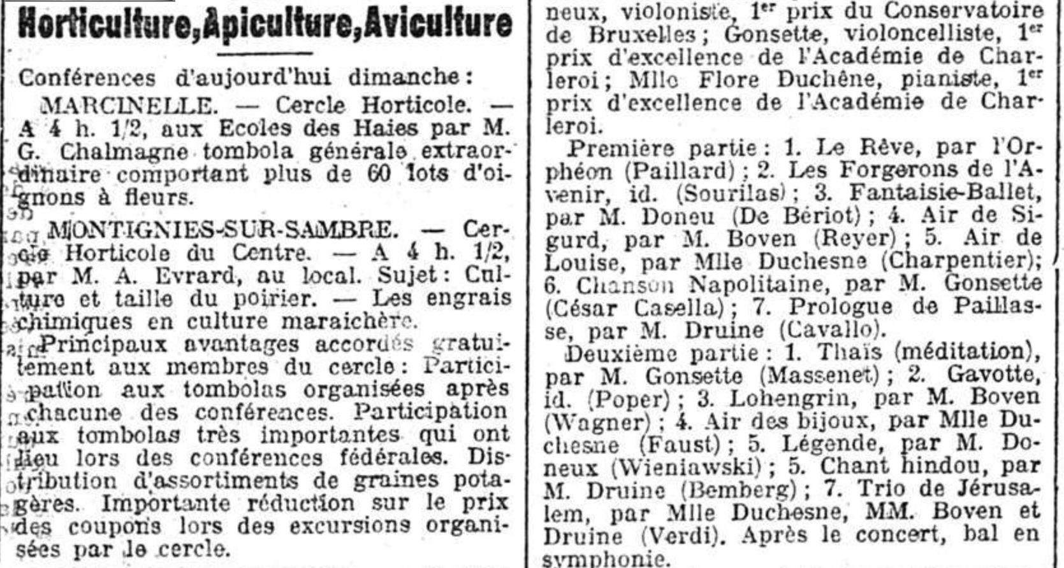
Documents selection
KBR, JB527 - Gazette De Charleroi, 13-03-1910 - Ed.0 - 4

Slide 25
Documents preprocessing
Goals:
Obtaining a machine-readable document
(which is currently digitized, not yet digitalised);

Slide 26
Documents preprocessing
Goals:
Obtaining a machine-readable document
(which is currently digitized, not yet digitalised);
Clean-up and correction of the output text file

Slide 27
Documents preprocessing
Goals:
Obtaining a machine-readable document
Optical Character Recognition Tool (Free OCR)
Clean-up and correction of the output text file

Slide 28
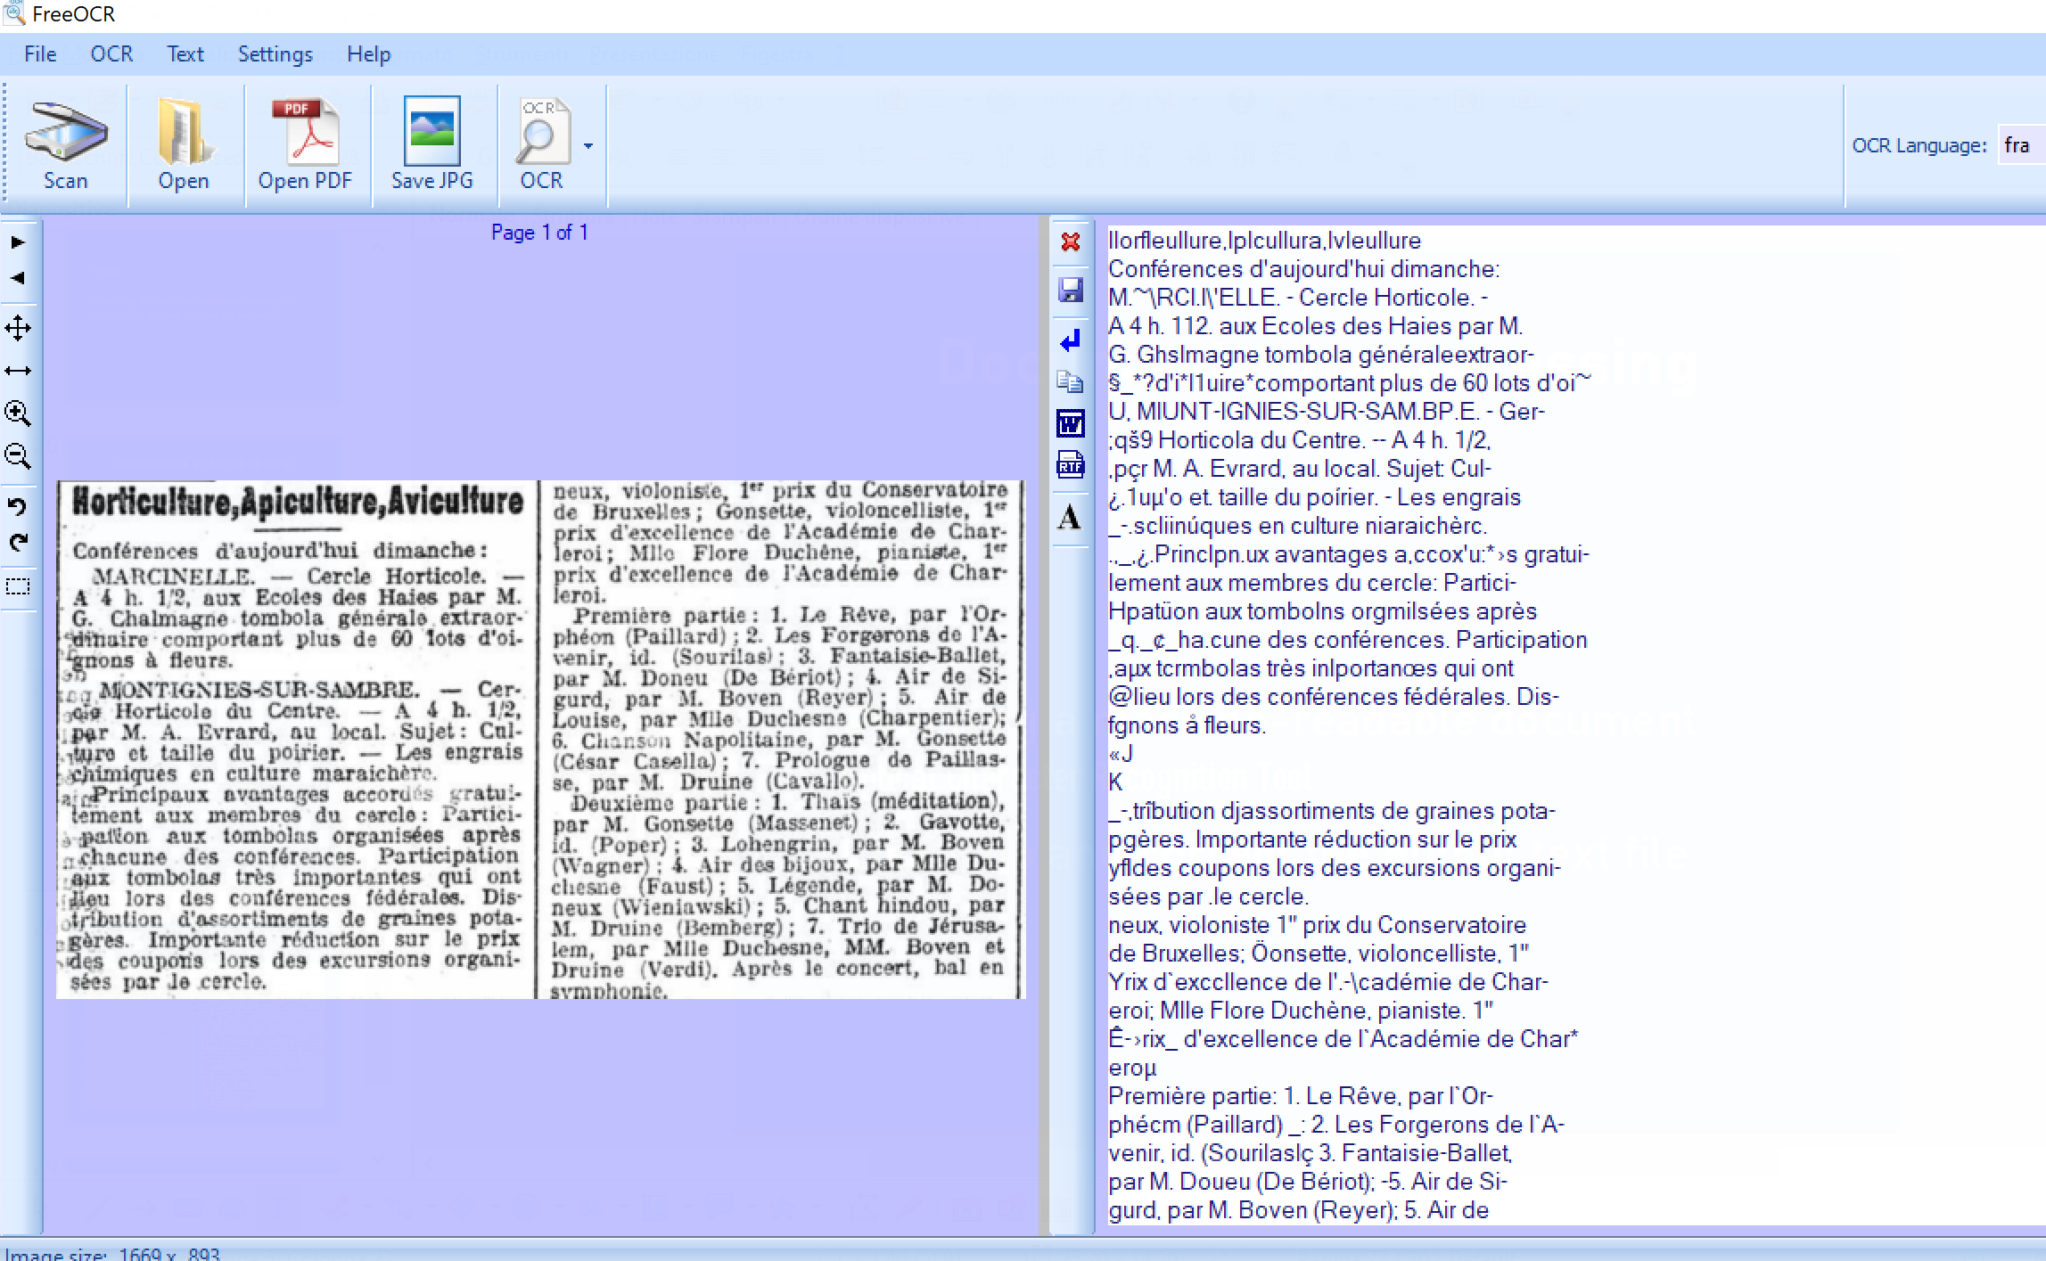
Documents preprocessing

Slide 29
Document preprocessing
Given its size, the selected-document's clean-up could be performed manually.
For bigger corpora a better OCR is required, whereas wrong words can be easily detected and corrected by Transformers-based algorithms as well

Slide 30
Final considerations
My explorative approach won’t represent the best solution for a real project, which could present:

Slide 31
Final considerations
My explorative approach won’t represent the best solution for a real project, which could present:
Specific entity types that are not included in the available packages;

Slide 32
Final considerations
My explorative approach won’t represent the best solution for a real project, which could present:
Specific entity types that are not included in the available packages;
Specific kinds of text differing from the ones Py-packages models are trained on;

Slide 33
Final considerations
My explorative approach won’t represent the best solution for a real project, which could present:
Specific entity types that are not included in the available packages;
Specific kinds of text differing from the ones Py-packages models are trained on;
Particular requirements (e.g. Accuracy may be weighted according to needs)

Slide 34
Thank you for the attention

