Slide 1
AME 585
Project 6 - Bellow
Henry Glover
3/02/2025

Slide 2
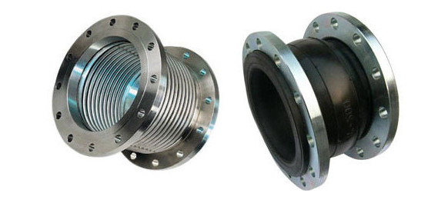
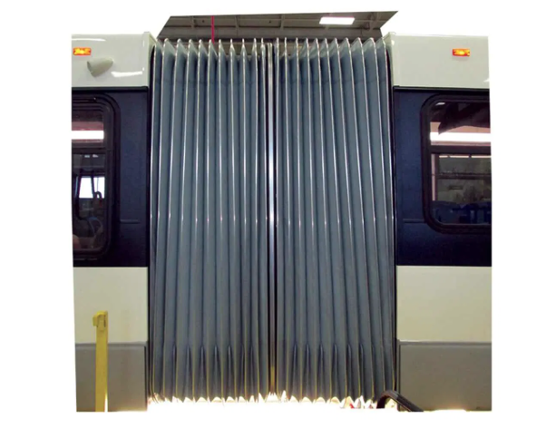
#1
Bellows are manufactured expansion joints that require high strength and good flexibility.
These are elastic vessels that can be compressed when pressure is applied to the outside of the vessel or extended under vacuum
Allows flexibility and movement of pipe systems
Used in high pressure systems
Where they are used
In aerospace
In chemical plants
In power systems
In heat exchangers
In automotive vehicle parts
In piping systems
In petrochemical plants
In refineries
Other than what is mentioned in the lecture, bellows can be used in the following applications
On trains or busses, bellows are used to connect or extend a cabin car to another
Bellows used for air suspension on luxury cars

Slide 3
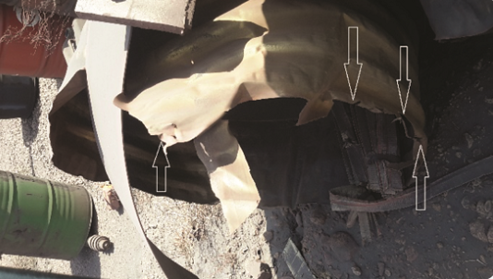
#2
Examples of failure
https://ntrs.nasa.gov/api/citations/20050198895/downloads/20050198895.pdf - - Orbiter LH₂ Feedline Flowliner Cracking Problem
Cracks were discovered in the flowlines of the space shuttles liquid hydrogen feedlines
Nasa detected 3 cracks in the downstream flowliner at the gimble joint in the LH₂ feedline at the interface with the low-pressure fuel turbopump
8 additional cracks were found in other orbiters
Result of low-stress, high cycle fatigue caused by backflow conditions from the space shuttle main engine
Caused by the vibratory strains
A weld repair solution was used to repair all the detachable cracks as well as polishing all slot edges to remove manufacturing discrepancies that could initiate new cracks
https://www.materialsperformance.com/articles/material-selection-design/2021/06/failure-of-expansion-joint-caused-by-corrosion-cracking
A below expansion joint made of type 304 stainless steel exploded in a methane gas pipeline
Operating temperature was around 400 Celsius
Deemed to have been caused by stress corrosion cracking induced by hydrogen sulfide present in the gas stream
Combined with stainless steel, the hydrogen sulfide led to a corrosive environment
The corrosive environment led to a crack initiation followed by propagation under the operational stresses of pressure and elevated temperature

Slide 4
Bellow Type | Pros | Cons
Single Bellow | Simplest type of expansion joint. Can absorb small amounts of axial, lateral, and angular movement. | Needs adequate anchors and guides. Limited movement capabilities
Universal Expansion Joint | Allows large axial, lateral, and angular movement. Consists of two single bellows connected by a center spool piece. | Needs adequate anchors and guides. Requires greater number of external restraints to counteract pressure thrust.
Externally Pressurized Expansion Joint | Good for large axial movements. Have self-draining convolutions. | More expensive, harder to install, complex design.
Tied Single bellows | Has design flexibility, tie rods eliminate the need for main anchors. | Cannot absorb axial growth, still needs a well-planned guide system, only lateral and angular movement can be absorbed.
Tied Universal Expansion Joint | Tie rods absorb pressure thrust and limit lateral deflection | Requires precise alignment, has complex installation
Hinged Expansion Joint | Allows angular movement while absorbing pressure thrust, used in pairs to absorb large amounts of expansion, the hinge hardware can carry the pressure thrust of the system and can be used to combat torsional movement | Movement is limited to angulation in one plane, does not allow axial or lateral movement
Gimbal Expansion Joint | Can absorb pressure thrust and torsional twist while allowing angulation in any plane, when paired, it can absorb movement in multi-planer piping systems | Large system and requires complex design
Metal Bellows | High temperature and pressure resistance, very high strength | Fatigue, prone to cyclical loading failure, can be prone to corrosive environments, expensive
Rubber Bellows | Good vibration, shock, and noise absorption, very flexible and can be used in complex piping systems | Low temperature limit, low strength/pressure resistance, easily degradable
Plastic Bellows | Lightweight, corrosion resistant, low cost, | Low temperature limit, low strength/pressure resistance, low mechanical strength
Welded Bellows | Very precise, high strength, reliable in vacuum | Susceptible to corrosive environments, complex manufacturing, susceptible to manufacturing variability
#3

Slide 5
#4
Parameters that drive bellow selection
Operating environment
For space, in vacuum
Outside or underground
Underwater
For high temperature resistance – use, metal bellows
Low-Temperature but needs flexibility – use rubber or plastic bellows
Corrosive or chemical resistance – used stainless steel, rubber, or plastic bellow material
Pressure ratings
Internal pressure loads
Use of externally pressurized bellows for high pressure applications
If axial thrust needs to be absorbed – Use tied, hinged, or gimbal expansion joints
If no external restraints are needed – externally pressurized bellows or universals bellows will be considered
Movement requirements
Axial (compression and extension)
Lateral
Angular
Torsional requirements
Material parameters
Material formability requirements
Corrosion properties
Low cycle fatigue properties
Good elongation, good weldability, high strength-to-weight ratio
Installation and space constraints
Large displacements
Limit space
Cost
Cost for maintenance
Cost for installation
Vibration and noise considerations
Application specific requirements
For aerospace – alloys such as Inconel or titanium
For vacuum applications – use welded bellows
For exhaust system – rubber or metal bellows depending on temperature

Slide 6
#5
Failure Modes
Fatigue and fracture failure
High cycle fatigue crack
Repeated flexing
Handling damage
Reduction in fatigue life
Surface effects – oxidation and local stress risers
Elevated temperature operation
Defective welds
Corrosion and chemical degradation
Exposure to humidity, salt, chemicals could cause deterioration
High temperature failure
Creep (premature deformation under constant stress, especially at elevated temperatures)
Manufacturing variability and improper installation
FOD and abrasion
Foreign objects can cause a bellow to crack or fail
A loss of pressure containment
Burst failure or collapse failure caused by overpressure
Buckling instability from internal and external pressures
Flow induced vibrations in bellow sections caused
Inter-ply rupture
Stress corrosion cracking
Handling damage
Dents, scratches, cracks

Slide 7
#6
Bellow fatigue life
Fatigue life for metal bellows is affected by primary and secondary mean stress
Affected by internal stress
Affected by micro support effects
Affected by exceeding pressure capacity
Affected by handling damage and manufacturing variability
How to improve bellow fatigue life
Optimize convolution geometry
Shallow, wider convolutions – reduced local stress concentrations
Uniform convolution profiles – prevents uneven stress distribution
Avoid sharp transition regions
Electropolishing
Coating that improves surface quality for better fatigue life
Multi-ply bellows
Multiple thin layers distribute stress better
Allows for higher flexibility and longer cycle life
Thicker ply can improve durability, but there needs to be a balance
Don’t make it too thick, it can reduce flexibility and increase stress from cyclical loads
Proper material selection
Work hardened materials – annealing, shot peening
Corrosion resistance materials
Fatigue resistance alloys
Pre-conditioning – subject bellows to few cycles of operating conditions
This allows the material properties to stabilize
Minimizing internal pressure stress
Proper manufacturing and handling

Slide 8
#7
Recommended requirements for bellow design
Deflection limitation
Duct routing should ensure that each flexible joint handles only one type of deflection (angular, axial, or shear) at a time
Maximum bellows joint deflection
The total combined deflections on a bellows joint must not exceed its fatigue life stress limits
Torsional deflection
Duct assembly design should avoid or minimize torsional loading on the ducts.
Sizing
The duct should maintain the required flow area to meet pressure loss limits while being lightweight yet strong enough to withstand all expected loads
Control of pressure drop
Flow direction change
Flow direction changes, such as bends or branch tap-offs, should be designed to minimize pressure loss
Flow area change
Changes in flow area should be designed to minimize system pressure drop
Flow distribution
Propellant flow needs to be evenly distributed going in and out
Flow resistance
Inner surface of the duct needs to have the least amount of possible resistance for flow
Components
Separable Connectors
Flanged duct joints must remain leak-free under operating conditions
Structural adequacy
Structure needs to withstand mechncial and dynamic loads during operation

Slide 9
#7 Cont.
Recommended requirements for bellow design
Components
Cleanability
Brackets and mounting hardware
Brackets, bosses, and mounting lugs must withstand service loads without cracking or distorting the duct wall
Insulation
Thermal resistivity
Insulation must effectively prevent heat transfer into lines carrying cryogenic fluids
Leak tightness
Vacuum jackets cannot leak beyond acceptable limits
Hot to cold duct interaction
Withstand thermal loads without leaking when there is a temperature difference in the connection
Handling protection devices
Protect critical surfaces of the duct assembly when shipping or handling
Materials
Chemical compatibility
Selected materials must be compatible with the system fluid and external environment throughout storage and service life
Hydrogen embrittlement
Ducting and filter materials must resist the harmful effects of a high-pressure gaseous hydrogen environment
Weldability
The line material must have sufficient weldability to allow secure attachment of bellows, end flanges, brackets, and bosses
Formability
The line material must be formable enough to allow bending or shaping into required convolutions
Mechanical properties
The line material's physical and mechanical properties must meet functional requirements and operating conditions

Slide 10
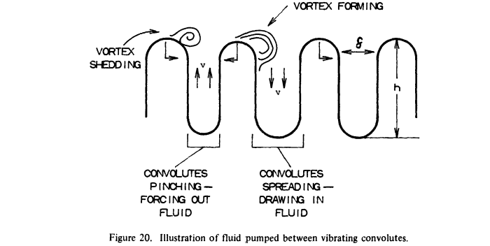
#8
Flow Induced Vibrations - https://ntrs.nasa.gov/api/citations/19840014844/downloads/19840014844.pdf
Occur when fluid flow interact with a structure causing oscillations due to pressure forces
These oscillations and vibrations can lead to fatigue over time, noise, and performance issues
Can introduce a liner to keep the fluid away from the convolutes
Expensive and hard to do
Causes upstream effects
Momentum fluctuation
Bubbles in fluid
Thermal-hydraulic vibration due to phase change
Figure 20 illustrates the vortex formation and shedding process interacting with fluid motion in the convolutes
From the free stream flow, as the convolutes vibrate, they pump fluid in and out at a velocity, which can strengthen or weaken the vortices depending on the phase relationship. The interaction on the fluid force depends on the vibration amplitude.

Slide 11
#8 Cont.
Examples of flow induced vibrations
Vortex induced vibrations
Fluid flows around a bluff body, vortices are shed creating fluctuating lift forces
Resonance can amplify oscillation if phase is matched from shedding frequency and natural frequency of the bluff body
Ex) High velocity stream of gas in a gas pipeline, as fluid flows past convolutes there is vortex shedding creating alternating pressure forces
Turbulence induced vibrations
Irregular fluid motion can cause random fluctuations in pressure
Can cause the convolutes to have unwanted expansion and contraction
Ex) Heat exchanger tubes that experience turbulent flow
Acoustic induced vibrations
High pressure flow generate sound waves that can cause vibrations in the structure
Ex) High speed fuel flow to an engine
Fluidelastic variability
When structural instability are met with fluid forces there can be an unstable feedback loop creating large amplitude oscillations
Ex) Multi-bellow system used in series can introduce interaction points where vortices form because of interaction points and structural motions of expansion/contraction
Pressure pulsation-induced vibrations
Rapid pressure fluctuations lead to pulsating forces
Ex) Rocket engine fuel feed lines with flexible bellows where a sudden change in fuel flow can create pressure pulsations (can be caused by starvation or bubbles interrupting fluid flow)

Slide 12
#9
NASA 8123 - https://ntrs.nasa.gov/api/citations/19780008146/downloads/19780008146.pdf
The main problems in manufacturing of convoluted bellows have been because of material thinning, proper heat-treatment control, proper welding, and convolution stackoff
Practice of joining bellows is intricate – use weld fixturing, chill blocks, and automatic welding. Electron-beam welding and diffusion bonding have their advantages for joining dissimilar metals. For heat treatable bellows vs non heat treatable, a transition section is used to attached the two dissimilar bellows.
Fatigue failures of liners in which cracks appeared in the trailing edge and in the weld joint are common – caused by vibrations .
When routing, the pressure drop in a convoluted inner core is 10 to 15 times that for a comparable diameter hard tube.
On most flexible hose designs, it is practice to keep velocities of gases below Mach number of 0.3 to avoid pressure loss and flow induced vibrations
Interconnecting ducts/bellows are routed based on where the optimal positions are for the rocket engine components, not the other way around.
The maximum effective line stress is limited to a factor of safety of 1.4 on combined loading and 1.5 on ultimate and 1.1 on yield for pressure loading.
Flow contraction pressure losses can be reduced by 90% if the edges of the contraction are radiused rather than sharp.
Surface friction between the duct walls and the flowing fluid can produce large pressure losses if the walls are rough.
To reduce weight, the number of separable connectors used in the line assembly is kept to a minimum. Need to be easily accessible for maintance as well.

Slide 13
#10
Design Problem 1
Requirements
Needs to be lightweight
Single bellow with 4 plies
LOX = -297F to 160F
P = 1000 Psi
Axial extension = 0.15 in
Design cycle = 5000
Internal diameter = 10 in
Free length = 10 in
Choose a corrosive resistance material
Ensure bellows does not yield
Lightest material possible
Approach
Using the EJMA worksheet
Material properties from MMPDS (2003)
Plug material properties into worksheet to see which one is best case
Thinking about using AL T6 or T8 because of low cycle count (5000)

Slide 14
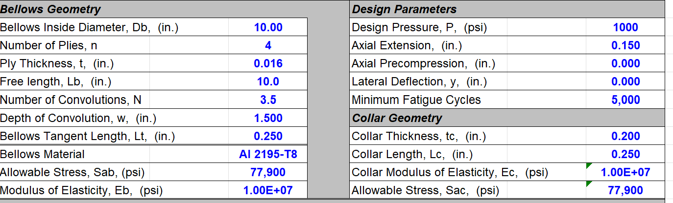
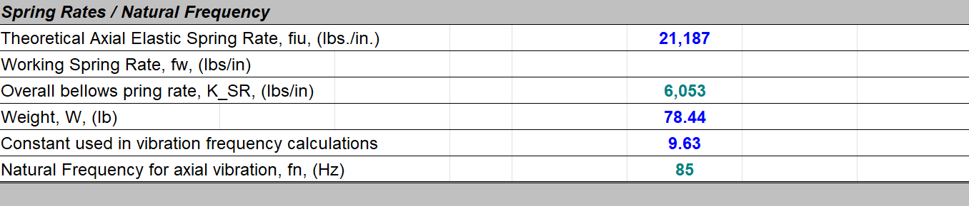
#10 Cont.
Thanks to Tony, I only considered Aluminum 2195-T8 and Aluminum 2219-T8
Used the excel worksheet to plug in values to get properties
For Aluminum 2195-T8 (https://www.makeitfrom.com/material-properties/2195-2195-T8-Aluminum)
Yield strength = 82 e3 Psi
Yield strength at 160F = 77.9 e3 Psi
Elastic modulus = 10 e6 Psi
Density = 0.110 Ib/in³
Weight = 0.144 Ib

Slide 15
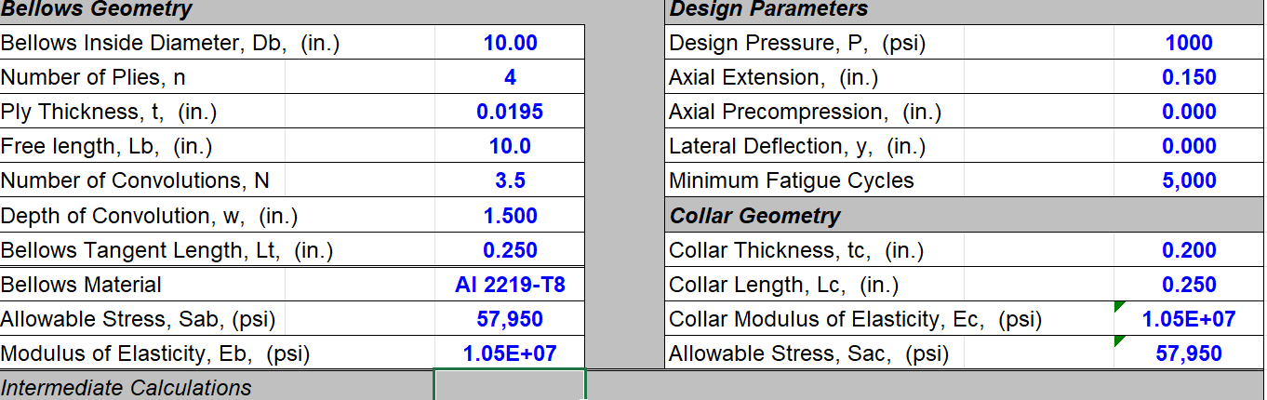
#10 Cont.
For Aluminum 2219-T8
Yield strength = 61 e3 Psi
Yield strength at 160F = 57.95 e3 Psi
Elastic modulus = 10.5 e6 Psi
Density = 0.103 Ib/in³
Weight = 0.165 Ib

Slide 16
#10 Cont.
Final choice is Aluminum 2195-T8
Properties are listed below
Fatigue life
5000 cycles is low and is a LCF concern
Resonance check
Bellow has 3.5 convolutions = 4 inner convolutions
Natural frequency is 85 Hz
Bellow mass
Total weight = Dry mass + LOX mass
Convolutions are idealized as semi-circles with a radius equal to their depth

Slide 17
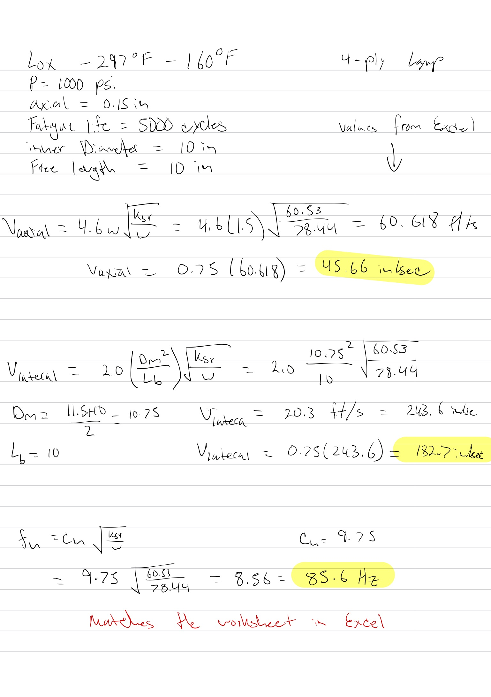
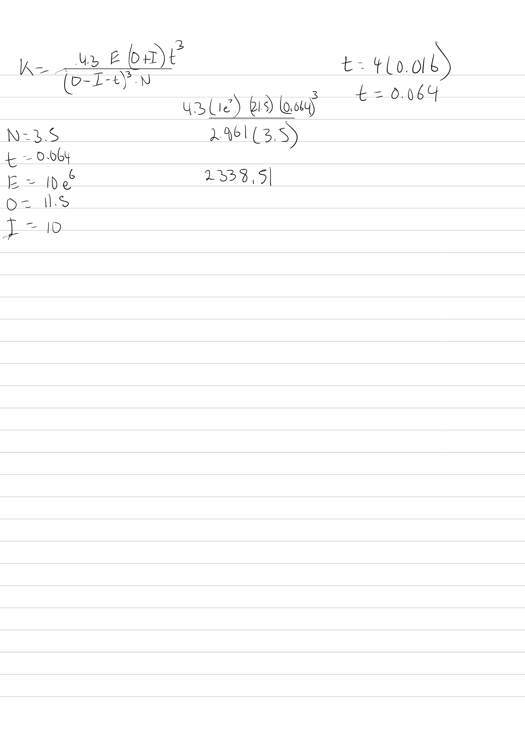
#10 Cont.
Hand Calc

Slide 18
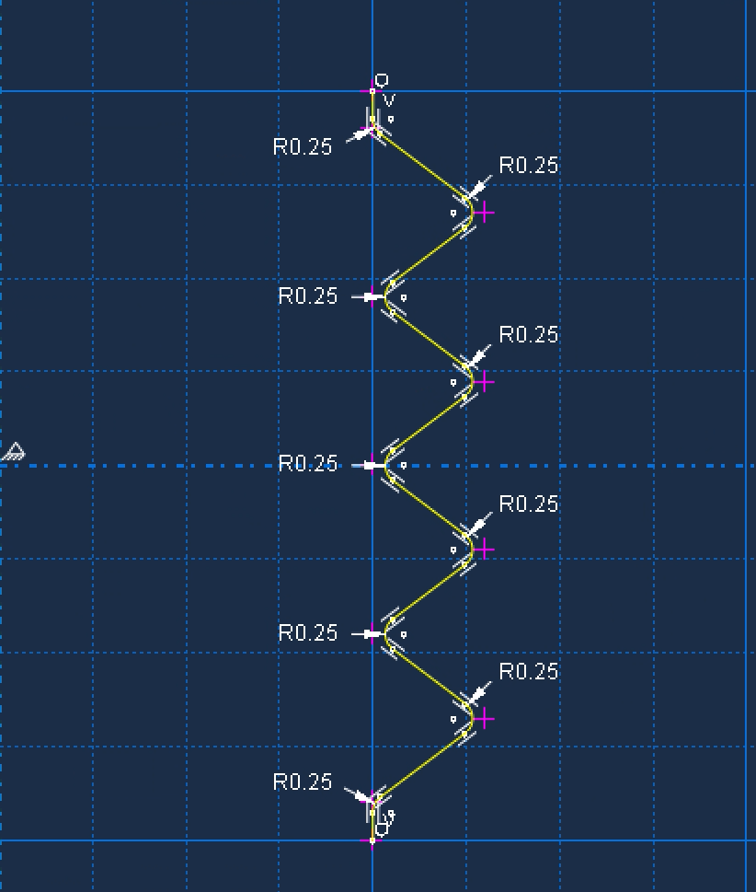
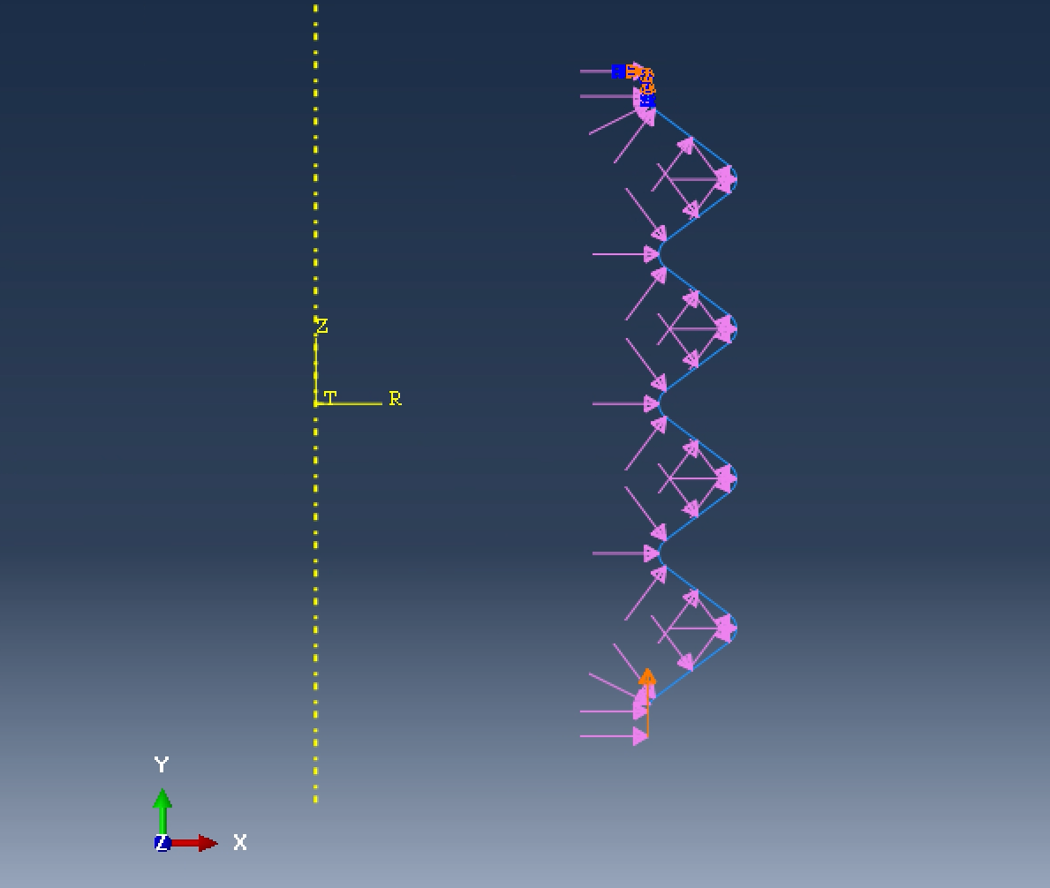
#10 Cont.
Model dimension and setup
Fillet = 0.25
Length = 10 in
4 total convolutions
Load parameters
Pressure = 1000 Psi
Top node = encaster (fixed)
Bottom Node = Displacement/rotation = 0.15

Slide 19
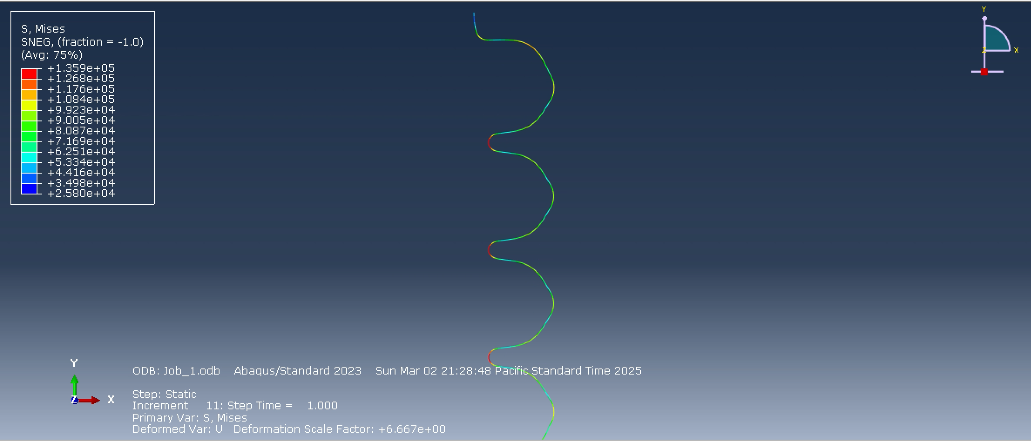
#10 Cont.
Abaqus Run 1
Run 1 used a thickness of 0.064in
Results were way below our allowable had more room to reduce thickness
Max stress = 1.359e5

Slide 20
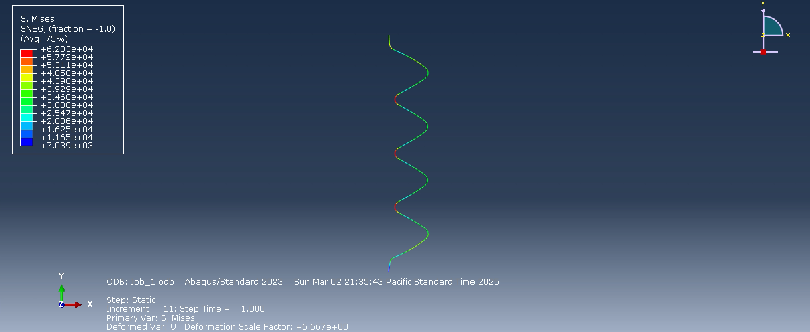
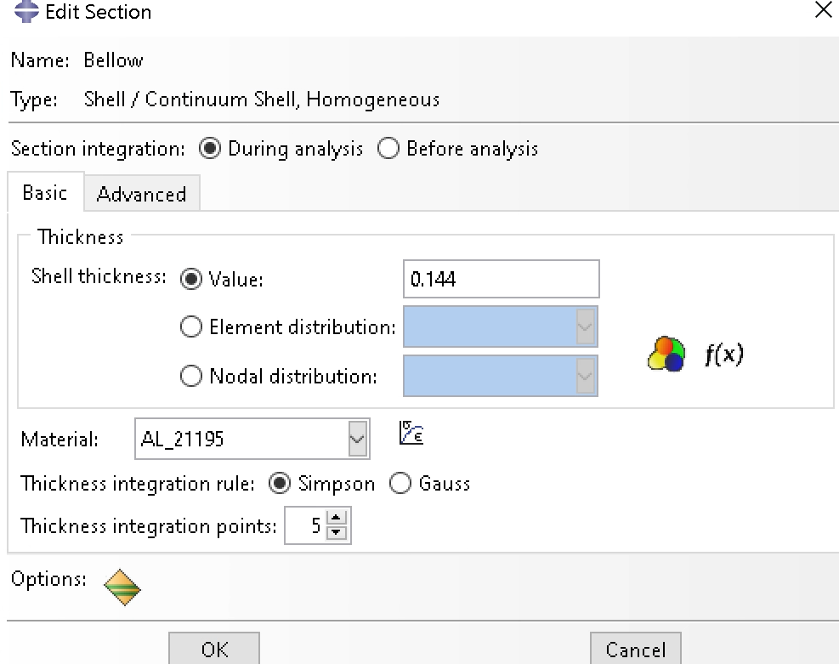
#10 Cont.
Abaqus Run 2
Run 2 used a thickness of 0.144 in
Results were still below our allowable had more room to reduce thickness
Max stress = 6.233e4

Slide 21
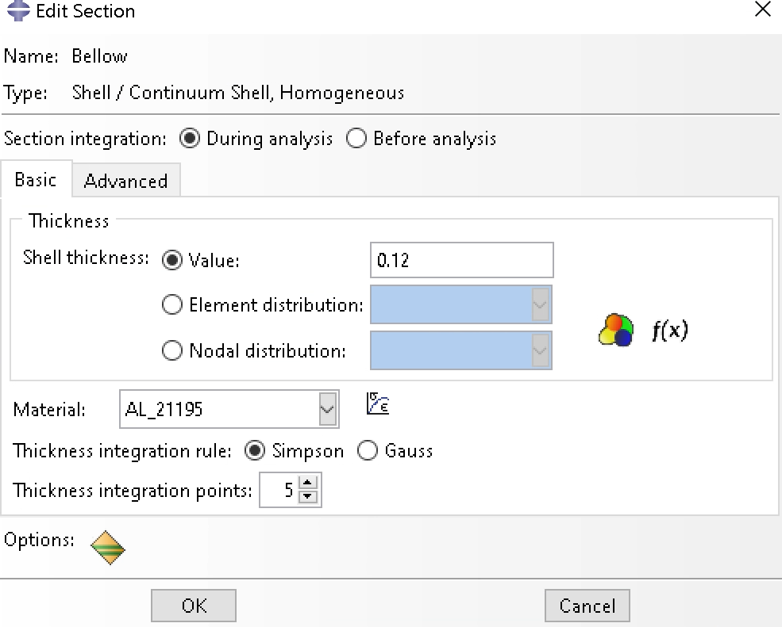
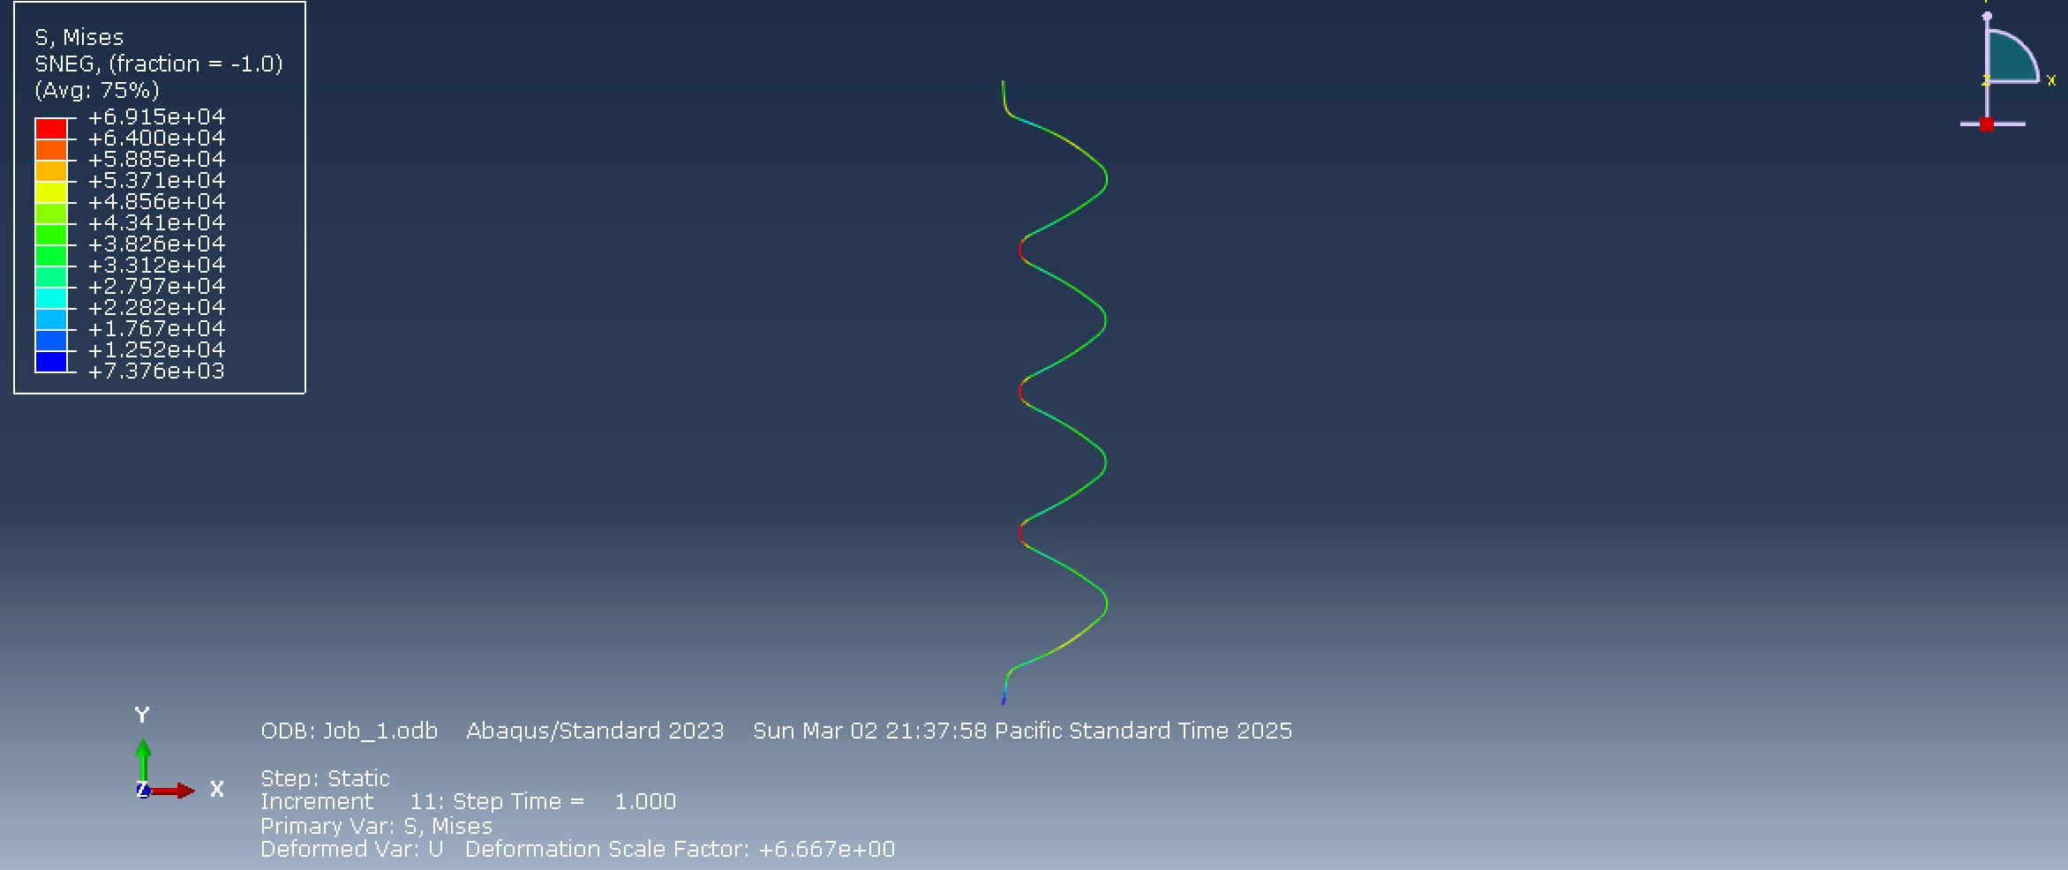
#10 Cont.
Abaqus Run 3
Run 3 used a thickness of 0.12 in
Results were still below our allowable had more room to reduce thickness
Max stress = 6.915e4

Slide 22

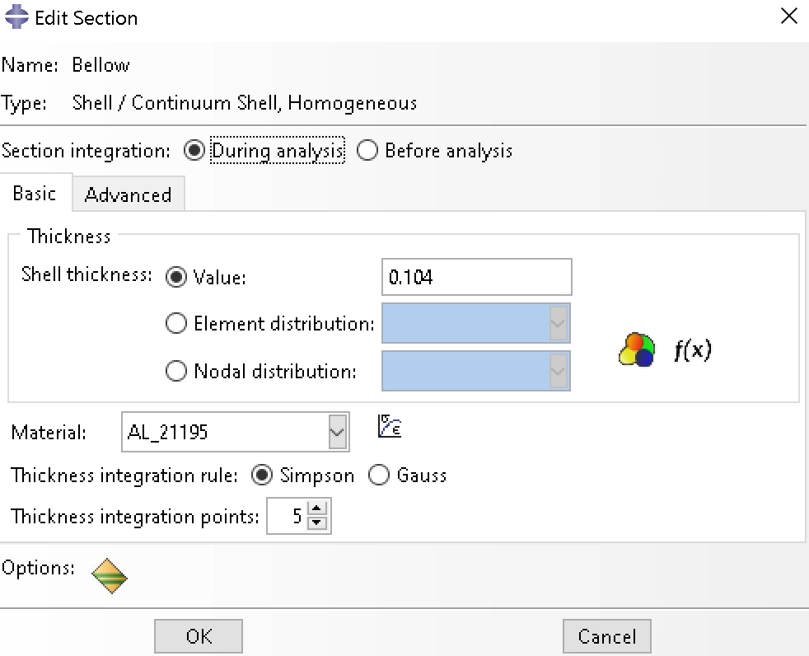
#10 Cont.
Abaqus Run 4
Run 4 used a thickness of 0.104in
Results are now right under our allowable and we had no more room to reduce thickness
Max stress = 7.78e4
Remember allowable = 7.79e4
These results are within our boundaries and as close as possible to max allowable

Slide 23
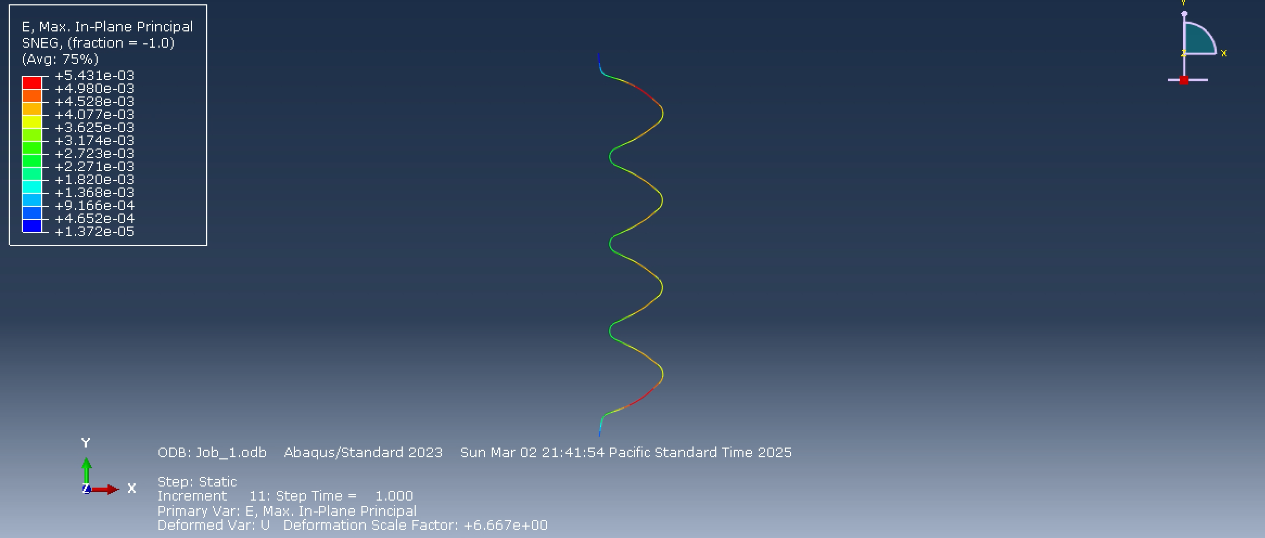
#10 Cont.
Abaqus Conclusion and Strains
Run 4 with a thickness of 0.104in was my best result
Results are now right under our allowable and we had no more room to reduce thickness
Max stress = 7.78e4
Remember allowable = 7.79e4
These results are within our boundaries and as close as possible to max allowable
Max strain for this run was 5.431e3

