Slide 1
AME 585
Project 7
Henry Glover
3/14/2025

Slide 2
#1
NASA 5019
A fracture control plan needs to be developed and maintained for human rated spaceflight hardware that
Addresses hazard, the parts in the program-specific flight hardware
Meets the requirements of the NASA technical slandered
Specifics fracture controls to mitigate risk of catastrophic failure
Has approval by the RFCB
If part failure does not result in a credible catastrophic hazard, then it is classified as non-fracture critical
For pressurized components perform proof tests to a minimum of 1.5 times the MDP during individual acceptance
For rotating hardware, it is proofed by a spin test to a minimum rotational energy factor of 1.05
A loading spectra is needed for the damager tolerance life analysis
Assume that initial flaw in a part is the size and shape that is not screened by NDE, proof test, or process control and it is in the worst location and orientation
If fatigue crack growth is minimal or the service life is a single event, the analysis must ensure a factor of safety of 1.4 on the critical stress intensity factor
Develop an impact damage mitigation plan to define, document, implement, and prescribe impact protection and detection strategies for flight hardware to mitigate identified damage threats
For proof testing composite or bonded hardware a flight article needs to be 1.2 times the limit load under the appropriate environment conditions or by adjusting the test loads using coupon or hardware element tests verified ECF
All parts go through a fracture control classification process for all mission phases to determine which parts are fracture critical. Parts are classified as:
Exempt
NFC – Not fracture critical
Fracture critical

Slide 3
#1 Cont.
NASA 5009
NDE inspection is conducted by certified inspectors who have a clear criteria defined for each type of part and NDE methods need to be selected for the entirety of the component's life cycles including – manufacturing, transportation, maintance, and operations
All detected crack or crack-like flaws can be cause for rejection
NDE inspection zones need to be clearly identified in drawings and subsequently updated
NDE capability demonstration specimens must be used to assess detection capability for Special NDE applications, represent the inspected material and flaw characteristics, and be documented in NDE procedures and personnel qualifications, with specimens sourced or created as needed
Nondestructive inspections of fracture-critical hardware must detect initial crack sizes from damage tolerance analyses with 90% probability at 95% confidence
Liquid penetrant testing (fluorescent penetrant), eddy current, magnetic particle inspections, UT, RT, and other NDE need to be in accordance with the standard practices and specification sheets (ASTM, SAE, etc.)
All deviations from the standard NDE need to be approved by the qualified and approved NDE engineering organization, the RFCB, and the Technical Authority
Special NDE is require with approval when the damage tolerance analysis requires smaller flaw sizes than those given for standard NDE
The Point Estimate Method assumes flaw detection capability increases with flaw size near the test flaw and requires few flaws, making the minimum detectable flaw size potentially non-determinant
NDE needs a summary report with the supporting data

Slide 4
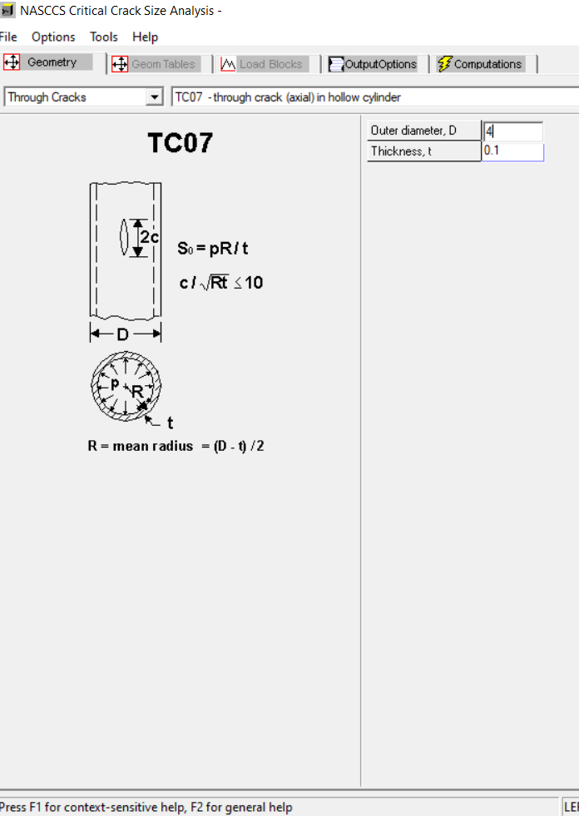

#2
NASGRO
Geometry = TC07
Radius = 2 in
Diameter = 2 x R = 4
Thickness = 0.1 in
Material = Aluminum 2024-T3
Fracture Toughness = $22×{10}^{3} psi−{in}^{1/2}$
Yield strength = $47×{10}^{3} psi−{in}^{1/2}$
Through crack in a pipe
Crack propagation analysis
NASCCS
Pressure = 5,550 psi
Incorporate F.S. = 1.4
K_{IC} / 1.4
15714 $psi−{in}^{1/2}$
$R=\frac{D−t}{2}$ = 1.95
$S_{0}=\frac{pR}{t}=$ 108225 psi
Is the acceptable flaw size inspectable by dye penetrant?
Need to find critical crack size
Aluminum Properties - https://www.makeitfrom.com/material-properties/2024-T3-Aluminum

Slide 5
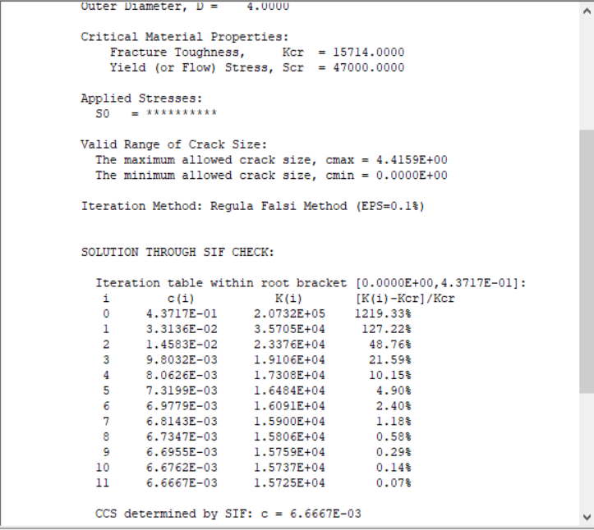
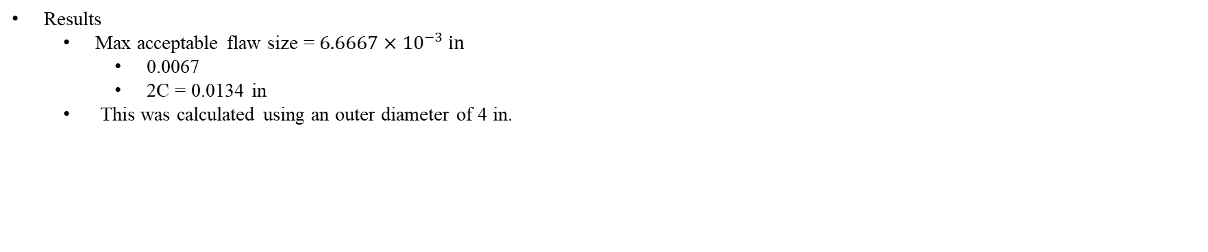
#2 Cont..
Results
Max acceptable flaw size = $6.6667×{10}^{−3} in$
0.0067
2C = 0.0134 in
This was calculated using an outer diameter of 4 in.

Slide 6
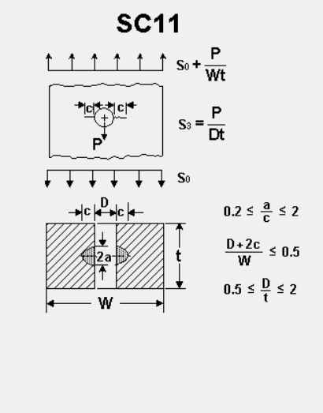
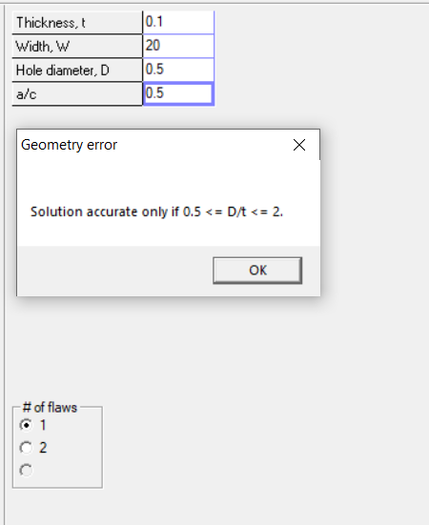

#3
NASGRO
Surface flaw = a/c = 0.5
$S_{0}=20 ksi=20×{10}^{3} psi$
Geometry = SC11
Width = 20 in
Thickness = 0.1 in
Diameter = 0.5
Error occurred so changed diameter to 0.2
This is a conservative number, lets see what happens
Bearing load = 1000 lbs.
$\frac{p}{D×t}$ = 50000 psi
Material = Aluminum 2024-T3
Fracture Toughness = $22×{10}^{3} psi−{in}^{1/2}$
Yield strength = $47×{10}^{3} psi−{in}^{1/2}$
Incorporate F.S. = 1.4
K_{IC} / 1.4
15714 $psi−{in}^{1/2}$

Slide 7
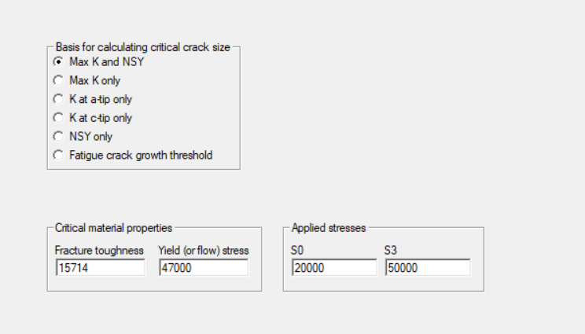
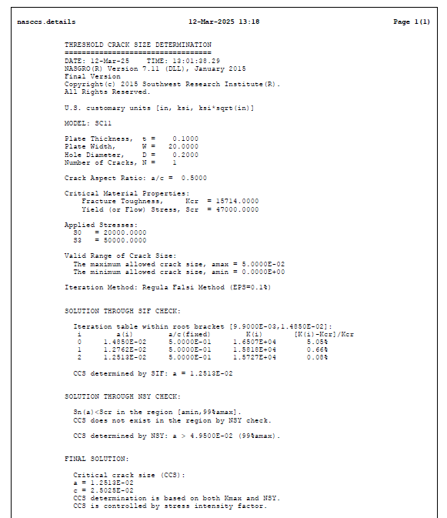
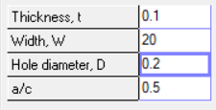
#3 Cont.
Results
The current flaw size in the problem is c = 0.5 in
Is the flaw safe for flying?
No
Critical flaw size is 0.025
The found flaw size is much larger than the critical crack size
No difference in using only fracture toughness and assuming no yielding

Slide 8
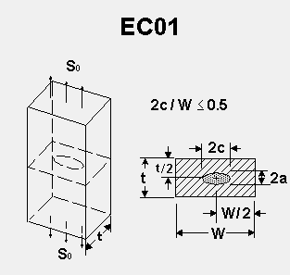
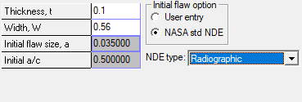
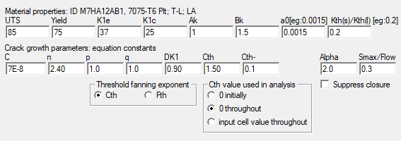
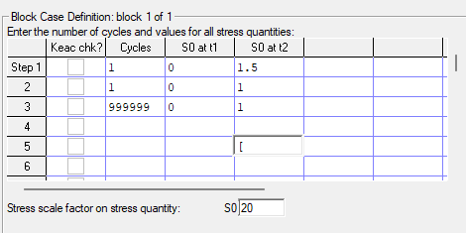
#4
AL 7075-T6 [12AB1]
Thickness = 0.1 in
Width
2c/W <= 0.5
c = 0.07
2c = 0.14
W >= 4c
W = 0.56
Pressure = 20 Ksi
Use X-ray 5009 flaw size
Assumptions
EC01 is the right geometry
Proof factor = 1.5
30 Ksi
Proof test completed once
Leak test at 20 Ksi
Cycles set to infinity to see when the valve will fail

Slide 9
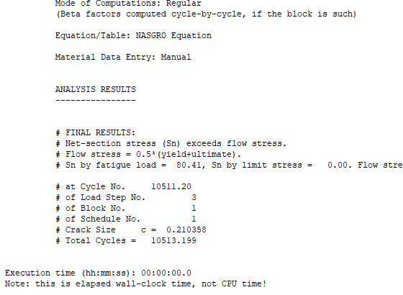
#4 Cont.
Results
Failure at cycle 10511
Based on FOS of 4x, valve service life should be at 2500 cycles
This doesn’t not account for temperature fluctuations, manufacturing variability, handling, or environmental loads on the valve

Slide 10
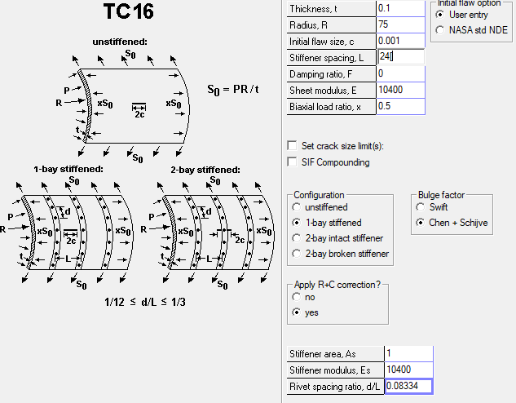
#5
TC16
Assumptions
Flying at = 40,000 ft
Cabin pressure = 7,000 ft
P = 11.34 - 2.72 = 8.62 psi
S₀ = PR/t = 6.47
Al 7075-T6[12AB1]
E = 10400
1-bay stiffened
Area =1 in²
Rivet every 2 in
Length between stiffeners = 24 in
Radius = 75 in
Thickness = 0.15
NASGRO adjusted to 0.1 thickness
Biaxial load ratio = 0.5
Dampening ratio = 0

Slide 11
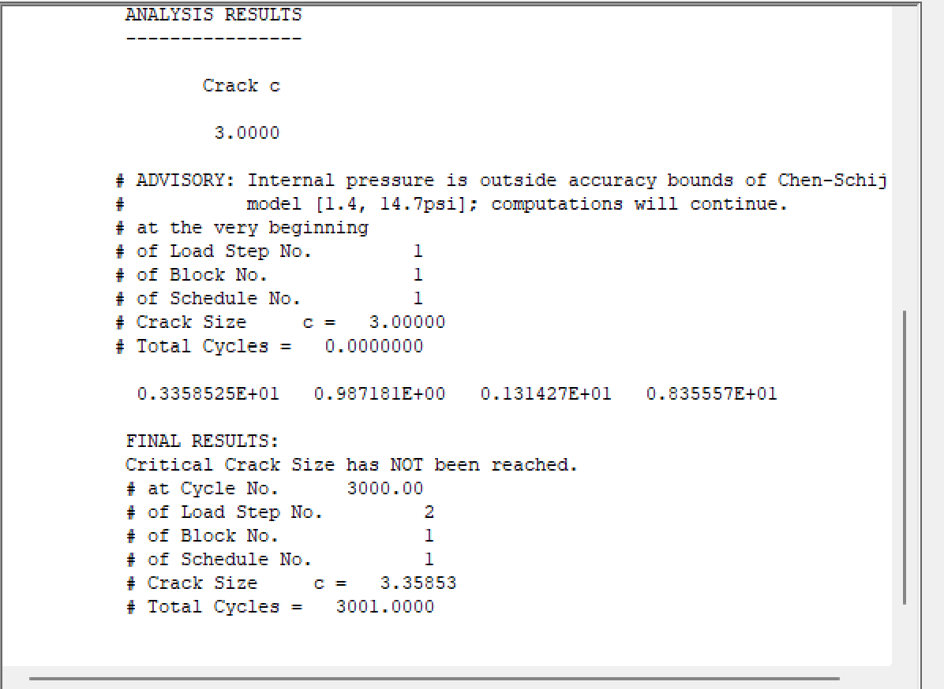
#5 Cont.
Results
Iterate crack size, until a finite life solution
3.35 crack size
2 x 3.35 = 6.7 in
Conservative estimate of 6.7 in of a critical crack size

Slide 12
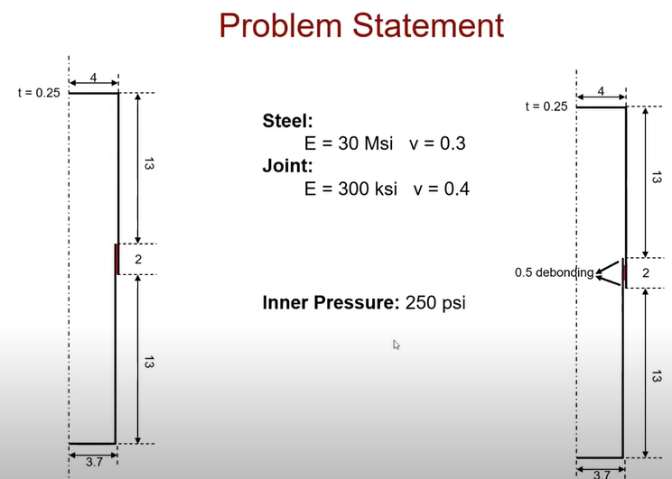
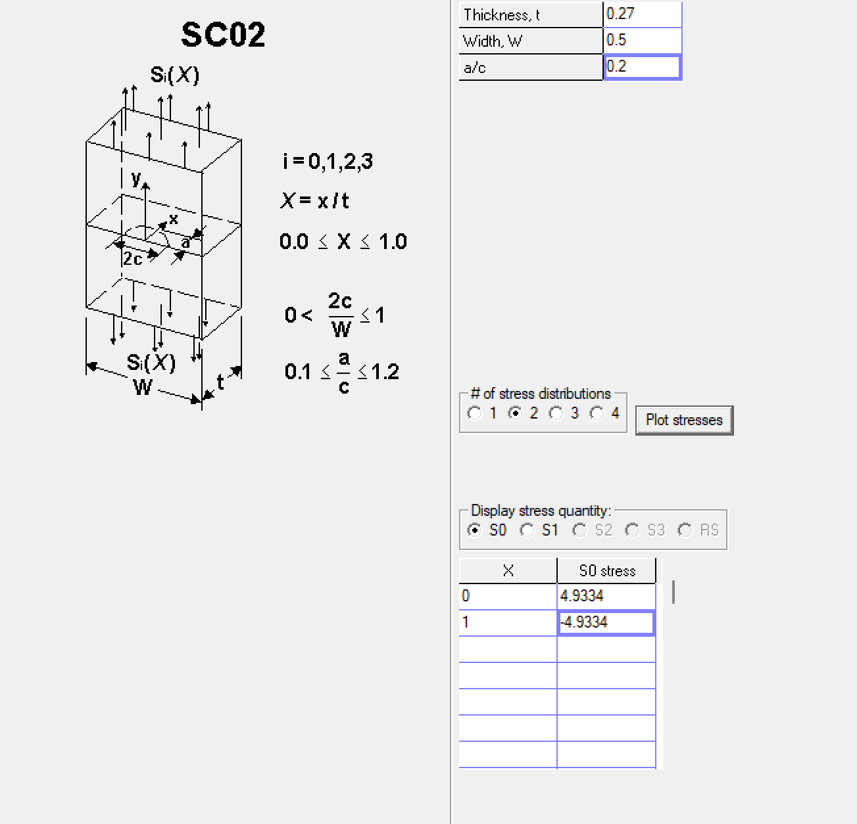
#6
Tubular joint under pressure
Fracture toughness = 2 lb/in
Aluminum 7075
Cannot rupture at an internal pressure of 400 Psi
Bond thickness = 0.27
Bond hoop stress = (400*3.85)/0.27 = 5704 psi​
Inner cylinder hoop stress = (400*3.7)/0.03 = 49334 psi​
Outer cylinder hoop stress = (400*4)/0.03 = 53334 psi​
Shear caused by cylinders = 4000 psi​
Fracture toughness = K = sqrt(GE)​
Sqrt(2*300e3) = 774.59 psi-in1/2​

Slide 13
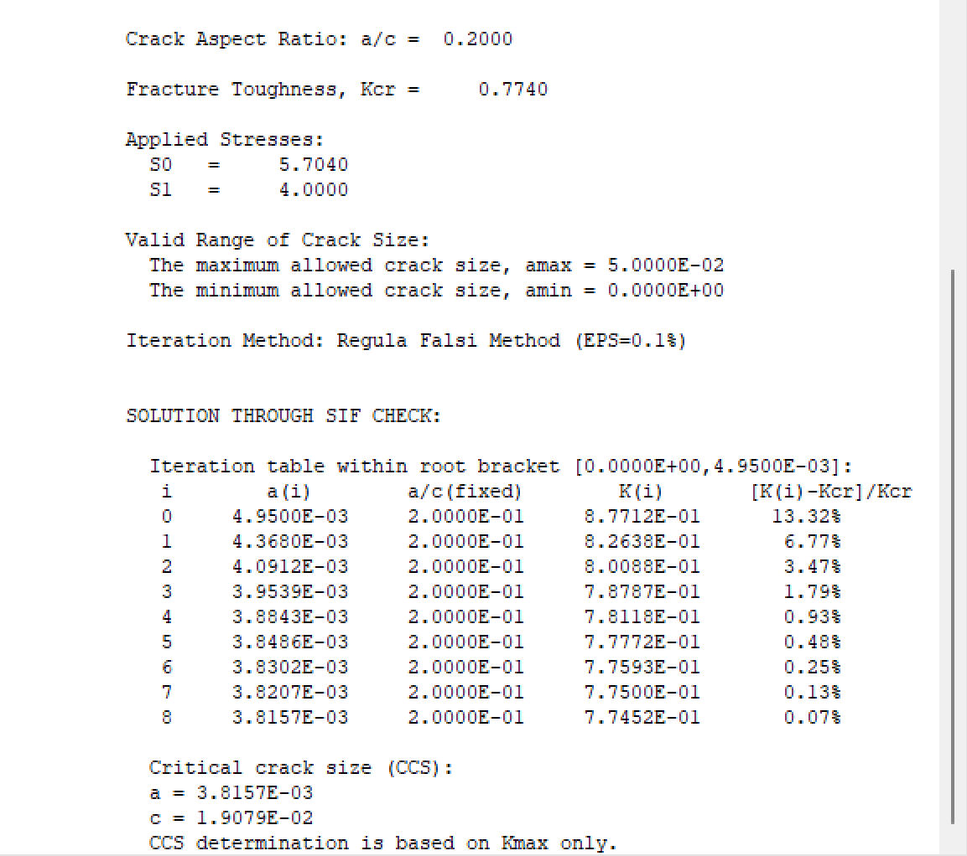
#6 Cont.
Results using SC02
a = 3.8157e-3

Slide 14
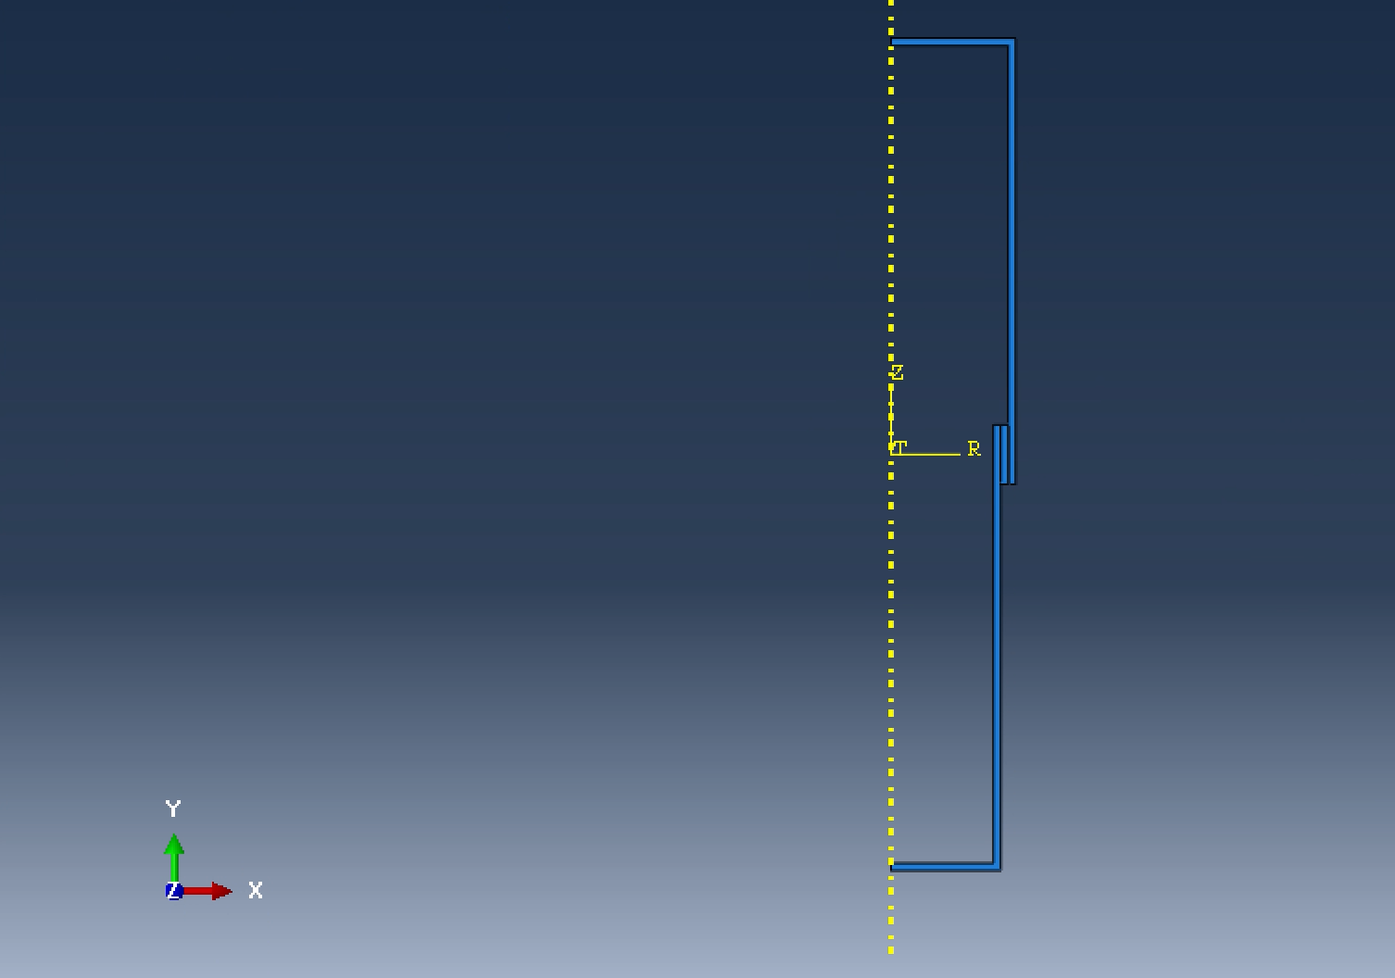
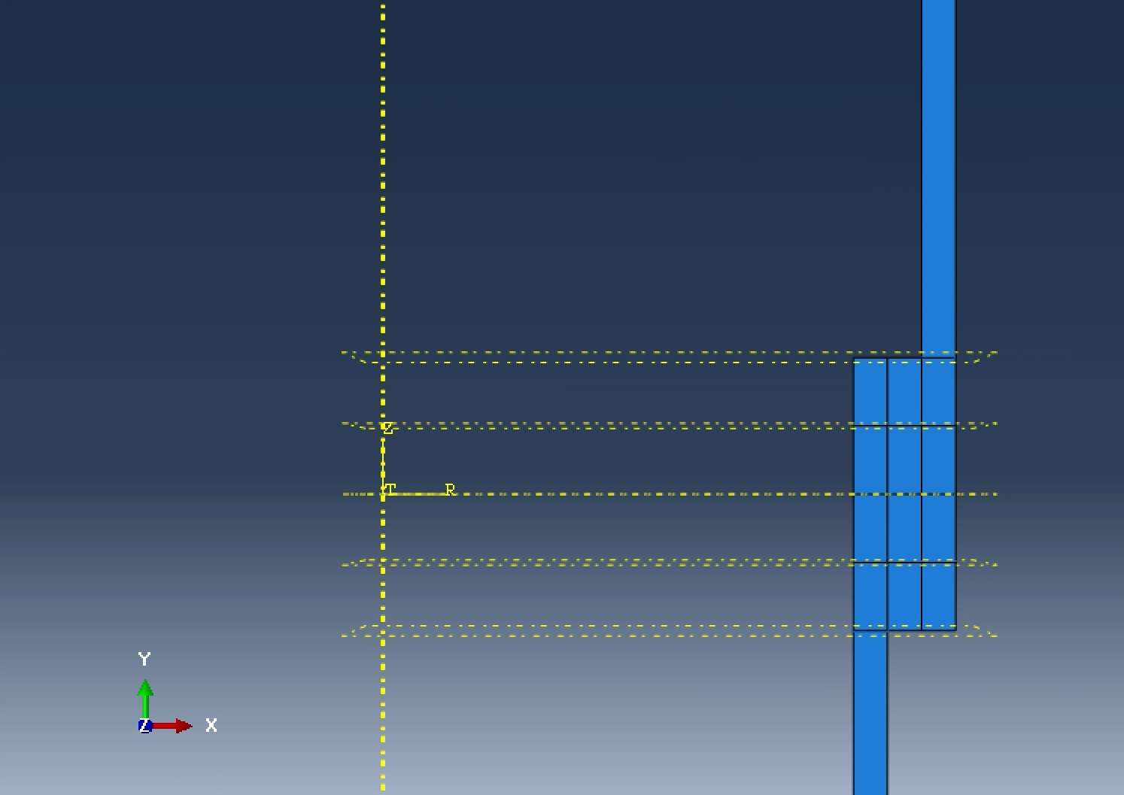
#6 Cont.
Abaqus setup
Joint thickness = 0.25
Upper and lower bounds were kept the same from the video
Partitions were created to discretize mesh

Slide 15
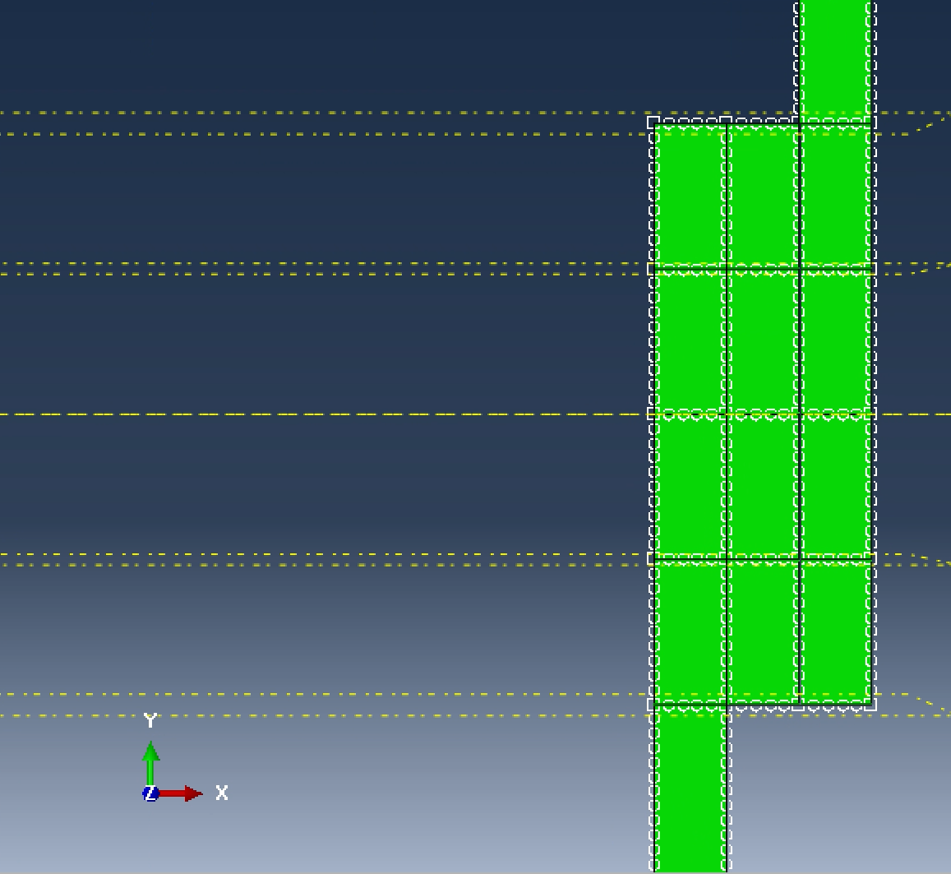
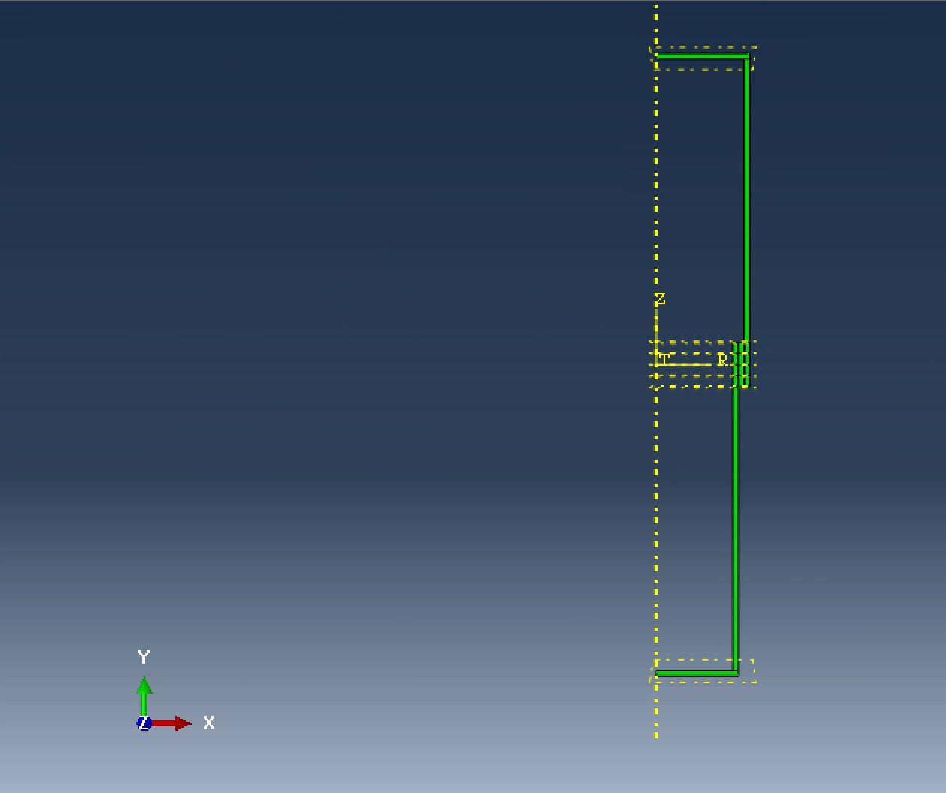
#6 Cont.
Mesh was changed to structures
Mesh seeds were set

Slide 16
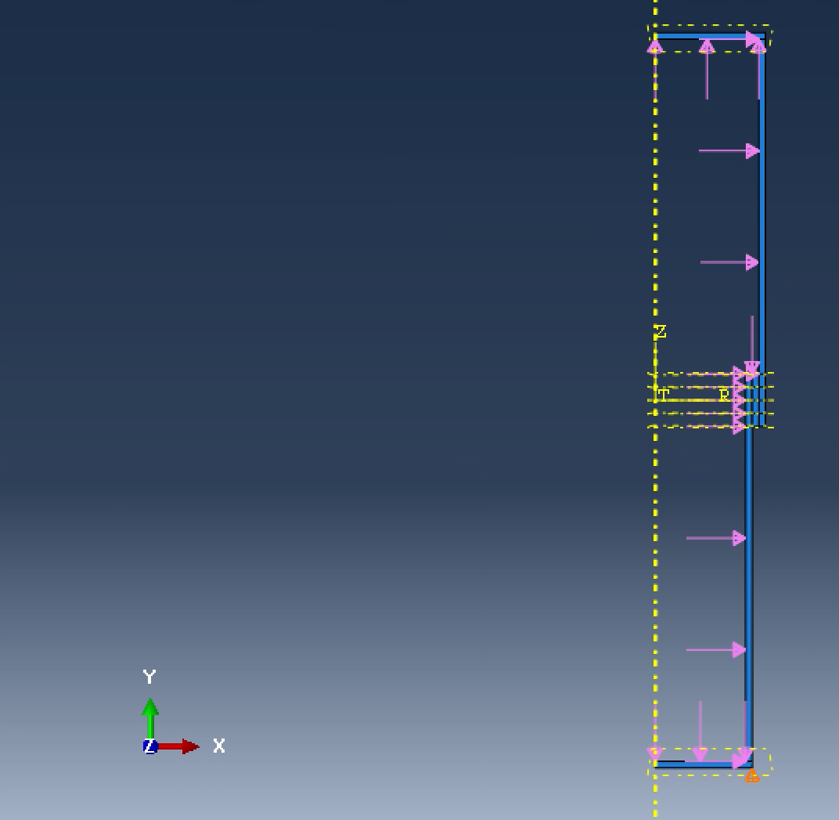
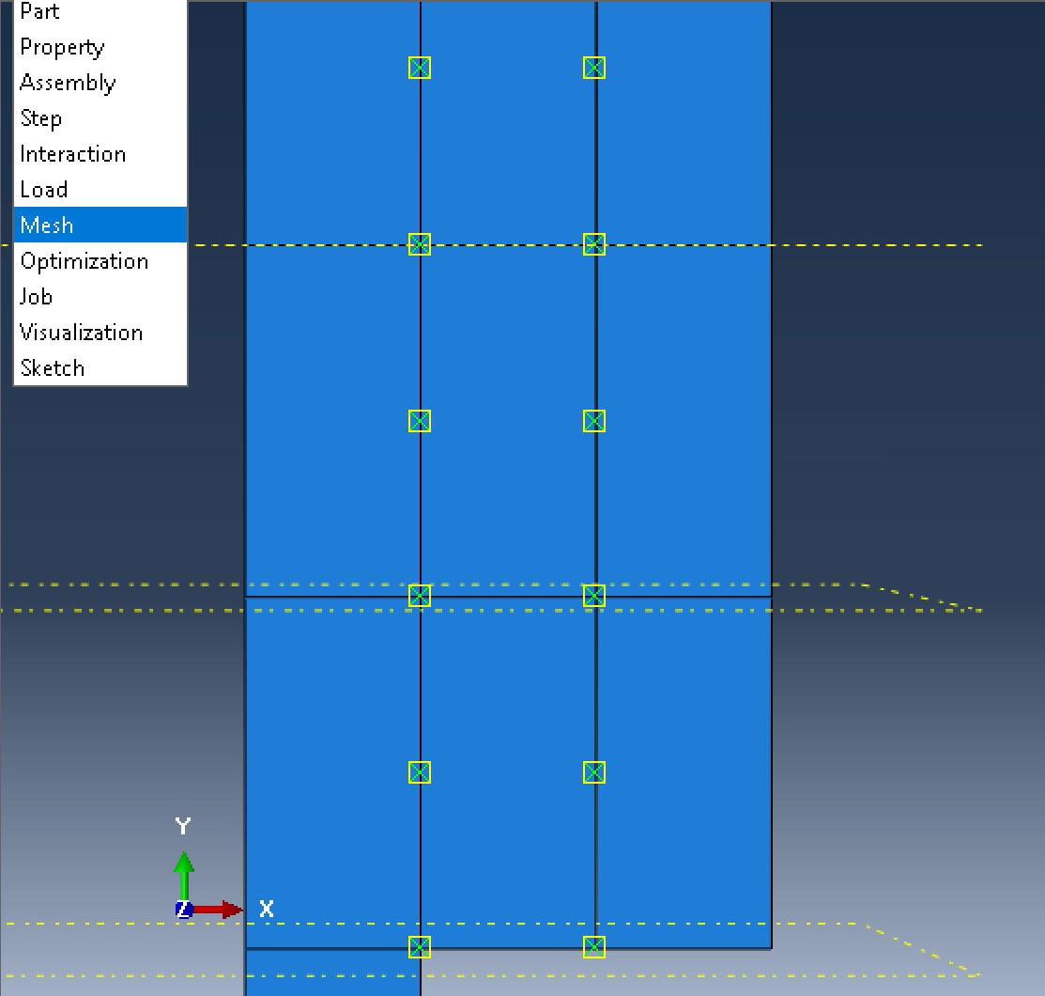
#6 Cont.
Load of 250 Psi was placed
Mesh for the joint was set

Slide 17
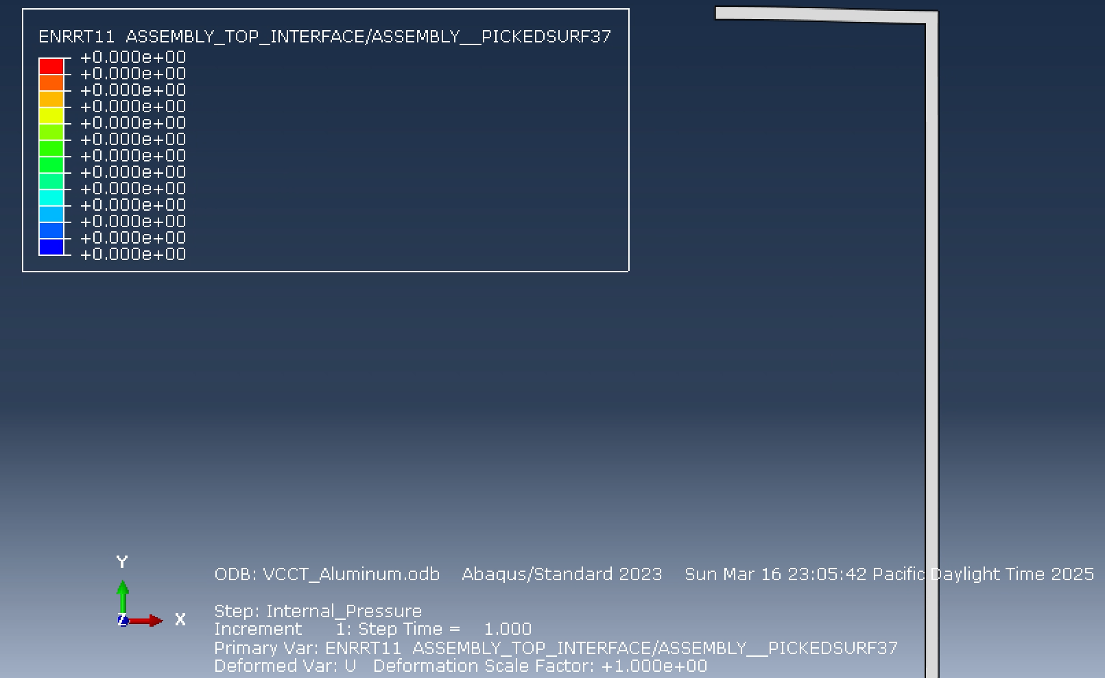
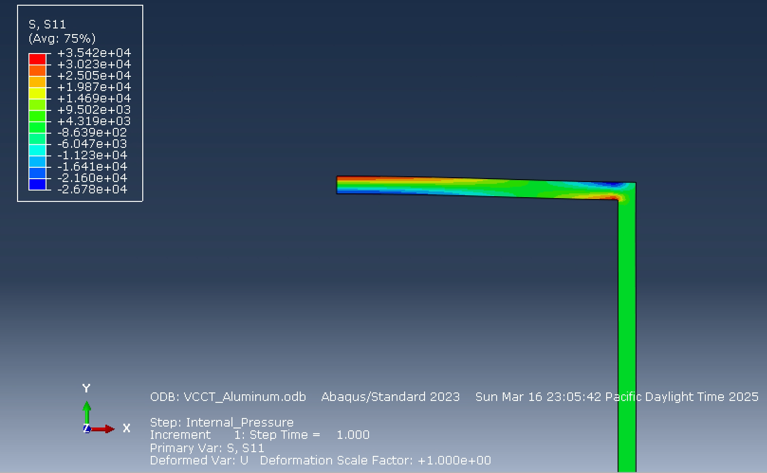
#6 Cont.
Result with no debonding showed 0 ENRPT11
Deformation was located on the y-constraint

Slide 18
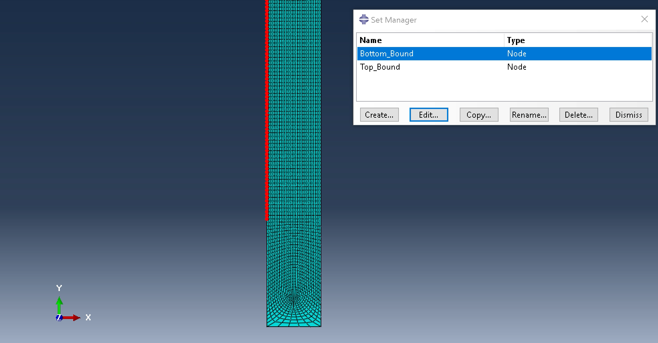
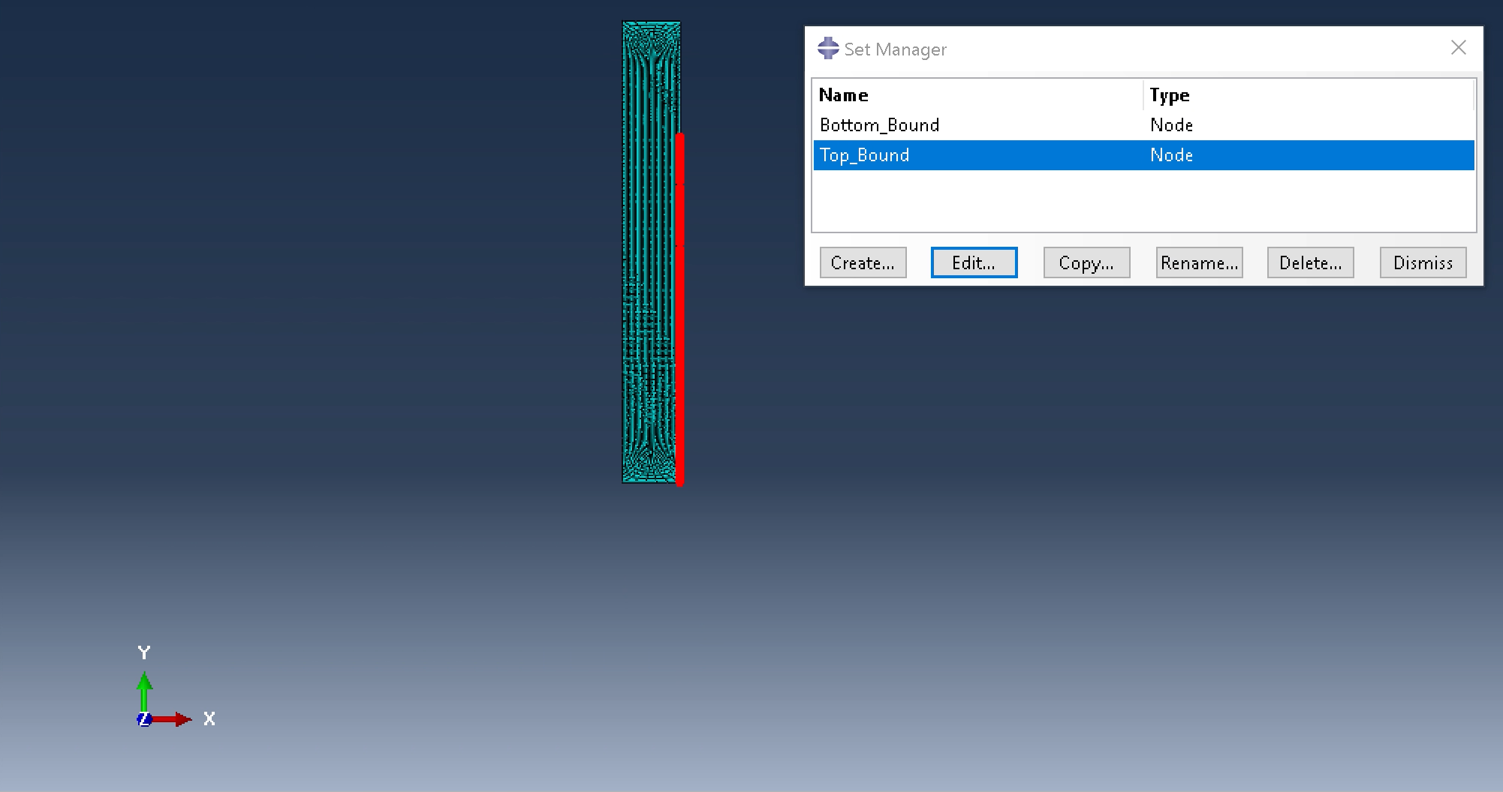
#6 Cont.
To add debonding, the structure was altered

Slide 19
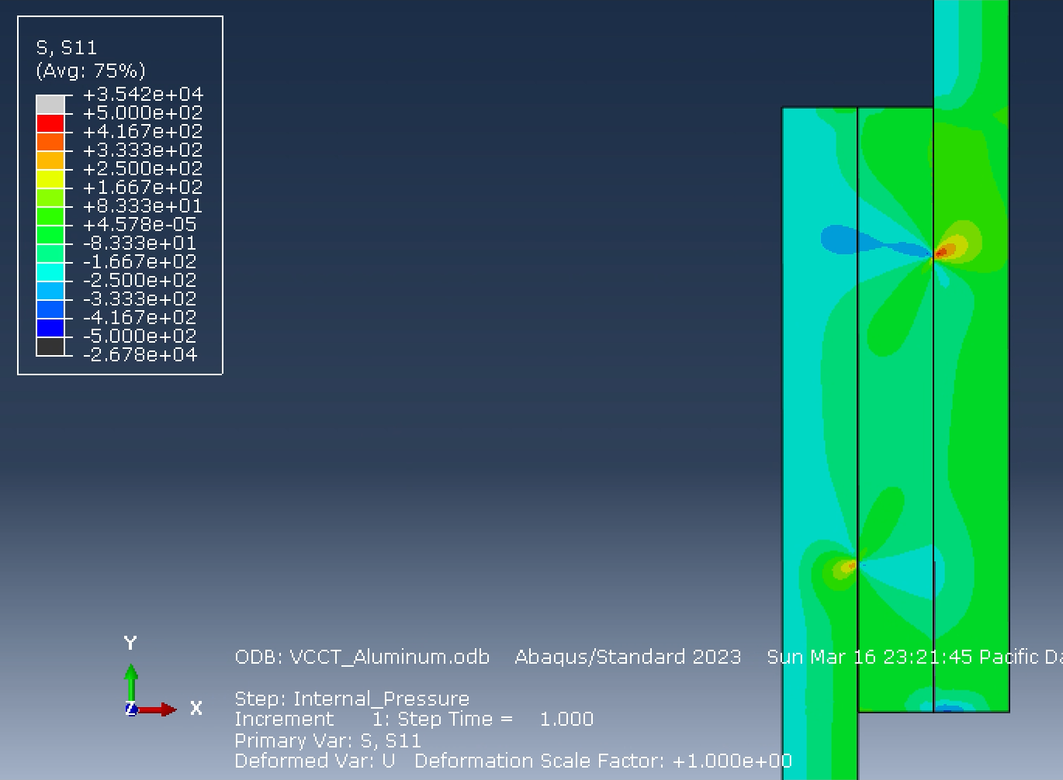
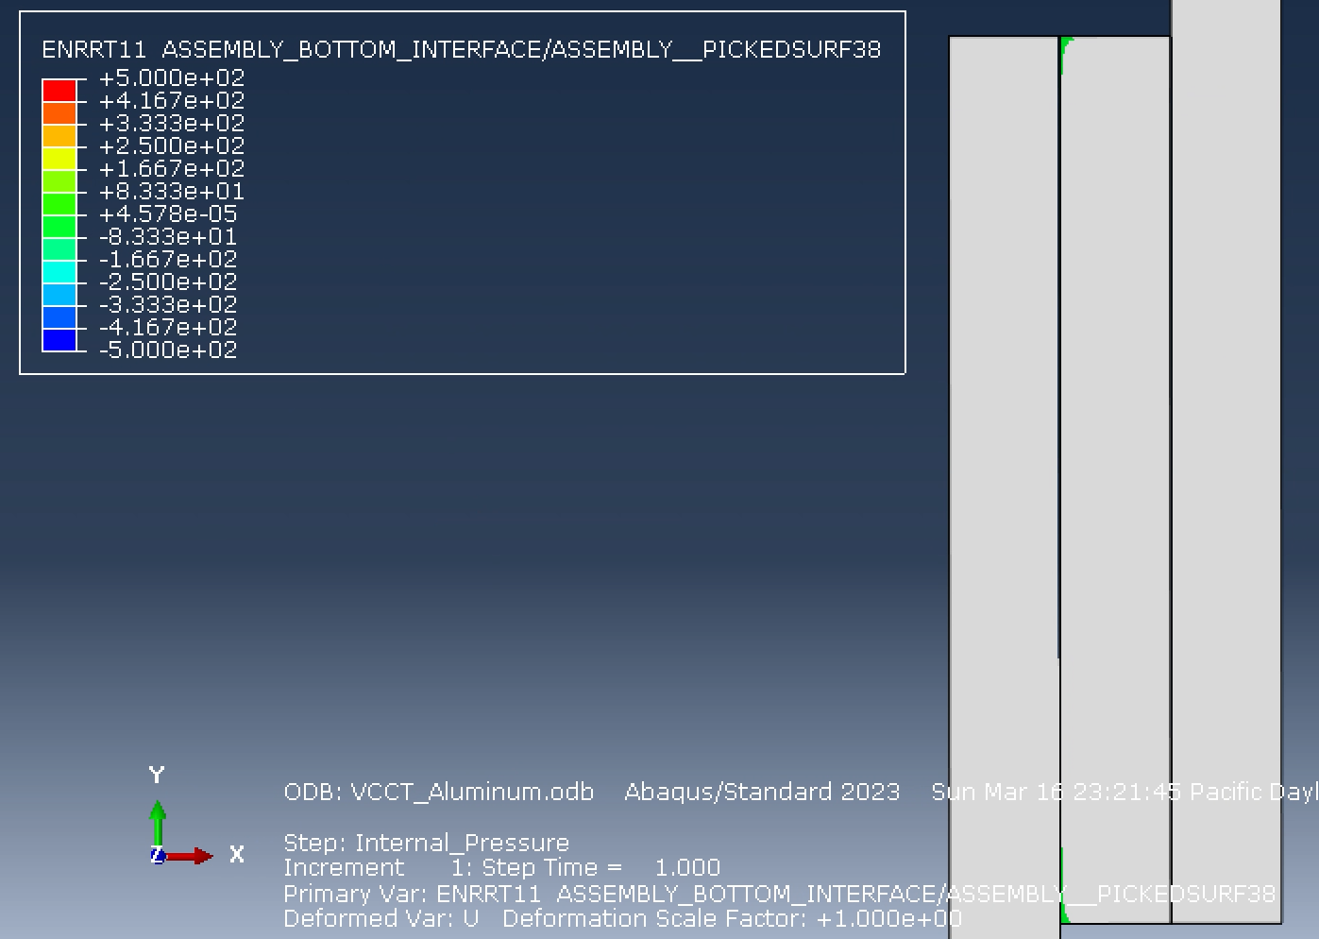
#6 Cont.
Aluminum structure with debonding

Slide 20
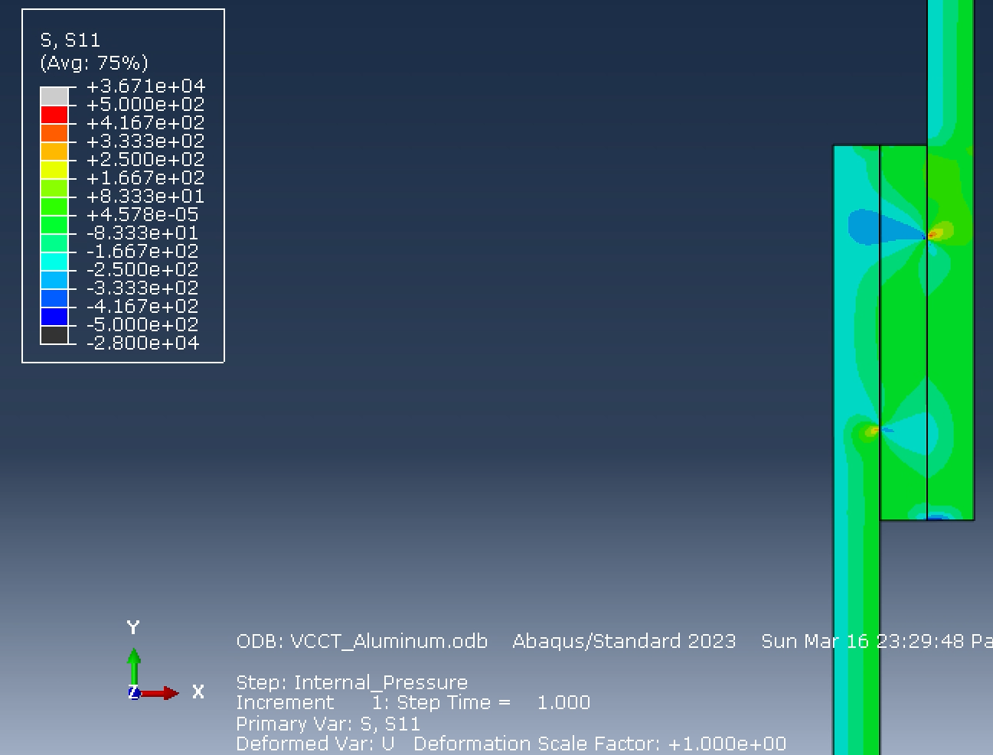
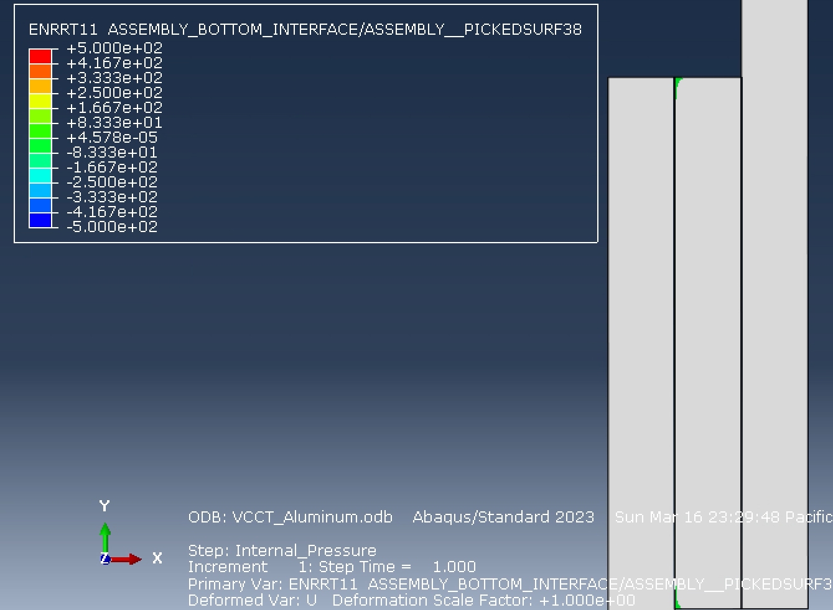
#6 Cont.
Steel structure with debonding

