Slide 1
AME 585
Project 8
Henry Glover
3/27/2025

Slide 2
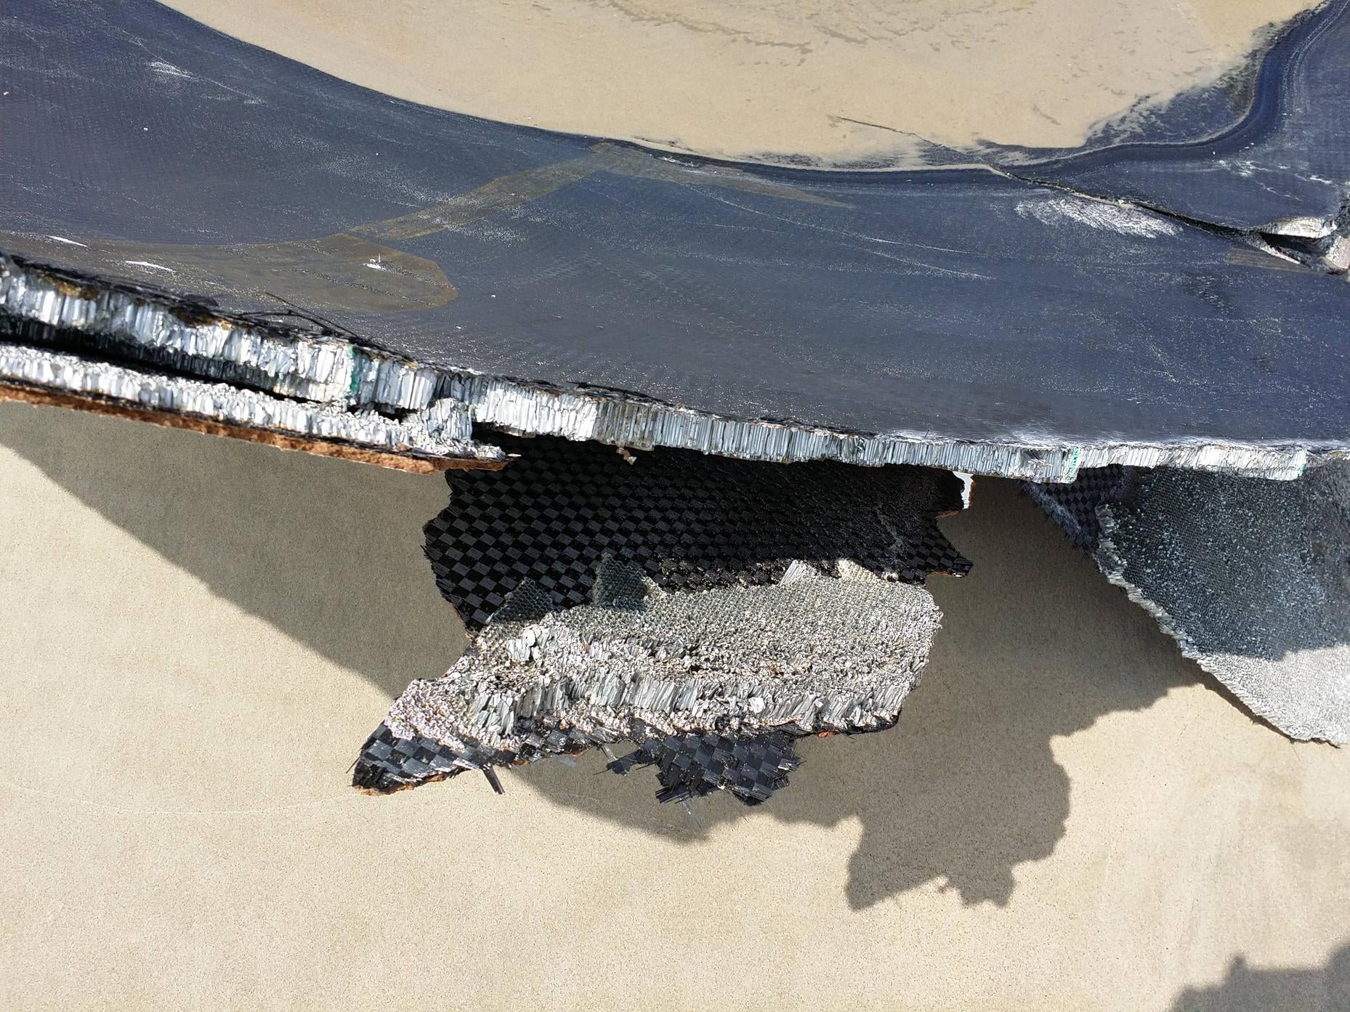
#1
Why failure occurs when air is entrapped in a honeycomb
Generates a differential pressure across the face-sheets during ascent
Due to external atmospheric pressure decreasing as altitude increases
Due to trapped air expanding from aerodynamic heating (may exceed >20 Psi of pressure)
Internal cavity pressure accompanies an unvented core
Adhesive failures due to weak face-sheet core bondlines
Face-sheet separation or rupture
Compression loads can further expand the effects of pressure differential
Change is pressure is the main cause of failure in an unvented core
Defects are not necessary to enable this failure mode
Defects can activate/inhibit catastrophic failure
Decreases the structures' ability to resist negative effects/failure’s
Poor manufacturing quality issues can affect bondline strength
Aging of adhesive, poor surface preparation, contamination, cure cycle problems, uniformity of cure pressure, improper dry fit, improper storage

Slide 3
#2
Moisture
In an unvented honeycomb, moisture or entrapped air cannot escape causing internal, unwanted pressure within the structure
During harsh launch conditions or environments, the moisture can be heated and turned into gasses that can creates additional internal pressure
Moisture can also freeze are create unwanted problems
Can also cause a corrosive environment that can be a determent to the mechanical properties, reducing strength and life of the component
Need to avoid moisture absorbing core materials
Heat
Heat can cause air to expand, leading to over pressurization and pressure build up
Can cause debonding/delamination
Overtime, the cycle pressurization and in-plane loading can affect disbanding propagation and structural integrity

Slide 4
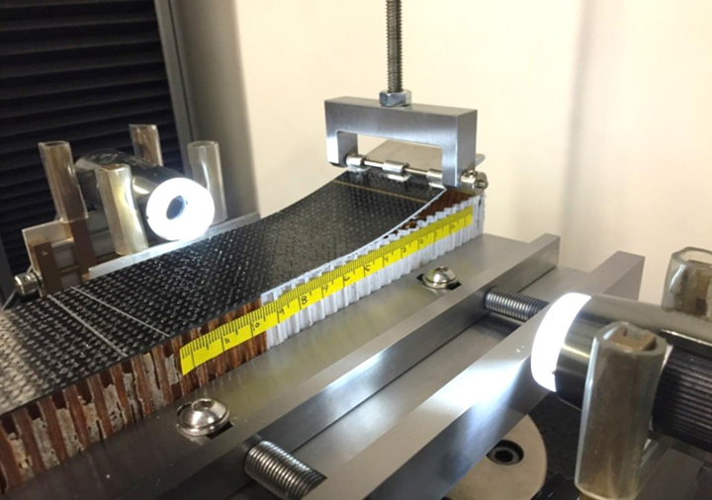
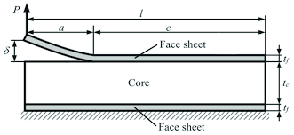
#3
Energy release rate
Amount of energy released per unit area of crack growth in a material
Amount of stored elastic energy to drive the propagation of a crack in a composite structure
Interface between face-sheet and core
Fracture toughness is the critical energy release rate
Threshold value of energy release rate at which a crack begins to propagate
If applied energy release rates exceed the critical energy release rate, the crack will grow
Single Cantilever beam (SCB) test
Used to measure fracture toughness in composite structures
It specifically tests, Mode 1 loading (opening)
How it works
A specimen with pre delamination is bonded on one side
The cantilever is loaded on the free end of the specimen causing the crack to open and propagate
Load and displacements are measured
The energy release rates are found using beam theory as the crack propagates
Useful for characterizing the face-sheet and core interface in composite structures
https://www.researchgate.net/figure/Single-cantilever-beam-Mode-1-fracture-test-SCB-configuration_fig1_358431799
https://www.compositesworld.com/articles/the-single-cantilever-beam-test-for-sandwich-composites

Slide 5
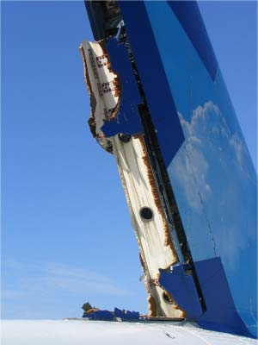
#4
3 aircraft incidents due to unvented honeycomb designs
Air Transat Flight 961 – Airbus A310 - 308 aircraft
At cruising altitude, the rudder fell off and the aircraft entered a Dutch roll
Pilots were able to stabilize aircraft and return safely
Rudder is a sandwich composite constructed of a non-metallic Nomex® aramid-based honeycomb core, with CFRP face-sheets, and a glass fiber-reinforced plastic (GFRP) intermediate layer between the CFRP and the honeycomb
There is a layer of Tedlar® on the interior face for moisture protection, and a layer of film adhesive (AF 126) on the exterior face for aerodynamic smoothness
Pieces of honeycomb are bonded together along their side edges by a bonding adhesive and unvented for aerodynamic purposes
Findings concluded that the rudder had pre-existing dis-bond or an in-plane core fracture that deteriorate in flight
Caused by poor manufacture’s recommended inspection policy that was not adequate in detecting all rudder defects
https://journals.sagepub.com/doi/full/10.1177/10996362221116887
https://www.tsb.gc.ca/eng/rapports-reports/aviation/2005/a05f0047/a05f0047.html

Slide 6
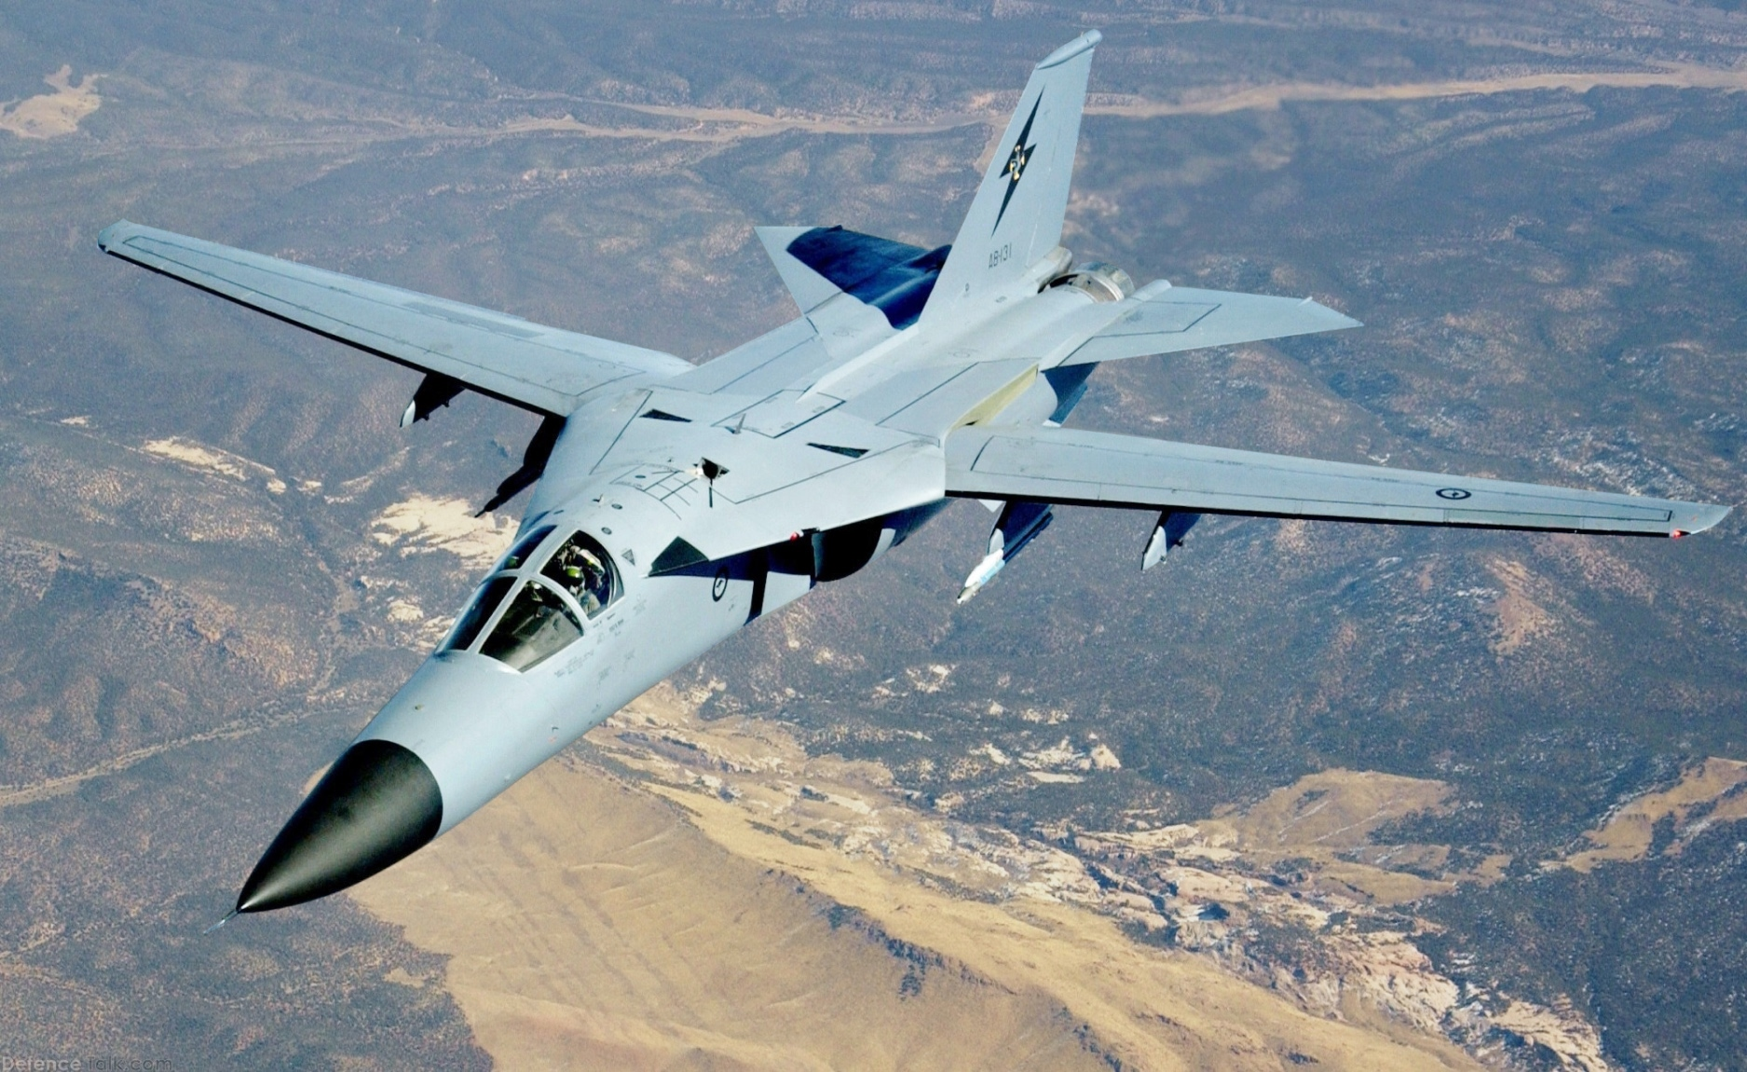
#4 Cont.
3 aircraft incidents due to unvented honeycomb designs
RAAF F-111 aircraft
Made up honeycomb sandwich panels
Serious degradation issues that cause failure
Panels were found on the aircraft with large areas of adhesive bond separation and corrosion damage
Damage was caused by the ingress of water in the panels either because of poor sealing from the manufacture or after a failed repair
Moisture in the panel caused adhesive degradation that reduced material strength on the bonds holding the panels together
Boeing 747-433 (Cargo)
In 2024, an upper left-wing panel detached from the aircraft during landing
Caused by fatigue cracking in the honeycomb structure
FOD on the runway was of main concern as the wind panel detachment had minimal impact on controllability
Manufacture released a service bulletin but it did little to prevent the incident
https://en.wikipedia.org/wiki/General_Dynamics_F-111C
https://apps.dtic.mil/sti/tr/pdf/ADA385139.pdf

Slide 7
#4 Cont.
3 spacecraft incidents due to unvented honeycomb designs
Block II Global Positioning System
Initially used an unvented honeycomb design to avoid outgassing in the Space Shuttle cargo bay
Testing revealed the bond failed during thermal cycling
Panel rupture occurred at the thinner skin without Kapton during testing, so in 1983 the engineers switched to a vented honeycomb core and a higher temp FM-300 adhesive
X-33 LH2 Tank Failure
Unvented honeycomb design with graphite epoxy facesheets
LH2 tank failed during testing due to pressure buildup in the core of the sandwich
Fachseets disbanded and separated from the core
Caused by microcracking, hydrogen pressure buildup, manufacture flaws, and reduced bondline strength
Loral space systems
Experienced solar array damage
Caused by a tight seal at the end of the solar panels that prevented necessary venting and proper bonding
Pressure build up in the honeycomb structure that caused an explosive depressurization
Caused by manufacturing defects and flaws
https://apps.dtic.mil/sti/pdfs/ADA276713.pdf
https://ntrs.nasa.gov/api/citations/20030067586/downloads/20030067586.pdf
https://journals.sagepub.com/doi/full/10.1177/10996362221116887
https://www.spacesafetymagazine.com/aerospace-engineering/spacecraft-design/space-systemsloral-case-study-ineffective-incident-investigation/

Slide 8
#4 Cont.
3 launch vehicle incidents due to unvented honeycomb designs
Titan III LV in 1966
Fiberglass honeycomb sandwich payload fairing exploded
Investigation showed that the stresses induced by aerodynamic heating were relatively low, but the lack of venting and defects lead to failure
Improved skin-to-core bonding, better testing methods (for the time), denser honeycomb cores, and process to reduce water absorption
Atlas AC-58 payload fairing
In 1987 a proof test of the AC-58 payload fairing failed due to inner skin-to-core disbanding
Failure originated from a weak bond area undetected by NDE “tap” testing
The flaw was possibly caused by contamination, poor adhesive flow, or low cure pressure/temp
Non-veneted honeycomb construction also affected AC-59 payload fairing
Mariner 3
Mars probe that was commissioned to take pictures of mars in 1964
Failed due to the shrouds inner fiberglass separating from the shrouds outer skin, preventing jettison
Was a pressure buildup in the fiberglass honeycomb core
Ground tests were never conducted with the combined pressure and temperature environment
https://apps.dtic.mil/sti/pdfs/ADA276713.pdf

Slide 9
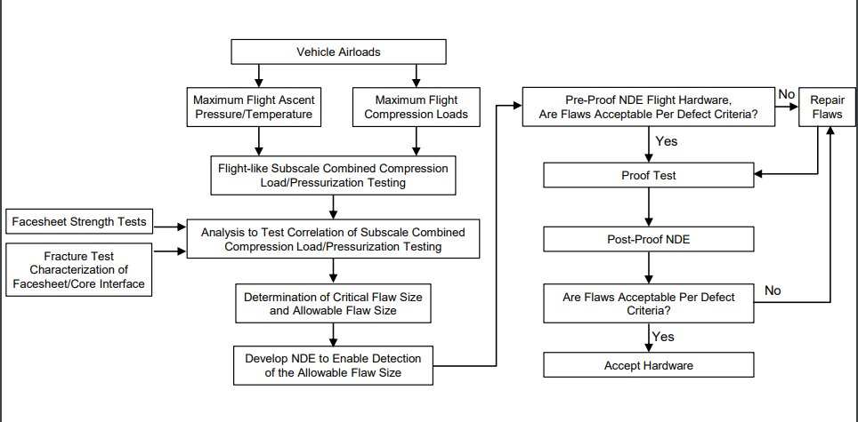
#5
Acceptance testing performed on spacecraft and aircraft
Weak bonds between the core and the face-sheet can be hard to detect using standard NDE methods
Finding the acceptable flaw size is instrumental in proof testing
Load definition
External loads
Core pressure
Venting rates
Heating environments
Altitude
Building block approach
Face-sheet failure strength
Find core-to-facesheet interfacial fracture toughness
Environmental strength reduction
Combined load testing (pressure + external loads)
Define acceptable flaw size
Develop NDE that can detect flaw size
Hand-held ultrasonic inspection
Shearography
Flash thermography
Pulse echo ultrasound
Air-coupled through transmission
Proof test to match requirements
Pre and post proof NDE to demonstrate flaw within envelope

Slide 10
#6
“We have flown successfully before”
Complacency and comfort is detrimental to any industry
Have to cross your T’s and dot your I’s
Just because a system has prior success it still must undergo a rigorous verification process
Verification, redesign, proof testing, inspection are among the few things that need to occur before recommissioning a structure or using old information
Have to treat every mission with the same standards and same level of importance
In every flight and every design there are new challenges, new failures, and new information that may have not been available before
Just because it works once, twice….etc. doesn’t mean it will automatically work every time
This is a boost of confidence for a system but does not substitute verification

Slide 11
#7
Biggest lesson learned
Unvented honeycombs have their place in Aerospace
Used for aerodynamic purposes
Needs constant inspection and maintenance schedules
Corrosion is less likely to happen because they are sealed
Vented honeycombs have their place in Aerospace as well
No air entrapment – no pressure build up
No moisture build up
Corrosion susceptible
Good thermal properties
Vented honeycombs used in space application on LV and Spacecraft
That being said, both have their pros and cons
Both are susceptible to manufacturing and handling defects
A vented design can act like an unvented design if it is manufactured incorrectly
Venting rates can be so poor or improperly manufactured that they are basically useless and act like unvented honeycombed composites

Slide 12
#8
10 lessons learned - https://ntrs.nasa.gov/citations/20090008664
The use of finite element thermal solver is very important for ascent rate heating and honeycomb composite understanding
Result comparison using different FEA software's is important for redundancy
The use of a temperature-based heat transfer coefficient increased supposed results
Heating rates provided in the data include gas convection, gas radiation, particle convection, and particle kinetic energy heat transfer
For the spacecraft adapter (SA) only gas convection contributes to heating rate
Spacecraft adaptors (SA) fairings are formed by a honeycomb core and an inner face sheet
Necessary thermal protection is need for areas where the temperature can reach higher than predicted
The ascent trajectory and profile significantly influence the thermal environment and need to be considered
Collaboration and communication among different teams and companies are essential for successful thermal analysis
Mesh, node control, and boundary conditions are all extremely important in finding accurate/relevant results

Slide 13
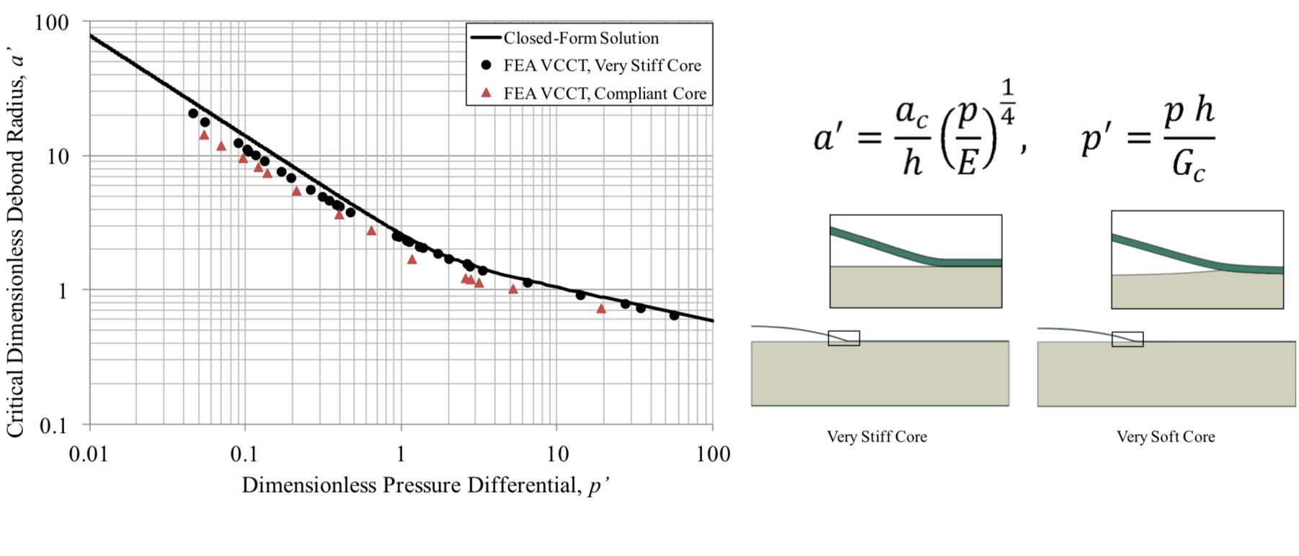
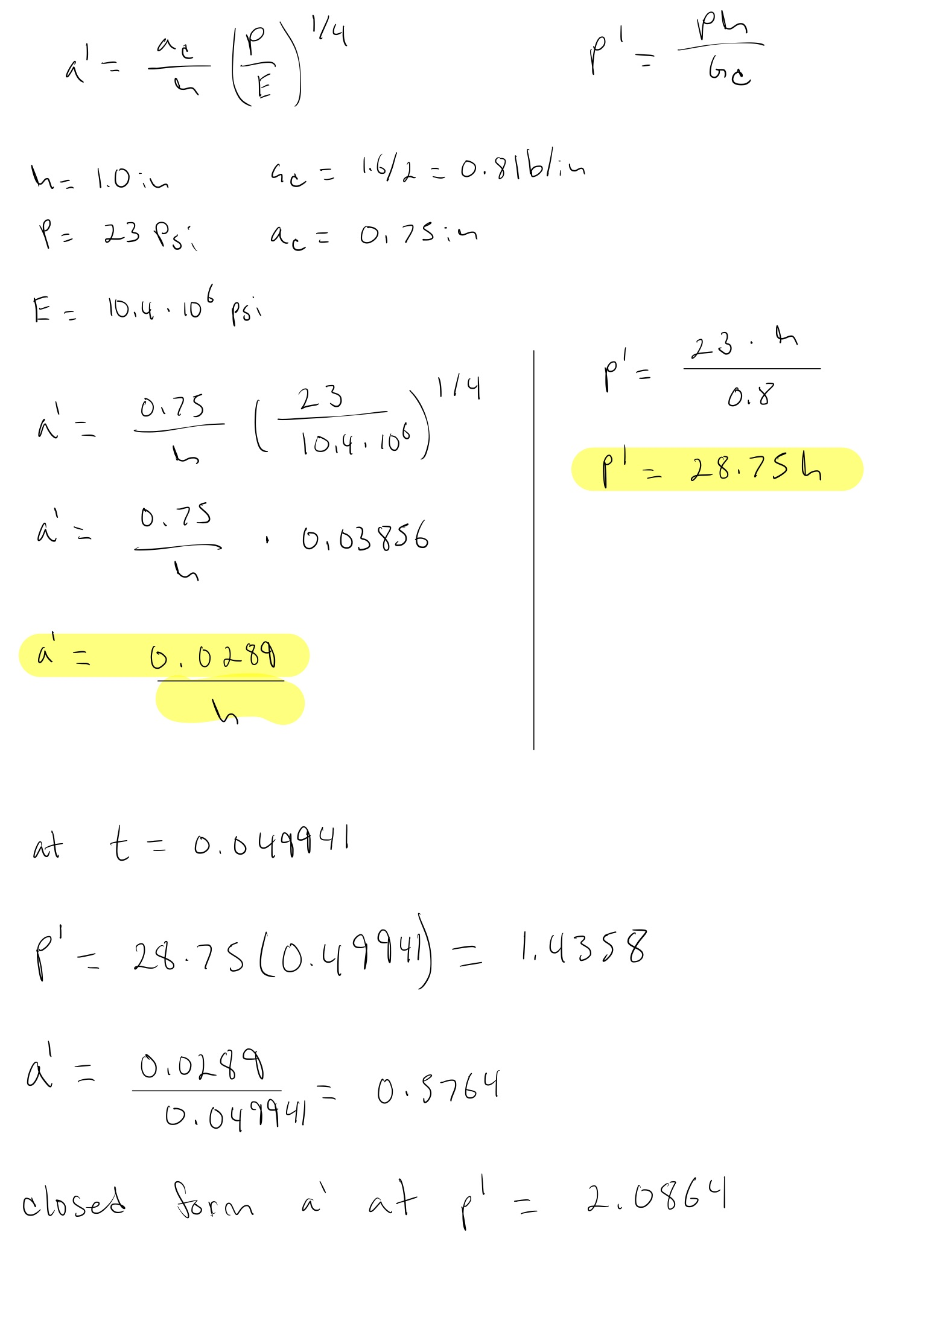
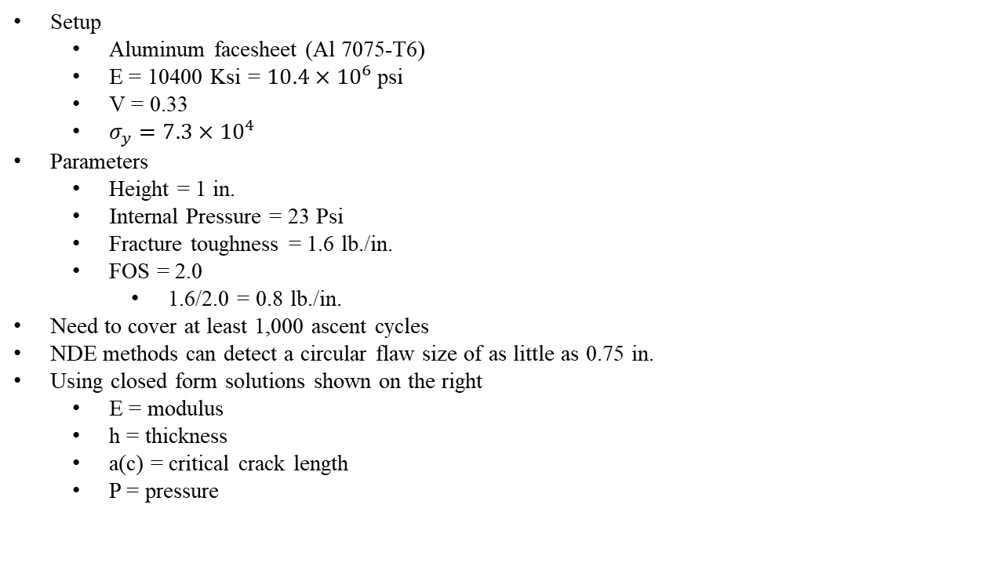
#9
Setup
Aluminum facesheet (Al 7075-T6)
E = 10400 Ksi = $10.4×{10}^{6}$ psi
V = 0.33
$σ_{y}=7.3×{10}^{4}$
Parameters
Height = 1 in.
Internal Pressure = 23 Psi
Fracture toughness = 1.6 lb./in.
FOS = 2.0
1.6/2.0 = 0.8 lb./in.
Need to cover at least 1,000 ascent cycles
NDE methods can detect a circular flaw size of as little as 0.75 in.
Using closed form solutions shown on the right
E = modulus
h = thickness
a(c) = critical crack length
P = pressure

Slide 14
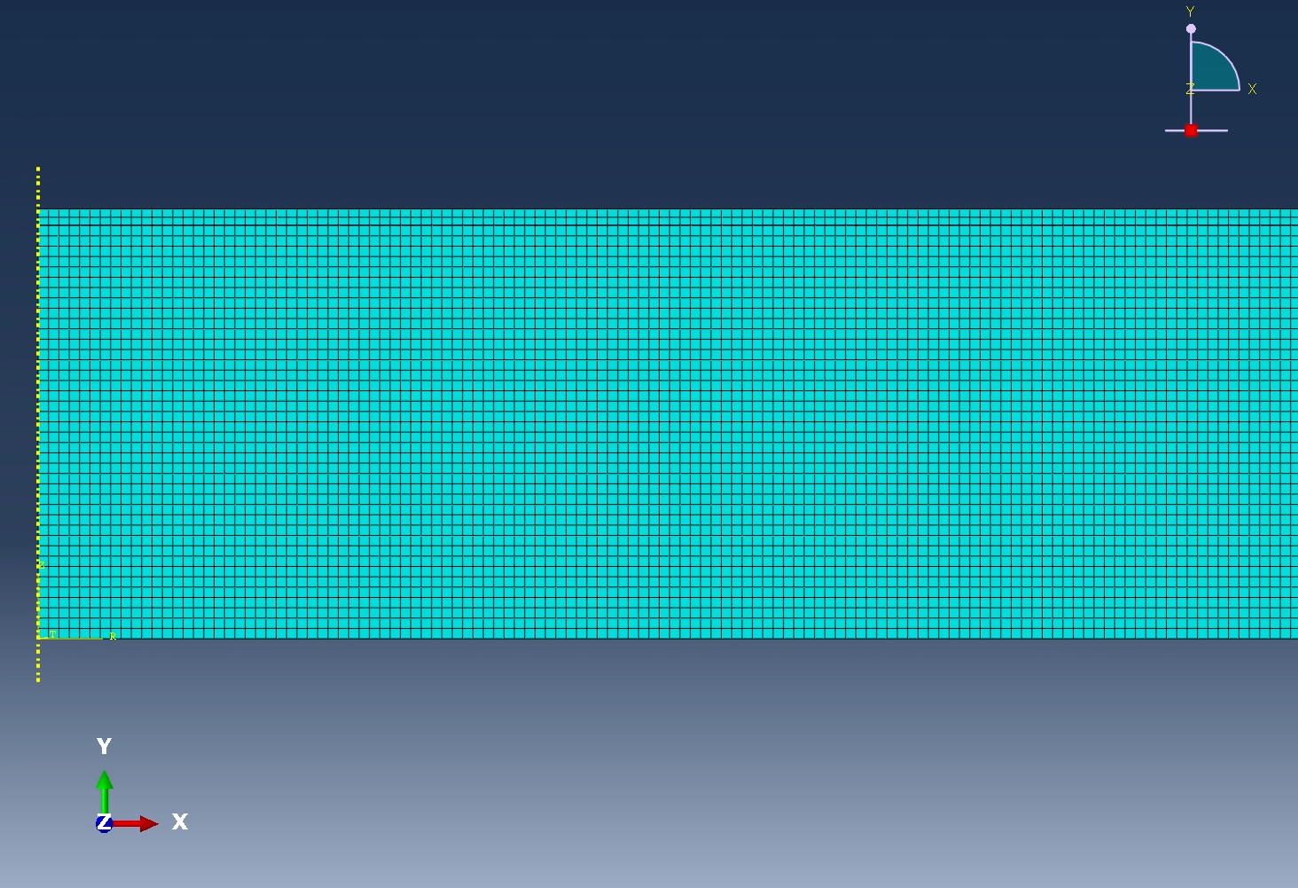
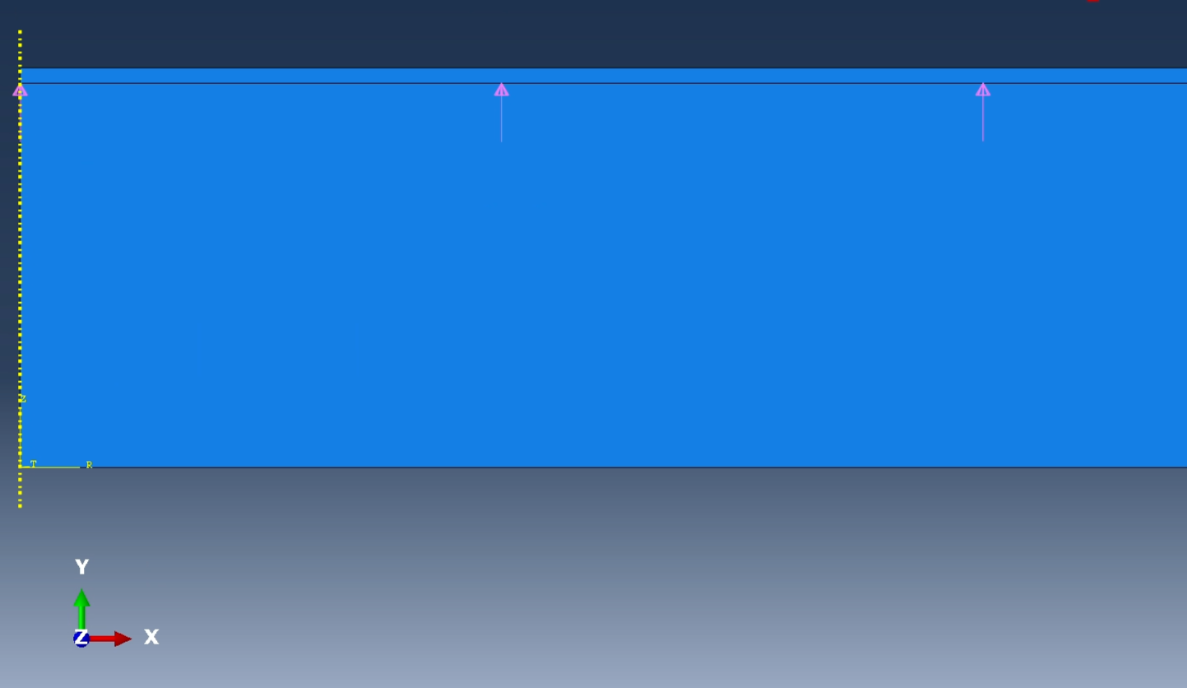
#9
FEA
Will be using hand calculated thickness of 0.049941 in
Mesh is made
23 Psi is applied on the faces-heet

Slide 15
#9
FEA
Had an extremely hard time with converging into a solution
Ran into incrementation issues

