Slide 1
General Tree Concepts
Binary Trees
These are the slides of the textbook by Mark Allen Weiss, modified/corrected as necessary.

Slide 2
Trees
Definitions
Representation
Binary trees
Traversals
Expression trees

Slide 3
Definitions
Tree: a non-empty collection of vertices & edges
Vertex (node): can have a name and carry other associated information
Path: list of distinct vertices in which successive vertices are connected by edges

Slide 4
Definitions
Any two vertices must have one and only one path between them. Else, it is not a tree
A tree with N nodes has N-1 edges

Slide 5
Definitions
Root: starting point (top) of the tree
Parent (ancestor): the vertex “above” this vertex
Child (descendent): the vertices “below” this vertex

Slide 6
Definitions
Leaves (terminal nodes): have no children
Level: the number of edges between this node and the root
Ordered tree: where children’s order is significant

Slide 7
Definitions
Depth of a node: the length of the path from the root to that node
  root: depth 0
Height of a node: the length of the longest path from that node to a leaf
  any leaf: height 0
Height of a tree: The length of the longest path from the root to a leaf

Slide 8
Balanced Trees
The difference between the height of the left sub-tree and the height of the right sub-tree is not more than 1

Slide 9
Trees - Example
Level
root
0
E
1
A
Child (of root)
R
E
2
A
S
T
Leaves or terminal nodes
3
M
P
L
E
Depth of T: 2
Height of T: 1

Slide 10
Tree Representation
class TreeNode
{
object element;
TreeNode firstChild;
TreeNode nextSibling;
}

Slide 11
Example
a
b
f
e
a
c
d
g
b
e
f
c
g
d

Slide 12
Binary Tree
S
P
O
I
N
S
M
Internal node
A
External node
B
D
N

Slide 13
Height of a Complete Binary Tree
L 0
L 1
L 2
L 3
At each level the number of the nodes is doubled.
total number of nodes:
1 + 2 + 2² + 2³ = 2⁴ - 1 = 15

Slide 14
Nodes and Levels in a Complete Binary Tree
Number of the nodes in a tree with M levels:
1 + 2 + 2² + …. 2^{M} = 2^{(M+1)} - 1 = 2*2^{M} - 1
Let N be the number of the nodes.
N = 2*2^{M} - 1, 2*2^{M} = N + 1
2^{M} = (N+1)/2
M = log((N+1)/2)
N nodes : log( (N+1)/2 ) = O(log(N)) levels
M levels: 2^{(M+1)} - 1 = O(2^{M}) nodes

Slide 15
Binary Tree Node
class BinaryNode
{
object Element; // the data in the node
BinaryNode left; // Left child
BinaryNode right; // Right child
}

Slide 16
Binary Tree – Preorder Traversal
Root
Left
Right
C
O
T
M
E
R
P
U
L
A
N
First letter - at the root
Last letter – at the rightmost node
D

Slide 17
Preorder Algorithm
preorderVisit(current)
{
if (current != null)
{
process(current);
preorderVisit(left_tree);
preorderVisit(right_tree);
}
}

Slide 18
Binary Tree – Inorder Traversal
Left
Root
Right
U
P
T
O
R
E
C
M
A
L
D
First letter - at the leftmost node
Last letter – at the rightmost node
N

Slide 19
Inorder Algorithm
inorderVisit(current)
{
if (current != null) {
inorderVisit(left_tree);
process(current);
inorderVisit(right_tree);
}
}

Slide 20
Binary Tree – Postorder Traversal
Left
Right
Root
D
P
N
M
A
U
C
O
L
T
R
First letter - at the leftmost node
Last letter – at the root
E

Slide 21
Postorder Algorithm
postorderVisit(current)
{
if (current != null) {
postorderVisit(left_tree);
postorderVisit(right_tree);
process(current);
}
}

Slide 22
Expression Trees
The stack contains references to tree nodes (bottom is to the left)
+
3
1
2
*
1
2
+
3
(1+2)*3
Post-fix notation: 1 2 + 3 *
1
2

Slide 23
Expression Trees
In-order traversal:
(1 + 2) * ( 3)
Post-order traversal:
1 2 + 3 *
*
+
3
1
2

Slide 24
BINARY SEARCH TREES

Slide 25
Binary Search Trees
Definitions
Operations and complexity
Advantages and disadvantages
AVL Trees
  Single rotation
  Double rotation
Splay Trees
Multi-Way Search

Slide 26
Definitions
Each node contains:
  a record with a key and a value
  a left link
  a right link
All records with smaller keys
  in the left subtree
All records with larger keys
  in the right subtree

Slide 27
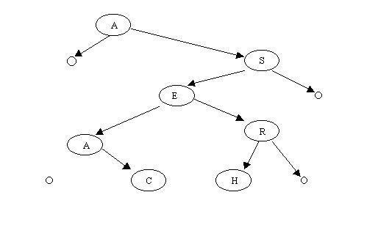
Example

Slide 28
Operations
Search: Compare the values and proceed either to the left or to the right
Insertion: Unsuccessful search - insert the new node at the bottom where the search has stopped
Deletion: Replace the value in the node with the smallest value in the right subtree
or the largest value in the left subtree
Retrieval in sorted order: Inorder traversal

Slide 29
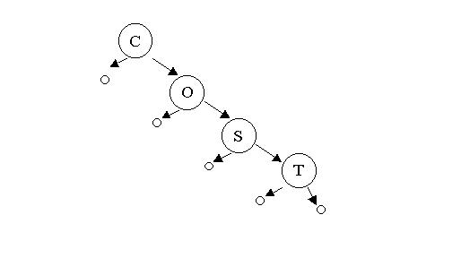
Complexity
Logarithmic, depends on the shape of the tree
In the worst case – O(N) comparisons

Slide 30
Advantages of BST
 Simple
 Efficient
 Dynamic
One of the most fundamental algorithms in CS
The method of choice in many applications

Slide 31
Disadvantages of BST
☹ The shape of the tree depends on the order of insertions, and it can be degenerated
☹ When inserting or searching for an element, the key of each visited node
has to be compared with the key of the element to be inserted/found
  Keys may be long and the run time may increase much

Slide 32
Improvements on BST
Reducing the time for key comparison:
Radix trees: comparing only the leading bits of the keys
Keeping the tree balanced:
AVL trees (Adelson - Velskii and Landis)
  Balance condition: left and right subtrees of each node can differ by at most one level
  It can be proven that if this condition is observed, the depth of the tree is O(logN)

Slide 33
RADIX SEARCH TREES

Slide 34
Radix Search Trees
Radix Searching
Digital Search Trees
Radix Search Trees
Multi-Way Radix Trees

Slide 35
Radix Searching
Idea: Examine the search keys one bit at a time
Advantages:
Reasonable worst-case performance
Easy way to handle variable length keys
Some savings in space by storing part of the key within the search structure
Competitive with both binary search trees and hashing

Slide 36
Radix Searching
Disadvantages:
Biased data can lead to degenerate trees with bad performance
For some methods, use of space is inefficient
Dependent on computer’s architecture – difficult to do efficient implementations in some high-level languages

Slide 37
Radix Searching
Methods
  Digital Search Trees
  Radix Search Trees
  Multiway Radix Searching

Slide 38
Digital Search Trees
Similar to binary tree search
Difference:
  Branch in the tree by comparing the key’s bits, not the key as a whole

Slide 39
Example
A 00001
S 10011
E 00101
R 10010
C 00011
H 01000
I 01001
N 01110
G 00111
X 11000
M 01101
P 10000
L 01100
A
0
1
S
1
0
E
0
1
R
H
1
X
1
0
C
0
0
1
0
1
N
P
I
1
0
1
0
1
0
G
0
M
1
0
1
L
0
1

Slide 40
Example
inserting Z = 11010
go right twice
go left – external node
attach Z to the left of X
A
0
1
S
1
0
E
0
1
R
H
1
X
1
0
C
0
0
1
0
1
N
P
I
1
Z
0
1
0
1
0
0
1
G
0
M
1
0
1
L
0
1

Slide 41
Digital Search Trees
Things to remember about digital search trees:
  Equal keys to be avoided: Must be kept in separate data structures, linked to the nodes
  Worst case: Better than for binary search trees – the length of the longest path is equal to the longest match in the leading bits between any two keys

Slide 42
Digital Search Trees
Search or insertion requires about log(N) comparisons on the average and b comparisons in the worst case in a tree built from N random b-bit keys
No path will ever be longer than the number of bits in the keys

Slide 43
Radix Search Trees
If the keys are long, digital search trees have low efficiency
Radix search trees: Do not store keys in the tree at all, the keys are in the external nodes of the tree
Called tries from “retrieval”

Slide 44
Radix Search Trees
Two types of nodes:
  Internal: contain only links to other nodes
  External: contain keys and no links

Slide 45
Radix Search Trees
To insert a key:
Go along the path described by the leading bit pattern of the key until an external node is reached.
If the external node is empty, store there the new key.
  If the external node contains a key, replace it by an internal node linked to the new key and the old key. If the keys have several bits equal, more internal nodes are necessary.
NOTE: Insertion does not depend on the order of the keys.

Slide 46
Radix Search Trees
To search for a key:
Branch according to its bits
Don’t compare it to anything, until we get to an external node
One full key comparison there completes the search

Slide 47
Example
A 00001
S 10011
E 00101
R 10010
C 00011
0
1
0
1
1
0
0
1
1
0
0
1
E
0
1
A
C
0
1
R
S

Slide 48
Example: Insertion
A 00001
S 10011
E 00101
R 10010
C 00011
H 01000
0
1
0
1
1
0
H
0
1
1
0
0
1
E
0
1
A
C
0
1
R
S
External node - empty

Slide 49
Example: Insertion
A 00001
S 10011
E 00101
R 10010
C 00011
H 01000
I 01001
0
1
0
1
1
0
0
1
0
1
1
0
1
0
E
0
1
0
1
1
A
C
0
0
1
H
I
R
S
External node - occupied

Slide 50
Radix Search Trees - summary
Program implementation:
  Necessity to maintain two types of nodes
  Low-level implementation
Complexity: About logN bit comparisons in average case and b bit comparisons in the worst case in a tree built from N random b-bit keys.
Annoying feature: One-way branching for keys with a large number of common leading bits:
  The number of the nodes may exceed the number of the keys.
  On average: N/ln2 = 1.44N nodes

Slide 51
Multi-Way Radix Trees
The height of the tree is limited by the number of the bits in the keys
If we have larger keys – the height increases. One way to overcome this deficiency is using a multi-way radix tree searching
The branching is not according to 1 bit, but rather according to several bits (most often 2)
If m bits are examined at a time – the search speeds up by a factor of 2^{m}
Problem: If m bits at a time, the nodes will have 2^{m} links, may result in considerable amount of wasted space due to unused links

Slide 52
Example
Search – take left,
right or middle links
according to the first two bits.
Insert – replace external node by the key
(e.g. insert T 10100)
Nodes with 4 links – 00, 01, 10, 11
00
11
01
10
X
A
C
E
G
N
P
T
H
S
I
L
M
R

Slide 53
Multi-Way Radix Trees
Wasted space – due to the large number of unused links
Worse if M, the number of bits considered, gets higher
The running time: log_{M}N – very efficient
Hybrid method:
  Large M at the top,
  Small M at the bottom

Slide 54
AVL TREES

Slide 55
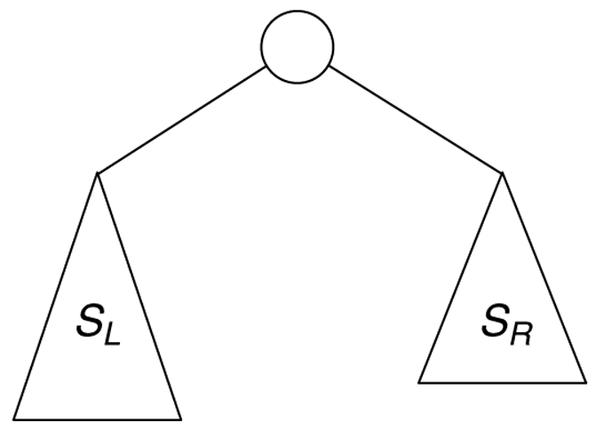
Recursive Size of Binary Tree
Recursive view used to calculate the size of a tree:
S_{T} = S_{L} + S_{R} + 1

Slide 56
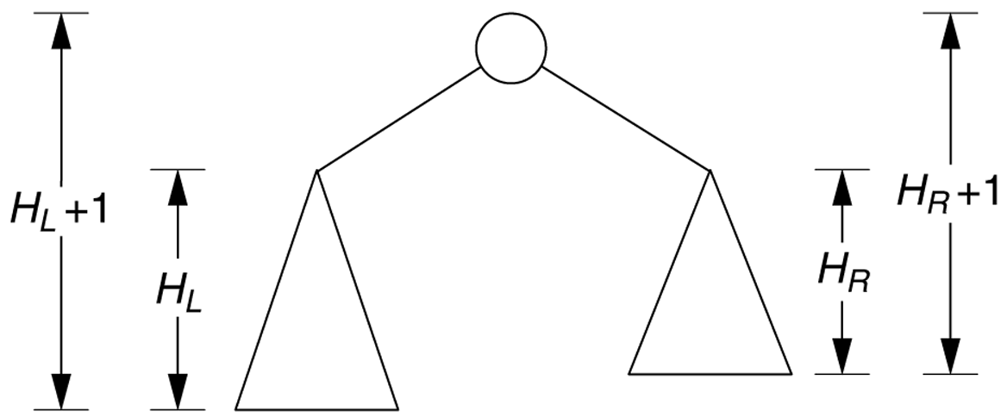
Recursive Height of Tree
Recursive view of the node height calculation:
H_{T} = max (H_{L} + 1, H_{R} + 1)

Slide 57
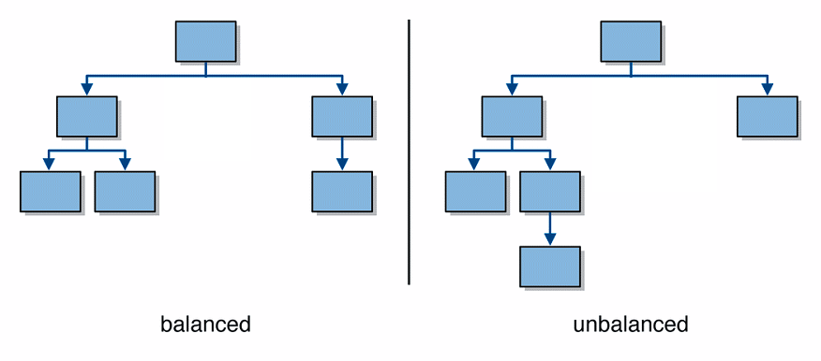
Balanced Trees
A balanced tree is one where no node has two subtrees that differ in height by more than 1
  visually, balanced trees look wider and flatter

Slide 58
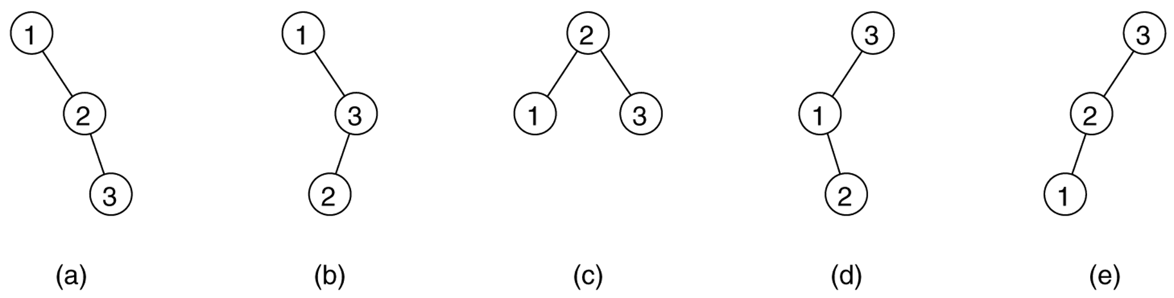
Tree Balance: Probabilities
Binary search trees that can result from adding a random permutation of 1, 2, and 3:
  Which is most likely to occur, given random input?
Notes:
The balanced tree shown in part (c) is twice as likely to result as any of the others.
Which input orderings are "bad" or "good”? → In-order input order is bad

Slide 59
AVL Trees
Observation: BSTs that are balanced will have log n search time for contains.
  It is desirable to have a BST that stays balanced
AVL tree: A binary search tree that uses modified add and remove operations to stay balanced as items are added into it
  Invented in 1960 by two Russian mathematicians:
    Georgii Maksimovich Adelson-Velskii
    Evgenii Mikhailovich Landis
  One of several auto-balancing trees

Slide 60
AVL Trees: Formal Definition
Balance factor, for a tree node n :
  Height of n's right subtree minus height of n's left subtree
    BF_{n} = Height_{n.right} - Height_{n.left}
  Reminder: Height of empty tree is -1
A binary search tree is an AVL tree if:
  balance factor of each node is 0, 1, or -1
  (if no node's two child subtrees differ in height by more than 1)

Slide 61
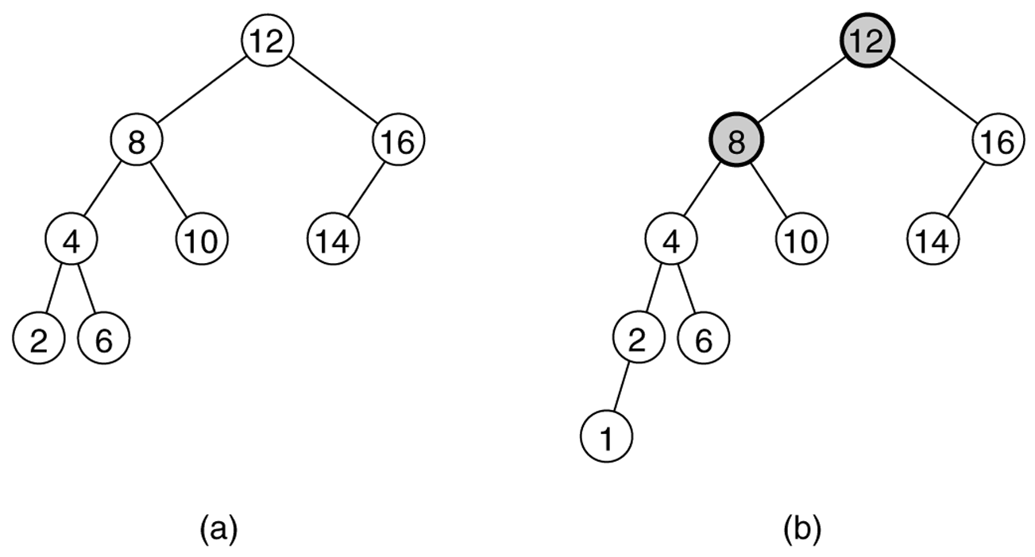
AVL Tree Examples
Two binary search trees:
(a) an AVL tree
(b) not an AVL tree (unbalanced nodes are darkened)

Slide 62
More AVL Tree Examples
1
0
-1
0
0
0
-1
0
-1
1
-1
0
0
0
0

Slide 63
Not AVL Tree Examples
-1
-2
-2
-1
2
-1
2
0
0
1
0
-1
0
0

Slide 64
Which are AVL Trees?

Slide 65
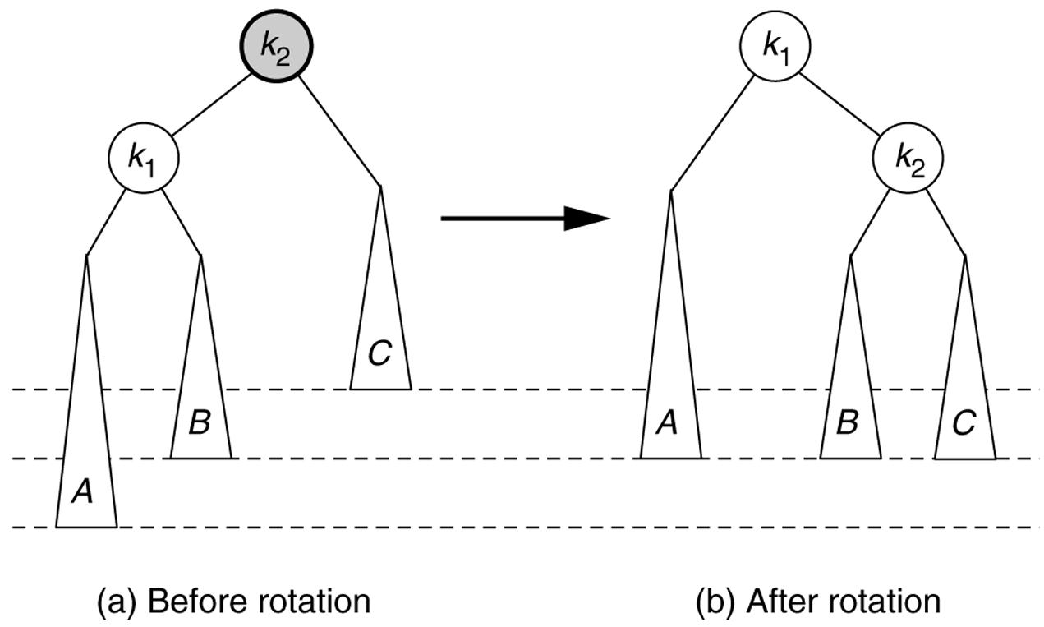
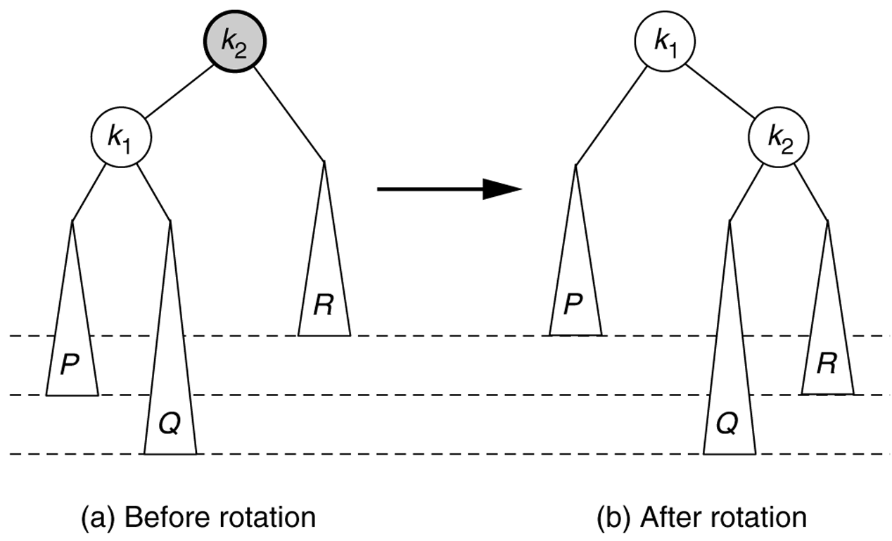
Problem Cases for AVL add
1. Insertion into left subtree of node's left child
2. Insertion into right subtree of node's left child

Slide 66
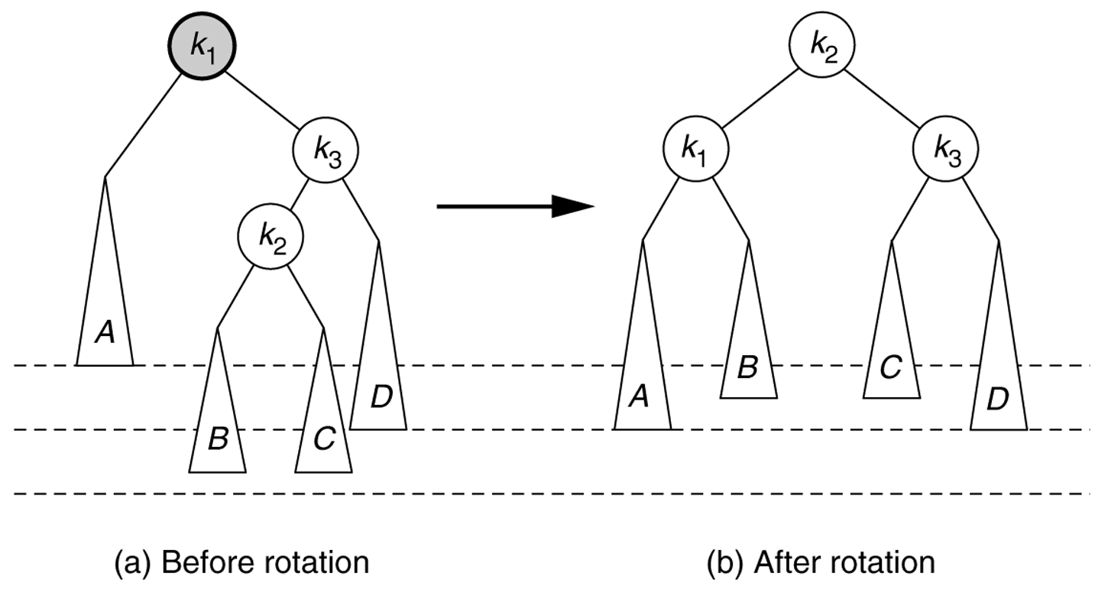
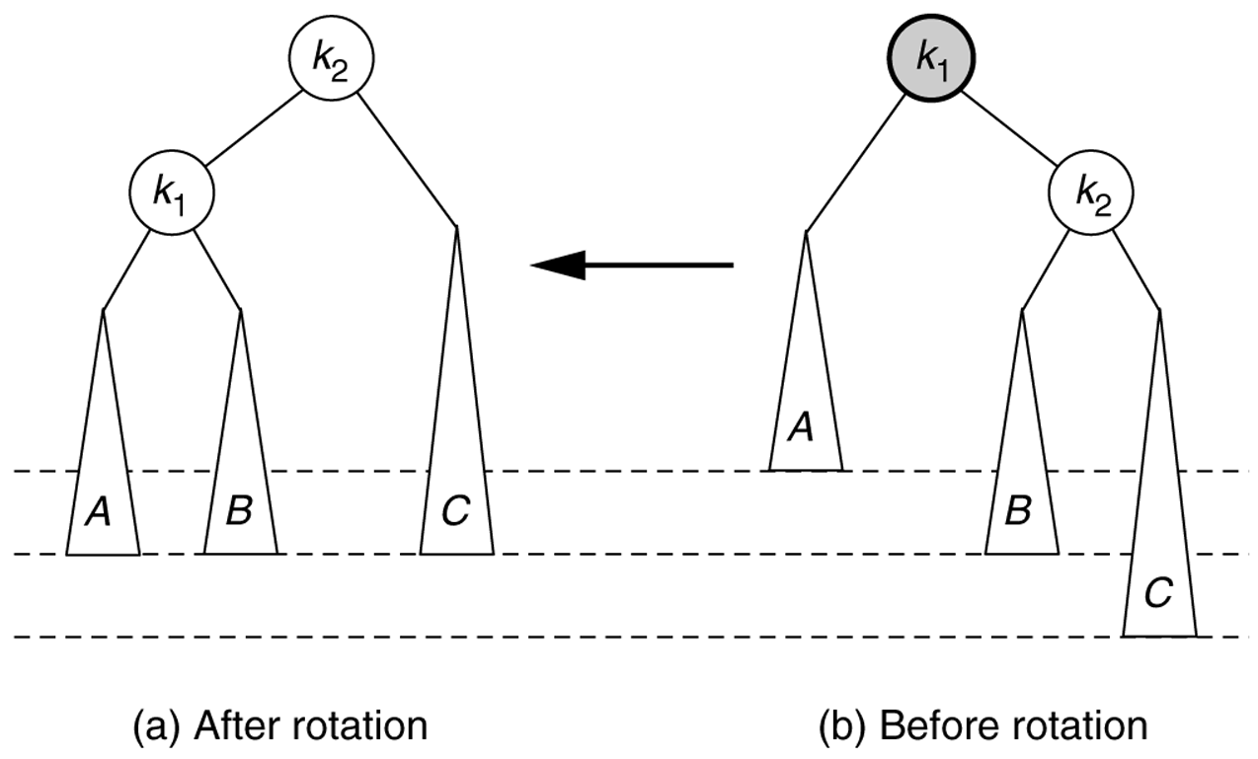
Insertion Problem Cases (cont’d)
3. Insertion into left subtree of node's right child
4. Insertion into right subtree of node's right child

Slide 67
AVL Tree Data Structure
Potential balancing problems occur when a new element is added or removed
Maintain balance using rotations
  The idea: reorganize the nodes of an unbalanced subtree until they are balanced, by "rotating" a trio of parent-leftChild-rightChild
  Tree will maintain its balance so that searches (contains) will take O(log n)
Notes:
Possible optimization: At each node, keep track of height of subtree rooted at node (for balance factor computations)

Slide 68
Right Rotation to Fix Case 1
Right rotation (clockwise): left child becomes parent; original parent demoted to right

Slide 69
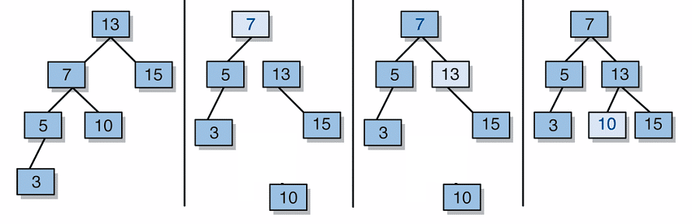
Right Rotation Steps
Detach left child (7)'s right subtree (10)
(don't lose it!)
Consider left child (7) be the new parent
Attach old parent (13) onto right of new parent (7)
Attach old left child (7)'s old right subtree (10) as left subtree of new right child (13)

Slide 70
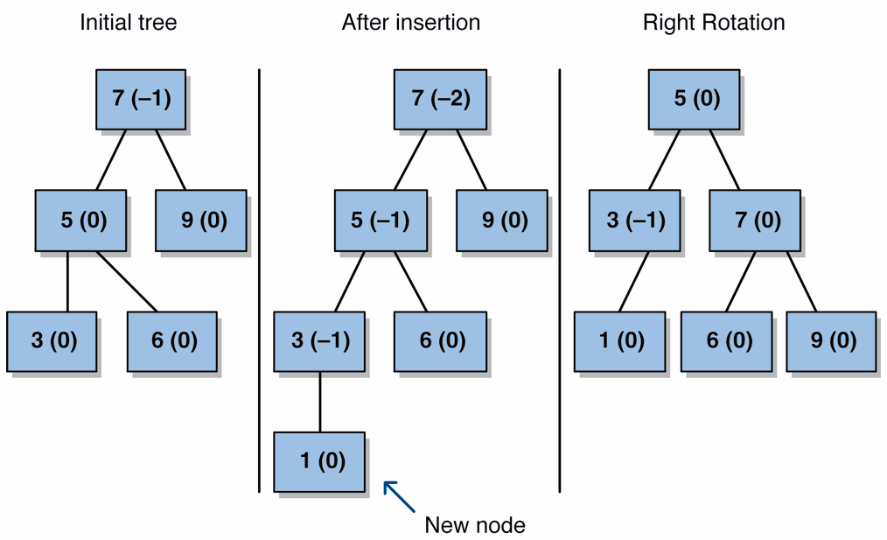
Right Rotation Example

Slide 71
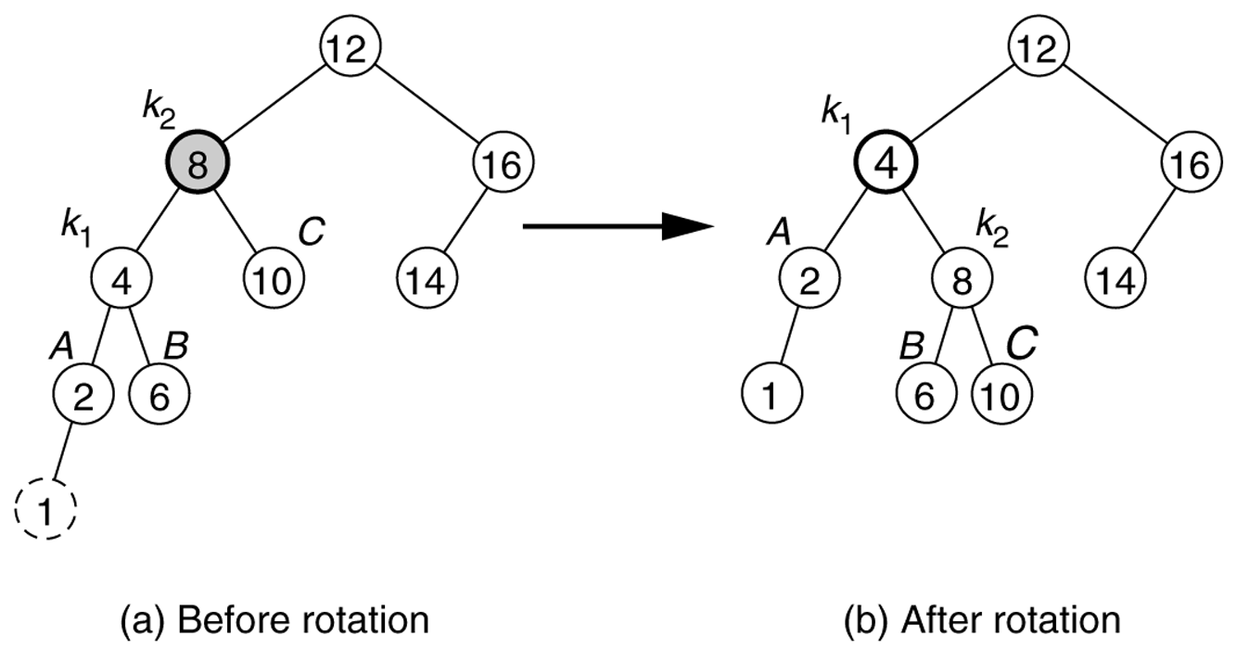
Right Rotation Example

Slide 72
Code for Right Rotation
private TreeNode rightRotate(TreeNode parent) {
// 1. detach left child's right subtree
TreeNode leftright = parent.left.right;
// 2. consider left child to be the new parent
TreeNode newParent = parent.left;
// 3. attach old parent onto right of new parent
newParent.right = parent;
// 4. attach old left child's old right subtree as
// left subtree of new right child
newParent.right.left = leftright;
return newParent;
}

Slide 73
Left Rotation to Fix Case 4
Left rotation (counter-clockwise): right child becomes parent; original parent demoted to left

Slide 74
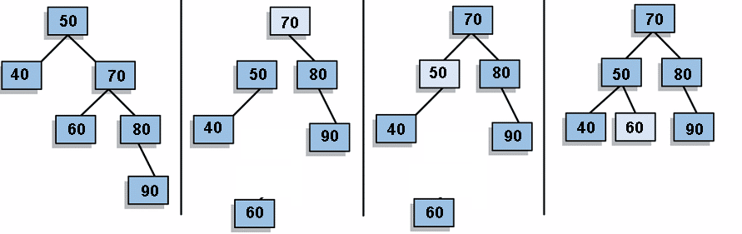
Left Rotation Steps
Detach right child (70)'s left subtree (60)
(don't lose it!)
Consider right child (70) be the new parent
Attach old parent (50) onto left of new parent (70)
Attach old right child (70)'s old left subtree (60) as right subtree of new left child (50)

Slide 75
Code for Left Rotation
private TreeNode leftRotate(TreeNode parent) {
// 1. detach right child's left subtree
TreeNode rightleft = parent.right.left;
// 2. consider right child to be the new parent
TreeNode newParent = parent.right;
// 3. attach old parent onto left of new parent
newParent.left = parent;
// 4. attach old right child's old left subtree as
// right subtree of new left child
newParent.left.right = rightleft;
return newParent;
}

Slide 76
Problem: Cases 2, 3
A single right rotation does not fix Case 2
A single left rotation also does not fix Case 3

Slide 77
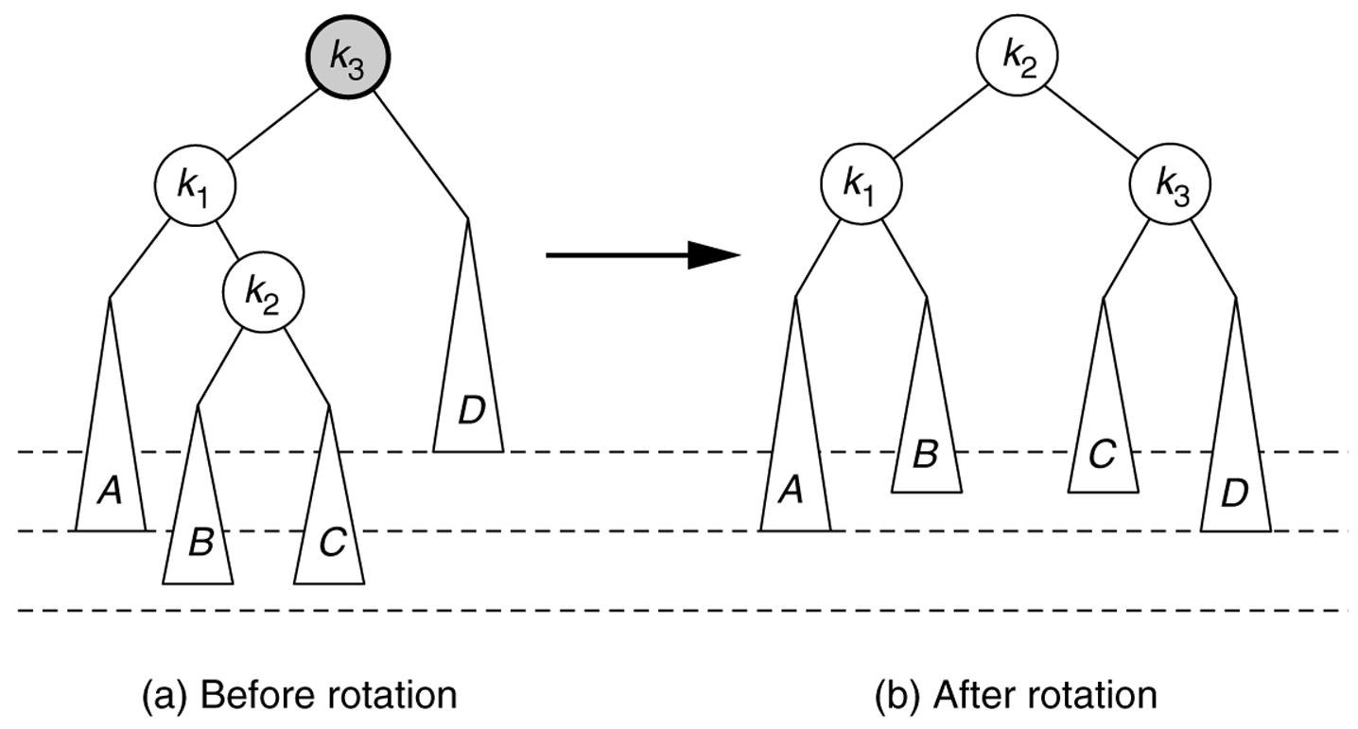
Left-Right Rotation for Case 2
Left-right double rotation: A left rotation of the left child, followed by a right rotation at the parent

Slide 78
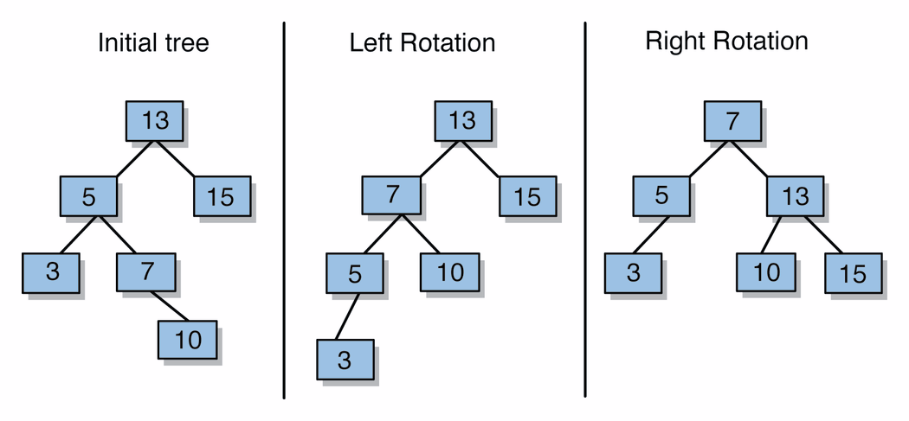
Left-Right Rotation Steps
Perform left-rotate on left child
Perform right-rotate on parent (current node)

Slide 79
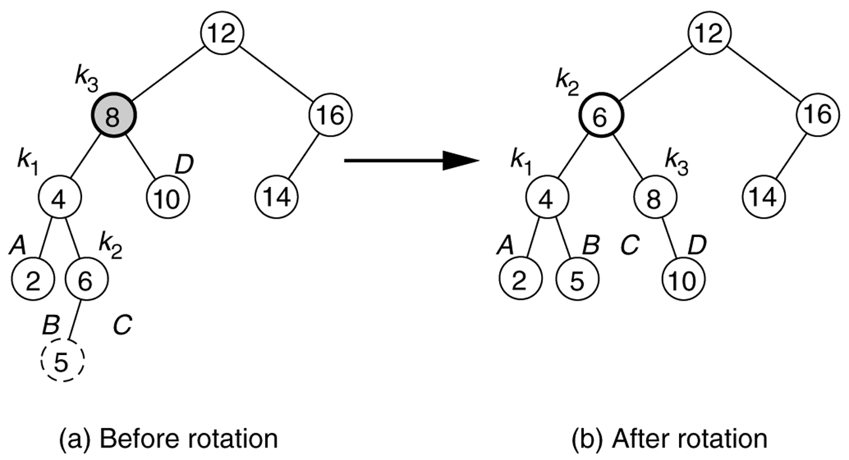
Left-Right Rotation Example

Slide 80
Right-Left Rotation for Case 3
Right-left double rotation: A right rotation of the right child, followed by a left rotation at the parent

Slide 81
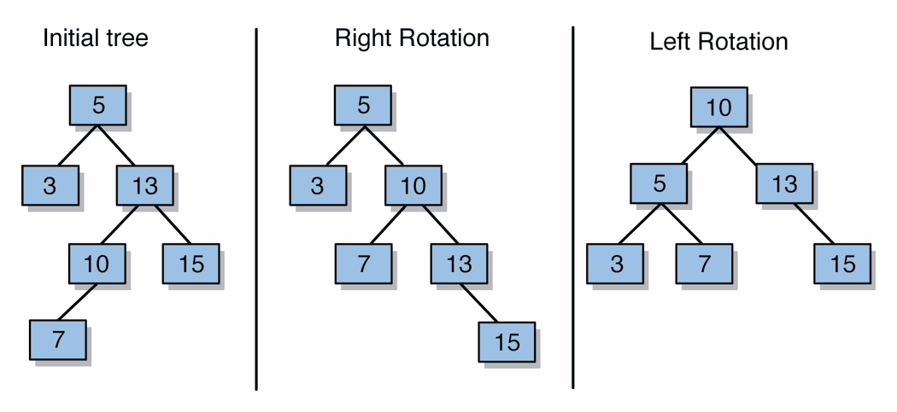
Right-left Rotation Steps
Perform right-rotate on right child
Perform left-rotate on parent (current node)

Slide 82
Implementing AVL add
After normal BST add, update heights from new leaf up towards root
  If balance factor changes to > +1 or < -1, then use rotation(s) to rebalance
Let n be the first unbalanced node found
  Case 1: n has balance factor -2 and n's left child has balance factor of –1
    fixed by performing right-rotation on n
  Case 2: n has balance factor -2 and n's left child has balance factor of 1
    fixed by perform left-rotation on n's left child, then right-rotation on n (left-right double rotation)

Slide 83
AVL add (cont'd)
  Case 3: n has balance factor 2 and n's right child has balance factor of –1
    fixed by perform right-rotation on n's right child, then left-rotation on n (right-left double rotation)
  Case 4: n has balance factor 2 and n's right child has balance factor of 1
    fixed by performing left-rotation on n
After rebalancing, continue up the tree updating heights
  What if n's child has balance factor 0?
  What if another imbalance occurs higher up?
Notes:
If A has balance factor –2, then
A’s left child cannot have balance factor 0
A’s left child has balance factor –1 if and only if new node was added to subtree rooted at A’s leftmost grandchild
A’s left child has balance factor 1 if and only if new node was added to subtree rooted at A’s left child’s right child

Slide 84
Code for AVL add
protected TreeNode add(TreeNode node, E element) {
node = super.add(node, element);
node = rebalance(node);
return node;
}
protected TreeNode rebalance(TreeNode node) {
int bf = balanceFactor(node);
if (bf < -1) {
if (balanceFactor(node.left) < 0) { // case 1 (R)
node = rightRotate(node);
} else { // case 2 (LR)
node.left = leftRotate(node.left);
node = rightRotate(node);
}
} else if (bf > 1) {
if (balanceFactor(node.right) < 0) { // case 3 (RL)
node.right = rightRotate(node.right);
node = leftRotate(node);
} else { // case 4 (L)
node = leftRotate(node);
}
}
return node;
}

Slide 85
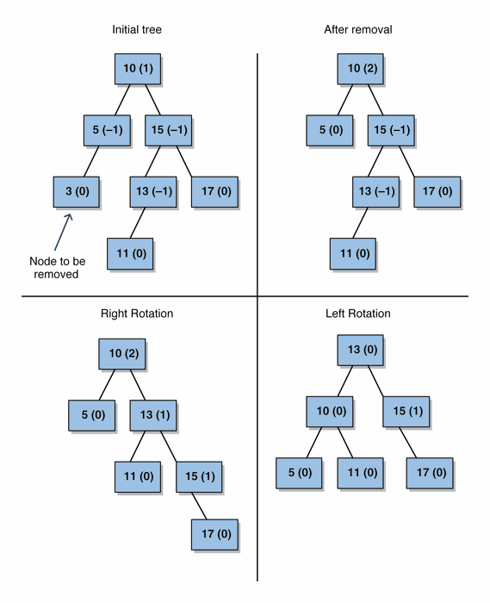
Problems for AVL remove
Removal from AVL tree can also unbalance the tree

Slide 86
Right-Left Rotation on remove

Slide 87
AVL remove, cont'd
Perform normal BST remove (with replacement of node to be removed with its successor)
Update heights from successor node location upwards towards root
  If balance factor changes to +2 or -2, then use rotation(s) to rebalance
remove has the same 4 cases (and fixes) as insert
  Are there any additional cases?
After rebalancing, continue up the tree updating heights; must continue checking for imbalances in balance factor, and rebalancing if necessary
Notes:
Are all cases handled?
What if item removed was A’s left child or right child?
What if A’s child has balance factor 0?

Slide 88
SPLAY TREES
Notes:
KALDIM (11 MAYIS 2011)

Slide 89
Problems with BSTs
Because the shape of a BST is determined by the order that data is inserted, we run the risk of trees that are essentially lists
21
12
32
20
24
37
15
40
55
56
77

Slide 90
BST Sequence of Operations
Worst case for a single BST operation can be O(N)
Not so bad if this happens only occasionally
BUT... It is not uncommon for an entire sequence of “bad” operations to occur. In this case, a sequence of M operations take O(M*N) time and the time for the sequence of operations becomes noticeable.

Slide 91
Splay Tree Sequence of Operations
Splay trees guarantee that a sequence of M operations takes at most O(M * log N) time.
We say that the splay tree has amortized running time of O(log N) cost per operation. Over a long sequence of operations, some may take more than log N time, some will take less.

Slide 92
Splay Tree Sequence of Operations (cont’d)
Does not preclude the possibility that any particular operation is still O(N) in the worst case
  Therefore, amortized O(log N) not as good as worst case O(log N)
If any particular operation is O(N) and we still want amortized O(log N) performance, then whenever a node is accessed, it must be moved. Otherwise, its access time is always O(N)

Slide 93
Splay Trees
The basic idea of the splay tree is that every time a node is accessed, it is pushed to the root by a series of tree rotations. This series of tree rotations is knowing as “splaying”.
If the node being “splayed” is deep, many nodes on the path to that node are also deep and by restructuring the tree, we make access to all of those nodes cheaper in the future.

Slide 94
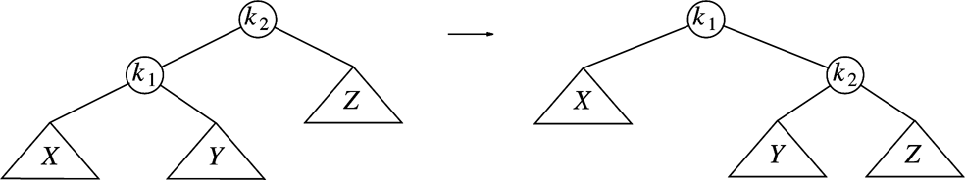
Basic “Single” Rotation in a BST
Rotating k₁ around k₂
Assuming that the tree on the left is a BST, how can we verify that the tree on the right is still a valid BST?
Note that the rotation can be performed in either direction.

Slide 95
Splay Operation
To “splay node x”, traverse up the tree from node x to root, rotating along the way until x is the root. For each rotation:
  If x is root, do nothing.
  If x has no grandparent, rotate x about its parent.
  If x has a grandparent,
    If x and its parent are both left children or both right children, rotate the parent about the grandparent, then rotate x about its parent.
    If x and its parent are opposite type children (one left and the other right), rotate x about its parent, then rotate x about its new parent (former grandparent).

Slide 96
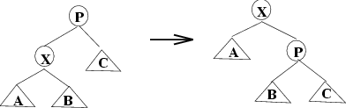
Node has no Grandparent

Slide 97
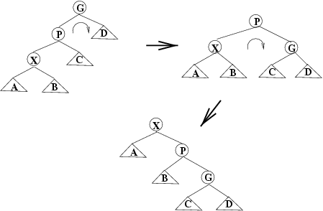
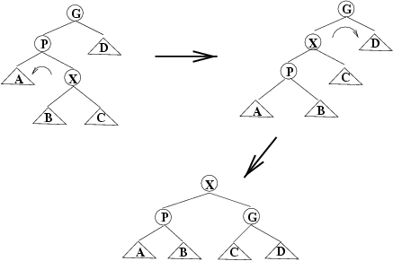
Node and Parent are Same Side
Zig-Zig
Rotate P around G, then X around P

Slide 98
Node and Parent are Different Sides
Zig-Zag
Rotate X around P, then X around G

Slide 99
Operations in Splay Trees
insert
  First insert as in normal binary search tree
  Then, splay inserted node
  If there is a duplicate, the node holding the duplicate element is splayed
find/contains
  Search for node
  If found, splay it; otherwise, splay last node accessed on the search path

Slide 100
Operations on Splay Trees (cont)
remove
  Splay element to be removed
    If the element to be deleted is not in the tree, the node last visited on the search path is splayed
  Disconnect left and right subtrees from root
  Do one or both of:
    Splay max item in T_{L} (then T_{L} has no right child)
    Splay min item in T_{R} (then T_{R} has no left child)
  Connect other subtree to empty child of root

Slide 101
Exercise - find(65)
50
40
60
20
43
70
16
65
63
66

Slide 102
Exercise - remove(25)
50
40
60
20
43
70
16
65
25
63
66

Slide 103
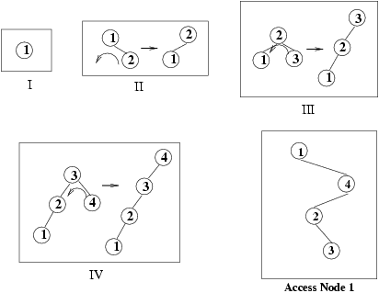
Insertion in order into a Splay Tree
In a BST, building a tree from N sorted elements was O(N²). What is the performance of building a splay tree from N sorted elements?

Slide 104
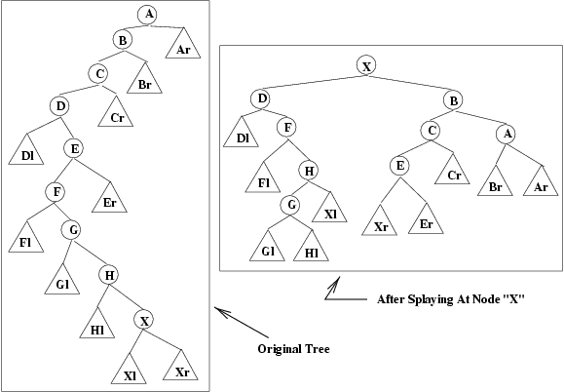
An Extreme Example of Splaying

Slide 105
Splay Tree Code
The splaying operation is performed “up the tree” from the node to the root.
How do we traverse “up” the tree?
How do we know if X and P are both left/right children or are different children?
How do we know if X has a grandparent?
What disadvantages are there to this technique?

Slide 106
Top-Down Splay Trees
Rather than write code that traverses both up and down the tree, “top-down” splay trees only traverse down the tree. On the way down, rotations are performed and the tree is split into three parts depending on the access path (zig, zig-zig, zig-zag) taken
  X, the node currently being accessed
  Left – all nodes less than X
  Right – all nodes greater than X
As we traverse down the tree, X, Left, and Right are reassembled
This method is faster in practice, uses only O(1) extra space and still retains O(log N) amortized running time

Slide 107
B-TREES

Slide 108
Large Trees
Tailored toward applications where tree doesn’t fit in memory
  CPU operations much faster than disk accesses
  Want to limit levels of tree (because each new level requires a disk access)
  Keep root and top level in memory

Slide 109
An Alternative to BSTs
Up until now we assumed that each node in a BST stored the data (except for radix trees)
What about having the data stored only in the leaves? The internal nodes just guide our search to the leaves, which contain the data we want
We will restrict this discussion of such trees to those in which all leaves are at the same level

Slide 110
A BST with Data Stored in the Leaves
20
12
40
8
17
33
45
1
2
5
7
9
10
12
15
18
19
27
29
20
33
37
40
41
45
Figure 1: A BST with data stored in the leaves

Slide 111
Observations
Store data only at leaves; all leaves at same level
  Interior and exterior nodes have different structure
  Interior nodes store one key and two subtree pointers
  All search paths have same length: ⎡log n⎤
  (assuming one element per leaf)
  Can store multiple data elements in a leaf

Slide 112
M-Way Trees
A generalization of the previous BST model
  Each interior node has M subtrees pointers and M-1 keys
    the previous BST would be called a “2-way tree” or “M-way tree of order 2”
  As M increases, height decreases: ⎡log_{M} n⎤ (assuming one element per leaf)
  A perfect M-way tree of height h has M^{h} leaves

Slide 113
An M-Way Tree of Order 3
Figure 2 (next page) shows the same data as Figure 1, stored in an M-way tree of order 3. In this example M=3 and h=2, so the tree can support 9 leaves, although it contains only 8
One way to look at the reduced path length with increasing M is that the number of nodes to be visited in searching for a leaf is smaller for large M
We will see that when data is stored on the disk, each node visited requires a disk access, so reducing the nodes visited is essential

Slide 114
An M-Way Tree of Order 3
12
20
5
9
15
18
26
1
2
4
5
7
10
11
12
15
16
18
19
21
24
27
30
34
42
Figure 2 -- An M-Way tree of order 3

Slide 115
Searching in an M-Way Tree
Different from standard BST search
  Search always terminates at a leaf node
  Might need to scan more than one element at a leaf
  Might need to compare with more than one key at an interior node
Trade-offs
  Tree height decreases as M increases
  Computation at each node during search increases as M increases

Slide 116
Searching in an M-Way Tree
Search (MWayNode v, DataType element, boolean foundIt)
{
if (v == NULL) foundIt=failure;
if (v is a leaf)
search the list of values looking for element
if found, foundIt=success
otherwise foundIt=failure
else (if v is an interior node)
search the keys to find the subtree the element is in
recursively search the subtree
}

Slide 117
Search Algorithm: Traversing the M-way Tree
Everything in this subtree is smaller than this key
18
32
10
13
22
28
39
1
2
9
10
11
13
14
16
18
23
24
25
28
30
32
35
38
39
44
In any interior node, find the first key > search item, and traverse the link to the left of that key. Search for any item >= the last key in the subtree pointed to by the rightmost link. Continue until search reaches a leaf.

Slide 118
Searching in an M-way Tree of Order 4
22
36
48
6
12
18
26
32
42
54
2
4
6
8
10
14
16
18
19
20
22
24
26
28
30
32
34
38
40
42
44
46
48
50
52
54
56
Figure 3 – Searching in an M-way tree of order 4

Slide 119
Is It Worth It?
Is it worthwhile to reduce the height of the search tree by letting M increase?
Although the number of nodes visited decreases, the amount of computation at each node increases.
Where is the payoff?

Slide 120
An Example
Consider storing 10⁷ items in a balanced BST and in an M-way tree of order 10.
The height of the BST will be log(10⁷) ~ 24.
The height of the M-Way tree will be lg(10⁷ ) = 7 (assuming that we store just 1 record per leaf)
However, in the BST, just one comparison will be done at each interior node, but in the M-Way tree, 9 will be done (worst case)

Slide 121
How can This Be Worth the Price?
Only if it somehow takes longer to descend the tree than it does to do the extra computation
This is exactly the situation when the nodes are stored externally (e.g., on disk)
Compared to disk access time, the time for extra computation is insignificant
We can reduce the number of accesses by sizing the M-way tree to match the disk block and record size.

Slide 122
A Generic M-Way Tree Node
public class MWayNode
{
// code for public interface here
// constructors, accessors, mutators
private boolean isLeaf; // true if node is a leaf
private int m; // the “order” of the node
private int nKeys; // nr of actual keys used
private ArrayList<Ktype> keys; // array of keys(size = m - 1)
private MWayNode subtrees[ ]; // array of pts (size = m)
private int nElems; // nr poss. elements in leaf
private List<Dtype> data; // data storage if leaf
}

Slide 123
B-Tree Definition
A B-Tree of order M is an M-Way tree with the following constraints
  The root is either a leaf or has between 2 and M subtrees
  All interior nodes (except maybe the root) have between ⎡M/2⎤ and M subtrees (i.e., each interior node is at least “half full”)
  All leaves are at the same level. A leaf must store between ⎡L/2⎤ and L data elements, where L is a fixed constant >= 1 (i.e., each leaf is at least “half full”,
  except when the tree has fewer than L/2 elements)

Slide 124
A B-Tree Example
The following figure shows a B-Tree with M=4 and L=3
The root node can have between 2 and M=4 subtrees
Each other interior node can have between ⎡M/2⎤ = ⎡4/2⎤ = 2 and M=4 subtrees and up to M–1=3 keys.
Each exterior node (leaf) can hold between ⎡L/2⎤ = ⎡3/2⎤ = 2 and L=3 data elements

Slide 125
A B-Tree with M=4 and L=3
22
36
48
6
12
18
26
32
42
54
2
4
6
8
10
14
16
18
19
20
22
24
26
28
30
32
34
38
40
42
44
46
48
50
52
54
56
Figure 4 – A B-Tree with M = 4 and L = 3

Slide 126
Designing a B-Tree
Recall that M-way trees (and therefore B-trees) are often used when there are too much data to fit in memory. Therefore, each node or leaf access costs one disk access
When designing a B-Tree (choosing the values of M and L), we need to consider the size of the data stored in the leaves, the size of the keys and pointers stored in the interior nodes, and the size of a disk block

Slide 127
Student Record Example
Suppose our B-Tree stores student records which contain name, address, etc., and other data totaling 1024 bytes.
Further, assume that the key to each student record (ID) is 8 bytes long.
Assume also that a pointer (really a disk block number, not a memory address) requires 4 bytes
And finally, assume that our disk block is 4096 bytes

Slide 128
Calculating L
L is the number of data records that can be stored in each leaf. Since we want to do just one disk access per leaf, this is the same as the number of data records per disk block
Since a disk block is 4096 and a data record is 1024, we choose L = ⎣4096 / 1024⎦ = 4 data records per leaf

Slide 129
Calculating M
Each interior node contains M pointers and M-1
keys. To maximize M (and therefore keep the tree flat and wide) and yet do just one disk access per interior node, we have the following relationship
4M + 8 (M–1) <= 4096
12M <= 4104
M <= 342
So, choose the largest possible M (making tree as shallow as possible) of 342

Slide 130
Performance of Our B-Tree
With M=342, the height of our tree for N students will be ⎡log₃₄₂ ⎡N/L⎤⎤
For example, with N = 100,000 (about 10 times the size of student population) the height of the tree with M=342 would be no more than 2, because ⎡log₃₄₂(25000)⎤ = 2
So, any student record can be found in 3 disk accesses. If the root of the B-Tree is stored in memory, then only 2 disk accesses are needed

Slide 131
Insertion of X in a B-Tree
Search to find the leaf into which X should be inserted
If the leaf has room (fewer than L elements), insert X and write the leaf back to the disk.
If the is leaf full, split it into two leaves, each with half of elements. Insert X into the appropriate new leaf and write new leaves back to the disk.
  Update the keys in the parent
  If the parent node is already full, split it in the same manner
  Splits may propagate all the way to the root, in which case, the root is split (this is how the tree grows in height)

Slide 132
Insert 33 into This B-Tree
22
36
48
6
12
18
26
32
42
54
2
4
6
8
10
12
14
16
18
19
20
22
24
26
28
30
32
34
36
38
40
42
44
46
48
50
52
54
56
Figure 5 – Before inserting 33
Notes:
BURADA KALDIM (19 ARALIK 2012)

Slide 133
Inserting 33
Traversing the tree from the root, we find that 33 is less than 36 and is greater than 22, leading us to the 2nd subtree. Since 33 is greater than 32 we are led to the 3rd leaf (the one containing 32 and 34).
There is room for an additional data item in the leaf it is inserted (in sorted order which means reorganizing the leaf)

Slide 134
After Inserting 33
22
36
48
6
12
18
26
32
42
54
2
4
6
8
10
12
14
16
18
19
20
22
24
26
28
30
32
33
34
36
38
40
42
44
46
48
50
52
54
56
Figure 6 – After inserting 33

Slide 135
Now Insert 35
This item also belongs in the 3rd leaf of the 2nd subtree. However, that leaf is full
Split the leaf in two and update the parent to get the tree in Figure 7

Slide 136
After Inserting 35
22
36
48
6
12
18
26
32
34
42
54
2
4
6
8
10
12
14
16
18
19
20
22
24
26
28
30
32
33
34
35
36
38
40
42
44
46
48
50
52
54
56
Figure 7 – After inserting 35

Slide 137
Inserting 21
This item belongs in the 4th leaf of the 1st subtree (the leaf containing 18, 19, 20)
Since the leaf is full, we split it and update the keys in the parent
However, the parent is also full, so it must be split and its parent (the root) updated
But this would give the root 5 subtrees which is not allowed, so the root must also be split
This is the only way the tree grows in height

Slide 138
After Inserting 21
36
18
22
48
6
12
20
26
32
34
42
54
2
4
6
8
10
12
14
16
18
19
20
21
22
24
26
28
30
32
33
34
35
36
38
40
42
44
46
48
50
52
54
56
Figure 8 – After inserting 21

Slide 139
B-Tree Deletion
Find leaf containing element to be deleted
If that leaf is still full enough (still has at least ⎡L/2⎤ elements after remove) write it back to disk without that element. Then, change the key in the ancestor if necessary
If leaf is now too empty (has less than ⎡L/2⎤ elements), borrow an element from a neighbor.
  If neighbor would be too empty, combine two leaves into one
  This combining requires updating the parent, which may now have too few subtrees
  If necessary, continue the combining up the tree

