Slide 1
第4章
4.3最短路问题

Slide 2
目录 CONTENTS
01
固定起点的最短路
02
所有顶点对之间最短路的Floyd算法
03
最短路应用范例
04
最短路问题的0-1整数规划模型

Slide 3
固定起点的
最短路
01

Slide 4
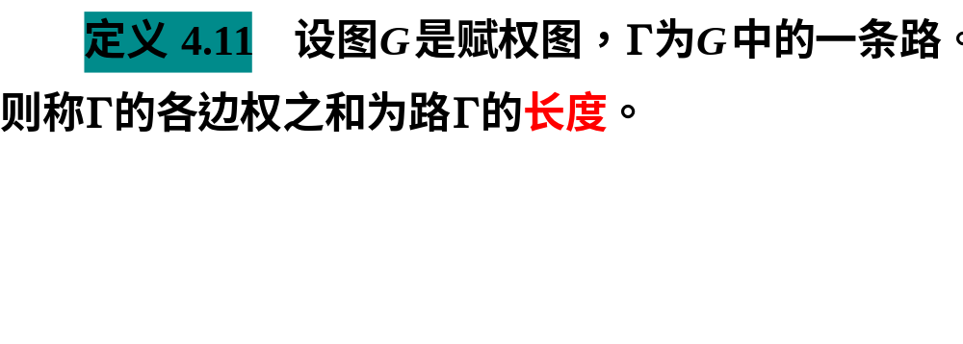
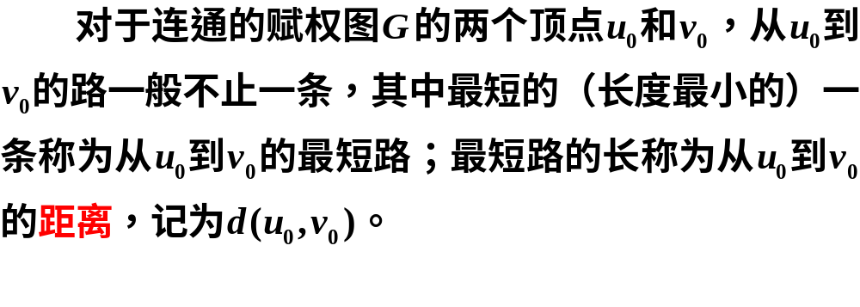

Slide 5
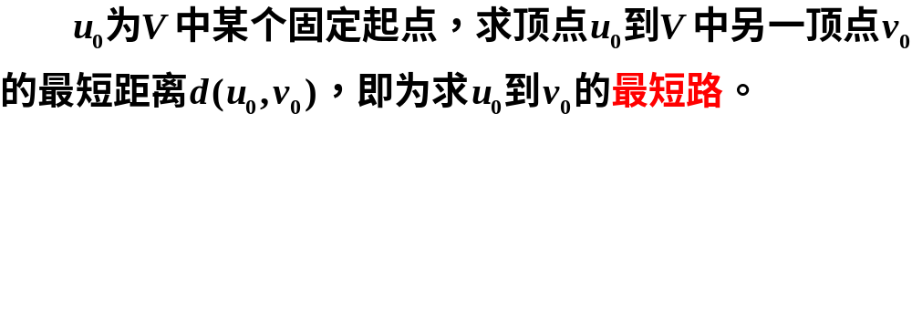
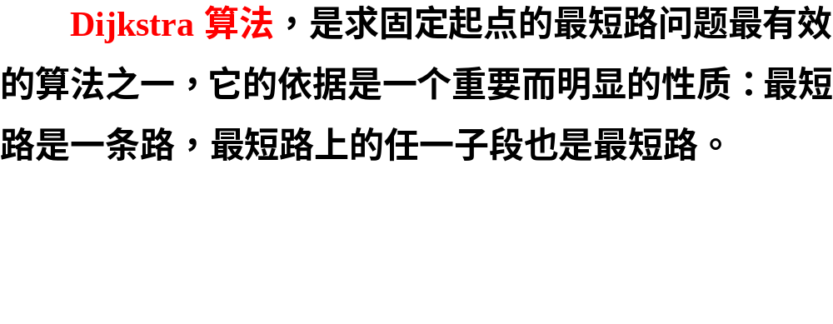

Slide 6
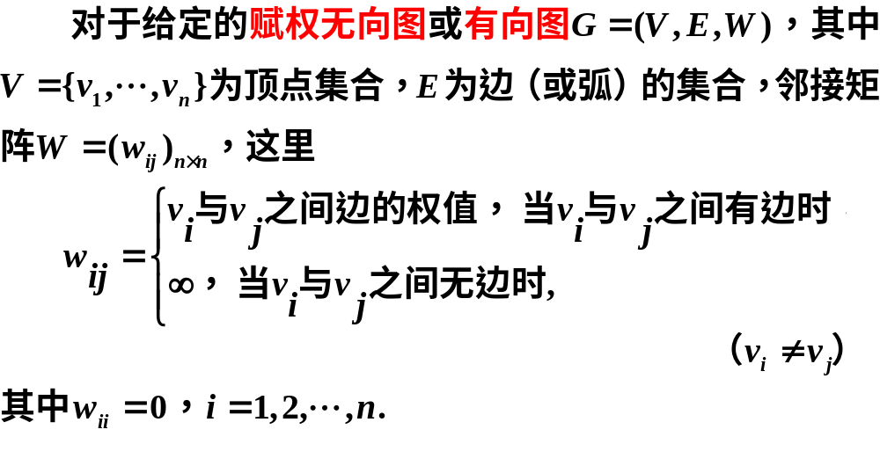
1.Dijkstra标号算法

Slide 7
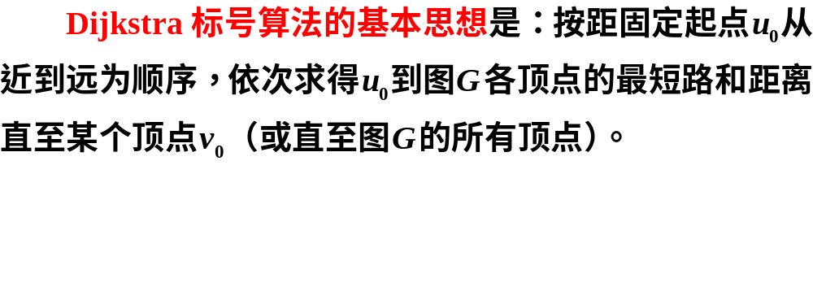

Slide 8
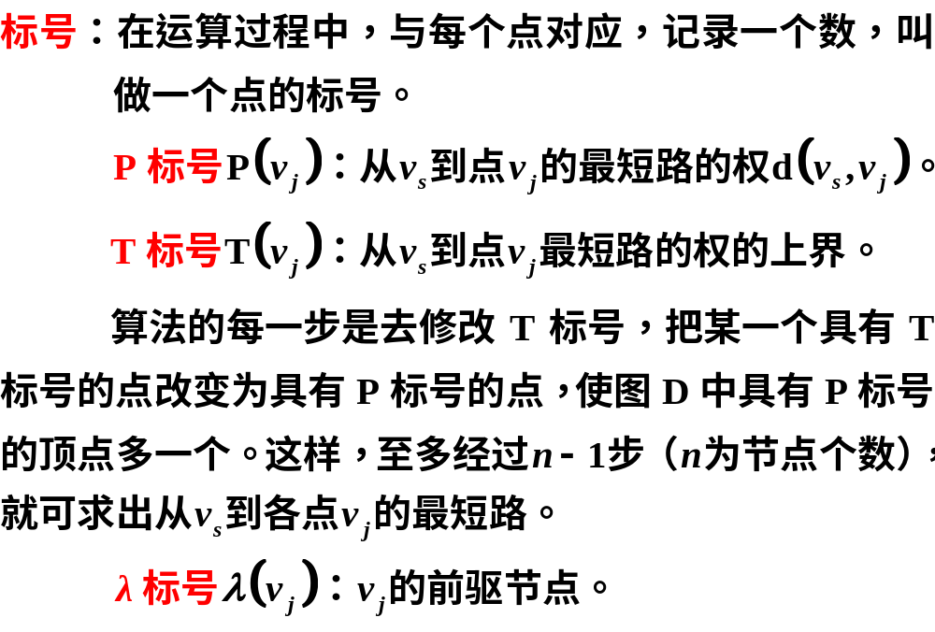

Slide 9
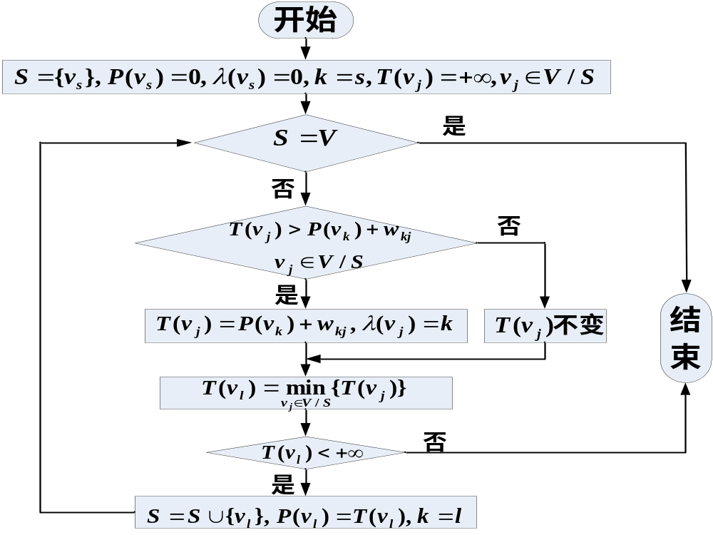
Dijkstra标号算法
流程图

Slide 10
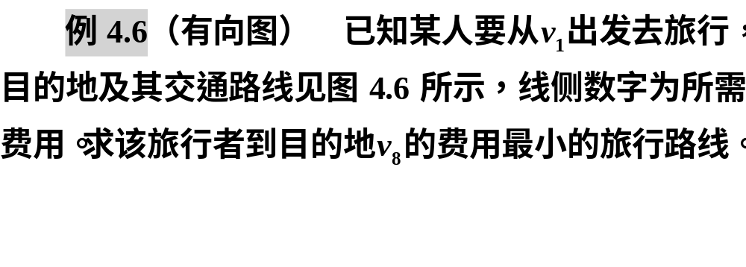
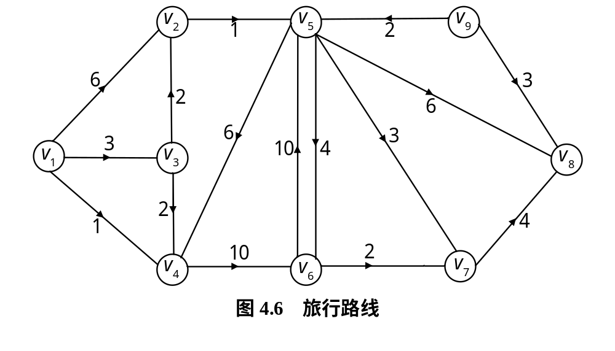

Slide 11
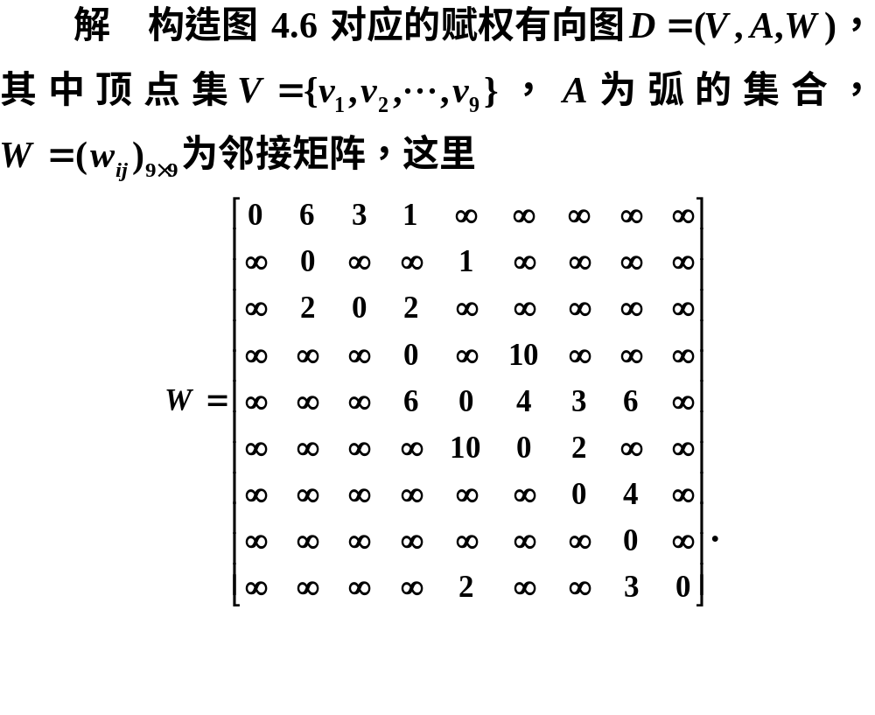

Slide 12
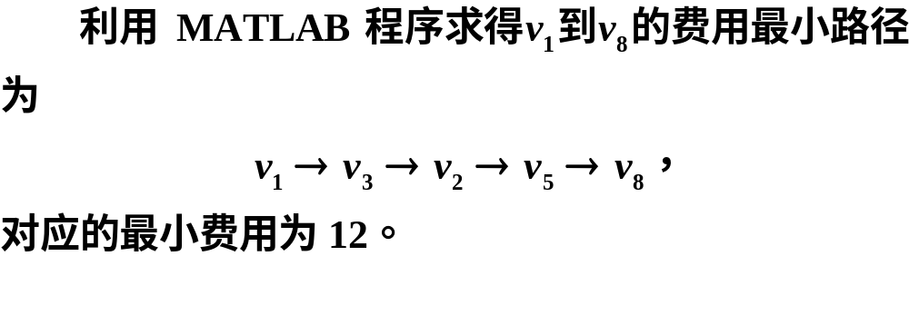
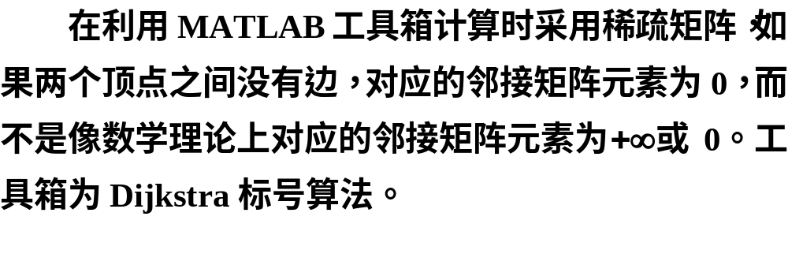

Slide 13
clc, clear, close all
E = [1,2,6; 1,3,3; 1,4,1; 2,5,1; 3,2,2; 3,4,2; 4,6,10; 5,4,6
5,6,4; 5,7,3; 5,8,6; 6,5,10; 6,7,2; 7,8,4; 9,5,2; 9,8,3];
G = digraph(E(:,1), E(:,2), E(:,3));
[path, d] = shortestpath(G, 1, 8, 'method','positive')
p = plot(G,'EdgeLabel',G.Edges.Weight,'Layout', 'circle');
highlight(p,path,'EdgeColor','r','LineWidth',1.5)

Slide 14
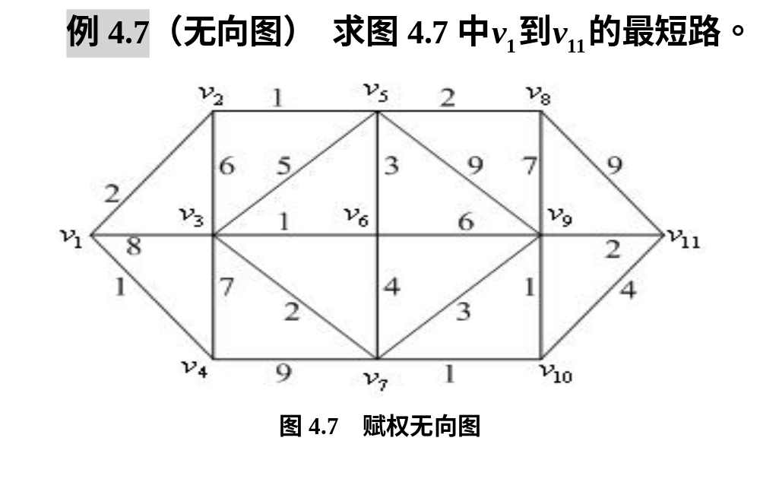

Slide 15
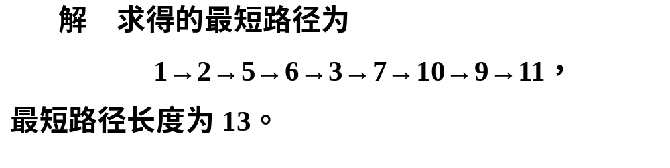
clc, clear, close all, a=zeros(11);
a(1,2)=2;a(1,3)=8;a(1,4)=1;
a(2,3)=1;a(2,3)=6;a(2,5)=1;
a(3,4)=7;a(3,5)=5;a(3,6)=1;a(3,7)=2;
a(4,7)=9; a(5,6)=3;a(5,8)=2;a(5,9)=9;
a(6,7)=4;a(6,9)=6; a(7,9)=3;a(7,10)=1;
a(8,9)=7;a(8,11)=9;
a(9,10)=1;a(9,11)=2; a(10,11)=4;
s=cellstr(strcat('v',int2str([1:11]'))); %顶点字符串
G=graph(a,s,'Upper'); %利用邻接矩阵的上三角元素构造无向图
[p,d]=shortestpath(G,1,11) %求最短路径和最短距离
h=plot(G,'EdgeLabel',G.Edges.Weight); %画无向图
highlight(h,p,'EdgeColor','r','LineWidth',2) %最短路径加粗

Slide 16
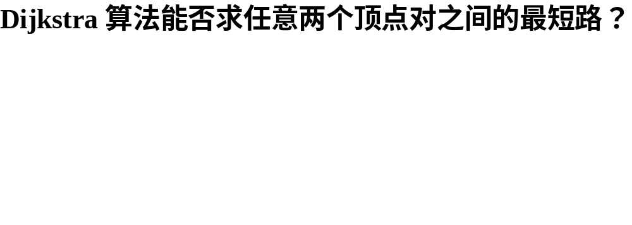
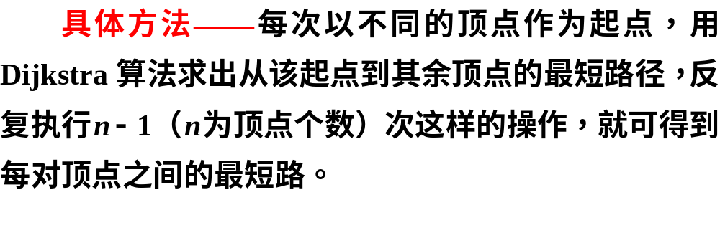

重复计算效率低

Slide 17
所有顶点对之间
最短路的
Floyd算法
02

Slide 18
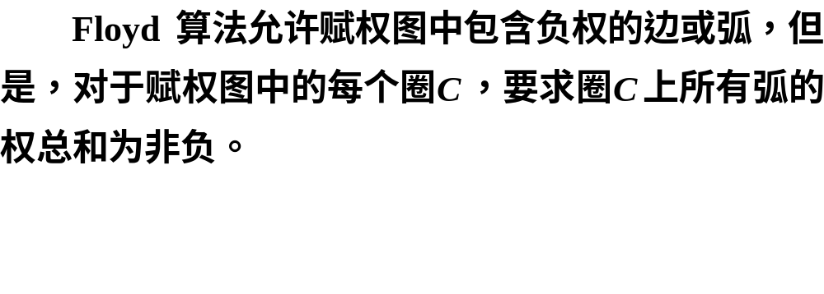
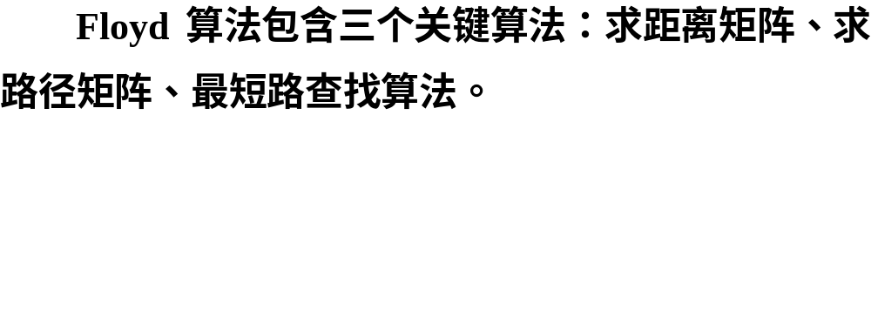

Slide 19
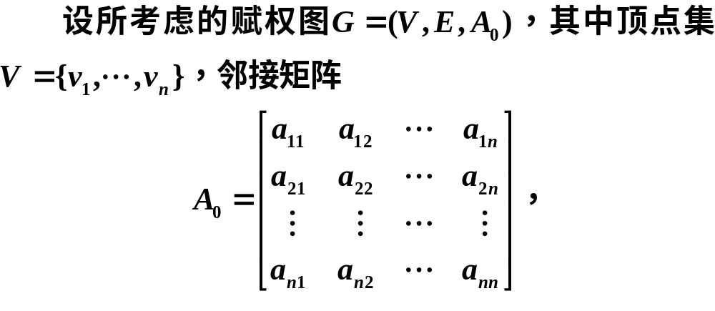

Slide 20
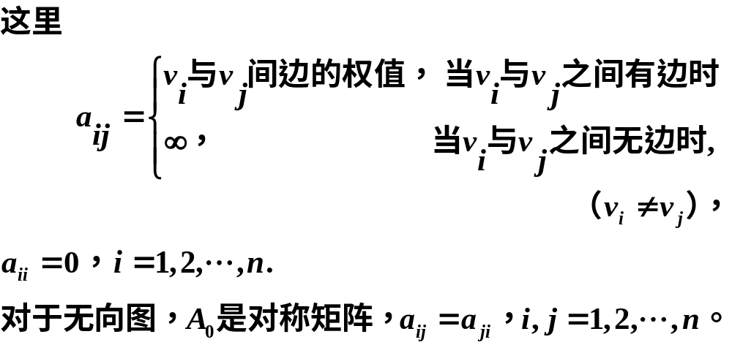

Slide 21
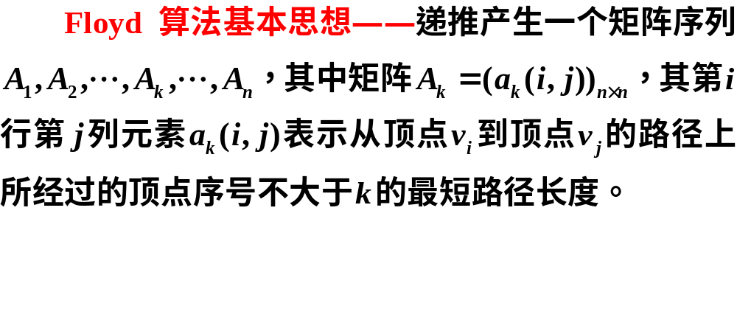
1.求距离矩阵的算法

Slide 22
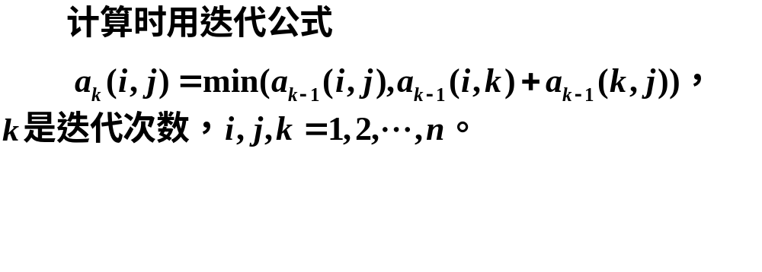
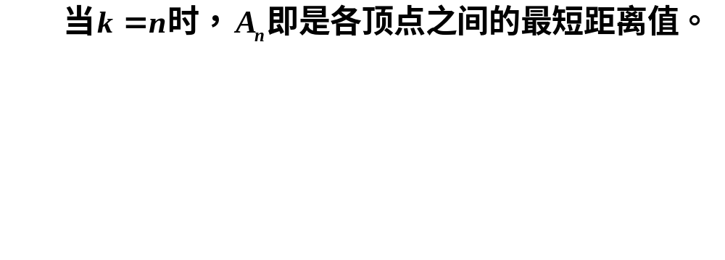

Slide 23
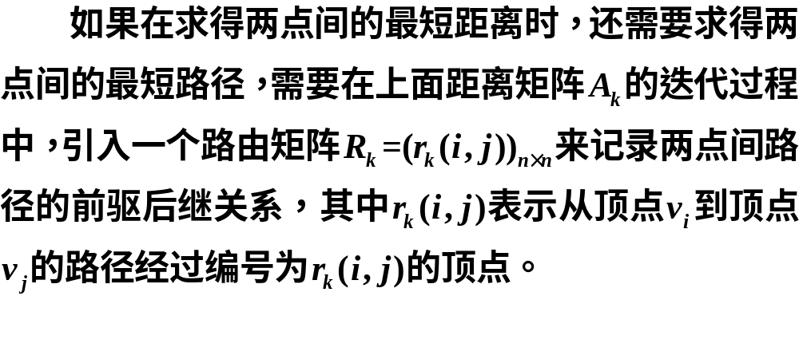
2.建立路径矩阵的算法

Slide 24
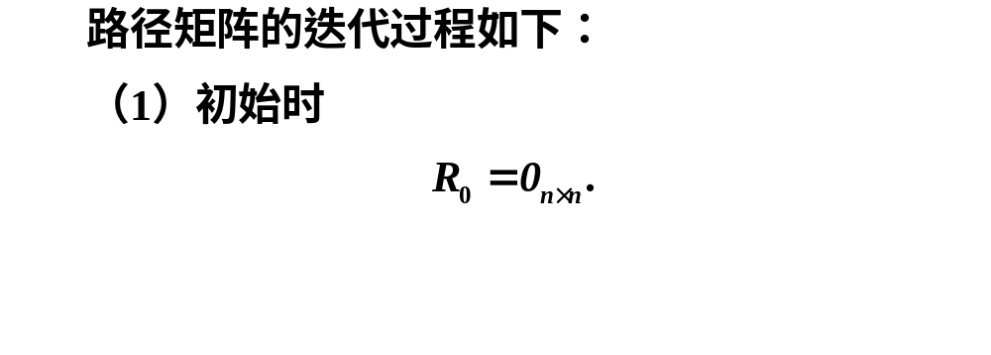
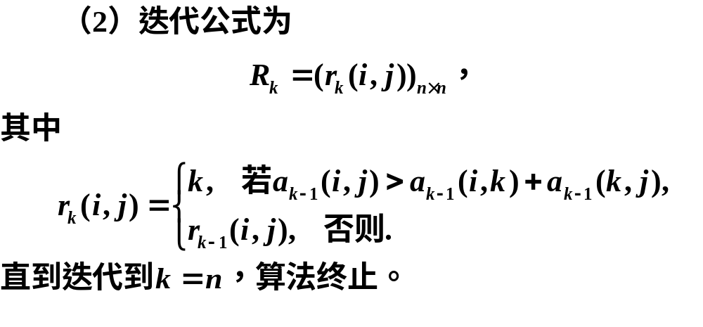

Slide 25
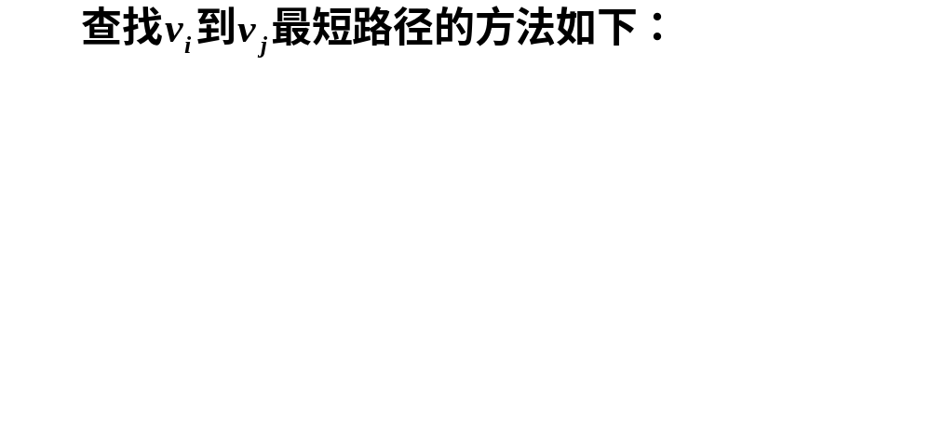
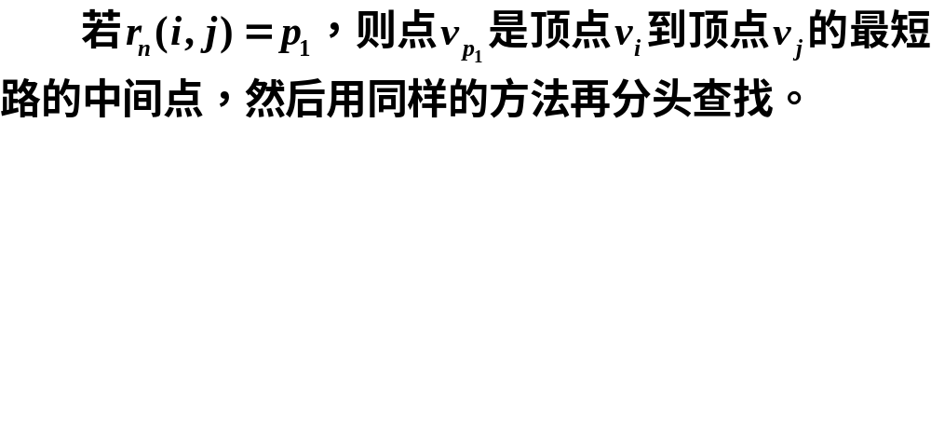
3.最短路的路径查找算法

Slide 26
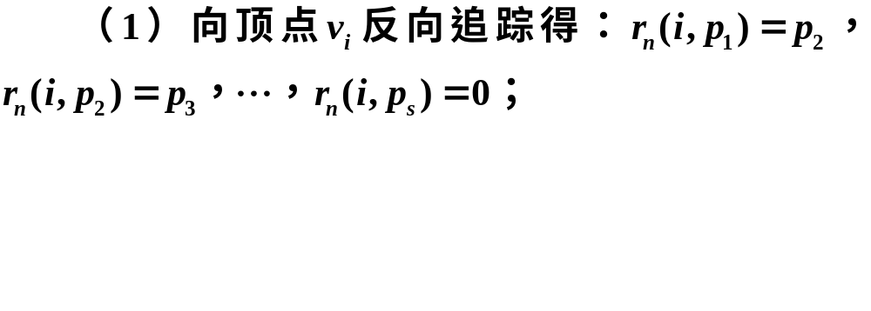

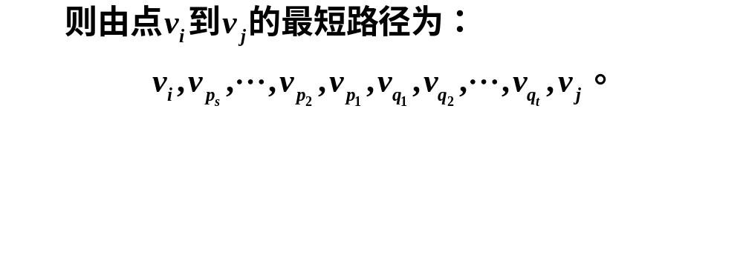

Slide 27
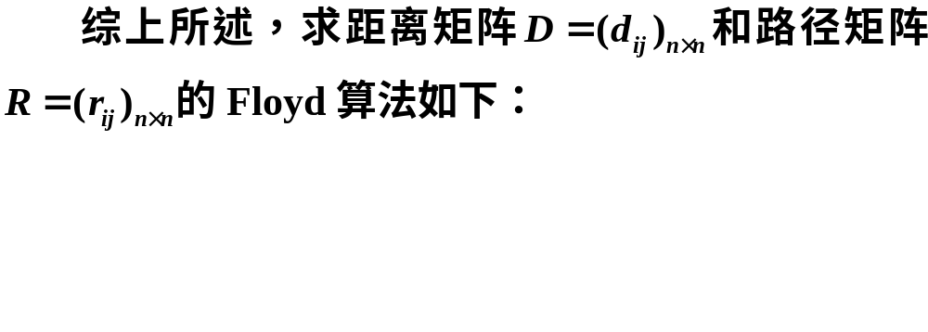
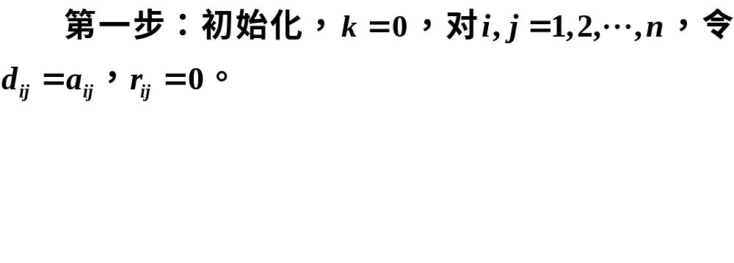
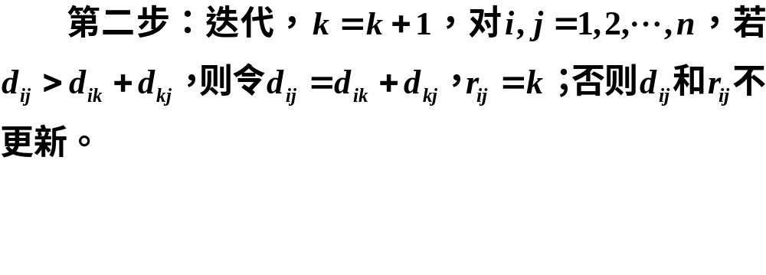
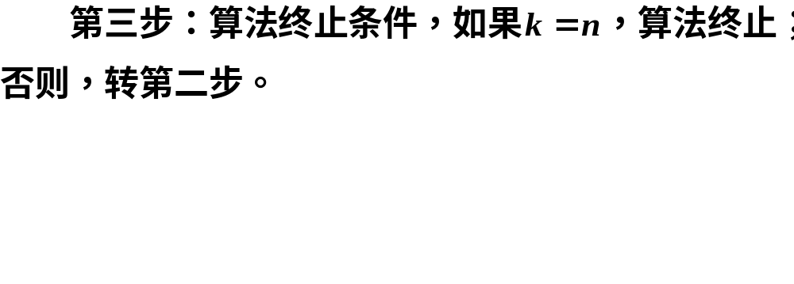

Slide 28
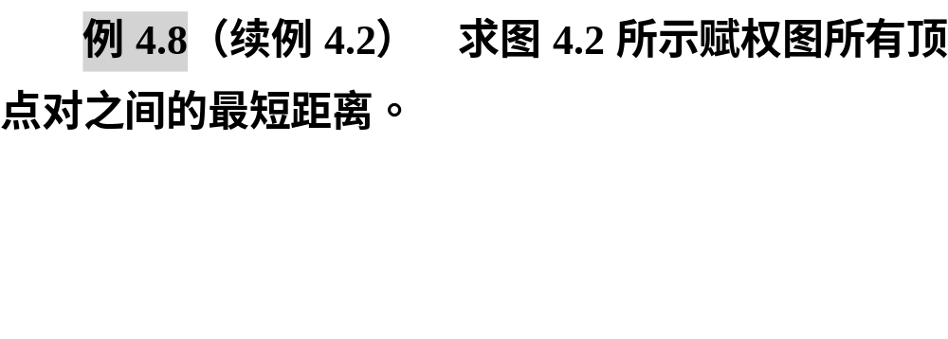
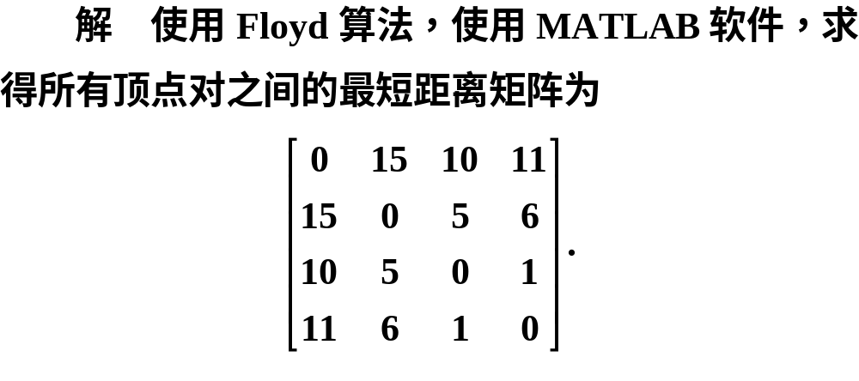

Slide 29
clc, clear, a = zeros(4);
a(1,[3,4])=[10,60]; %输入邻接矩阵的上三角元素
a(2,[3,4])=[5,20]; a(3,4)=1;
n=length(a); b=a+a'; %构造完整的邻接矩阵
b(b==0)=inf; %把零元素换成inf
b(1:n+1:end)=0; %把对角线元素换成0
for k=1:n
for i=1:n
for j=1:n
if b(i,k)+b(k,j)<b(i,j)
b(i,j)=b(i,k)+b(k,j);
end
end
end
end
b %显示两两顶点之间的最短距离

Slide 30

clc, clear, a = zeros(4);
a(1,[3,4])=[10,60];
a(2,[3,4])=[5,20]; a(3,4)=1;
G = graph(a,'upper');
d = distances(G,'Method','positive')

Slide 31
最短路应用范例
03

Slide 32
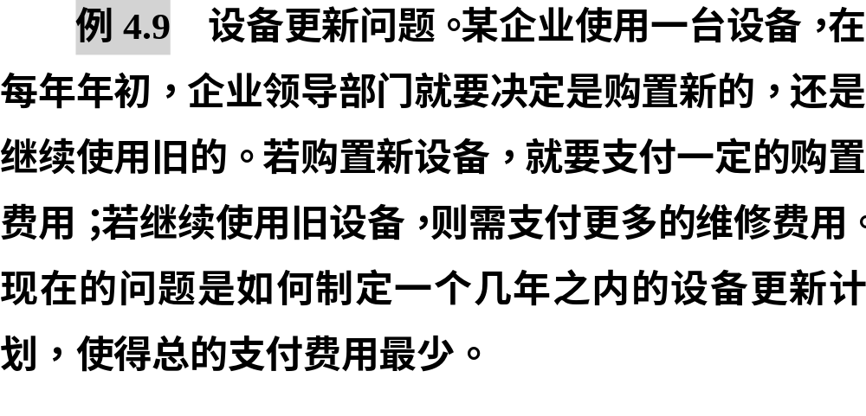

Slide 33
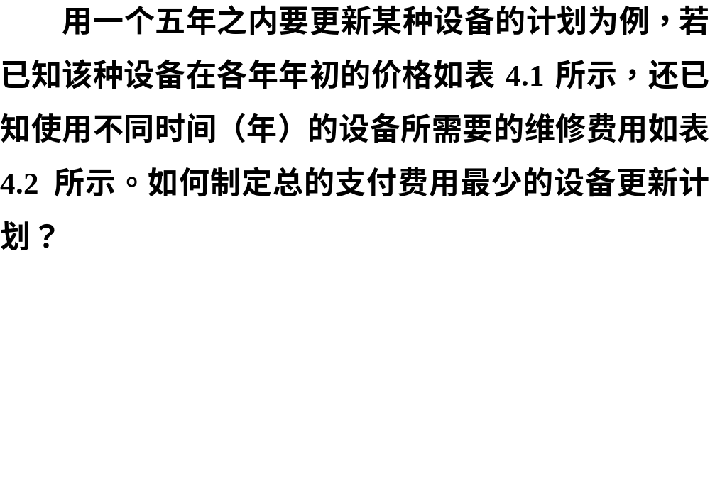

Slide 34
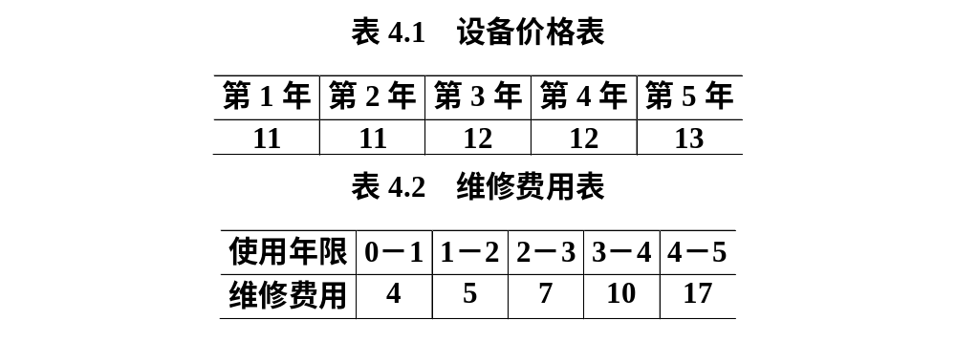

Slide 35
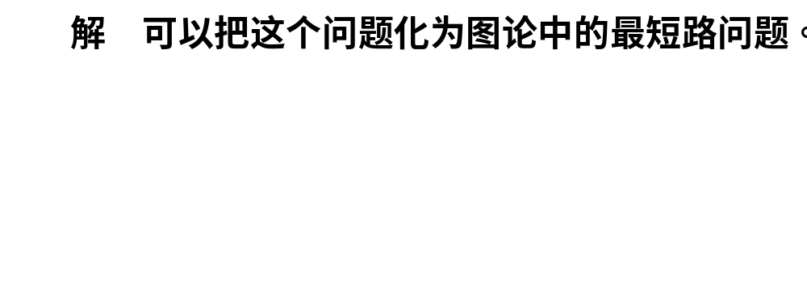
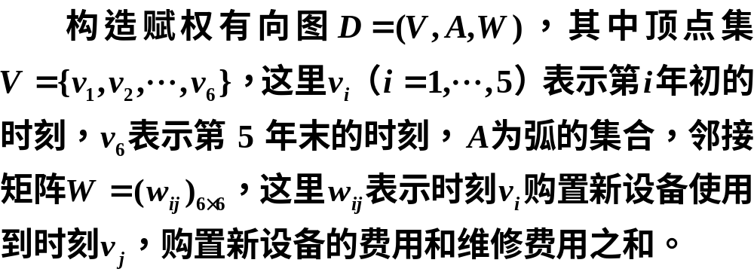

Slide 36
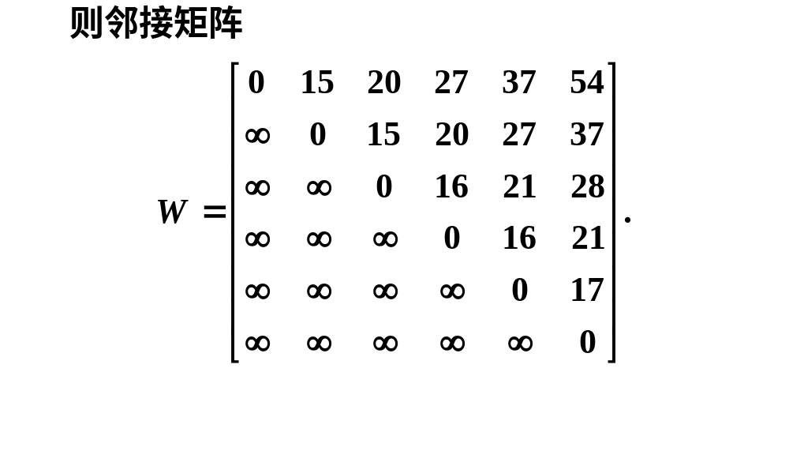

Slide 37
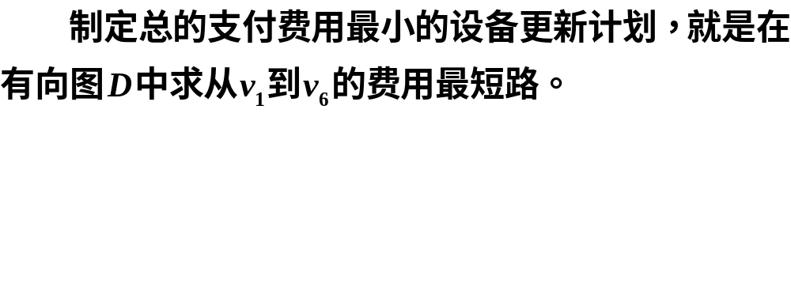
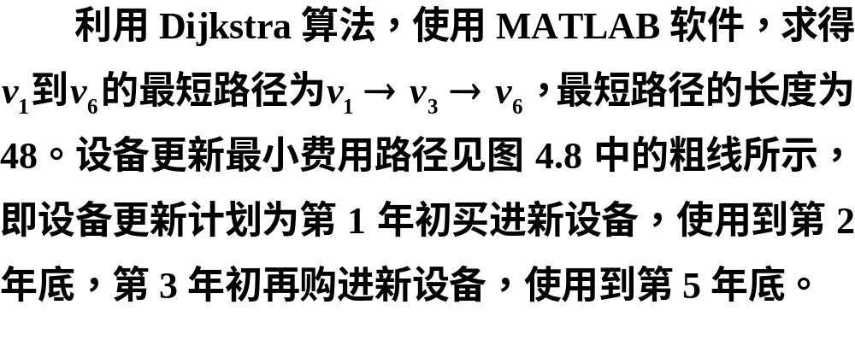

Slide 38
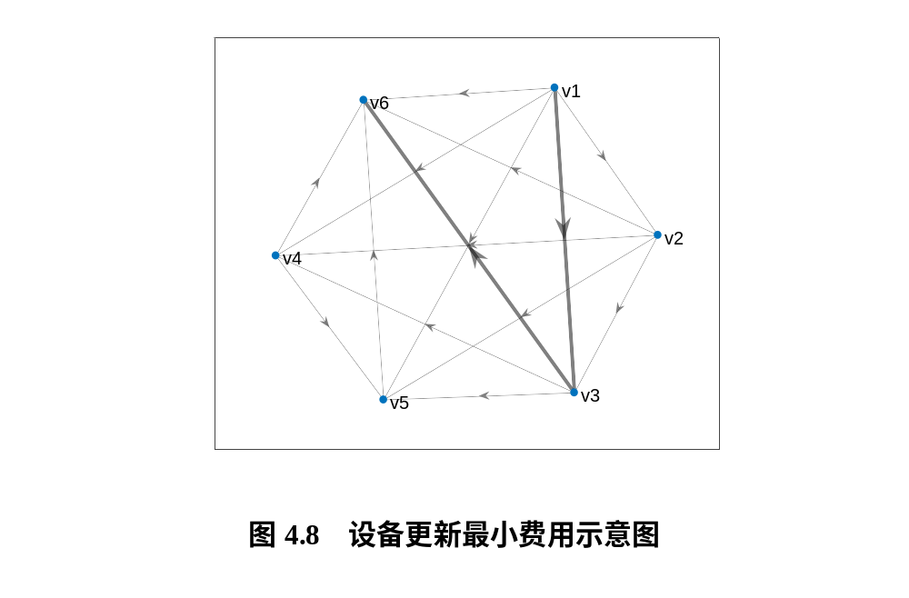

Slide 39
clc, clear, close all
a=zeros(6); %邻接矩阵初始化
a(1,[2:6])=[15 20 27 37 54];
a(2,[3:6])=[15 20 27 37];
a(3,[4:6])=[16 21 28];
a(4,[5,6])=[16 21]; a(5,6)=17; %输入有向图的邻接矩阵
s=cellstr(strcat('v',int2str([1:6]')));
G=digraph(a,s); %构造赋权有向图
p=plot(G,'Layout','force','EdgeColor','k','NodeFontSize',12);
[path,d,edge]=shortestpath(G,1,6)
highlight(p,'Edges',edge)

Slide 40
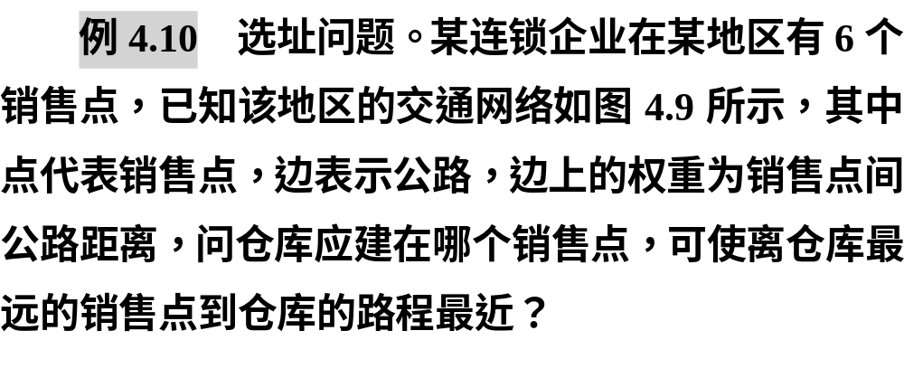

Slide 41
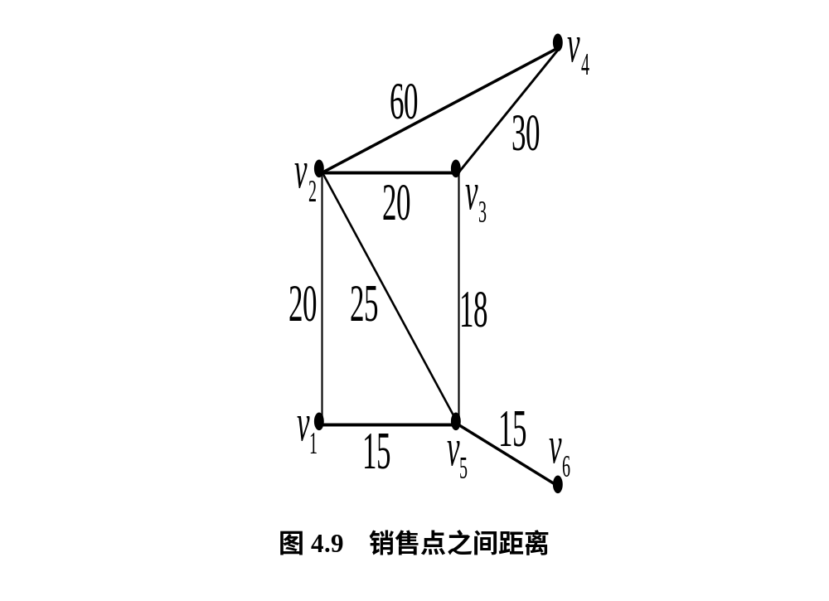

Slide 42
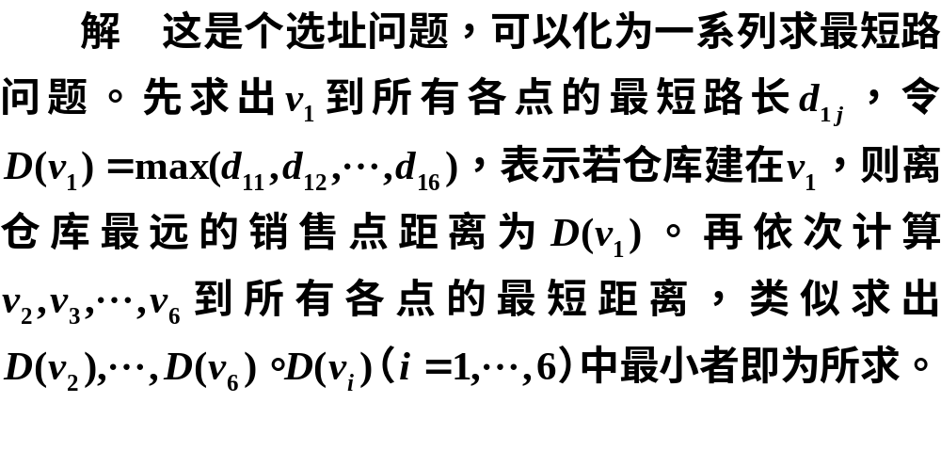
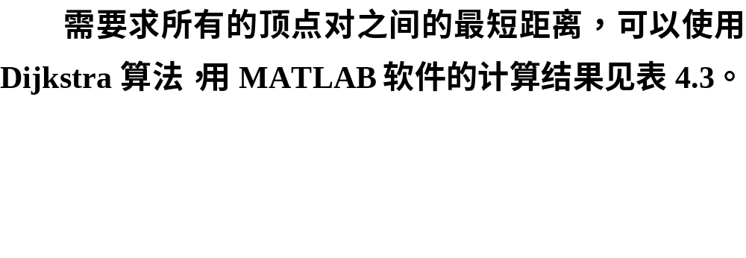

Slide 43



Slide 44
clc, clear, close all
a=zeros(6); a(1,[2 5])=[20 15];
a(2,[3:5])=[20 60 25];
a(3,[4 5])=[30 18]; a(5,6)=15;
s=cellstr(strcat('v',int2str([1:6]')));
G=graph(a,s,'upper'); d=distances(G)
plot(G,'EdgeLabel',G.Edges.Weight,'Layout','force')
d1=max(d,[],2) %逐行求最大值
[d2,ind]=min(d1) %求向量的最小值,及最小值的地址
v=find(d(ind,:)==d2) %求向量中取值为d2的地址

Slide 45
最短路问题的
0-1整数规划模型
04

Slide 46


Slide 47


Slide 48


Slide 49


Slide 50


Slide 51


Slide 52


Slide 53


Slide 54
clc, clear, a = zeros(6);
a(1,[2,5])=[18,15]; a(2,[3:5])=[20,60,12];
a(3,[4,5])=[30,18]; a(4,6)=10; a(5,6)=15;
b = a+a'; %输入完整的邻接矩阵
b(b==0)=1000000; %这里1000000表示充分大的正实数
prob = optimproblem;
x = optimvar('x',6,6,'Type','integer','LowerBound',0,'UpperBound',1);
prob.Objective = sum(sum(b.*x));
con1 = optimconstr(4);
for i =setdiff([1:6],[2,4])
con1(i) = sum(x(i,:))==sum(x(:,i));
end
prob.Constraints.con1 = con1;
prob.Constraints.con2 = [sum(x(2,:))==1; sum(x(:,2))==0; sum(x(:,4))==1];
[sol,fval,flag,out]= solve(prob), xx=sol.x
[i,j] = find(xx); %找非零元素的行标和列标
ij = [i'; j']

