Slide 1
第4章
4.4最小生成树

Slide 2
目录 CONTENTS
01
基本概念和算法
02
最小生成树的数学
规划模型

Slide 3
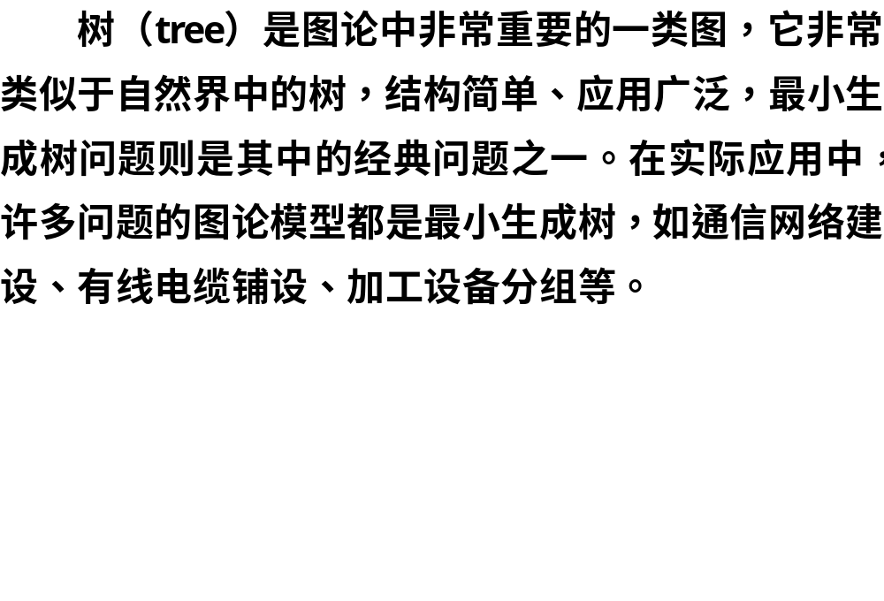

Slide 4
基本概念和算法
01

Slide 5

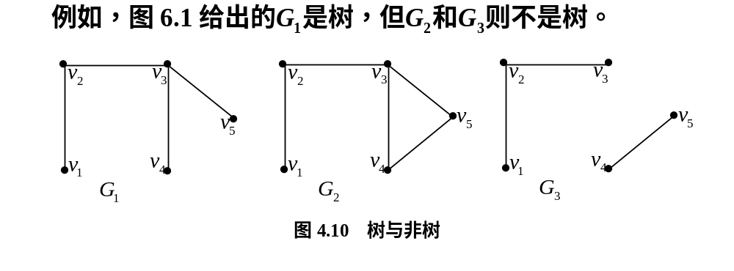
1.数值矩阵的建立

Slide 6
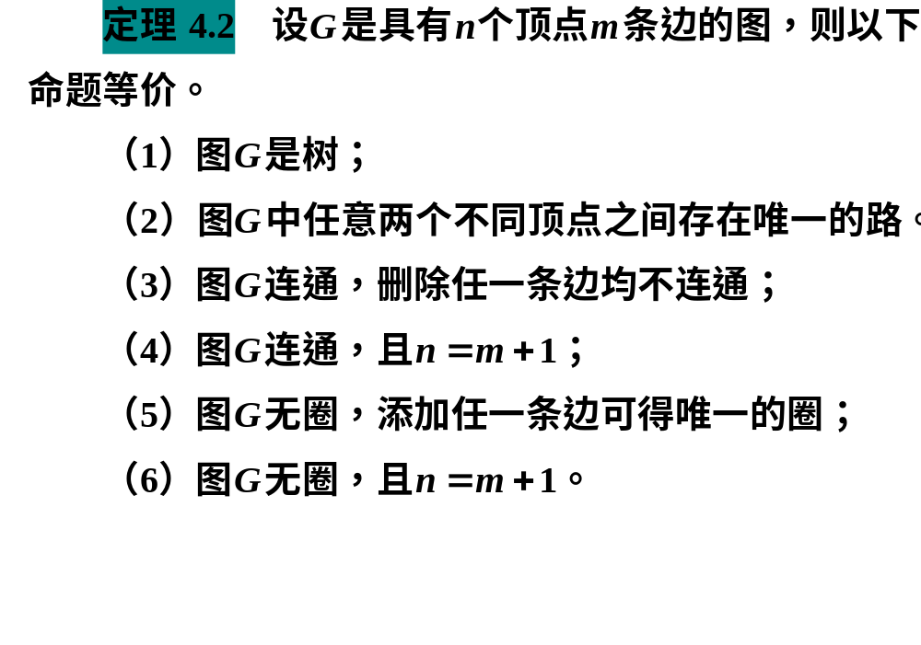

Slide 7



Slide 8


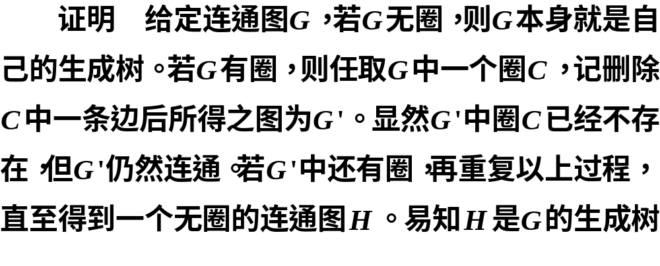

Slide 9

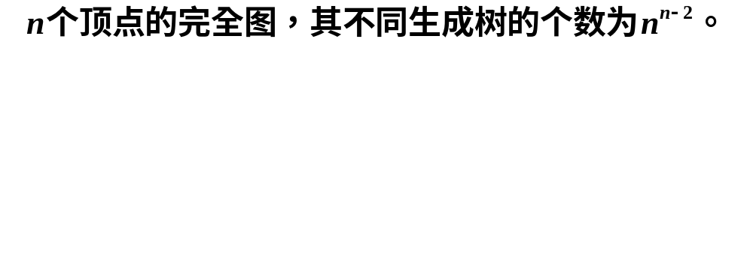


Slide 10
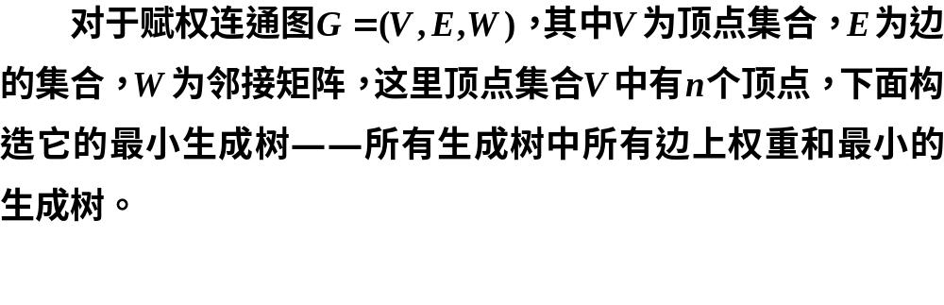

Slide 11


2.Kruskal算法

Slide 12
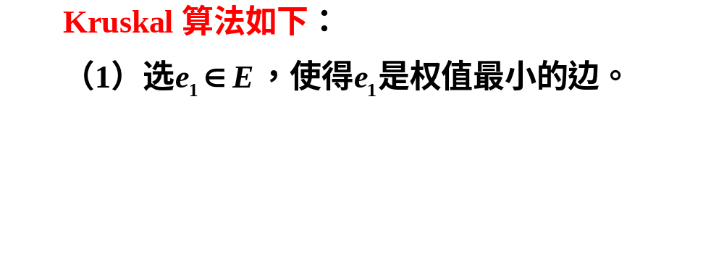
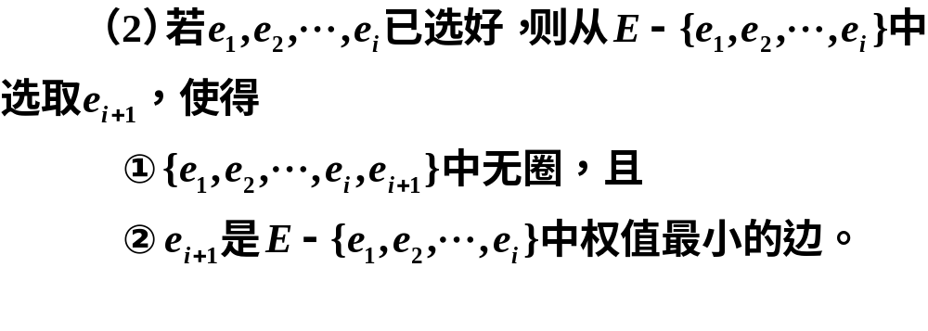
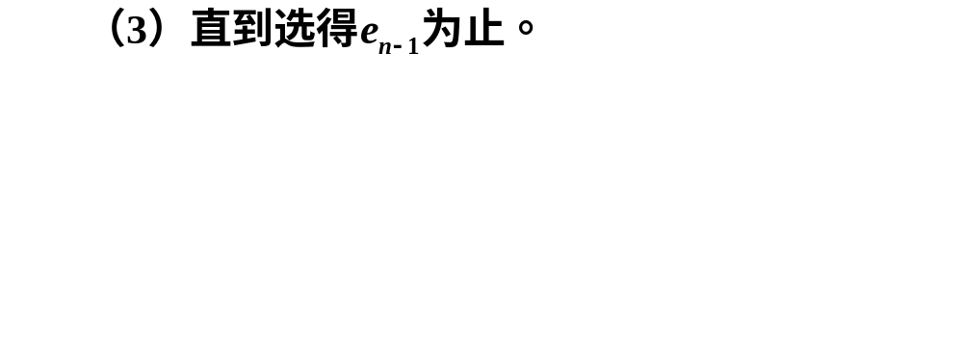

Slide 13
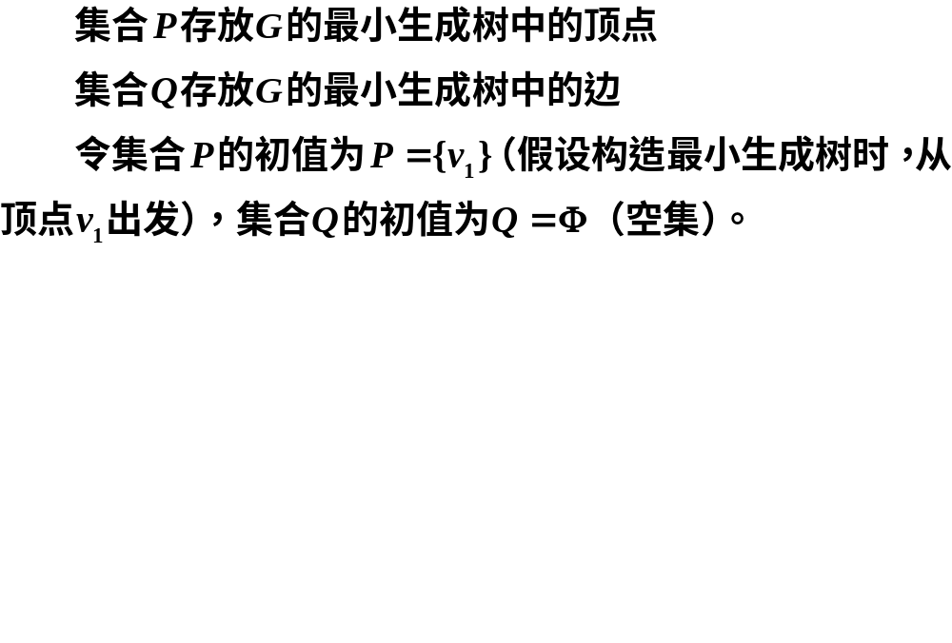
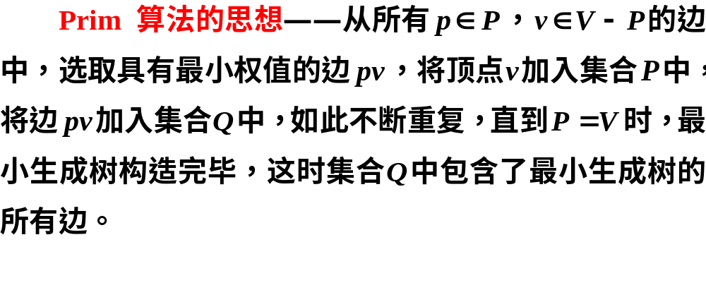
3.Prim算法

Slide 14
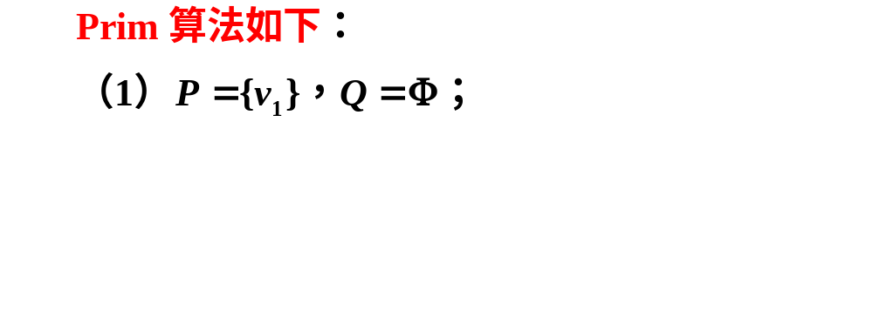
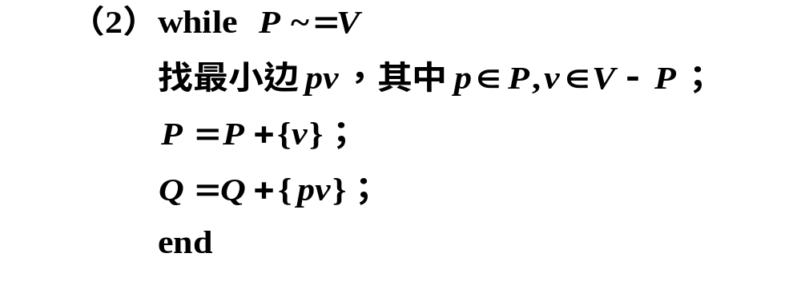

Slide 15
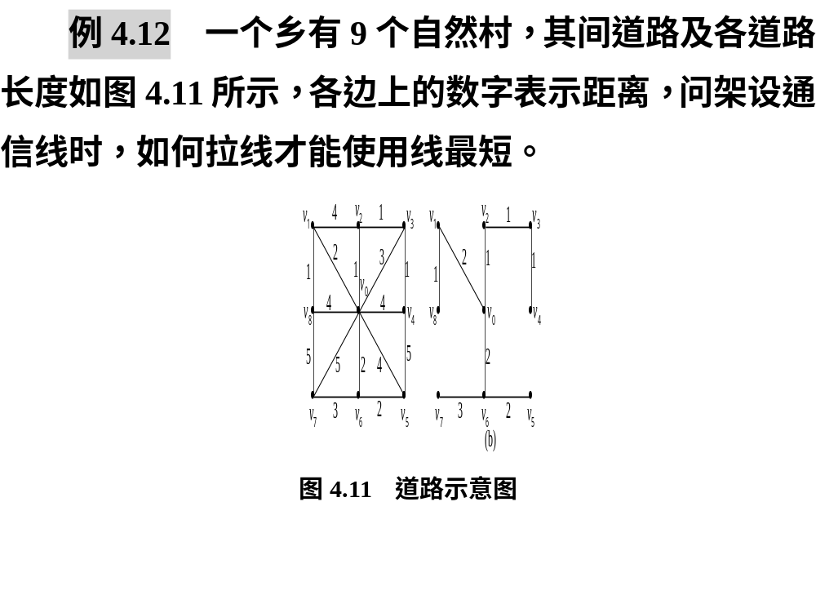
4.最小生成树举例

Slide 16

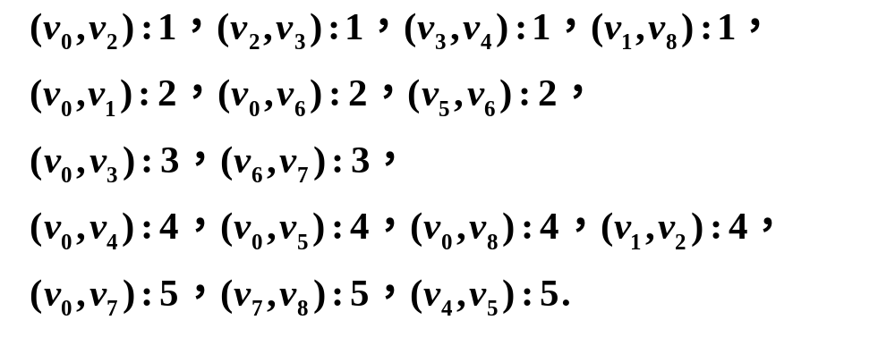

Slide 17
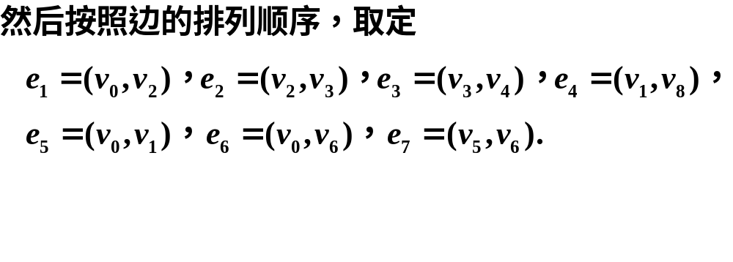

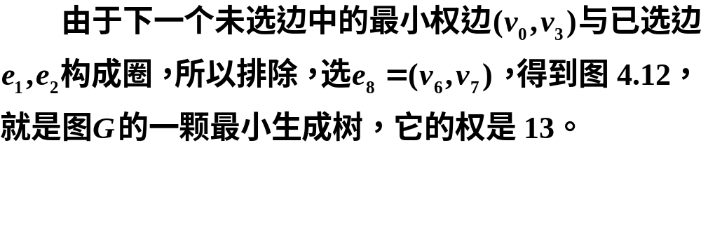

Slide 18
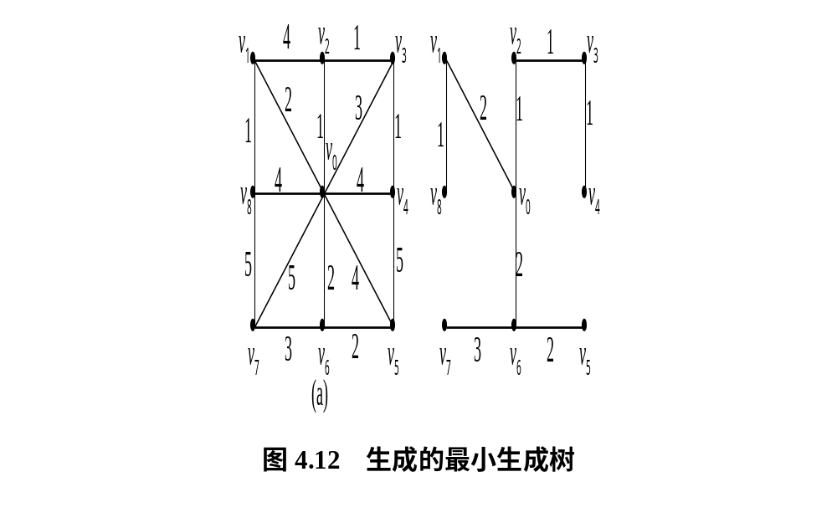

Slide 19

clc, clear, close all, a=zeros(9);
a(1,[2:9])=[2 1 3 4 4 2 5 4];
a(2,[3 9])=[4 1]; a(3,4)=1; a(4,5)=1;
a(5,6)=5; a(6,7)=2; a(7,8)=3; a(8,9)=5;
s=cellstr(strcat('v',int2str([0:8]')));
G=graph(a,s,'upper'); p=plot(G,'EdgeLabel',G.Edges.Weight);
T=minspantree(G,'Method','sparse') %Kruskal算法
L=sum(T.Edges.Weight), highlight(p,T)

Slide 20

clc, clear, close all
nod =cellstr(strcat('v',int2str([0:8]')));
G = graph; G = addnode(G,nod);
ed ={ 'v0','v1',2;'v0','v2',1;'v0','v3',3;'v0','v4',4
'v0','v5',4;'v0','v6',2;'v0','v7',5;'v0','v8',4
'v1','v2',4;'v1','v8',1;'v2','v3',1;'v3','v4',1
'v4','v5',5;'v5','v6',2;'v6','v7',3;'v7','v8',5};
G = addedge(G,ed(:,1),ed(:,2),cell2mat(ed(:,3)));
p=plot(G,'EdgeLabel',G.Edges.Weight);
T=minspantree(G), L=sum(T.Edges.Weight)
highlight(p,T)

Slide 21
最小生成树的
数学规划模型
02

Slide 22
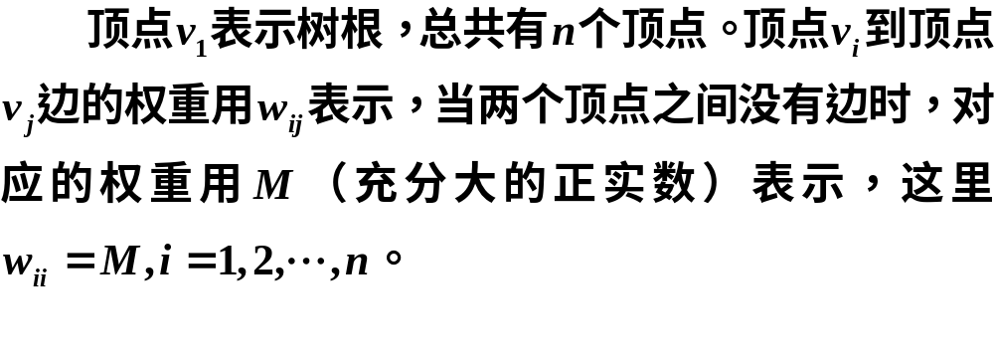
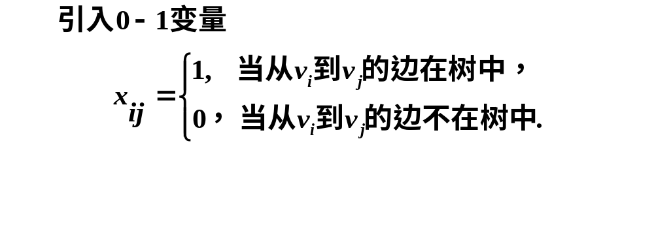

Slide 23


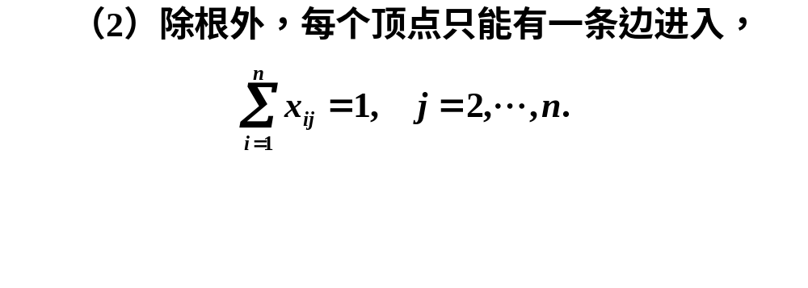



Slide 24
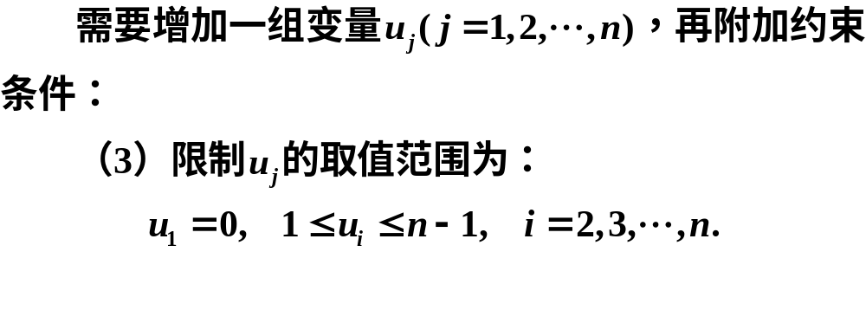
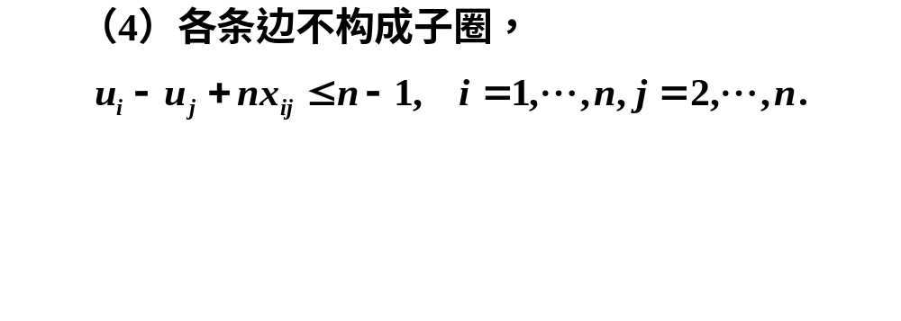

Slide 25
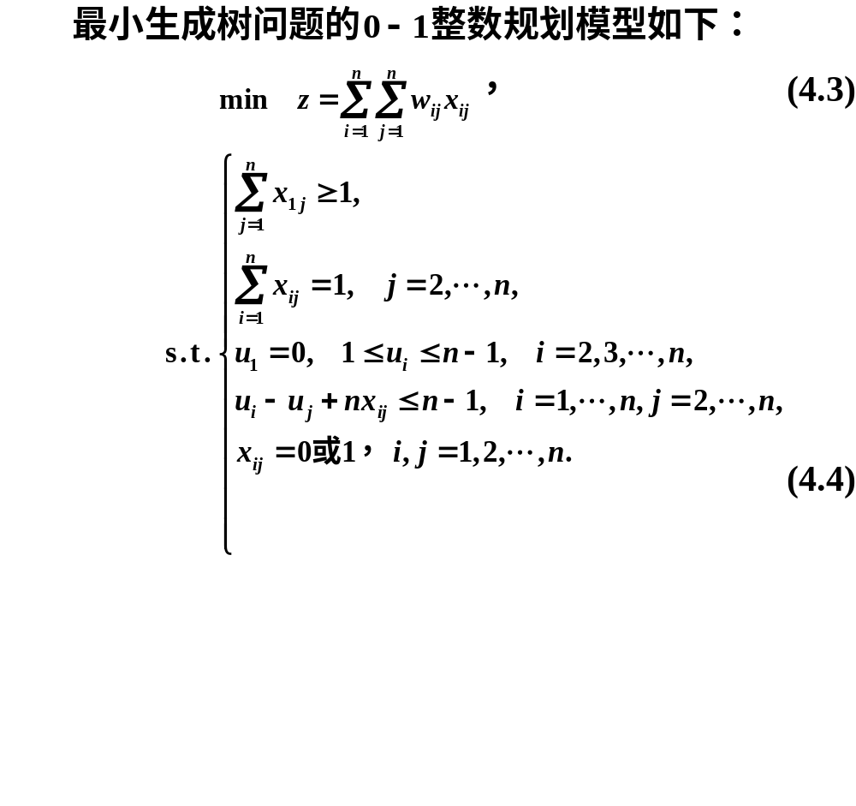

Slide 26
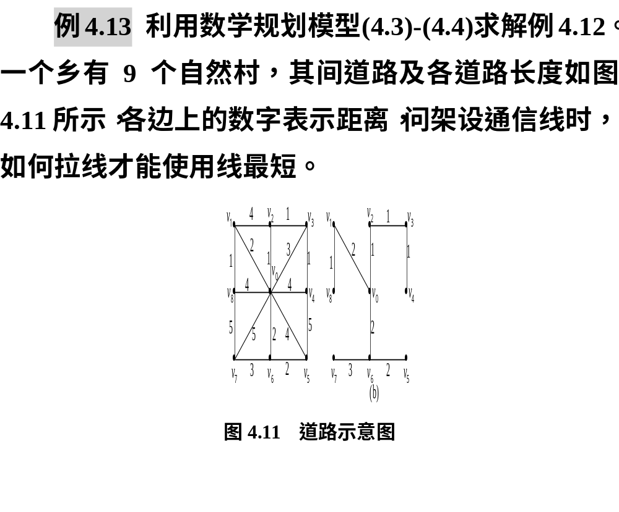

Slide 27
clc, clear, close all, n = 9;
nod =cellstr(strcat('v',int2str([0:n-1]')));
G = graph(); G = addnode(G,nod);
ed ={ 'v0','v1',2;'v0','v2',1;'v0','v3',3;'v0','v4',4
'v0','v5',4;'v0','v6',2;'v0','v7',5;'v0','v8',4
'v1','v2',4;'v1','v8',1;'v2','v3',1;'v3','v4',1
'v4','v5',5;'v5','v6',2;'v6','v7',3;'v7','v8',5};
G = addedge(G,ed(:,1),ed(:,2),cell2mat(ed(:,3)));
w = full(adjacency(G,'weighted'));
w(w==0) = 1000000; %这里1000000表示充分大的正实数
prob = optimproblem;
x = optimvar('x',n,n,'Type','integer','LowerBound',0,'UpperBound',1);
u = optimvar('u',n,'LowerBound',0);
prob.Objective = sum(sum(w.*x));
prob.Constraints.con1 = [sum(x(:,[2:end]))'==1; u(1)==0];
con2 = [1<=sum(x(1,:)); 1<=u(2:end); u(2:end)<=n-1];
for i = 1:n
for j = 2:n
con2 = [con2; u(i)-u(j)+n*x(i,j)<=n-1];
end
end
prob.Constraints.con2 = con2;
[sol,fval,flag,out] = solve(prob)
[i,j]=find(sol.x);
ind = [i'; j'] %输出树的顶点编号

