Slide 1
第4章
4.6网络最大流问题
4.7MATLAB的
图论工具箱及其应用

Slide 2
目录 CONTENTS
最大流与
最小费用流问题
01
MATLAB的图论
工具箱及其应用
02

Slide 3
最大流与
最小费用流问题
01

Slide 4
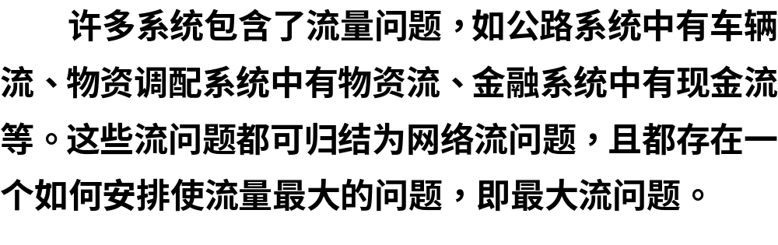
4.6.1 最大流问题

Slide 5
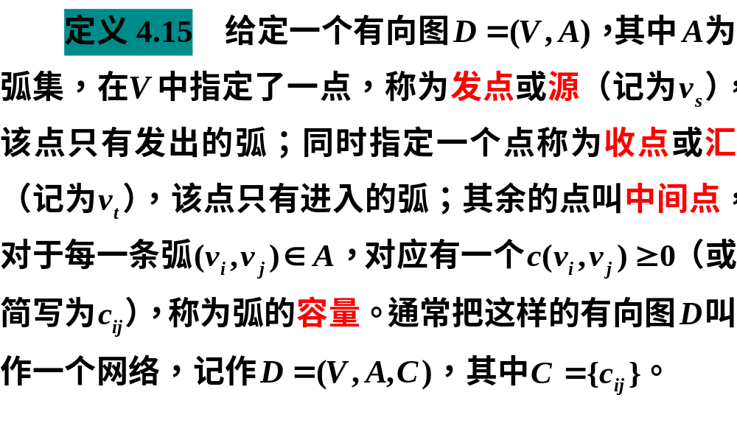
1.基本概念

Slide 6
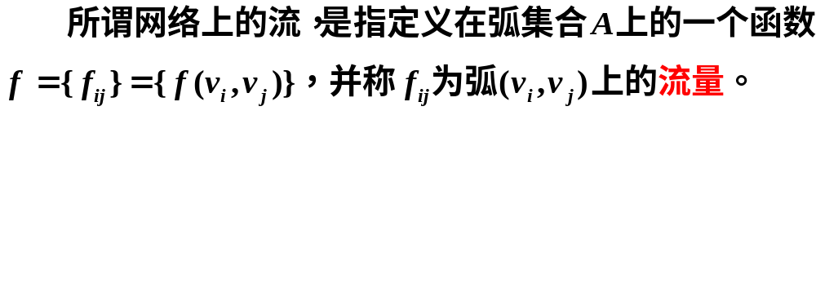

Slide 7
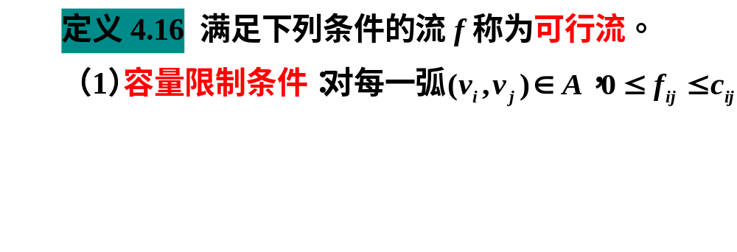
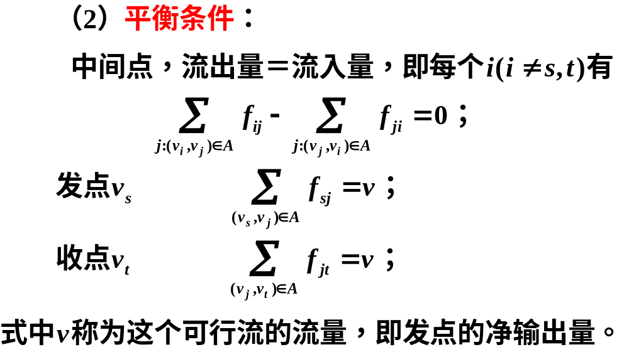


Slide 8
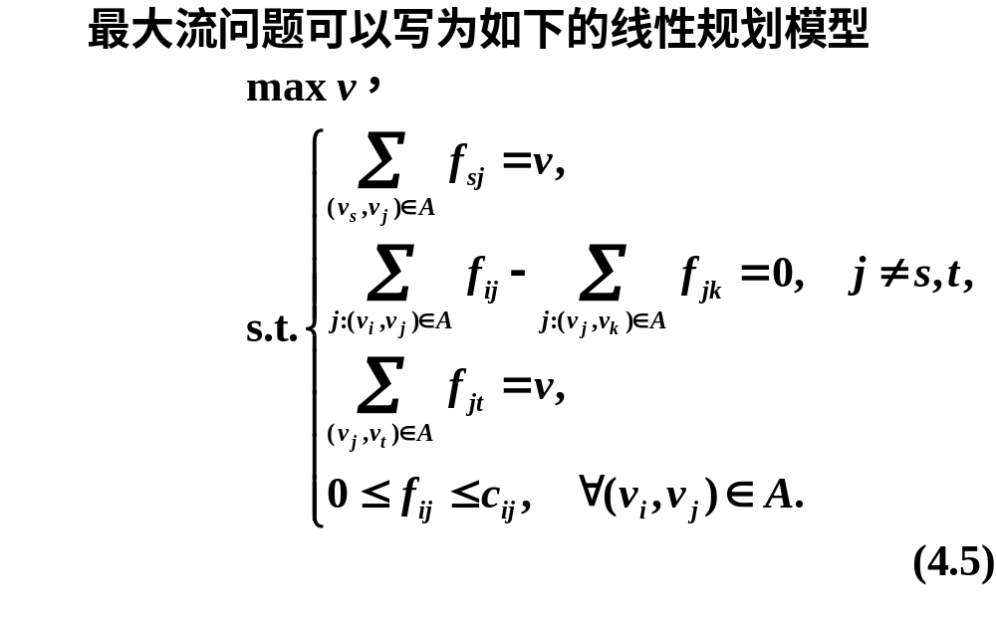

Slide 9
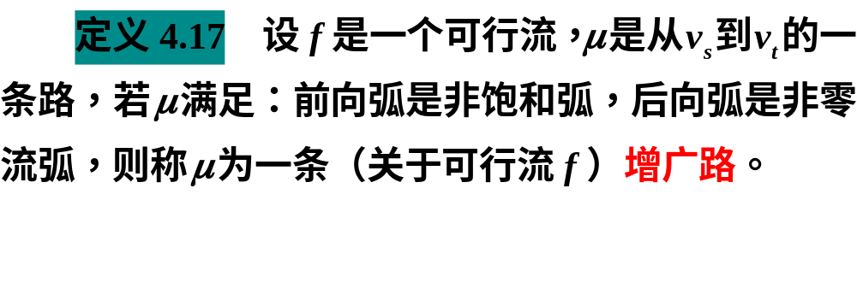

Slide 10
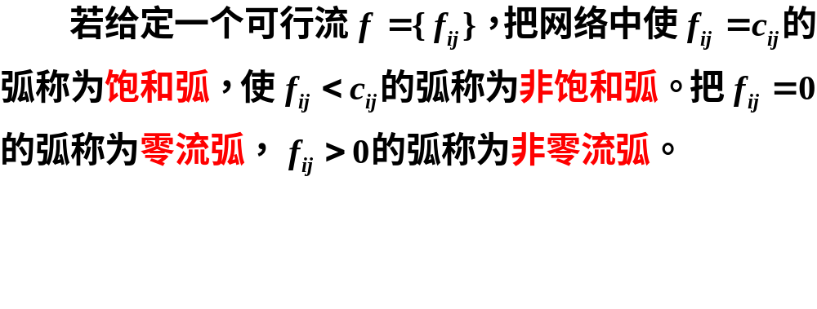
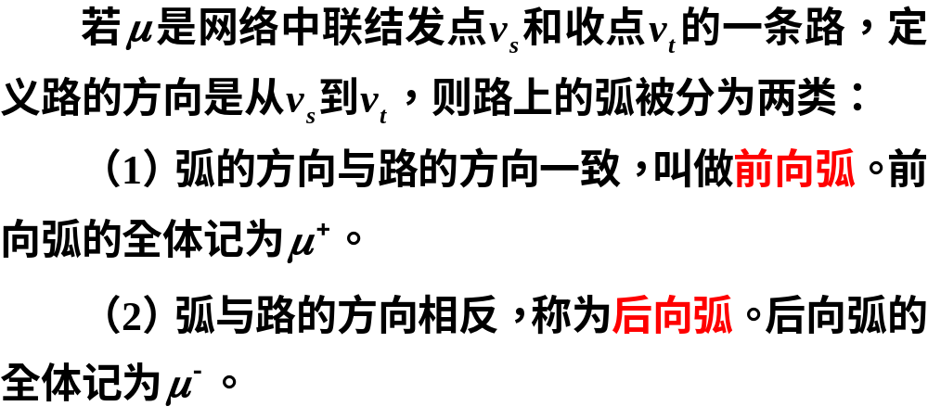

Slide 11
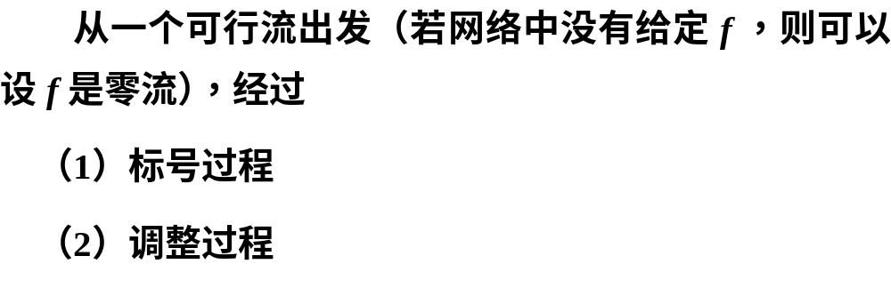
2.寻求最大流的标号法（Ford－Fulkerson）
寻找可增广链
增大可行流流量

Slide 12
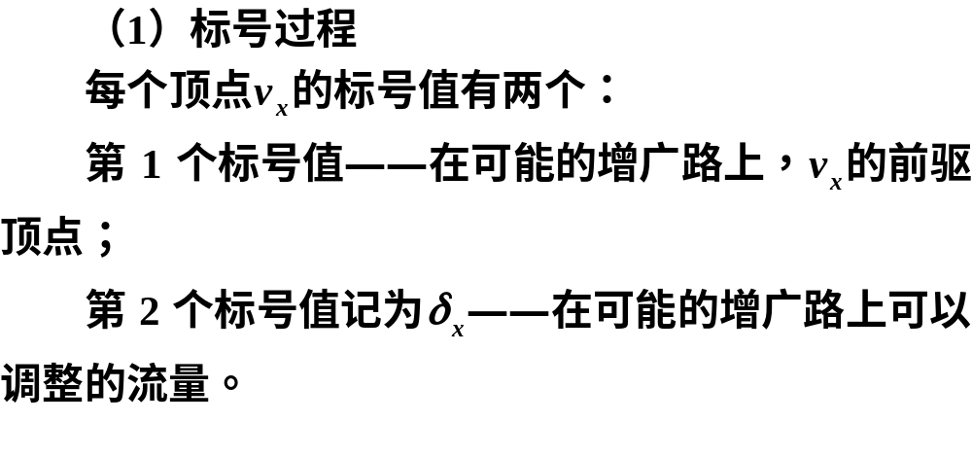
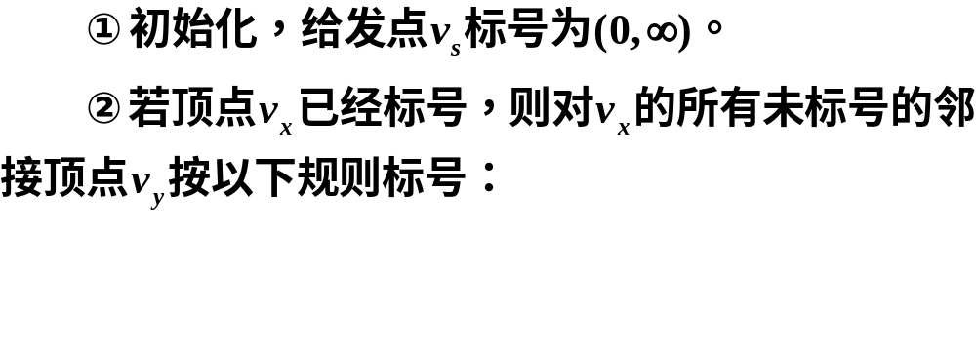

Slide 13
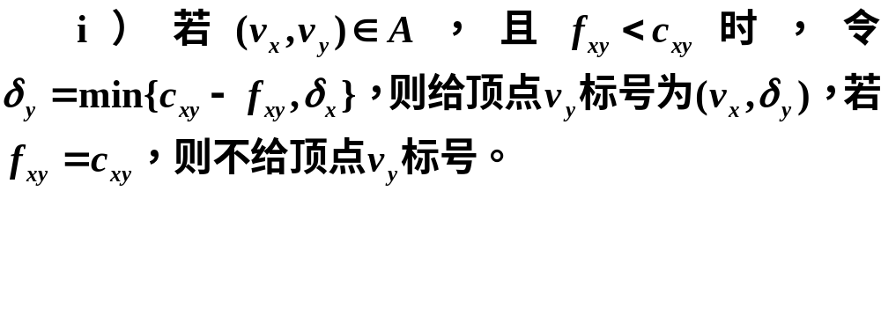
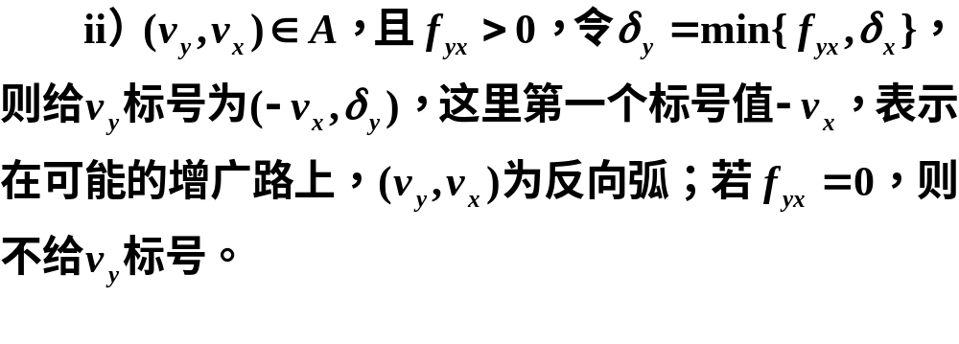

Slide 14
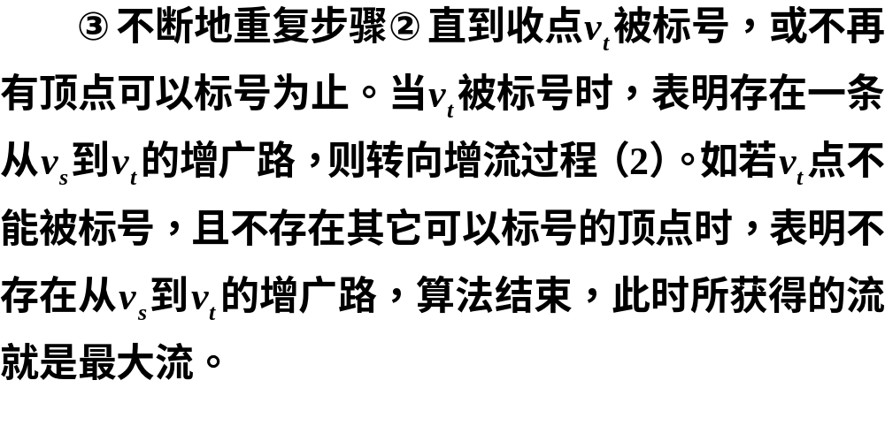

Slide 15
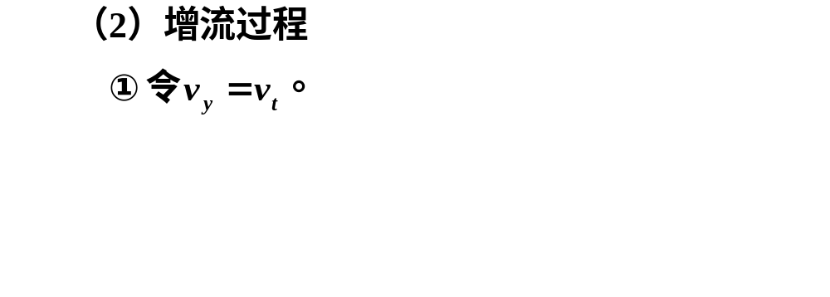
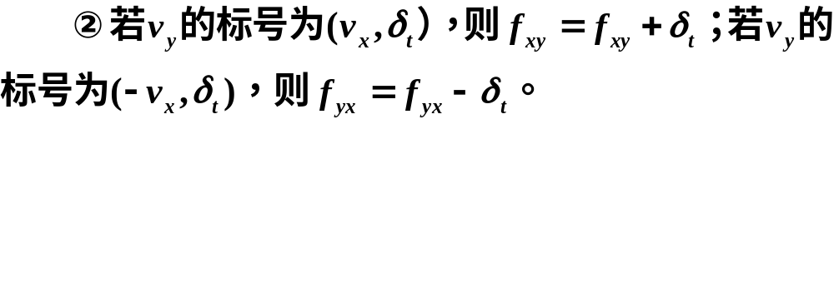
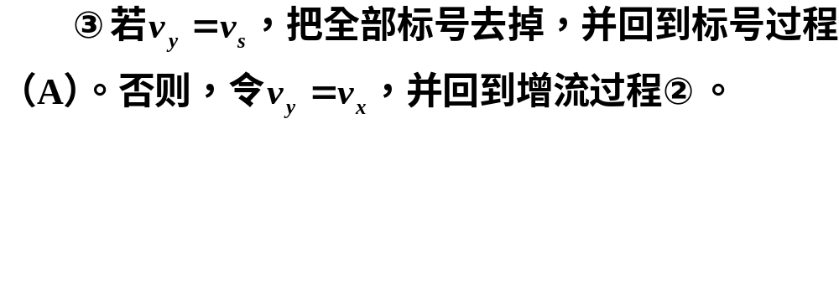

Slide 16
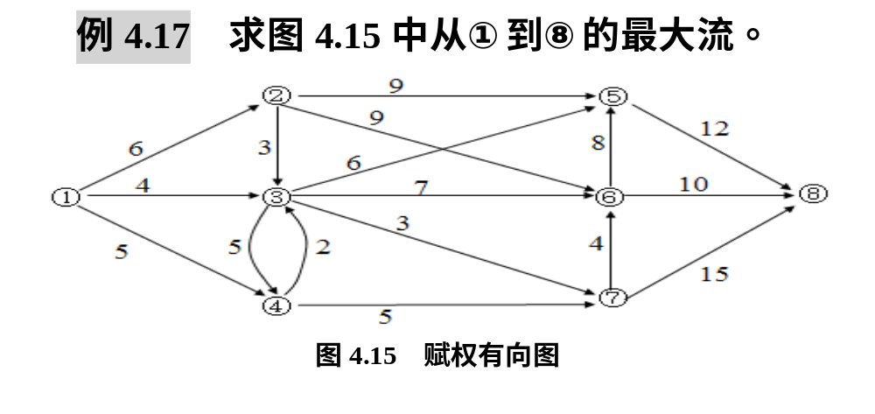
3.用MATLAB求网络最大流

Slide 17
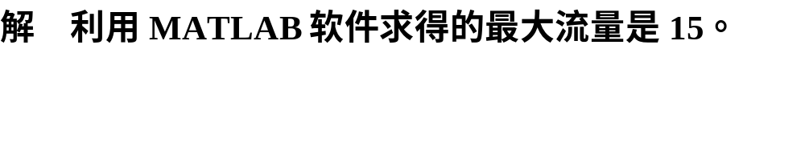
clc, clear
a = zeros(8); a(1,[2:4])=[6,4,5];
a(2,[3,5,6])=[3,9,9]; a(3,[4:7])=[5,6,7,3];
a(4,[3,7])=[2,5]; a(5,8)=12;
a(6,[5,8])=[8,10]; a(7,[6,8])=[4,15];
G = digraph(a); H=plot(G,'EdgeLabel',G.Edges.Weight);
[M,F]=maxflow(G,1,8) %求有向图的最大流
F.Edges, highlight(H,F) %显示最大流并画出最大流

Slide 18

clc, clear, close all
a = zeros(8); a(1,[2:4])=[6,4,5];
a(2,[3,5,6])=[3,9,9]; a(3,[4:7])=[5,6,7,3];
a(4,[3,7])=[2,5]; a(5,8)=12;
a(6,[5,8])=[8,10]; a(7,[6,8])=[4,15];
prob = optimproblem('ObjectiveSense','max');
f = optimvar('f',8,8,'LowerBound',0);
v = optimvar('v'); prob.Objective = v;
con1 = [sum(f(1,:))==v
sum(f(:,[2:end-1]))'==sum(f([2:end-1],:),2)
sum(f(:,8))==v];
prob.Constraints.con1 = con1;
prob.Constraints.con2 = f<=a;
[sol, fval, flag, out] = solve(prob)
ff = sol.f %显示最大流对应的矩阵

Slide 19
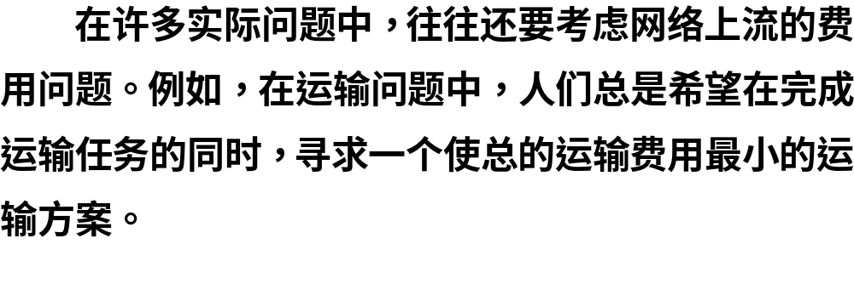
4.6.2 最小费用流问题

Slide 20
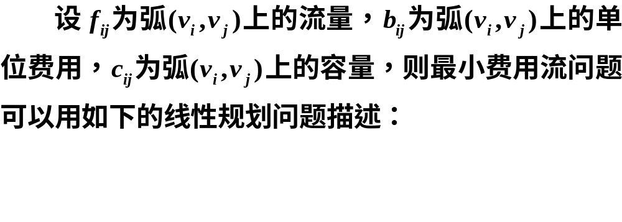
1.最小费用流的线性规划模型

Slide 21
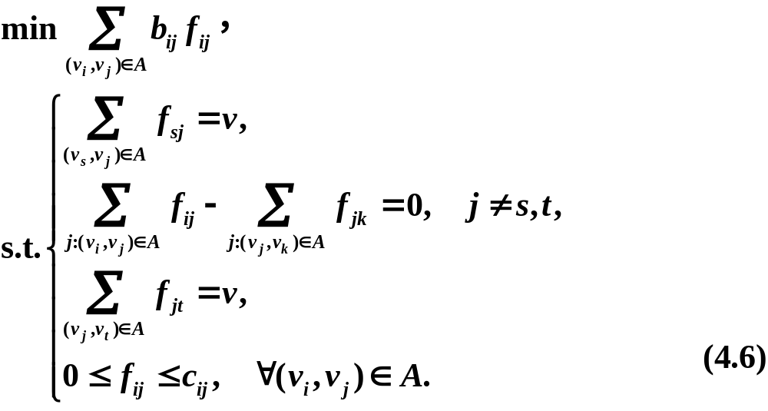
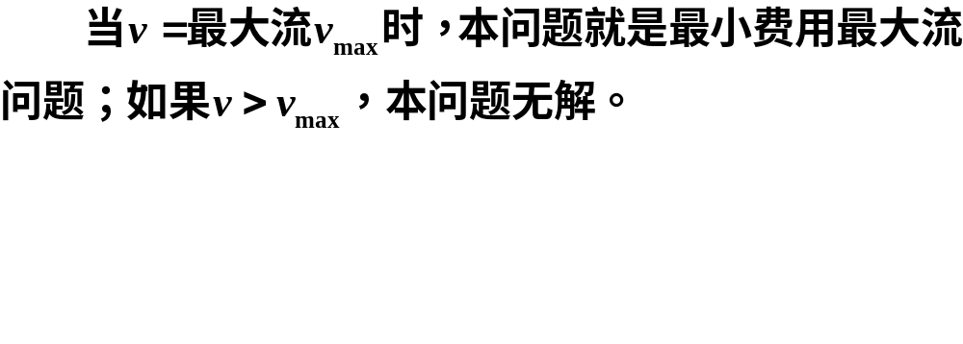

Slide 22
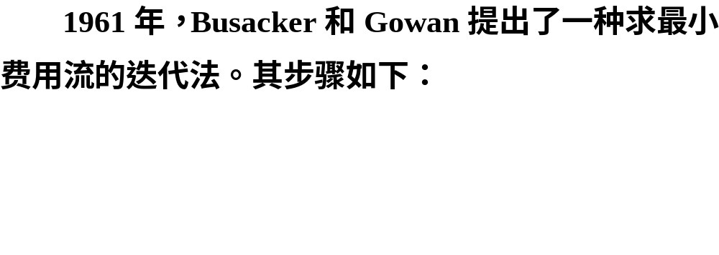
2.最小费用流的对偶算法

Slide 23
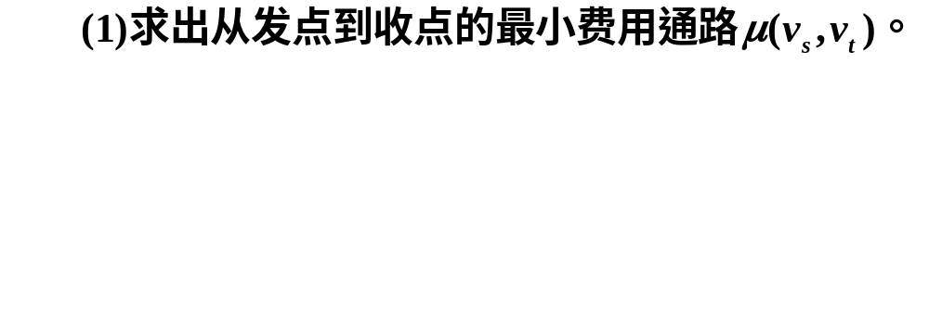
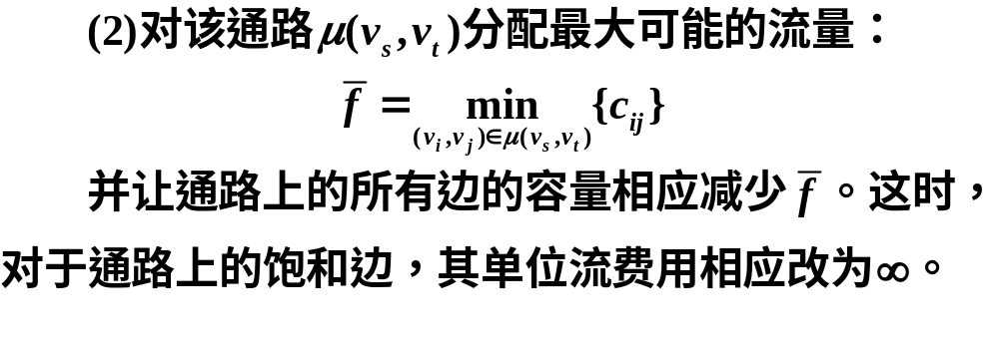
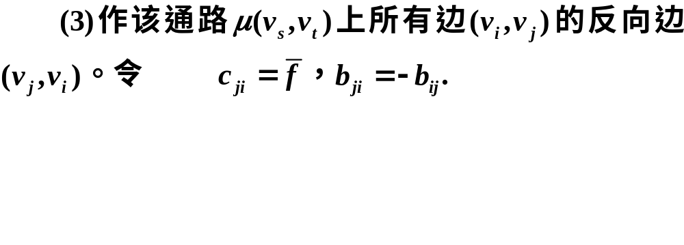
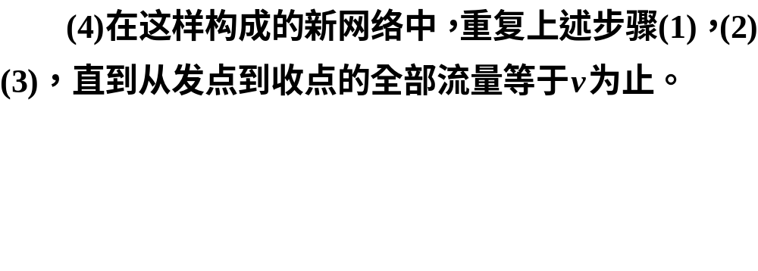

Slide 24
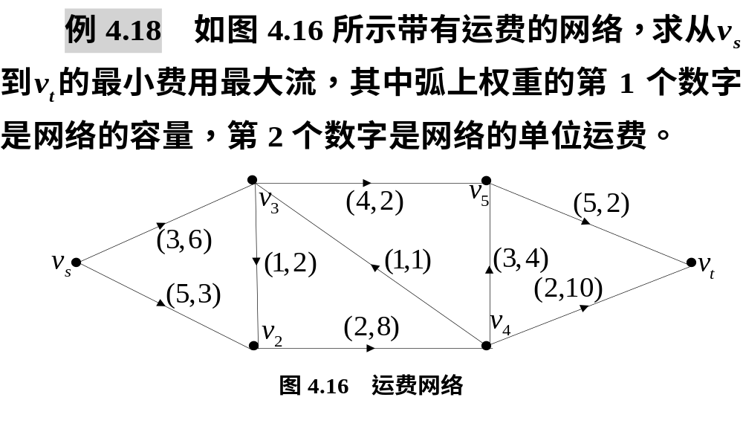

Slide 25
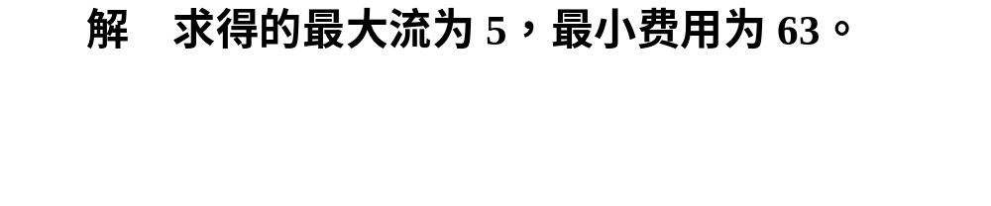
clc, clear
NN = cellstr(strcat('v',int2str([2:5]'))); %构造中间节点
NN = {'vs',NN{:},'vt'}; %添加发点和收点
L={'vs','v2',5,3; 'vs','v3',3,6; 'v2','v4',2,8; 'v3','v2',1,2
'v3','v5',4,2; 'v4','v3',1,1; 'v4','v5',3,4; 'v4','vt',2,10
'v5','vt',5,2};
G = digraph; G = addnode(G, NN);
G1 = addedge(G,L(:,1),L(:,2),cell2mat(L(:,3)));
[M, F] = maxflow(G1,'vs','vt') %求最大流
G2 = addedge(G, L(:,1), L(:,2), cell2mat(L(:,4)));
c = full(adjacency(G1, 'weighted')); %导出容量矩阵
b = full(adjacency(G2, 'weighted')); %导出费用矩阵
f = optimvar('f',6,6,'LowerBound',0);
prob = optimproblem; prob.Objective = sum(sum(b.*f));
con1 = [sum(f(1,:))==M
sum(f(:,[2:end-1]))'==sum(f([2:end-1],:),2)
sum(f(:,end))==M];
prob.Constraints.con1 = con1;
prob.Constraints.con2 = f<=c;
[sol, fval, flag, out] = solve(prob)
ff = sol.f %显示最小费用最大流对应的矩阵

Slide 26
MATLAB的图论
工具箱及其应用
02

Slide 27
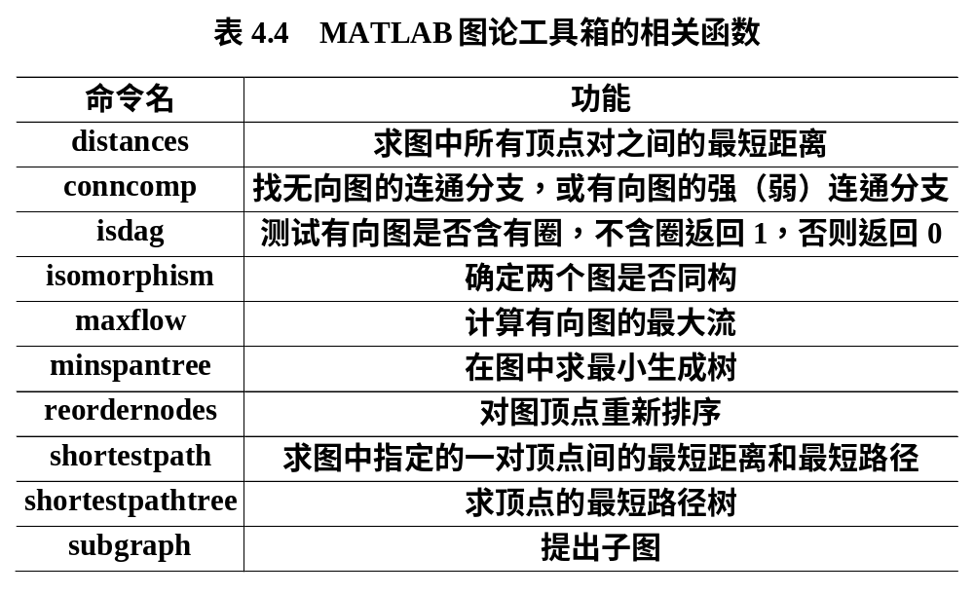
4.7.1 MATLAB图论工具箱的函数

Slide 28


4.7.2 应用举例

Slide 29
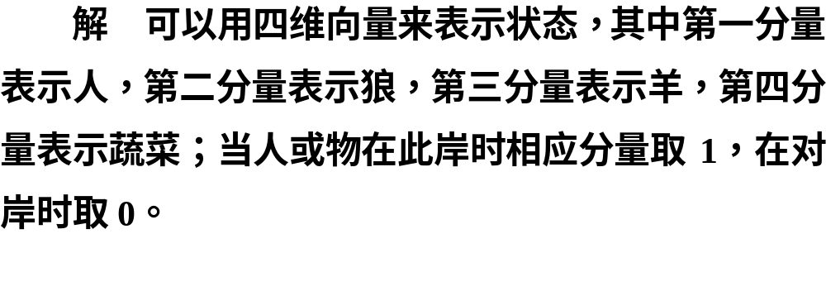
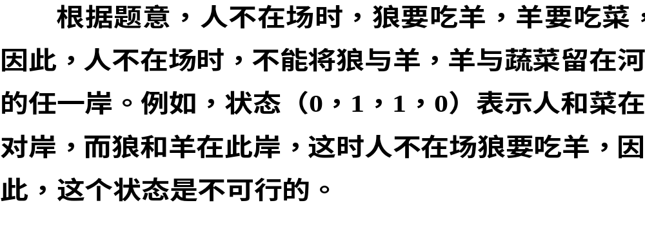

Slide 30
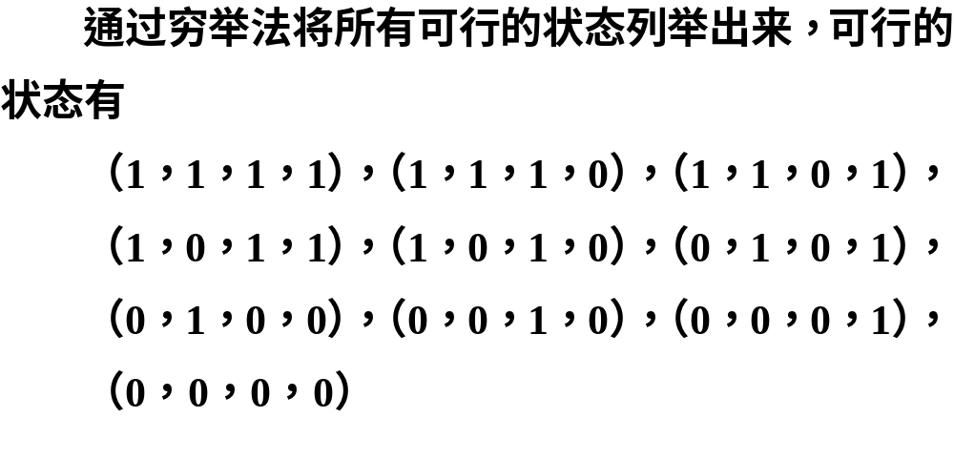

Slide 31
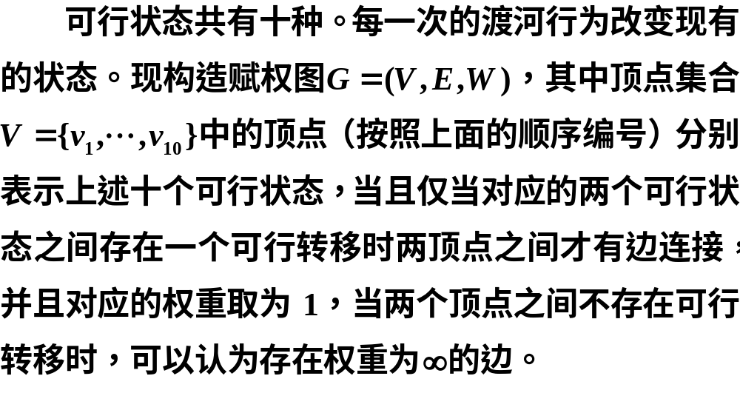

Slide 32
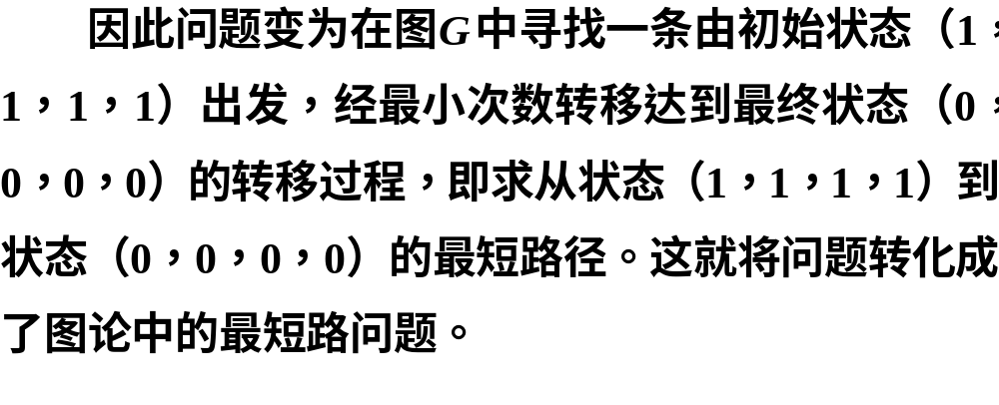

Slide 33
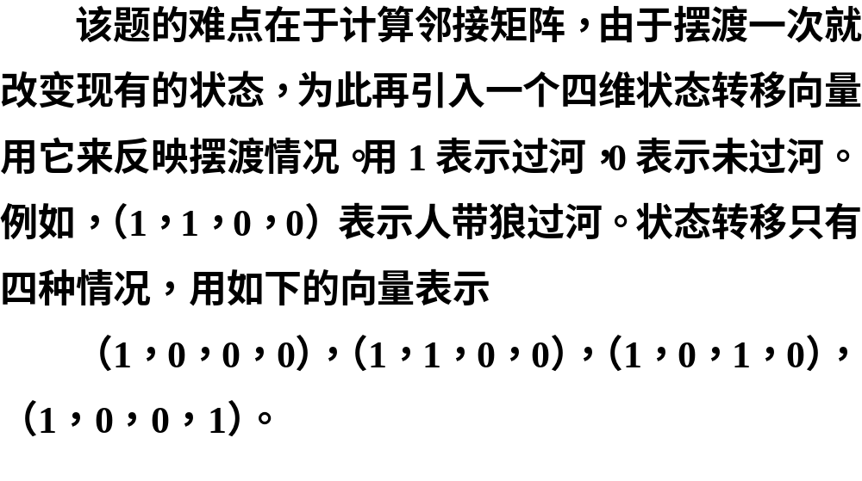

Slide 34
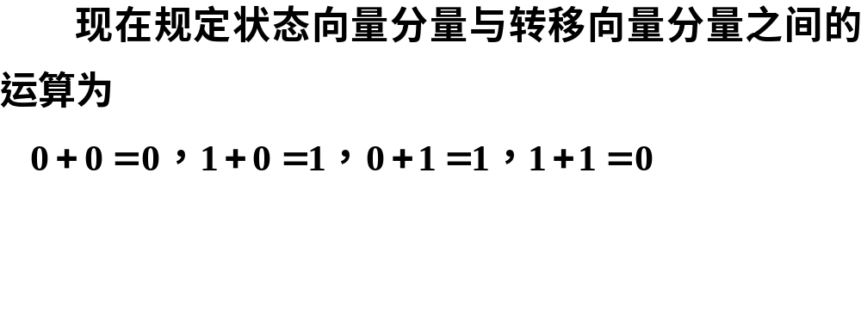


Slide 35

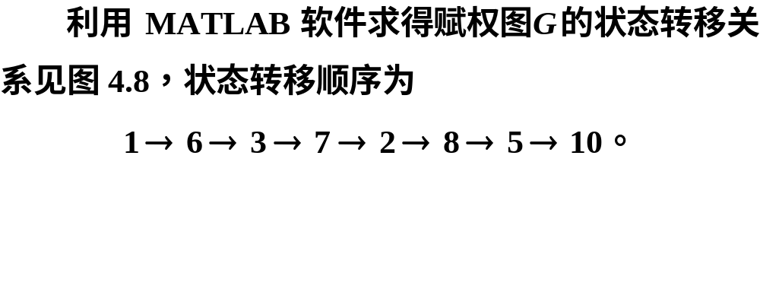

Slide 36
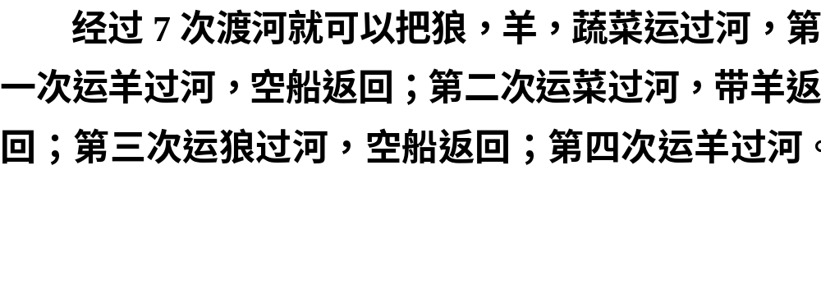
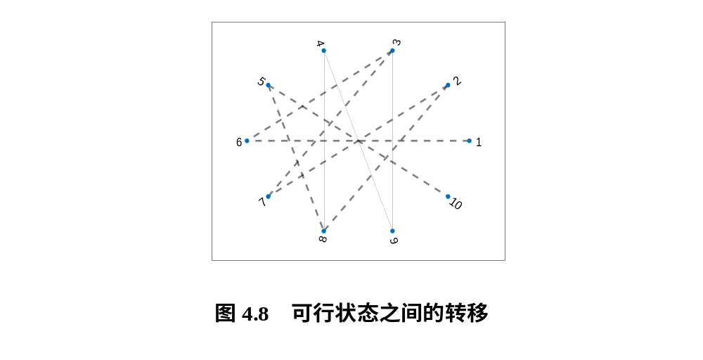

Slide 37
clc, clear, close all
a=[1 1 1 1;1 1 1 0;1 1 0 1;1 0 1 1;1 0 1 0
0 1 0 1;0 1 0 0;0 0 1 0;0 0 0 1; 0 0 0 0]; %每一行是一个可行状态
b=[1 0 0 0;1 1 0 0;1 0 1 0;1 0 0 1]; %每一行是一个转移状态
w=zeros(10); %邻接矩阵初始化
for i=1:9
for j=i+1:10
for k=1:4
if strfind(xor(a(i,:),b(k,:)),a(j,:))
w(i,j)=1;
end
end
end
end
[i,j,v]=find(w); %找非零元素
s=cellstr(int2str([1:10]')); %构造顶点字符串
G=graph(i,j,v,s) %构造无向图
[p,d]=shortestpath(G,1,10) %求最短路径和最短距离
h=plot(G,'Layout','circle','NodeFontSize',12,'EdgeColor','k')
highlight(h,p,'LineWidth',2,'LineStyle','--') %最短路径虚线加粗

Slide 38
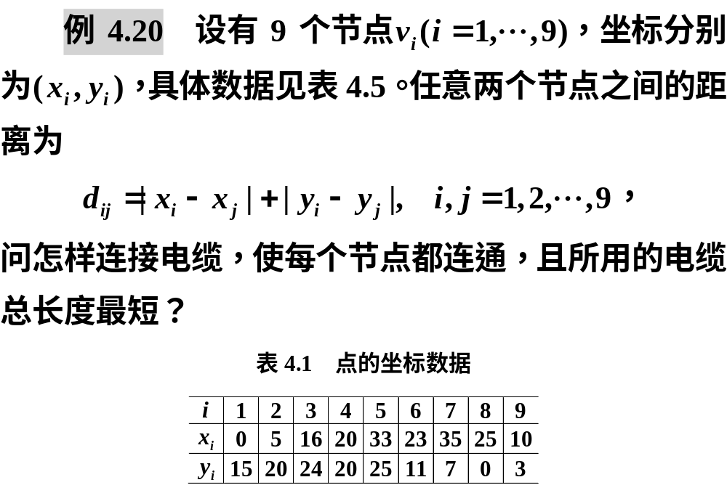

Slide 39
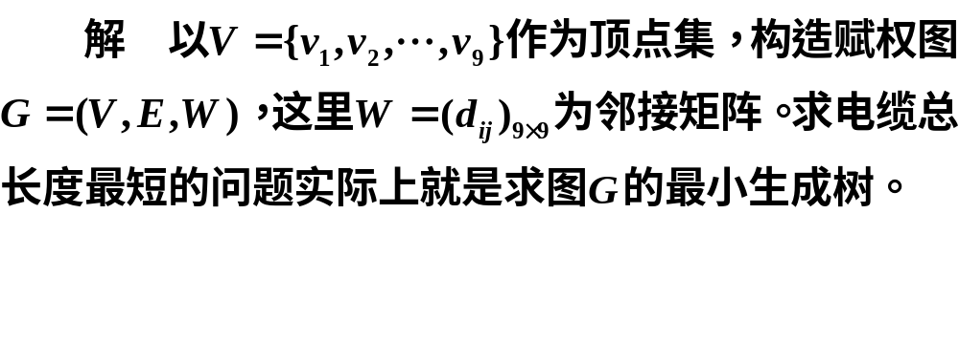
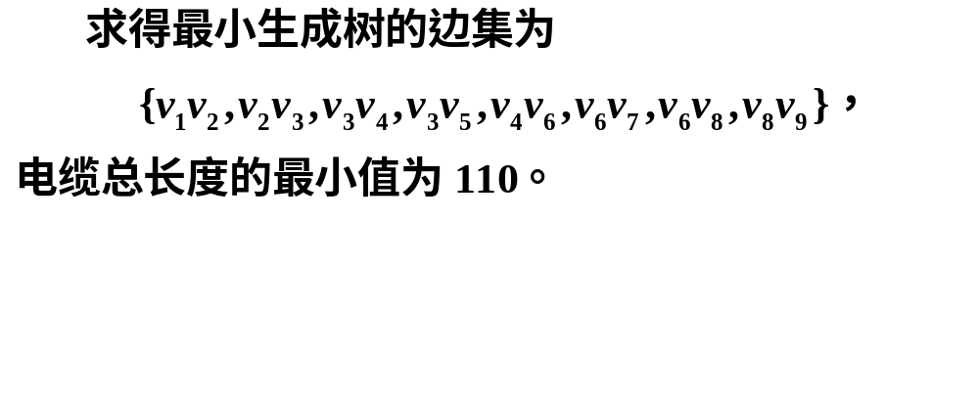

Slide 40
clc, clear, xy=load('data4_20.txt');
d=mandist(xy); %求xy的两两列向量间的绝对值距离
s=cellstr(strcat('v',int2str([1:9]'))); %构造顶点字符串
G=graph(d,s); %构造无向图
T=minspantree(G); %用默认的Prim算法求最小生成树
L=sum(T.Edges.Weight) %计算最小生成树的权重
T.Edges %显示最小生成树的边集
h=plot(G,'Layout','circle','NodeFontSize',12); %画无向图
highlight(h,T,'EdgeColor','r','LineWidth',2) %加粗最小生成树的边

