Slide 1
第10讲
4.9计划评审法
和关键路线法

Slide 2
目录 CONTENTS
01
计划网络图
02
时间参数
03
计算网络图的计算
关键路线与计算
的优化
04
完成作业期望和实现事件的概率
05

Slide 3
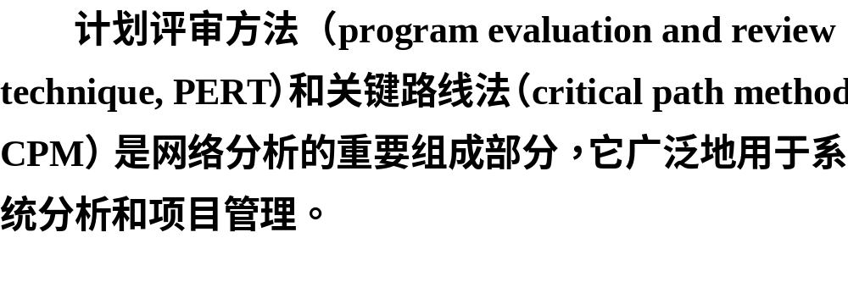


Slide 4

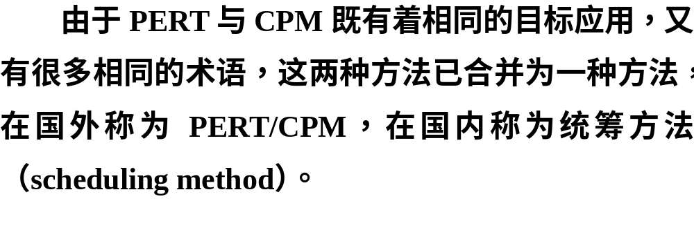

Slide 5
计划网络图
01

Slide 6
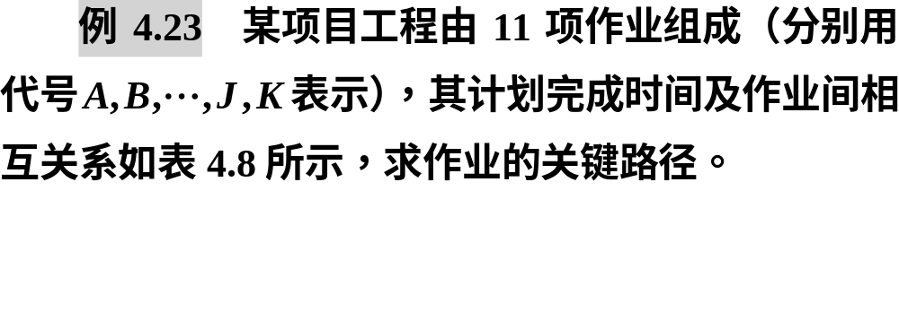

Slide 7
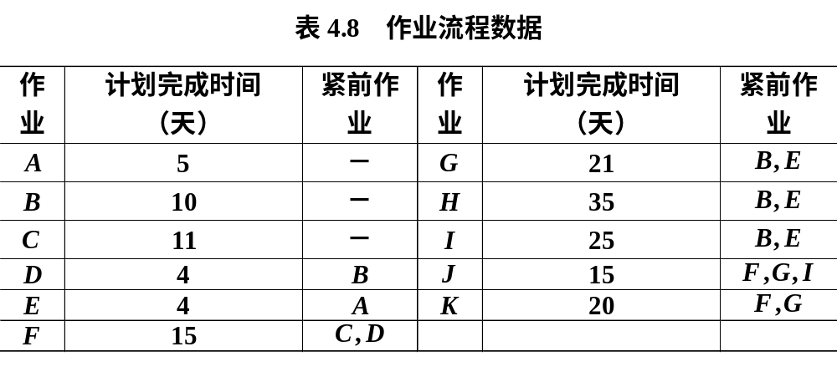


Slide 8

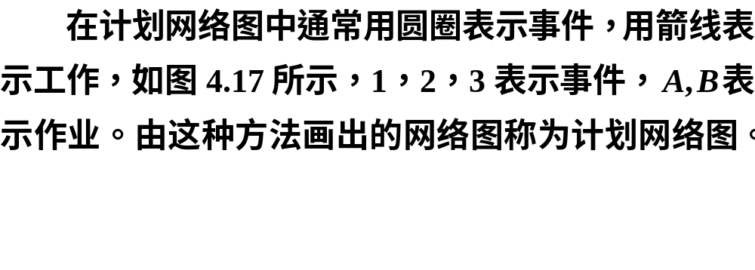
1.计划网络图的概念

Slide 9
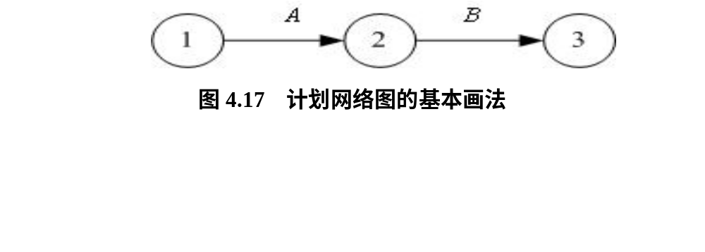


Slide 10



Slide 11

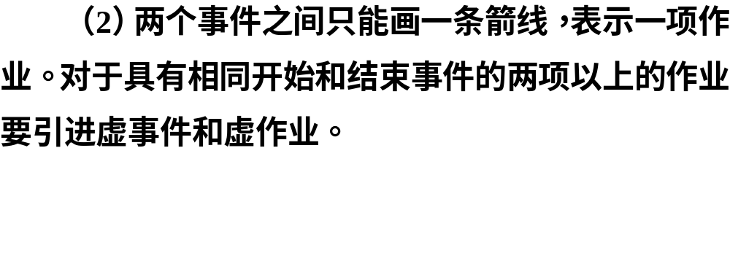
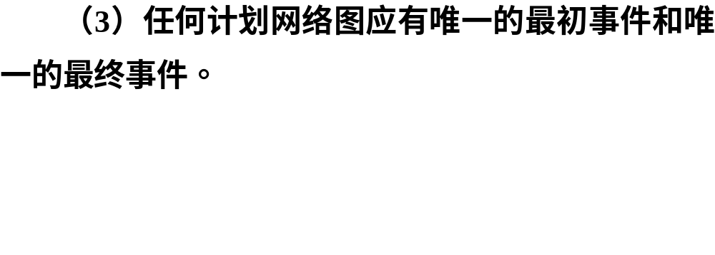
2.建立计划网络图应注意的问题

Slide 12
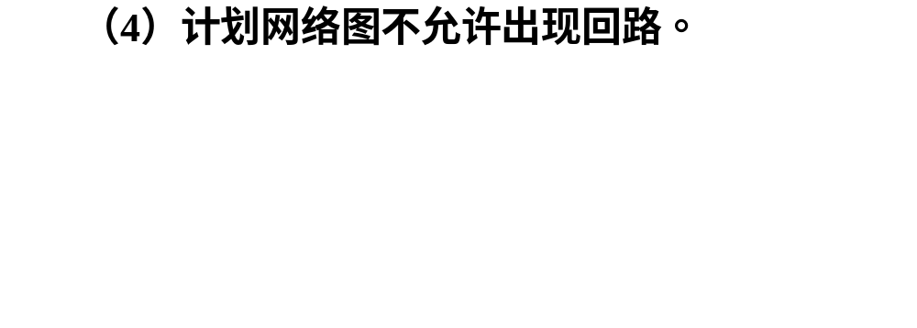


Slide 13
时间参数
02

Slide 14
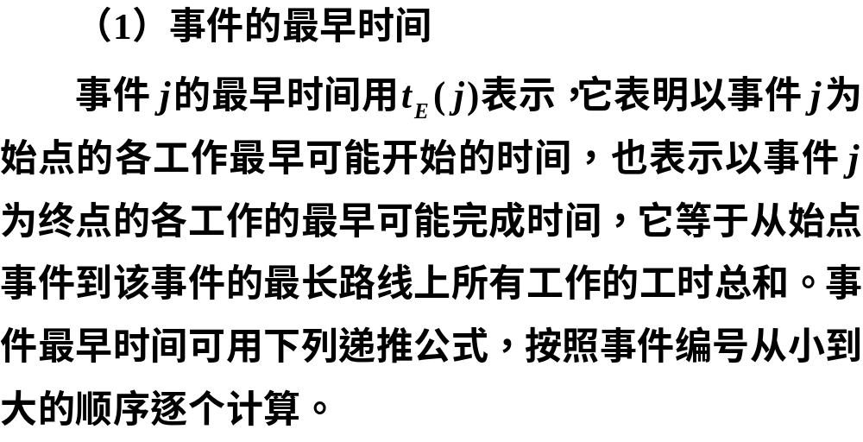
1.事件时间参数

Slide 15
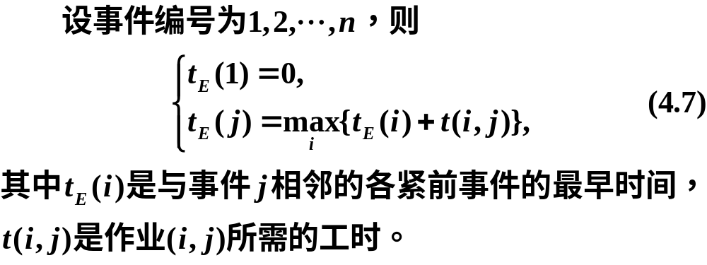
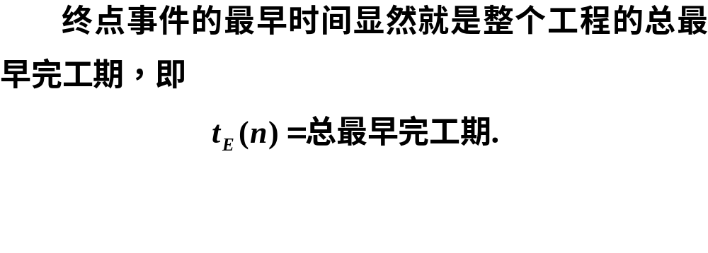

Slide 16
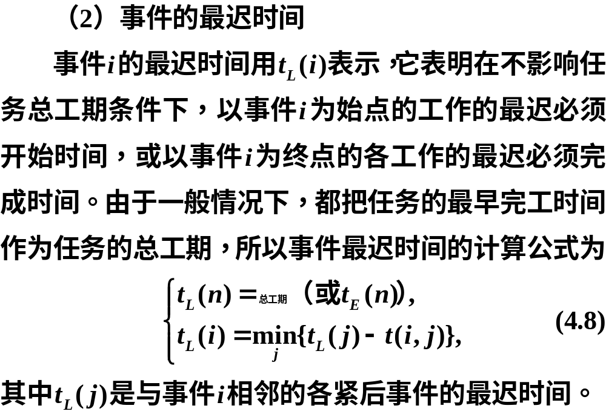

Slide 17
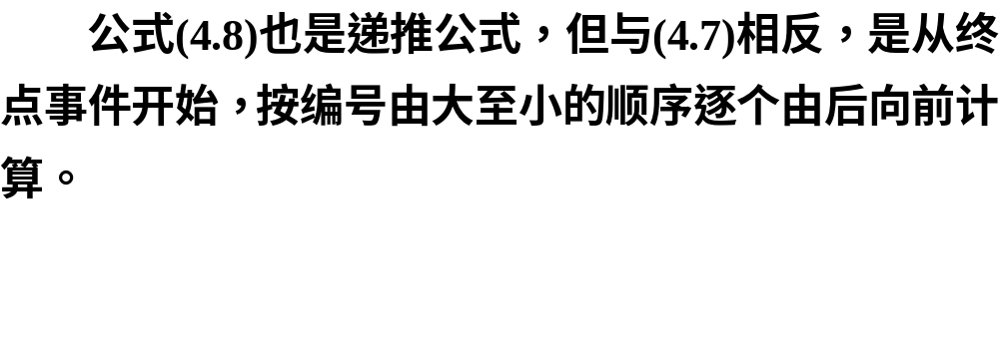

Slide 18
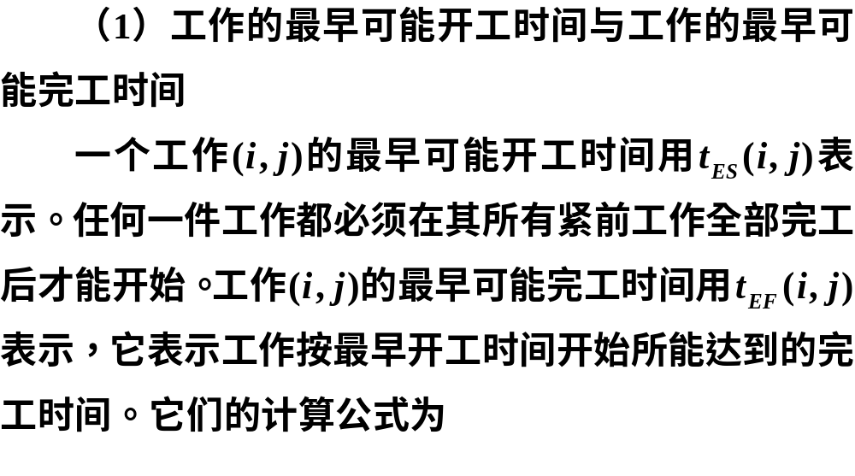
1.工作的时间参数

Slide 19
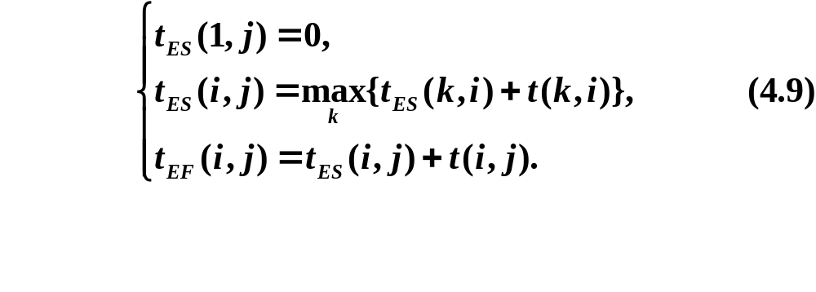
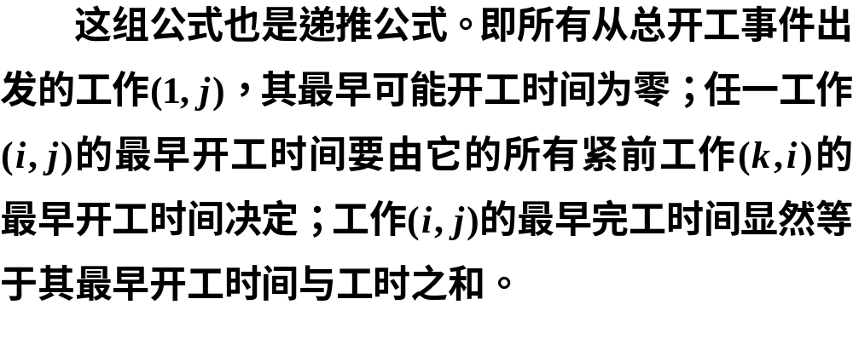

Slide 20
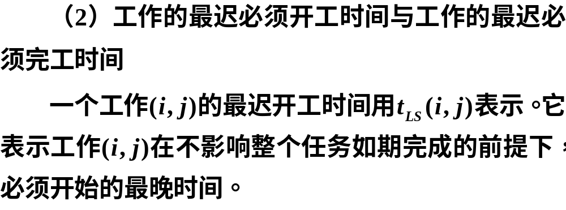

Slide 21
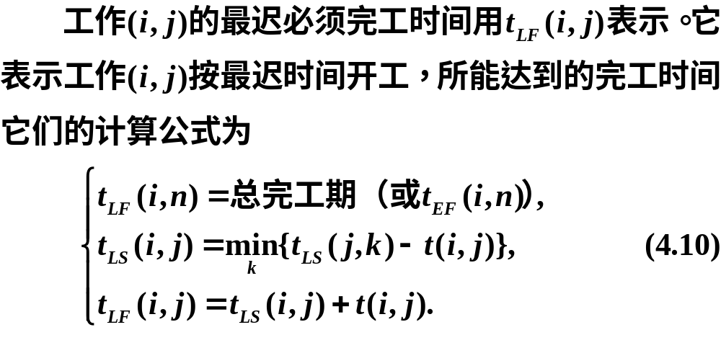

Slide 22
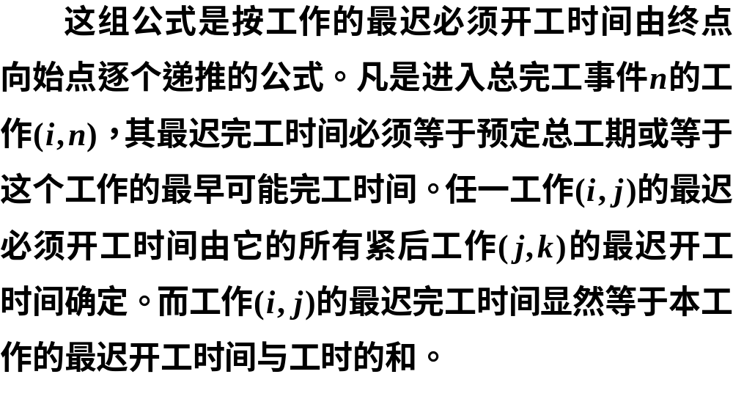

Slide 23
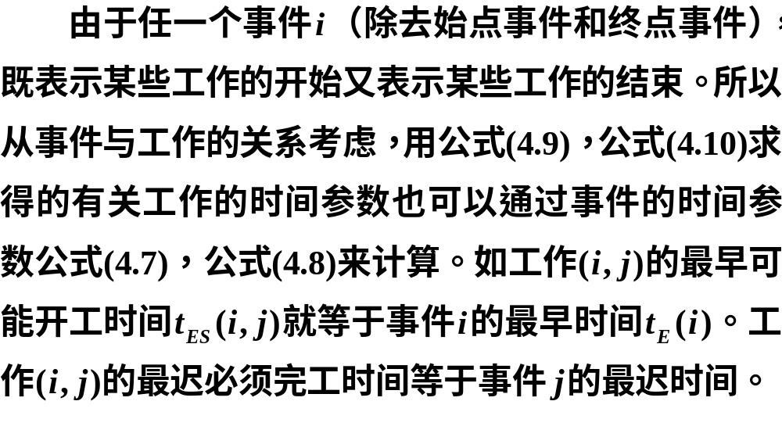

Slide 24

3.时差

Slide 25
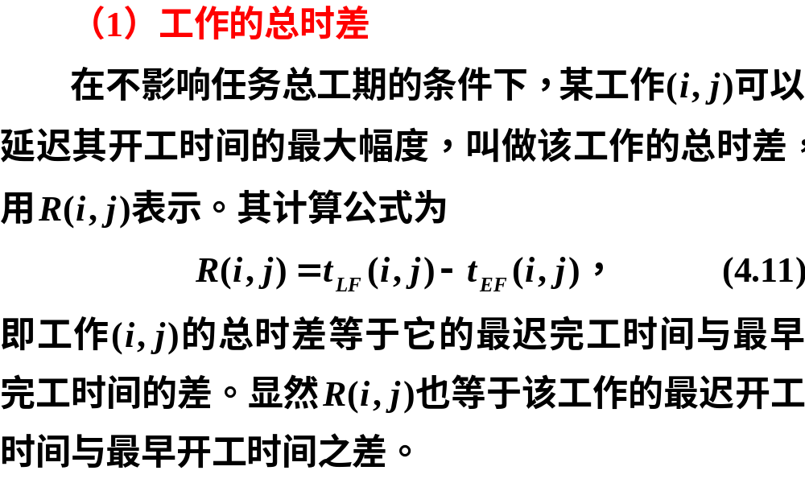

Slide 26
计划网络图
的计算
03

Slide 27
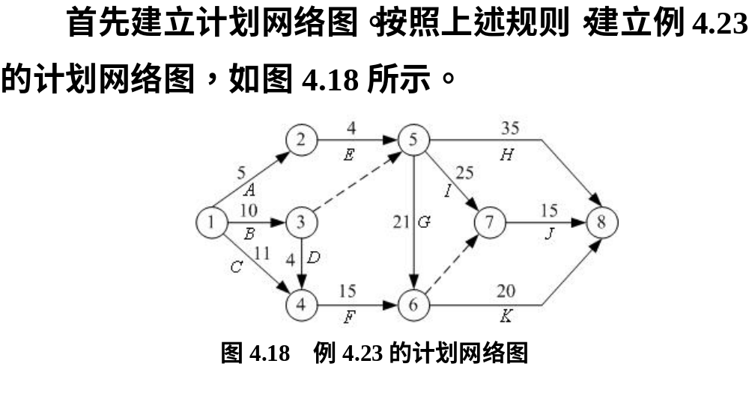
1.建立计划网络图

Slide 28
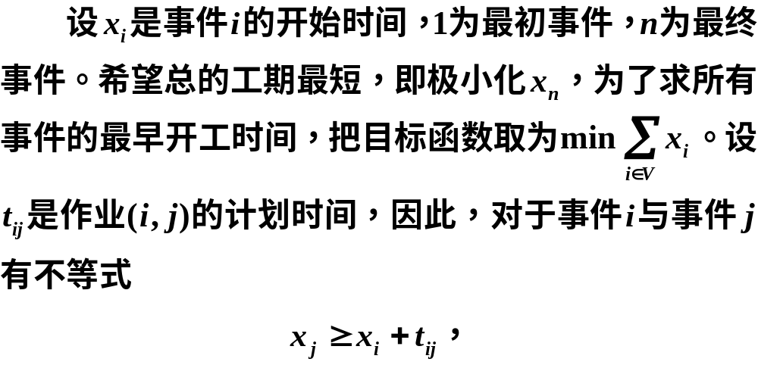
2.写出相应的规划问题

Slide 29
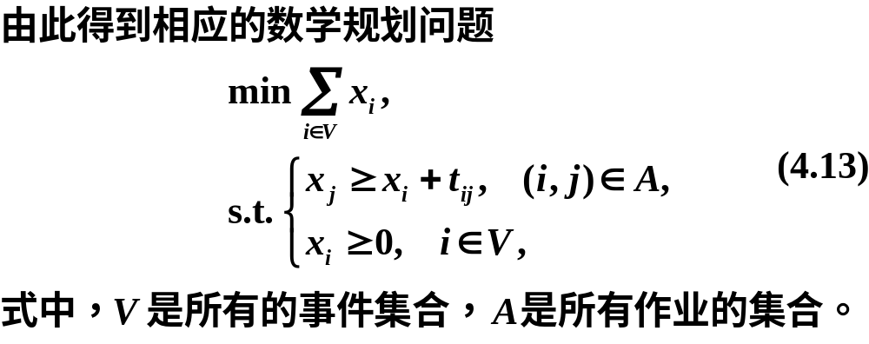

Slide 30
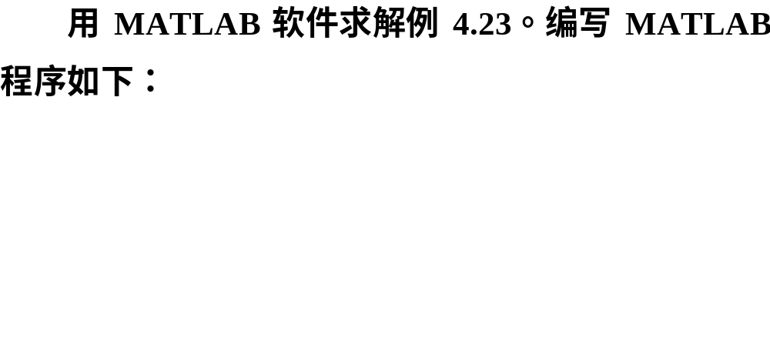
3.问题求解

Slide 31
clc, clear
L = [1,2,5; 1,3,10; 1,4,11; 2,5,4
3,4,4; 3,5,0; 4,6,15; 5,6,21
5,7,25; 5,8,35; 6,7,0; 6,8,20; 7,8,15];
prob = optimproblem;
x = optimvar('x', 8, 'LowerBound',0)
prob.Objective = sum(x);
n = length(L); con = optimconstr(n);
for k = 1:n
con(k) = x(L(k,2))>=x(L(k,1))+L(k,3);
end
prob.Constraints.con = con;
[sol, fval, flag, out] = solve(prob)
xx = sol.x' %显示最优解

Slide 32
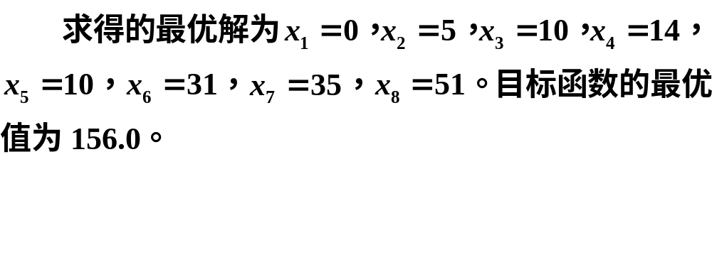
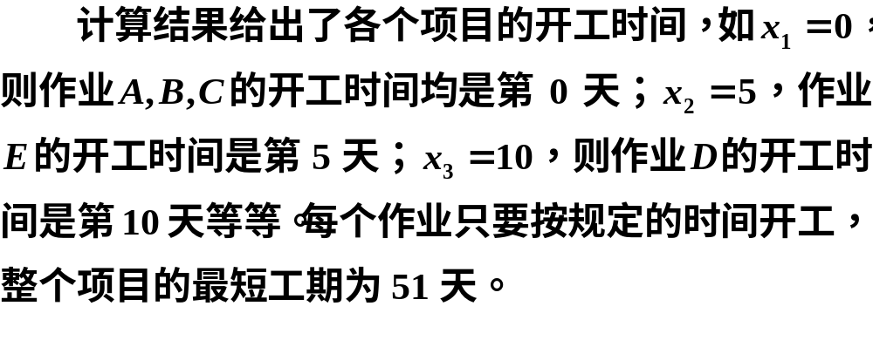

Slide 33


Slide 34

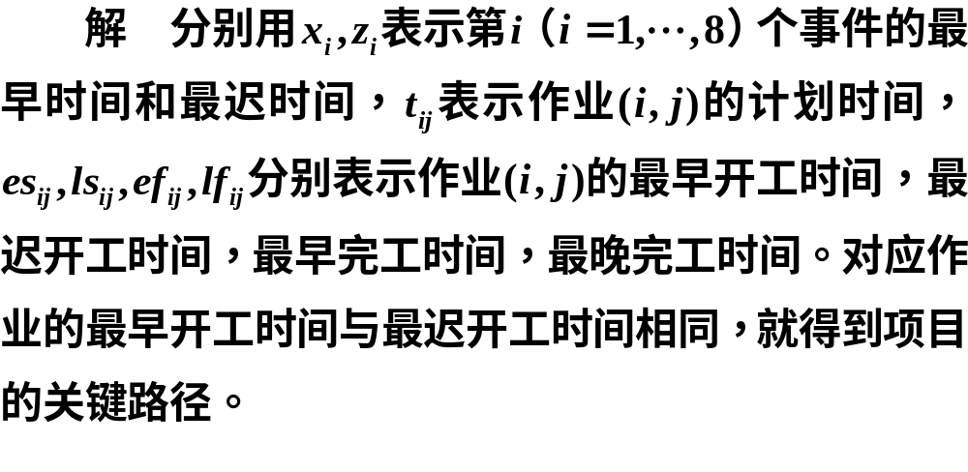

Slide 35
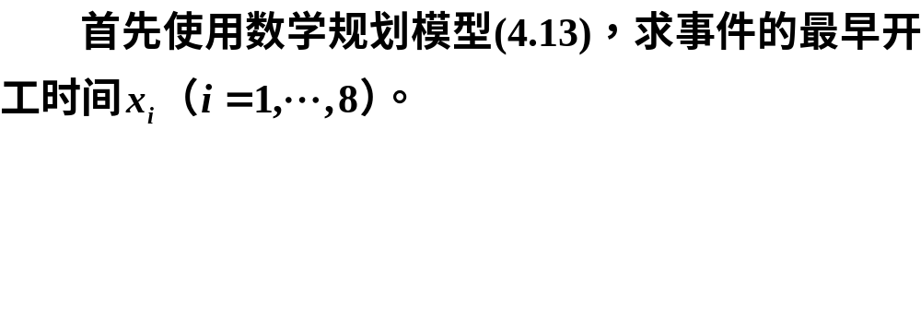
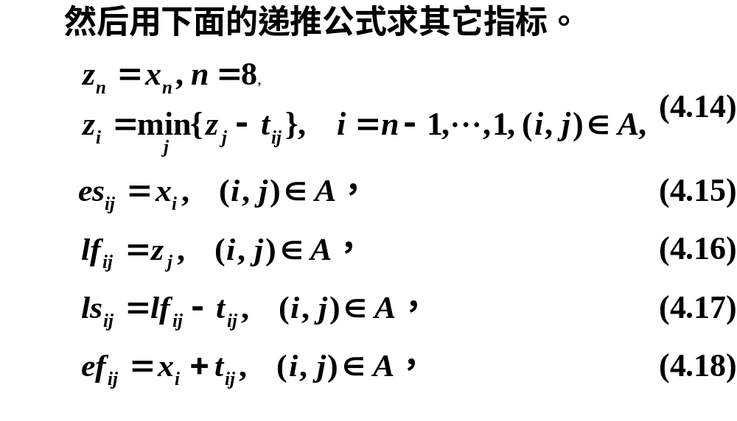

Slide 36
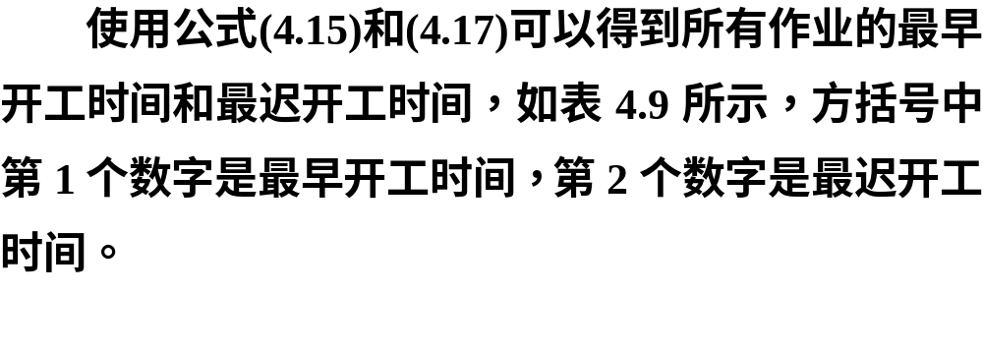

Slide 37
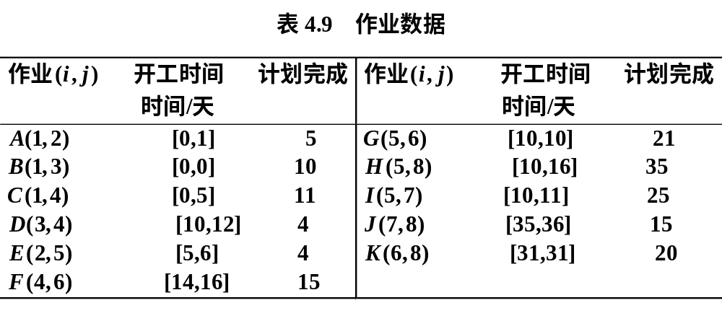

Slide 38
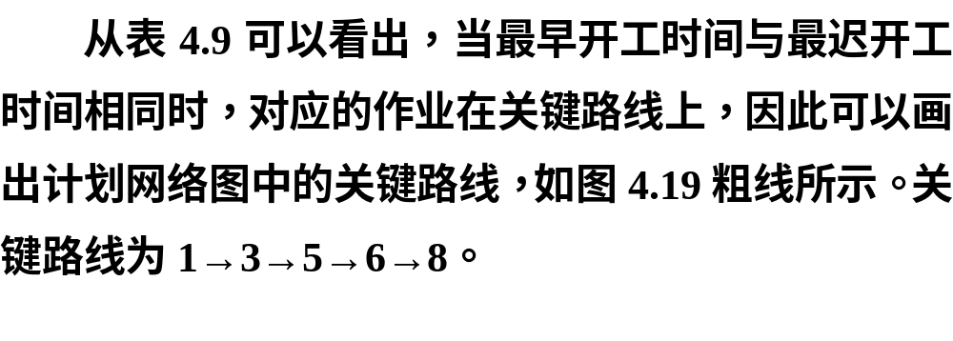

Slide 39
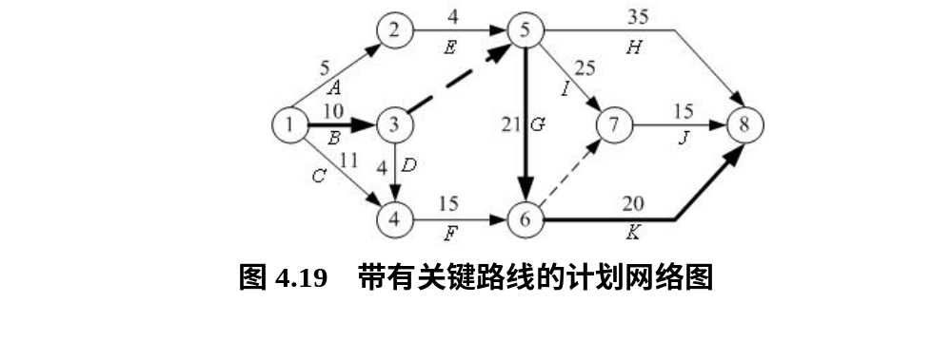

Slide 40
clc, clear
L = [1,2,5; 1,3,10; 1,4,11; 2,5,4
3,4,4; 3,5,0; 4,6,15; 5,6,21
5,7,25; 5,8,35; 6,7,0; 6,8,20; 7,8,15];
prob = optimproblem;
x = optimvar('x', 8, 'LowerBound',0)
prob.Objective = sum(x);
n = length(L); con = optimconstr(n);
for k = 1:n
con(k) = x(L(k,2))>=x(L(k,1))+L(k,3);
end
prob.Constraints.con = con;
[sol, fval, flag, out] = solve(prob)
xx = sol.x' %显示最优解
z(8) = xx(end);
for k = 7:-1:1
ind = find(L(:,1)==k)
z(k)=min(z(L(ind,2))-L(ind,3)')
end
es = []; lf =[]; ls =[]; ef = [];
for i = 1:n
es = [es; [L(i,1),L(i,2),xx(L(i,1))]];
lf = [lf; [L(i,1),L(i,2),z(L(i,2))]];
ls = [ls; [L(i,1),L(i,2),z(L(i,2))-L(i,3)]];
ef = [ef; [L(i,1),L(i,2),xx(L(i,1))+L(i,3)]];
end
es, lf, ls, ef

Slide 41

4.将关键路线看成最长路

Slide 42
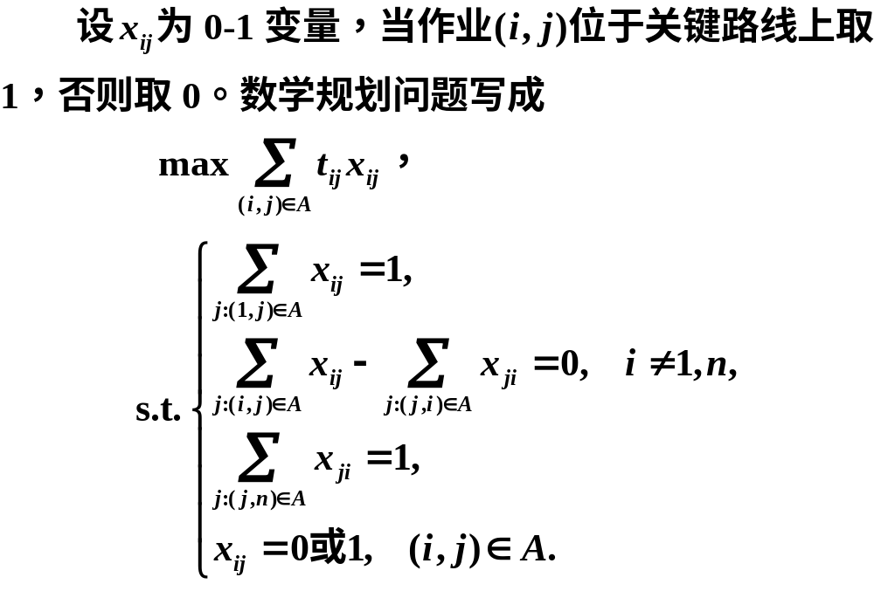

Slide 43
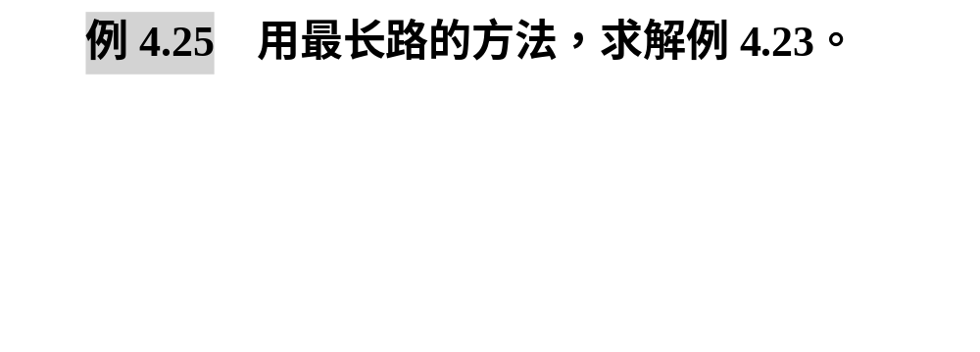


Slide 44
clc, clear
L = [1,2,5; 1,3,10; 1,4,11; 2,5,4
3,4,4; 3,5,0; 4,6,15; 5,6,21
5,7,25; 5,8,35; 6,7,0; 6,8,20; 7,8,15];
n = 8; N=size(L,1); obj=0; %目标函数初始化
prob = optimproblem('ObjectiveSense','max');
x = optimvar('x', n, n, 'Type','integer','LowerBound',0,'UpperBound',1);
for k=1:N
obj=obj+x(L(k,1),L(k,2))*L(k,3);
end
con=optimconstr(n);
ind1=find(L(:,1)==1); con(1)=sum(x(1,L(ind1,2)))==1;
for i=2:n-1
out=find(L(:,1)==i); in=find(L(:,2)==i);
con(i)=sum(x(i,L(out,2)))==sum(x(L(in,1),i));
end
indn=find(L(:,2)==n); con(n)=sum(x(L(indn,1),n))==1;
prob.Constraints.con = con; prob.Objective=obj;
[sol, fval] = solve(prob), xx = sol.x %显示最优解
[i,j] = find(xx); ij = [i'; j']

Slide 45
关键路线与
计划网络的优化
04

Slide 46
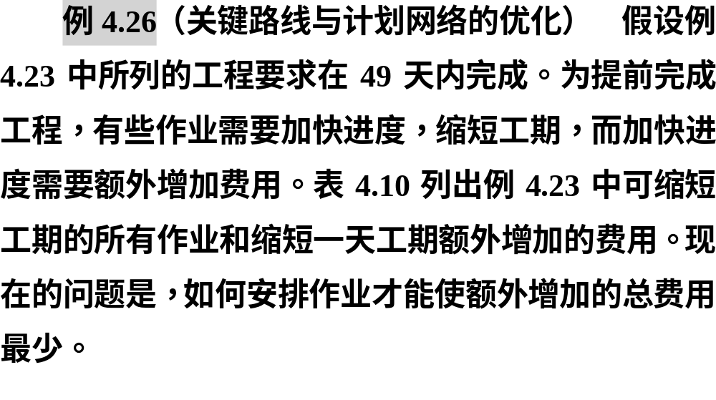

Slide 47
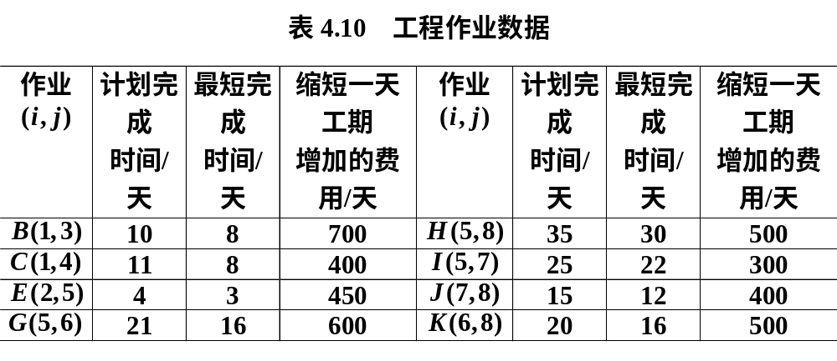


Slide 48
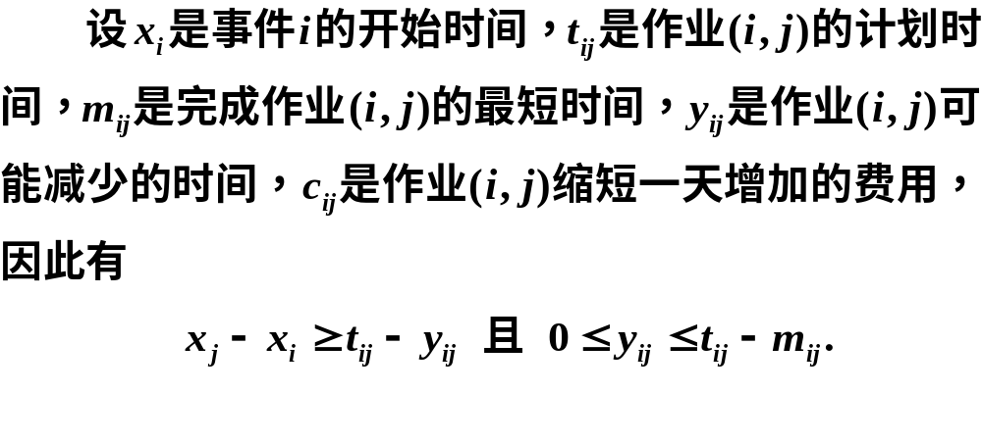
1.计划网络优化的数学表达式

Slide 49
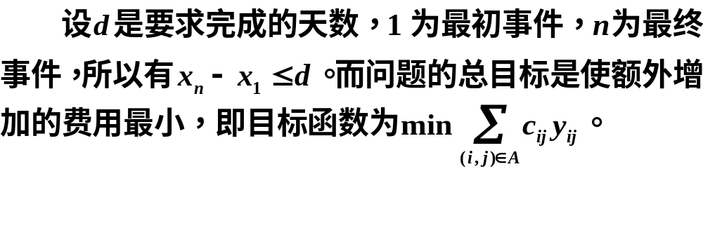


Slide 50
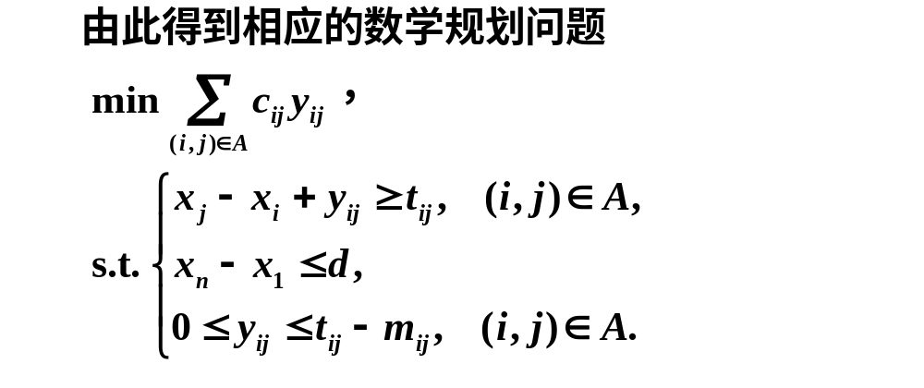

Slide 51
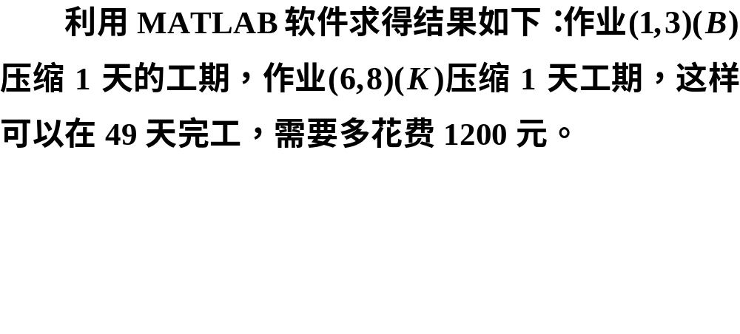
2.计划网络优化的求解

Slide 52
clc, clear
L = [1,2,5,5,0;1,3,10,8,700; 1,4,11,8,400; 2,5,4,3,450
3,4,4,4,0; 3,5,0,0,0; 4,6,15,15,0; 5,6,21,16,600
5,7,25,22,300; 5,8,35,30,500; 6,7,0,0,0
6,8,20,16,500; 7,8,15,12,400];
n = 8; obj=optimexpr; %目标函数初始化
prob = optimproblem;
x = optimvar('x',n,'Type','integer','LowerBound',0);
y = optimvar('y', n, n, 'Type','integer','LowerBound',0);
N = size(L,1); con = optimconstr(2*N+1);
con(1)=x(n)-x(1)<=49;
for k=1:N
obj=obj+L(k,5)*y(L(k,1),L(k,2));
con(2*k)=L(k,3)<=x(L(k,2))-x(L(k,1))+y(L(k,1),L(k,2));
con(2*k+1)=y(L(k,1),L(k,2))<=L(k,3)-L(k,4);
end
prob.Objective = obj;
prob.Constraints.con = con;
[sol, fval, flag, out] = solve(prob)
xx = sol.x, yy = sol.y
[i,j] = find(yy); ij = [i'; j']

Slide 53
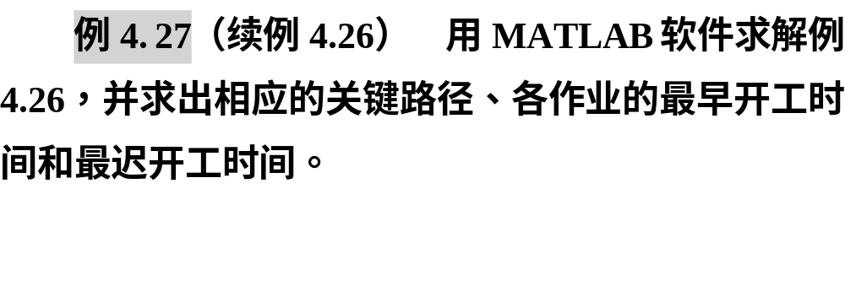

Slide 54
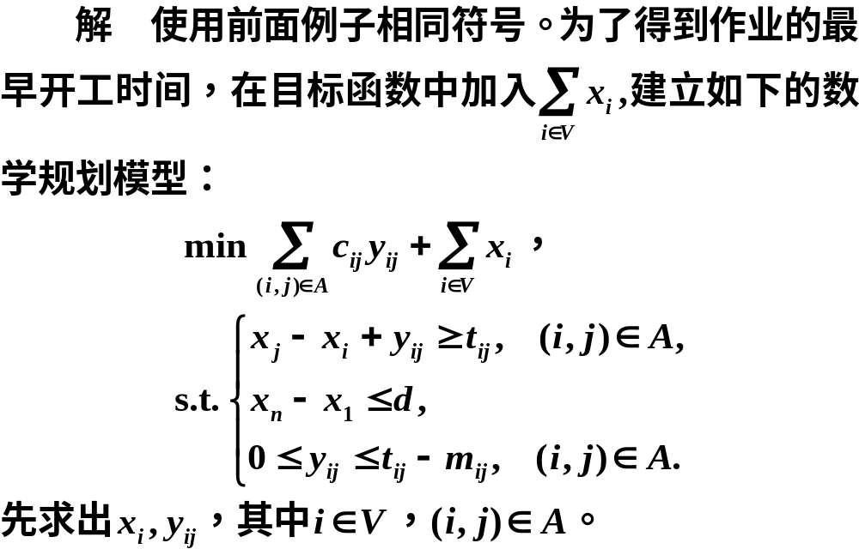

Slide 55
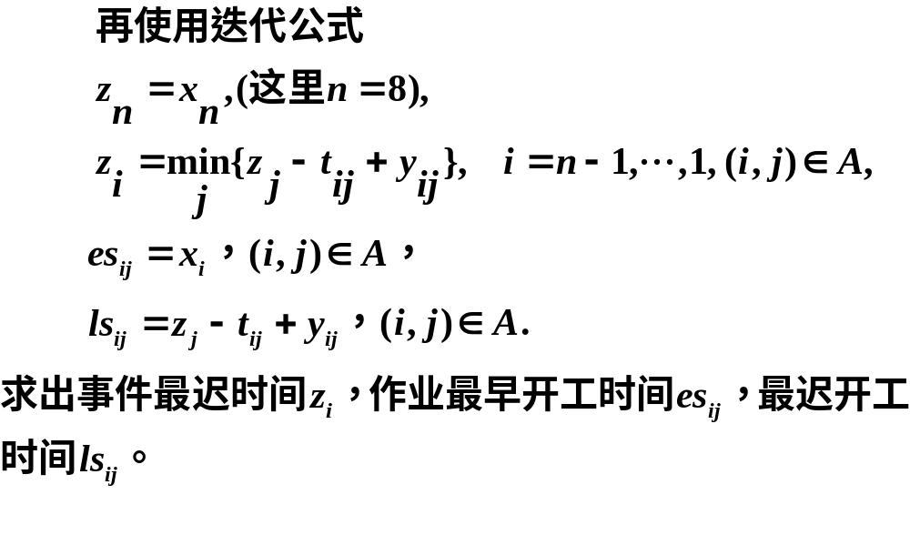

Slide 56
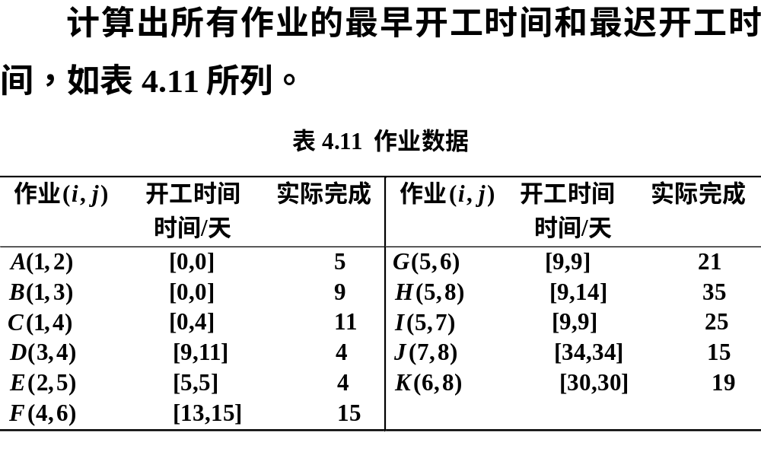

Slide 57
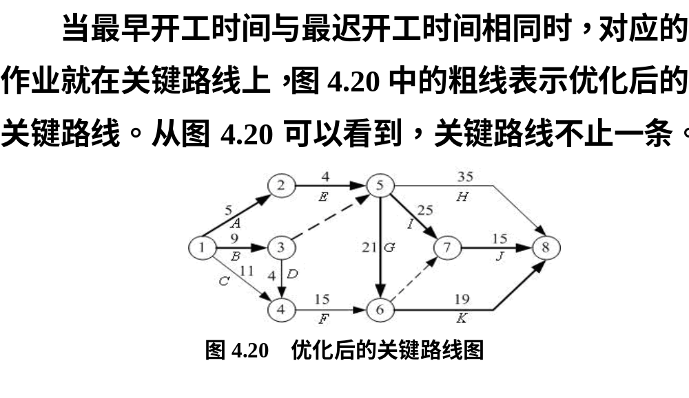

Slide 58
clc, clear
L = [1,2,5,5,0;1,3,10,8,700; 1,4,11,8,400; 2,5,4,3,450
3,4,4,4,0; 3,5,0,0,0; 4,6,15,15,0; 5,6,21,16,600
5,7,25,22,300; 5,8,35,30,500; 6,7,0,0,0
6,8,20,16,500; 7,8,15,12,400];
N=size(L,1); n = 8;
x = optimvar('x',n,'Type','integer','LowerBound',0);
y = optimvar('y', n, n, 'Type','integer','LowerBound',0);
prob = optimproblem; obj=sum(x); %目标函数初始化
con = optimconstr(2*N+1); con(1)=x(n)-x(1)<=49;
for k=1:N
obj=obj+L(k,5)*y(L(k,1),L(k,2));
con(2*k)=L(k,3)<=x(L(k,2))-x(L(k,1))+y(L(k,1),L(k,2));
con(2*k+1)=y(L(k,1),L(k,2))<=L(k,3)-L(k,4);
end
prob.Objective=obj;
prob.Constraints.con = con;
[sol, fval, flag, out] = solve(prob)
xx = sol.x, yy = sol.y
[i,j] = find(yy); ij = [i'; j']
z(8) = xx(end);
for k = 7:-1:1
ind = find(L(:,1)==k);
z(k)=min(z(L(ind,2))-L(ind,3)'+yy(k,L(ind,2)));
end
els = [];
for i = 1:length(L)
els = [els; [L(i,1),L(i,2),xx(L(i,1)),...
z(L(i,2))-L(i,3)+yy(L(i,1),L(i,2))]];
end
els %显示最早和最迟开工时间

Slide 59
完成作业期望
和实现事件的概率
05

Slide 60
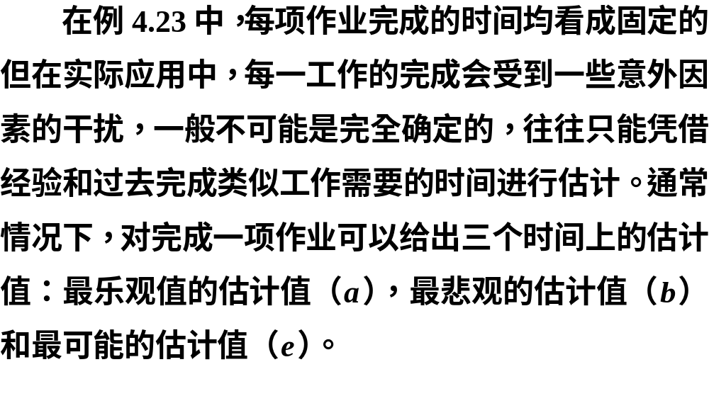

Slide 61
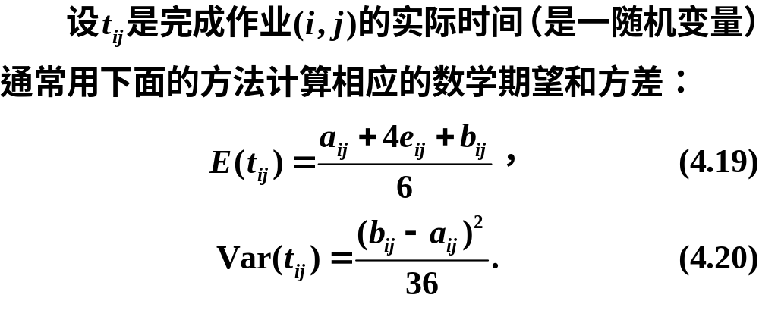

Slide 62


Slide 63


Slide 64


Slide 65



Slide 66


Slide 67



Slide 68


Slide 69
clc, clear
L = [1,2,3,5,7;1,3,8,9,16; 1,4,8,11,14; 2,5,3,4,5
3,4,2,4,6; 3,5,0,0,0; 4,6,8,16,18; 5,6,18,20,28
5,7,18,25,32; 5,8,26,33,52; 6,7,0,0,0
6,8,11,21,25; 7,8,12,15,18];
et=(L(:,3)+4*L(:,4)+L(:,5))/6; %计算均值
dt=(L(:,5)-L(:,3)).^2/36; %计算方差
prob = optimproblem('ObjectiveSense','max');
n = 8; N=size(L,1); obj=0; con=optimconstr(n);
x = optimvar('x',n,n,'Type','integer','LowerBound',0,'UpperBound',1);
for k=1:N
obj=obj+x(L(k,1),L(k,2))*et(k);
end
ind1 = find(L(:,1)==1); con(1)=sum(x(1,L(ind1,2)))==1;
for i=2:n-1
out=find(L(:,1)==i); in=find(L(:,2)==i);
con(i)=sum(x(i,L(out,2)))==sum(x(L(in,1),i));
end
indn=find(L(:,2)==n); con(n)=sum(x(L(indn,1),n))==1;
prob.Constraints.con = con; prob.Objective=obj;
[sol, f] = solve(prob)
xx = sol.x, [i,j] = find(xx); ij = [i, j]
s2=0; %方差的初值
for k=1:size(ij,1)
s2=s2+dt(find(ismember(L(:,[1,2]),ij(k,:),'rows')));
end
s=sqrt(s2), p=normcdf(52,f,s) %计算标准差和概率
n = norminv(0.95)*s+f

