Slide 1
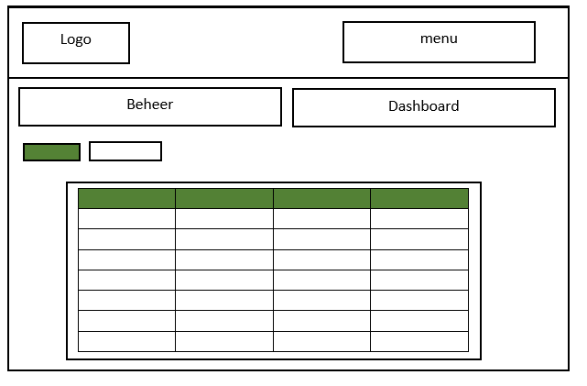

Mock Screen main

Slide 2
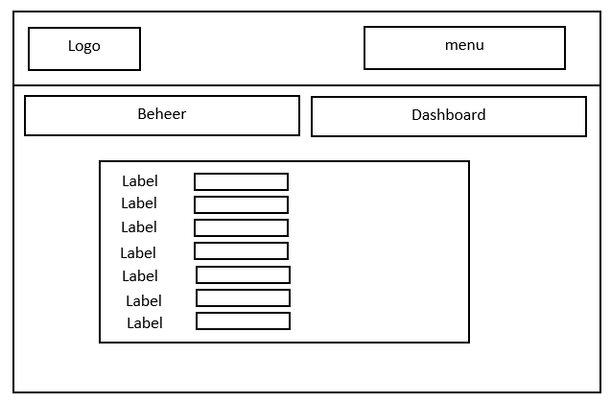
Mock Screen Edit

