Slide 1

Introduction and Background

Slide 2

Welcome to Scala
Scalable Language
A modern language developed for the JavaTM platform
Interoperates with Java
Also .Net, JavaScript versions
Supports Object Oriented and Functional paradigms
Many toolkits/frameworks built on Scala
Akka
Play
Slick
Spark

Slide 3
A Short History
Pizza
Initial investigation on adding Generics to Java- late 1990s
Generic Java(GJ)
Compiler for superset of Java with Generics and basic FP – 2001
Scala
First experimental release of Scala - 2003
Martin Odersky
Java 8 runtime integration Ongoing performance improvements
Scala 2.0
Scala 2.11
Scala 2.12

Slide 4
Getting Started
A first Scala program
A "Singleton object, define class and instance
No requirements on file naming
Hello.scala
object HelloWorld {
def main( args: Array[String] ) {
println("Hello from scala")
}
}
Further simplification possible:
Semicolon optional as separator at end of line
Type follows identifier in declarations (where type is needed)
object HelloWorld extends App {
println("Hello from scala")
}
Notes:
The slide shows the definition of the ubiquitous "Hello World" example in Scala.
There are no requirements for mapping class/type names to filenames in Scala. The content of the source file is the definition of an object, a Scala construct that represents a "Singleton" class. In other words a class that will have a single instance. The instance will be created by the runtime as required – in this case when the program starts but this may not always be the case.
Scala does not have the keyword "static", by implication all fields and methods in an "object" are considered static.
Notice the type of the parameter to the main method is shown after the identifier. Scala requires declarations to be written in this way, as it is felt that declarations of variables of complex types will be easier to read and understand. In many cases, however, the type can be omitted as it will be inferred during compilation (although never in the case of parameter specifications!!)
As part of its goal to reduce syntax, Scala does not require a semicolon at the end of a line, although it may be necessary as a separator in other cases.
The code can be simplified further, by defining the object containing the main() method as extending the trait (like a Java Interface) scala.App. When we do this, then all of the code in the body of the object is wrapped in the main() method implicitly so there is no need to define the method itself.
@exhibit;

Slide 5
Running the Program
Standard Scala compile/execution tools available
similar to JDK
Runtime will invoke compiler if suitable class with main method can be found
$ scalac Hello.scala
$ ls –l
-rw-r--r-- 1 george staff 604 18 Sep 09:27 HelloWorld$.class
-rw-r--r-- 1 george staff 632 18 Sep 09:27 HelloWorld.class
$ scala HelloWorld
Hello from scala
$ scala Hello.scala
Hello from scala
Notes:
Scala code is compiled using the compiler scalac – the result is a class file for each class, as for Java. In the case of "object"s, an additional class file is created to manage the usage as a singleton. The application can be executed using the scala command. Pass the name of the object containing the main() method as the parameter, as well as any other command line arguments.

Slide 6
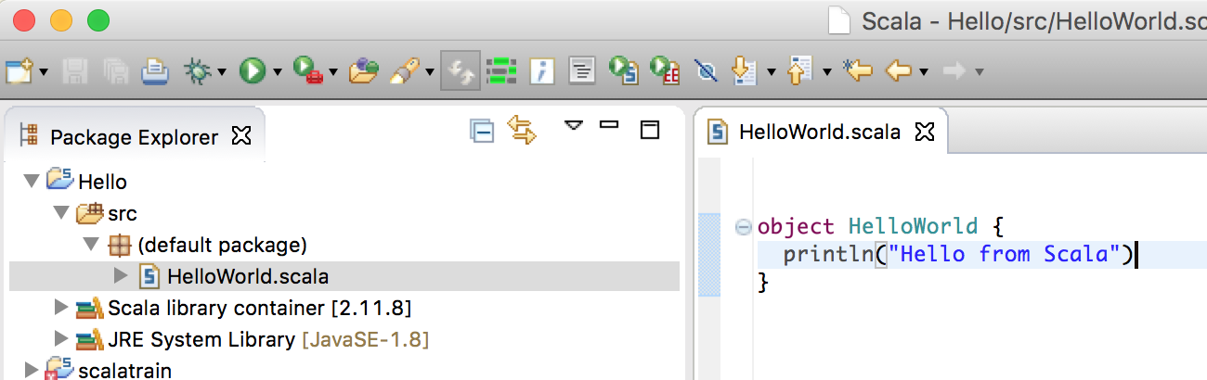
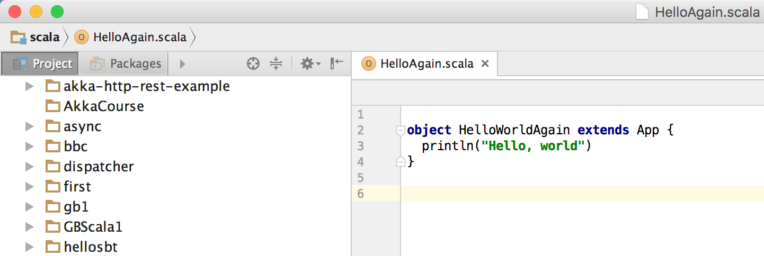
Using an IDE
Plugins available for common IDEs

Slide 7
The Scala REPL
An interactive mode for experimenting with Scala
$ scala
Welcome to Scala 2.11.8 (Java HotSpot(TM) 64-Bit Server VM, Java 1.8.0_51).
Type in expressions for evaluation. Or try :help.
scala> println("Hello to all...")
Hello to all...
scala> :help
All commands can be abbreviated, e.g., :he instead of :help.
…
:load <path> interpret lines in a file
:paste [-raw] [path] enter paste mode or paste a file
:quit exit the interpreter
:replay [options] reset the repl and replay all previous commands
:require <path> add a jar to the classpath
:type [-v] <expr> display the type of an expression without evaluating it
…

Slide 8

sbt: The Scala Build Tool
Like Gradle
Build files use Scala based DSL
Unlike Maven which uses XML
Leverages Ivy for dependencies
Incremental compilation reduces build times
Also server mode of operation
Basis of Lightbend Activator tool

Slide 9
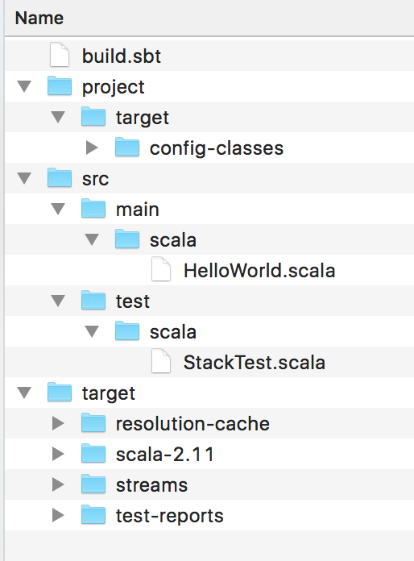
sbt Project Layout
sbt has a basic structure for projects
Same as for Maven
Other languages (e.g. Java) can be incorporated
Main source files
Test source files

Slide 10
Working with sbt
$ sbt
…
> run
[info] Compiling 1 Scala source to .../target/scala-2.11/classes...
[info] Running HelloWorld
Hello all
[success] Total time: 2 s, completed 08-Aug-2016 15:42:10
>
…
> test
…
[info] Run completed in 324 milliseconds.
[info] Total number of tests run: 2
[info] Suites: completed 1, aborted 0
[info] Tests: succeeded 2, failed 0, canceled 0, ignored 0, pending 0
[info] All tests passed.
[info] Passed: Total 2, Failed 0, Errors 0, Passed 2
[success] Total time: 1 s, completed 08-Aug-2016 15:50:41
>

Slide 11
The sbt Build File
build.sbt
Written using a Scala DSL
Possible to manage build for several Scala versions
name := "Hello World"
version := "1.0"
scalaVersion := "2.11.8"
libraryDependencies += "org.specs2" %% "specs2-core" % "3.8.4" % "test"
libraryDependencies ++= Seq( "org.scalatest" % "scalatest_2.11" % "3.0.0" % "test",
"org.scalactic" %% "scalactic" % "3.0.0" )
Dependencies can be specified individually or as a list

Slide 12
The sbt Console
Allows Scala REPL interaction with dependencies resolved
$ sbt
[info] Set current project to Hello World (in build file:../latest/)
> console
[info] Starting scala interpreter...
[info]
Welcome to Scala 2.11.8 (Java HotSpot(TM) 64-Bit Server VM, Java 1.8.0_51).
Type in expressions for evaluation. Or try :help.
scala> println("Hello there")
Hello there
scala> :quit
[success] Total time: 4 s, completed 08-Aug-2016 16:17:33
>

Slide 13
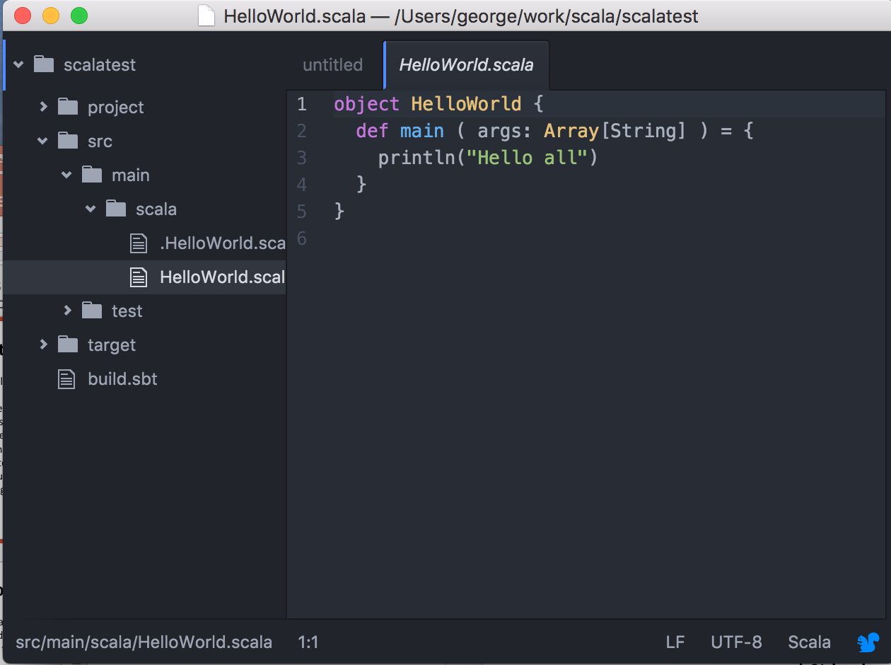
Continuous Mode
sbt can monitor for changes to files in the build
rerun the task if any change is detected
prepend ~ to task
$ sbt
[info] Set current project to Hello World (in build file:../latest/)
> ~run
[info] Running HelloWorld
Hello all
[success] Total time: 0 s, completed 08-Aug-2016 16:18:46
1. Waiting for source changes... (press enter to interrupt)
[info] Running HelloWorld
Hello all
[success] Total time: 0 s, completed 08-Aug-2016 16:19:11
2. Waiting for source changes... (press enter to interrupt)
>

Slide 14
Basic Language Principles
Scala is designed to have few principles, but have these principles applied consistently across the language
Everything is an expression
Should yield a value
If no value returned, expression is known as a statement
Every value is an object
Compiler optimises to use JVM primitive types when appropriate
Every operation is a method call

Slide 15
Values
Named pieces of immutable storage
scala> val myVal = 10
myVal: Int = 10
scala> myVal += 20
<console>:9: error: reassignment to val
myVal += 20
^
scala> val y: Int = "Hello"
<console>:7: error: type mismatch;
found : String("Hello")
required: Int
val y: Int = "Hello"
^
scala> val z = { val a = 5; a + 3 }
z: Int = 8
Type inferred from initialising expression
val introduces immutable data
Explicitly typed – compiler ensures initialising expression is compatible
Expression may be compound
Notes:
Scala uses the keyword “val” to introduce a named piece of immutable storage. The value used to initialise this must be specified at the point of definition. Each val has a type, which may be deduced by the compiler or explicitly specified as shown, in which case the compiler ensures that the initialisation expressions is of a compatible type.
The expression used to initialise a val can be simple, such as a literal value or more complex. It may be a compound expressions consisting of multiple steps (perhaps on different lines), in which case it is enclosed in braces { }. Each set of braces introduces a new scope. The value of the expressions is that of the last sub-expression that is evaluated. In the example the value is calculated from a + 3, where a is set to 5, so the overall value is 8.

Slide 16
Variables
Named pieces of mutable storage
may be initialised after definition
must be initialised before use
Use of mutable data is discouraged in Scala
scala> var myVar: Int = 20
myVar: Int = 20
scala> myVar += 10
scala> myVar
res3: Int = 30
scala> myVar + myVal
res4: Int = 40
var and val may be mixed in expressions
Notes:
Variables in Scala are named pieces of mutable storage – in other words their value may be changed after initialisation. The functional programming paradigm discourages the use of mutable data as much as possible, so although its use is not prohibited in Scala care should be taken so that it does not become pervasive as this will limit the flexibility of code and make concurrency much harder to implement.
As with val, the type may be omitted from the declaration of a var, as long as it is being intialised (in which case the compiler will infer the type from the initialising expression).
The var may be explicitly typed (it must be explicitly typed if it is not being initialised). This causes any initialising expression to also be type-checked.
Once defined, val and var may be mixed in expressions, so long as any immutability is not compromised through side effects.

Slide 17
Methods/Functions
Use def keyword
scala> def times2 ( i: Int ) = i * 2
times2: (i: Int)Int
scala> times2 ( 3 )
res17: Int = 6
scala> def upper ( strings: String* ) = strings.map( _.toUpperCase() )
upper: (strings: String*)Seq[java.lang.String]
scala> upper ( "one", "two" )
res18: Seq[java.lang.String] = ArrayBuffer(ONE, TWO)
scala> def sayHello = println( "Hello everyone" )
sayHello: Unit
scala> sayHello
Hello everyone
* means variable number of parameters
Unit similar to
Java void type
No args so () not required
Notes:
Methods are introduced by the "def" keyword.
Various examples are shown on the slide.
Note the syntax for variable number of arguments – the argument type is followed by the * character. Notice also use of the Java type java.lang.String.
As with variables, the return type of the function can be inferred by the compiler, or explicitly stated.
Notice that if no parameters are defined for a function, then we can leave off the parentheses in both the definition and the call. However in the case where a variable number of parameters are expected, as with the sum() function in the slide, the parentheses are required on the call, even if there are no parameters being passed. Additionally, coding conventions recommend that if a method has no return value, such as the sayHello() method shown here, then it is always defined and called with empty parentheses.

Slide 18
About Strings
Scala String type based on java.lang.String
Some additional capabilities
String interpolation allows Scala expressions to be evaluated inside String literals
scala> val a = 1
a: Int = 1
scala> val b = 3
b: Int = 3
scala> s"$a + $b = ${a + b}"
res2: String = 1 + 3 = 4
scala> f"$a%2d + $b%2d = ${a + b}%3.2f"
res3: String = " 1 + 3 = 4.00"
Simple substitution
Formatted substitution

Slide 19
Regular Expressions
Powerful notation for working with Strings
scala> val s1 = "I like coffee before lunch, and Tea after lunch"
s1: String = I like coffee before lunch, and Tea after lunch
scala> s1.matches( raw".*[Tt]ea.*" )
res14: Boolean = true
scala> s1.replaceAll( raw"[tT]ea", "coffee" )
res16: String = I like coffee before lunch, and coffee after lunch
scala> s1.replaceAll( raw"[tT]ea", "coffee" ).replaceFirst( raw"[Cc]offee", "tea" )
res12: String = I like tea before lunch, and coffee after lunch
raw string interpolator prevents expansion of \... sequences in string.

Slide 20
Regular Expressions
RE Capture groups may be accessed
Slightly unusual syntax
scala> val s1 = "I like coffee before lunch, and Tea after lunch"
s1: String = I like coffee before lunch, and Tea after lunch
scala> val drink = raw".*([tT]ea|[Cc]offee) before.*([tT]ea|[cC]offee) after.*".r
drink: scala.util.matching.Regex = .*([tT]ea|[Cc]offee) before.*([tT]ea|[cC]offee) after.*
scala> val drink(morningDrink, afternoonDrink) = s1
morningDrink: String = coffee
afternoonDrink: String = Tea

Slide 21
Conditional Expressions
if expression
Similar syntax to Java/C/C++
Similar semantics to ?: operator
Yields a value
scala> val amount = 25000
amount: Int = 25000
scala> val taxRate = if ( amount < 41000 ) 0.25 else 0.4
taxRate: Double = 0.25
scala> val x = 10
x: Int = 10
scala> if ( x % 2 == 0 ) println("even") else println("odd")
even
Unit valued expression/statement

Slide 22
Pattern Matching
match expression
similar to switch statement
each branch is an expression
scala> val month = 5
month: Int = 5
scala> month match {
| case 1 => println("January")
| case 2 => println("February")
| case 3 => println("March")
| case 4 => println("April")
| case 5 => println("May")
| …
| case 12 => println("December")
| case _ => println("Ooops")
| }
May
No automatic fall-through, so no need for break
Default case represented using _ wildcard
Notes:
Scala does not provide a switch statement like Java/C/C++. However the alternative, the match statement, is considerably more powerful as we will see over the next few slides.
Here we see a very basic usage of the match statement, emulating a conventional usage of the switch statement. Notice that each possible branch is self-contained, there is no fall-through to the next case and so no need for the break statement. The default case is selected when no other matches are provided, this is indicated using the _ character (a common wildcard character in Scala syntax).
The default case is not mandatory, however if it is not present and a value not otherwise matched is encountered, then a runtime exception (MatchError) occurs.

Slide 23
Pattern Matching
match is an operator (method)
Part of expression yielding a value
scala> def season ( m: Int ) =
| m match {
| case 1 | 2 | 3 => "Winter"
| case 4 | 5 | 6 => "Spring"
| case 7 | 8 | 9 => "Summer"
| case 10 | 11 | 12 => "Autumn"
| case _ => "Weird"
| }
season: (m: Int)java.lang.String
scala> season(2)
res5: java.lang.String = Winter
Notes:
Recall one of the guiding principles of Scala – everything is a value. This means that we can use match as an operator in an expression, ultimately yielding a value.
The example shows how we can define a function that maps a month number onto a season. The example also illustrates how multiple possible values can match against a single block of code – the | character serves as an "or" operator in this context.

Slide 24
Pattern Matching
Case options can have guards associated
Allows continuous ranges of values to be matched
scala> def state ( t: Int ) =
| t match {
| case i if ( i < 0 ) => "ice"
| case i if ( i >= 0 && i < 100 ) => "water"
| case i if ( i >= 100 ) => "steam"
| }
state: (t: Int)java.lang.String
scala> state (120)
res9: java.lang.String = steam
scala> state (-10)
res10: java.lang.String = ice
Notes:
It is possible to further enhance match expression by introducing guards to the case options (rather like in for comprehensions). This allows a range of values to be matched, rather than a list of discrete values as with the "|" character. Of course if options are being used, it is possible to associated a guard with each option.
Notice that in this case, all possible values are catered for in the three cases so no default is required.

Slide 25
While Loop
Note var used as
variables are mutable
Conventional behaviour
Imperative style
scala> var j = 1
j: Int = 1
scala> while ( j <= 5 ) {
| if ( j % 2 == 0 )
| println(j + ": even")
| else
| println(j + ": odd")
| j += 1
| }
1: odd
2: even
3: odd
4: even
5: odd
scala> var j = 1
j: Int = 1
scala> var tot = 0
tot: Int = 0
scala> while ( j <= 5 ) {
| tot += j
| j += 1
| }
scala> tot
res10: Int = 15
Notes:
Scala also provides the standard while construct.
Although this provides familiar syntax for Java programmers, in practice the functional approach of Scala, based on recursion, often leads to more concise and readable code. Because of "tail recursion" optimisations this style of code can often be as efficient as iteration.

Slide 26
Basic for Loop
Special case of for comprehension
Body is a statement
Evaluated for its side effects
Control variable is immutable
Equivalent to foreach on input Seq
scala> for ( a <- 1 to 5 ) println(a)
1
2
3
4
5
scala> 1 to 5 foreach ( println(_) )
1
2
3
4
5
Notes:
Scala provides a way of implementing the semantics and behaviour of a traditional for loop, through a special case of a construct known as the for comprehension.
The distinguishing feature of the for loop against the for comprehension is that the body of the construct is an expression with type Unit – in other words it does not return any value. The body is executed solely for any side effects it may have. In the example, the side effect is the printing of the value held in the variable a. Note that in the body of the loop, a is considered a val and cannot be changed.
The for loop as shown is equivalent to using the foreach method on the input sequence of values. Since all sequences, indeed all collections in the Scala collections library, are subtypes of the Traversable type (which defines the foreach method) we know that this is a valid equivalence. Indeed, the compiler will translate the for loop into a call of foreach on the input.

