Slide 1

Functional Programming in Scala

Slide 2
What is Functional Programming?
Functional Programming views computation as function evaluation
in the mathematical sense
avoiding state and mutable data
FP started with Lisp in the 1950s
but the ideas are much older than that…
Today, many languages support FP
Haskell
Clojure
Scala
Java
C#
C++
Python
…
f(x)
Domain
Codomain

Slide 3
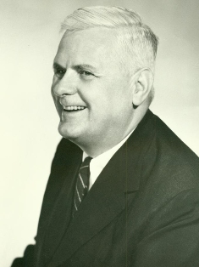
What is Functional Programming?
Notes:
The first functional programming language Lisp, developed by John McCarthy in the 1950s. It was a very simple language that essentially implemented the Lambda Calculus. However it is still in use today through variants such as Clojure, Scheme and eLisp (emacs).

Slide 4
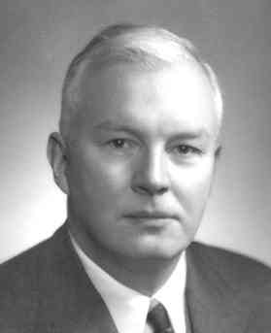
What is Functional Programming?
Notes:
The first functional programming language Lisp, developed by John McCarthy in the 1950s. It was a very simple language that essentially implemented the Lambda Calculus. However it is still in use today through variants such as Clojure, Scheme and eLisp (emacs).

Slide 5

What is Functional Programming?
Notes:
The first functional programming language Lisp, developed by John McCarthy in the 1950s. It was a very simple language that essentially implemented the Lambda Calculus. However it is still in use today through variants such as Clojure, Scheme and eLisp (emacs).

Slide 6
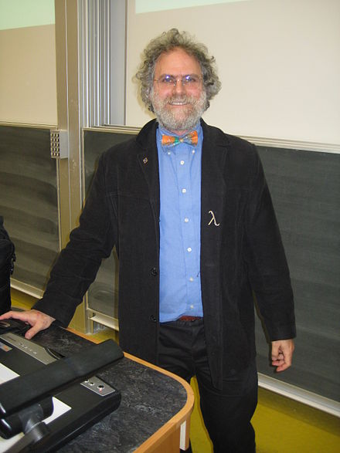
What is Functional Programming?
Notes:
The first functional programming language Lisp, developed by John McCarthy in the 1950s. It was a very simple language that essentially implemented the Lambda Calculus. However it is still in use today through variants such as Clojure, Scheme and eLisp (emacs).

Slide 7
What is Functional Programming?
Notes:
The first functional programming language Lisp, developed by John McCarthy in the 1950s. It was a very simple language that essentially implemented the Lambda Calculus. However it is still in use today through variants such as Clojure, Scheme and eLisp (emacs).

Slide 8
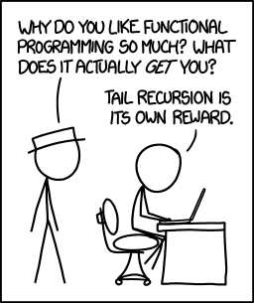
What Characterises Functional Programming?
First-class and higher-order functions
lambdas
closures
Immutable state
Use of recursion
Declarative style
Lazy evaluation
Type inference

Slide 9
What are FP's Strong Points?
Higher-order functions and declarative style
concise expression of algorithms
efficient implementation
Immutable state
less concern with concurrency problems
easy parallelization
Especially well suited to Big Data processing
declarative style allows flexibility of implementation
thanks to ease of parallelization

Slide 10
Functional Programming in Scala
We have already seen "functions" in Scala
These are not strictly speaking first class functions
E.g. cannot be assigned
scala> def twice ( i: Int ) = i * 2
twice: (i: Int)Int
scala> twice(3)
res59: Int = 6
scala> val doubleIt = twice
<console>:12: error: missing argument list for method twice
…

Slide 11
Functional Programming in Scala
First class functions are objects
doubleIt is an instance of a type that extends Function1[Int, Int]
trait
How does the function get called?
Many other Functionn types – up to Function22[…]
scala> val doubleIt = (n: Int) => n * 2
doubleIt: Int => Int = <function1>
scala> doubleIt(3)
res60: Int = 6

Slide 12
Function Literals
AKA Lambda Expressions
scala> (n: Int) => n * n
res61: Int => Int = <function1>
scala> ( (n:Int) => n * n )(10)
res62: Int = 100
scala> val squareIt = (n: Int) => n * n
squareIt: Int => Int = <function1>
scala> (a: Int, b: Int) => a + b
res65: (Int, Int) => Int = <function2>
scala> ((a: Int, b: Int) => a + b)(4,3)
res66: Int = 7

Slide 13
Higher Order Functions
Functions that take other functions as arguments
scala> val doIt = ( i: Int, f: Int => Int ) => f(i)
doIt: (Int, Int => Int) => Int = <function2>
scala> doIt(10, doubleIt)
res63: Int = 20
scala> doIt(10, squareIt)
res64: Int = 100

Slide 14
Function Composition
Chaining function invocations, building a pipeline of processing
Fundamental principle of functional programming
scala> val f = (x: Int) => x + 1
f: Int => Int = <function1>
scala> val g = (x: Int) => x * 2
g: Int => Int = <function1>
scala> f(2)
res199: Int = 3
scala> g(2)
res200: Int = 4

Slide 15
Function Composition
Chaining function invocations, building a pipeline of processing
Fundamental principle of functional programming
scala> val f = (x: Int) => x + 1
f: Int => Int = <function1>
scala> val g = (x: Int) => x * 2
g: Int => Int = <function1>
scala> val h = f compose g
h: Int => Int = <function1>
scala> f(2)
res199: Int = 3
scala> g(2)
res200: Int = 4
scala> h(2)
res202: Int = 5

Slide 16
Function Composition
Chaining function invocations, building a pipeline of processing
Fundamental principle of functional programming
scala> val f = (x: Int) => x + 1
f: Int => Int = <function1>
scala> val g = (x: Int) => x * 2
g: Int => Int = <function1>
scala> val j = g compose f
j: Int => Int = <function1>
scala> f(2)
res199: Int = 3
scala> g(2)
res200: Int = 4
scala> j(2)
res203: Int = 6

Slide 17
Function Composition
Chaining function invocations, building a pipeline of processing
Fundamental principle of functional programming
scala> val f = (x: Int) => x + 1
f: Int => Int = <function1>
scala> val g = (x: Int) => x * 2
g: Int => Int = <function1>
scala> val k = f andThen g
k: Int => Int = <function1>
scala> f(2)
res199: Int = 3
scala> g(2)
res200: Int = 4
scala> k(2)
res201: Int = 6

Slide 18
Higher Order Functions
Functions that return functions
scala> val multBy = (n: Int) => ( (x: Int) => x * n )
multBy: Int => (Int => Int) = <function1>
scala> val double = multBy(2)
double: Int => Int = <function1>
scala> val triple = multBy(3)
triple: Int => Int = <function1>
scala> double(4)
res67: Int = 8
scala> triple(4)
res68: Int = 12

Slide 19

Closures
Function definition may refer to external values
Function "captures" or "closes over" these external values
Beware closing over mutable state!
scala> var extVal = 100
extVal: Int = 100
scala> def foo(n: Int): Int = n * extVal
foo: (n: Int)Int
scala> foo(2)
res0: Int = 200
scala> extVal = 200
extVal: Int = 200
scala> foo(2)
res1: Int = 400

Slide 20
Methods and Functions
Method can be converted to a function object
"lifting"
Use explicit type
Use special syntax
def myMethod(a: Int) = a + 10
scala> val myMethod3: Int => Int = myMethod
myMethod3: Int => Int = <function1>
scala> myMethod3(10)
res10: Int = 20
scala> val myMethod2 = myMethod _
myMethod2: Int => Int = <function1>
scala> myMethod2(10)
res8: Int = 20

