Slide 1

Media, Image and Marketing
Diana J. Mason, PhD, RN, FAAN
Rudin Professor
Director, Center for Health, Media & Policy
Hunter College, City University of New York
Diana.mason@hunter.cuny.edu
www.centerforhealthmediapolicy.com

Slide 2
Experience with Media?
Positive and not-so-positive?
Goals for today

Slide 3
Objectives
New media vs. traditional media
Framing for a target audience
Strategies for accessing media
Strategies for working with journalists and tips for being interviewed

Slide 4
Last Year’s Best Headlines
Or don’t believe everything you read in the papers…
Columbia School of Journalism

Slide 5
“A Reason for Odor Found at Sewer Plant”
The Sand Mountain Reporter (Albertville, AL)
1/27/04

Slide 6
“Prostate Cancer More Common in Men”
The Hermann Advertiser-Courier, Hermann, MO.

Slide 7
“Tips to Help Prevent Headaches After You Die”
The Record (Hackensack, NJ)
1/22/04

Slide 8
“Never Withhold Herpes From a Loved One”

Slide 9
The Power of Media in an Information Age

Slide 10

Power of Media in an Information Age
Information overload

Slide 11
Power of Media in an Information Age
Information overload
Power = Capturing your attention

Slide 12
Power of Media in an Information Age
Information overload
Power = Capturing your attention
Extraordinary power = Changing your values, beliefs, behaviors

Slide 13
Power of Media in an Information Age
Information overload
Power = Capturing your attention
Extraordinary power = Changing your values, beliefs, behaviors
Accessing media is highly competitive: think strategically

Slide 14
why do media?
Notes:
1) To inspire people to take action 2)To influence policy 3)To establish your expertise

Slide 15
Importance of Sharing Your Expertise
Public’s health
Promoting evidence-based practice
Advancing different perspectives on health and health care
Inspire people
Establish your expertise
Influence Policy
Notes:
I’ll do this

Slide 16
News media are key to getting our messages to the public and policymakers.
Agenda-setting
Grassroots mobilization
Media advocacy

Slide 17
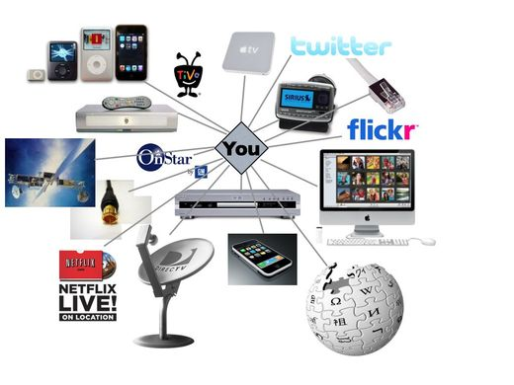
Possibilities
Translational paper
Commentaries and narratives in scholarly publications
Op eds in news media
Policy brief
Broadcast media
Social media

Slide 18
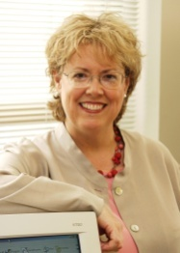






Diana J. Mason, PhD, RN, FAAN
Rudin Professor of Nursing
www.centerforhealthmediapolicy.com
Healthstyles
@djmasonrn

Slide 19
Blogging
Disruptive Women in Health Care
www.disruptivewomen.net
JAMA Forum
www.newsatjama.jama.com
Center for Health, Media & Policy at Hunter College
www.centerforhealthmediapolicy.com

Slide 20
What do you do when a journalist contacts you for an interview?

Slide 21
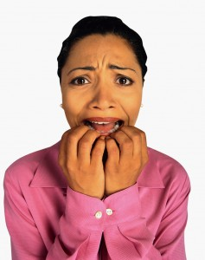

Slide 22
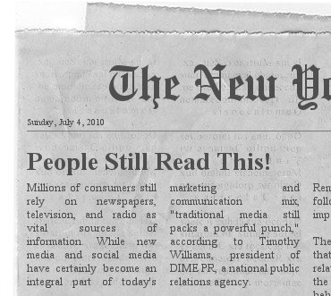

If we want to be leaders in health care, we must understand how to respond to and be proactive with traditional and new media

Slide 23
“Expert” Sources
Specializes in research area on the story topic
Ability to explain complicated medical information in layperson’s terms
Treats patients
Professional rank and affiliation
Quotability
Degrees earned
Hinnant & Len-Rios (2009). Tacit Understandings of Health Literacy: Interview and Survey Research With Health Journalists. Science Communication.

Slide 24


Slide 25
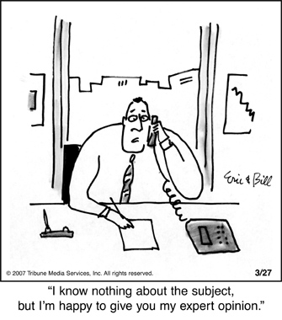

Slide 26
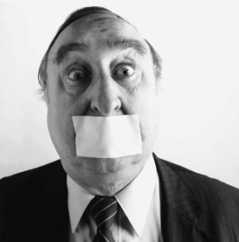
Barriers
Fear
Access to journalists
Framing
Translating research and
jargon
Institutional policies

Slide 27
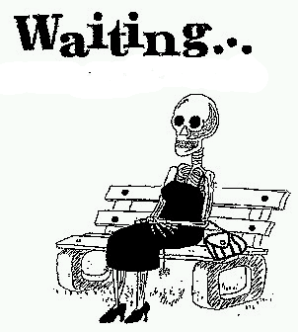
In a Web 2.0 world, you do not need to wait for journalists to come to you to disseminate your work.

Slide 28
Access to Media to Shape the Message
Entertainment Traditional Social
Media News Media Media
Hard to Easy to
Access Access

Slide 29
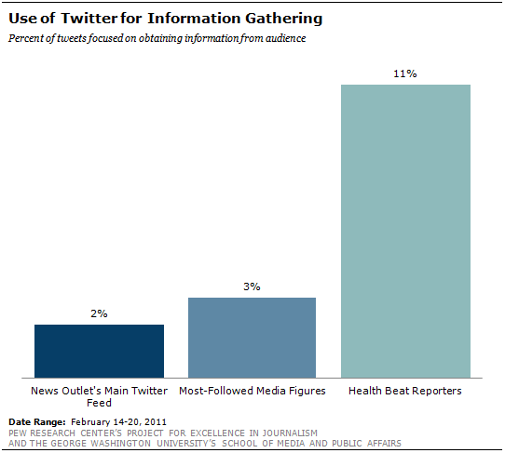

Slide 30

New Media Opportunities
Dedicated web site/page with user-friendly url
Social networks (your own or others’)
Facebook
Twitter
Blogs

Slide 31

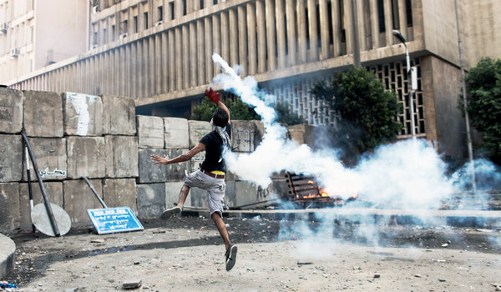

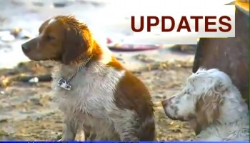
Framing for Accessing Media: What Makes the News?
Controversy
Injustice
Sensation
Timeliness
Prominence
Conflict
Novelty
Emotional

Slide 32
How you can access media
Call in on talk radio
Write Op-ed pieces
Write letters to editors
Explore starting radio or TV program
Use social media
Get media training/coaching
Press releases, media advisories

Slide 33
Be Responsive to Journalists

Slide 34

How to ace an interview

Slide 35


Be authentic
Have a message plan
Have fun

Slide 36
Message Plan and Framing

Slide 37

VALUES
BELIEFS
ATTITUDES
Who am I trying to reach?

Slide 38

What am I trying to get them to do?

Slide 39
Create three key messages
Values, attitudes, beliefs of audience

Slide 40
Framing for advocacy
Careful use of language and images
Images for TV and print
Create the rhetoric
Designated Driver
“Preserving Medicare” vs. “Cutting Medicare”
Social Security: “Personal accounts” vs. “privatization”

Slide 41
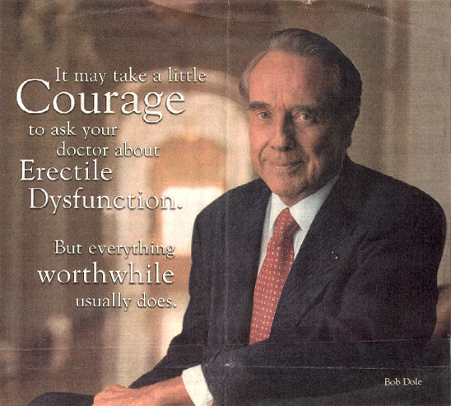

Slide 42
Frame your language to fit the audience you are trying to reach

Slide 43
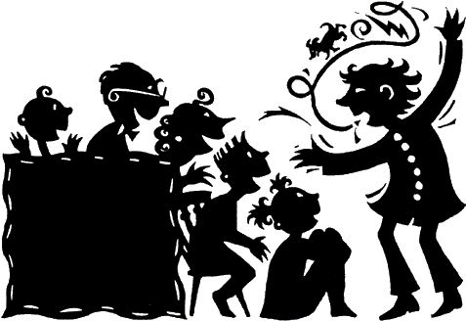
What is the story you have to tell?

Slide 44
Use a personal story or anecdote to make your message stick

Slide 45

Paint a Picture
Data can be overwhelming for a lay audience.
Select one or two key statistics.
Life-like examples put meat around the bones of the story.

Slide 46
Reporters primarily want two things: An interesting story and an interesting person to interview

Slide 47
You want to be quotable & memorable

Slide 48
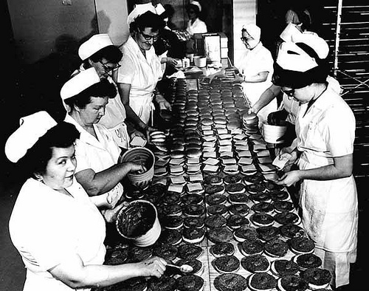
Be Prepared
Write down the three major points you want to make.
Anticipate likely questions.
Have facts at hand
Know what you’re going
to say.
Know why you are going
to say it.

Slide 49
Key Messaging Techniques

Slide 50
Responding to Questions and Taking Charge of the Interview
?
?
?
?
?
?
?
?
?
?
?

Slide 51
Common Pitfalls
Do more than give a yes or no answer to the question.
Don’t speak off the record or say “No Comment” or “I don’t know.”

Slide 52
Common Pitfalls
Don’t give answers that are too long and rambling.
Don’t overwhelm with statistics.
Notes:
52

Slide 53
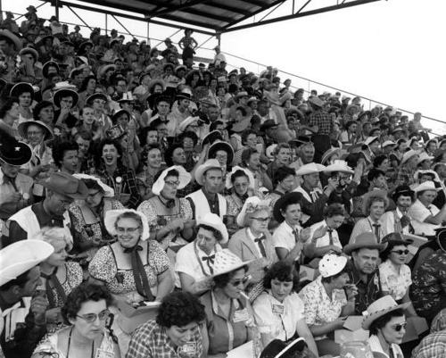
Remember Your Audience
Your audience is the person
at home reading the article,
watching or listening to the
program.
Speak in language that
anyone can understand.
Avoid complex medical terms
or jargon.
Some medical/science
reporters are knowledgeable
about their beat.

Slide 54

People Are the Story
Use patient/subject examples as often as possible.
Need permission of patient/subject or must change details so not recognizable.
Is patient/subject willing to tell his or her story to the media?

Slide 55
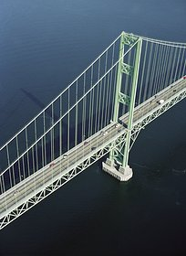
Bridging
Used when asked a question not on your agenda.
Briefly respond to (acknowledge) the question before moving or “bridging” to your key messages.

Slide 56
Simple Bridges
“That was the case previously. Today, what happens is …”
“I don’t know the answer to that. What I do know is …”
“That used to be important. What’s changed is …”
“That’s a good question, but the important thing I’d like you to know …”
“Yes, and furthermore …”

Slide 57
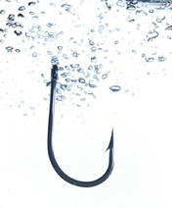
Hooking
Leave a sweet taste at the end of something you’ve said so that the reporter will want to ask you a follow-up question.
Turns monologue into dialogue.
Creates opening for the reporter to ask follow-up question.
Adds credibility by involving the reporter in the conversation. The stage is set for you to emphasize key points.

Slide 58
Sample Hooks
“You’d be surprised at what our research indicates …”
“We found several things that are particularly important …”

Slide 59

Flagging
Plant a flag or highlight a point with your voice or by using superlative expressions.
A way of underscoring what is important either through repetition or by saying:
“The most exciting part of this research is”
“If there’s one thing you need to know it’s”

Slide 60
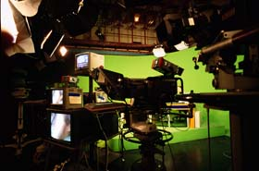
Presentation Basics
How to speak
What to wear
What to drink
How to relate to the
interviewer
How to relate to the
audience
How to handle
disagreement with the
interviewer or other guest

Slide 61
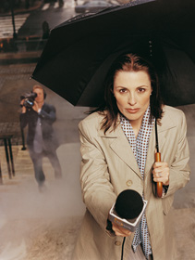
Your worst fears…
I’ll be misquoted
I’ll forget what I’m saying
I’ll say the wrong thing
My work will be attacked
And…

Slide 62
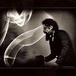
Accessing Media

Slide 63

Building relationships with journalists
Respond stat
Ask about deadline
Offer to call back once you have your thoughts together, if necessary
Offer to be a resource
For interviews
To recommend others
Don’t always expect to be quoted; you can still shape the journalist’s story

Slide 64
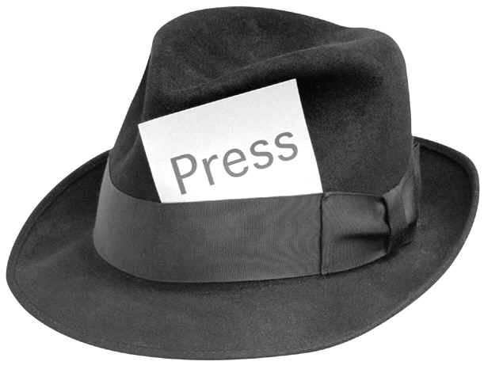
Discussions with journalists
Journalists have little time and often are on deadline; help them.
The story or part of the story or neither?
Roche, J.P. (2002). Print media coverage of risk-risk tradeoffs associated with West Nile Encephalitis and pesticide spraying. Journal of Urban Health, 79(4), 482-490.
Level of precision: “deadly virus”
vs. “10 people died” vs. “5% or
5 of 100 people were infected”
Become a trusted source

Slide 65

Media Resources
University or health care employer
Funder
Health-related or nursing organization most pertinent to your work
Social media

Slide 66

Working with PR
Talk to your facility’s PR department before you agree to an interview.
Institution’s guidelines
Deciding whether to use your affiliation
When working with external PR people, tell them everything.

Slide 67
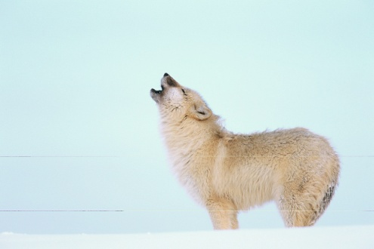
PR Department
Develop a comprehensive strategy to saturate media with your message
Connections with print and broadcast media
Help with framing and messaging
Consider developing a press event with online component
Flip cameras, recorders and other accessible AV equipment

Slide 68
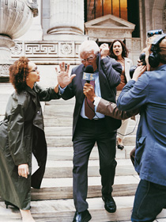
Questions?
Diana.mason@hunter.cuny.edu

