Slide 1
COSC 3P96 | Machine Learning
Project Overview
Ensemble Learning for Robust Facial Attribute Classification
• Three tree-based classifiers compared on a real binary classification task
• Decision Tree → Random Forest → AdaBoost
• 202 000 CelebA celebrity images, 39 binary facial attributes
• Goal: predict whether a person is Smiling
• "One tree makes mistakes → many trees fix each other → a smarter trainer focuses on hard cases"
Dataset: CelebA Target: Smiling
March 2026

Slide 2
02 Dataset Overview
CelebA Dataset
Class Balance
Train / Val / Test Split
• 202 000 celebrity photos
• 40 binary facial attributes per image
• Drop 'Smiling' → 39 input features
• All features are ±1 (converted to 0/1)
• Widely used CV fairness benchmark
• ~48 % labelled Smiling
• ~52 % labelled Not Smiling
• Near-perfect balance → accuracy is a meaningful metric
• No need for class-weighted scoring
• Stratified splits preserve the 48 % rate in every subset
• 60 % Training – fit model weights
• 20 % Validation – tune hyperparams (depth, n_estimators)
• 20 % Test – held out until the end; unbiased performance estimate
• NEVER tune on the test set
• stratify=y used throughout

Slide 3
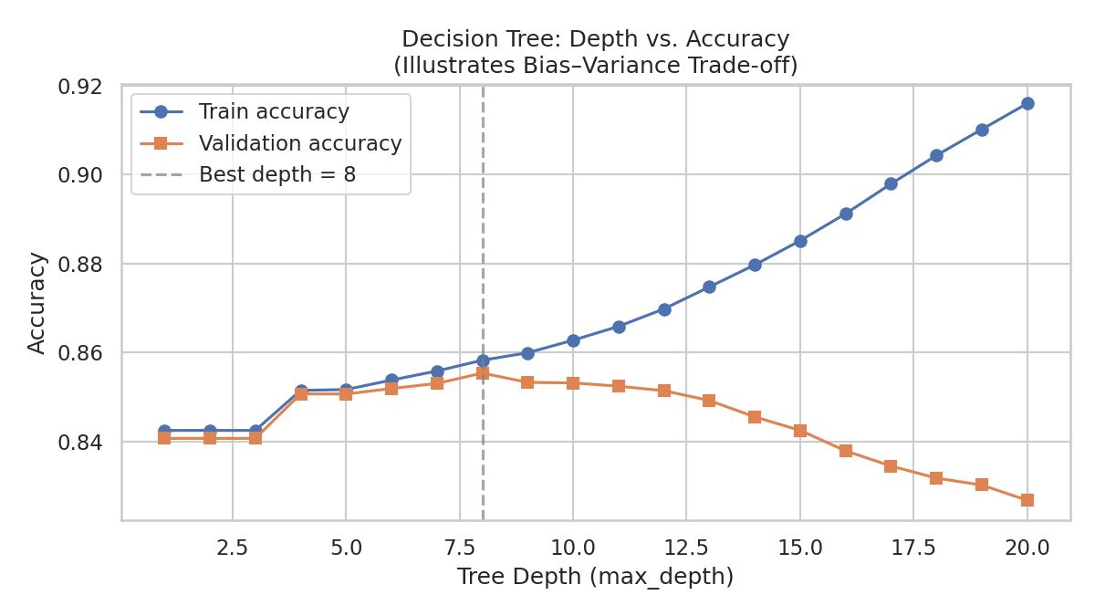
03 Baseline: Decision Tree
• Recursively splits data on the most informative feature
• Split criterion: Gini impurity (1 − Σpᵢ²) Pure node → 0; 50/50 node → 0.5
• Key hyperparameter: maximum depth
• Shallow → high bias (underfits)
• Deep → high variance (overfits, memorises noise)
• Sweet spot found at depth = 3 on validation set
• random_state=42 for full reproducibility
Fig 1: Depth vs Accuracy — the bias–variance trade-off

Slide 4
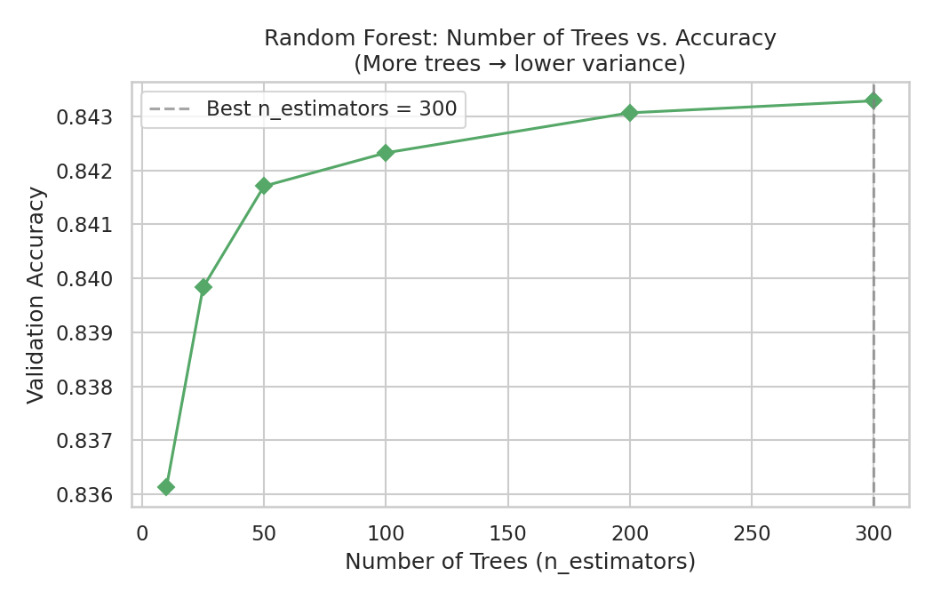
04 Bagging: Random Forest
• Grow many trees, take a majority vote
• Two sources of randomness → decorrelated trees:
• Bootstrap sampling: each tree trained on a random draw of N samples with replacement (~63 % unique)
• Feature subsets: each split considers only √p features → prevents one strong feature from dominating
• Averaging T uncorrelated estimators reduces variance by ~factor of 1/T
• Accuracy stabilises after ~100 trees (see Fig 2)
• Adding more trees never hurts — it just stops helping
• Best n_estimators from validation; retrain on train+val before final test evaluation
Fig 2: n_estimators vs Validation Accuracy

Slide 5
05 Boosting: AdaBoost
How AdaBoost Works
Sequential Training Flow
• Builds weak learners (stumps, depth=1) sequentially
• After each stump, up-weight misclassified samples
• Stump voting weight: α = ½ ln((1−ε)/ε)
• Lower error → larger α → more say in final vote
• 200 stumps, learning_rate = 0.5
• Reduces bias (not variance like RF)
1. Round 1: Equal weights (1/N)
2. Fit stump₁ → compute α₁
3. Up-weight misclassified samples
4. Round 2: Fit stump₂ on reweighted data
5. Repeat for 200 rounds
6. Final vote: Σ αₜ × stumptₜ(x)
RF vs AdaBoost at a Glance
 | Random Forest | AdaBoost
Trees built | In parallel | Sequentially
Main benefit | Reduces variance | Reduces bias
Sample strategy | Bootstrap (random) | Reweight hard samples
Sensitive to noise | No | Yes

Slide 6
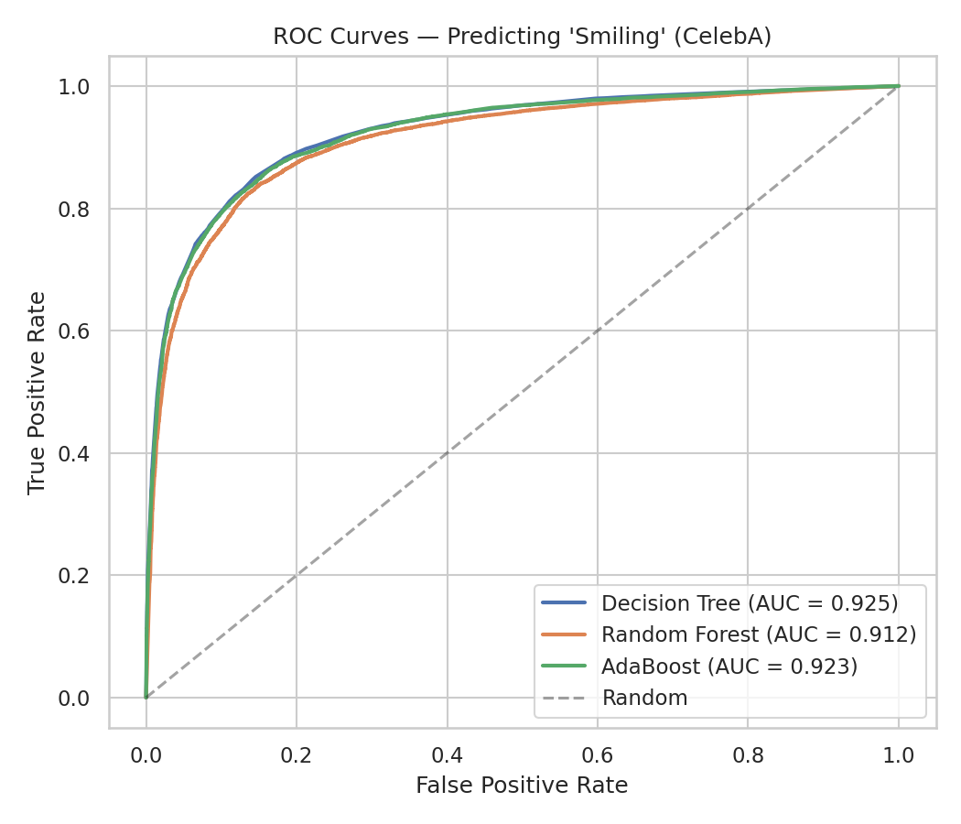
06 Results: ROC Curves
How to Read This Chart
• X-axis: False Positive Rate (wrongly flagged non-smiles)
• Y-axis: True Positive Rate (correctly detected smiles)
• Perfect model → top-left corner
• Random coin flip → diagonal
• AUC = area under curve; higher is better
• Ensemble curves bulge further toward top-left
• Gap largest at low FPR — the strict operating point
Fig 3: ROC Curves — all three models

Slide 7
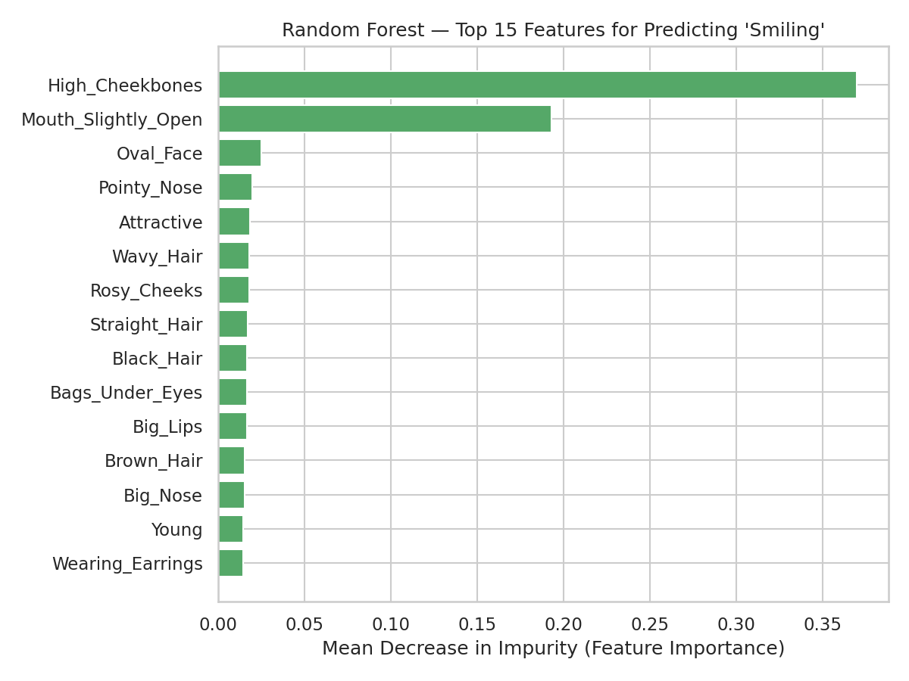
07 Results: Feature Importance (Random Forest)
What It Tells Us
• Importance = Mean Decrease in Impurity averaged over all trees & splits
• Top predictor: Mouth_Slightly_Open → smiling parts the lips / exposes teeth
• High_Cheekbones → smiling raises cheeks
• Attractive → smiling is an attractive facial expression
• Sanity-check: features align with anatomical & social intuition
• MDI measures predictive correlation, not causation
• All features binary → MDI bias toward high-cardinality features is minimal
Fig 4: Top-15 Feature Importances (MDI)

Slide 8
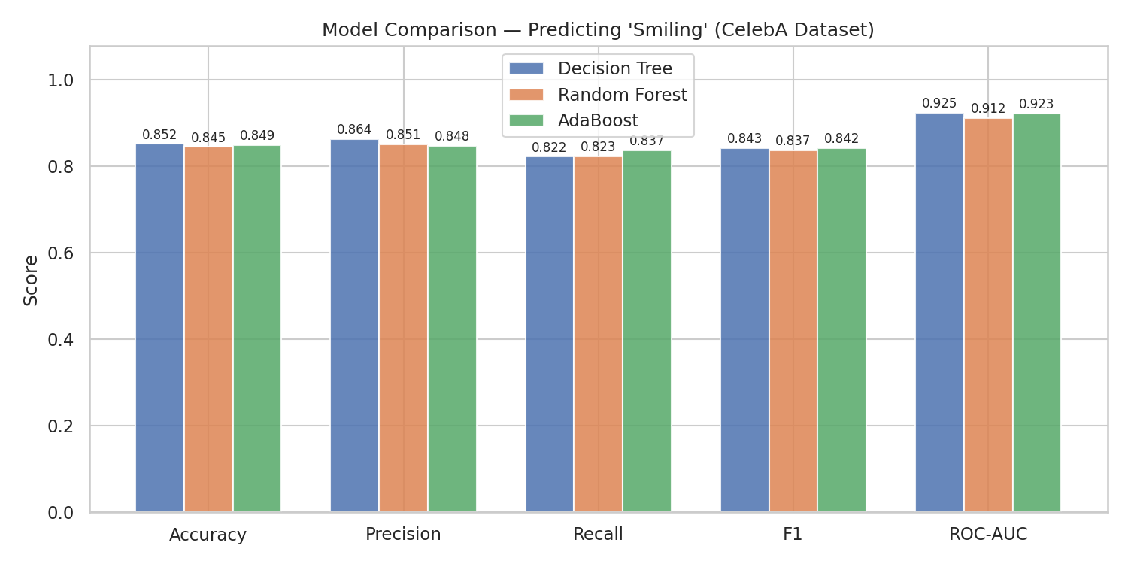
08 Results: Metric Comparison
Metric Definitions
Accuracy
(TP+TN)/N — reliable when balanced
Precision
TP/(TP+FP) — few false alarms
Recall
TP/(TP+FN) — few missed detections
F1
Harmonic mean of P & R
ROC-AUC
Ranking quality; threshold-independent
Fig 5: Accuracy / Precision / Recall / F1 / AUC across all models
Both ensemble methods match or beat the single Decision Tree across all 5 metrics

Slide 9
09 Discussion & Conclusion
Key Findings
Future Work
• Combining learners produces more robust classifiers
• Random Forest reduced variance via bagging of decorrelated trees
• AdaBoost reduced bias via sequential reweighting
• Both outperformed the single Decision Tree across all five metrics
• Top features (Mouth_Slightly_Open, High_Cheekbones) align with anatomical intuition
• Gradient Boosted Trees — XGBoost / LightGBM — typically outperform AdaBoost on tabular data
• Grid search over learning_rate, depth, n_estimators
• Permutation importance / SHAP for more robust feature attribution
• k-fold cross-validation for lower-variance generalisation estimates
• CNN operating on raw CelebA pixels
Limitations
"One tree makes mistakes → many trees fix each other → a smarter trainer focuses on hard cases."
• Attribute labels only — not raw pixels
• Label noise from human annotators (hurts AdaBoost)
• CelebA skews toward lighter skin tones → fairness risk
• A CNN on raw images would push accuracy much higher

