Slide 1

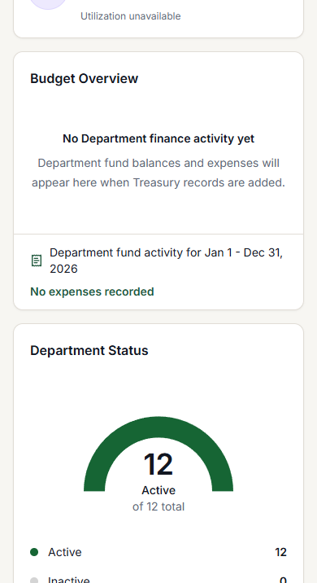
DEVELOPMENT PREVIEW
Church Administration
& Member Portal
A practical introduction to the two connected workspaces in the MPG Church System.
Administrator tutorial · Member first-use guide
10–15 MINUTE GUIDED TOUR
DEVELOPMENT PREVIEW · MPG CHURCH SYSTEM
01
Notes:
Purpose: Welcome the audience and set the scope.
Presenter cue: Explain that this is a Development Preview and a short guided tour—not a production-readiness claim.
Click path: None.
Screenshot pointer: The phone image is a sanitized mobile administration view.
Animation: Native Fade transition on slide advance.
Limitation: Conference, public registration, installation, and technical setup are not part of this presentation.
[Sources]
- E:/mpg-church-system/public/icons/icon-512.png
- E:/mpg-church-system/artifacts/ministry-workspace/admin-390.png

Slide 2
ORIENTATION
Two workspaces. One connected church.
The same church information is presented differently according to responsibility.
ADMINISTRATION
MEMBER PORTAL
Run the work
Stay connected
+
Members · households · attendance
Ministries · events · treasury
Approvals · access · reports
Home · ministries · events
Recorded giving · profile
Personal information at a glance
For authorized church workers
For each church member
DEVELOPMENT PREVIEW · MPG CHURCH SYSTEM
02
Notes:
Purpose: Distinguish the two experiences before teaching either one.
Presenter cue: Administration is operational; the Member Portal is personal and simpler. Both use the current church context.
Click path: Administration routes begin under /c/[churchSlug]; member routes begin under /my/[churchSlug].
Animation: Native Fade transition. Pause on the left, then compare with the right.
Limitation: The exact items visible depend on assigned role and available preview data.
[Sources]
- E:/mpg-church-system/src/components/church-workspace/shell/navigation.ts
- E:/mpg-church-system/src/app/(member)/my/[churchSlug]/components/MemberPortalShell.tsx

Slide 3
ACCESS
Your role shapes what you can see and do
Use the least access needed for the responsibility—not one shared administrator login.
PERSONAL VIEW
FULL CHURCH OVERSIGHT
Member
Department
Leader
Clerk
Treasurer
Pastor
Administrator
Three safe habits
01 Use individual accounts
02 Match access to responsibility
03 Review access regularly
DEVELOPMENT PREVIEW · MPG CHURCH SYSTEM
03
Notes:
Purpose: Explain role-based visibility without teaching technical permissions.
Presenter cue: Move left to right: personal access becomes more operational as responsibility increases. Mention that roles are examples, not a promise that every installation uses identical assignments.
Click path: Church workspace → Invites & Access for authorized users.
Animation: Native Fade transition; reveal the role spectrum verbally from left to right.
Limitation: A role label does not automatically guarantee every module; access remains responsibility-based.
[Sources]
- E:/mpg-church-system/src/components/church-workspace/shell/navigation.ts

Slide 4
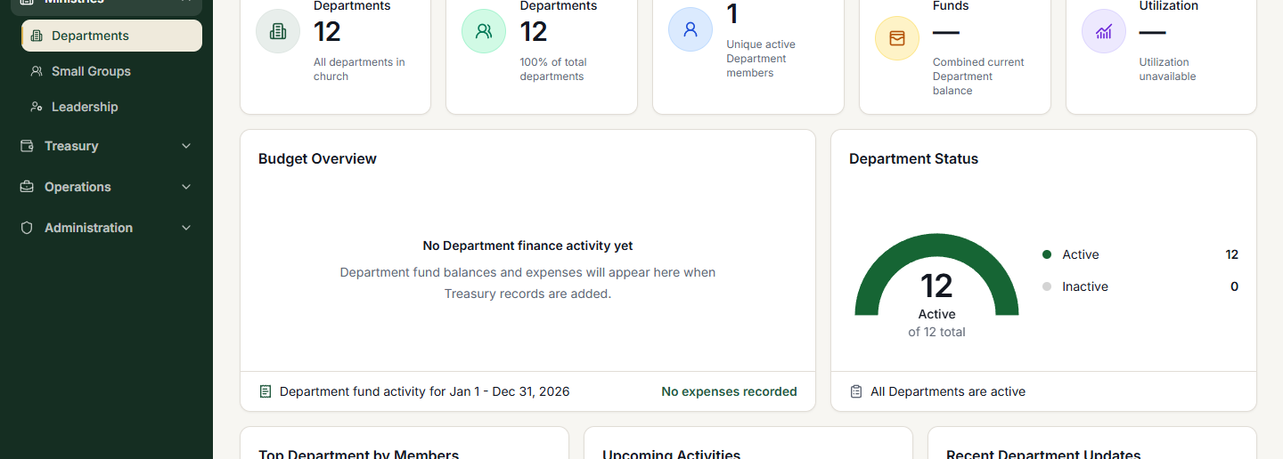
ADMINISTRATOR WORKSPACE
Start with the workspace anatomy
The navigation gives you context; the central workspace is where church work happens.
SANITIZED ADMIN VIEW
2
Tabs and live controls
1
Navigation by area
3
Live status + totals
DEVELOPMENT PREVIEW · MPG CHURCH SYSTEM
04
Notes:
Purpose: Give administrators a map before demonstrating tasks.
Presenter cue: Point to 1) the left navigation, 2) tabs and actions inside the active workspace, and 3) live status and totals.
Click path: Sign in → select the appropriate church workspace → Dashboard or a navigation item.
Screenshot pointer: The screenshot is sanitized and shows the Departments overview in an administrator session.
Animation: Native Fade transition; introduce callouts in numeric order.
Limitation: Counts and visible actions vary with church data and account access.
[Sources]
- E:/mpg-church-system/artifacts/ministry-workspace/admin-1440.png
- E:/mpg-church-system/src/components/church-workspace/shell/navigation.ts

Slide 5
ADMINISTRATOR TUTORIAL
People and households: find, open, review
Use the registry for the person; use the household view for the family context.
1
2
3
4
Open Members
Search or filter
Open the record
Check household
Choose People → Members.
Use name, status, or ministry context.
Review details before making changes.
Confirm family and relationship context.
Nearby workspaces
Households · Attendance · Departments and small groups
Use only the module needed for the task in front of you.
DEVELOPMENT PREVIEW · MPG CHURCH SYSTEM
05
Notes:
Purpose: Teach a safe first workflow without overpromising record-edit behavior.
Presenter cue: Emphasize search first, then open and review the right person before proceeding. Household context is separate from the individual record.
Click path: People → Members → search/filter → select a member; People → Households for family context.
Animation: Native Fade transition; teach the four steps left to right.
Limitation: Available actions and fields depend on role, status, and current preview behavior.
[Sources]
- E:/mpg-church-system/src/app/(church)/c/[churchSlug]/members/page.tsx
- E:/mpg-church-system/src/components/church-workspace/shell/navigation.ts

Slide 6
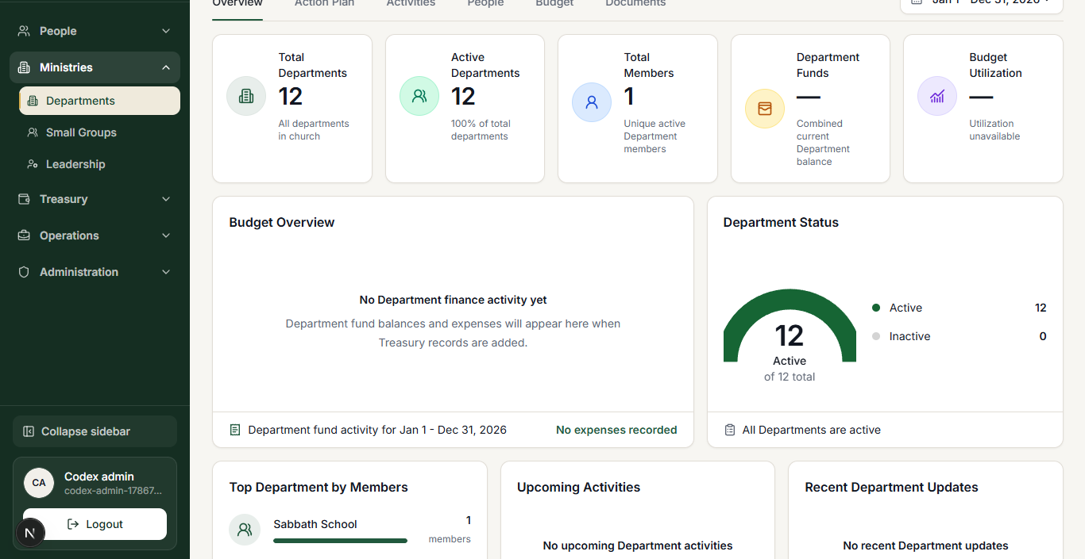
ADMINISTRATOR TUTORIAL
Ministries: move from overview to action
Departments bring people, activities, plans, and budget context into one shared workspace.
A SIMPLE ROUTE
REAL PREVIEW SCREEN
1 · Workspace tabs
Open Departments
2 · Live summary
Choose a department or team
Use the workspace tabs
Overview · Action Plan · Activities
People · Budget
3 · Open details
Keep the task in its ministry context.
DEVELOPMENT PREVIEW · MPG CHURCH SYSTEM
06
Notes:
Purpose: Show how one ministry workspace supports coordinated work.
Presenter cue: Open Departments, choose the right ministry, then move across the relevant tabs. Keep activities and people attached to their ministry context.
Click path: Ministries → Departments → select a department → choose Overview, Action Plan, Activities, People, or Budget.
Screenshot pointer: The image is a sanitized real preview of the Departments workspace.
Animation: Native Fade transition; introduce the three screenshot pointers in order.
Limitation: Documents are intentionally not taught because a complete upload workflow is not verified in this preview.
[Sources]
- E:/mpg-church-system/artifacts/ministry-workspace/admin-1366.png
- E:/mpg-church-system/src/app/(church)/c/[churchSlug]/departments/components/DepartmentsTabBar.tsx

Slide 7
ADMINISTRATOR WORKSPACE
Responsible administration lives in three lanes
Use the lane that matches the decision, record, or review you are performing.
01
02
03
Governance & records
Stewardship & reporting
Roles & setup
Church Office
Approvals
Treasury
Reports
Invites & Access
Settings
Formal records and review queues.
Financial context and summaries.
Who can enter and how the workspace is configured.
DEVELOPMENT PREVIEW · MPG CHURCH SYSTEM
07
Notes:
Purpose: Group advanced administrator modules by responsibility so the navigation feels manageable.
Presenter cue: Governance handles records and approval work; stewardship covers treasury and reports; access and settings manage entry and configuration.
Click path: Use the left navigation to open Church Office, Approvals, Treasury, Reports, Invites & Access, or Settings.
Animation: Native Fade transition; present the three lanes from left to right.
Limitation: Some lanes are hidden unless the signed-in user has the appropriate role.
[Sources]
- E:/mpg-church-system/src/components/church-workspace/shell/navigation.ts

Slide 8
ADMINISTRATOR TUTORIAL
Assign access with purpose
Before adding access, identify the responsibility—and avoid shared credentials.
1
Open Invites & Access
ACCESS PRINCIPLE
Administration navigation
Enough to serve.
No more than needed.
2
Find the person or invite
Confirm the correct identity
3
Choose the needed role
Match real responsibility
Review access when responsibilities change.
4
Review and save
Recheck before confirming
DEVELOPMENT PREVIEW · MPG CHURCH SYSTEM
08
Notes:
Purpose: Teach the basic access-assignment sequence and a safe operating principle.
Presenter cue: Confirm the person, choose only the role needed, and review before saving. Never share one administrator account across a team.
Click path: Administration → Invites & Access → person/invite → role or access → review/save.
Animation: Native Fade transition; teach steps top to bottom.
Limitation: Exact controls and selectable roles depend on the signed-in user’s authority.
[Sources]
- E:/mpg-church-system/src/components/church-workspace/shell/navigation.ts

Slide 9
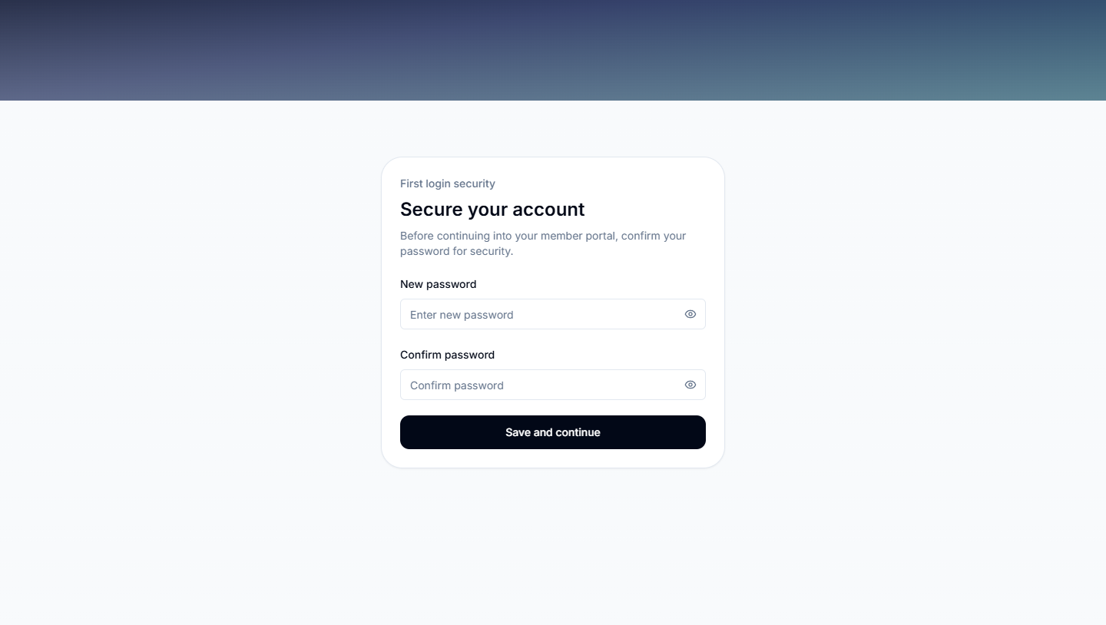
MEMBER PORTAL
A simpler, personal view of church life
Members see the information most relevant to them—without the administration workspace.
FIVE MAIN AREAS
SECURE FIRST SIGN-IN
1
Home
2
Ministries
3
Events
4
Giving
5
Profile
First sign-in
Confirm your password before continuing.
DEVELOPMENT PREVIEW · MPG CHURCH SYSTEM
09
Notes:
Purpose: Orient members to the personal portal and its first-sign-in safeguard.
Presenter cue: The portal has five main areas. On first sign-in, the member may need to confirm a password before reaching Home.
Click path: Sign in → select/open Member Portal → complete first-login password confirmation if shown.
Screenshot pointer: The image is a sanitized real preview of the first-login gate.
Animation: Native Fade transition; name the five areas, then point to the secure-entry screen.
Limitation: Portal content depends on published events and recorded church data.
[Sources]
- E:/mpg-church-system/artifacts/ministry-workspace/leader-scope-1440.png
- E:/mpg-church-system/src/app/(member)/my/[churchSlug]/components/MemberPortalShell.tsx

Slide 10
MEMBER TUTORIAL
Your first five minutes in the portal
Start at Home, then follow the area that answers your question.
HOME
MINISTRIES
1
Sign in
Use your individual account.
2
Open Member Portal
Select the church context if prompted.
3
Read the Home snapshot
Check Next Up, membership, and quick access.
4
Choose one area
Ministries, Events, Giving, or Profile.
5
Review the information
Contact church administration if something needs correction.
DEVELOPMENT PREVIEW · MPG CHURCH SYSTEM
10
Notes:
Purpose: Give members a repeatable first-use path.
Presenter cue: Start with Home because it summarizes what is next and provides quick links. Choose Ministries for team context, Events for published events, Giving for recorded contributions, and Profile to review personal details.
Click path: Sign in → Member Portal → Home → Ministries / Events / Giving / Profile.
Animation: Native Fade transition; count through the five steps.
Limitation: The deck does not promise direct editing of every profile field. If information is incorrect, follow the church’s normal support process.
[Sources]
- E:/mpg-church-system/src/features/member-portal/components/MemberPortalHomeModule.tsx
- E:/mpg-church-system/src/features/member-portal/components/MemberPortalEventsModule.tsx
- E:/mpg-church-system/src/features/member-portal/components/MemberPortalGivingModule.tsx
- E:/mpg-church-system/src/features/member-portal/components/MemberPortalProfileModule.tsx

Slide 11
DEVELOPMENT PREVIEW
The right workspace
for the right responsibility
CHURCH WORKERS
MEMBERS
Use Administration to coordinate people, ministries, events, stewardship, approvals, access, and reports.
Use the Member Portal to stay connected through Home, Ministries, Events, Giving, and Profile.
NEXT STEP
Run a guided sign-in and complete one real task in each workspace.
DEVELOPMENT PREVIEW · MPG CHURCH SYSTEM
11
Notes:
Purpose: Close with a clear division of responsibility and a practical next action.
Presenter cue: Church workers operate the shared system; members use the personal portal. Invite the audience into a live, supervised demonstration using fictional or approved training data.
Click path: None on this slide; move into the live demonstration if scheduled.
Animation: Native Fade transition.
Limitation: Use only approved preview data and do not present the Development Preview as a certified production release.
[Sources]
- E:/mpg-church-system/public/icons/icon-512.png

