Slide 1
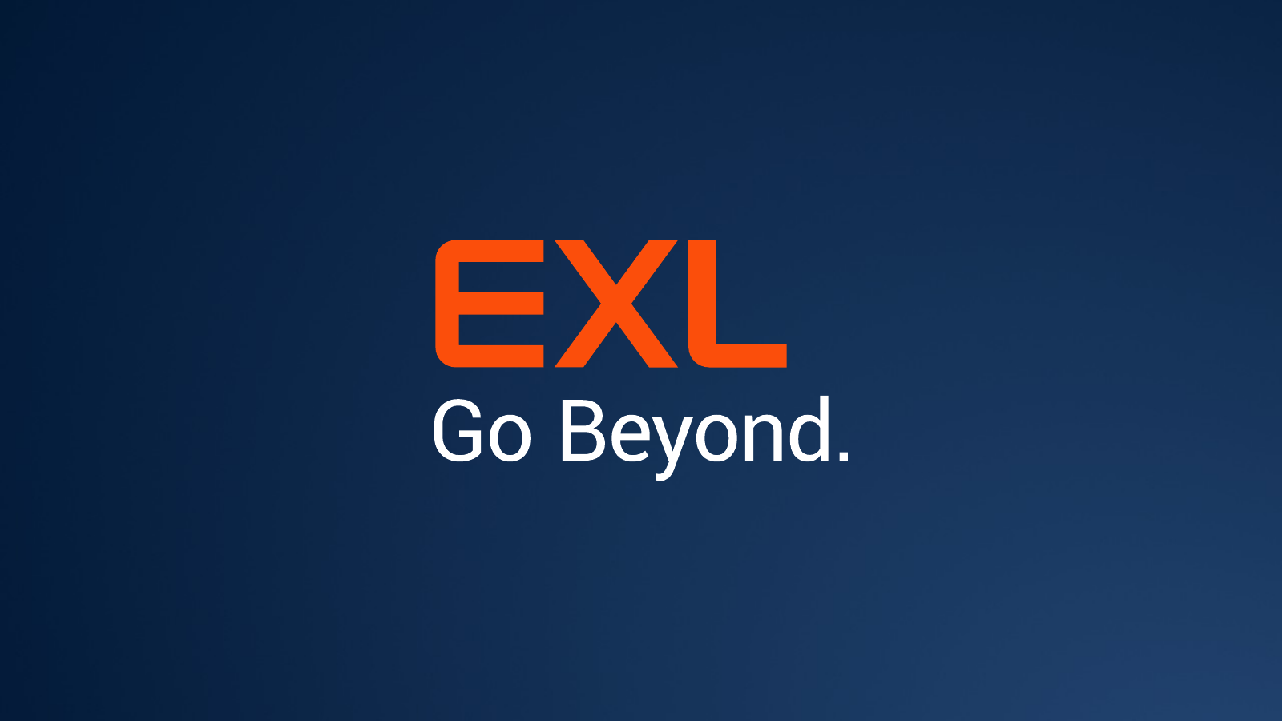

Slide 2



PROOF OF CONCEPT · HEALTHCARE APPEALS & GRIEVANCES
AI Assistant
DataTalk.AI
Which operational unit has the best TAT performance?
Ask your Appeals & Grievances data in plain English and get answers you can verify.
AI Insight Findings
Direct answer in plain English, written from the verified result.
The problem
Ad-hoc questions about SLA, compliance, overturns and backlog each need an analyst, a query, a chart and a write-up. Dashboards only cover questions someone anticipated.
Who it is for
Appeals operations leads, compliance and quality teams, business analysts.
Chart (illustrative)
Insight panel
Recommended actions
Exact SQL
The value
Answers from live Databricks data in one place: finding, charts, evidence, recommended actions and the exact SQL. AI interprets; code calculates.
Illustrative layout of an answer.
DataTalk.AI
EXL
1
Notes:
PURPOSE: introduce the POC in one minute.
Business problem: appeals teams are measured on turnaround (SLA) and compliance. Today every ad-hoc question needs an analyst, a SQL query, a chart and a written explanation, so answers are slow and dashboards only cover questions somebody anticipated.
What DataTalk.AI does: a user types (or speaks) a question; the app drafts a read-only database query, runs it on live Databricks data, and returns a direct finding, charts, an evidence-linked insight panel, recommended actions and the exact SQL.
Design principle: the AI is used to understand the question and word the answer; code computes and verifies every number.
The card on the right is an illustrative layout of an answer. It contains no real data. The sample question is one of the built-in example questions in the app.
[Sources] README.md (Business problem, Key capabilities); dashboards/ai_assistant.py; core/example_questions.py.

Slide 3






Turn Questions into Trusted Business Outcomes.
Try asking
Built-in example questions
AI Assistant
Governed SQL
Verified insights
Which operational unit has the best TAT performance?
Which plan sponsor has high appeal volume but also a high overturn rate?
Which provider has the highest appeal volume and what is its overturn rate?
How many appeals were received each month?
Typed or spoken questions; simple to very complex questions in one message.
One read-only query per question, validated before it can run.
AI wording is kept only when every number traces to the result.
Reconciled charts
Actions + Outlook drafts
Dashboards
One-click quick actions
Chart type follows the data; plotted values are checked against the table.
Owner, timeframe and success measure. Drafts are never sent automatically.
Deep Dive, Intelligence, Risk & Findings, Data Explorer, plus no-AI quick actions such as forecast and anomaly scan.
Forecast · Anomalies · Overdue · Sponsors · Compare two sites
DataTalk.AI
EXL
2
Notes:
PURPOSE: show what is implemented today and how it is used.
Walk the six cards left to right. Key message: every answer arrives as a pack: finding, charts, insight panel, actions, result table and the exact SQL, so a reader can check where a number came from.
Governed SQL: the AI only drafts a single read-only SELECT on one approved table; code validates it before it runs. Verified insights: AI sentences containing numbers that cannot be traced to the query result are removed.
Outlook drafts open a compose window pre-filled with the action; the app never sends e-mail.
Quick actions and the four dashboards are deterministic (pandas) and do not call the AI.
The right-hand panel lists the built-in example questions from the app and the quick-action buttons. Answer quality on other questions has not been benchmarked yet (see slide 5).
[Sources] README.md (Key capabilities); core/example_questions.py; dashboards/ai_assistant.py; components/outlook_mail.py; components/insight_panel.py.

Slide 4
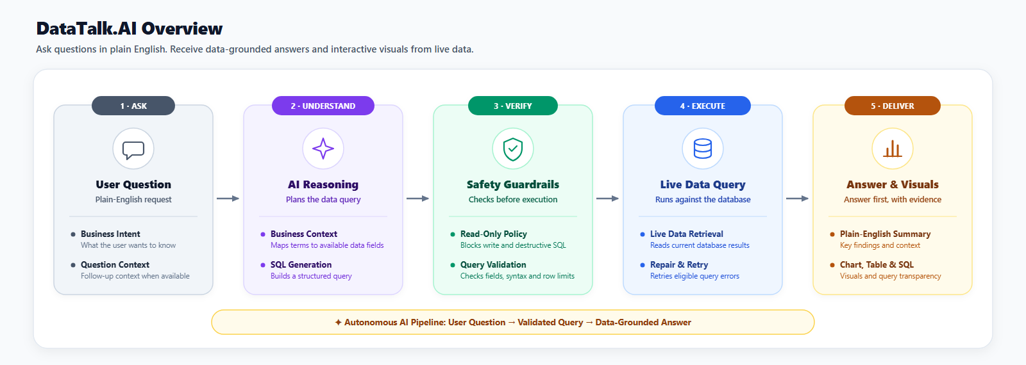
END-TO-END WORKFLOW
From User Question to Verified Answer, Charts & Insights
DataTalk.AI
EXL
Notes:
Walk left to right. Only steps 3 and 4 use the AI model (purple); everything else is code. Step 2 sends recognised quick actions such as 'forecast' or 'overdue appeals' straight to deterministic analytics, so they make no AI call. In step 4 the generated query must pass a read-only safety check limited to the approved table and columns; if it is rejected, the AI gets exactly one repair attempt. In step 5 the numbers, charts and evidence are computed by code; AI may reword the narrative, but any sentence with a number that is not in the evidence is removed. A typical single question uses 2 to 4 AI calls; a previously answered question is reused without any AI call.
[Sources] DataTalk.AI repository: app.py, agents/, core/, components/, dashboards/, docs/*.svg, README.md.

Slide 5


Architecture: AI understands, code verifies
Integrations
AI Assistant · Deep Dive · Intelligence · Risk & Findings · Data Explorer · Documentation
Databricks
SQL warehouse; a SELECT-only token is recommended.
Orchestration · routing and sequencing
Supervisor Agent decides the route. Analytics Reasoning Agent runs plan → query → check → run → chart → insight for each sub-question.
LLM
Model is configurable; the repository default is openai/gpt-oss-20b.
AI agents
Deterministic code
Outlook
Planner · SQL Agent · Insight wording · Response Agent. All calls go through one validated client with retries and fallbacks.
SQL guard · charts · evidence checks · quick actions · anomaly detection · forecast · answer cache
Compose link pre-filled with an action. Nothing is sent by the app.
Data sent to the AI
The question, table schema, metric definitions, a capped list of category values, the last three chat messages and evidence values. Needs a PHI/PII review before real data is used.
Data · Databricks SQL warehouse
Read-only access to one approved appeals table. Loaded for dashboards; queried live for AI answers.
DataTalk.AI
EXL
4
Notes:
PURPOSE: explain the building blocks simply and where each integration sits.
Read the stack top to bottom. The Streamlit app is the only user-facing layer. The Supervisor Agent routes each question without calling the AI. The Analytics Reasoning Agent orchestrates the AI agents and the deterministic services.
Colour code (same as the repository diagrams): purple = AI step, blue = deterministic code, green = data.
Division of labour: AI agents understand the question, draft SQL and propose wording. Code validates SQL, computes every statistic, chooses and reconciles charts, and removes any AI sentence with an untraceable number or a causal claim.
Integrations: Databricks (data), Groq (hosted language model, model name is a setting), Outlook (compose link only).
Privacy point for technical leads: row-level data is not sent to the AI, but the question text, schema, metric definitions, category values and aggregated evidence values are. A PHI/PII review is recommended before use with real data (README, Security).
Full diagram: docs/datatalk_dataflow_diagram.svg.
[Sources] README.md (Architecture, Safety, Data sent to the LLM); core/llm.py; core/settings.py; components/outlook_mail.py; docs/datatalk_dataflow_diagram.svg.

Slide 6
exlservice.com
Global headquarters
320 Park Ave, 29th floor
New York, NY 10022
+1(212) 277-7100
United States | United Kingdom | Australia
Bulgaria | Colombia | Czech Republic
India | Ireland | Philippines | Mexico
Romania | South Africa
© 2026 ExlService Holdings, Inc. All rights reserved. For more information go to www.exlservice.com/legal-disclaimer

