Slide 1
COMPARATIVE STUDY OF
OPTIMIZERS
AND REGULARIZATION
TECHNIQUES
Fixed CNN • Fashion-MNIST • 15 controlled experiments
Presented by: Gouri Nandana. V FET-BAML-2024-28-005
Irshita Yadav FET-BAML-2024-28-006
Mohit Biswal FET-BAML-2024-28-007
Oam Prakash Sharma FET-BAML-2024-28-008

Slide 2
02
Problem Statement & Objectives
PROBLEM
OBJECTIVES
Training performance depends on more than the CNN architecture.
● Compare SGD, SGD + Momentum, RMSprop, and Adam.
● Evaluate Step Decay and Cosine Annealing.
● Study L2, Dropout, Early Stopping, and Batch Normalization.
● Evaluate selected combinations and their effect on generalization.
● Analyze validation/test performance, curves, training time, and train–validation gaps.
This study keeps the CNN fixed and systematically varies the training choices so their effects can be compared under the same dataset and architecture.
15
1
controlled experiments
fixed CNN
02

Slide 3
03
Dataset & Preprocessing
70,000
28×28
10
48k / 12k / 10k
total images
grayscale pixels
clothing classes
train / validation / test
PIPELINE
RAW
FLOAT32
NORMALIZE
RESHAPE
TRAIN
VALIDATE
TEST
28×28 grayscale
numeric conversion
÷ 255.0
28×28×1
48k images
12k images
10k untouched
No data augmentation or handcrafted feature extraction was used.
03

Slide 4
04
Fixed CNN Architecture
The architecture stays constant across all experiments
INPUT
CONV2D
MAX POOL
CONV2D
MAX POOL
FLATTEN
DENSE
SOFTMAX
28×28×1
32 filters
3×3 + ReLU
2×2
64 filters
3×3 + ReLU
2×2
7×7×64
128 + ReLU
10 classes
421,642
Optional controls
L2 kernel regularization • Dropout 0.5 • Batch Normalization
baseline trainable parameters
04

Slide 5
05
Experimental Design
Same model • same data split • controlled training choices
COMMON SETTINGS
EXPERIMENT GROUPS
● Batch size: 64
● Maximum epochs: 20
● Loss: sparse categorical cross-entropy
● Random seed: 42
● Official test set kept untouched
Optimizers
SGD • Momentum • RMSprop • Adam
Schedules
Step Decay • Cosine Annealing
Individual
L2 • Dropout • Early Stopping • BatchNorm
REGULARIZATION
Combinations
L2+Dropout • L2+BN • Dropout+BN • L2+Dropout+BN
L2 = 0.0001 • Dropout = 0.5 • Early Stopping patience = 4 • BatchNorm after convolution layers
15
total experiments
05

Slide 6
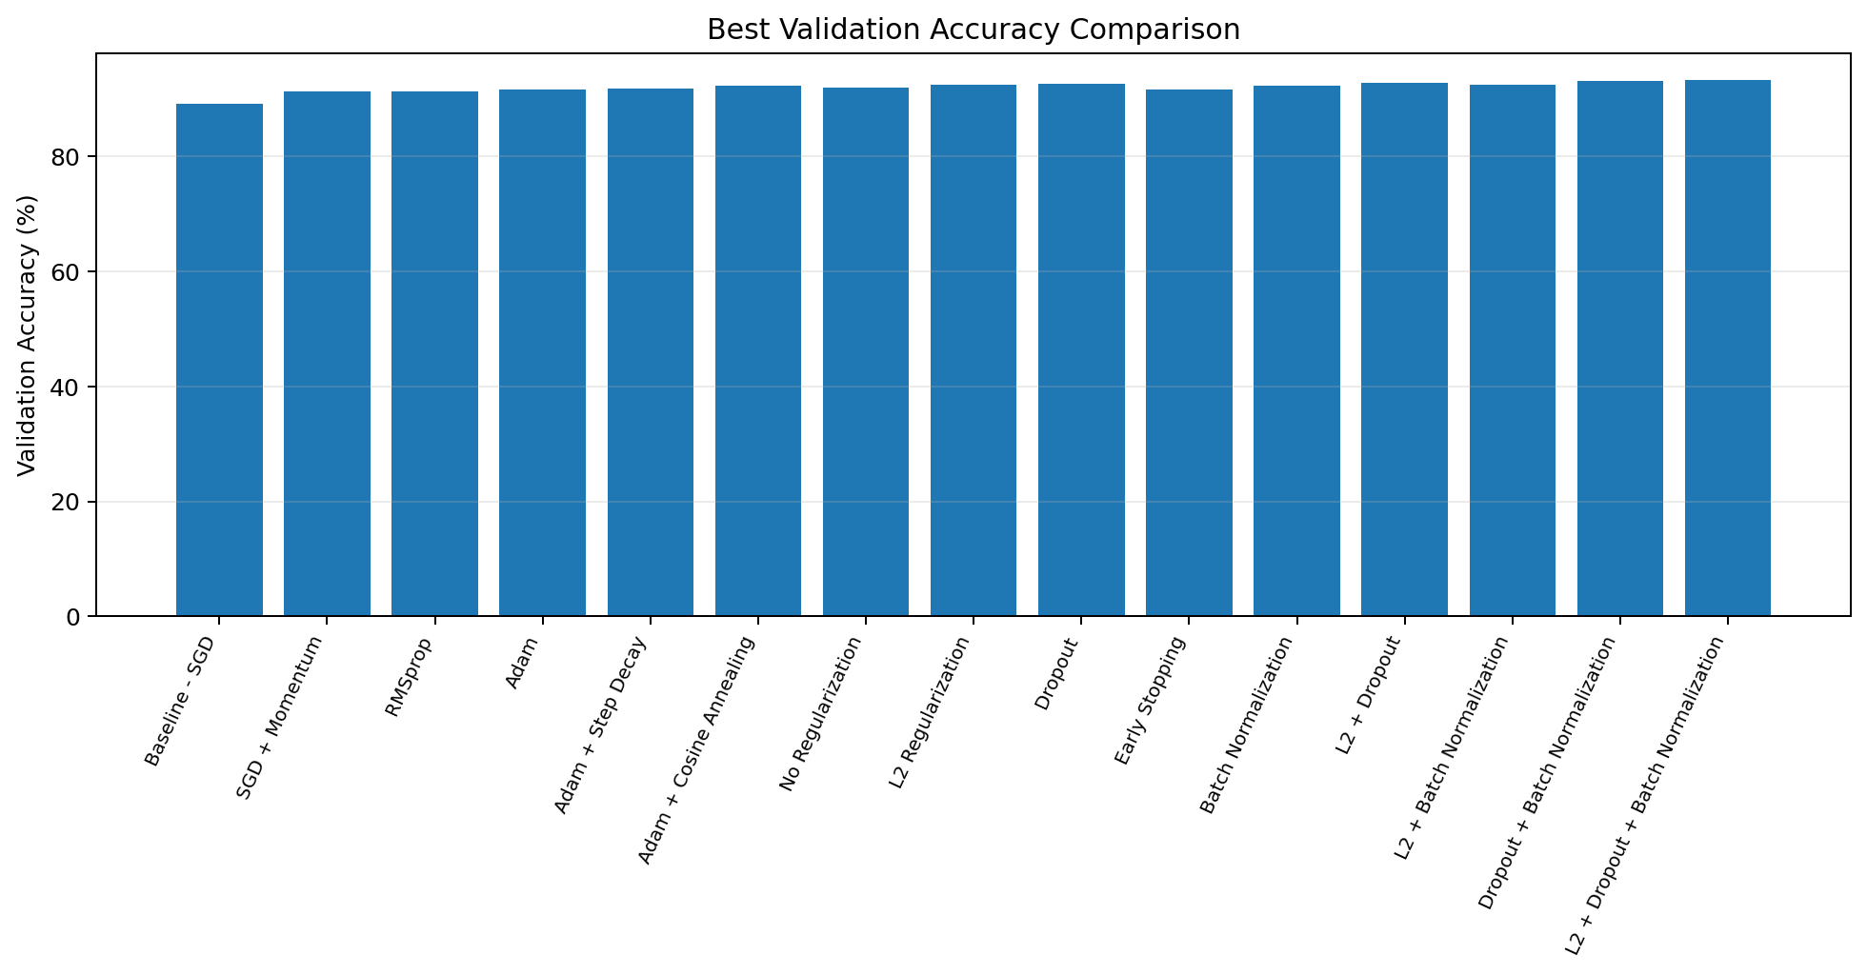
06
Optimizer & Learning-Rate Results
Validation accuracy — first six controlled comparisons
KEY OBSERVATIONS
Baseline SGD
89.23%
Adam
91.63%
Adam + Cosine
92.34%
Cosine Annealing produced a higher validation accuracy than the Adam baseline in this run.
Validation accuracy across all experiments
06

Slide 7
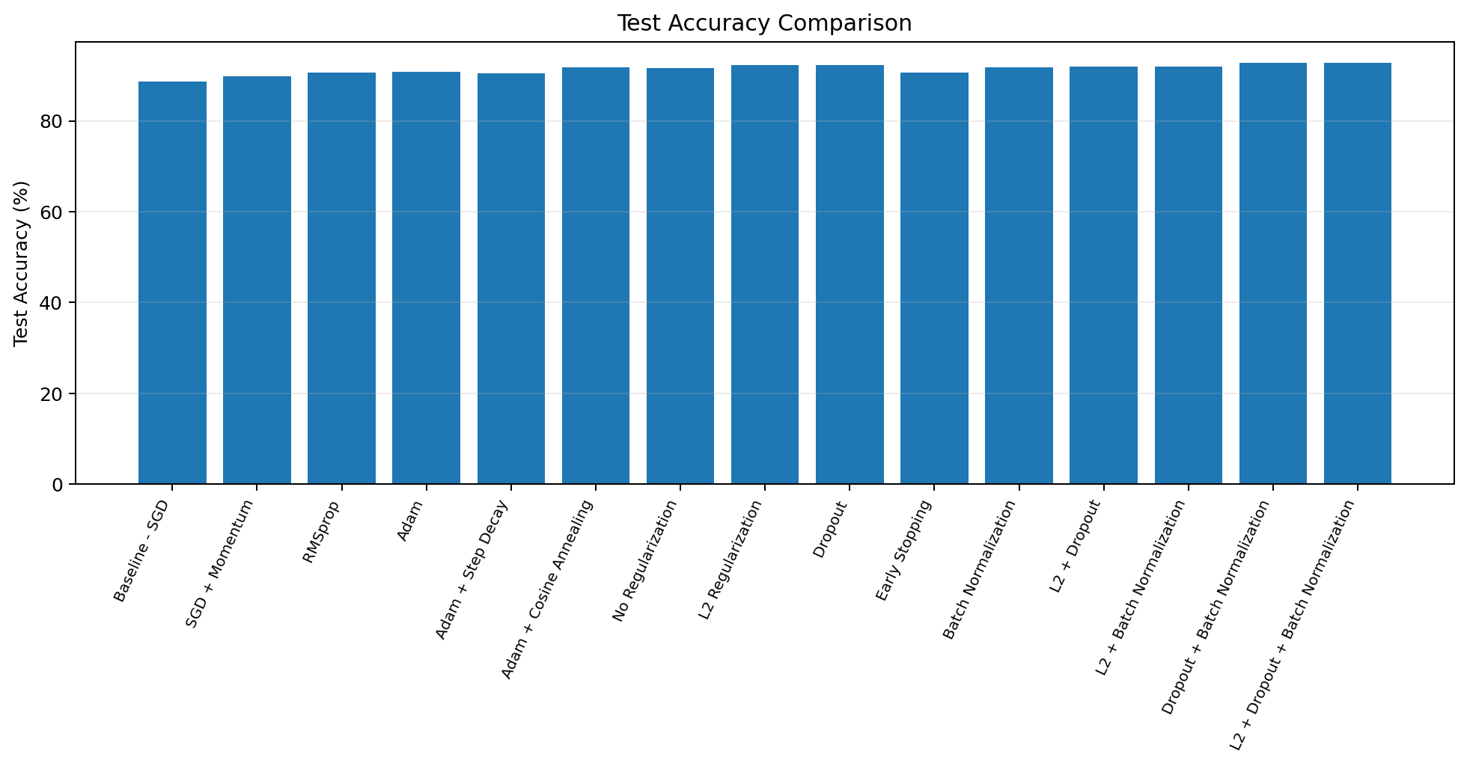
07
Regularization & Combination Results
Validation accuracy — effect of generalization controls
TOP OBSERVED RESULTS
Highest validation
93.33%
L2 + Dropout + BN
Highest test
92.79%
Dropout + BN
The validation and test leaders were not identical.
Held-out test accuracy across all experiments
07

Slide 8
08
Test Accuracy: All 15 Experiments
Held-out test set — the final generalization check
Test accuracy comparison
08

Slide 9
09
Validation Accuracy: All 15 Experiments
Best observed validation configuration
Validation accuracy comparison
09

Slide 10
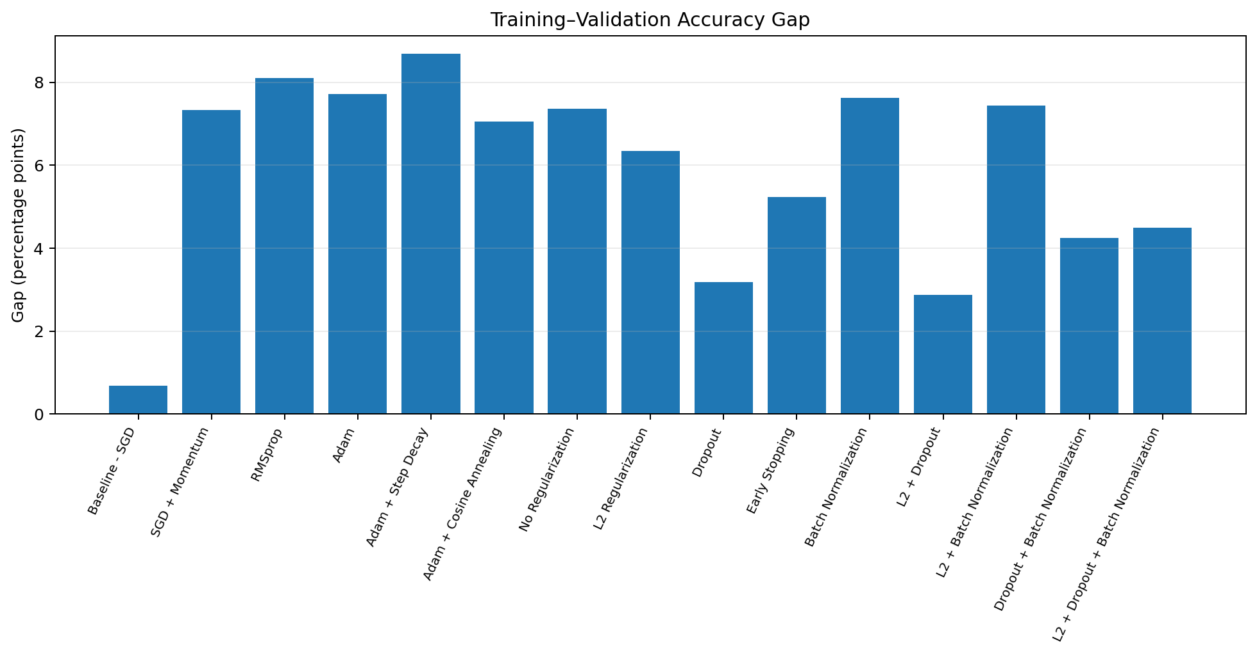
10
Underfitting / Overfitting Analysis
WHAT IT SHOWED
● All 15 were classified as “Reasonably Fitted” by the implemented thresholds.
● Gaps ranged from 0.69 to 8.69 percentage points.
● Smallest gap: L2 + Dropout — 2.86 pp.
● Largest gap: Adam + Step Decay — 8.69 pp.
● Early Stopping stopped at epoch 9 after the best validation loss at epoch 5.
Train–validation accuracy gap
10

Slide 11
11
Key Findings
93.33%
92.79%
+4.19 pp
best validation accuracy
L2 + Dropout + BN
best test accuracy
Dropout + BN
vs. 88.60% baseline test accuracy
INTERPRETATION
● Dropout + Batch Normalization had the highest held-out test accuracy in this run.
● L2 + Dropout + Batch Normalization had the highest validation accuracy.
● Because the leaders differ, both validation and test results should be reported rather than treating them as interchangeable.
● These findings are specific to the Fashion-MNIST dataset, fixed CNN, random seed, and selected hyperparameters.
11

Slide 12
CONCLUSION
A controlled comparison changed the outcome — without changing the CNN.
Baseline test accuracy
Best observed test
Future scope
88.60%
→
92.79%
● Multi-seed experiments and hyperparameter search
● Confusion matrices and class-wise precision / recall / F1
● Evaluation on CIFAR-10 and other datasets
Thank you
Questions?
12

